Slide 1
The Cancer in the Family
Clinical Decision Support Tool
Linda Squiers, PhD
Moderated by: Gurvaneet Randhawa, MD
September 2010
www.rti.org
Notes:
1

Slide 2
RTI Study Team
Robert Furberg, MBA
Lauren McCormack, PhD
Marjorie Margolis, BA
Roger Osborn, BS
Eric Peele, BA
Doug Rupert, MPH
Claudia Squire, MS
Janice Tzeng, MPH
Nedra Whitehead, PhD, MS, CGC
Sue West, PhD

Slide 3
The tool should…
Be user-friendly and computerized
Easily updated and maintained
Capable of working on different IT platforms, systems, and architecture
Empirically and accurately assess patients’ risk of BRCA mutations and provide results via cancer family history
Encourage patient-provider communication
Educate patients on HBOC, BRCA mutations, genetic counseling and BRCA testing
Encourage patients to share cancer family history
Educate providers risk for HBOC, including USPSTF recommendations about referring patients for BRCA counseling and testing

Slide 4
Development Challenges
Motivation: providers and patients
  Provider priorities: clinicians not trained in genetics, perceived risk, perceived benefit
Only a small minority of women will be at increased risk. How can the tool help women who are not at increased risk for BRCA mutations?
Collecting family history
  Providers and patients unsure about what a complete family history includes
  Asking relatives about cancer history
  Length of time to gather and enter cancer family history
Integration with EMRs

Slide 5
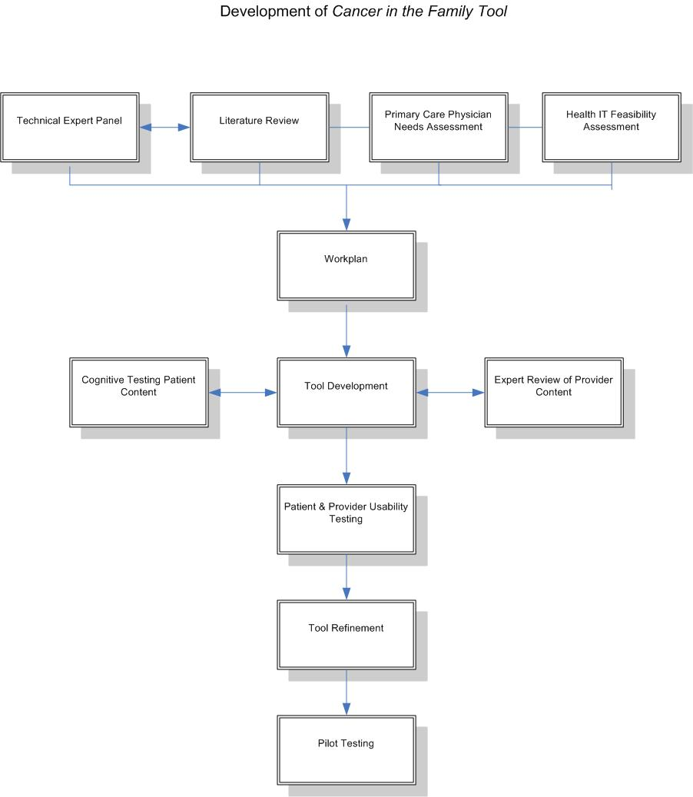

Slide 6
Patients – Steps in Using the Tool
Tool Login
(Home)
Step 1: Learn about HBOC and BRCA
Step 2: Decide Whether to Gather Family History & Learn Risk
Step 3: Collect Family History
Step 4: Calculate BRCA Risk
Step 5: Understand Risk
Step 6: Action Plan
Clinic Visit Review Risk with Provider
6

Slide 7
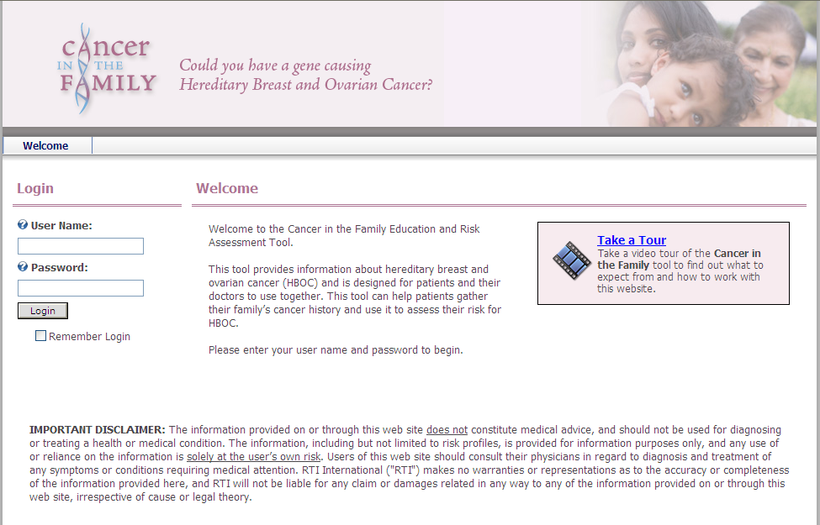
Login Screen
7
Notes:
Alt:This is a screenshot of the login page for the tool. Users login with a user name and password on the left side. A welcome message appears in the center. To the far right, is an icon that can be selected to launch a video that takes the user on a tour of the website.

Slide 8
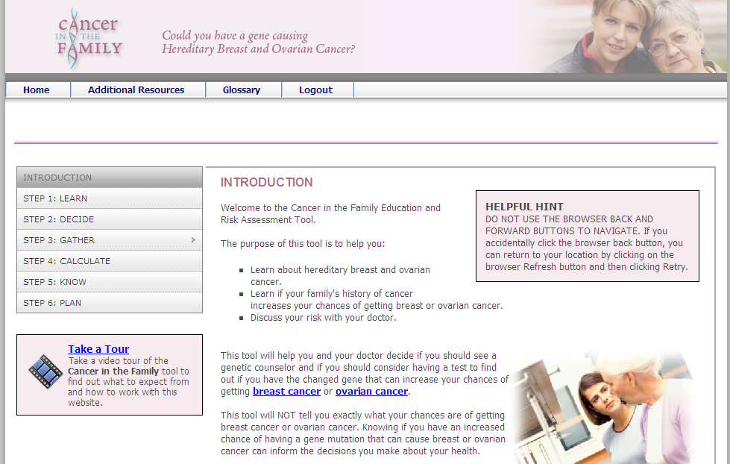
Patient Interface – Introduction
8
Notes:
Alt: This is a screenshot of the patient tool’s introduction page that outlines the 6 steps of the tool: Step 1: learn; Step 2: decide; Step 3: gather; Step 4: calculate; step 5: know; and step 6 plan.

Slide 9
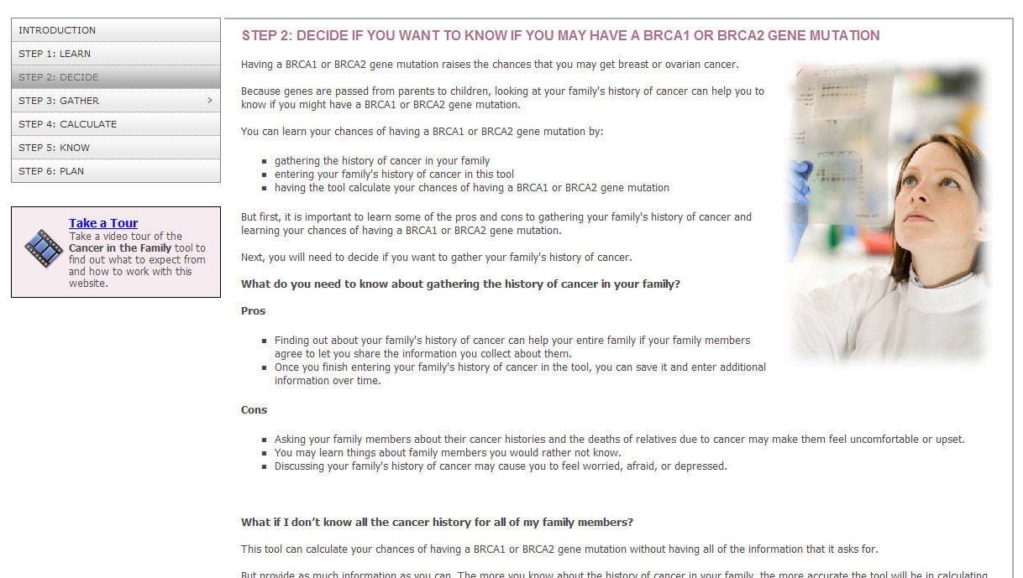
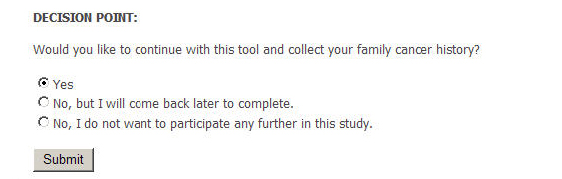
Patient Interface – Step 2: Decide
Notes:
Alt: This is a screenshot of the patient tool, Step 2 Decide which displays a decision point where patients need to decide if they want to continue on to collect their family history.

Slide 10
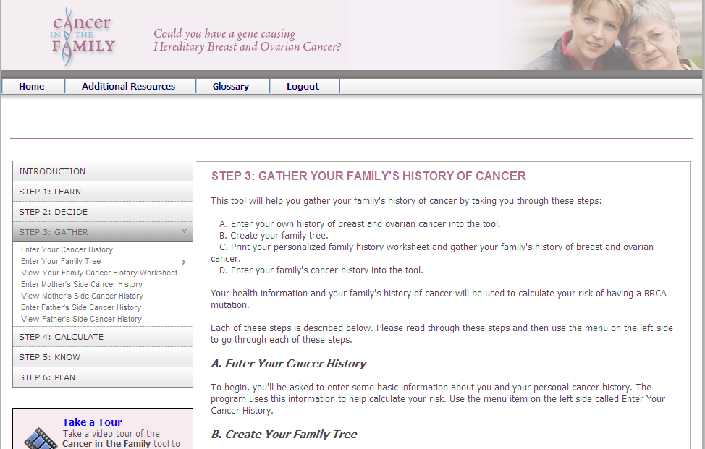
Patient Interface – Step 3: Gather
Notes:
Alt: This is a screenshot of the patient tool, Step 3: Gather that provides patients instructions about the steps involved in gathering their family history.

Slide 11
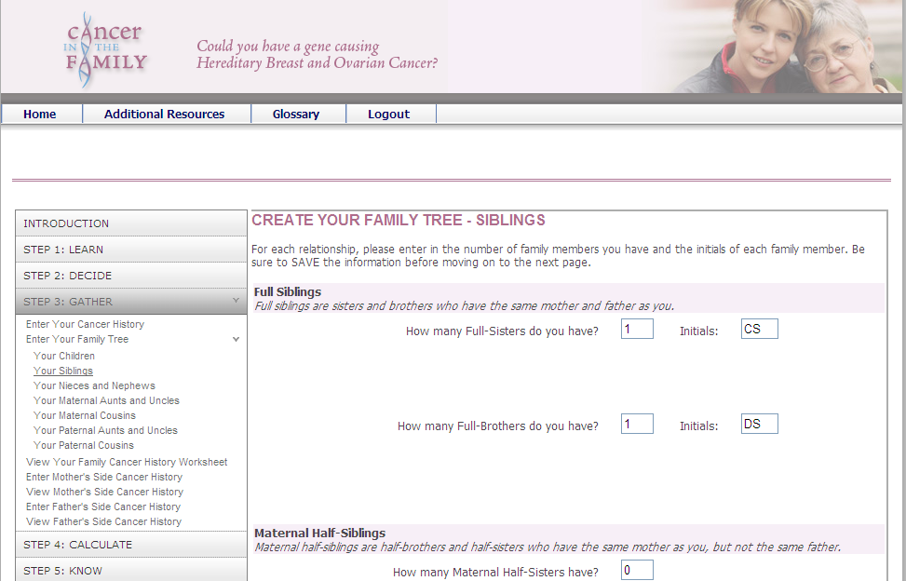
Patient Interface – Step 3: Gather
Notes:
Alt: This is a screenshot of patient tool that displays how users enter in their family members.

Slide 12
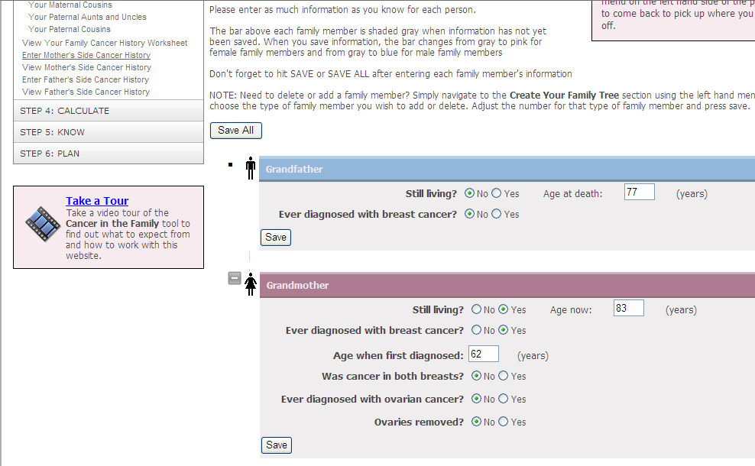
Patient Interface – Step 3: Gather
Notes:
Alt: This is a screenshot of the patient tool which displays how patients enter in their family members’ history of breast and ovarian cancer.

Slide 13
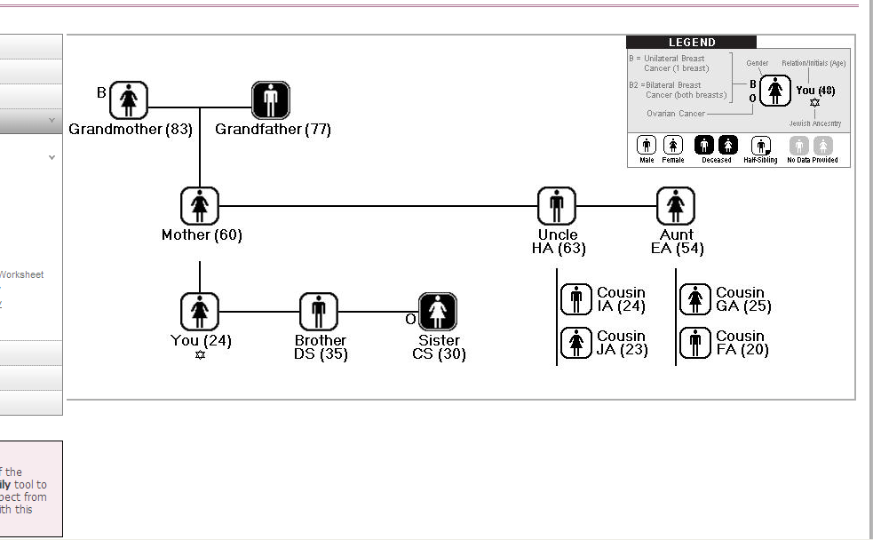
Patient Interface – Step 3: Gather
Notes:
This is a screenshot of the family tree that is produced by the tool. It users male and female bathroom symbols, includes the relationship of the family member (e.g., brother) and their age.

Slide 14
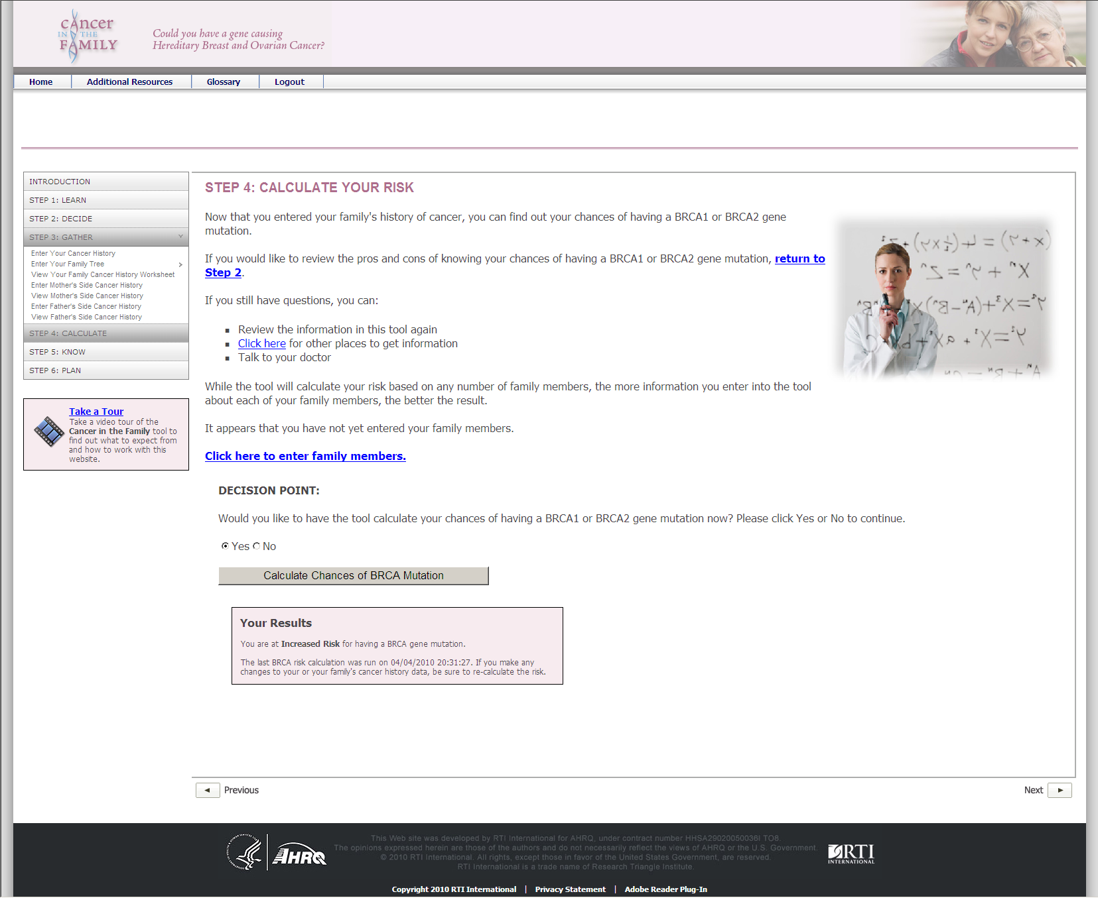
Patient Interface – Step 4: Calculate
Notes:
Alt: This is a screenshot of step 4 – calculate of the tool. It displays the patient’s risk results in a box at the bottom of the page.

Slide 15
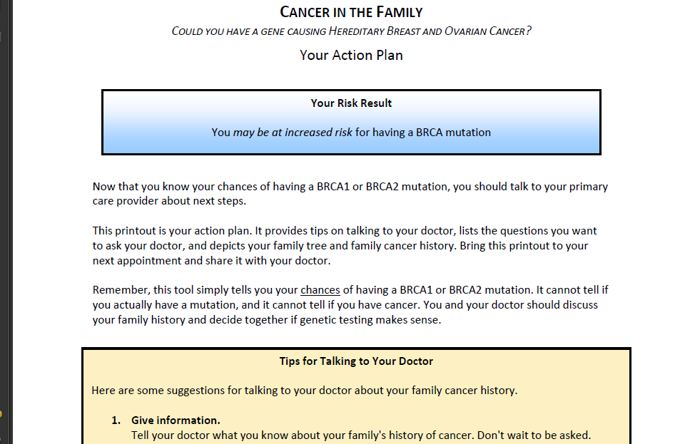
Patient Interface – Action Plan
Notes:
Alt: This is a screenshot of the patient’s action plan produced by the tool. It displays the patients risk results and tips for talking to your doctor.

Slide 16
Providers – Steps in Using the Tool
Explore Tool
BRCA Basics
Beyond Basics
Sharing Risk Results
See Study Patients
(Use Tool During Visit)
Review Family History
Review BRCA Risk
Review Screening Recommendations
Provide Genetic Counseling Referral (if appropriate)
Includes USPSTF cancer screening recommendations (e.g., Pap, cervical cancer)
Complete Checklist
Each Patient Visit
16

Slide 17
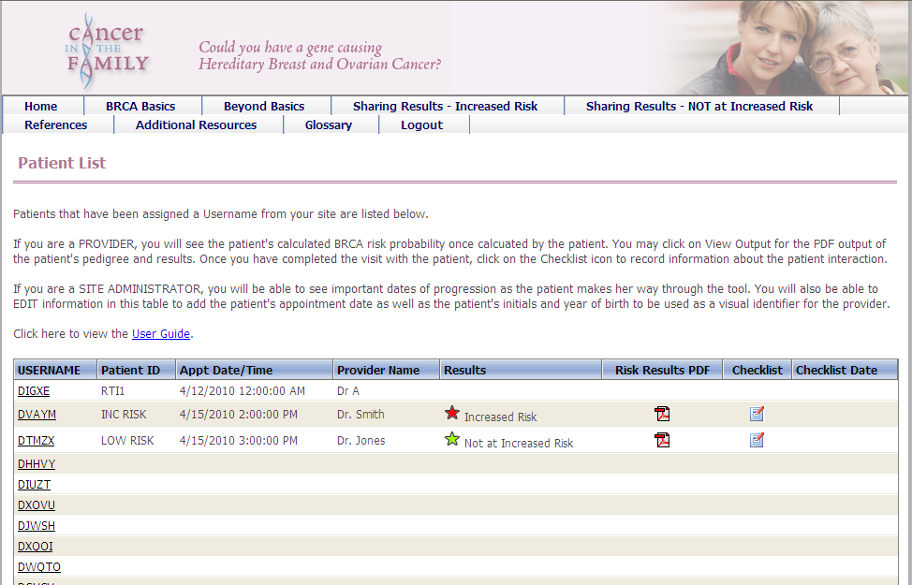
Provider Interface – Patient List
17
Notes:
Alt: This is a screenshot of the provider interface of the tool where providers find the study patient.

Slide 18
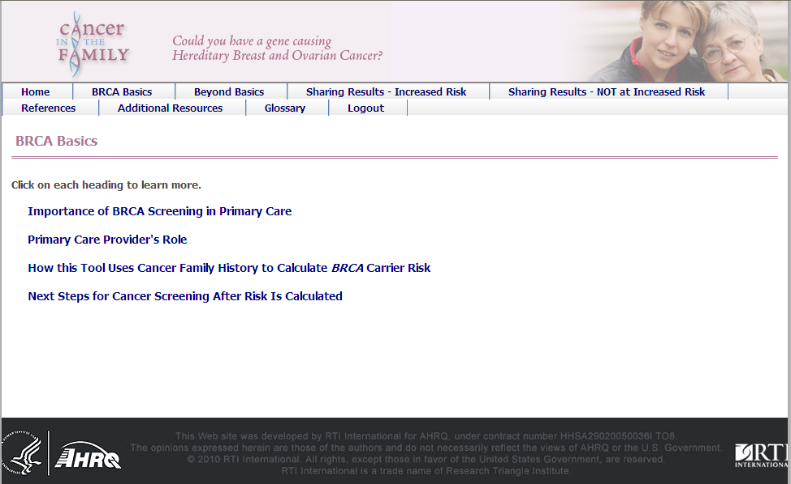
Provider Interface – BRCA Basics
Notes:
Alt: This is a screenshot of BRCA Basics on the provider interface.

Slide 19
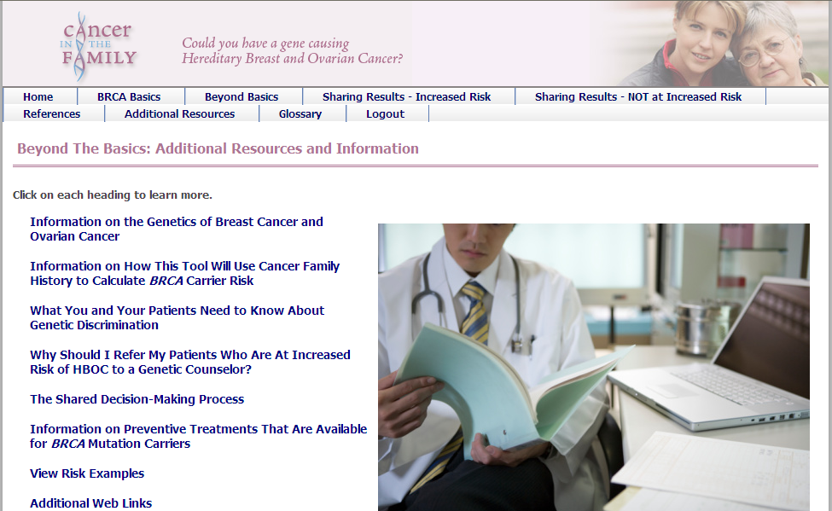
Provider Interface – Beyond Basics
Notes:
Alt: This is a screenshot of Beyond Basics on the provider tool.

Slide 20
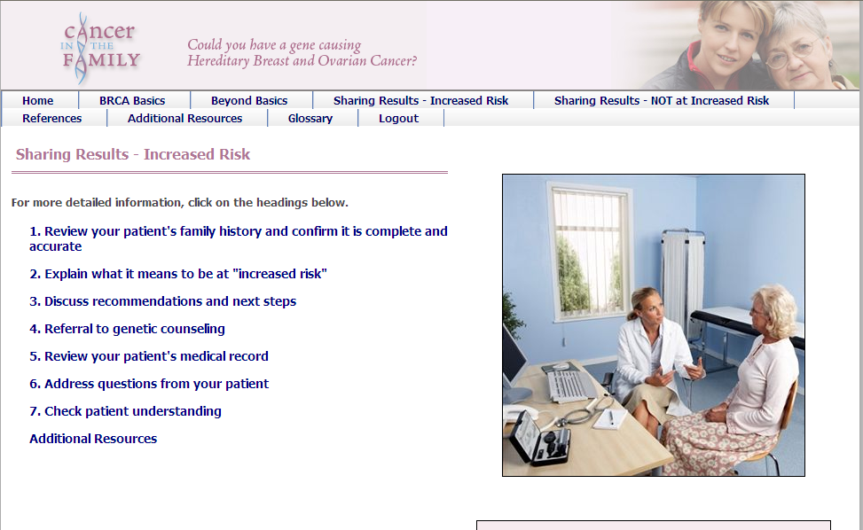
Provider Interface – Sharing Results
Notes:
Alt: This is a screenshot of Sharing Results on the provider tool.

Slide 21
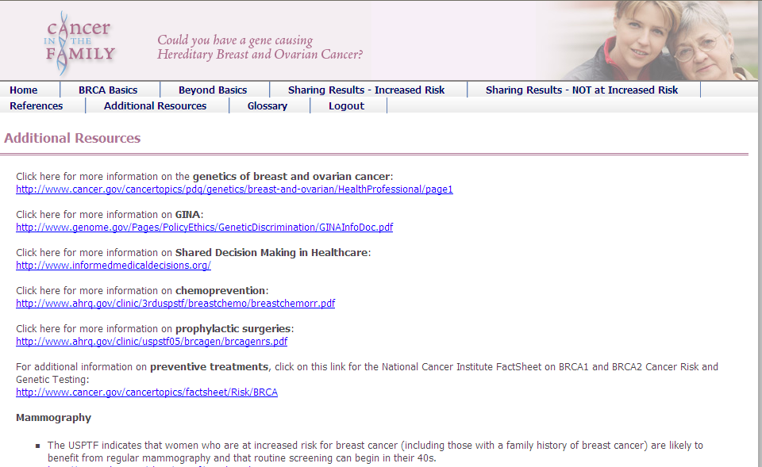
Provider Interface – Additional Resources
Notes:
Alt: This is a screen shot of Additional resources on the provider interface.

Slide 22
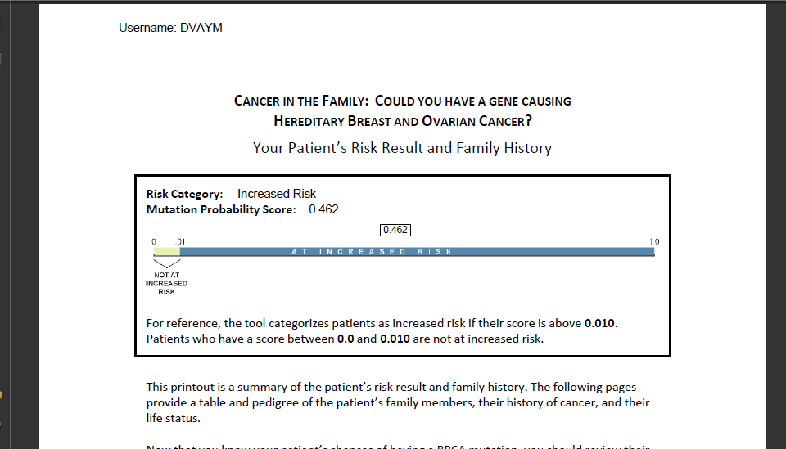
Provider Interface – Patient Risk Results
Notes:
Alt: This is screenshot of the provider printout which includes the patient’s risk results in numeric form.

Slide 23
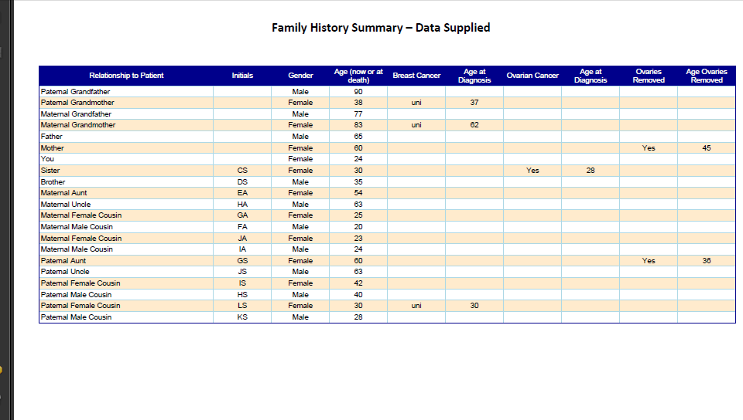
Provider Interface – Patient Risk Results
Notes:
Alt: This is a screenshot of the family history data in table format included in the provider printout.

Slide 24
Usability Testing
PATIENTS (n=8)
Education
  4 high school graduates
  3 some college

Slide 25
Results of Formative Research
Web-based tool
Patient-driven tool with step-by-step navigation
BRCA risk vs. cancer risk
Family history collection
  Family tree builder & personalized, printable worksheet
    Only asks for required information: living/dead, age, breast cancer history, age at diagnosis, unilateral vs. bilateral, ovarian cancer history, age at diagnosis, removal of ovaries
  Tips on discussing family history
  Pedigree graphics
Risk result display
  Increased vs. not at increased risk patients
Patient action plan
  1 college graduate
Age
  3 were 18-34
  4 were 35-49
  1 was 50-64
Race
  3 African American
  4 White
  1 Asian
5 had a family history of breast/ovarian cancer
PROVIDERS (N=6)
Providers sent link approximately 1 week before interview
  Asked to review and complete a worksheet
  Then interviewed by RTI interviewer
Provider Type
  2 preventive medicine residents
  3 family medicine MD
  1 OB-GYN
  5 females/1 male

Slide 26
Modifications to Patient Interface Based on Usability Testing
Clarifying language about risk (mutations vs. cancer risk)
Security features (concerns about PHI)
  Added RTI’s Privacy Policy at bottom of home page
  Password protected accounts
  Eliminate full names for cancer family history
  Store data on RTI’s secure server
Provided clarifications on instructions on using the tool
  Instructional tips throughout the tool, especially in introduction
  Side bar navigation steps numbered
  Step 3: Gather - broken down into several sub-steps
  Pedigree renamed Family Tree and Health History and modified with new symbols
    B1, B2 and O
    Dropped age at diagnosis
    Size of legend increased

Slide 27
Issues Raised in Provider Usability Testing
Images (e.g., male mammography technician and physicians)
Content
  Make more concise by using succinct, bulleted content collapsed beneath each subheading
  Reorganize Beyond Basics and make less redundant with BRCA Basics
Identifying patients
  Patient username convention developed
  Can sort alphabetically and by appointment date
Output
  Made physician version of risk results
    Use numeric risk and categorical risk
    Include pedigree and table
    PDF
  Develop Visit Summary PDF (for future)

Slide 28
Take-a-Tour Video for Patient Tool
Goal: develop a brief, persuasive, and engaging multimedia asset that effectively communicates the purpose of the tool, the importance of BRCA screening, and the estimated burden associated with the tool
7-8 minutes
Voice over narration
Native resolution in high definition, but delivered through Flash

Slide 29
Pilot Testing Overview
29

Slide 30
Evaluation
Implementation Evaluation
  Was the tool used as planned?
Outcome Evaluation
  What are the potential effects of the tool on patients and providers?
Pilot Evaluation Procedures, Instruments, and Processes
  How well did the evaluation protocol work?

Slide 31
Pilot Testing Overview
Timeline
April – June 2010 (8 weeks)
Clinical Sites
Baylor Health Care System (Dallas, TX)
Fairfax Family Practice (Fairfax, VA)
31

Slide 32
Pilot Testing Participants
Patient Participants
Women with scheduled annual exams
Age 21-60, English fluency
No personal cancer history
Residential access to computer / Web
Provider Participants
Primary care provider
Scheduled to see patients during pilot
Number of providers involved varies by site
32

Slide 33
Pilot Study Sites
Site | Providers (n=9) | Patients (n=48)
BHCS Garland | 3 | 17
BHCS Southlake | 3 | 19
Fairfax | 3 | 12
Patient and provider samples not representative
Notes:
Patient Sample not representative
90% white
81% married
68% had incomes of 100k or more
98% privately insured
Provider
Gender: 8 female, 1 male
Race: 9 white
Type of providers: 7 primary care, 1 internal medicine, 1 nurse practitioner
Length of time being provider:
1 less than 10 years
4 10-15 years
2 16-20 years
2 more than 20 years
Past use of decision aids: 5 yes

Slide 34
BRCA Risk Results (n=48)
Increased Risk (n=2) 4.2%
Not at Increased Risk (n=44) 91.6%
Missing/Don’t Remember (n=2) 4.2%
34

Slide 35
Perceived Accuracy and Satisfaction
Accuracy of Risk Results
Very accurate (n=18) 37.5%
Somewhat accurate (n=18) 37.5%
Satisfied with Decision to Learn Risk
Very satisfied (n=27) 56.3%
Somewhat satisfied (n=10) 20.8%
35

Slide 36
Family History Collection
  75% entered some or all family cancer history
  71% said very easy or easy to enter history
  75% found worksheet useful or very useful
  73% printed results of risk assessment
  65% brought printout to doctor’s visit
36

Slide 37
Percent of Patients that Rated Tool as Very Effective or Effective
…in helping them understand…
80% BRCA mutations
79% Advantages/disadvantages of learning risk
37

Slide 38
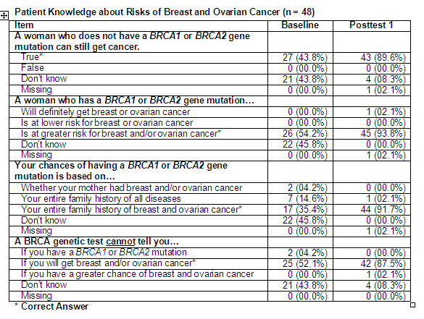
70% Results of BRCA risk assessment
79% Satisfied or very satisfied with tool

Slide 39
Provider Findings
39

Slide 40
Educational Module
Quality of Information
Extremely high 56%
High 33%
Made Me Feel More Confident
Strongly agree 56%
Agree 44%
Learned a Great Deal
Strongly agree 22%
Agree 56%
40

Slide 41
Clinical Visit Activities
Referrals Provided
Genetic counseling 4%
Mammography 60%
Pap test 44%
Visit Activities
Reviewed patient’s family history 88%
Updated patient’s family history 67%
Explained risk result 88%
Addressed questions about risk 83%
41

Slide 42
Provider Checklist Responses Following Visit with Patient (n = 9 providers for 48 patients)
When did you use the tool to review this patient’s risk results | No. (%)
Before patient’s appointment | 16 (33.3%)
During patient’s appointment | 22 (45.8%)
Both before an during patient’s appointment | 4 (8.3%)
Did not use tool | 4 (8.3%)
Missing | 2 (4.2%)

Slide 43
Tool Perceptions
Ease of Use | Baseline* | Post-Study*
Tool is clear and understandable | 3.0 | 4.3
Tool will be easy to use | 2.3 | 4.2
Trialability
Can properly try out tool before using it in practice | 3.0 | 4.5
Tool will take too long to learn | 2.7 | 1.8
* Responses on a strongly agree (5) – strongly disagree (1) scale
43

Slide 44
Tool Perceptions
Quality of Care | Baseline* | Post-Study*
Tool will likely improve clinical care | 4.4 | 4.0
Tool will be useful for patients | 4.3 | 4.4
Workflow Effects
Tool will allow me to accomplish tasks more quickly | 1.8 | 2.8
Tool will fit well with way I like to work | 3.3 | 3.8
Tool will be compatible with workflow | 2.8 | 3.3
* Responses on a strongly agree (5) – strongly disagree (1) scale
44

Slide 45
Conclusions
Patient and provider outcomes positive
Evaluation protocol worked well
  Recruit challenging
    Getting through to participants via phone was difficult
  Email may help
No major redesign needed
  Enhancements to printouts desired
  Produce appointment summary for providers
  Additional references and resources

Slide 46
Future Studies
Use a control or comparison group
  Important to assess proportion of patients in primary care population at increased risk
  High risk cutoff of 0.01 used. We recommend 0.02 for future studies.
Randomly select clinic sites
Ensure more representative patient and provider population
Alternate ways of using the tool
  Providers could discuss results with patients by phone
    Use different types of providers to discuss results (e.g., nurse)
  Patient tool could be stand alone tool
  Develop the current tool to transfer risk results to EMR

Slide 47
For Discussion

Slide 48
Surgeon General’s My Family Health Portrait
New version released 1/2009
  Web-based
  Family history can be downloaded to individual’s computer and shared
  Standards based, customizable and open source allowing for use in EHRs or CDS’
  Includes history for 15 common diseases and other to be added
  Now allows addition of family members beyond 1st and 2nd degree relatives
Limitations
Age at diagnosis is collected by age category rather than actual age which affects risk calculation in BRCAPRO
Does not ask if breast cancer was unilateral or bilateral
Limited cognitive and usability testing prior to release

Slide 49
Other Available Interactive Tools
Interactive Cancer Family Tree, University of Nebraska Medical Center: http://app1.unmc.edu/gencancer/
MyGenerations, NorthShore University Health System’s Center for Medical Genetics, Illinois: http://www.northshore.org/genetics/mygenerations/
Family HealthLink, The Ohio State University Medical Center: https://familyhealthlink.osumc.edu/Notice.aspx
Breast Cancer Genetics Referral Screening Tool
(B-RST): http://www.brcagenscreen.org/

Slide 50
Future IT Development Projects
Include more thorough formative research
  Interviews or focus groups with user groups
  Cognitive testing of draft content
  Multiple rounds of usability testing

Slide 51
Results from ITS Feasibility Assessment: EMR Integration
Operating Systems and Internet Access
Practices have restricted access to many outside Web sites (especially those with video).
Electronic Medical Records (EMRs)
EMRs cannot be linked to outside tools or systems to protect patient privacy without arduous review and approval.
Tool–EMR integration is strongly desired by physicians, who want to document patients’ BRCA risk results within existing medical records.
Patients cannot access their EMRs to view results or enter/update family history.
Test results and tool output cannot be sent directly to EMRs. However, staff can manually scan or save visual files into the system.
Physicians and practices are adverse to the time/cost of maintaining a tool themselves.

