Slide 1
The Transitional Care Model
Translating Research into Practice and Policy
Mary D. Naylor, PhD, RN, FAAN
Marian S. Ware Professor in Gerontology
Director, NewCourtland Center for Transitions and Health
University of Pennsylvania School of Nursing
AHRQ 2011 Annual Conference
Leading Through Innovation & Collaboration September 19, 2011

Slide 2
Transitional Care
Transitional care – range of time limited services and environments that complement primary care and are designed to ensure health care continuity and avoid preventable poor outcomes among at risk populations as they move from one level of care to another, among multiple providers and across settings.

Slide 3
The Case for Transitional Care
High rates of medical errors
Serious unmet needs
Poor satisfaction with care
High rates of preventable readmissions
Tremendous human and cost burden
Notes:
3

Slide 4
Major Affordable Care Act Provisions
Center for Medicare and Medicaid Innovation
Community-Based Care Transitions Program
Patient Centered Medical Homes
Shared Savings Program (ACOs)
Federal Coordinated Health Care Office
Payment Innovation (Bundled Payments)

Slide 5
Context: Acute Care Episode
Trajectory 1 (T1)
Relatively healthy adult with onset of new chronic illness
Population
At Risk
Post
Acute/
Rehab
Phase
Acute Phase
Secondary Prevention
Trajectory 2 (T2)
Adult with multiple chronic conditions
Trajectory 3 (T3)
Adults at end of life
Adapted from the National Quality Forum (NQF) steering committee on Measurement Framework: Evaluating Efficiency Across Patient-Focused Episodes of Care. The committee’s report presents the NQF-endorsed measurement framework for assessing efficiency, and ultimately value, associated with the care over the course of an episode of illness and sets forth a vision to guide ongoing and future efforts.

Slide 6
Published Evidence
21 RCTs of diverse “hospital to home” innovations targeting primarily chronically ill older adults
9/21, + impact on at least one measure of rehospitalization plus other health outcomes
Effective interventions
  Multidimensional and span settings
  Use inter-professional teams with primarily nurses, as “hubs”
Naylor MD, Aiken LH, Kurtzman ET, Olds DM, & Hirschman KB. (2011). THE CARE SPAN -- The Importance of Transitional Care in Achieving Health Reform. Health Affairs, 30(4):746-754.

Slide 7
Different Goals of
Evidence-Based Interventions
Address gaps in care and promote effective “hand-offs”
Address “root causes” of poor outcomes with focus on longer-term value
Notes:
7

Slide 8
Transitional Care Model (TCM)
Screening
Engaging Elder & Caregiver
Educating/ Promoting Self-MGMT
Managing Symptoms
Collaborating
Assuring Continuity
Coordinating Care
Maintaining Relationship

Slide 9
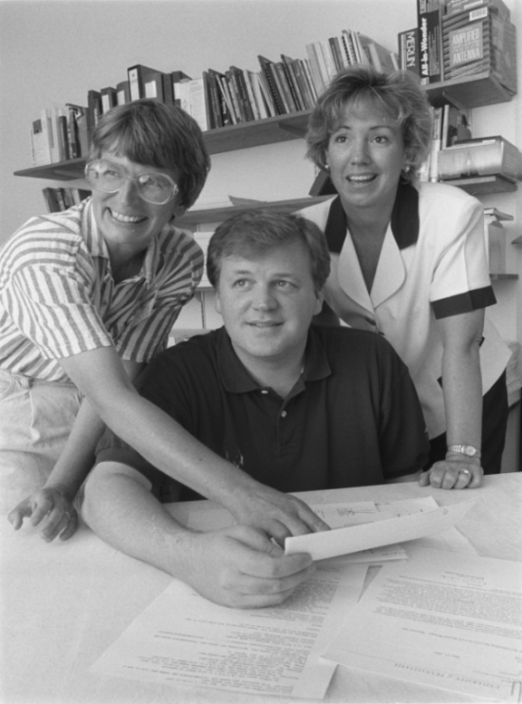
Unique Features
Care is delivered and coordinated
…by same advanced practice nurse
…in hospitals, SNFs, and homes
…seven days per week
…using evidence-based protocol
…with focus on long term outcomes

Slide 10
Core Components
Holistic, person/family centered approach
Nurse-coordinated, team model
Protocol guided, streamlined care
Single “point person” across episode of care (relational/management continuity)
Information systems that span settings (communication continuity)
Focus on increasing value over long term

Slide 11
Across Reported RCTs, TCM has…
  Increased time to first readmission or death
  Improved physical function and quality of life*
  Increased patient satisfaction
  Decreased total all-cause readmissions
  Decreased total health care costs
  *Most recently completed RCT only

Slide 12
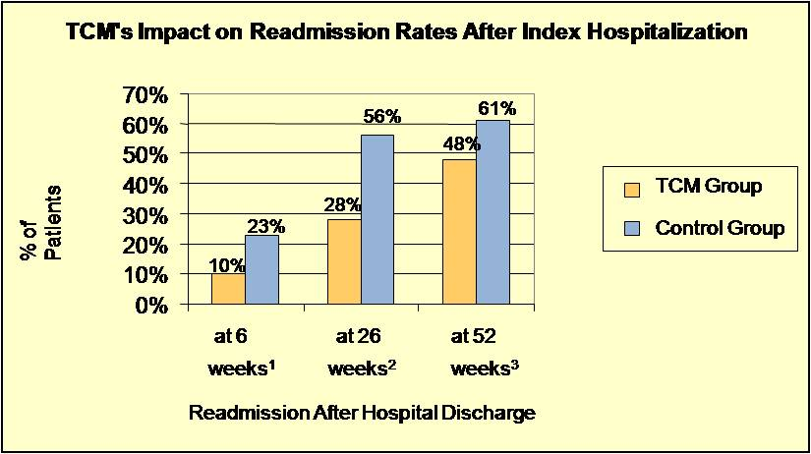
¹ Naylor MD, Brooten D, Jones R, Lavizzo-Mourey R, Mezey M, & Pauly MV. Comprehensive discharge planning for the hospitalized elderly. Ann Intern Med. 1994;120:999-1006.
² Naylor MD, Brooten D, Campbell R, Jacobsen BS, Mezey MD, Pauly MV, & Schwartz JS. Comprehensive discharge planning and home follow-up of hospitalized elders: a randomized clinical trial. JAMA. 1999;281:613-620.
³ Naylor MD, Brooten DA, Campbell RL, Maislin G, McCauley KM, & Schwartz JS. Transitional care of older adults hospitalized with heart failure: a randomized, controlled trial. J Am Geriatr Soc. 2004;52:675-684.

Slide 13
* Total costs were calculated using average Medicare reimbursements for hospital readmissions, ED visits, physician visits, and care provided by visiting nurses and other healthcare personnel. Costs for TCM care is included in the intervention group total.
** Naylor MD, Brooten D, Campbell R, Jacobsen BS, Mezey MD, Pauly MV, & Schwartz JS. Comprehensive discharge planning and home follow-up of hospitalized elders: a randomized clinical trial. JAMA. 1999;281:613-620.
*** Naylor MD, Brooten DA, Campbell RL, Maislin G, McCauley KM, & Schwartz JS. Transitional care of older adults hospitalized with heart failure: a randomized, controlled trial. J Am Geriatr Soc. 2004;52:675-684.

Slide 14
Barriers to Widespread Adoption
Organization of care
Regulatory challenges
Quality and financial incentives
Culture of caring
Notes:
14

Slide 15
Translating TCM into Practice
Penn research team formed partnerships with Aetna Corporation and Kaiser Permanente to test “real world” applications of research-based model of care among high risk elders.
Funded by The Commonwealth Fund and the following foundations: Jacob and Valeria Langeloth, The John A. Hartford, Gordon & Betty Moore, and California HealthCare; guided by National Advisory Committee (NAC)
Notes:
15

Slide 16










National Advisory Committee
VHA
Penn Home Care & Hospice Services

Slide 17
Project Goals (Aetna)
Test TCM in defined market
Document facilitators and barriers
Present findings to Aetna decision makers
Widely disseminate findings
Notes:
17

Slide 18
Tools of Translation
Patient screening and recruitment
Orientation of nurses (web-based modules)
Documentation and quality monitoring (clinical information system)
Quality improvement (case conferences grounded in root cause analysis)
Evaluation
Notes:
18

Slide 19
Key Indicators of Success
Decisions by Aetna re: adoption
Decisions by other insurers and providers to implement model
Use of findings by CMS and insurers to reimburse evidence-based transitional care
Notes:
19

Slide 20
Value =
[Improved] Quality/Satisfaction
[Relative to] Health Resource Utilization (Costs)
Environment: Extant comprehensive system of geriatric telephonic care management
Question: Does the Transitional Care Model offer greater value in this environment?
Notes:
20

Slide 21
Findings
Improvements in all quality measures
Increased patient and physician satisfaction
Reductions in rehospitalizations through 3 months
Cost savings of $2170 per member through one year
All significant at p < 0.05
Naylor, MD, et al. (2011). High-value transitional care: translation of research into practice. Journal of Evaluation in Clinical Practice. doi: 10.1111/j.1365-2753.2011.01659.x.

Slide 22

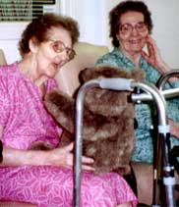
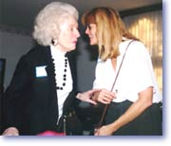
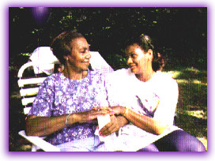
Would cognitively impaired hospitalized older adults and
their caregivers benefit
from TCM?
Funding: Marian S. Ware Alzheimer Program, and National Institute on Aging, R01AG023116, (2005-2010)

Slide 23
Time to First Readmission
P=0.0005

Slide 24
Mean Number of All-Cause Rehospitalizations Through Six Months
P=.0049
Notes:
* Outliers have been removed
Updated using 30 day cut points between 91– 180 days instead of a total number between 91-180 days
ID # total rehops total LOS 91-180 days → # rehosps → LOS
Phase 1
8880058 – had 3 rehosps; LOS=27 days. During the 91-180: 1 rehosp - 25 days (RNC)
7770140 – had 6 rehosps: LOS=46 days. During the 91-180: 2 rehosps - 23 days (TCM)
7772010 – had 3 rehosps: LOS=23 days. During the 91-180: 1 rehosp -14 days (TCM)
Phase 2
5559082 – had 4 rehosps: LOS=20 days. During the 91-180: 2 rehosps -14 days (TCM)
3338003 – had 2 rehosps: LOS=17 days. During the 91-180: 2 rehosps -17 days (TCM)
3338053 – had 1 rehosp: LOS=14 days. During the 91-180: 1 hosp -14 days (TCM)

Slide 25
Mean Number of Total All-Cause Rehospitalization Days Through Six Months
P=.0044
Notes:
* Outliers have been removed
Updated using 30 day cut points between 91– 180 days instead of a total number between 91-180 days
ID # total rehops total LOS 91-180 days → # rehosps → LOS
Phase 1
8880058 – had 3 rehosps; LOS=27 days. During the 91-180: 1 rehosp - 25 days (RNC)
7770140 – had 6 rehosps: LOS=46 days. During the 91-180: 2 rehosps - 23 days (TCM)
7772010 – had 3 rehosps: LOS=23 days. During the 91-180: 1 rehosp -14 days (TCM)
Phase 2
5559082 – had 4 rehosps: LOS=20 days. During the 91-180: 2 rehosps -14 days (TCM)
3338003 – had 2 rehosps: LOS=17 days. During the 91-180: 2 rehosps -17 days (TCM)
3338053 – had 1 rehosp: LOS=14 days. During the 91-180: 1 hosp -14 days (TCM)

Slide 26
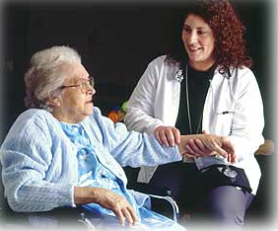



What do we know about effects of transitions among elderly long-term care recipients over time?
Funding: National Institute on Aging, National Institute of Nursing Research, R01AG025524, (2006-2011)

Slide 27
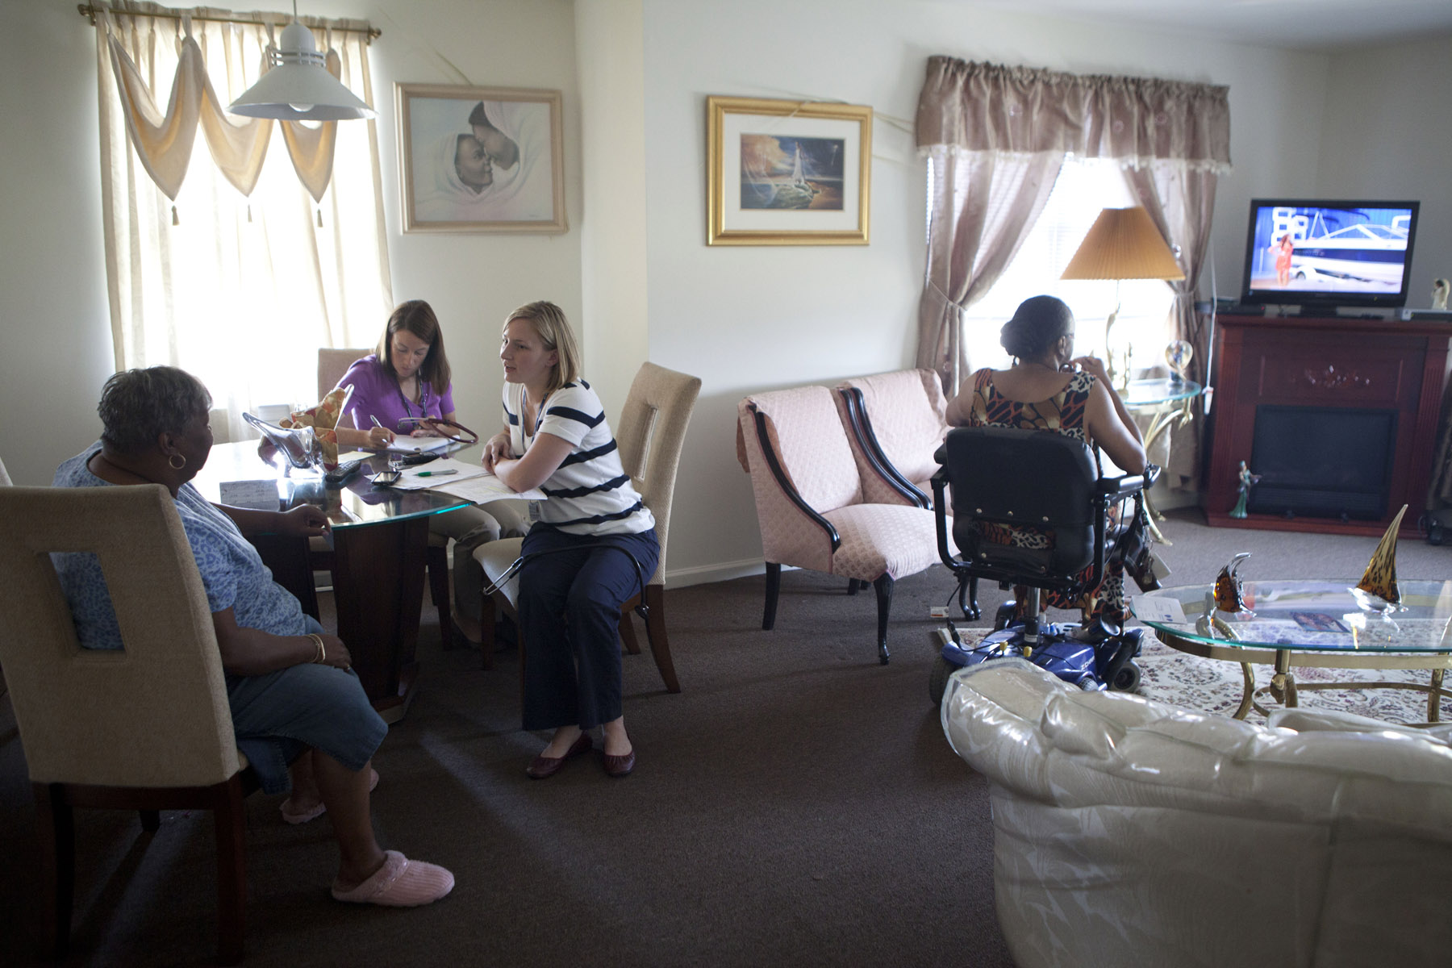
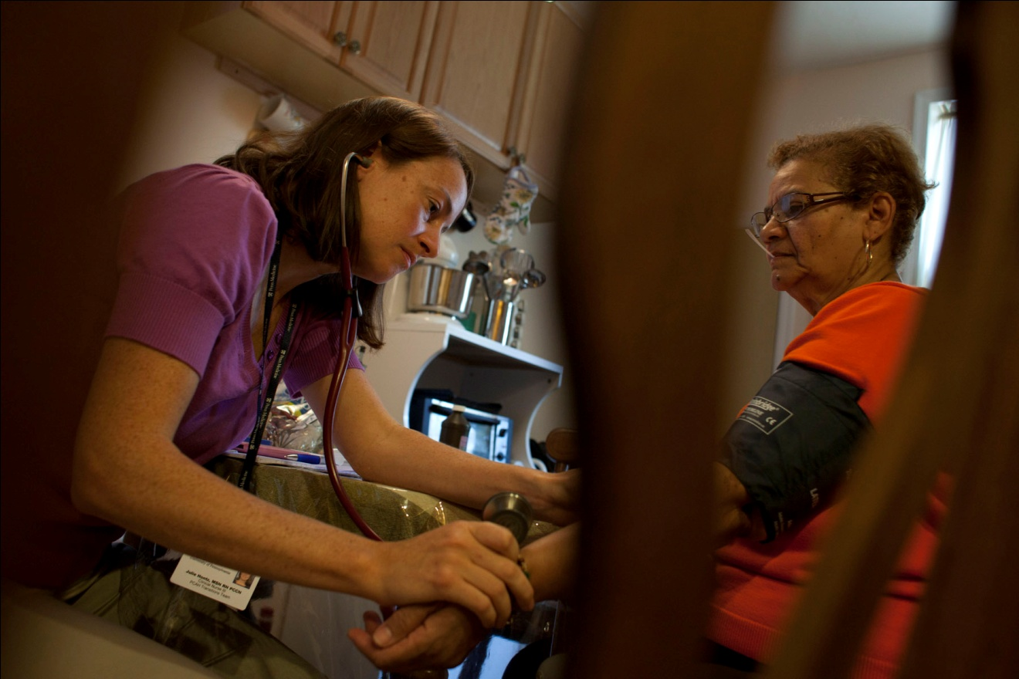

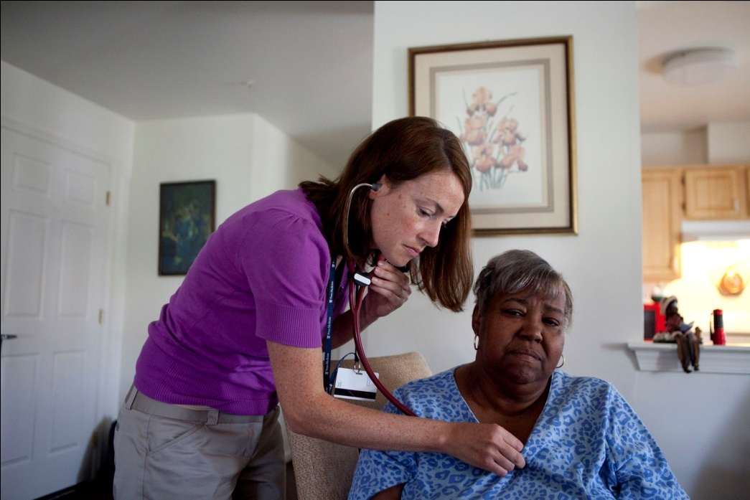
Does the TCM add value to the Patient Centered Medical Home?
Funding: Gordon and Betty Moore Foundation, Rita and Alex Hillman Foundation and the Jonas Center for Excellence

Slide 28
The TCM…
Focuses on transitions of high-risk cognitively intact and impaired older adults across multiple settings
Has been successfully translated into practice
Has been recognized by the Coalition for Evidence-Based Policy as an innovation meeting “top-tier” evidence standards

Slide 29
Implementation Progress
Aetna – expansion of TCM proposed as part of Aetna’s Strategic Plan
University of Pennsylvania Health System – adopted TCM (Aetna and Blue Cross reimbursing)
Other health care systems adapting
Experience informing implementation of ACA provisions
Notes:
29
29

Slide 30
Key Lessons
Solving complex problems will require multidimensional solutions
Evidence is necessary but not sufficient
Change is needed in structures, care processes, and health professionals’ roles and relationships to each other and people they serve
Overcoming inertia requires substantial force

Slide 31
Transformational Drivers
At National Level
National goals, endorsed measures and public reporting platforms that focus on transitions
Large scale pilots of evidence-based TC
Stretch performance targets with more generous rewards for higher performance
Distribution of rewards across providers/health care professionals involved
Enhanced preparation of current/emerging work force

Slide 32
Transformational Drivers
At Local Level
Strong champions
Provider awareness of what works and does not work
Clearly defined, aligned and actionable goals
Organizational commitment (C-Suite and front line)
Upfront + ongoing investment in care teams
Shared accountability for higher value

