Slide 1
Health Literacy in Pharmacy: Introduction
Curricular Modules for Pharmacy Faculty
Content adapted from Kripalani and Jacobson (2007)

Slide 2
Objectives
Introduction to health literacy
Health literacy skills
Health system demands
Consequences of a mismatch
Implications for pharmacy
Notes:
The presentation will cover two main areas. First, we’ll get an overview of health literacy including an understanding of health literacy skills as well as the demands the health care system puts on patients. Secondly, we’ll learn about the consequences of a mismatch between the health literacy skills of individuals and the demands our health care system puts on patients.

Slide 3
Health Literacy Skills
Notes:
Let’s talk about the health literacy skills of individuals.

Slide 4
Health Literacy: An Interaction
Health Literacy
Adults’ Skills:
“The degree to which individuals have the capacity to obtain, process, and understand basic health information and services needed to make appropriate health decisions” (Healthy People 2010)
Our Expectations and System Demands:
Managing medications, remembering and following spoken and written directions, interpretation
Notes:
You are probably familiar with the definition of literacy– the ability to read and write--but what about health literacy?
Health literacy refers to a constellation of reading and numeracy skills (e.g., making calculations) required to function in the health care environment. Health literacy as a concept is a combination of individual-level factors and system level factors.
These include:
• Reading prescription bottles.
• Figuring out appointment slips.
• Understanding informed consent documents.
• Understanding discharge instructions.
• Following diagnostic test instructions.
• Reading health education materials.
• Completing health insurance applications.
Health literacy is context specific. Someone who has excellent reading and writing skills, and who functions very well in another environment (for example, an accountant), may still have low health literacy. Just like reading and writing literacy, having low health literacy does not mean having low intelligence.

Slide 5
Adults’ Skills
A majority of U.S. adults have difficulty using print materials to accomplish everyday tasks such as:
Calculate a 15% tip on a bill
Use a bus schedule to determine time of arrival
Use labels to compare and contrast safety ratings on a piece of equipment such as a bicycle helmet
Read an over-the-counter medicine box to determine how much medicine to give a child of a specified weight and age
Determine the point-of-view [bias] in an editorial
SOURCE: 1) Kirsch, I., Jungeblut A., Jenkins, L. and Kolstad, A. (1993) ‘Adult Literacy in America: A First Look at the Results of the National Adult Literacy Survey (NALS)’, National Center for Education Statistics, US Department of Education Washington, DC. 2) Kutner, M., Greenberg, E. and Baer, J. (2005) ‘A First Look at the Literacy of America’s Adults in the 21st Century’, National Center for Education Statistics, NCES 2006–2470, Washington, DC

Slide 6
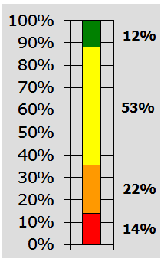
Health Literacy in America
National Assessment of Adult Literacy Survey Results:
Proficient: Define medical term from complex document; calculate share of employee’s health insurance costs
Intermediate: Determine healthy weight from BMI chart; interpret prescription and over-the-counter drug labels
Basic: Understand simple patient education handout
Below Basic: Circle date on appointment slip, understand simple pamphlet about pre-test instructions
*Approximately 45% of high school graduates have limited health literacy.
SOURCE: 1) Kutner et al (2006) 2) Centers for Disease Control and Prevention Health Literacy Training for Public Health Professionals: http://www2a.cdc.gov/TCEOnline/registration/detailpage.asp?res_id=2074 Found in: Kripalani, S. & Jacobson, K. L. (2007). Strategies to Improve Communication Between Staff and Patients: Training Program for Pharmacy Staff. Rockville, MD: Agency for Healthcare Research and Quality
Notes:
The National Assessment of Adult Literacy (NAAL) provided the first measure of the health literacy of Americans. This household survey found that 14% of American adults function at the below basic level, 22% function at the basic level, 53% have an intermediate level of health literacy, and 12% have proficient health literacy. Note that interpreting medication labels requires intermediate skill. This means that 36% of adult Americans – 80 million people – have levels of health literacy below what is required to understand typical medication information.
A person can be literate and still have limited health literacy. In fact, approximately 45% of high school graduates have limited health literacy.

Slide 7
High-Risk Groups
The following groups are more likely to have limited literacy skills:
Elderly
Minorities
Limited English Proficiency (LEP) patients
Low income
Homeless
Prisoners
Persons with limited education
SOURCE: Kirsch et al (1993) Found in: Kripalani, Jacobson (2007)
Notes:
Certain groups are more likely to have limited health literacy. These groups include…
However, it is important to remember that low health literacy is a problem that touches all groups and segments of society. In terms of raw numbers, most people with low health literacy are White.

Slide 8
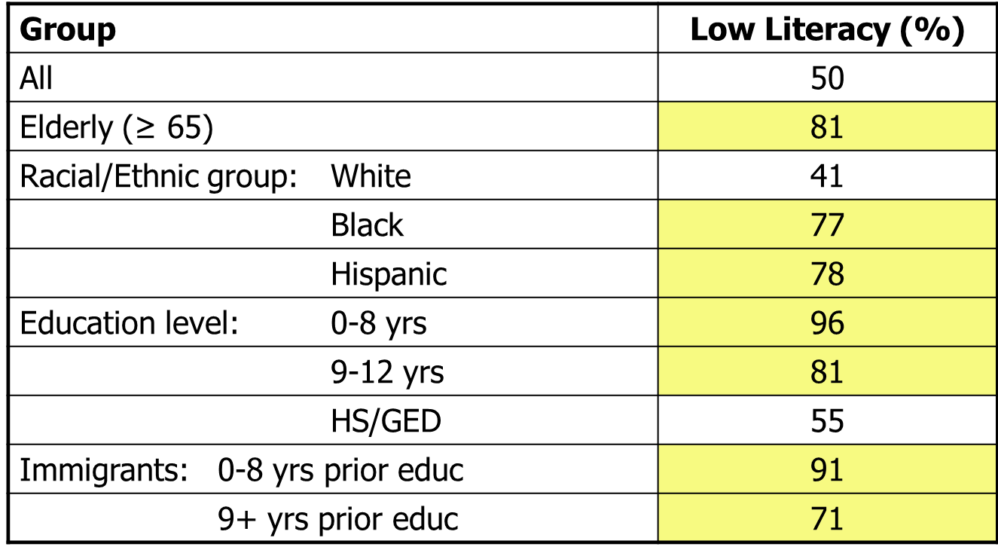
Functional Literacy of High-Risk Populations
SOURCE: Weiss, BD. Epidemiology of Low Health Literacy. In: Schwartzberg JG, VanGeest JB, Wang CC, eds. Understanding Health Literacy: Implications for Medicine and Public Health. AMA Press; 2005:19. Found in: Kripalani, Jacobson (2007)
Notes:
Here are some figures from another national study which looked at general literacy skills.
Of those aged 65 or greater, 81% have low literacy
Blacks and Hispanics are more likely to have low literacy: 77% and 78% compared to 41% of Whites
Those with the least amount of education have the highest prevalence of limited literacy.

Slide 9
Our Expectations IN HEALTH CARE and the System Demands
Notes:
Now let’s learn about the expectations and system demands we put on patients.

Slide 10
We Expect Patients to…
Read
Labels & inserts
Names of medicines
Dosage instructions
Read between the lines [eg, BID, TID, QID]
Listen to explanations and directions
Talk to busy professionals
Describe new feelings (e.g., side effects)
Present problems
Ask questions
Track experiences
Watch for side effects and seek appropriate help as needed
Take action for missed dose when needed
Calculate
Measure doses
Count pills
Track amount of meds left and refill as necessary
Use clocks and calendars to set time/day
Notes:
Health literacy is an interaction between patients’ skills and knowledge and the demands that our health system places on them. Let’s think about the tasks we expect of a patient taking captopril for blood pressure. What do we expect patients taking captopril or other medications to be able to do? (Either break students into small groups to brainstorm a list, or ask students to volunteer answers in the large group.)
(If probe is needed): Think about timing, measuring, and following instructions.
We expect patients to perform a broad array of tasks, including reading, listening to explanations and directions, talking to busy professionals, tracking their experiences, calculating and counting, and using complex tools.
OPTIONAL IN-CLASS LEARNING ACTIVITY: Faculty, you could have the class break into small groups and do Activity Guide #3, “Understanding Steps Required to Take Medications.”

Slide 11
Patients’ Experiences
People commonly hide their difficulty with reading or understanding.
Many feel ashamed of poor reading or understanding.
People with limited literacy often avoid reading.
Do you know someone who has problems reading or understanding?
What have you observed?
SOURCE: 1) Parikh N, Parker R, Nurss J. Shame and health literacy: the unspoken connection. Patient Education and Counseling. 1995;25:109–199 2) Weiss BD. Health Literacy: A Manual for Clinicians. American Medical Association and American Medical Association Foundation; 2003. Found in: Kripalani, Jacobson (2007)
Notes:
Patients are very savvy in masking the signs of limited health literacy, as there is a great deal of shame associated with this. In fact, one study found that 24% of individuals who suffered from limited health literacy had never informed their spouse (Parikh et al 1995).
Patients with limited health literacy skills may be very articulate and smart enough to navigate through life and the health care environment with these limitations. If someone who you think is better educated, and has more authority than you tells you something you don’t understand, chances are good you might act as if you understand to avoid embarrassment. This is the situation that many patients find themselves in with pharmacists, doctors, and other health professionals.
(Depending on experience level of class)
Tell me, when do you suspect a patient has low health literacy? What are some of your experiences with low-literacy patients?

Slide 12
What Patients are Saying…
Watch the American College of Physicians (ACP) Foundation Health Literacy Video
What surprised you about the patients featured in this video?
What types of tasks were the patients in this video asked to complete?
How could these patients’ experiences have been improved?
Notes:
Let’s think a little more about the challenges that patients face in the health care system every day.
Instructor: show ACP Foundation video on health literacy and health care system challenges, then ask questions on the slide.
http://acpfoundation.org/player/?w=640&h=480&t=Health%20Literacy&v=http://static.acponline.org/media/foundation/health-literacy.flv

Slide 13
Consequences of a Mismatch

Slide 14
Patient-Level Consequences
Poorer health outcomes
Increased hospitalizations
Greater use of emergency care
Missed prescription refills
Difficulty understanding medication instructions and warning labels
Inappropriate dosing or timing of meds
Failure to recognize side effects or drug interactions
SOURCE: 1) Agency for Healthcare Research and Quality. Health Literacy Interventions and Outcomes: An Updated Systematic Review. March 2011. 2) American Medical Association Foundation. Health Literacy and Patient Safety: Help Patients Understand. August 2007.
Notes:
Low health literacy is associated with a variety of negative health behaviors and health outcomes. People with low literacy are more likely to have….[read list]

Slide 15
Health Literacy and Medication Understanding
↓ Ability to identify their own medications
12-18 x greater odds of being unable
↓ Understanding of how to take medications
Take med every 6 hours 52% correct
Take med on empty stomach 46% correct
↓ Understanding of drug mechanisms and side effects
Warfarin works by thinning blood 70% correct
Bleeding/bruising most common SE 49% correct
↑ Misinterpretation of common warning labels
3-4 x more likely to misinterpret
SOURCE: 1) Gazmararian JA, Baker DW, Williams MV, Parker RM, Scott TL, Green DC, Fehrenbach SN, Ren J, Koplan JP. Health Literacy Among Medicare Enrollees in a Managed Care Organization. JAMA. 1999;281:545-551. 2) Fang MC, Machtinger EL, Wang F, Schillinger D. Health Literacy and Anticoagulation-related Outcomes Among Patients Taking Warfarin. Journal of General Internal Medicine. 2006;21(8):841-846. 3) Davis T.C., Wolf M.S., Bass P.F. 3rd, Thompson J.A., Tilson H.H., Neuberger M., Parker R.M.. Literacy and misunderstanding prescription drug labels. Annals of Internal Medicine. December 2006. 19;145(12). Found in: Kripalani, Jacobson (2007)
Notes:
Several studies have assessed patients’ understanding of their medications.
In these studies, researchers found that individuals with limited health literacy demonstrated…
12 to 18 times the odds of being unable to identify their own medications and distinguish one from the other
Common difficulty understanding simple instructions such as taking a medication every 6 hours or on an empty stomach
Worse understanding of common drug mechanisms and side effects, such as how warfarin works (despite being on warfarin and having attended educational classes on its use)
Greater misinterpretation of drug warning labels

Slide 16
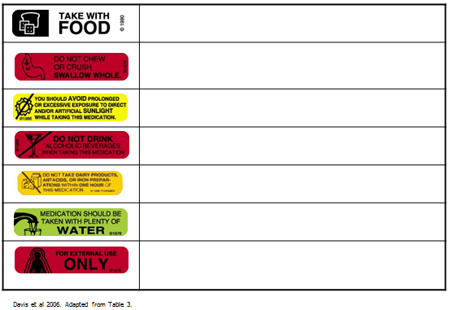
Misinterpretation of Warning Labels
SOURCE: Davis et al (2006) Found in: Kripalani, Jacobson (2007)

Slide 17
Medication Errors
“How would you take this medicine?”
395 primary care patients in 3 states
46% did not understand instructions ≥ 1 labels
38% with adequate literacy missed at least 1 label
SOURCE: Davis et al (2006) Found in: Kripalani, Jacobson (2007)
Notes:
Let’s look at some interesting research that was done. When researchers asked patients how would you take this medicine and handed them a pill bottle, almost half did not understand the instructions on a least one of the labels they looked at. And it is interesting to note that for patients with adequate literacy, 38% missed at least one label.

Slide 18
Medication Errors (cont’d)
“Show me how many pills you would take in 1 day.”
SOURCE: Davis et al (2006)
John Smith Dr. Red
Take two tablets by mouth twice daily.
Humibid LA 600MG
1 refill
Notes:
These researchers went on to have patients show them how they take their medicines. So the first question was to have them read the bottle to show that they can actually read it. Then they asked them to take the pills out of the bottle and show how many pills you would take each day and when you’re going to take them.

Slide 19
Medication Errors (cont’d)..
Rates of Correct Understanding vs. Demonstration “Take Two Tablets by Mouth Twice Daily”
SOURCE: Davis et al (2006)
Notes:
This slide shows some results from this study. Along the bottom (x-axis) you have the patient literacy level. Patients were categorized as having low, marginal or adequate literacy. The yellow bars show the percent of patients in each literacy level who can read the instructions on the pill bottle correctly. The green bar shows the percentage of patients who actually took the right amount of pills out of the bottle when showing how they would take the medicine. It is troubling to see how many patients would be taking this prescription incorrectly. Most of us assume that when we write a prescription, the patient will be able to take it correctly.
OPTIONAL IN-CLASS LEARNING ACTIVITY: Faculty, you could have the class break into small groups and do Activity Guide #4, “Critique of Medication Labels.”

Slide 20
Societal Consequences
Societal Consequences
Nonadherence
Missed refills
Inappropriate dosing or timing of meds
Failure to recognize side effects or drug interactions
Increased emergency department costs among low health literacy patients
Undermines efforts to increase patient self-management and engagement in care
SOURCE: 1) American Medical Association Foundation (2007) 2) AHRQ (2011)
Notes:
Patient-level consequences of low health literacy also affect the health care system and society at large. Costs associated with nonadherence place unnecessary burden on the health care system. Patients with low health literacy also have higher average emergency health care costs, placing additional financial burden on the health care system. Lack of patient understanding of medication instructions can also undermine efforts to guide patients in self-management processes.
At the pharmacy level, consequences of failing to meet the needs of patients with low health literacy can result in decreased customer loyalty or satisfaction, decreased profits due to missed refills, and, in some cases, legal actions against the pharmacy. For example, in 2007, three law and civil rights groups filed a complaint with the New York Office of the Attorney General alleging failure of seven chain pharmacies to provide language services in accordance with state regulations. All seven pharmacies settled with New York State, and are now required to provide a variety of language services and to inform customers of their right to free language assistance in multi-lingual signs.

Slide 21
Pharmacy-Level Consequences
Pharmacy-Level Consequences
Impact on customer loyalty/satisfaction
Decreased profits due to missed refills
Liability—NYS settlement for LEP patients
SOURCE: 1) American Medical Association Foundation (2007) 2) AHRQ (2011)
Notes:
At the pharmacy level, consequences of failing to meet the needs of patients with low health literacy can result in decreased customer loyalty or satisfaction, decreased profits due to missed refills, and, in some cases, legal actions against the pharmacy. For example, in 2007, three law and civil rights groups filed a complaint with the New York Office of the Attorney General alleging failure of seven chain pharmacies to provide language services in accordance with state regulations. All seven pharmacies settled with New York State, and are now required to provide a variety of language services and to inform customers of their right to free language assistance in multi-lingual signs.

Slide 22
References
Agency for Healthcare Research and Quality. Health Literacy Interventions and Outcomes: An Updated Systematic Review. March 2011. Available at: http://www.ahrq.gov/downloads/pub/evidence/pdf/literacy/literacyup.pdf
American Medical Association Foundation. Health Literacy and Patient Safety: Help Patients Understand. August 2007. Available at: http://www.ama-assn.org/ama1/pub/upload/mm/367/healthlitclinicians.pdf
Centers for Disease Control and Prevention Health Literacy Training for Public Health Professionals: http://www2a.cdc.gov/TCEOnline/registration/detailpage.asp?res_id=2074
Davis T.C., Wolf M.S., Bass P.F. 3rd, Thompson J.A., Tilson H.H., Neuberger M., Parker R.M.. Literacy and misunderstanding prescription drug labels. Annals of Internal Medicine. December 2006. 19;145(12).
DeWalt D.A., Callahan L.F., Hawk V.H., Broucksou K.A., Hink A., Rudd R., Brach C. Health Literacy Universal Precautions Toolkit. (Prepared by North Carolina Network Consortium, The Cecil G. Sheps Center for Health Services Research, The University of North Carolina at Chapel Hill, under Contract No. HHSA290200710014.) AHRQ Publication No. 10-0046-EF) Rockville, MD. Agency for Healthcare Research and Quality. April 2010.
Notes:
The following is a list of the references cited in this presentation. For a list of resources addressing the topics discussed in this presentation go to the Advancing Health Literacy Practices through Quality Improvement: Curricular Modules for Faculty.

Slide 23
References (cont’d)
Kirsch, I., Jungeblut A., Jenkins, L. and Kolstad, A. (1993) ‘Adult Literacy in America: A First Look at the Results of the National Adult Literacy Survey (NALS)’, National Center for Education Statistics, U.S. Department of Education, Washington, DC.
Kutner, M., Greenberg, E. and Baer, J. (2005) ‘A First Look at the Literacy of America’s Adults in the 21st Century’, National Center for Education Statistics, NCES 2006–2470, Washington, DC.
Kripalani, S. & Jacobson, K. L. (2007). Strategies to improve communication between staff and patients: Training program for pharmacy staff. Rockville, MD: Agency for Healthcare Research and Quality.
Spector S.L. and Youdelman, M. Analysis of State Pharmacy Laws: Impact of Pharmacy Laws on the Provision of Language Services. National Health Law Program (2010).
Warholak T.L., Nau D., (Editors). Quality & Safety in Pharmacy Practice. New York, NY: McGraw- Hill Medical; 2010
Warholak T.L, West D., Holdford D.A. Educating Pharmacy Students and Pharmacists to Improve Quality. Journal of the American Pharmacists Association (2003). 2010 Jul-Aug;50(4):534-8.
Notes:
The following is a list of the references cited in this presentation. For a list of resources addressing the topics discussed in this presentation, go to the Advancing Health Literacy Practices through Quality Improvement: Curricular Modules for Faculty.

