Slide 1
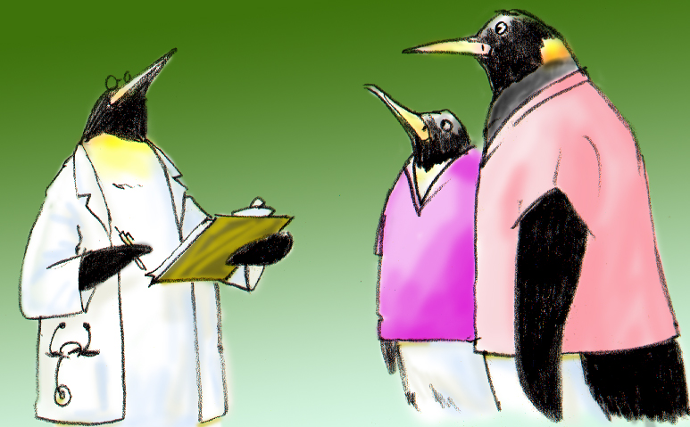
Summary
Pulling It All Together

Slide 2
Objectives
Discuss how to use the tools and strategies presented in this training
Demonstrate how to appropriately apply the tools and strategies in clinical scenarios

Slide 3
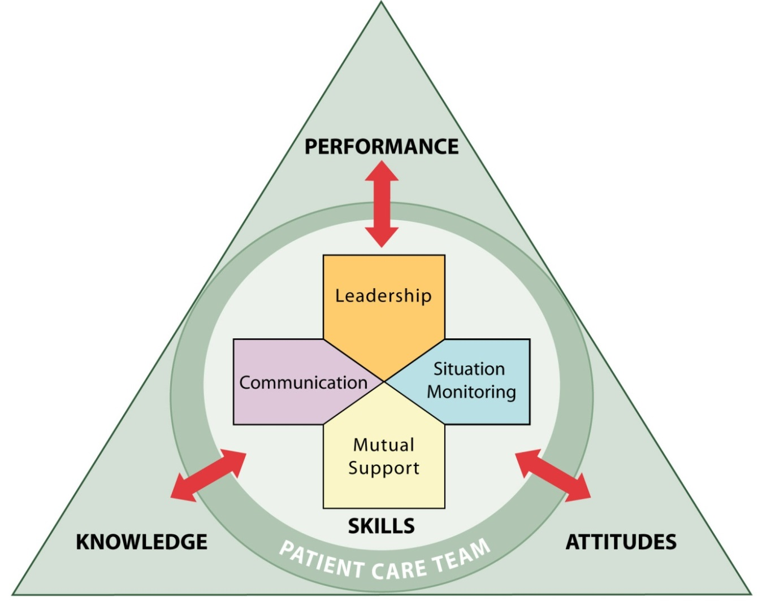
Summary
Each TeamSTEPPS teamwork skill:
Facilitates teamwork
Is dependent upon or moderated by the other skills
Contributes to team performance, quality of care, and patient safety

Slide 4
Tools & Strategies Summary
BARRIERS
Inconsistency in Team Membership
Lack of Time
Lack of Information Sharing
Hierarchy
Defensiveness
Conventional Thinking
Complacency
Varying Communication Styles
Conflict
Lack of Coordination and Followup With Coworkers
Distractions
Fatigue
Workload
Misinterpretation of Cues
Lack of Role Clarity
TOOLS and STRATEGIES
Communication
SBAR
Call-Out
Check-Back
Handoff
Leading Teams
Brief
Huddle
Debrief
Situation Monitoring
STEP
I’M SAFE
Mutual Support
Task Assistance
Feedback
Assertive Statement
Two-Challenge Rule
CUS
DESC Script
OUTCOMES
Shared Mental Model
Adaptability
Team Orientation
Mutual Trust
Team Performance
Patient Safety!!

Slide 5
TeamSTEPPS Outcomes
Improved team performance (e.g., Weaver, et al., 2010)
Improved team processes (e.g., Capella, et al., 2010)
Improved patient safety culture (e.g., Thomas & Galla, 2013)

Slide 6
Skills Practice

Slide 7
Identifying Opportunities to Use TeamSTEPPS Tools and Strategies

Slide 8
Effective Use of TeamSTEPPS Tools and Strategies

Slide 9
Summary
In the preceding section, we learned that teamwork strategies and tools:
Are available to both team members and leaders
Can be used to address barriers to team effectiveness in a given situation
Can all be applied to most situations because they complement one another

Slide 10
Applying TeamSTEPPS Exercise
Are there any changes you would make to your assessment of the teamwork issue that needs to be addressed in your organization?
If yes, what is the teamwork issue that needs to be addressed?
If you had to identify only one tool or strategy to implement first, which one would it be and why?

