Slide 1
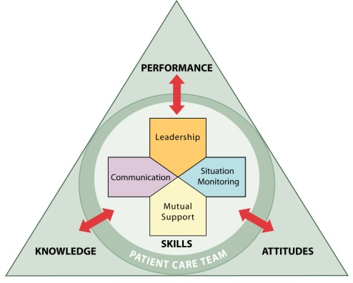
Strategies and Tools to Enhance Performance and Patient Safety

Slide 2
Ice Breaker

Slide 3
Sue Sheridan Video

Slide 4
Video Discussion
How are residents harmed as a result of medical errors?
How can we prevent medical errors?
What are the solutions?
…Improved teamwork and communications…
Ultimately, a culture of safety

Slide 5
Objectives
Describe the TeamSTEPPS training initiative
Explain resident safety in your nursing home
Describe the impact of errors and why they occur
Describe the TeamSTEPPS framework
State the outcomes of the TeamSTEPPS framework

Slide 6
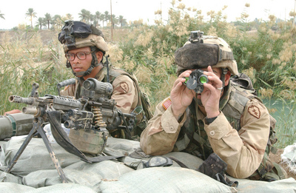
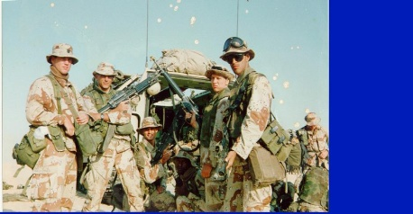
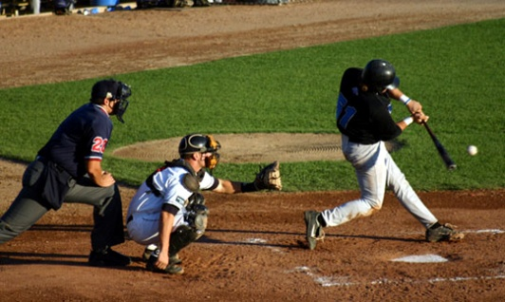
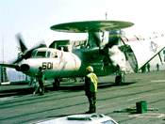
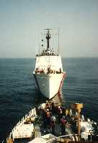
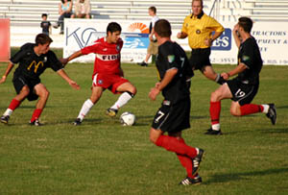
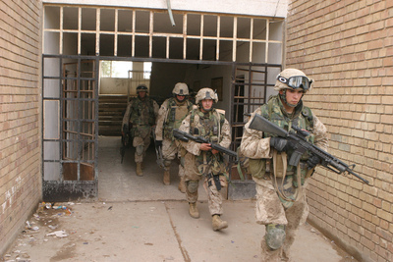
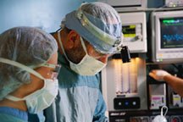
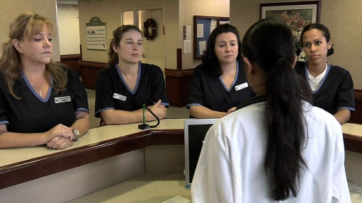
Teamwork Is All Around Us

Slide 7
Introduction
Evolution of TeamSTEPPS
Curriculum Contributors
Department of Defense
Agency for Healthcare Research and Quality
Research Organizations
Universities
Medical and Business Schools
Quality Improvement Organizations
Nursing Homes
Hospitals—Military and Civilian, Teaching and Community-Based
Healthcare Foundations
Private Companies
Subject Matter Experts in Teamwork, Human Factors, and Crew Resource Management (CRM)

Slide 8
Team
Strategies & Tools to Enhance Performance & Patient Safety
“Initiative based on evidence derived from team performance…leveraging more than 25 years of research in military, aviation, nuclear power, business and industry…to acquire team competencies”

Slide 9
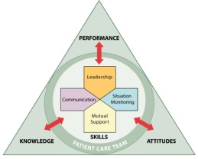
Patient Safety Movement
TeamSTEPPS
“To Err is Human” IOM Report
JCAHO National Patient Safety Goals
Patient Safety and Quality Improvement Act of 2005
DoD MedTeams®
ED Study
Executive Memo from President
Institute for Healthcare Improvement
100K lives Campaign
1995
1999
2001
2003
2004
2005
2006
Medical Team Training

Slide 10
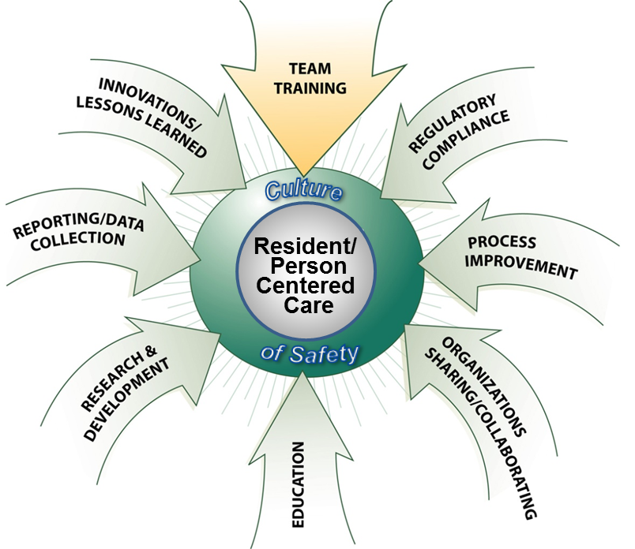
The Components of Resident Safety

Slide 11
Course Agenda
Module 1—Introduction
Module 2—Team Structure
Module 3—Leadership
Module 4—Situation Monitoring
Module 5—Mutual Support
Module 6—Communication
Module 7—Summary—Pulling It All Together

Slide 12
Introductions and Exercise: Magic Wand
If I had a “Magic Wand” and could make changes within my unit or facility in the areas of resident quality and safety…

Slide 13
Why Do Errors Occur—Some Obstacles
Workload fluctuations
Interruptions
Fatigue
Multitasking
Failure to follow up
Poor handoffs
Ineffective communication
Not following protocol
Excessive professional courtesy
Halo effect
Passenger syndrome
Hidden agenda
Complacency
High-risk phase
Strength of an idea
Task (target) fixation

Slide 14
Institute of Medicine Report
Impact of Error:
44,000–98,000 annual deaths occur as a result of errors
Medical errors are the leading cause, followed by surgical mistakes and complications
More Americans die from medical errors than from breast cancer, AIDS, or car accidents
7% of hospital patients experience a serious medication error
Federal Action:
By 5 years;
↓ medical errors by 50%,
↓ nosocomial by 90%; and
eliminate “never-events” (such as wrong-site surgery)
Cost associated with medical errors is $8–29 billion annually.

Slide 15
Medical Errors Still Claiming Many Lives By Elizabeth Weise, USA TODAY
05/18/2005
As many as 98,000 Americans still die each year because of medical errors despite an unprecedented focus on patient safety over the last five years, according to a study released today. Significant improvements have been made in some hospitals since the Institute of Medicine released a landmark report in 2000 that revealed many thousands of Americans die each year because of medical mistakes.
But nationwide, the pace of change is painstakingly slow, and the death rate has not changed much, according to the study in The Journal of the American Medical Association.
The researchers blame the complexity of health care systems, a lack of leadership, the reluctance of doctors to admit errors and an insurance reimbursement system that rewards errors — hospitals can bill for additional services needed when patients are injured by mistakes — but often will not pay for practices that reduce those errors.
"The medical community now knows what it needs to do to deal with the problem. It just has to overcome the barriers to doing it," says study co-author Lucian Leape of Harvard's School of Public Health.
The institute, a public policy organization, pushed key health care organizations to focus on patient safety, the new report says. As a result, reductions as much as 93% have been made in certain kinds of error-related illnesses and deaths.
Computerized prescriptions, adding a pharmacist to medical teams and team training in the delivery of babies are among the improvements medical centers are making, the study finds.
But "we have to turn the heat up on the hospitals," Leape says.
For example, 5% to 8% of intensive-care patients on ventilators develop pneumonia, the study says. But by strictly following a simple protocol of bed elevation, drugs and periodic breathing breaks, those outbreaks can be reduced to almost zero. "A little hospital in DeSoto, Miss., called Baptist Memorial did it, so it doesn't take a big academic medical center," Leape says.
Hospitals that eliminate infections should receive bonuses, Leape says. "If insurance companies paid 20% more for patients in (intensive-care units) where there were no infections, they'd cut costs substantially.
"We really need to rethink how we pay for health care. What we do now is pay for services, but what we should do is pay for care and outcomes."
Improvements
Hospitals have taken steps to reduce medical errors and injuries.
Examples:
Computerized prescriptions: 81% decrease in errors.
Including pharmacist in medical team: 78% decrease in preventable drug reactions.
Team training in delivery of babies: 50% decrease in harmful outcomes — such as brain damage — in premature deliveries.
Source: Journal of the American Medical Association
…little progress towards the goal
Leape and Berwick, JAMA May 2005

Slide 16
Targets for Teamwork
Sentinel event information provided by Joint Commission

Slide 17
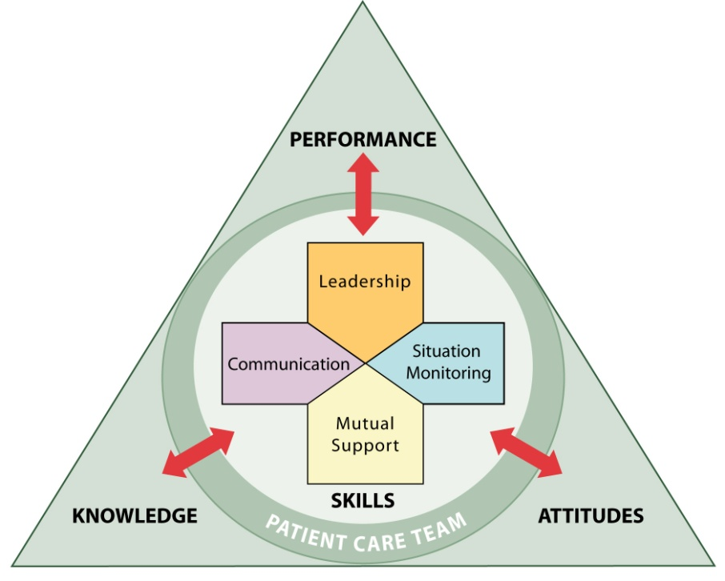
What Comprises Team Performance?
Knowledge Cognitions “Think”
Attitudes Affect “Feel”
Skills Behaviors “Do”
…team performance is a science…consequences of errors are great…

Slide 18
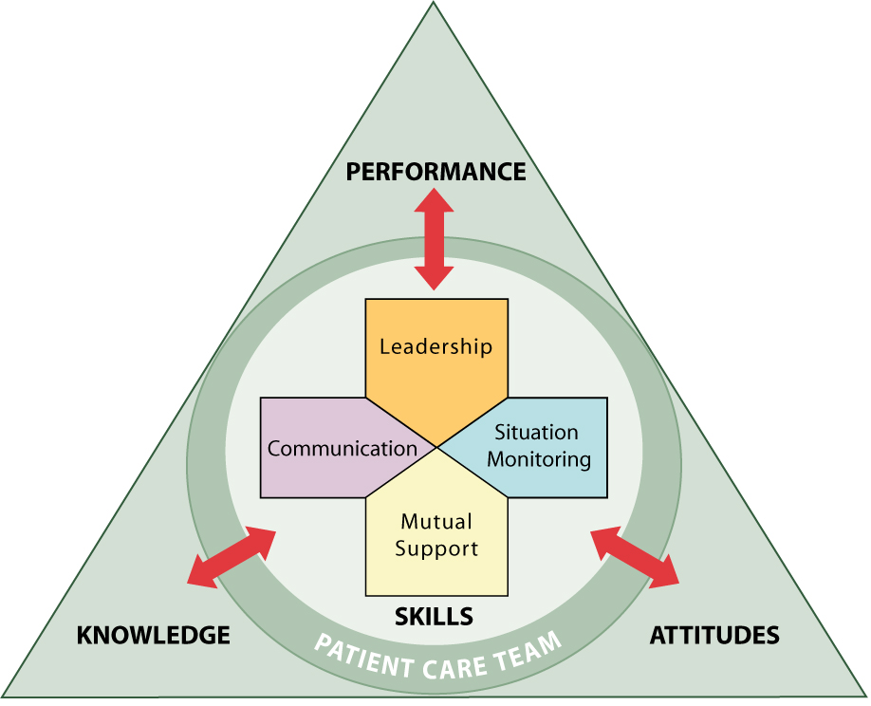
Outcomes of Team Competencies
Knowledge
Shared Mental Model
Attitudes
Mutual Trust
Team Orientation
Performance
Adaptability
Accuracy
Productivity
Efficiency
Safety

Slide 19
Teamwork Actions
Recognize opportunities to improve resident safety
Assess your current organizational culture and supporting components of resident safety
Identify a teamwork improvement action plan by analyzing data and survey results
Design and implement an initiative to improve team-related competencies among your staff
Integrate TeamSTEPPS into daily practice
“High-performance teams create a safety net for your healthcare organization as you promote a culture of safety."

Slide 20
Supplemental Instructor Slides

Slide 21
Train-the-Trainer/ Coach Session Agenda
Module 1—Introduction
Module 2—Team Structure
Module 3—Leadership
Module 4—Situation Monitoring
Module 5—Mutual Support
Module 6—Communication
Module 7—Summary—Putting It All Together
Change Management: How to Achieve a Culture of Safety
Coaching Workshop
Implementation
Course Management
Developing a Teamwork Improvement Action Plan
Practice Teaching Session

Slide 22
Teamwork Encompasses CRM
DoD has led the way in team research and innovations
Non-Health Care
Combat Information Centers
Joint Forces Operations
Emergency Management Communities
Army Special Forces
Tank, Submarine, and Air Crews
Health Care
ED, OR, L&D, ICU, Dental, Nursing Home
Whole Hospital
Combat Casualty Care
Team Training
CRM
"Learning and
Safety Culture"
…striving to be a high-reliability health care system…

Slide 23
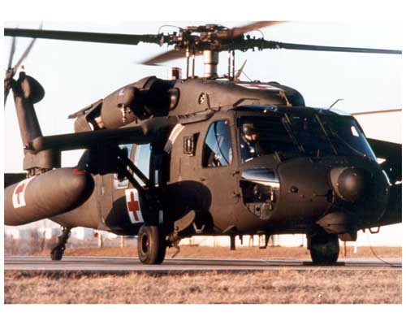
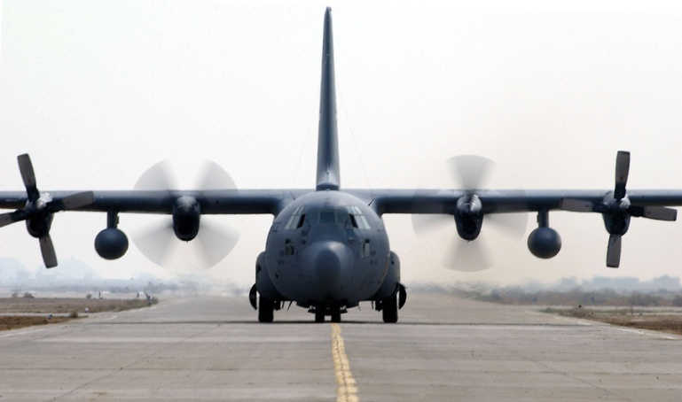
Background: U.S. Army Aviation
Army aviation crew coordination failures in mid-80s contributed to 147 aviation fatalities and cost more than $290 million
The vast majority involved highly experienced aviators
Failures were attributed largely to crew communication, workload management, and task prioritization

Slide 24
U.S. Navy Breakthroughs: Tactical Decisionmaking Under Stress (TADMUS)
Cross-Training
Stress Exposure Training
Team Coordination Training (CRM)
Scenario-Based Training and Simulation
Team Leader Training
Team Dimensional Training
Team Assessment

Slide 25
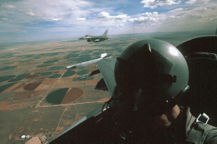
U.S. Air Force CRM History
Mid to late 80s, AF bombers and heavy aircraft started CRM training
In 1992, Air Combat Command developed Aircrew Attention Management /CRM Training
By 1998, CRM deployed uniformly across the AF
Steady decline in human factors based mishaps since CRM training deployed
AF Medical Service adapted training, rolled out in 2000

Slide 26
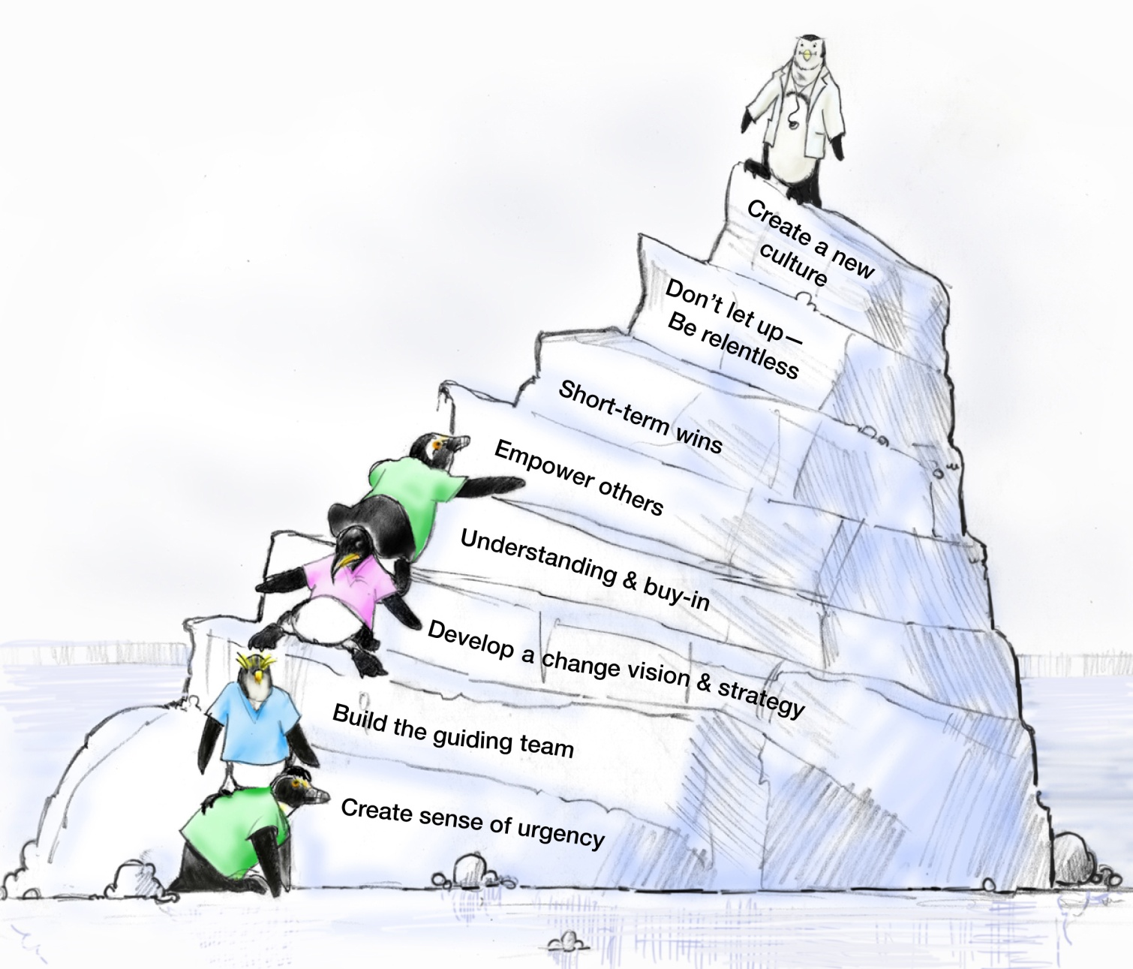
Eight Steps of Change
John Kotter

Slide 27
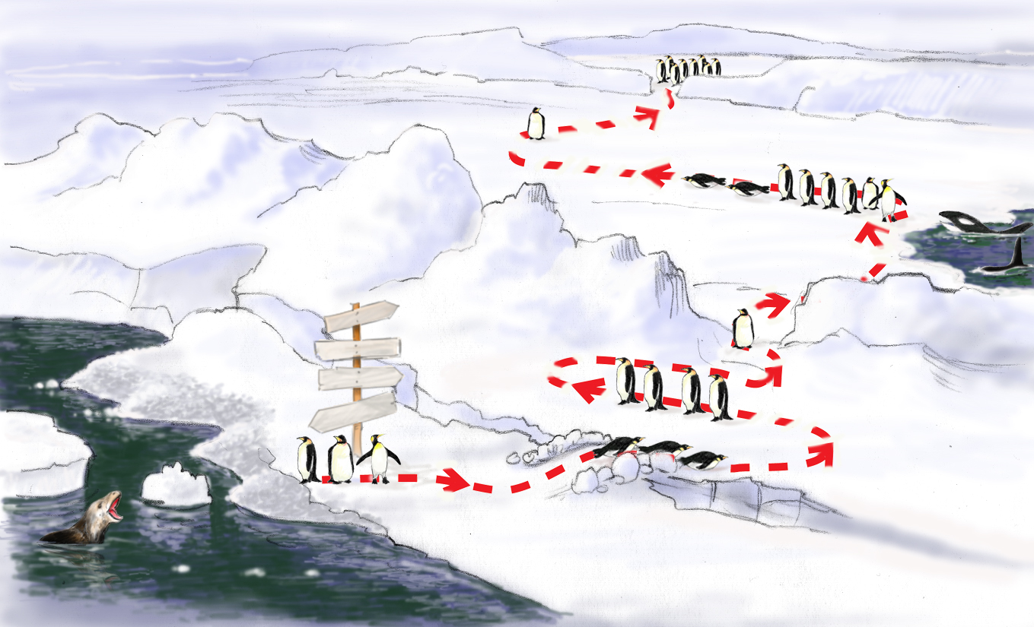
Roadmap to a Culture of Safety
Monitor, Integrate, Continuous Process Improvement
Celebrate wins! Staying the course Sustaining
Implement Action Plan, Train, Empower Others
Test Intervention
(Outcomes)
TeamSTEPPS Change Coaching
I’m staying right here. Yeah they’ll be back.
Jt. Comm.
What are they doing?
Develop Action Plan
Status QUO
FUTURE
Why do we need change?
Errorville
Prepare the Climate
Catalytic event drives need for change
Build team, strategy, buy-in, establish goals

