Slide 1
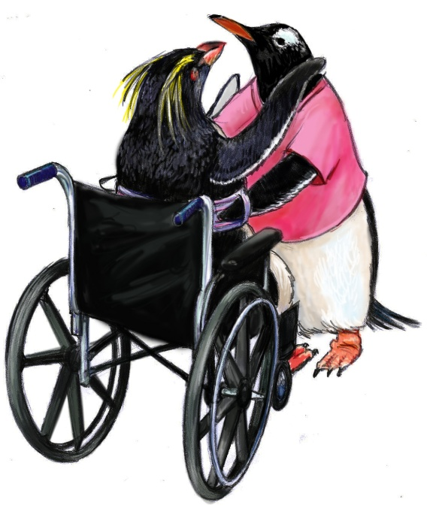
TEAM STRUCTURE
The ratio of We’s to I’s is the best indicator of the development of a team.
– Lewis B. Ergen
SUBSECTIONS
Why Teamwork?
High-Performing Teams
Barriers to Team Performance
Multi-Team System for Patient Care
Team Member Characteristics
TIME: 50 minutes

Slide 2
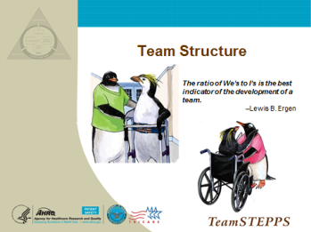
TEAM STRUCTURE
SAY:
Teamwork cannot occur in the absence of a clearly defined team. Therefore, improving upon an existing—or designing a new—team structure is the first step in implementing a teamwork system in any environment.
Organizational researchers have long focused on the value of teams as a unit of task work, with leadership serving as a means for improving employee performance and attitudes. It is important to first understand the structure of teams to learn how to promote teamwork and create a climate conducive to effective team functioning. Such a climate is based on a commitment to collaboration, mutual accountability, acknowledgment, recognition, and professional respect.
MODULE
TIME:
50 minutes

Slide 3
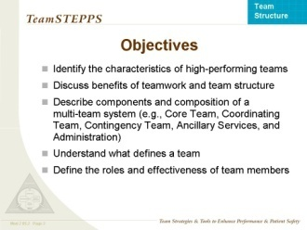
OBJECTIVES
SAY:
Upon completion of this module, participants will be able to:
  Identify the characteristics of high-performing teams.
  Discuss the benefits of teamwork and team structure.
  Describe the components and the composition of a multi-team system (e.g., Core Team, Coordinating Team, Contingency Team, Ancillary Services, and Administration).
  Understand what defines a team.
  Define the roles and effectiveness of team members.

Slide 4
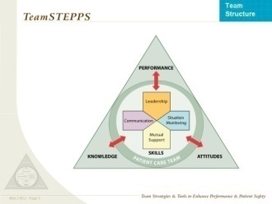
TeamSTEPPS TEAM SKILLS
SAY:
Team structure is an integral part of the teamwork process. A properly structured resident care team is an enabler and the result of effective leadership, communication, situation monitoring, and mutual support.
Team structure is the glue that holds together an effective strategy for ensuring resident safety and reducing error, taking into account the knowledge, performance, skills, and attitudes of team members.

Slide 5
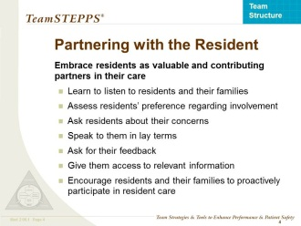
PARTNERING WITH THE RESIDENT
SAY:
A key concept of team structure is partnering with the resident. Residents, and many times their families or significant others, are part of the resident care team. They should be embraced and valued as contributing partners to resident care. This “culture change” to resident-centered care is especially important in nursing homes where individuals can often live for many years.
For decades institutionalized care, originating from hospital settings, was the customary culture. Beginning with the Omnibus Reconciliation Act of 1987 (OBRA ’87) and continued research, it was noted that an organization could have better outcomes by involving residents in their care decisions. Pressure from both consumers and nursing home providers caused nursing homes and other long-term care settings to shift their focus to a more inclusive care approach, where residents are true partners in their care. In nursing homes across the Nation, this culture shift is known as resident- or person-centered care.
Resident- or person-centered care in the context of the nursing home setting describes a philosophy that puts the needs, interests, and choices of residents at the center of care. It provides residents with the ability to exercise control and autonomy over their own lives, to the fullest extent possible. Evidence shows that giving residents a greater role in their care can improve their health.
Ways to effectively involve residents in their own care are to actively enlist the resident’s (and family members’) participation in unit-based rounds, care planning, and key committees.
KEY POINT:
  Residents and their family members or significant others are part of the resident care team.
Continued…

Slide 6
PARTNERING WITH THE RESIDENT
SAY:
Learning to work with residents and families as true partners is neither easy nor intuitive.
  Learn to listen.
  Ask residents how involved they prefer to be in their own care—this includes medical decisions as well as lifestyle choices (e.g., what activities they prefer to attend, when and how they prefer to bathe, what time they would like to go to sleep and rise).
  Explain things to residents and their families in language they will understand . Speaking in lay terms can prevent any inadvertent embarrassment or confusion.
  Ask residents about their concerns before any details are provided . This can help ensure residents will be active listeners and understand what is being said to them.
  Remind residents and families that they have access to relevant information (e.g., their medical record).
  Continuously ask residents and their families for feedback and to be proactive participants in their care and life at the nursing home.
DISCUSSION (Optional):
Residents, families, and other visitors may have questions and concerns from time to time. Understanding the complexity of nursing home staffing can be confusing to residents, families, and visitors. Consider directing residents, families, and visitors to the appropriate staff person or agency to alleviate their concerns and have their questions answered. A posting or brochure of the nursing home’s hierarchy (organizational structure) and names of department contacts can be a useful and appreciated tool to residents and their families.
Does your nursing home have a process to communicate resident/family concerns?
How is it communicated? How often?
How well is the process working?
KEY POINT:
  Residents and their family members or significant others are part of the resident care team.

Slide 7
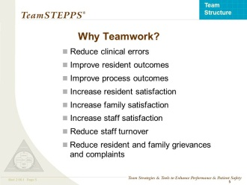
WHY TEAMWORK?
SAY:
The goals of teamwork are to:
  Reduce clinical errors.
  Improve resident outcomes.
  Improve process outcomes.
  Improve resident satisfaction.
  Increase family satisfaction.
  Increase staff satisfaction.
  Reduce staff turnover.
  Reduce resident and family grievances and complaints.
Teamwork may be determined by the physical or organizational structure of facilities. Teams may include those assigned to work in that area (e.g., neighborhoods, secured units, floors) but are not limited to only the individuals who work in a particular department. Individuals from several departments may work together on a team.
DISCUSSION:
  What are some other benefits of teamwork?

Slide 8
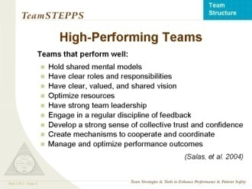
HIGH-PERFORMING TEAMS
SAY:
Over the course of this training, we will touch on the many interrelated aspects of high-performing teams. Generally speaking, high-performing teams have some common traits.
DISCUSSION:
  In what way do “Shared Mental Models” contribute to the success of high-performing teams?
  Answers include: members can anticipate each other’s needs; coordinate without the need to communicate overtly; know when explicit communication is best; and know where to look for expertise.
SAY:
Other traits of high-performing teams, which we will explore in more detail later in this course, include:
  Have clear roles and responsibilities.
  Have a clear, valued, and shared vision
    ) A common purpose
    An engaging purpose
    A leader who promotes the vision with the appropriate level of detail
  Optimize resources.
  Have strong team leadership.
  Engage in a regular discipline of feedback
    Regularly provide feedback to each other and as a team
    Establish and revise team goals and plans
    Differentiate between higher and lower priorities
    Have mechanisms for anticipating and reviewing issues of team members
    Periodically diagnose team effectiveness, including its
    results, processes, and vitality (including morale, energy, and retention
Continued…

Slide 9
HIGH-PERFORMING TEAMS (continued)
  Develop a strong sense of collective trust, team identity, and confidence
    Manage conflict by effectively confronting one another
    Have a strong sense of team orientation
    Trust other team members’ intentions
    Believe strongly in the team’s collective ability to succeed
    Develop collective efficacy
    Have a high degree of psychological safety
  Create mechanisms to cooperate, coordinate, and generate ongoing collaboration
    Identify teamwork and task requirements
    Ensure that the team possesses the right mix of competencies through staffing and development
    Distribute and assign work thoughtfully
    Consciously integrate new team members
    Involve the right people in decisions in a flexible manner
    Examine and adjust the team’s physical workplace to optimize communication and coordination
  Manage and optimize performance outcomes
    Communicate often and at the right time to ensure that fellow team members have the information they need to contribute
    Use closed-loop communication
    Learn from each performance outcome
    Continually strive to learn

Slide 10
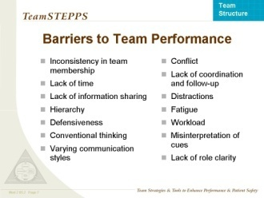
BARRIERS TO TEAM PERFORMANCE
SAY:
There are many barriers to effective team performance:
  Inconsistency in team membership.
  Lack of time.
  Lack of information sharing.
  Hierarchy.
  Defensiveness.
  Conventional thinking.
  Varying communication styles.
  Conflict.
  Lack of coordination and followup.
  Distractions.
  Fatigue.
  Workload.
  Misinterpretation of cues.
  Lack of role clarity.
DISCUSSION:
  Can you provide examples of how some of these barriers
  might play out in your nursing home, department, or work area?

Slide 11
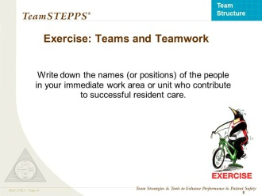
EXERCISE: TEAMS AND TEAMWORK
SAY:
Now let's look at the team in your own work area. Please take a few minutes to complete the Teams and Teamwork Exercise Sheet.
DO:
Give the participants several minutes to complete their sheets.
DISCUSSION:
  Who are the team members in your work area or department?
  What is the goal of your work area or department?
  What properties or characteristics make a group a team?
TIME:
5 minutes
MATERIALS:
  Teams and Teamwork Exercise Sheet

Slide 12
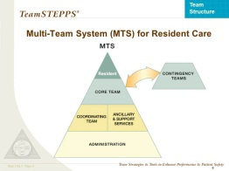
MULTI-TEAM SYSTEM FOR RESIDENT CARE
SAY:
This slide shows the model of a multi-team system (MTS). Each team within an MTS is responsible for various parts of resident care, but all must act in concert to ensure quality resident care.
The MTS is composed of several different teams.
The Administrative team includes the executive leadership and has 24-hour accountability for the overall function and management of the nursing home.
The Coordinating Team is responsible for day-to-day operational management and coordination of functions.
  The Ancillary Team provides direct, task-specific, time-limited care to residents.
  The Support Services Team provides indirect, task-specific services to the whole nursing home.
The Core Team consists of team leaders and team members who are involved in the direct care of residents.
  The Contingency Team provides time-limited assistance for specific or emergent events.
Often, staff in the nursing home setting wear multiple “hats,” so the same staff may serve on multiple teams. Their role and type of team will change depending on the situation. This is also true for the relationships between teams. Not every situation will require all teams. It is important to recognize that all nursing home staff are essential, regardless of their role or team.
Continued…
SPEAKER NOTE:
  MTS will be different from nursing home to nursing home. Refer to the MTS Exercise Sheet for examples of teams and their members.

Slide 13
MULTI-TEAM SYSTEM FOR RESIDENT CARE
SAY:
Example 1:
MTS Structure on a Dementia Unit
  The Core Team may be composed of the attending physician, physician assistant (PA), advanced practice registered nurse (APRN), nurse, nursing assistants, and restorative aides responsible for treating a resident. They come in direct contact with the resident.
  The Contingency Team may consist of the care planning team, emergent “code” teams, and hospice/palliative care teams, or a consulting pharmacist who can be called upon to participate if the medication regimen is complicated and requires special pharmacological expertise.
  The Coordinating Team in this example might include nurse supervisors, department heads, and unit managers or unit secretaries who may be responsible for resource management and promotion of teamwork for the unit.
Example 2:
MTS Structure on a Subacute Unit
  The Core Team may be composed of the physician, nurse, and rehabilitation staff responsible for cardiac rehabilitation of a resident. They come in direct contact with the resident.
  The Contingency Team may consist of the MDS Coordinators and the care planning team.
  The Coordinating Team in this example might include the unit’s charge nurse or the director of nursing responsible for admissions and resource management for the cardiac rehab or subacute units.
.
SPEAKER NOTE:
  MTS will be different from nursing home to nursing home. Refer to the MTS Exercise Sheet for examples of teams and their members.

Slide 14
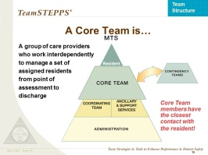
CORE TEAMS
SAY:
Core Teams consist of team leaders and team members who are involved in the direct care of the resident. The Core Team is based where the resident receives care.
Core Teams should be small enough to ensure situation monitoring, development of situation awareness, and direct, unfiltered communication between members. To establish a shared mental model, Core Teams should be large enough to include skill overlap between members to allow for workload sharing and redistribution when necessary. Every Core Team has a primary leader who is readily identified by all members of the team. When multiple Core Teams exist on a unit/floor/neighborhood, a method for denoting team affiliation is established to expedite information flow and resource coordination within the teams. A team distribution scheme denotes the assigned work area of each Core Team and facilitates the allocation of resources across the unit based on fluctuations in team workload.
Core Team leadership is dynamic; Core Team leaders are required to take on different roles at various points in the plan of care. Often these may be nonleadership roles, such as supporting a nurse starting an IV.
To establish a Core Team:
  Select the leader.
  Designate roles and responsibilities.
  Communicate essential team information.
Don’t forget, the resident and his/her family/significant other are part of the Core Team too.
SPEAKER NOTE:
  MTS will be different from nursing home to nursing home. Refer to the MTS Exercise Sheet for examples of teams and their members.

Slide 15
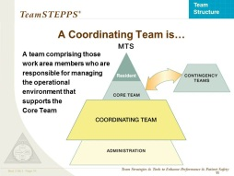
COORDINATING TEAMS
SAY:
The Coordinating Team is the group responsible for:
  Day-to-day operational management.
  Coordination functions.
  Resource management for Core Teams.
Direct resident care may be a secondary function with the exception of small facilities.
Coordinating Team leaders generally are designated. They usually consist of managers, such as nursing supervisors and department heads. Multiple-role groups are usually required for each work area, unit/floor/neighborhood, or department.
It is the role of the Coordinating Team to provide policy-level guidance, triage all emerging events, and prioritize decisionmaking to ensure maximal support to the Core Team.
Coordinating Team members facilitate Core Team actions and outcomes by collaborating with the Administrative Team and the Ancillary Services Teams to assign priorities and ensure throughput. It is also the Coordinating Team’s responsibility to make certain that potential contingency situations are recognized and that the Contingency Team is notified of potential activities (e.g., the care plan coordinators are notified of a change in the resident’s status).
Coordinating Teams frequently comprise experienced personnel with strong clinical backgrounds or management skills. This combination enhances the ability of the Coordinating Team members to rapidly assess the overall picture, anticipate the needs or potential needs between and across teams, and make priority-based decisions.
DISCUSSION:
  Who might be the members of the Coordinating Team for your nursing home?
  How might the members of the Coordinating Team be different for your
    Dementia unit?
    Subacute/Rehabilitation unit?
    Other specialty units?
SPEAKER NOTE:
  MTS will be different from nursing home to nursing home. Refer to the MTS Exercise Sheet for examples of teams and their members.

Slide 16
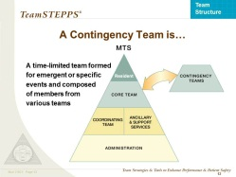
CONTINGENCY TEAMS
SAY:
Contingency Teams are:
  Formed for emergent or specific events .
Time limited.
  Composed of team members drawn from a variety of teams.
Contingency Teams are responsible for immediate, direct resident care during emergency situations requiring more resources than are available to the Core Team. In the nursing home, this may be referred to as “all hands on deck.” They generally consist of preidentified members derived from varying units or departments and have limited time to prepare for emergencies.
In nonemergent situations, Contingency Teams are charged with addressing various topics related to the care and safety of residents. An example is a team (composed of various staff) that may be formed to address wound care.
Contingency Team roles can be very specific and limited to a certain situation (e.g., Code Team) or have general responsibility for a broad category of situations (e.g., care planning teams, Continuous Quality Improvement (CQI)/Quality Assurance (QA) teams, safety teams). The more general the responsibility, the greater the need for clear and unambiguous policy guidance from the Administrative Team to facilitate rapid decisionmaking and clear assignment of responsibilities.
For instance, the safety team and/or CQI team might meet regularly on a quarterly basis, but in the event of an accident or sentinel event, the teams might meet to examine the event and determine its root cause. Care plan teams review residents on a quarterly basis as well, yet might need to come together sooner when a resident has a change in condition.
SPEAKER NOTE:
  MTS will be different from nursing home to nursing home. Refer to the MTS Exercise Sheet for examples of teams and their members.

Slide 17
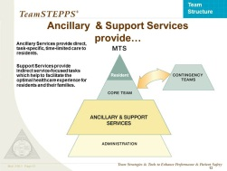
ANCILLARY and SUPPORT SERVICES
SAY:
Ancillary Services consist of individuals who:
  Provide direct, task-specific, time-limited care to residents.
  Support the services that facilitate care of residents.
  May or may not be located where the residents receive their routine care (depending on the size of the nursing home).
Ancillary Services are primarily a service delivery team whose mission is to support the Core Team. In general, an Ancillary Services Team functions independently.
Support Services consist of individuals who:
  Provide indirect, task-specific services in a health care facility.
  Are service focused, helping to facilitate the optimal health care and homelike experience for residents and their families.
  Have integrated roles in that they manage the environment, assets, and logistics within a facility.
  Support Services are primarily a service-focused team whose mission is to create efficient, safe, comfortable, and clean health care environments, which affect the resident care team, market perception, operational efficiency, and resident safety.
DISCUSSION:
  What are some examples of Ancillary and Support Services Teams?
Possible Answers:
  Ancillary services
    Laboratory − Recreation Services
    X Ray − Social Services
    Pharmacy − Rehabilitation Services
  Support services
    Housekeeping − Laundry
    Supply − Physical Plant
    Human Resources − Dietary
    Vounteers − Staff Development/Staff Education
SPEAKER NOTE:
  MTS will be different from nursing home to nursing home. Refer to the MTS Exercise Sheet for examples of teams and its members.

Slide 18
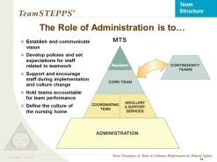
THE ROLE OF ADMINISTRATION
SAY:
Administration includes the executive leadership of a unit or facility, and has 24-hour accountability for the overall function and management of the nursing home. Administration creates the climate and culture for a teamwork system to flourish by:
  Establishing and communicating vision.
  Developing and enforcing policies.
  Setting expectations for staff.
  Providing necessary resources for successful implementation.
  Holding teams accountable for team performance.
  Defining the culture of the nursing home.
The Administrative Team provides the framework and guidance that ensure each team understands its role and responsibility and has access to the necessary resources to be successful. The Administrative Team also holds everyone accountable for exhibiting teamwork behaviors. For all teams to function effectively and provide the necessary mutual support, it is critical for the Administrative Team to develop and institutionalize proper policies and procedures that clearly articulate the roles and responsibilities of the other teams and team members.
Administration should strive to create a learning culture where there is trust and transparency to create a “safe harbor” to report, analyze, and share information openly. This philosophy serves to define a culture of safety; however, just as in aviation and other high-risk industries, the change will not happen overnight.
SPEAKER NOTE:
  MTS will be different from nursing home to nursing home. Refer to the MTS Exercise Sheet for examples of teams and their members.

Slide 19
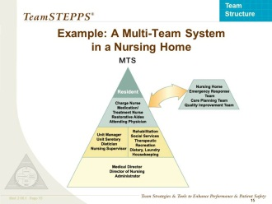
EXAMPLE: A MULTI-TEAM SYSTEM IN A NURSING HOME
SAY:
Here we see an example of a multi-team system in a 120-bed long- term care facility. In this example, the core team consists of: nurses (e.g., charge nurse, medication/treatment nurse), nursing assistants, restorative aides, attending physicians, and APRN/PA. The coordinating team consists of: the nursing supervisor or unit manager, unit secretary, and dietitian. The ancillary services team includes: rehabilitation therapy staff, social services, and therapeutic recreation staff. The support services team consists of dietary, laundry and housekeeping. The contingency team consists of: the nursing home’s emergency response team, care planning team, and quality improvement teams. Administration consists of: the medical director, the nursing director, and the administrator.

Slide 20
EXERCISE: YOUR MULTI-TEAM SYSTEM
SAY:
Individually, map out a multi-team system for your department, work area, or facility.
DO:
Allow several minutes for individuals to map out their multi-team system on paper or on the Multi-Team System Exercise Sheet.
NOTE: Refer to the list of sample nursing home multi-team system members on the Multi-Team System Sheets. These sheets can be used during this exercise to help individuals map out their multi-team system.
SAY:
Think about:
  What types of team members make up each team?
  How do the teams in your unit or department interact with one another?
TIME:
5 minutes
MATERIALS:
  Paper or Multi-Team System Exercise Sheet

Slide 21

TEAM MEMBER CHARACTERISTICS
SAY:
Now that we have examined the structure of teams within a given unit or department, we are going to look at team leaders and team members.

Slide 22
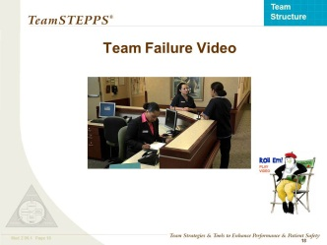

TEAM FAILURE VIDEO
SAY:
Please consider how the lack of team structure plays a role in the situation shown in this video.
DO: Play the video by clicking the director icon on the slide.
DISCUSSION: Go to next slide >
VIDEO TIME:
3:15 minutes
MATERIALS:
  TeamSTEPPS Opportunities_
  LTC Video
CUSTOMIZABLE CONTENT

Slide 23
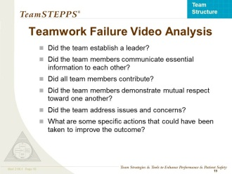
TEAMWORK FAILURE VIDEO ANALYSIS
SAY:
Now let’s discuss what you saw in the video vignette.
DISCUSSION:
  Did the team members communicate essential information to each other?
    No. The recreation therapist did not seek out the nursing assistant or nurse to report the change in Mrs. Smith. The nursing assistants did not listen to input from the social worker during shift report. The nurse did not relay a detailed comprehensive assessment to the physician.
  Did the team demonstrate mutual respect toward one another?
    No. For example, Carmen and Lucy (the nursing assistants) dismissed the comments of the social worker.
  Did the team address issues and concerns?
    No. The social worker does not speak up when her comments are ignored by the nursing assistants.
  What are some specific actions that could have been taken to improve the outcome?
    The recreation therapist could have reported her concerns to the nursing assistant or nurse.
    The social worker could have reported her observations to the nurse or supervisor when the nursing assistants did not acknowledge her concerns.
    The nursing assistant giving the report could have provided more detail on the resident’s condition.

Slide 24
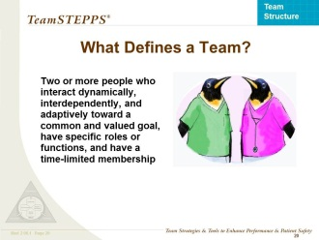
WHAT DEFINES A TEAM?
SAY:
A team is different from a group. A group can achieve its goal through independent individual contributions. Real-time coordination of tasks between individuals is not required.
A team consists of two or more people who interact dynamically, interdependently, and adaptively toward a common and valued goal, have specific roles or functions, and have a time-limited membership. During the temporal life of a team, the team’s mission is of greater value than the goals of the individual members.
Team members:
  Include anyone involved in the process of resident care who can take action, including the leader.
  Have clearly defined roles.
  Are accountable to the team for their actions.
  Must stay continually informed for effective team functioning.

Slide 25
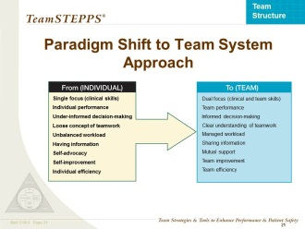
PARADIGM SHIFT TO A TEAM SYSTEM APPROACH
SAY:
Moving to a team system approach will result in a number of shifts in traditional work patterns:
  FROM TO
  a single focus (clinical skills) a dual focus (clinical
  and team skills)
  individual performance team performance
  underinformed decisionmaking informed decisionmaking
  a loose concept of teamwork a clear understanding of teamwork
  an unbalanced workload a managed workload
  having information sharing information
  self-advocacy mutual support
  self-improvement team improvement
  individual efficiency team efficiency

Slide 26
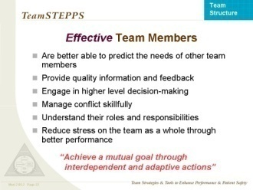
EFFECTIVE TEAM MEMBERS
SAY:
Effective team members:
  Are better able to predict the needs of other team members and are proactive versus reactive.
  Provide quality information and feedback.
  Engage in higher level decisionmaking.
  Manage conflict skillfully.
  Understand their roles and responsibilities.
  Reduce stress on the team as a whole through better performance.
Effective team members “achieve a mutual goal through
interdependent and adaptive actions.”

Slide 27
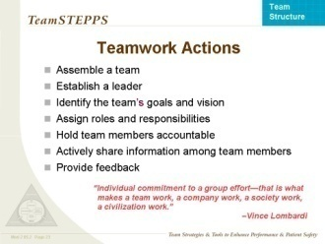
TEAMWORK ACTIONS
SAY:
Teamwork actions include:
  Assembling a team.
  Selecting a leader.
  Identifying the team’s goals and vision.
  Assigning roles and responsibilities.
  Holding team members accountable.
  Actively sharing information among team members.
  Providing feedback.
DISCUSSION:
  What actions will you take to improve your team’s structure and effectiveness?
MATERIALS:
  Flipchart or Whiteboard (Optional)
  Markers (Optional)

Slide 28
REFERENCES
  DeChurch, L. A. and M. A. Marks. “Teams Leading Teams: Examining the Role of Leadership in Multi-Team Systems.” Journal of Applied Psychology 89. 2003.
  Fleishman, E. A., M. D. Mumford, S. J. Zaccaro, et al. “Taxonomic Efforts in the Description of Leader Behavior: A Synthesis and Functional Interpretation.” Leadership Quarterly, 2: 245, 1991.
  Harris, T. C. and J. L. Barnes-Farrell. “Components of Teamwork: Impact on Evaluations of Contributions to Work Team Effectiveness.” Journal of Applied Social Psychology 27, 1694-1715. 1997.
  Kozlowski, S. W. and B. S. Bell. “Work Groups and Teams in Organizations.” Borman, W. C., D. R. Ilgen, D. R., and R. Klimoski. In Comprehensive Handbook of Psychology: Vol. 12 Industrial and Organizational Psychology. New York, Wiley.
  McGrath, J. E. “The Influence of Quasi-Therapeutic Relations on Adjustment and Effectiveness in Rifle Teams.” Journal of Abnormal and Social Psychology 65, 365-375. 1962.
  Morgeson, F. P. “Leading as Event Management: Toward a New Conception of Team Leadership.” Poster session presented at meeting of the Society of Industrial and Organizational Psychology, St. Louis, MO. 1997.
  Salas, E., C. S. Burke, and K. C. Stagl. “Developing Teams and Team Leaders: Strategies and Principles.” Leader Development for Transforming Organizations. Edited by Demaree, R. G., S. J. Zaccaro, and S. M. Halpin. Lawrence Erlbaum Associates, Inc., Mahwah, NJ, 2004.
  Sims, D. E., E. Salas, and C. S. Burke. “Is There a ‘Big Five' in Teamwork?” 19th Annual Meeting of the Society for Industrial and Organizational Psychology. 4. Chicago, IL, 2004.
  Sundstrom, E. “Supporting Work Team Effectiveness: Best Management Practices for Fostering High Performance.” Jossey-Bass, Inc., San Francisco, CA, 1-1-1999.
  Tjosvold, D. “Flight Crew Collaboration to Manage Safety Risks.“ Group and Organization Studies 15, 177-191. 1990.
  Zaccaro, S. J., A. L. Rittman, and M. A. Marks. “Team Leadership.” Leadership Quarterly, 12: 451, 2001.

