Slide 1
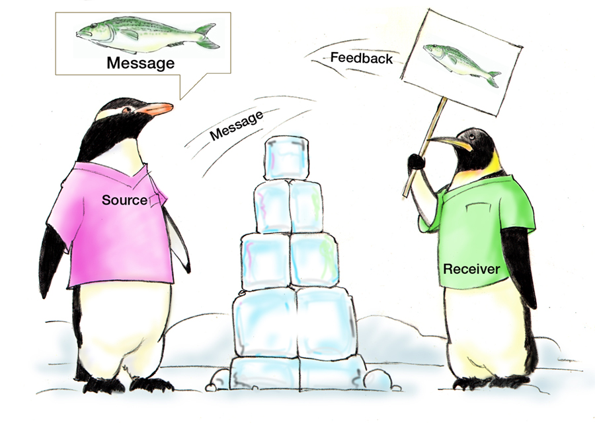
COMMUNICATION
Assumptions
Fatigue
Distractions
HIPAA
Communication is the response you get from the message you sent regardless of its intent.
– Author Unknown
SUBSECTIONS
Communication
Standards of Effective Communication
Information Exchange Strategies (e.g., SBAR, check-back, call-out, and handoff)
Communication Challenges
Teamwork Actions
TIME: 45 minutes

Slide 2
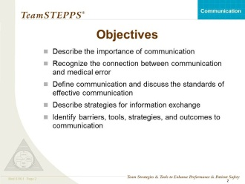
COMMUNICATION
SAY:
Communication is the lifeline of a well-functioning team. This module provides strategies and tools to improve the effectiveness and promote the sharing of information. Improving the quality of information exchange decreases communication-related errors.
Before we get started, let’s review how communication plays a role in the following situation.
Example:
Beth is taking her mother, Margaret, a long-term care resident who is wheelchair dependent, out for the afternoon to attend a family gathering. As the nurse is signing out Margaret for the leave of absence, she tells Beth, “Your mother is at risk for pressure ulcers now that she uses the wheelchair. Her skin is intact and she will be fine as long as you reposition her at least every 2 hours.” Later that evening, during evening care, the nursing assistant reports that Margaret has an open area on her coccyx. The nurse calls Beth. Beth, sounding confused, says, “How could this have happened? I did just as you said, I turned her chair every 2 hours!”
DISCUSSION:
  Where did miscommunication occur in this situation?
  How would you have handled the communication of this resident’s condition and to whom?
SAY:
In this module, we will:
  Describe the importance of communication
  Recognize the connection between communication and medical error
  Define communication and discuss the standards of effective communication
  Describe strategies for information exchange
  Identify barriers, tools, strategies, and outcomes of communication
MODULE TIME:
45 minutes

Slide 3
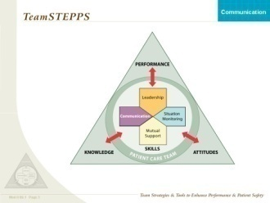
TeamSTEPPS FRAMEWORK
SAY:
Communication is an important component of the team process because it serves as a coordinating mechanism or supporting structure for teamwork. Communication skills interplay directly with leadership, situation monitoring, and mutual support. Team leaders provide guidance through verbal feedback. Effective communication skills are needed to convey clear information, provide awareness of roles and responsibilities, and explain how performance affects outcomes. Team members monitor situations by communicating any changes to keep the team informed and the resident protected. Communication facilitates a culture of mutual support. It is also important to recognize the resident as part of the team and be aware that clinical and nonclinical people have an important role in affecting the care of the resident.
This module focuses on communication. It informs participants about the components of effective communication and how communication affects team performance. The communication module covers two areas: communication delivery and information exchange. Communication delivery includes the intended audience, the mode of communication (written and oral), and the delivery technique (clear and brief). Effective information exchange involves:
  Sending techniques—seeking information from all available sources, sharing information before asked, and providing situation updates as necessary
  Recurring techniques—analyzing the data (information) provided and synthesizing it into or modifying the existing plan of care
  Verifying techniques—checking back information to investigate the intent of the sender
  Validating techniques—confirming the intent of the sender orally or in writing
As an unknown author said, “Communication is the response you get to a message you sent regardless of its intent.”

Slide 4
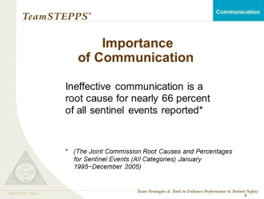
IMPORTANCE OF COMMUNICATION
SAY:
According to Sentinel Event data compiled by the Joint Commission between 1995 and 2005, ineffective communication was identified as a root cause of 66 percent of reported errors.
Root cause analysis is used to help identify what, how, and why something happened, thus preventing the event from occurring again.
ASK:
  Have you experienced a situation on your unit, department, or work area involving a breakdown of communication?
  What are some examples?
Example:
An 89-year-old female resident with Alzheimer’s disease has been living at the nursing home for many years. The family decides they no longer want aggressive measures taken and request that the resident’s code status be changed to Do Not Resuscitate/Allow Natural Death. The evening shift documents in the progress note that the family (and designated health care agent) requested that the resident not be resuscitated. The evening shift does not relay the information during shift change or on the 24-hour report, or notify the attending physician. The day shift does not read the night shift’s notes because of several immediate emergencies. The family, who had been keeping vigil at her bedside, leaves to go home to shower and eat. Upon return, they find the staff attempting CPR. The resident is successfully resuscitated but now lies in a vegetative state. The family is very unhappy and considering legal action.

Slide 5
TOP CONTRIBUTING FACTORS
Instructor Note: Optional content.
SAY:
Discuss examples of top causal factors for inadequate information sharing and communication. Ask the audience to draw examples from their own nursing home/unit/department and other personal experiences.
Examples:
  Jack, a newly admitted resident to the subacute unit, is at the nursing home for rehabilitation following hospitalization for an acute episode of congestive heart failure. The dietitian orders a low salt diet and speaks with Jack and his wife about the importance of eating low sodium foods and not adding salt to any foods. They agree and say they have been following those recommendations as given by their doctor. Jack says that he misses foods such as ham but is thankful he can still eat bacon. This is an example of inadequate verbal communication with residents and families.
  Christine, a resident who takes warfarin, is noted to have a bloody nose, bleeding gums, and a large bruise on her arm. The nurse reports these findings to her physician. He orders a CBC and INR and assumes she understands his intent to have these labs drawn stat. The nurse orders the labs to be drawn on the next lab day, 2 days from now. This is an example of inadequate verbal communication between nurse and physician.

Slide 6
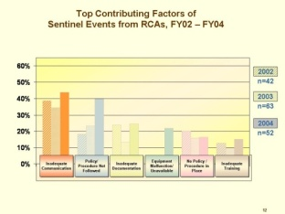
CAUSAL FACTORS
Instructor Note: Optional content.
ASK:
  What tools and strategies have we discussed that would help eliminate causal factors related to poor communication?
    Some potential answers include: huddles, advocacy and assertion, Two-Challenge rule, checklists
SAY:
Lack of communication among staff can lead to failure of:
  Sharing information with the team
  Requesting information from others
  Directing information to specific team members
  Including residents in communication involving their care
Examples of missed communication opportunities include:
  Inconsistencies in the utilization of automated systems
  Poor documentation—not timed, nonspecific, illegible, and incomplete
  Strategies to avoid these pitfalls:
  Having the right information will facilitate the right action
  Directing information to the particular individual you expect to execute the order ensures that it will not be delayed or missed
  Remembering that residents and their families are an important information source will improve communication
In this module, we will discuss additional approaches to eliminate these causal factors in poor communication.

Slide 7
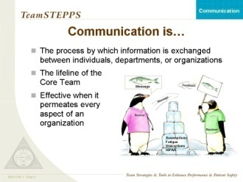
COMMUNICATION IS…
SAY:
Communication can be defined as the “exchange of information between a sender and a receiver” (McIntyre and Salas, 1995). More specifically, it is “the process by which information is clearly and accurately exchanged between two or more team members in the prescribed manner and with proper terminology and the ability to clarify or acknowledge the receipt of information.”
A tremendous body of evidence exists to support the efficacy of good communication skills for effective teamwork. For example, Cannon-Bowers, et al., found that communication comprises two critical skills: exchanging information and consulting with others. Information exchange was defined by behaviors such as closed-loop communication, which is the initiation of a message by a sender, the receipt and acknowledgment of the message by the receiver, and the verification of the message by the initial sender. Other behaviors include information sharing, procedural talk, and volunteering and requesting information. Likewise, Dickinson and McIntyre found that effective communication required information to be exchanged in a set manner using proper terminology and acknowledgment of the information received.
Some things to consider when communicating:
  The audience—How might your interaction with a nursing assistant be different from that with a physician?
  The mode of communication—Verbal, nonverbal, written, email.
  Standards associated with the specific mode of communication (e.g., use of "do not use" abbreviations; refer to the Joint Commission Official “Do Not Use” List). Nonverbal communication requires verbal clarification to avoid making assumptions that can lead to error. The simple rule is, "When in doubt, check it out, offer information, or ask a question.”
  The power of nonverbal communication—The way you make eye contact and the way you hold your body during a conversation are signals that can be picked up by the person with whom you are communicating, although powerful, nonverbal communication does not provide an acceptable mode to verify or validate (acknowledge) information.
KEY POINTS:
  Communication is the “exchange of information between a sender and a receiver.”
  Consider the audience,
  your chosen method of communication, and the standards for
  that method.
Continued…

Slide 8
COMMUNICATION IS… (continued)
ASK:
  What are some ways you nonverbally communicated or received information? How was it taken?
  Do you know if that was the actual intent of the person?
  How could face masks impair communication?
Example:
The nonverbal cues a nurse gives when assessing an injury would quickly tell another nurse the severity of the situation and might lead to proactive action. Likewise, the nonverbal cues from a nursing assistant’s face might communicate the urgency of the situation and need for interruption to a nurse who is with a resident’s family members.
SAY:
Visual cues also provide another layer of nonverbal communication. Albert Mehrabian found that there are basically three elements in any face-to-face communication: words, tone of voice, and body language.
These three elements account differently for the meaning of the message: words account for 7 percent, tone of voice accounts for 38 percent, and body language accounts for 55 percent of the message.
Nonverbal communication is not, however, an acceptable mode of communication. For safety to exist, the message must be verified orally or be written.

Slide 9
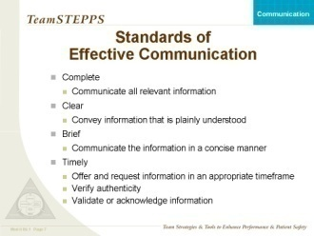
STANDARDS OF EFFECTIVE COMMUNICATION
SAY:
Whether sharing information with the team, resident, or family, communication must meet four standards to be effective.
Effective communication is:
  Complete
    Communicate all relevant information while avoiding unnecessary details that may lead to confusion
    Leave enough time for residents to ask questions, and answer questions completely
  Clear
    Use information that is plainly understood (avoid medical jargon, use layperson’s terminology with residents and their families)
    Use common or standard terminology when communicating with members of the team
  Brief
    Be concise
  Timely
    Be dependable about offering and requesting information
    Avoid delays in relaying information that could compromise a resident’s situation
    Note times of observations and interventions in the resident’s record
    Update residents and families frequently
    Verifying requires checking that the information received was the intended message of the sender
    Validate or acknowledge
Example:
  A well-written discharge prescription or medication reconciliation
  is:
  Complete—It includes medication, dosage, and frequency
  Clear—It is clearly written and legible
  Brief—It contains only the necessary information
  Timely—It is written before discharge

Slide 10
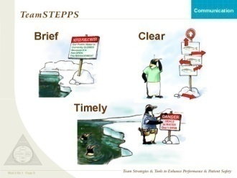
BRIEF, CLEAR, AND TIMELY
SAY:
Provide information that is brief, yet as complete as possible. Do not overexplain the situation; be concise.
Be clear—Plainly understood.
Timely—Looks like it may be a little too late for these penguins!

Slide 11
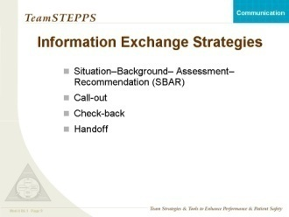
INFORMATION EXCHANGE STRATEGIES
SAY:
A number of strategies to potentially reduce errors associated with miscommunication or lack of information are listed. These four strategies are simple to integrate into daily practice and have been shown to improve team performance.
  Situation−Background−Assessment–Recommendation (SBAR)
  Call-Outs
  Check-Backs
  Handoffs
ASK:
By a raise of hands, how many of you are familiar with these strategies?

Slide 12
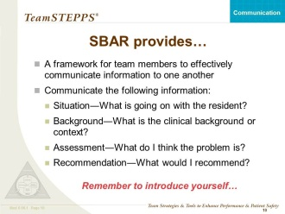
SBAR PROVIDES…
SAY:
The SBAR technique provides a standardized framework for members of the health care team to communicate about a resident's condition.
SBAR is an easy-to-remember, concrete mechanism that is useful for framing any conversation, especially a critical one requiring a clinician's immediate attention and action. SBAR originated in the U.S. Navy submarine community to quickly provide critical information to the captain. It provides members of the team with an easy and focused way to set expectations for what will be communicated and how. Standards of communication are essential for developing teamwork and fostering a culture of resident safety. In phrasing a conversation with another member of the team, consider the following:
  Situation—What is happening with the resident?
  Background—What is the clinical background?
  Assessment—What do I think the problem is?
  Recommendation—What would I recommend?
SBAR provides a vehicle for individuals to speak up and express concern in a concise manner. Since SBAR is a structured communication method, it can be used in nonclinical settings and departments as well.
  Situation—What is happening?
  Background—What is the background?
  Assessment—What do I think the problem is?
  Recommendation—What would I recommend?
ASK:
Give me some examples of communication exchanges between staff on your unit, in your department, or in your work area—for example: staff to staff, nurse to doctor, nurse to nurse, nurse to supervisor, nursing assistant to housekeeper, maintenance staff to administrator, administrator to director of nursing.
KEY POINTS:
  SBAR stands for: Situation– Background– Assessment– Recommendation.
  The SBAR is one technique that can be used to standardize communication, which is essential for developing teamwork and fostering a culture of resident safety.
  SBAR creates a consistent format for information to be sent and creates an expectation for information to be received.

Slide 13
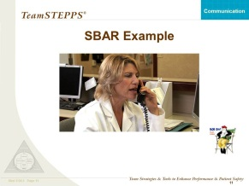

SBAR VIDEO
SAY:
Let’s review how to properly use the SBAR technique. In this video, the resident’s condition has worsened, resulting in a telephone call to the attending physician. Watch the video to see the transfer of information using the SBAR technique.
DO: Play the video by clicking on the director icon on the slide.
DISCUSSION:
  How did the SBAR technique improve this “handoff” between nurse and physician?
    The nurse identified herself and the reason she was calling
    The physician was quickly made aware of Mrs. Smith’s deteriorating situation
    The nurse provided the background of the diagnosis and all current labs
    The recent assessment of the resident has led the nurse to call the physician with her concerns
    The recommendation was initiated by the nurse for additional labs and a plan was discussed for future care
    Some find recommendation difficult as they attempt not to diagnose but give broader indirect suggestions that may not provide clear or concise resident information.
VIDEO TIME:
  1:35 minutes
MATERIALS:
  SBAR_LTC Video
CUSTOMIZABLE CONTENT

Slide 14
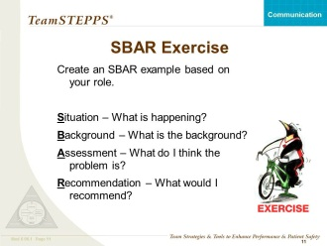
SBAR EXERCISE—OPTIONAL
You have the option of conducting the following exercise if you want.
DO (time permitting):
Have the participants create an SBAR example drawing from their role. Ask several participants to share their examples.
TIME:
10 Minutes
MATERIALS:
  Flipchart or Whiteboard (Optional)
  Markers (Optional)

Slide 15
CALL-OUT IS…
SAY:
A call-out is a tactic used to communicate critical information during an emergent event. Critical information called out in these situations helps the team anticipate and prepare for vital next steps in resident care. It also benefits a recorder when present during a code or emergent event. One important aspect of a call-out is directing the information to a specific individual.
ASK:
  On your unit or in your work area, what information would you want called out?
  Example:
  Vital signs for a resident with hemodynamic instability
  DO: Play the video by clicking the director icon on the slide.
DISCUSSION:
  How did the call-out of the vital signs assist in the care of Mr. Larkin?
    The nurse manager could focus on her assessment and prepare for his transfer to the emergency department.
    Mr. Larkin’s vital signs were accurately recorded into his medical record.
    The team (including Mr. Larkin) could hear Mr. Larkin’s vitals in real time, keeping them informed of the changing situation and preparing them for any other needed interventions.
VIDEO TIME:
  0:30 seconds
MATERIALS:
  Call-out_ Subacute Video

Slide 16
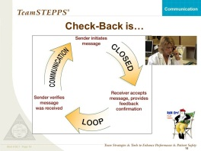
CHECK-BACK IS…
SAY:
A check-back is a closed-loop communication strategy used to verify and validate information exchanged. The strategy involves the sender initiating a message, the receiver accepting the message and confirming what was communicated, and the sender verifying that the message was received.
Typically, information is called out anticipating a response on any order that must be checked back.
Example:
  A nurse is accepting a telephone order from a physician: “Give amoxicillin 875 mg every 12 hours for 7 days.” The nurse verifies and validates the order by recording it directly into the chart and reading it back to the physician, “Okay, Doctor, that was amoxicillin 875 mg every 12 hours for 7 days?” The physician acknowledges the information with a check-back, “Yes, that is correct.”
  DO: Play the video by clicking on the director icon on the slide.
  DISCUSSION:
  Identify the sender and receiver.
    Nurse was the sender
    Physician was the receiver
  How did the sender and receiver “close the loop?”
    The physician acknowledges that the nurse has correctly recorded his orders
  What communication errors were avoided?
    Nurse does not rely on memory to record orders
    Medication dose and instruction errors are avoided
VIDEO TIME:
  0:36 seconds
MATERIALS:
  Check-back_LTC Video
CUSTOMIZABLE CONTENT

Slide 17
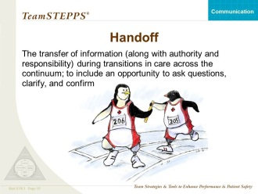
WHAT IS A HANDOFF?
SAY:
When a team member is temporarily or permanently relieved of duty, there is a risk that necessary information about the resident might not be communicated. The handoff strategy (or handover as it is sometimes called) is designed to enhance information exchange at critical times such as transitions in care. More important, it maintains continuity of care despite changing caregivers and residents.
Handoffs include the transfer of knowledge and information about the degree of uncertainty (or certainty about diagnoses, etc.), response to treatment, recent changes in condition and circumstances, and plan (including contingencies). In addition, both authority and responsibility are transferred. Lack of clarity about who is responsible for care and for decisionmaking has often been a major contributor to medical error (as identified in root cause analyses of sentinel events and poor outcomes).
  Remember, a handoff can also be used in nonclinical settings and departments.
ASK:
When do you typically use handoffs? How are handoffs handled on your unit or department?
  Is a standardized form used, such as the 24-hour report that includes information on the resident’s status?
  How are other members of the team notified?
  Do you use the reconciliation process?
  SAY:
Since 2006, it has been a requirement of hospitals to implement a standardized approach to handoff communications, including an opportunity to ask and respond to questions. Handoffs or handovers are just as important in the long-term care setting, with the same primary objective: “provide accurate information about a patient’s/client's/resident's care, treatment and services, current condition, and any recent or anticipated changes. The information communicated during a handoff must be accurate to meet [resident] safety goals” (refer to the Joint Commission at www.jointcommission.org).
KEY POINTS:
  Using the handoff technique can decrease medical error through the effective sharing of information.

Slide 18
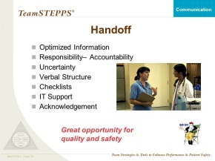
HANDOFF
SAY:
A proper handoff includes the components listed on this slide.
  Responsibility—When handing off, it is your responsibility to know that the person who must accept responsibility is aware of assuming responsibility.
  Accountability—You are accountable until both parties are aware of the transfer of responsibility.
  Uncertainty—When uncertainty exists, it is your responsibility to clear up all ambiguity of responsibility before the transfer is completed.
  Communicate verbally—You cannot assume that the person obtaining responsibility will read or understand written or nonverbal communications.
  Acknowledged—Until it is acknowledged that the handoff is understood and accepted, you cannot relinquish your responsibility.
  Opportunity—Handoffs are a good time to review and have a new pair of eyes evaluate the situation for both safety and quality.
DO: Play the video by clicking on the director icon on the slide.
DISCUSSION:
What are the positive elements of this handoff?
    Continuity of care maintained
    Presenting symptoms and current assessment communicated
    Actions taken to this point reviewed
    Face-to-face interchange more likely to ensure that any miscommunication will be detected
Any negative element?
    None noted
VIDEO TIME:
  0:23 seconds
MATERIALS:
  Handoff_ Subacute Video
CUSTOMIZABLE CONTENT

Slide 19
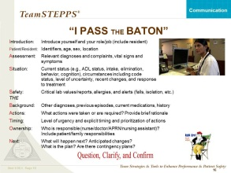
I PASS the BATON
SAY:
“I Pass the Baton" is an option for structured handoffs.
I Introduction—Introduce yourself and your role/job (include resident)
P Patient/Resident—Name, identifiers, age, sex, location
A Assessment— Relevant diagnoses and complaints, vital signs and symptoms
S Situation—Current status (e.g., ADL status, intake/appetite, elimination, behavior, cognition), including code status, level of uncertainty, recent changes, response to treatment
S Safety Concerns—Critical lab values/reports, allergies, alerts (falls, isolation, etc.)
THE
B Background—Other diagnoses, previous episodes, current medications, history
A Actions—What actions were taken or are required? Provide brief rationale
T Timing—Level of urgency and explicit timing and prioritization of actions
O Ownership—Who is responsible (nurse/doctor/APRN/nursing assistant)? Include resident/family responsibilities
N Next—What will happen next? Anticipated changes? What is the plan? Are there contingency plans?
DO: Play the video by clicking on the director icon on the slide.
DISCUSSION:
How was I PASS the BATON used in this nurse to nurse example?
    Nurse shift change report focused on an unstable resident
    Incoming nurse is given a comprehensive update covering the period since she last saw the resident
VIDEO TIME:
  1:26 minutes
MATERIALS:
  IPASS the BATON_LTC Video

Slide 20
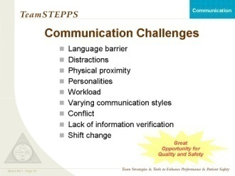
COMMUNICATION CHALLENGES
ASK:
  What are some barriers to communication that can lessen the effectiveness of teams?
SAY:
Challenges may include:
  Language barriers—Non-English-speaking residents/staff pose particular challenges
  Distractions—Emergencies can take your attention away from the current task at hand
  Physical proximity
  Personalities—Sometimes it is difficult to communicate with particular individuals
  Workload—During heavy workload times, all of the necessary details may not be communicated, or they may be communicated but not verified
  Varying communication styles—Health care workers have historically been trained with different communication styles
  Conflict—Disagreements may disrupt the flow of information between communicating individuals
  Verification of information—It is important to verify and acknowledge information exchanged
  Shift change—Transitions in care are the most significant times when communication breakdowns occur
ASK:
Given the challenges in your unit, work area, or department, which techniques or approaches would you use to help eliminate these challenges?
  Brief, huddle, or debrief
  Two-Challenge rule
  SBAR
  Call-Out
  Check-Back
  Handoff
KEY POINTS:
  Although you may run into communication challenges on a daily basis, there are many strategies to assist in eliminating or decreasing those challenges.

Slide 21
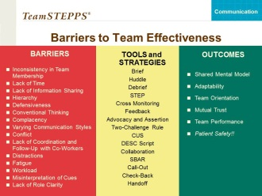
COMMUNICATION
SAY:
Within this module, we identified some barriers to a team’s effective communication. The tools of SBAR, call-out, check-back, and handoff were introduced for your use in communicating more efficiently and effectively within and across teams. As a result, improved communication provides for a safer resident care environment.
Good communication facilitates development of mutual trust and shared mental models, enabling teams to quickly adapt to changing situations. Communication is especially important as the environment becomes more complex (e.g., emergency situations)―it distributes needed information to other team members and facilitates the continual updating of the team’s shared mental model and its engagement in other team activities.

Slide 22
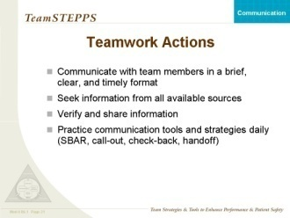
TEAMWORK ACTIONS
SAY:
Team members:
  Communicate effectively
  Seek information from all available sources
  Verify and share information
  Practice communication tools and strategies daily (SBAR,
  call-out, check-back, handoff)
Communication is an important component of the team process by serving as a coordinating mechanism or supporting structure for teamwork. Communication skills interplay directly with leadership, situation monitoring, and mutual support. Team leaders provide guidance through verbal feedback. Leaders also promote interaction among team members by clarifying team roles and defining team norms for conflict resolution. Effective communication skills are needed to clearly convey information, provide awareness of roles and responsibilities, or define how performance affected outcomes.
ASK:
  What actions will you take to improve your and your team’s communication skills?

Slide 23
REFERENCES
  Arora V., J. Johnson, D. Lovinger D., H. Z. Humphrey, and D. O. Meltzer. "Communication Failures in Patient Sign-Out and Suggestions for Improvement: A Critical Incident Analysis." Quality Safety Health Care, 2005: 14; 401-407.
  Cannon-Bowers, J. A., S. I. Tannenbaum, E. Salas et al. “Defining Competencies and Establishing Team Training Requirements.” Team Effectiveness and Decision-Making in Organizations. Ed. Guzzo, R. A., E. Salas and Associates: San Francisco, Jossey-Bass (1995) 333.
  Dickinson, T. L. and R. M. McIntyre. “A Conceptual Framework for Teamwork Measurement.” Team Performance Assessment and Measurement. Ed. Brannick, M. T., E. Salas, and C. Prince: Mahwah, NJ, Erlbaum (1997) 19.
  Hill, C. D. “Joint Commission Announces 2006 National Patient Safety Goals.” 2005. 14 September 2005 <http://www.jointcommission.org/news+room/news+release+archives/ 06_npsg.htm>.
  IHI. “SBAR Technique for Communication.” A situational briefing. 2004.
  Joint Commission 2006 National Patient Safety Goals Implementation Expectations. 2005. 14 September 2005 <http://www.jointcommission.org/accredited+organizations/ resident+safety/06_npsg_ie.pdf>.
  Kaiser Permanente of Colorado. “SBAR Technique for Communication: A Situational Briefing Model.” 2005. 14 September 2005 <http://www.ihi.org/IHI/Topics/ PatientSafety/SafetyGeneral/Tools/SBARTechniquefor
  CommunicationASituationalBriefingModel.htm>.
  McIntyre, R. M. and E. Salas. “Measuring and Managing for Team Performance: Emerging Principles from Complex Environments.” Team Effectiveness and Decision-Making in Organizations. Ed. Guzzo, R. A., E. Salas and Associates: San Francisco, Jossey-Bass (1995) 9.
  Mehrabian, A. (1971). Silent messages. Wadsworth, Belmont, California.

Slide 24
REFERENCES
  Patterson, E. S., E. M. Roth, D. D. Woods, et al. “Handoff Strategies in Settings with High Consequences for Failure: Lessons for Health Care Operations.” International Journal for Quality in Health Care 16.2 (2004) 125-132.
  Rooney, J.J and L.V. Vanden Heuvel. “Root Cause Analysis for Beginners”. Quality Progress, July 2004.
  Sims, D. E., E. Salas, and C. S. Burke. “Is There a ‘Big Five' in Teamwork?” 19th Annual Meeting of the Society for Industrial and Organizational Psychology. Chicago, IL, 2004.
  Weinger, M. and G. Blike., “Intubation Mishap.” AHRQ: Case and Commentary. September 2003 <http://www.webmm.ahrq.gov/case.aspx?caseID=106>.

