Slide 1
Change Management: How To Achieve A Culture Of Safety
®

Slide 2
Objectives
Identify and discuss the Eight Steps of Change
Describe the actions required to set the stage for organizational change
Identify ways to empower team members to change
Discuss what is involved in creating a new culture
Begin planning for the change in the nursing home

Slide 3
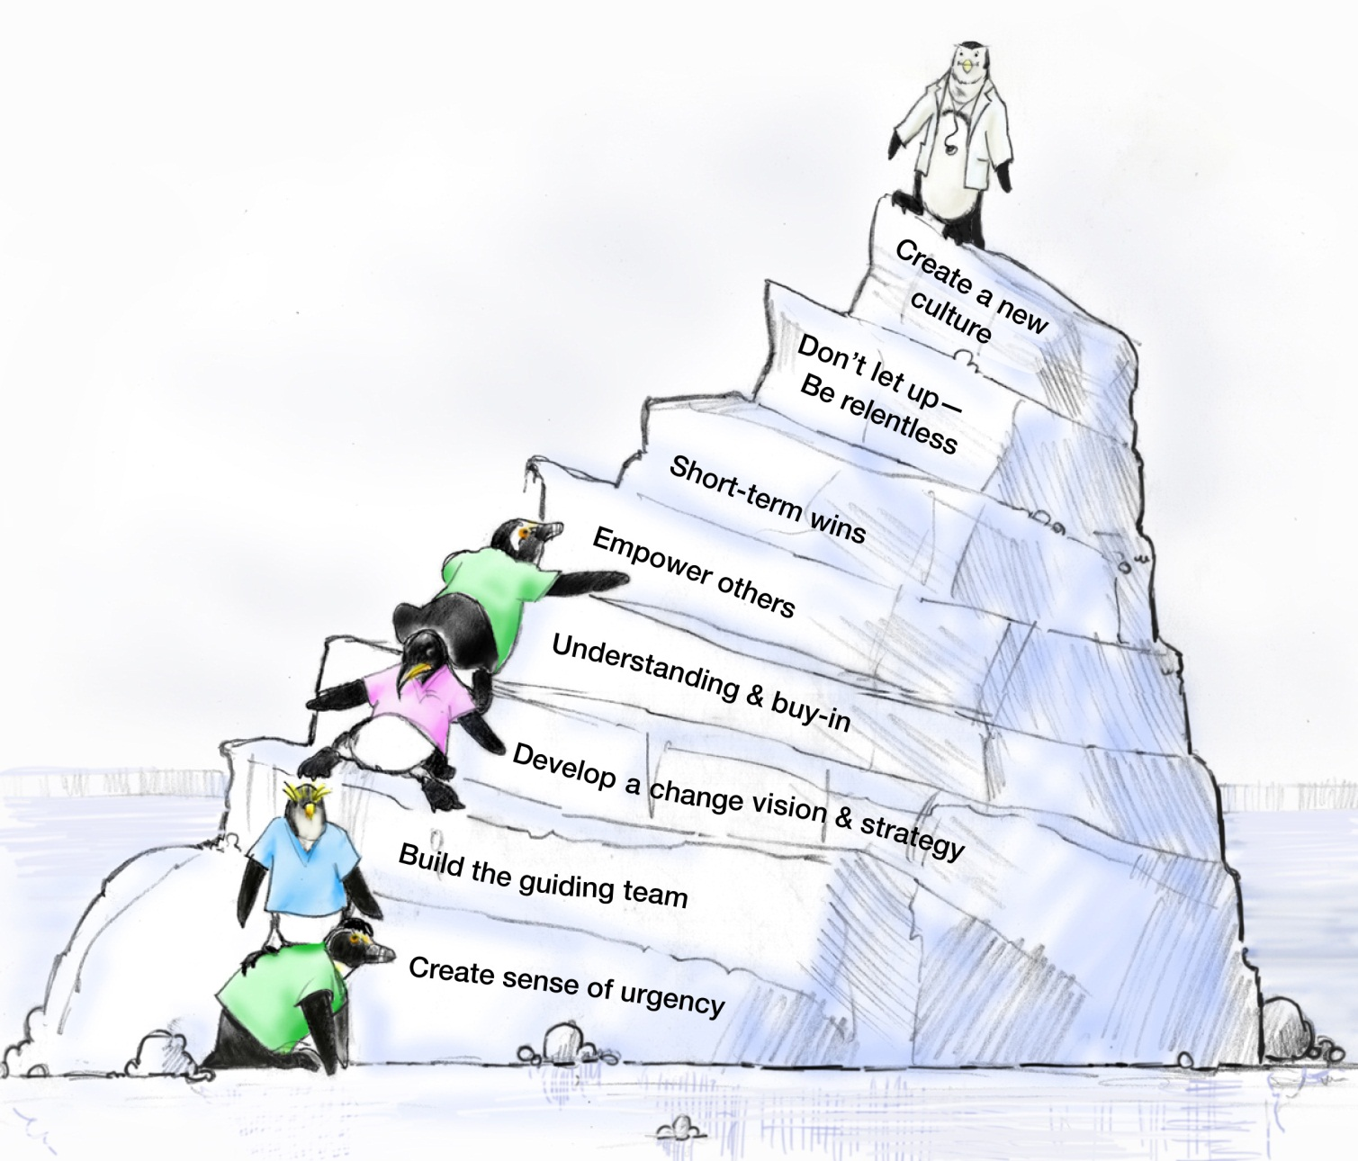
8 Steps of Change
John Kotter

Slide 4
Set the Stage and Create a Sense of Urgency
Get people’s attention!
Sell the need for change … sell the pain and the consequences of not changing
Immerse people in information about the change
Discuss ways to solve the problems people identify with the change
Empower people to solve the “problem”

Slide 5
Pull Together the Guiding Team
Choose key players, especially staff-level managers
Multidisciplinary
Goal is informed; intelligent decisions are being made
Credibility and integrity of change leaders
Choose proven leaders who can drive the change process
Strong position power, broad expertise, and high credibility
Need both management and leadership skills
Management skills control the process
Leadership skills drive the change
…TeamSTEPPS initiative should have a designated executive sponsor

Slide 6
Develop the Change Vision and Strategy
Senior Leadership is responsible for:
Establishing the definition of a “culture of safety” aligned with expectations, core values, and shared beliefs
Informing the nursing home staff of these values and evaluating the culture
Leading the process of:
Establishing trust and accountability
Translating values into expected behaviors
Communicating a commitment to shaping the culture

Slide 7
Communicate for Understanding and Buy-In
Provide supportive actions for fear, anger, and resistance
Encourage discussion, dissent, disagreement, debate … keep people talking
Tell people what you know―and what you don’t know
Acknowledge people’s pain, perceived losses, and anger
Value resisters
They clarify the problem and identify other problems that need to be solved first
Their tough questions can strengthen and improve the change
They may be right―it is a dumb idea!
…communicate, communicate, communicate…

Slide 8
Empower Others to Act
Develop a shared sense of purpose
Align structures with vision and goals
Train employees so they have the desired skills and attitudes
Align information systems and personnel with the vision and goals
Confront high-level resisters
An organization cannot be improved from the top only

Slide 9
Produce Short-Term Wins
Provide further impetus for change
Provide positive feedback
Further builds morale and motivation
Lessons learned help in planning next goal
Create greater difficulty for resisters to block further change
Provide leadership with evidence of success
Build momentum
Helps draw in neutral or reluctant supporters

Slide 10
Don’t Let Up
Acknowledge hard work
Celebrate successes and accomplishments
Reaffirm the vision
Bring people together toward the vision
Acknowledge what people have left behind
Develop long-term goals and plans
Provide tools and training to reinforce new behaviors
Reinforce and reward the new behaviors
Create systems and structures that reinforce new behaviors
Prepare people for the next change

Slide 11
Create a New Culture
Develop action steps for stabilizing, reinforcing, and sustaining the change:
Give people time to mourn their actual losses
Provide skill and knowledge training
Revise job descriptions
Develop new reward systems
Strengthen social connections and relationships
Recognize and celebrate accomplishments
Develop performance measures to continually monitor the results from the change and to identify opportunities for further improvements
Make adjustments to the change vision and strategy to reflect new learning and insights
Challenge people to be open to new challenges, forces, and pressures for the next change

Slide 12
Errors Common to Organizational Change
Allowing for complacency
Failing to create a sufficiently powerful Guiding Coalition and Change Team
Not truly integrating the vision
Allowing for obstacles
Not celebrating “short-term wins”
Declaring victory too soon
Neglecting to anchor changes firmly in the culture

Slide 13
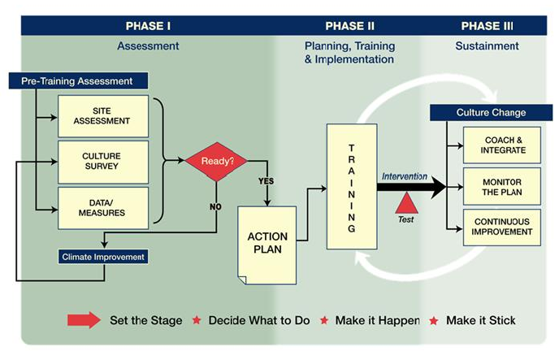
Shift Toward a Culture of Safety

Slide 14
Culture Change Comes Last, Not First!
Most alterations in norms and shared values come at the end of the transformation process
New approaches sink in after success has been proven
Feedback and reinforcement are crucial to buy-in
Sometimes the only way to change culture is to change key people
Individuals in leadership positions need to be on board
Otherwise, the old culture will reassert itself
…Reculturing takes time and it really never ends

Slide 15
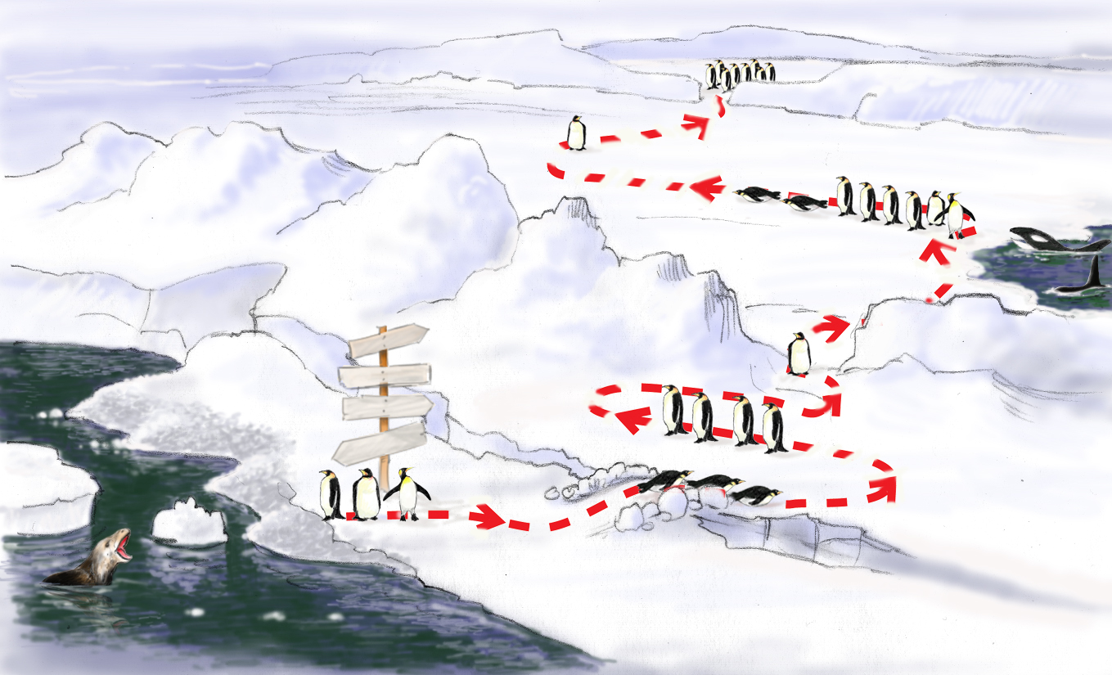
Roadmap to a Culture of Safety
Monitor, Integrate, Continuous Process Improvement
Celebrate Wins! Staying the Course Sustaining
Implement Action Plan, Train, Empower Others
Test Intervention
(Outcomes)
TeamSTEPPS Change Coaching
I’m staying right here. Yeah, they’ll be back.
CMS
What are they doing?
Develop Action Plan
Status QUO
FUTURE
Why do we need change?
Errorville
Prepare the Climate
Catalytic Event Drives Need For Change
Build Team, Strategy, Buy-In, Establish Goals

Slide 16
Sizing Up The Iceberg
Break into groups
Read through and answer the questions on the “Sizing Up the Iceberg Exercise Sheet” assigned to your group by the instructor
As you answer the questions, consider the current state of your nursing home and the current safety climate.

Slide 17
Teamwork Actions
Relate the Eight Steps of Change to your nursing home
Within each change step, identify at least one key action to affect your nursing home
“Create a new culture. Don’t let up – Be relentless. Empower.”
John Kotter

