Slide 1
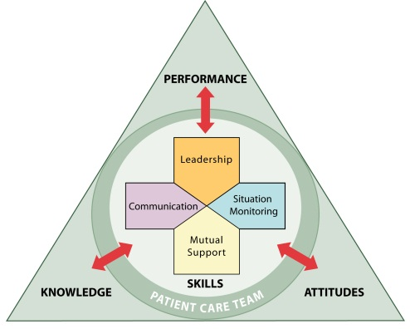
Strategies and Tools to Enhance Performance and Patient Safety

Slide 2
Identifying TeamSTEPPS Skills Supplement

Slide 3
Nutrition Report Video

Slide 4
Trigger Report Video

