Slide 1

^{Adapting TeamSTEPPS}
^{Tools for New Uses}
^{Paul C. Mullan, MD, MPH}
^{Jason Stein, MD, SFHM}
^{Katherine J. Jones, PT, PhD}

Slide 2
Teamwork and Organizational Learning
The knowledge, skills, attitudes, language, and coordinating mechanisms inherent in teamwork¹ create the flexibility team members need to manage complexity² and learn from experience.³⁻⁵

Slide 3
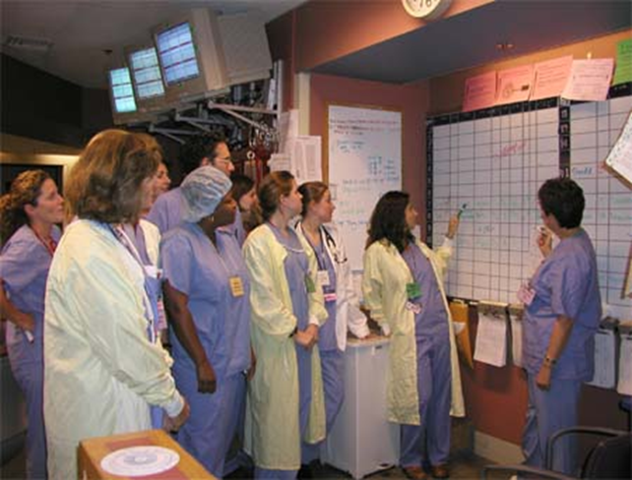
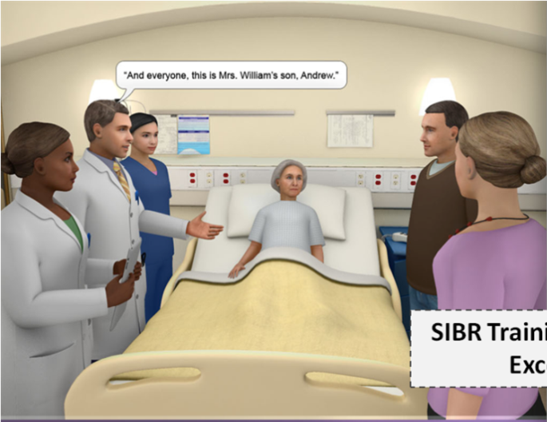
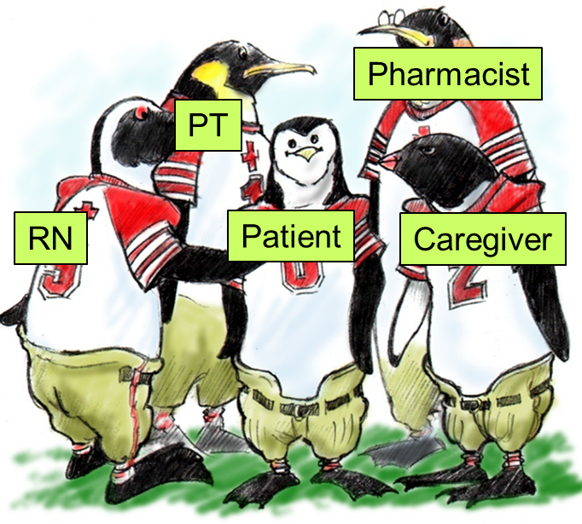
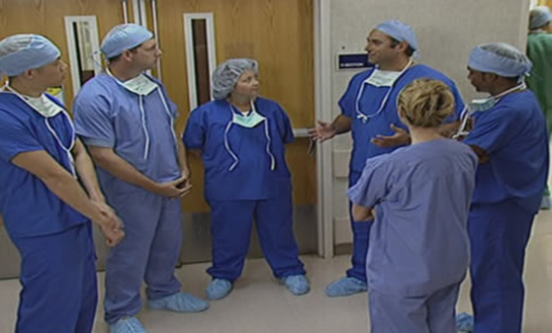
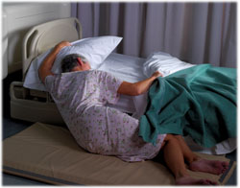
Structured Team Events Facilitate Learning
Jason Stein, MD:
Structured inter-
disciplinary
bedside rounds
Paul Mullan, MD: Standardized briefing checklist at shift handoff & debriefing after resuscitations in Pediatric Emergency Department
Katherine Jones, PT, PhD:
Post-Fall Huddles

Slide 4
Leadership
BARRIERS
Hierarchical
Culture
Lack of Resources
or Information
Ineffective Communication
Conflict
TOOLS and STRATEGIES
Brief
Huddle
Debrief
OUTCOMES
Shared Mental
Model
Adaptability
Team Orientation
Mutual Trust

Slide 5
References
Salas E, Sims DE, Burke CS. Is there a "Big Five" in teamwork? Small Group Research. 2005;36:555-599.
Cannon-Bowers JA, Salas E. Team performance and training in complex environments: Recent findings from applied research. Curr Dir Psychol Sci. 1998;7:83-87.
Senge PM. The Fifth Discipline: The Art & Practice of the Learning Organization. New York, NY: Doubleday; 1990.
Edmonson AC. Learning from failure in health care: Frequent opportunities, pervasive barriers. Qual Saf Health Care. 2004;12(Suppl II):ii3-ii9.
Salas E, Rosen MA, Burke CS, Goodwin GF. The wisdom of collectives in organizations: An update of the teamwork competencies. In: Salas E, Goodwin GF, Burke CS, eds. Team effectiveness in complex organizations: Cross-disciplinary perspectives and approaches. New York, NY: Routledge/Taylor & Francis Group; 2009:39-79.

Slide 6

Implementation and evaluation of a standardized briefing checklist at shift handoff in a pediatric emergency department
Team STEPPS Conference
Dallas, Texas
June 13, 2013
Paul C. Mullan¹, MD MPH
Sartaj Alam², PhD
Charles G. Macias², MD MPH
Deborah Hsu², MD MEd
Binita Patel², MD
¹Children’s National Medical Center –
George Washington School of Medicine
²Texas Children’s Hospital – Baylor College of Medicine
Notes:
Hello everyone, my name is Paul Mullan, and I want to start by thanking you for the opportunity to speak to you today about a Quality improvement project that I completed during my fellowship at Texas Children’s Hospital. I am passionate about using communication tools to improve the quality of care we all deliver and I would love to hear your feedback on this briefing checklist tool used at shift handoff.

Slide 7
Disclosure
No financial disclosures or conflicts of interest from any study authors
Notes:
We have no financial disclosures or conflicts of interest

Slide 8
Background
High error rates with serious consequences occur in Emergency Departments¹
Ineffective communication a root cause in 82% of sentinel events²
  National Patient Safety Goal 2011-2012
    Improve communication effectiveness of caregivers³
1To Err is Human, IOM, 2000 2Joint Commission (2010 data) 3Joint Commission, 2011
Notes:
From the Institute of Medicine’s report and our shared experiences working in the ER, we know that emergency departments can have high error rates with serious consequences.
The Joint Commission has determined that ineffective communication was the most common root cause of sentinel events
And has made one of their National Patient Safety Goals the improvement of communication effectiveness among caregivers.

Slide 9
Background
ED signout risk factors for error:
  Interruptions, fatigue, lack of pre-determined teams
ED signout adverse outcomes:
  Delays in care and disposition¹
  Increased medico-legal liabilities²
1Smith D, 2011 2Kachalia A, 2007
Notes:
We know that ED physician handoffs are at particularly high risk for errors for many reasons including frequent interruptions, provider fatigue from shiftwork, and a team of providers that is rarely ever composed of the exact same set of people.
ED handoff has been linked to delays in care, delays in disposition, and increased medico-legal liabilities.
A national survey of fellowship directors found that 72% agreed that a standardized signout system would improve communication and reduce errors.

Slide 10
ED Signout Components
1. Patient information
2. Situational awareness information
  Goal: anticipate and react more effectively
  Potentially easier to standardize
Notes:
Two of the major informational components of ED signout include specific patient information and situational awareness information.
The goal of gaining situational awareness is to anticipate and react more effectively to future circumstances.
While we ultimately aim to standardize both components, we reasoned that situational awareness would be the easier of two to initially standardize across all providers.

Slide 11
Accomplishing Situational Awareness
  Briefing: Planning event prior to another event¹
  Explain goals
  Get team input
  Cover contingencies
  Ensure role awareness
  Operating Room:
  Surgical Safety Checklist: mortality ↓1.5 to 0.8% (p=0.003)²
  Communication failures ↓3.9 to 1.3 per surgery (p<0.01)³
ED: large variation in briefing content and practice
¹AHRQ, 2009. ²Haynes, 2009. ³Lingard, 2008
Notes:
To accomplish situational awareness, we sought to create a standardized briefing checklist.
A briefing is an event prior to an event in which planning occurs. A briefing allows to the team leader to explain future goals, get team input, cover contingencies, and ensure each member knows their roles.
In the surgical field, they have used briefings and checklists to demonstrate decreases in mortality and communication failures.
In our ED, we noticed large variations among ED providers in their briefing content and practices.
Lingard L, Regehr G, Orser B, et al. Evaluation of a preoperative checklist and team briefing among surgeons, nurses, and anaesthesiologists to reduce failures in communication. Arch Surg 2008;143:12–17.
Lingard L, Regehr G, Cartmill C, et al. Evaluation of a preoperative team briefing: a new communication routine results in improved clinical practice. BMJ Qual Saf 2011;20:475–82. IMPROVED PRE-PROCEDURAL ANTIBIOTIC ADMINISTRATION

Slide 12
Objective
To describe the creation, implementation and user perceptions of a standardized briefing checklist in a pediatric ED
PASSED Checklist: Pediatric Active Shift Signout in the Emergency Department
Notes:
The objective of our study was to describe the creation, implementation and user perceptions of a standardized briefing checklist in a pediatric ED
Because no QI project is complete without a mnemonic, we called it the Pediatric Active Shift Signout in Emergency Department.

Slide 13



Briefing Checklist Creation
Best practice guidelines
  Aviation, checklist, and human factors literature
    Pilot testing*
    Structural functuality
    Critical steps only
    Brevity
    Common language
    Versioned & Dated
    Read-Do vs Do-Check
    Feedback mechanisms
    Checklist development checklists…
Notes:
We used best practice guidelines adapted from the aviation, checklist and human factors literature to create a briefing checklist.
We conducted several multi-disciplinary focus groups to gather input in the tool’s development.
All staff were trained how to use to the tool, staff provided additional feedback, and staff were provided with individual and group feedback on their performance.
To keep the tool useful, we responded to user feedback by making several minor modifications to the tool

Slide 14
Briefing Checklist Creation
Checklist drafted
Stakeholder focus group feedback
Iterative piloting and modifications
Staff training and feedback
↓
Implementation
↓
Post-implementation modifications
  10 versions in project period
  Item ordering, additions, subtractions, clarifications, layout, timing…
July 26, 2013 Baylor College of Medicine

Slide 15
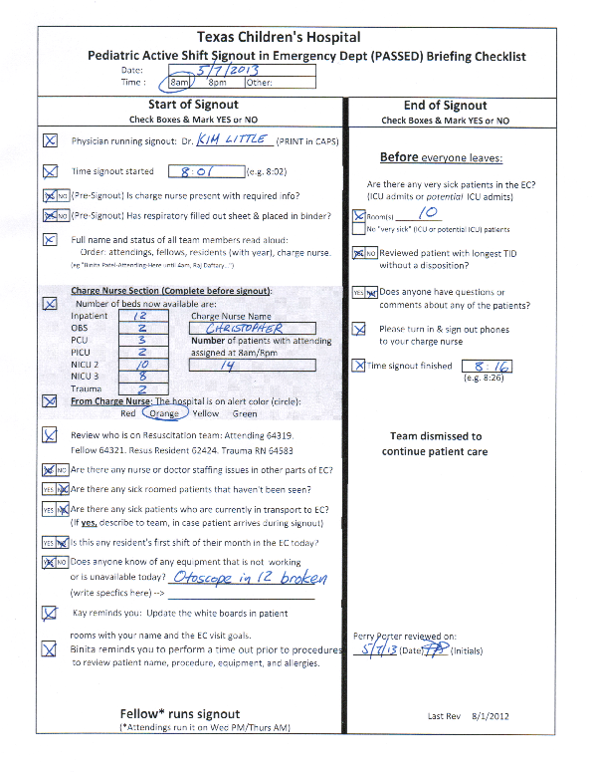
Briefing Checklist
(Tim Adams: SOPs)
1st
3rd
1st: ED situational awareness
2nd: Patient information
3rd: Patient situational awareness
2nd
Notes:
“Houston, We Have a checklist”
The PASSED Briefing Checklist
Signout entails first reviewing the left half of the tool, followed by specific patient information, and finishing with the items on the right half of the form.

Slide 16
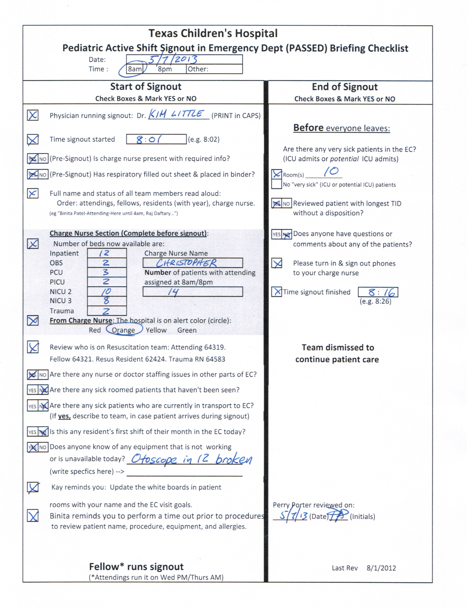
Briefing Checklist
Start time
Charge nurse
Introductions
Notes:
Start time is recorded
Charge nurse attendance is recorded
Everyone on the team introduces themselves with name and provider level

Slide 17
Briefing Checklist
Available beds
Resuscitation roles
Staffing
Notes:
The number of available beds in each of our admission areas is reviewed
Assignment of team members to the resuscitation team is performed
And any deficiencies in nurse or physician staffing are reviewed.

Slide 18
Briefing Checklist
Sick patients
1st shift alert
Notes:
Sick patients in rooms who haven’t been seen yet OR who are in transport to the ED are reviewed
For orientation purposes, we determine if anyone is on their first shift in the ED

Slide 19
Briefing Checklist
Equipment
Safety tips
Patient info
Notes:
If any equipment is unavailable or not working from the previous shift, it is recorded.
Two rotating safety tips are reviewed AND then specific patient information is reviewed.

Slide 20
Briefing Checklist
“ICU-sick”
patients
Longest time without a disposition
Notes:
Following patient information…. .
Any ICU-level sick patients are highlighted
And the patient with the longest time in department without a disposition is also reviewed

Slide 21
Briefing Checklist
Questions
End time
Notes:
Any final questions from the group were taken and the end time was recorded

Slide 22
Briefing Checklist Setting
Single 3° pediatric academic ED
Level-one trauma center
~80,000 patients annually
Checklist used in main ED area only
  24 beds, 2 resuscitation beds
  Highest acuity
Central desk area with computer availability
Notes:
Our setting was a tertiary pediatric academic ED, with a level 1 trauma center, that sees approximately 80,000 patients per year.
The checklist was used only in the main section of the ED that consisted of 24 beds and 2 resuscitation beds. The highest acuity patients are seen in this area of our ED.
The signout was done at a central desk near the resuscitation bays and had EMR access

Slide 23
Briefing Checklist Users
Signout rounds at 8 AM & 8 PM
PEM attendings (1-3) and fellows (1-3)
Pediatric & EM Residents (4-8)
Medical students (0-4)
Charge nurses (1-2)
Notes:
Staffing present for 8a and 8p signout rounds during which the briefing checklist was used included a group of about 12-18 different healthcare providers. All of the residents and some of the fellows and attendings would be at the end or beginning of their shift.

Slide 24
Methods Part 1:
Quantitative Observational Study of
Checklist Process Measures
    Usage rate (if any items checked)
    Completion rate (≥80% of items checked)
    Timing
    Identification of potential safety events
Notes:
The first part of this study was a quantitative study of checklist process measures.
We studied checklist usage rate, completion rate, timing, and the identification of what we termed as potential safety events.

Slide 25
Notes:
This is a graph detailing our group’s monthly performance in completing the year’s 732 checklists. The y-axis is the percentage of the 60 or so checklists each month that met criteria.
This red line on top is the usage rate for the checklist each month, meaning the proportion of the 60 checklists each month that had at least one item checked on the checklist.
This blue line on bottom is our completion rate, meaning the proportion of checklists each month that had at least 80% of the items checked on the checklist.
You can see here that we started out at around 80% completion, dipped in July when the new fellows arrived, increased, and then dipped again slightly during the Thanksgiving, Christmas and Easter holiday periods, settling out at around 92% completion rate.

Slide 26
Timing performance
Mean signout duration of 18 minutes
  Includes checklist + patient information
Mean of 14 patients per signout
Mean of 82 seconds per patient
Notes:
From a timing standpoint, the mean signout duration, which included the checklist & patient information, was 18 minutes.
We had a mean of 14 patients per signout and therefore averaged 82 seconds per patient.

Slide 27
Potential Safety Events
(Tim Adams: “Threats”)
Potential Safety Event | Percentage | Number
ICU-level sick patient in ED identified | 48% | 349
Broken or missing equipment identified | 46% | 338
Doctor or nurse staffing shortage | 21% | 157
High acuity patients roomed but unseen by MD | 16% | 97
Sick patients in transport identified & discussed | 16% | 116
Resident’s first shift in ED | 13% | 98
Questions identified at end of signout | 10% | 70
1.Expected
2.Environment
3.Unexpected
4.Expected
5.Latent
6. Other
84% of checklists: ≥1 Event
No significant change in mean time per patient handoff if
0, 1, 2, 3, or 4 potential safety events
Notes:
Several of the checklist items were categorized as potential safety events if they were checked.
Of these events, the most common issues addressed were the identification of ICU-level sick patients in the ED and identifying broken or missing equipment.
84% of the checklist cited at least one of these potential safety events
When we looked at the average time duration per patient for the total signout period, we found NO significant differences in duration whether 0, 1, 2, 3, or 4 potential safety events were discussed.

Slide 28
Methods Part 2:
Qualitative perception survey by checklist users
  1 year post-implementation
  Population: user experience in the ED pre- & post-checklist
    PEM attendings, PEM fellows, peds residents, charge nurses
  Survey development
    Three domains:
      Situational awareness
      Institute of Medicine quality domains
      Usability
    Face validity focus groups, pilot tested, intra-rater reliability
  Online with 3 reminder emails
Notes:
GO INTO WSRT BECAUSE PAIRED GROUP DISCUSSION???
Part 2 of our study was a perception survey that was distributed 1 year after the implementation of the checklist.
Subjects in our POPULATION SAMPLE were eligible if they had worked at least one month in the ED before and at least one month in the ED after the implementation of the checklist.
To create the online survey we created a list of questions evaluating the checklist based on three domains: situational awareness, the institute of medicine quality domains, and usability.
Focus groups were used to assure the face validity of the questions.
Questions were pilot tested on people who did not qualify for the study and these people also completed clinical sensibility tool evaluations.
Five test takers were used determine intra-rater reliability.
A survey invitation was emailed to all subjects with up to 3 reminders occurring over a 2 week period.
(Wilcoxon signed rank test was used for 2 paired groups analysis; Kruskal Wallis one way ANOVA used for 3+ independent group analysis)

Slide 29
Perception Survey
Role | Number Responded | Number Invited | Percentage Responded
Pediatric residents | 35 | 39 | 90%
PEM fellows | 10 | 11 | 91%
PEM attendings | 16 | 19 | 84%
Charge nurses | 20 | 25 | 80%
ALL | 81 | 94 | 86%
Test-retest intra-rater reliability: Kappa of 0.62
Cronbach’s alpha of 0.70
Excluded: 2 of 94 were partial respondents
Notes:
Of the 94 subjects in our population, we had 86% respond to the survey.
Our kappa for intra-rater reliability Was 0.62 which indicated substantial agreement per Landis and Koch criteria.
The cronbach’s alpha for survey responses was 0.70 which indicated a moderate degree of internal consistency.
(believed to indirectly indicate the degree to which a set of items measures a single unidimensional latent construct)

Slide 30
Survey Results:
Situational Awareness Domain
Question: What percentage of the time are you aware of ________ by the end of team signout? | All users Median (n=81)
 | Pre | Post
…staffing limitations | 2 | 5*
…critically ill (ICU-sick) patients in the ED | 4 | 5*
…the names of all your colleagues on shift | 3 | 5*
…broken or missing equipment | 3 | 5*
*p<0.001 (Wilcoxon rank sum test)
1: 0-20% 2: 21-40% 3: 41-60% 4: 61-80% 5: 81-100%
Notes:
In the situational awareness domain, we asked what percentage of the time you were aware of four items by the end of team signout, according to 5 quintiles of percentage agreement, both PRE and POST implementation of the PASSED briefing checklist.
We found significant improvements in the median awareness POST-implementation of the checklist across ALL users in awareness of staffing limitations, identification of ICU-sick patients in the ED, names of colleagues on shift, and awareness of broken or missing equipment.

Slide 31
Survey Results:
Institute of Medicine Quality Domains
Statement: The team signout promotes _______ in the ED | All users Median (n=81)
 | Pre | Post
Safety | 3 | 4*
Timeliness | 3 | 4*
Efficiency | 3 | 4*
Effective care | 3 | 4*
Patient-centered care | 3 | 4*
Equitable care | 3 | 4*
*p<0.001 (Wilcoxon rank sum test)
1:Strongly disagree 2:Disagree 3:Neutral 4:Agree 5:Strongly agree
Notes:
We asked about whether the team checkout promoted each of the 6 IOM quality domains before and after implementation of the briefing checklist, using a standard Likert scale with disagree, neutral, and agree components.
In the combined all user group, we found significant improvements in the median ratings of all 6 IOM quality domains POST-implementation of the checklist.

Slide 32
Survey Results:
Usability Domain
Statement | All users Median (n=81)
 | Pre | Post
Team signout facilitates good communication | 3 | 4*
I am satisfied with the team signout process | 3 | 4*
The time to complete signout is too long | 3 | 3**
*p<0.001 **p=0.55 (Wilcoxon rank sum test)
1:Strongly disagree 2:Disagree 3:Neutral 4:Agree 5:Strongly agree
Notes:
We asked three questions regarding usability using a Likert scale.
There were significant improvements across all users as to whether the team signout facilitated good communication and satisfaction with the team signout process.
As a balance measure questions, we found that across all users, no change was seen in the “time to complete checkout” question for the combined users; however, in sub-group analysis, the charge nurses had a significant change in perception that the signout system did NOT take too long, whereas the residents significantly changed their perception that that the signout DID take too long.
(DON”T MENTION: The percentage of respondents who showed at least one Likert scale position higher for improvement in perception of communication facilitation with the new system was 58% (95% CI, 47, 69); the percentage of respondents rating the new system at least one level worse was 1% (95% CI, 0, 3). )

Slide 33
Limitations
Potential recording bias:
  No verification process
  Commission & omission errors possible
Unable to causally link briefing checklist to safety outcomes
Notes:
This study had several limitations, including (but not limited to)
A Recording bias: the Quantitative data of the checklist items was recorded by the checklist leader and not verified by an independent observer Errors of commission or omission may have occurred.
Second a contamination bias could have affected user’s perceptions of improved communication in the ER because we had simultaneously rolled out a debriefing program
Thirdly, we can not say that our checklist directly improved safety outcomes, but it did improve awareness of potential safety issues.
There were some limitations in the design and results of our study. Because frequency of checklist completion and potential safety events reported were determined by the handoff leaders’ recorded values on the checklists, it is possible that there could have been under- or over-reporting of some checklist components. One factor limiting this phenomenon was that the checklist was completed in visible proximity to multiple other providers who were often looking at the checklist simultaneously. A video study would be needed to assess for accurate rates of checklist omission and commission error.
Also, this study was not able to assess objective impacts on patient outcomes or ED time processes given the retrospective nature of the study design, the lack of pre-intervention data, and multiple other confounders that would interfere in establishing any direct causality by the checklist itself. To partially account for this factor, all survey questions were given to subjects with ED experience both before and after the checklist implementation, and questions were designed to assess for the before-and-after effects attributable to the intervention itself. Whereas the results of our survey were generally very positive, these perception changes could have been influenced by other simultaneous changes that occurred during the time of this study. There were no other programs specifically targeted at the handoff process; however, a communication-oriented program on debriefing team members in situ following pediatric resuscitations was implemented during the study period (36).
From a timing standpoint, we were limited in that we captured only the time from handoff start to finish; a more precise method, which was deemed not to be feasible from an end-user acceptability standpoint, would have been to record the duration of checklist completion specifically. Anecdotally, the duration of completing the checklist typically was 1-3 minutes, similar to what has been reported anecdotally elsewhere (9). Lastly, our checklist did not address the standardization of communicating actual patient information during the handoff process. Efforts are currently underway at our institution and within the American Academy of Pediatrics’ Section of Emergency Medicine to address this area.

Slide 34
Lessons Learned
Departmental support is key
Resistance to change is a given
  80/20 rule for early aim
Don’t fall in love with version 1.0
System is designed perfectly to get intended results
  If it is failing, there is a reason
Notes:
DEVELOP THIS SLIDE FURTHER FOR GOTCHA
Serious harm events haven’t been defined for the ED… interesting to hear what they say.

Slide 35
Conclusions
The PASSED briefing checklist had a high usage and completion rate
Potential safety events frequently identified
Users perceived that the briefing checklist improved team signout
  Situational awareness
  Quality of care
  Usability
Future directions
  Standardized patient information
  Patient outcomes
  Non-learner areas
Notes:
Our conclusions include that the
PASSED checklist had a high usage and completion rate.
We frequently identified potential safety events.
Users perceived improvements in situational awareness, quality of care and usability.
Future interventions of this QI project will aim to standardize individual patient information, track patient outcomes, and implement the checklist in non-learner based areas of our ED.

Slide 36
                Adapting TeamSTEPPS Tools for New Uses:
                Post-Fall Huddle
TeamSTEPPS National Conference
June 13, 2013
Katherine J. Jones, PT, PhD
University of Nebraska Medical Center
Notes:
Introduce myself, background

Slide 37

Acknowledgement
This project is supported by grant number R18HS021429 from the Agency for Healthcare Research and Quality. The content is solely the responsibility of the authors and does not necessarily represent the official views of the Agency for Healthcare Research and Quality.
http://unmc.edu/patient-safety/capture_falls.htm
CAPTURE
Collaboration and Proactive Teamwork Used to Reduce
Falls
Notes:
Our experience implementing post-fall huddles is related to our CAPTURE Falls Research project.
Read this slide word for word

Slide 38
Learning Objectives
Describe the role of teamwork in organizational learning to support fall risk reduction
Explain how to use a multi-team system to implement inpatient post-fall huddles
Identify post-fall huddles as a new TeamSTEPPS tool that supports organizational learning about fall risk reduction
Describe how to conduct an interprofessional post-fall huddle to identify errors in four learning domains : task error, judgment error, coordination error, and system error.

Slide 39
Teaming is Critical When We Must…¹
Balance multiple objectives with minimal oversight
Quickly transition from one situation to another and maintain communication and coordination (shared mental models)
Integrate perspectives from multiple disciplines
Collaborate across multiple locations
Quickly adapt without a pre-existing plan
Quickly process complex information

Slide 40
Role of Teams in Fall Risk Reduction
The etiology of falls is multifactorial, thus fall risk reduction requires an interprofessional approach²
Fall risk has been reduced in studies where interprofessional team members actively engaged in fall risk reduction efforts³⁻⁵
An interprofessional team (vs. nursing only) strategy and use of benchmarks have been associated with sustained decreases in fall rates⁶⁻⁸
Notes:
Bullet #1: Because there are many factors that play a role in fall risk and the incidences of patient falls…
Bullet #2 & 3: Reiterate the importance of using teams to coordinate and implement the hospital’s fall risk reduction program, including teams with members of diverse clinical backgrounds and who review and make use of fall data, causes, and implement new prevention strategies to sustain decreases in fall rates

Slide 41
Integrating Multidisciplinary Evidence⁹
Does your fall risk reduction team integrate evidence from multiple disciplines to continually improve fall risk reduction efforts?
p=.030*
*Negative binomial model
Notes:
Another survey question was: Our fall risk reduction team integrates evidence from multiple disciplines (e.g., medicine, nursing, physical therapy, pharmacy) to continually improve fall risk reduction efforts.
First of all, having a team is also associated with integrating evidence from multiple disciplines to improve fall risk reduction efforts. Specifically, 61% of hospitals with teams have these discussions as compared to 40% of hospitals with an individual, and none of the hospitals where nobody is accountable.
Second, hospitals with teams that always or frequently integrated multidisciplinary evidence to improve fall risk reduction efforts had significantly lower total and injurious fall rates.

Slide 42
Team Reflexivity⁹
Does your fall risk reduction team…
Collect and analyze data regarding fall risk reduction program outcomes?
Modify fall risk reduction policies and procedures based on outcome data?
Conduct root cause analyses of injurious falls?
p=.056*
p=.002*
*Negative binomial model
Notes:
Another question was: Please indicate the activities performed by your fall risk reduction team. Of these activities, we considered the following to represent team reflexivity, or the activity of actively reflecting upon and learning from data
Collect data regarding fall risk reduction program outcomes
Analyze data regarding fall risk reduction program outcomes
Modify fall risk reduction policies and procedures based on outcomes data
Conduct or participate in individual root cause analyses of injurious falls
Hospitals with teams who engaged in all four of these reflexive behaviors reported significantly lower injurious fall rates than did those hospitals with teams who did not engage in all four of these reflexive behaviors

Slide 43
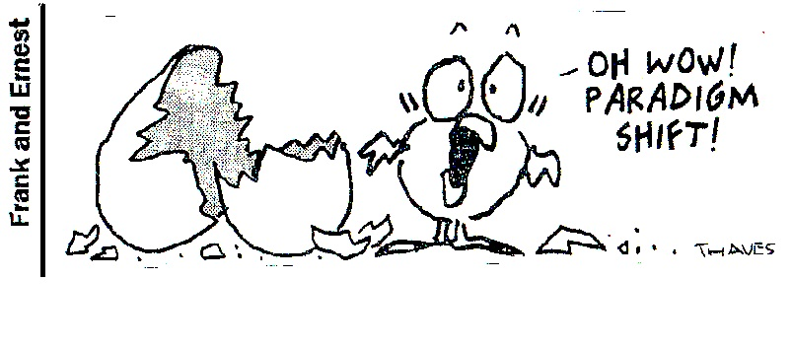
Team Reflexivity¹⁰
Teams are more likely to learn from errors and mistakes and adapt their actions to minimize future risks when they reflect on outcome data, and the policies and procedures that produced those outcomes
Paradigm shift: Interprofessional fall risk reduction teams should coordinate and facilitate organizational learning and innovation as they implement and evaluate a hospital’s fall risk reduction program
Notes:
Why is team reflexivity important? Team reflection on fall data and rates, the reliability of processes used to reduce falls, the causes of inpatient falls, and the success of fall risk reduction policies is related to a reduction in injurious fall rates. Notably, hospitals in which teams engaged in reflexivity had injury rates half that of those in which teams did not engage in reflexive behaviors

Slide 44
Fall Risk Reduction Multi-Team System¹¹
Contingency Team = Post Fall Huddle
Patient & Family
Teach back
Core Team
Physician
Nurse performs FRA
PT consults re mobility
Pharmacist reviews medications
All educate patient & family
Coordinating Team = Fall Risk Reduction Team
Holds core team accountable for reliability of processes
Ancillary & Support Services
Radiology is informed of fall risk and transfer strategy during handoff
Housekeeper can turn on alarms
Administration
Asks about fall rates
Provides time for coordinating team to meet
Holds coordinating team accountable for auditing reliability of fall risk interventions
Notes:
A team comprising those work area members who are responsible for managing the operational environment and resources that supports the Core Team; designated leaders.
The fall risk reduction team is just one, but a critical piece of a fall risk reduction multi-team system.
We view the fall risk reduction team as a coordinating team, that holds the core bedside team accountable for the reliability of processes, and who supports the use of the fall-contingency post-fall huddle teams

Slide 45
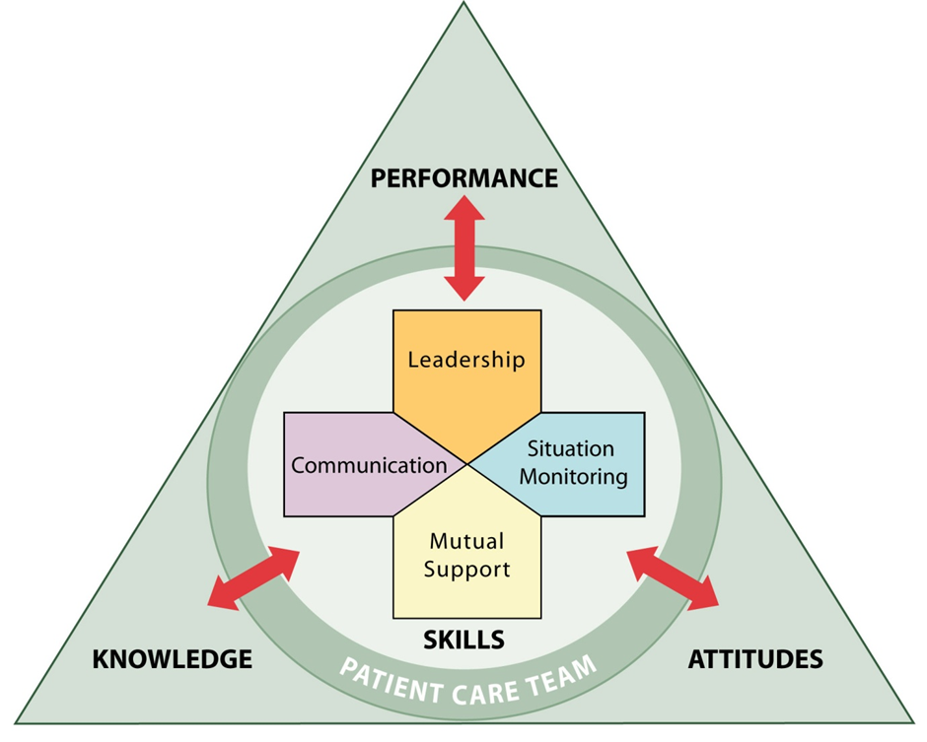
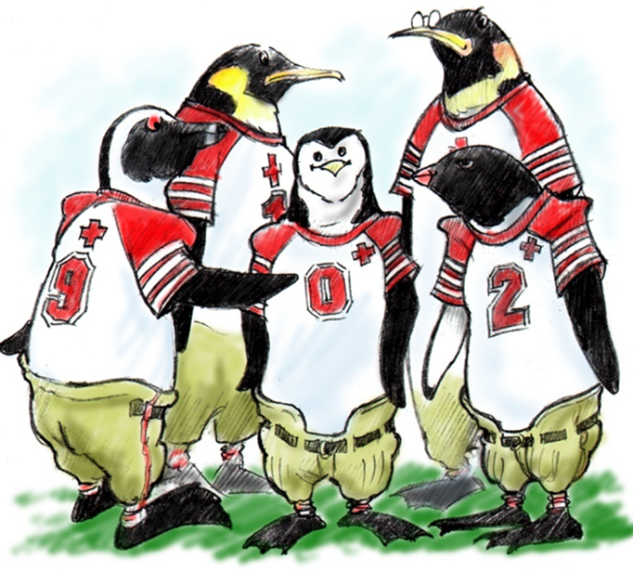

Huddles to Problem Solve: A Team Event¹¹
Briefs to plan
Huddles to problem solve
Debriefs to learn & improve
Leaders are responsible to assemble the team
and facilitate team events
But remember…
Anyone can request a brief, huddle, or debrief

Slide 46
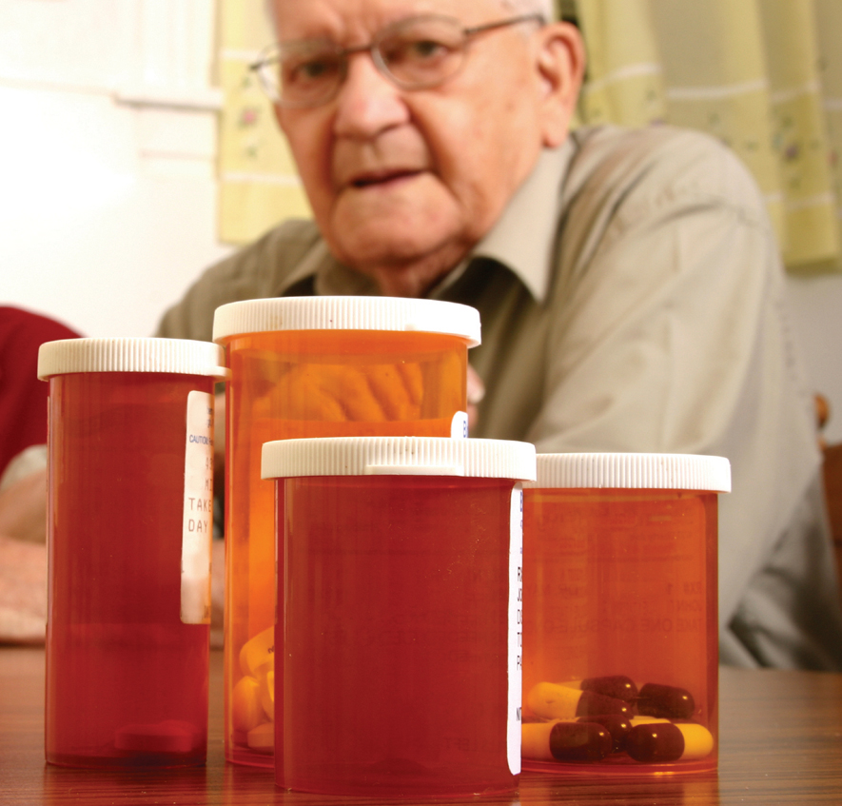
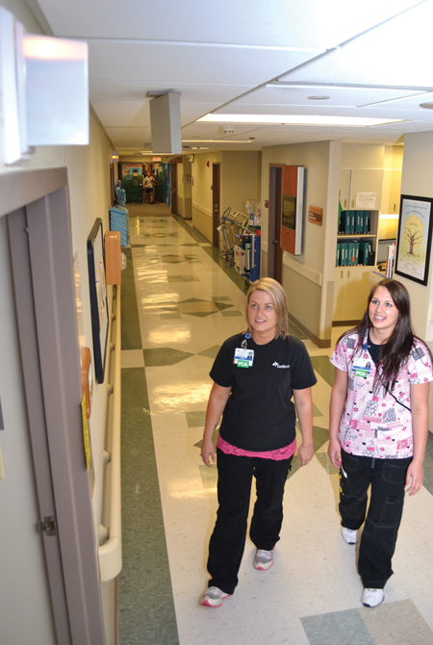
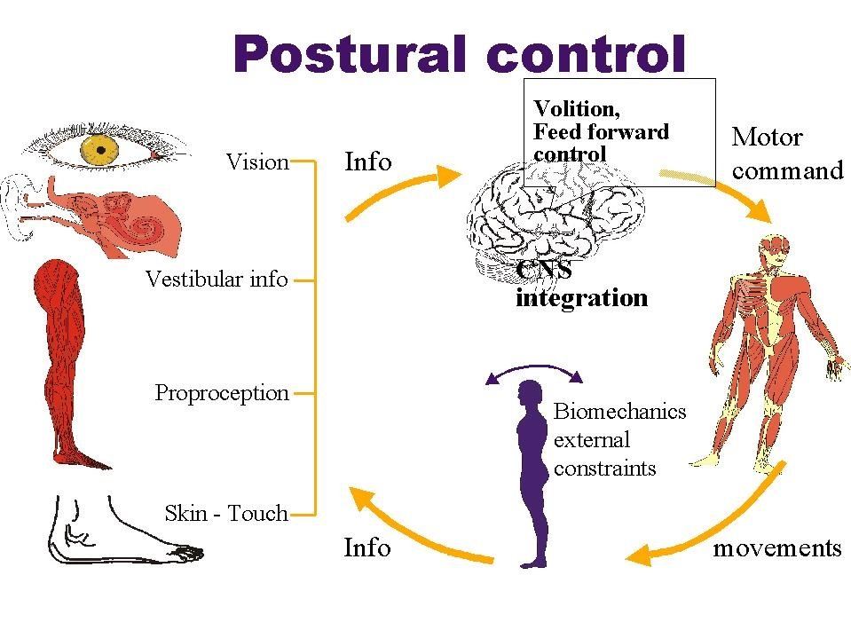
Shared Mental Model?

Slide 47
Shared Mental Model?
Center of Mass

Slide 48

Old Way vs. New Way Using Post-Fall Huddle
Remind patient to use call light when finished in bathroom
Complete incident report
Incident report sent to risk manager
Forget to mention fall at shift change
Patient with cognitive impairment falls in bathroom
NEW WAY:
Immediate learning
by front line staff
OLD WAY:
Lack of
front-line,
organizational
learning
Pharmacist
PT
RN
Patient
Caregiver

Slide 49
Role of Coordinating Team¹¹
Integrate evidence to support use of post-fall huddle
Train staff to conduct post-fall huddles
Audit reliability of conducting post-fall huddles
Collect, analyze, disseminate learning from post-fall huddles
Create policy/ procedure for use of post-fall huddles
Coordinating Team: Designated leaders who are responsible for managing the operational environment and resources that support the Core Team
NEW WAY:
Huddles
support
organizational
learning
Notes:
Interdisciplinary fall risk reduction teams and their meetings are a critical component of an effective fall risk reduction program
Well-structured and designed fall risk reduction team meetings:
Establish clear and effective fall risk reduction policies and interventions
Reflect upon and improve fall risk reduction practices and increase organizational learning
Reduce and sustain low fall rates

Slide 50
Role of Contingency Team¹¹
Obtain bed-side commode, identify need for standard assessment of cognition
Implement Mini-Cog to assess cognition
Patient with cognitive impairment falls in bathroom
Conduct post-fall huddle; develop shared mental model re: cognitive and mobility impairments
Failed Mini-Cog: Create levels of supervision: alarms, family, video monitor, sitters
Patient safe;
Referred for home health PT on discharge
Contingency Team: A time-limited team formed for emergent or specific events and composed of members from
various teams
X
NEW WAY:
Front-line
learning
Pharmacist
PT
RN
Caregiver
Patient
Notes:
If the patient fails Mini Cog do not rely on the patient’s memory when developing your treatment plan.

Slide 51

Post-Fall Huddles Overcome Barriers to Learning¹²
Organizational learning--activities that create shared understanding of causes of errors and what can be done to prevent similar errors in the future
Barriers to organizational learning
  Psychological, social, technical, practical
Different types of work create different contexts for error and learning
Notes:
Organizational learning refers to organizational activities that create shared understanding of causes of errors and what can be done to prevent similar errors in the future (Edmondson, p. 177)
Barriers to org learning include psychological, social, technical, practical
Different types of work create different contexts for error

Slide 52
Learning Domains¹²
 |  | Actor Interdependence
Process Uncertainty | Low | Low | High
 |  | Task Execution: Individuals perform well understood, routine tasks Task Error Example: Forget to turn on bed alarm | Coordination: Process knowledge high within groups; low between groups Coordination Error Example: Information about previous fall not handed off between shifts/departments
 | High | Judgment: Individuals perform unfamiliar processes that require decision making Judgment Error Example: Leave patient with cognitive impairment alone in bathroom | System Interaction: Multiple people involved in new activity System Error Example: No policy/ procedure to regularly replace batteries in newly acquired chair alarms

Slide 53
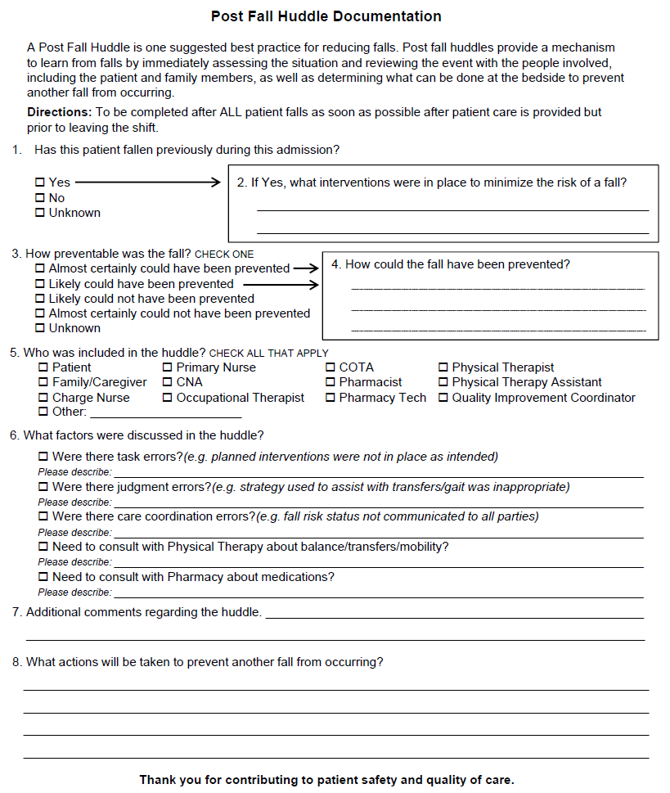

Slide 54
Implementation is the hard part…
Of 117 fall events reported 8/12 – 4/13, 47 (40%) included a post-fall huddle
13 of 19 project hospitals reported at least 1 huddle
  Range of huddles per hospital is 1 – 7
  Median number of huddles = 3
Presence/absence of injury not significantly related to conducting huddle
  43% (18/42) of injurious falls had a post-fall huddle
  39% (29/75) of noninjurious falls had a post-fall huddle

Slide 55
Implementation is the hard part…
Not as interprofessional as we would like…

Slide 56
Learning Domains of Reported Fall Events
 |  | Actor Independence
Process Uncertainty | Low | Low | High
 |  | 25 Task Errors: Bed alarm not on TABS alarm not in place Bed alarm function not checked CNA did not lock w/c brakes Chair pad not plugged into wall | 9 Coordination Errors: Fall risk and previous fall not communicated to family Transfer technique not handed off between shifts & disciplines Order for diuretics to be given at 10:00 p.m.
 | High | 11 Judgment Errors: Patient left alone in bathroom Did not use gait belt for transfer Did not take into account sensory deficits Consider use of sitter sooner Pt. with COPD fainted while walking from BR to bed after shower | 2 System Errors: No policy/procedure to regularly replace batteries in newly acquired chair alarms No policy/procedure regarding timing of diuretics

Slide 57
Outcome of Huddle: Take Action
Actions to prevent task errors
  Include safety device checks with hourly rounding to ensure they are in working order
  Situation monitoring for all personnel who enter the room
Actions to prevent judgment errors
  Staff education re: sensory deficits, inter-rater reliability of initial fall risk assessment, implementation of Mini-Cog to assess cognition and management of cognitive deficits
  Change policy: patients at risk of falls cannot be left alone in BR
Actions to prevent coordination errors
  Include families in education regarding fall risk
  PT conduct transfer training for all nursing personnel
  Suggested consults with PT x 1, pharmacist x 2

Slide 58
Summary
Conducting post-fall huddles supports immediate learning of front-line staff to address task, judgment, & coordination errors
Identification of the situational context in which the error occurs increases the likelihood that suggested solutions address the nature of the initial error
Implementation of post-fall huddles consistent with Rogers’ Organization Innovation Process¹³

Slide 59
References
Edmondson AC. teaming: How organizations learn, innovate, and compete in the knowledge economy. San Francisco: John Wiley & Sons; 2012.
American Geriatrics Society, British Geriatrics Society, American Academy of Orthopaedic Surgeons Panel on Falls Prevention. Guideline for the prevention of falls in older persons. American Geriatrics Society, British Geriatrics Society, and American Academy of Orthopaedic Surgeons panel on falls prevention. J Am Geriatr Soc. 2001;49:664-672.
Gowdy M, & Godfrey S. Using tools to assess and prevent inpatient falls. Joint Commission Journal on Quality and Safety. 2003;29:363-368.
Szumlas A, Groszek J, Kitt S, et al. Take a second glance: A novel approach to inpatient fall prevention. Joint Commission Journal on Quality and Safety. 2004;30:295-302.
von Renteln-Kruse W, Krause DG. Incidence of in-hospital falls in geriatric patients before and after the introduction of an interdisciplinary team-based fall-prevention intervention. JAGS. 2007;55:2068-2074.
Sulla S, McMyler E. Falls prevention at Mayo Clinic Rochester. Journal of Nursing Care Quality. 2007; 22:138-144.
Krauss MJ, Tutlam N, Costantinou E, et al. Intervention to prevent falls on the medical service in a teaching hospital. Infection Control and Hospital Epidemiology. 2008;29:539-545.

Slide 60
References
Murphy TH, Labonte P, Klock M, & Houser L. Falls prevention for elders in acute care: An evidence-based nursing practice initiative. Critical Care Nursing Quality. 2008;31:33-39.
Jones KJ, Venema DM, Nailon R, et al. Shifting the paradigm: An assessment of the quality of fall risk reduction in Nebraska hospitals. In progress.
De Dreu CKW. Team innovation and team effectiveness: The importance of minority dissent and reflexivity. European Journal of Work and Organizational Psychology. 2002;11: 285-298.
Agency for Healthcare Research and Quality. TeamSTEPPS: Strategies and tools to enhance performance and patient safety. http://www.teamstepps.ahrq.gov
MacPhail LH, & Edmondson AC. Learning domains: The importance of work context in organizational learning from error. In D. A. Hofmann & M. Frese, Errors in Organizations. New York: Routledge; 2011:177-198.
Rogers EM. Diffusion of innovations. 5th ed. New York: Free Press; 2003.

Slide 61


CAPTURE
Collaboration and Proactive Teamwork Used to Reduce http://unmc.edu/patient-safety/capture_falls.htm
University of Nebraska Medical Center
Falls

Slide 62
Structured Interdisciplinary Bedside Rounds (SIBR)
      And TeamSTEPPS
Jason Stein, MD SFHM
Department of Medicine
Emory University School of Medicine

Slide 63
Why Use TeamSTEPPS?
Goal: Produce highly effective medical teams that optimize the use of information, people and resources to achieve the best clinical outcomes
Rationale: Teams of individuals who communicate effectively and back each other up dramatically reduce the consequences of human error
Reality: Team skills are not innate - they must be trained And Practiced! Every day!
Notes:
Note: Review the goal statement
health care systems, like many HROs, depend on the coordinated interactions of care providers working in an environment that is:
Dynamic
Complex
High risk
TeamSTEPPS provides the resources to optimize team performance across our organization.
Human factors research has shown that even highly skilled, motivated professionals are vulnerable to error due to human limitations.
But research has also shown that:
Teams that communicate effectively and back each other up reduce the potential for error, which results in enhanced safety and improved performance.
For example, the Joint Commission analyzed the sentinel events that were reported to them over the last 10 years and identified communication failure as the leading root cause of sentinel events.
TeamSTEPPS improves communication and other teamwork skills (e.g., backup behaviors) that help an organization move toward attaining this goal. This is important because teamwork is not innate; it must be learned.

Slide 64
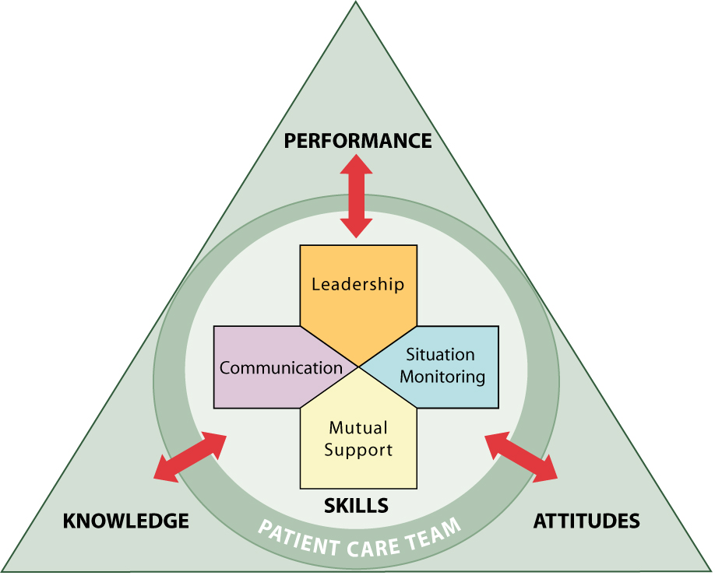
TeamSTEPPS
Daily Practice Makes Mastery Possible
Notes:
If we implement TeamSTEPPS, our teams will learn about the four competency areas that lead to improved team performance, safer practices, and change in culture:
Leadership – how to direct and coordinate, assign tasks, motivate team members, facilitate optimal performance.
Situation monitoring – how to develop common understandings of team environment, apply strategies to monitor teammate performance and maintain a shared mental model.
Mutual support – how to anticipate other team members’ needs through accurate knowledge and shift workload to achieve balance during periods of high workload or stress.
Communication – how to effectively exchange information among team members, regardless of how it is communicated.
They will also learn about specific tools and strategies that can be implemented in our units that support these competencies. Some of these tools and strategies include:
Briefings
Team Huddles
Two-challenge rule
SBAR
Check back
The end result will be a higher-performing team, where members:
Share a clear vision of the plan
Utilize concise, structured communication techniques
Adapt readily to changing situations
Maximize the use of information, skills, and resources for optimal outcomes
TeamSTEPPS understands the dynamics that can occur when teams consist of physicians, nurses, and technicians. The initiative focuses on gaining the support of both physicians and nurses to enhance teamwork. To support this, one of the two trainers for the program should be a physician or non-physician medical provider.

Slide 65
Daily Practice Structured Interdisciplinary Bedside Rounds (SIBR)
  Structured Interdisciplinary Bedside Rounds (SIBR)
  1. A shared mental model for teamwork
  2. A standardized interdisciplinary huddle for:
  a. collaborative cross checking
  b. accountability to a quality-safety checklist
  c. mutually supported plan of care
  3. An opportunity for daily practice
Jason Stein, MD SFHM | Department of Medicine | Emory University School of Medicine

Slide 66
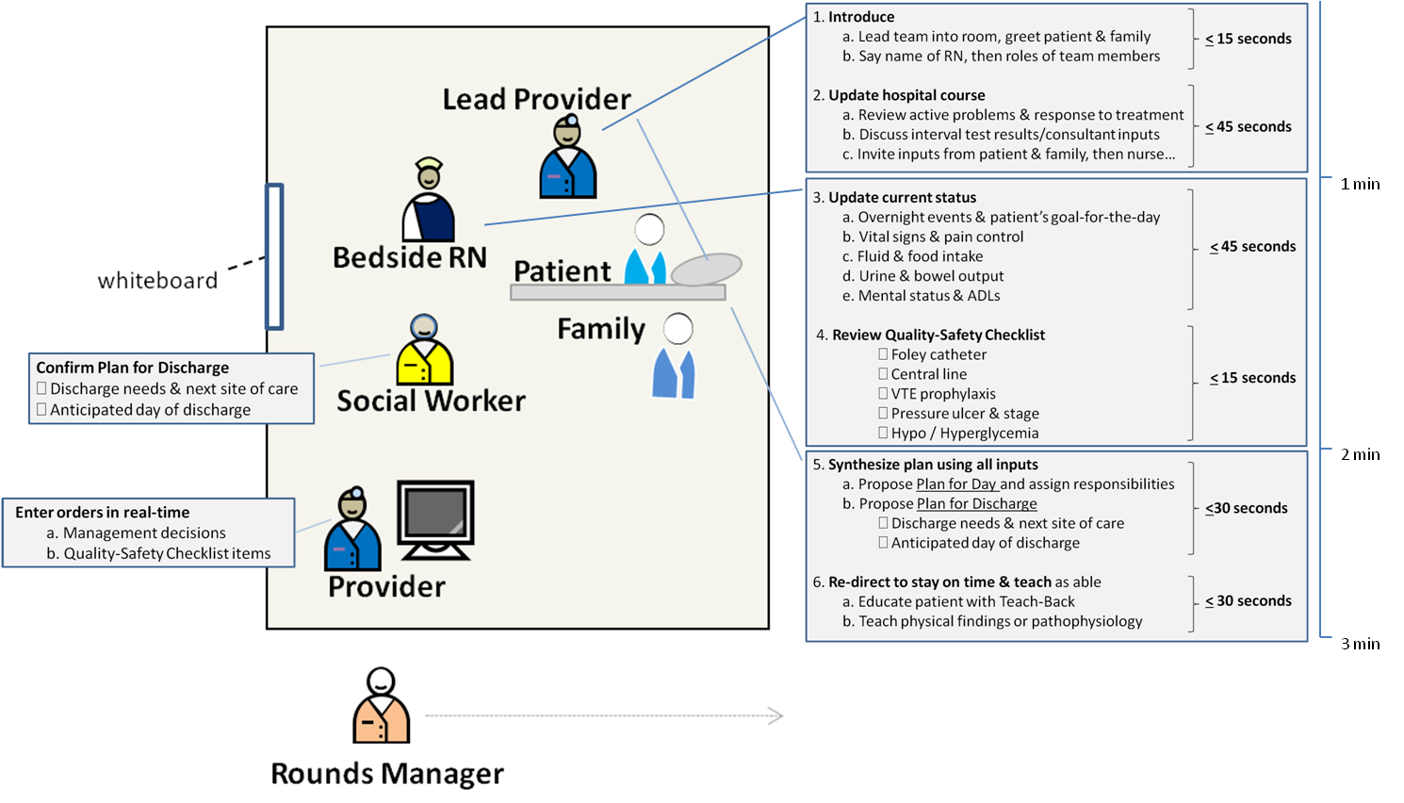
Daily Practice Structured Interdisciplinary Bedside Rounds (SIBR)
  Shared Mental Model for Teamwork
Jason Stein, MD SFHM | Department of Medicine | Emory University School of Medicine

Slide 67
Future State Synchronized Care
Standard communication protocol
Shared Mental Model
Jason Stein, MD SFHM | Department of Medicine | Emory University School of Medicine
Collaborative Cross Checking
Quality-Safety Checklist
Mutually Supported Plan

Slide 68
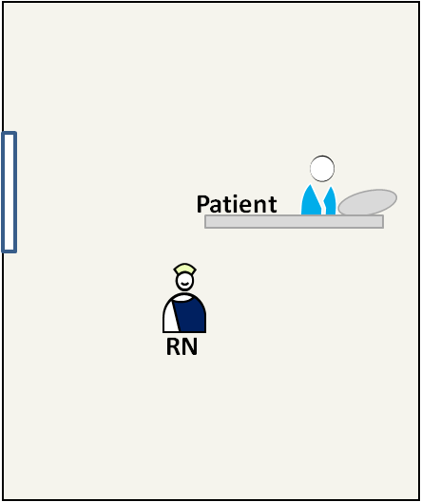
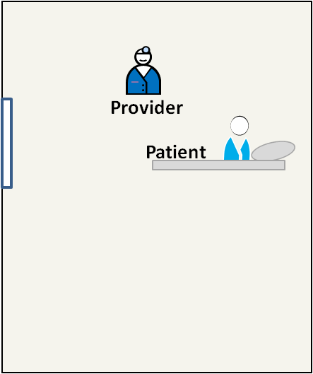
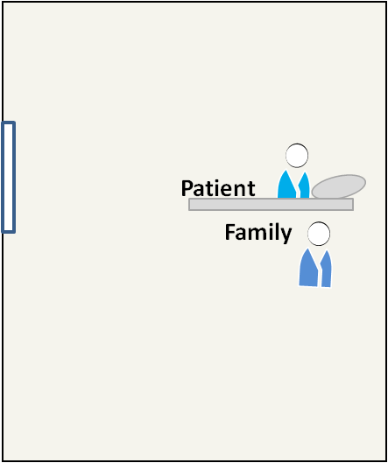
Status Quo Asynchronous Care
10:10a 10:30a 11:00a
Jason Stein, MD SFHM | Department of Medicine | Emory University School of Medicine

Slide 69
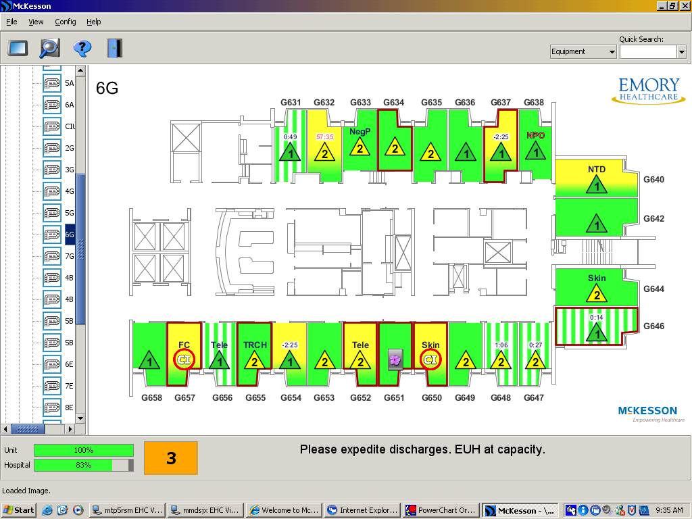
Designing Hospital Units to Optimize Outcomes
Accountable Care Unit (ACU)
Unit-based teams: physicians by units (predictability, cohesiveness, communication)
Patient-centered workflow: Structured Interdisciplinary Bedside Rounds (SIBR)
Unit-level performance data: rather than traditional facility or service level data
Unit-level management: nurse Unit Director + physician Medical Director
Jason Stein, MD SFHM | Department of Medicine | Emory University School of Medicine

Slide 70
Designing Hospital Units to Optimize Outcomes
Accountable Care Unit (ACU)
definition: a geographic inpatient area consistently responsible
for the clinical, service, and cost outcomes it produces
Jason Stein, MD SFHM | Department of Medicine | Emory University School of Medicine

Slide 71
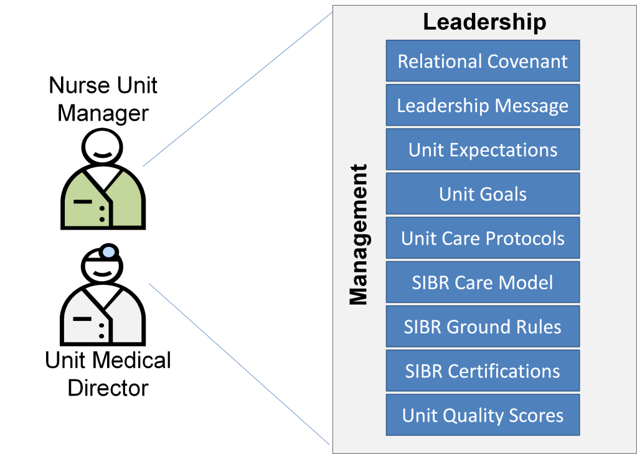
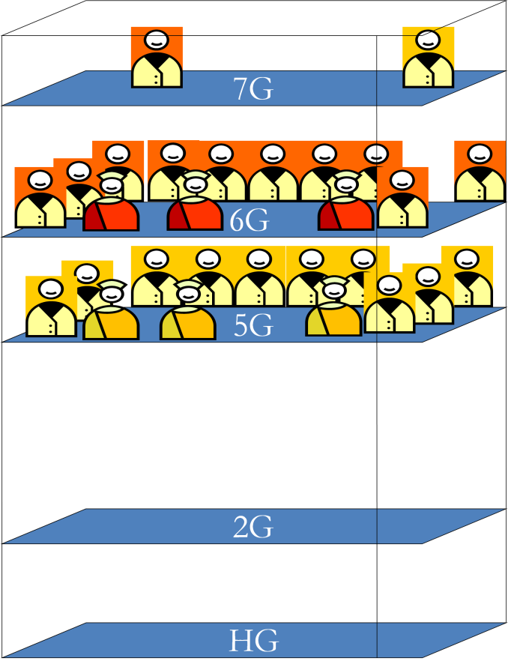


Designing Hospital Units to Optimize Outcomes
ACU Unit and Medical Directors manage unit process & outcomes
Jason Stein, MD SFHM | Department of Medicine | Emory University School of Medicine

Slide 72
Designing Hospital Units to Optimize Outcomes
Jason Stein, MD SFHM | Department of Medicine | Emory University School of Medicine

Slide 73
ACU Protocols
Glycemic Control Protocol
VTE Prevention Protocol
Structured Family Meeting Protocol
Jason Stein, MD SFHM |
Emory University School of Medicine
IUC/CVC Removal Protocols
Fall Prevention Protocol

Slide 74

Daily Practice Structured Interdisciplinary Bedside Rounds (SIBR)
Jason Stein, MD SFHM | Department of Medicine | Emory University School of Medicine
SIBR Training Manual
For Providers & Nurses
This manual provides you with the self-study and self-assessment materials needed to excel in your unit’s patient-centered, team-based hospital care model.

Slide 75

Daily Practice Structured Interdisciplinary Bedside Rounds (SIBR)
Jason Stein, MD SFHM | Department of Medicine | Emory University School of Medicine

Slide 76
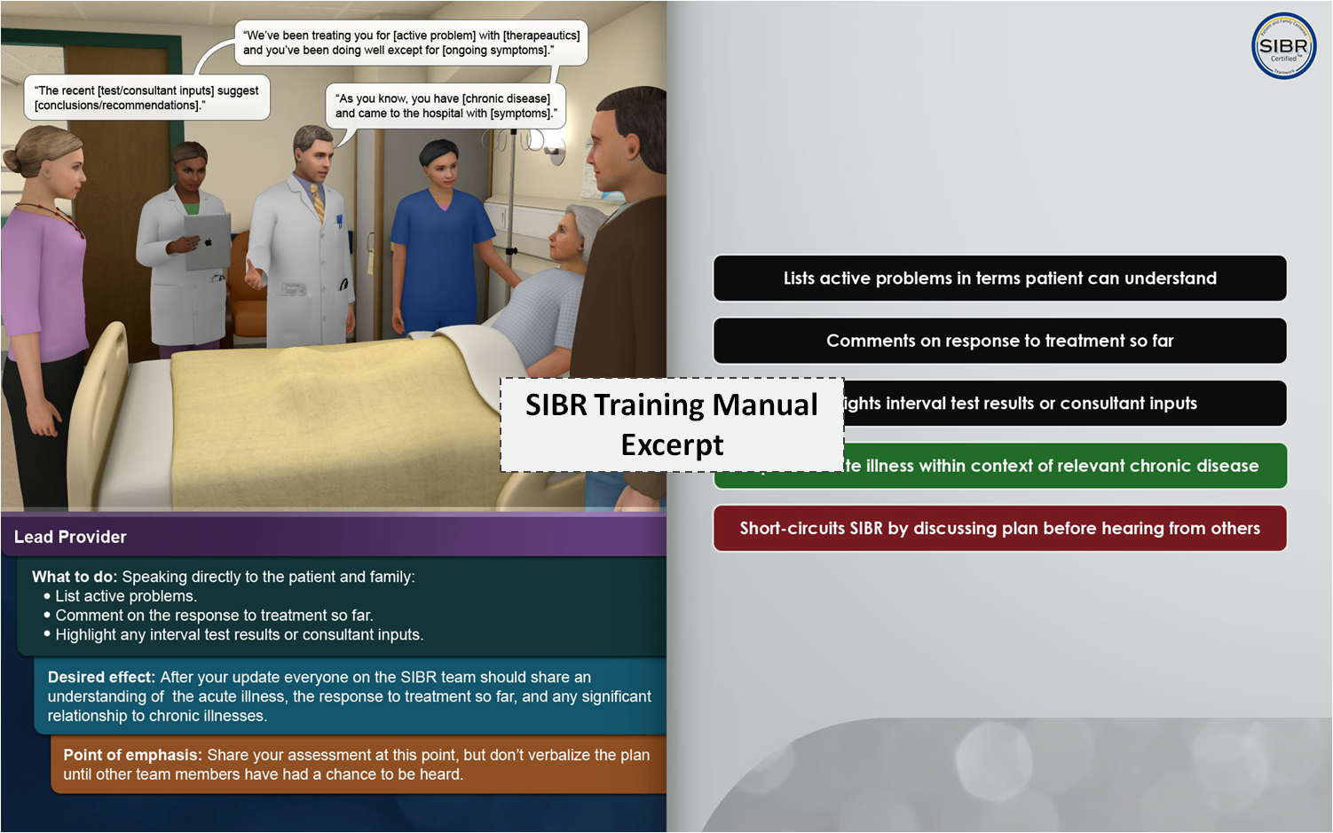
Daily Practice Structured Interdisciplinary Bedside Rounds (SIBR)
Jason Stein, MD SFHM | Department of Medicine | Emory University School of Medicine

Slide 77
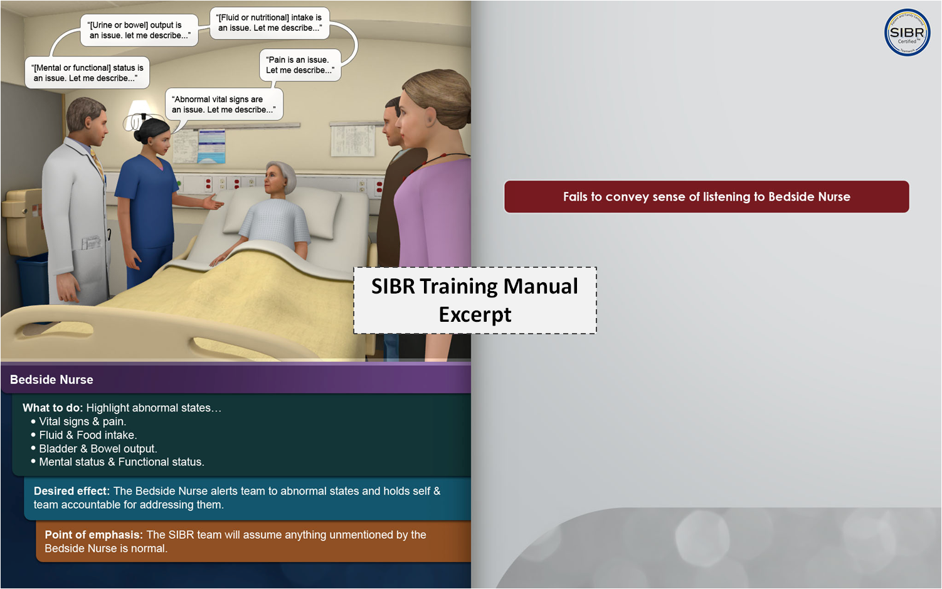
Daily Practice Structured Interdisciplinary Bedside Rounds (SIBR)
Jason Stein, MD SFHM | Department of Medicine | Emory University School of Medicine

Slide 78


Daily Practice Structured Interdisciplinary Bedside Rounds (SIBR)
Leadership
Provider & nurse co-direct SIBR so
it adheres to SIBR Diagram & SIBR
Ground Rules
Communication
Everyone confirms common ground through patient-friendly language or Teach-Back and learns to use body language & tone of voice effectively (>90% of communication)
Situation monitoring
Everyone collaboratively cross checks everyone else’s inputs (provider, nurse, and patient-family)
Mutual support
Everyone volunteers responsibility for meeting daily goals and holds each other accountable

Slide 79
Thank You

Slide 80
Debriefing after resuscitations in a pediatric emergency department
Team STEPPS Conference
Dallas, Texas
June 13, 2013
Paul C. Mullan¹, MD MPH
Sartaj Alam², PhD
Charles G. Macias², MD MPH
Deborah Hsu², MD MEd
Binita Patel², MD
¹Children’s National Medical Center –
George Washington School of Medicine
²Texas Children’s Hospital – Baylor College of Medicine
Notes:
Hello everyone, my name is Paul Mullan, and I want to start by thanking you for the opportunity to speak to you today about a Quality improvement project that I completed during my fellowship at Texas Children’s Hospital. I am passionate about using communication tools to improve the quality of care we all deliver and I would love to hear your feedback on this briefing checklist tool used at shift handoff.

Slide 81
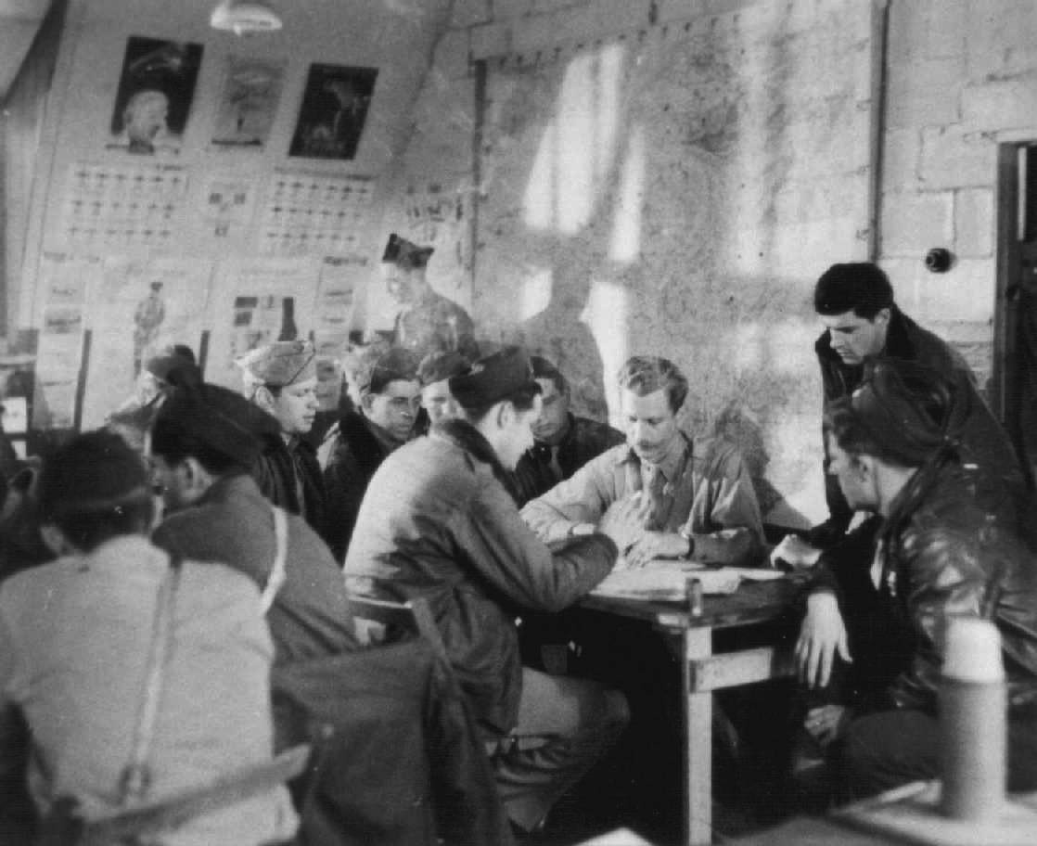
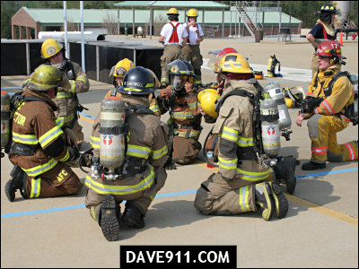


Debriefing Evolution
Notes:
Taken from: http://www.ahrq.gov/teamsteppstools/instructor/fundamentals/module3/slleadership.htm

Slide 82

What is Debriefing in Medicine?
A facilitator-led discussion by participants of an actual event with reflection and assimilation of learning to improve future performance and group morale¹
Why debrief?
Adapted from: Sutton R, et al. Emerg Med Clin N Am 30(2012):105-122
Notes:
- Conversation among 2 or more people to review a simulated event in which participants explore, analyze & synthesize their actions and thought processes, emotional states and other information to improve performance in real situations.

Slide 83
Physician Response to Patient Deaths:
Survey of UK pediatric residents¹
  69% did not debrief after their last patient death:
    79% felt a debriefing would have been useful
    55% felt they had no time to reflect afterwards
Two surveys of ER faculty on pediatric deaths²
  64% rarely or never debriefed patient deaths²
  55% with physical symptoms (37% insomnia) ²
  After a death, reactions included considerations to²:
    Change profession (32%), take time off (29%), quit job (28%)
  64% felt guilty or inadequate after the death³
  47% felt impaired during the remainder of their shift³
¹Baverstock A, et al. Arch Dis Child 2006;91:774-6.
²Strote J, et al. Acad Emerg Med 20011; 18:255-260.
3Ahrens WR, Hart RG. Am J Emerg Med. 1997 Nov;15(7):642-3
Notes:
Debriefing does not only have to take place after a patient death PER SE, but most of the literature out there describes the response of health care workers to failed patient resuscitations.
Median age 40 yo.
Survey of academic EM faculty from 4 programs across US (NW, SW, S, Mtn); (n=145; 70% response; median age 40 years); 49% witnessed a death once per month; Most frequent coping mechanism was talking to a colleague (78%); 64% reported rarely or never debriefing patient deaths in ED. 55% had experienced physical symptoms after a patient death (most commonly insomnia, 37%). After a patient death, 32% had considered changing professions, 29% considered taking time off, 28% considered quitting their job. Strote J, et al. Acd em Med 20011; 18:255-260.

Slide 84

Nursing Response to Patient Deaths:
Survey of UK hospital nurses¹
  7% reported formal debriefing after cardiac arrest
Survey of ER nurses²
  32% had debriefed; 88% found it decreased stress
1. Pittman J, et al. Resuscitation 49(2001):175-177
2. Burns C, et al. J Emerg Nurs 199a3 Oct;19(5):431-6
Notes:
Resuscitation training officer (specialized nurses who responds to cardiac arrests) survey (n=130;55% response) of perception of communication around cardiac arrests. Only 7% reported a formal debriefing after cardiac arrests. Pittman J, et al. Resuscitation 49(2001):175-177.

Slide 85

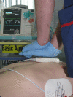
Clinical Outcomes
Internal medicine residents at U of Chicago
  All CPR events had CPR-sensing Audio-visual Feedback (CAF)
Compared:
  101 baseline CPR patients: CAF only
  123 intervention CPR patients: CAF + weekly team debriefings
Outcomes with intervention:
  Improved compression depth (50 vs 44 mm; p=0.001)
  Decreased ventilation rate (13 vs 18/min)
  Increased rate of ROSC (59% vs 45%)
  No increased survival to discharge (7% vs 9%)
Edelson D, et al. Arch Intern Med 168(10):1063-9
Notes:
. Internal medicine residents at a single university hospital in U.S.. A historical cohort of 1 year of cardiac arrests that had access to a CPR-sensing and feedback enabled defibrillator were compared with the prospective cohort of cardiac arrests whose residents received the same device plus weekly debriefings. Improved compression depth (50 vs 44 mm, p=0.001), decreased ventilation rate (13 vs 18/minute, p<0.001), increased rate of return of spontaneous circulation (59 vs 45%, p=0.03), but no increase in survial to discharge (7.4% vs 8.9%, p=0.69) Edelson D, et al. Arch Intern Med 168(10):1063-9.

Slide 86




Medical Recommendations
2010 American Heart Association
  “Reasonable to recommend the use of…debriefing…during actual clinical activities based on 1 LOE 1 & 16 LOE 3 and 4 studies.”
2010 European Resuscitation Council
  “Debriefings based on performance during…actual resuscitation attempts should be used to help improve resuscitation team & individual performance.”
Institute for Healthcare Improvement
  “Debriefing is an essential tool for effective teamwork and an environment of continuous learning and improvement.”
Committee on PEM, 2007 AAP Policy Statement
  “Provide training in teamwork and communication on… briefing and debriefing.”
Notes:
Canadian Patient Safety Institute
“Engage in continuous learning using debriefings.”

Slide 87
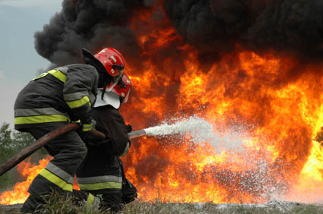
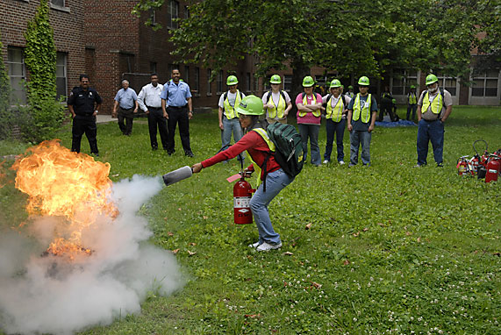
Differences between:
Actual Event vs. Simulation
Debriefing
Unscripted, non-scheduled events
Real consequences
Often lead by an involved team member
Lack of video/logbook review
More psychological risks for participants
Simultaneous need to care for other patients
Often less time allowance
Notes:
Actual debriefings: follow unscripted events, usually lead by an involved team member, lack the advantage of video or log review of all actions that occurred.

Slide 88
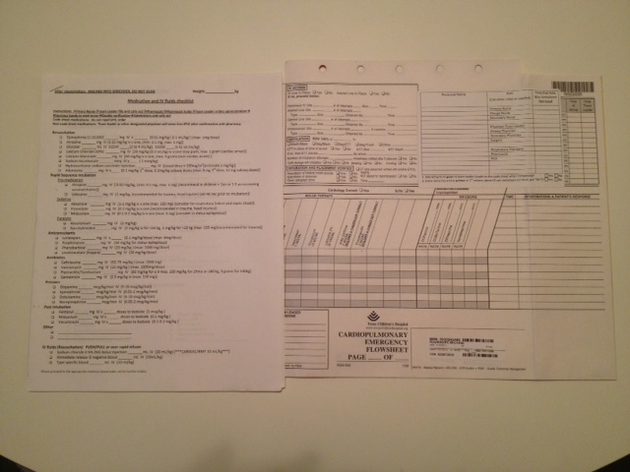
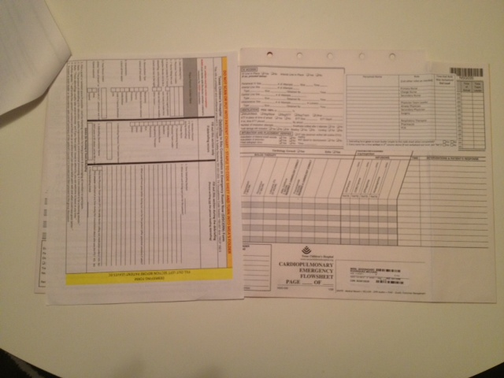
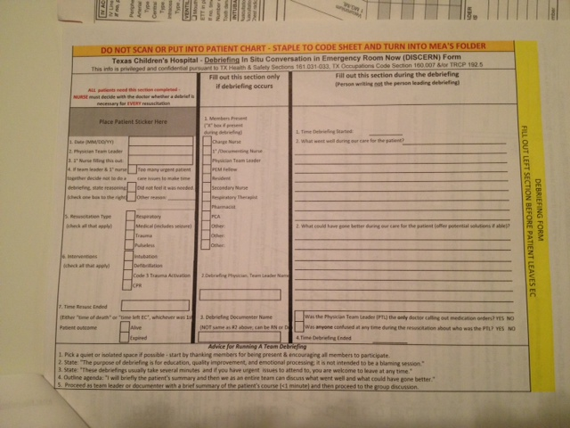
DISCERN Debriefing Form
Debriefing In Situ Conversation in E.R. Now
1st COLUMN
2nd & 3rd
COLUMNS
ADVICE AREA FOR DEBRIEFING LEADERS
Attached to all resuscitation (CPR, intubation, defibrllation) sheets

Slide 89

Debriefing Goals & Advice:
Advice at bottom of DISCERN tool as reference
1. Pick a quiet or isolated space if possible - start by thanking members for being present & encouraging all members to participate.^{1,2}
2. State: "The purpose of debriefing is for education, quality improvement, & emotional processing^{1,3}; it is not a blaming session. Everyone's participation is welcome & encouraged.”
1. Salas, 2008. 2. Tompkins, 2000. 3.Ireland, 2008
Notes:
Advice for Running A Team Debriefing 1. Pick a quiet or isolated space if possible - start by thanking members for being present & encouraging all members to participate. 2. State: "The purpose of debriefing is for education, quality improvement, & emotional processing; it is not a blaming session. Everyone's participation is welcome & encouraged."

Slide 90


Debriefing Goals & Advice:
3. State: "These debriefings usually take several minutes and if you have urgent issues to attend to, you are welcome to leave at any time."
4. State: "I will briefly review the patient's summary and then we as an entire team can discuss what went well and what could have gone better.¹ Please feel free to ask any questions."
1. Center for Management & Organization Effectiveness. Accessed 1/21/11: http://www.cmoe.com/blog/the-plusdelta-of-a-plusdelta.htm
Notes:
5. Proceed as team leader or documenter with a brief summary of the patient's course (<1 minute) and then proceed to the group discussion. * If anyone needs or requests referral for free counseling, call the appropriate instituation at 832-824-3327 (TCH) or 713-500-3327 (BCM)

Slide 91


Debriefing Goals:
5. Proceed as team leader with a brief summary of the patient's course (~1 minute) and then proceed to the group discussion.
  Record team findings¹
    Documenter ≠ Debriefing Leader
Bandura A, 1991
Notes:
5. Proceed as team leader or documenter with a brief summary of the patient's course (<1 minute) and then proceed to the group discussion. * If anyone needs or requests referral for free counseling, call the appropriate instituation at 832-824-3327 (TCH) or 713-500-3327 (BCM)

Slide 92
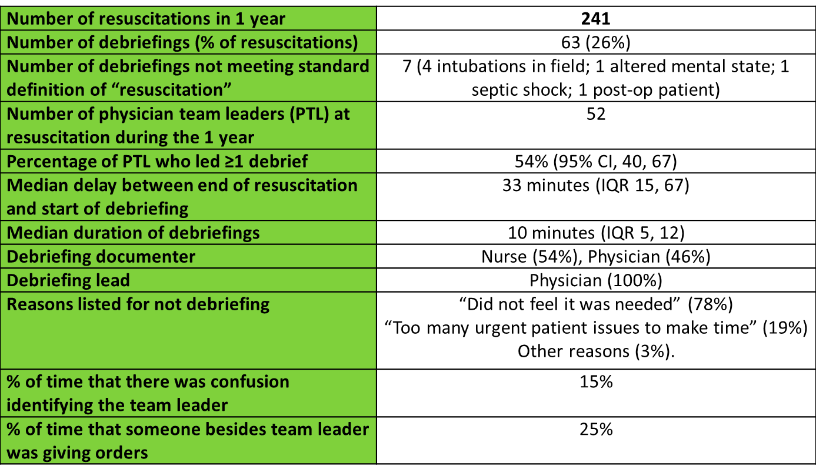
Debriefing Goals
Resuscitation = CPR/Death, Intubation, and/or Defibrillation
Notes:
5. Proceed as team leader or documenter with a brief summary of the patient's course (<1 minute) and then proceed to the group discussion. * If anyone needs or requests referral for free counseling, call the appropriate instituation at 832-824-3327 (TCH) or 713-500-3327 (BCM)

Slide 93
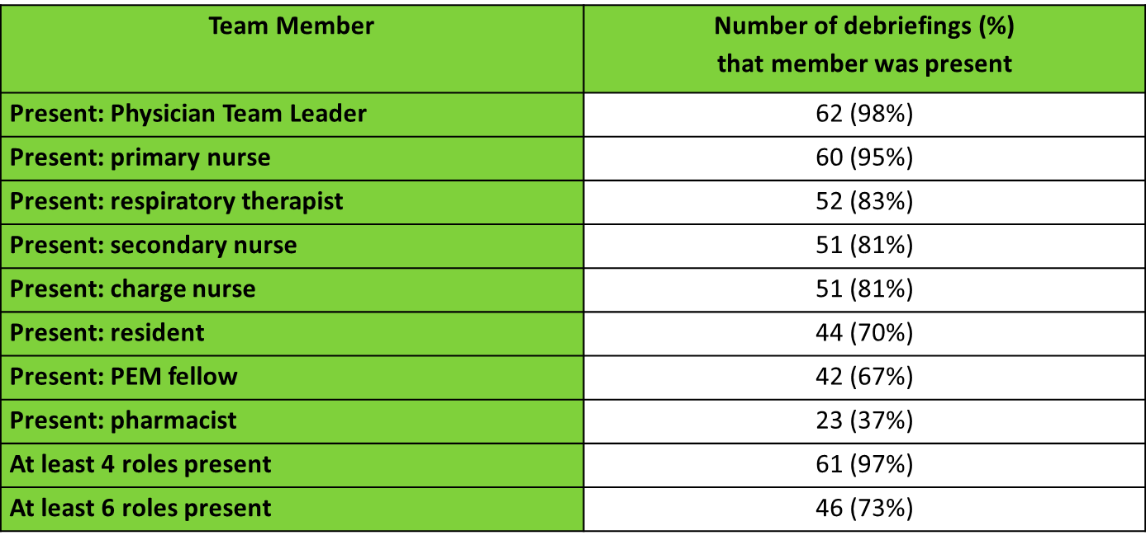
Team Members Present at Debriefings
**Multi-disciplinary**

Slide 94
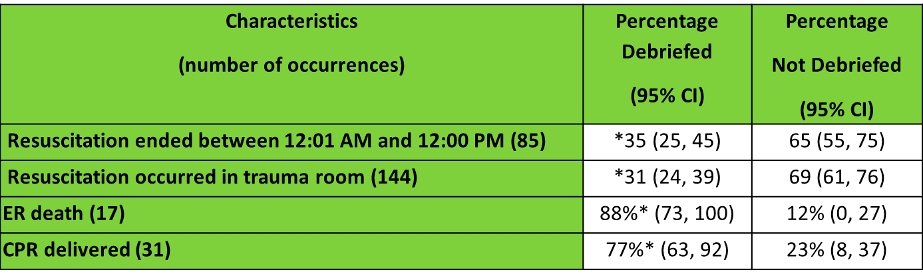
Predictors for debriefing out of the 241 resuscitations
*p<0.05
Notes:
Not a/w fellow/attending, solo/multiple, PTL gender, time of day, trauma vs non-trauma room, patient gender

Slide 95
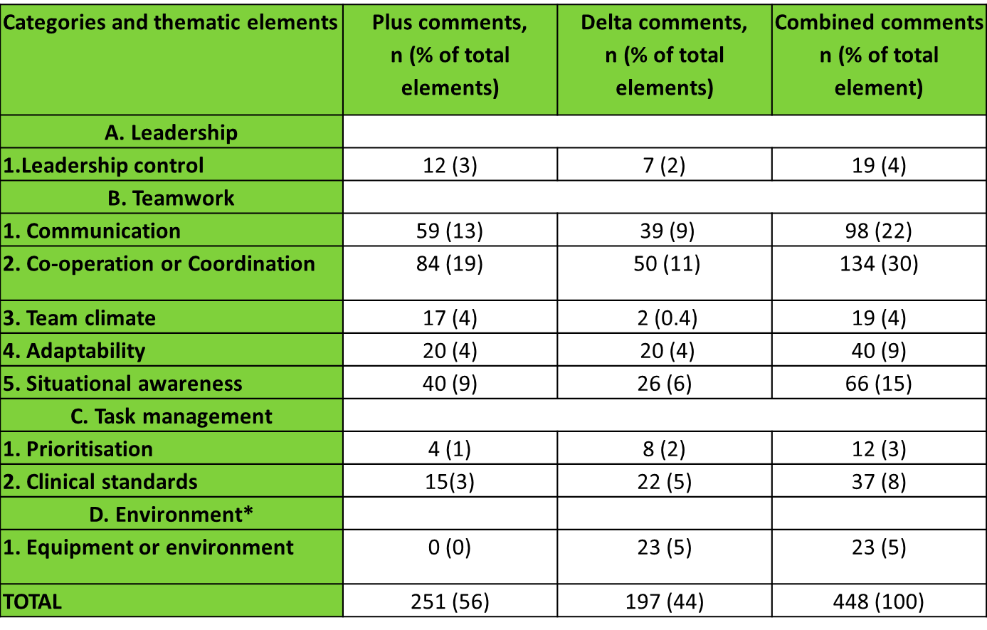
Debriefing Content
Framework Analysis of Plus/Delta Comments

Slide 96
Responses to Debrief Issues
Category | Best Practice Recommendations¹
Psychological/Emotional | Directed to professional help Discuss 1-on-1 with Sr. clinician Consideration for time off
System | Involve Sr. staff Staff meeting discussion + action plan Discussion with resuscitation educators
Practice | Reviewing guidelines & training as needed Equipment issues addressed
Texas Children’s Hospital Emergency Center
Colleague support Hospital counseling services
Reviewed by safety team MD & RN director meetings Closed loop feedback system
Guideline teaching as needed Equipment followed-up
¹Ireland, et al, 2008
Notes:
832.824.3327 (IDEAS) Counseling line at TCH. Licensed Masters level counselor; no cost ; no session limit; general hours + emergency . 800-1000/year. No diagnose. Professional counselor NEEDS to give a diagnosis. Coping mechanisms. Website: connect & HR. Mgr Brent Locaste-Wilken.
Baylor UT EAP (employee assistance program): 713.500.3327 (DEAR). Limited to 3 sessions. No cost. Do try to find someone in the network. 8a-5p. Masters level counselors & 1 psychologist. Phone line open 24-7. Over 67 organizations; come there ~ 2000-3000/year. Outsource about 5000/year (>20 intakes/day). Benefits → HR.

Slide 97
Implementation Challenges
Gathering the team
Finding a designated private space
Immediate patient care needs
Non-simultaneous shift start/end times
Leader comfort
Debriefing sheets “lost”

Slide 98
Future directions
Non-physician team leaders (nurses, etc.)
Track clinical outcomes or processes associated with those who debrief
Multi-center usage & tool improvement
Paper → electronic/tablet
Intermittent → routine

Slide 99
  References
1. Ahrens WR, Hart RG. Emergency physicians' experience with pediatric death. Am J Emerg Med 1997; Nov;15(7):642-3.
2. Baverstock A, Finlay F. Specialist registrars' emotional responses to a patient's death. Arch Dis Child 2006; Sep;91(9):774-6.
3. Burns C, Harm NJ. Emergency nurses' perceptions of critical incidents and stress debriefing. J Emerg Nurs 1993; Oct;19(5):431-6.
4. Donoghue A, Ventre K, Boulet J, Brett-Fleegler M, Nishisaki A, Overly F, et al. Design, implementation, and psychometric analysis of a scoring instrument for simulated pediatric resuscitation: a report from the EXPRESS pediatric investigators. Simul Healthc 2011; Apr;6(2):71-7.
5. Edelson DP, Litzinger B, Arora V, Walsh D, Kim S, Lauderdale DS, et al. Improving in-hospital cardiac arrest process and outcomes with performance debriefing. Arch Intern Med 2008; May 26;168(10):1063-9.
6. Edelson DP, Litzinger B, Arora V, Walsh D, Kim S, Lauderdale DS, et al. Improving in-hospital cardiac arrest process and outcomes with performance debriefing. Arch Intern Med 2008; May 26;168(10):1063-9.
7. Hayes CW, Rhee A, Detsky ME, Leblanc VR, Wax RS. Residents feel unprepared and unsupervised as leaders of cardiac arrest teams in teaching hospitals: a survey of internal medicine residents. Crit Care Med 2007; Jul;35(7):1668-72.
8. Ireland S, Gilchrist J, Maconochie I. Debriefing after failed paediatric resuscitation: a survey of current UK practice. Emerg Med J 2008; Jun;25(6):328-30.
9. Keene EA, Hutton N, Hall B, Rushton C. Bereavement debriefing sessions: an intervention to support health care professionals in managing their grief after the death of a patient. Pediatr Nurs 2010; Jul-Aug;36(4):185,9; quiz 190.
10. Magyar J, Theophilos T. Review article: debriefing critical incidents in the emergency department. Emerg Med Australas 2010; Dec;22(6):499-506.
11. Mancini ME, Soar J, Bhanji F, Billi JE, Dennett J, Finn J, et al. Part 12: Education, implementation, and teams: 2010 International Consensus on Cardiopulmonary Resuscitation and Emergency Cardiovascular Care Science With Treatment Recommendations. Circulation 2010; Oct 19;122(16 Suppl 2):S539-81.
12. Mitchell JT. When disaster strikes...the critical incident stress debriefing process. JEMS 1983; Jan;8(1):36-9.
13. Perkins GD, Davies RP, Quinton S, Woolley S, Gao F, Abella B, et al. The effect of real-time CPR feedback and post event debriefing on patient and processes focused outcomes: a cohort study: trial protocol. Scand J Trauma Resusc Emerg Med 2011; Oct 18;19:58.
14. Redinbaugh EM, Sullivan AM, Block SD, Gadmer NM, Lakoma M, Mitchell AM, et al. Doctors' emotional reactions to recent death of a patient: cross sectional study of hospital doctors. BMJ 2003; Jul 26;327(7408):185.
15. Salas E, Klein C, King H, Salisbury M, Augenstein JS, Birnbach DJ, et al. Debriefing medical teams: 12 evidence-based best practices and tips. Jt Comm J Qual Patient Saf 2008; Sep;34(9):518-27.
16. Serwint JR. One method of coping: resident debriefing after the death of a patient. J Pediatr 2004; Aug;145(2):229-34.
17. Soar J, Monsieurs KG, Ballance JH, Barelli A, Biarent D, Greif R, et al. European Resuscitation Council Guidelines for Resuscitation 2010 Section 9. Principles of education in resuscitation. Resuscitation 2010; Oct;81(10):1434-44.
18. Strote J, Schroeder E, Lemos J, Paganelli R, Solberg J, Range Hutson H. Academic emergency physicians' experiences with patient death. Acad Emerg Med 2011; Mar;18(3):255-60.
19. Sutton RM, Nadkarni V, Abella BS. "Putting it all together" to improve resuscitation quality. Emerg Med Clin North Am 2012; Feb;30(1):105-22.
20. Theophilos T, Magyar J, Babl FE, Paediatric Research in Emergency Departments International Collaborative (PREDICT). Debriefing critical incidents in the paediatric emergency department: current practice and perceived needs in Australia and New Zealand. Emerg Med Australas 2009; Dec;21(6):479-83.

