Slide 1

Engaging Patients through TeamSTEPPS
^{Carole Kulik,} RN, CCRN, MSN, ACNP-BC Bernadette Page, MD, FACEP
^{Martin F. Wieczorek, MD}

Slide 2
What will our Teams Learn?
Patient Engagement in Team STEPPS

Slide 3
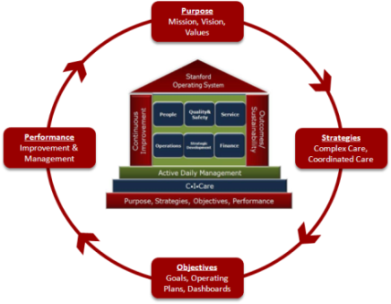
Incorporation into the Values and
Culture
Active Daily Management is rooted in Operating System…
Standard Work
Visual Displays & Controls
Continuous Improvement
Lean Methodology
Team STEPPS
Focus On People
Performance Orientation
Lean Methodology
Team STEPPS
Focus On People
Performance Orientation
Dashboards
Daily Metrics
Huddles
Rounds
Communication
Recruitment & Training
Rewards & Recognition
…and is designed to help us fulfill our Mission, Vision, and Values

Slide 4

We Learned About Lean, Active Daily Management & Stanford Operating System
Active Daily Management is rooted in Stanford Operating System…
Standard Work
Visual Displays & Controls
Continuous Improvement
Lean Methodology
Team STEPPS
Focus On People
Performance Orientation
Dashboards
Daily Metrics
Huddles
Rounds
Communication
Recruitment & Training
Rewards & Recognition
…and is designed to help us fulfill our Mission, Vision, and Values

Slide 5
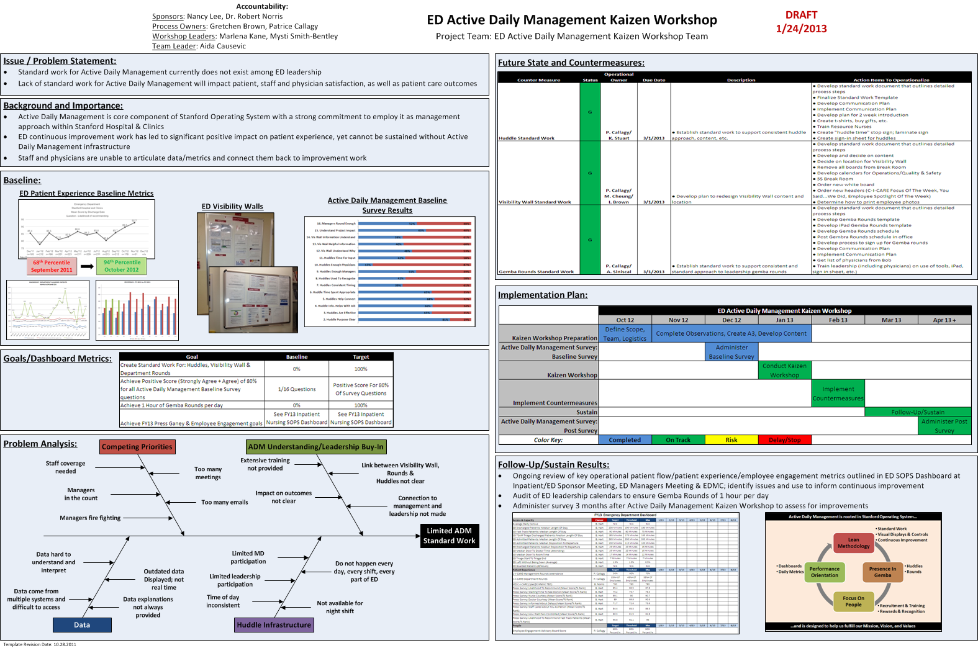
Where Do You Start?

Slide 6
What is needed to make this work
Clearly Defined Need
Support from Senior leadership
Allocation of Resources
Focus on Team
Patient and Family Centered
Standardized tools and Language
Communication

Slide 7
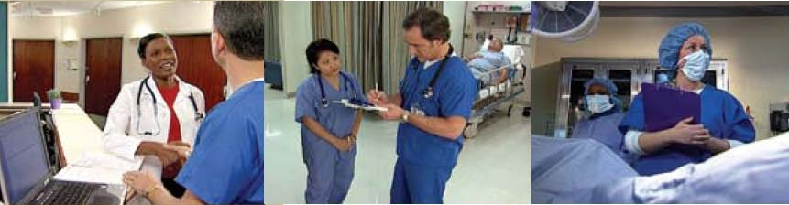
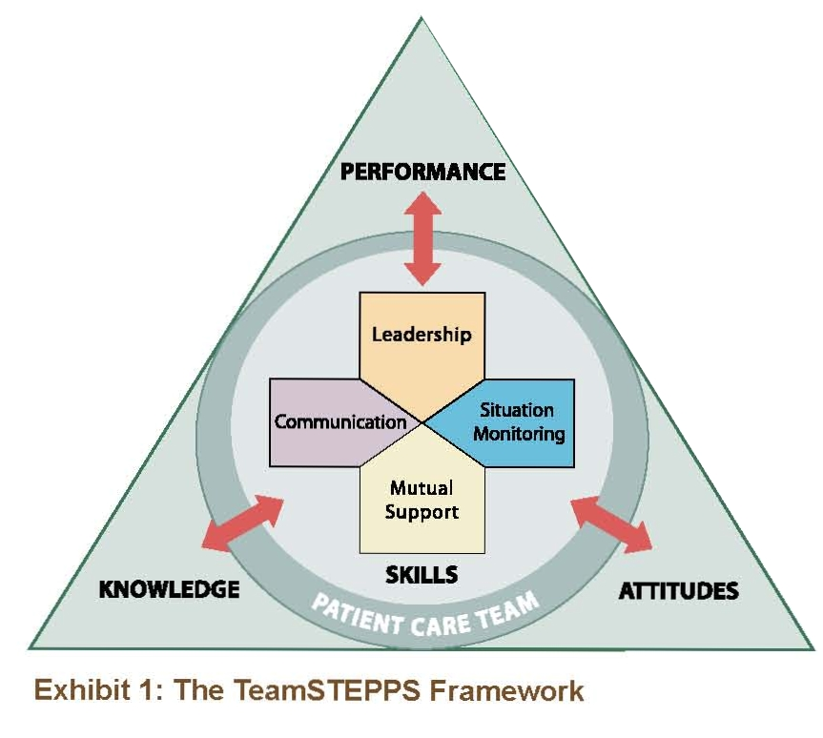
Interdisciplinary Team

Slide 8
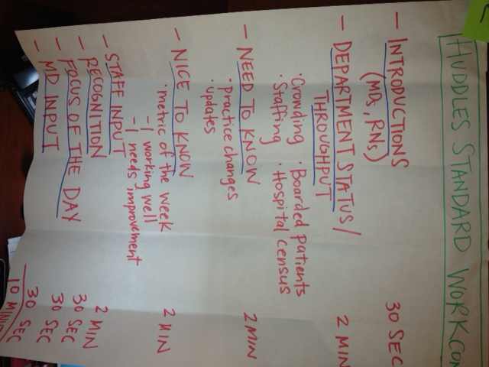
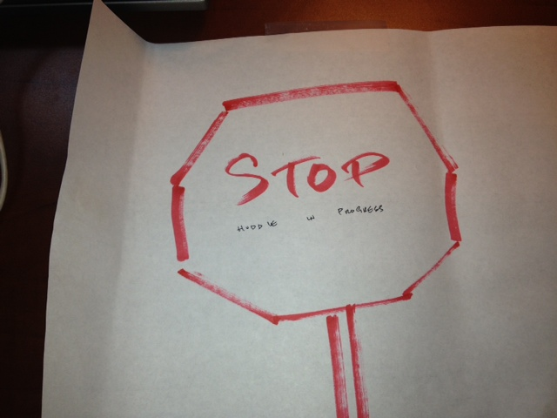
Start with Current State and Dream Big
Limited Structure
One Way Information Sharing
Minimal Physician Participation
Mostly Nursing Participation
Continuous Improvement Not A Focus
Minimal Data Shared
Patient Dissatisfaction
Lost Opportunities

Slide 9
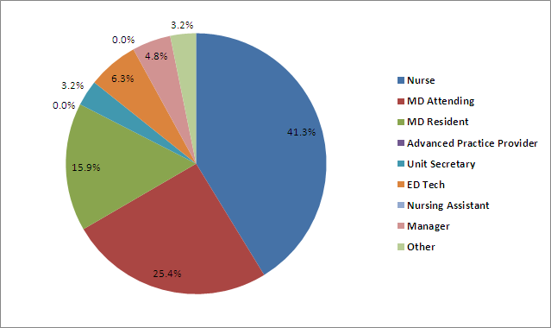
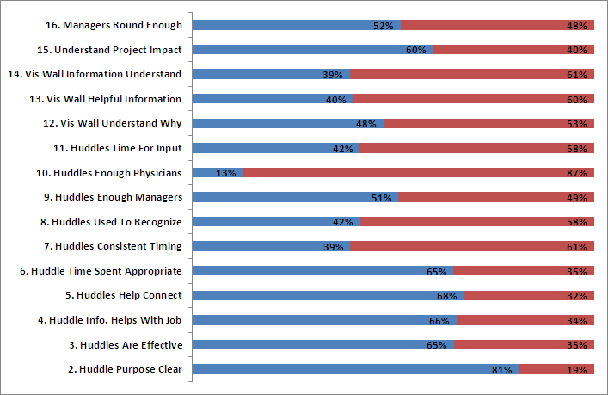
  We Reviewed The Current State: Baseline Survey
80 Team Members Out Of 275 Completed
% Positive Score:
Strongly Agree + Agree By Question
“I don’t know what the wall is”
“I only work nights, and as a result miss all the huddles”
“I did not know we had anything called a visibility wall”

Slide 10
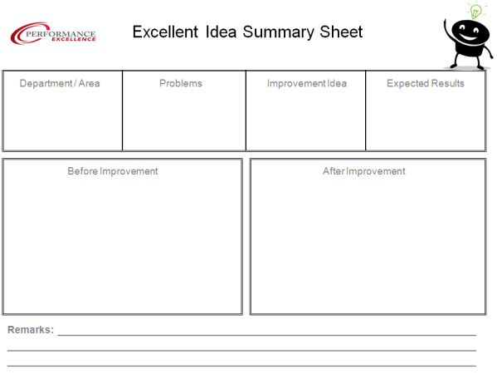
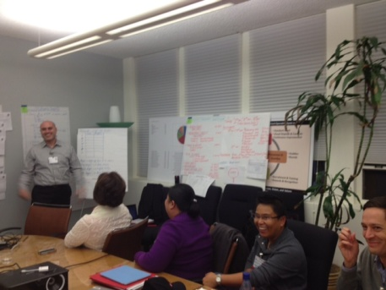
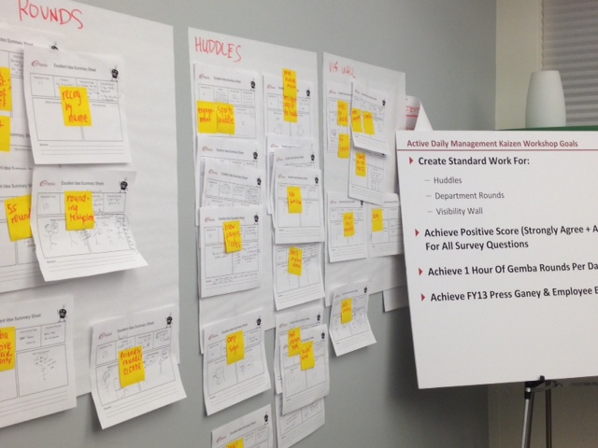
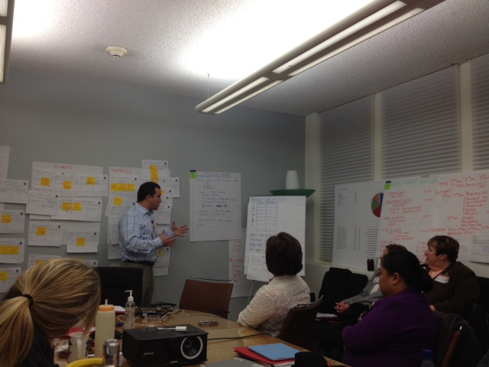
Engaging the Working Environment
Huddles
Standard Work
Standard Language
Visibility Wall
Redesign
Communication Tools
Gemba Rounds
Standard Work

Slide 11
Evolution of Change
CUS
“I really liked visiting the other departments and meeting other staff.”
“Loved standardizing the concepts!”
“The changes will be beneficial to our patients”
“I would not change anything! There were excellent outcomes!”
“We came up with very realistic action items.”
“Super enthusiasm and great ideas!”
“Everyone was on the same page and we could implement the tools quickly.”
“My Patients work with us more and speak up”

Slide 12
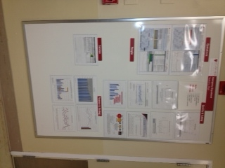
Current State: Visibility Wall
A3 Project Examples
Department Name
Quality
Metrics
Press Ganey Graph
(Nurse Courtesy)
Patient Flow
Metrics
Monthly Patient Experience Dashboard
Patient Suggestions

Slide 13
Thanks
              Any Questions?

Slide 14
The Patient’s Perspective
From the bed, looking upwards

Slide 15
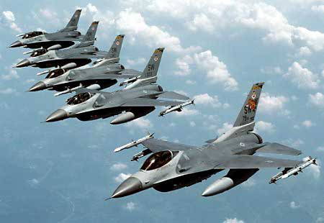

Slide 16
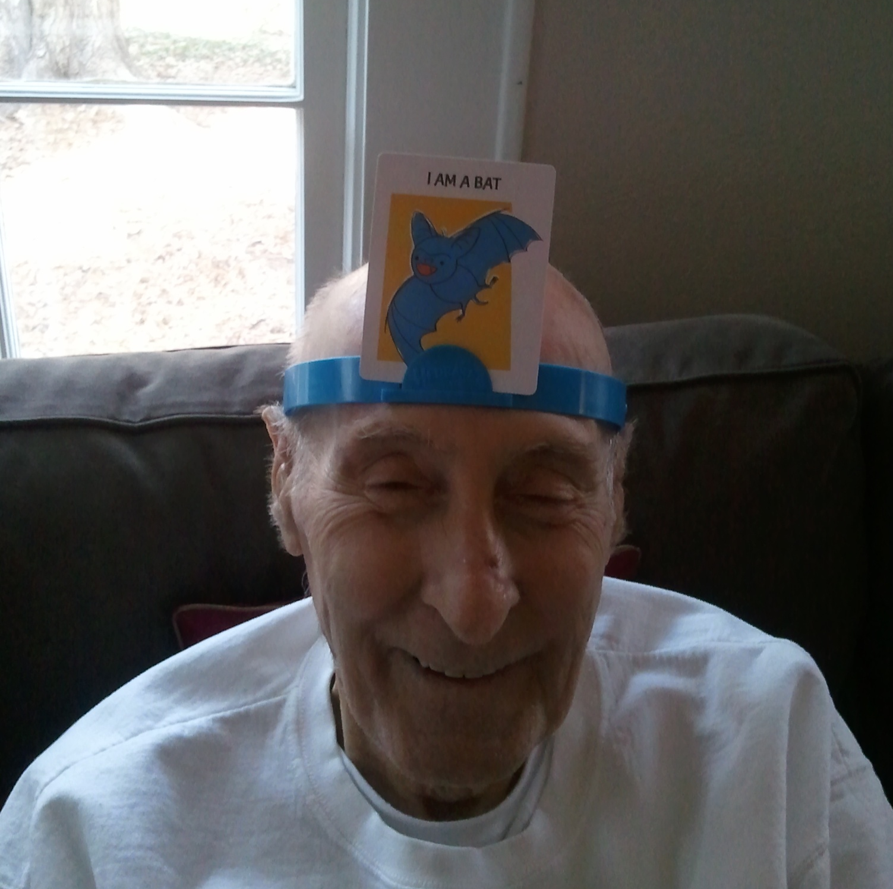

Slide 17
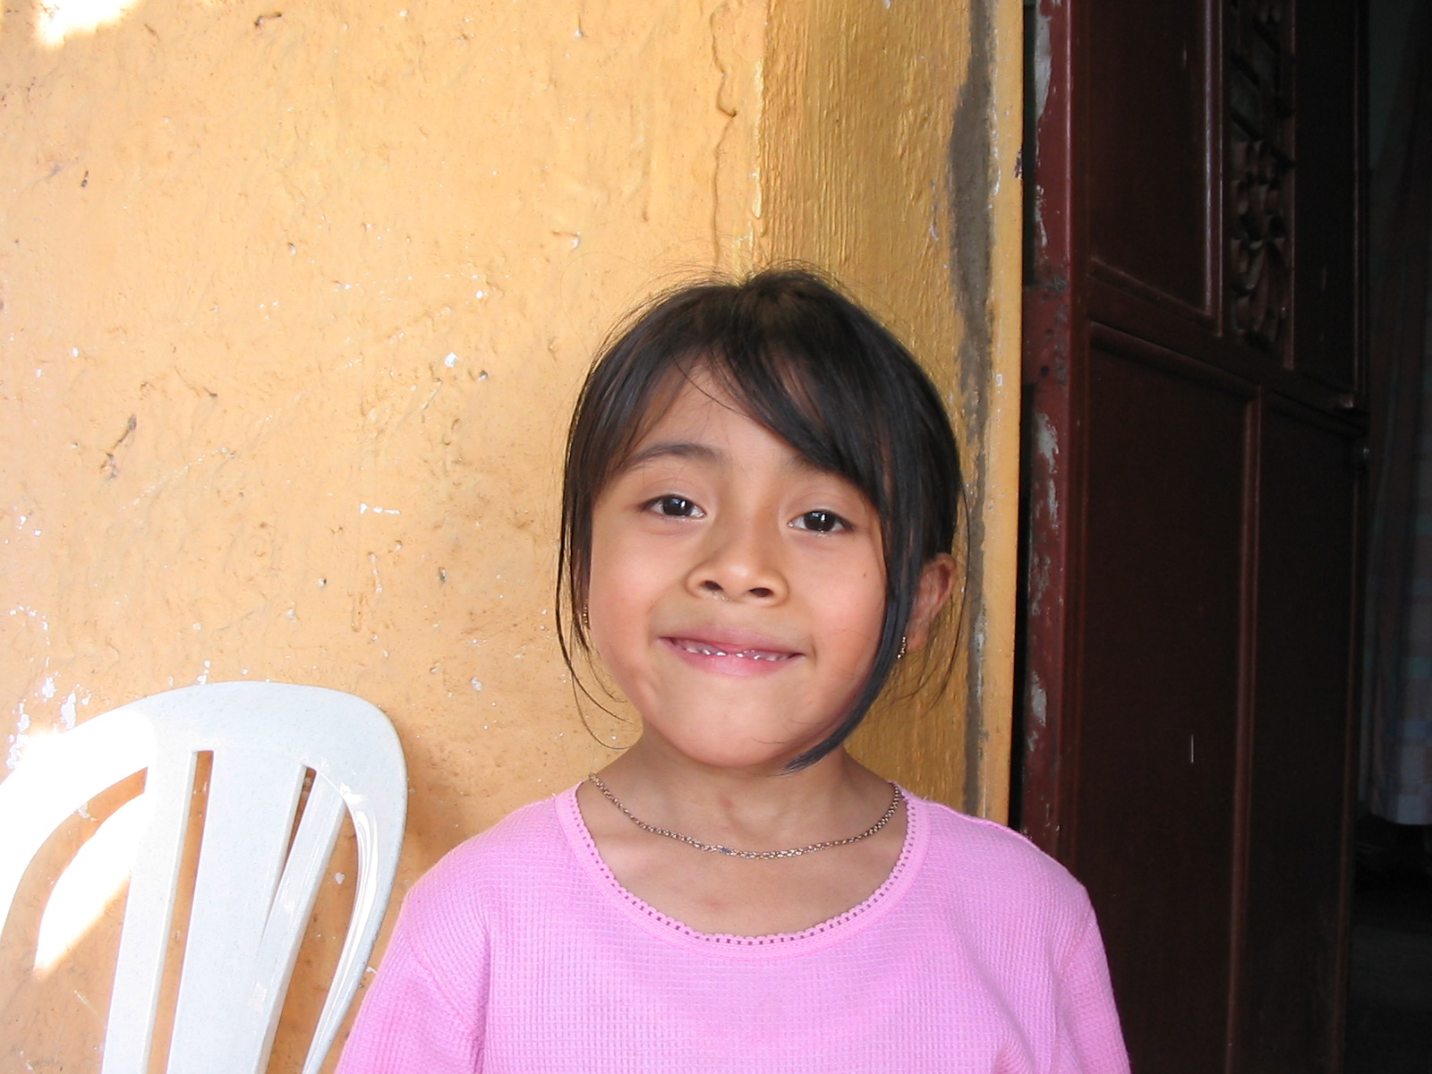

Slide 18
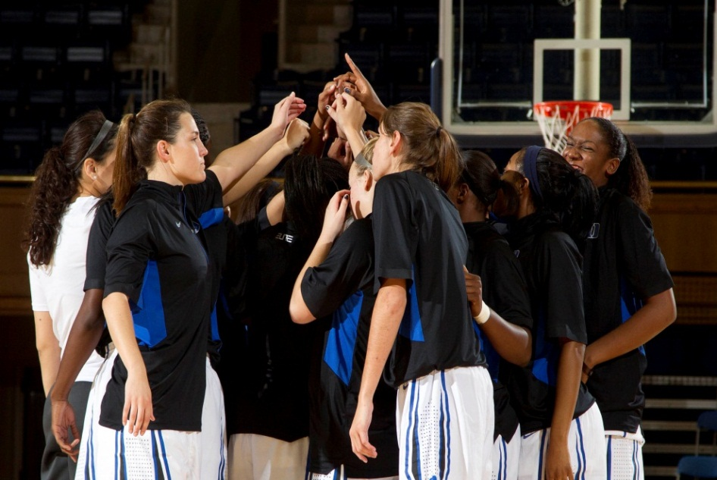

Slide 19
Patient
Core Team
Coordinating Team
Ancillary and Support services
Administration

Slide 20
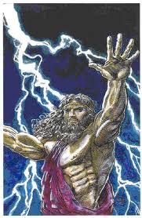

Slide 21


Slide 22
Characteristics
PATIENT
Feel ignorant
Feel powerless
Feel scared
Feel confused
Feel pain
Feel tired
Feel angry/alone/betrayed
CAREGIVER
Feel knowledgeable
Feel powerful
Feel confident
See issues clearly

Slide 23
More patient characteristics
Wonder whom to trust
Wonder how to pay
Worry about family and pets
Wonder what they may eat
Wonder what activities they may or should do
Wonder what’s next etc

Slide 24
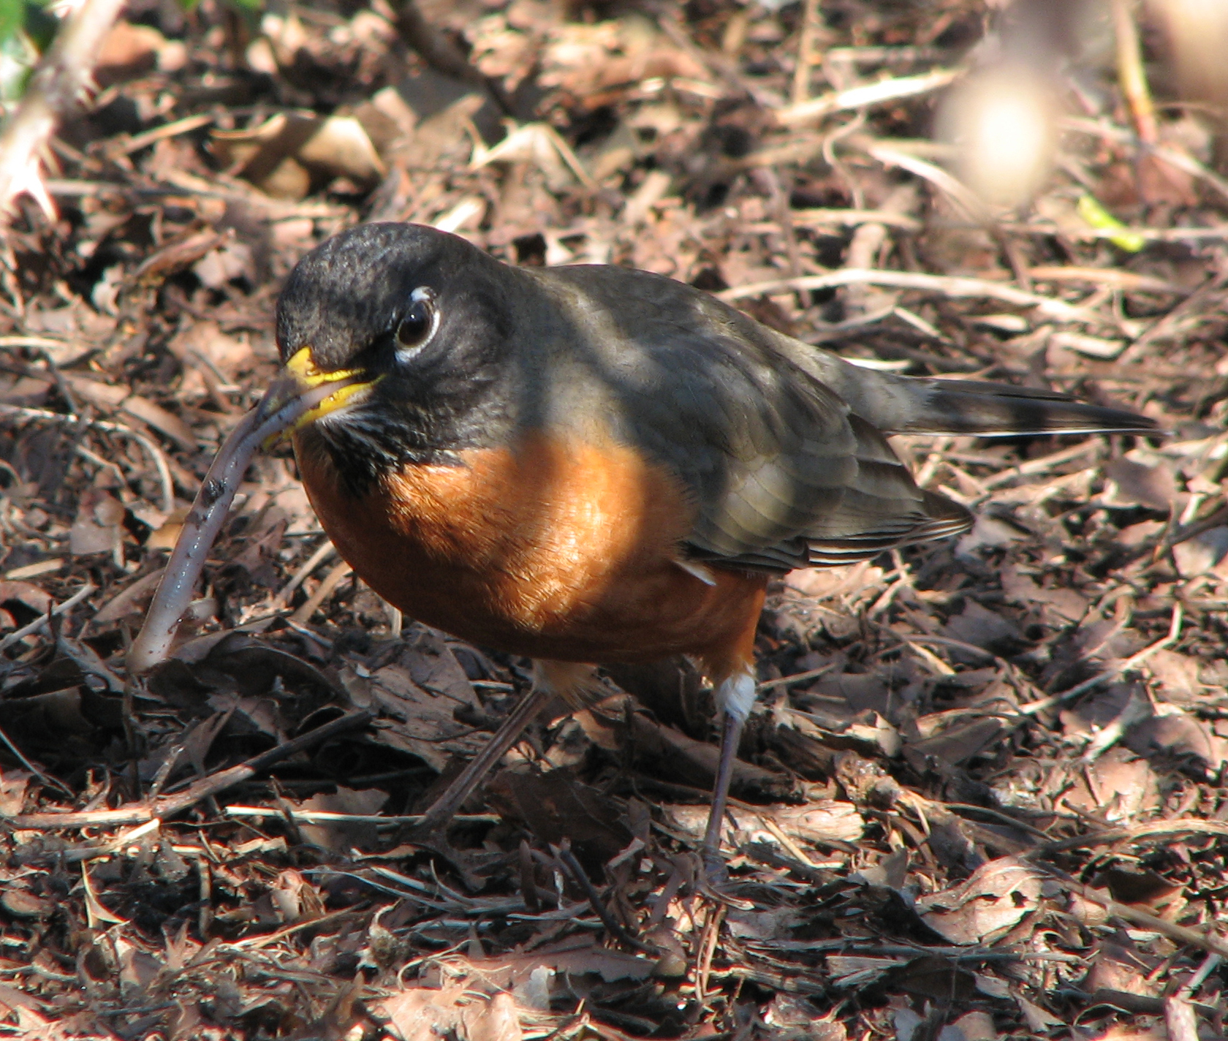

Slide 25
TeamSTEPPS
BARRIERS Inconsistency in Team Membership Lack of Time Lack of Information Sharing Hierarchy Defensiveness Conventional Thinking Complacency Varying Communication Styles Conflict Lack of Coordination and Follow-Up with Co-Workers Distractions Fatigue Workload Misinterpretation of Cues Lack of Role Clarity | TOOLS & STRATEGIES Brief Huddle Debrief STEP Cross Monitoring Feedback Advocacy and Assertion Two-Challenge Rule CUS DESC Script Collaboration SBAR Call-Out Check-Back Handoff | OUTCOMES Shared Mental Model Adaptability Team Orientation Mutual Trust Team Performance Patient Safety!!
25
Notes:
25

Slide 26
TeamSTEPPS for PATIENTS
BARRIERS Hierarchy Defensiveness Lack of Information Sharing Conventional Thinking Lack of Time Lack of Coordination and Follow-Up with Co-Workers Fatigue Lack of Role Clarity | TOOLS & STRATEGIES Advocacy and Assertion Collaboration | OUTCOMES Shared Mental Model Mutual Trust Patient Safety!!
26
Notes:
26

Slide 27
Foundation of Patient TeamSTEPPS
Encourage self advocacy
Empower the patient to use assertion

Slide 28
STEP TWO
Educating the patient so we can have a shared mental model. We don’t need to know what the care-givers know, but we need to know
Our diagnosis
Our plan of treatment
Our medicines
Our options
Our diet and activities
Our prognosis

Slide 31


Slide 32
Vision
To be the recognized leader in patient and family-centered care

Slide 33
Duke Values
“Caring for Our Patients, Their Loved Ones, and Each Other” through:
  Excellence: We strive to achieve excellence in all that we do.
  Safety: We hold each other accountable to constantly improve a culture that ensures the safety and welfare of all patients, visitors, and staff.
  Integrity: Our decisions, actions, and behaviors are based on honesty, trust, fairness, and the highest ethical standards.
  Diversity: We embrace differences among people.
  Teamwork: We have to depend on each other and work well together with mutual respect to achieve common goals.

Slide 34
Patient Engagement at Duke
Patient Engagement
Team STEPPS
RELATE
Patient and Family
Centered Rounding
Patient Advocacy
Council
Other

Slide 35

TeamSTEPPS for Patients
A National TeamSTEPPS Training Site
Hosted the national “TeamSTEPPS for Patients Conference” in 2012
10 Duke patients have been trained as Master Trainers
Those patients are part of the team that teaches TeamSTEPPS to the staff at Duke
Patient Advocate using modified CUS & SBAR for patients.

Slide 36
RELATE
Another program with many similar tools taught to care-givers regarding interactions with patients:
  Reassure
  Explain
  Listen
  Answer
  Take Action
  Express Appreciation

Slide 37
Patient and Family Centered Rounding
Duke is doing patient centered rounding on Pediatric wards and PICU, based on TeamSTEPPS principles
Duke Peds is developing an instructional brochure to educate patients to participate more fully in those rounds

Slide 38
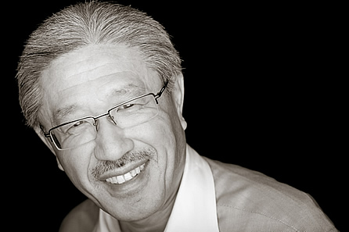
Patient Advocacy Council
Active patient advocacy council (PAC) which reports directly to the Chancellor of Health Affairs : Situation monitoring
Established 2005
Reports to Chancellor

Slide 39
Duke PAC Mission

Slide 40
Examples of PAC activities
Partake in focus groups on end of life issues
Are part of interview team for medical school applicants
Present our patient stories at the orientation of all new staff.
Developed videos on end of life and multicultural issues
advising on new bill forms, new furniture in ICU, discharge forms, new dietary plans., waiting room activities, hospital signage, pre-op brochures…...

Slide 41

Future Hopes at Duke
Reach for the stars!

Slide 42
Implementation of TEAM UP
System wide

Slide 43
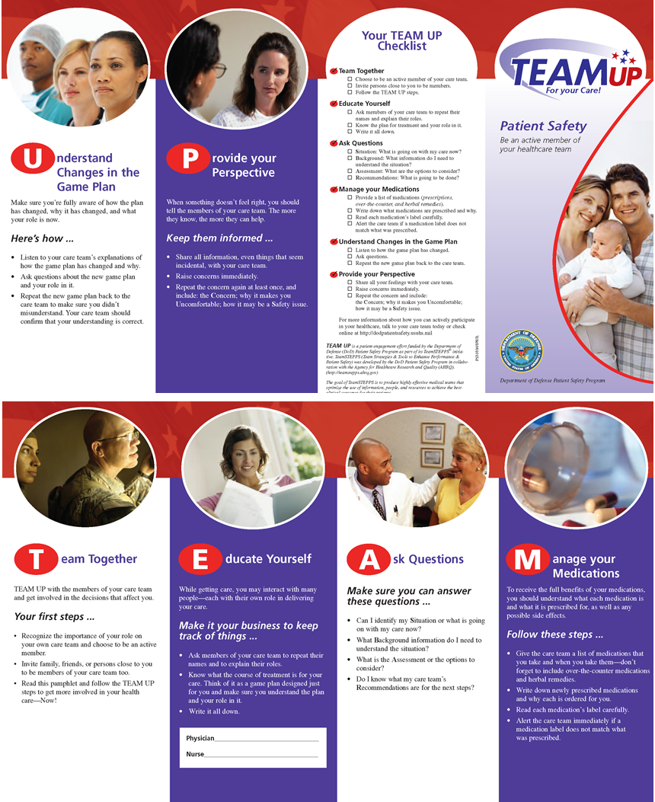
TEAM UP for your Care! Brochure Side 1

Slide 44
TEAM UP for your Care! Brochure Side 2

Slide 45
Duke Implemenetation of TEAM UP
Duke hopes to collaborate with the community to support and advance a common set of expectations and methods for consumer healthcare self-advocacy and self empowerment through the use of TeamSTEPPS skills and language

Slide 46
Steps to Implement TeamUP
Introduce the TeamUP model to care-givers across Duke
Identify how to roll it out across the entire community
Develop TeamUP Master Trainer course
(2-4 hr) for teachers
Develop TeamUP 1 hr class for patients
Develop when/how to give the course(s)
Develop means to include TeamUP guide in arrival etc documents.

Slide 47
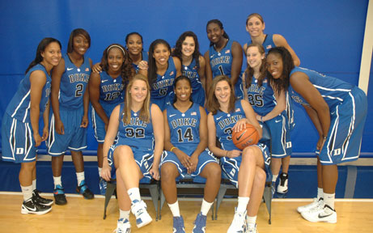

Slide 48
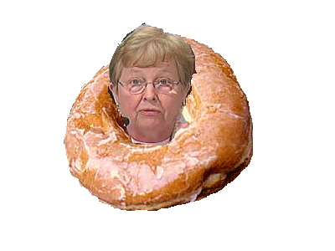

Slide 49
THANK YOU

Slide 51


Partnering With Our Patients
Martin F. Wieczorek MD
Director of Obstetric Education
MacDonald Women’s Hospital
MacDonald Women’s Hospital
October 2010

Slide 52
“Medicine is a team sport”
^{William Mayo, 1910}

Slide 53
We are you. You are us?
  2009-2010: A string of adverse outcomes
  Root Cause Analysis: Team work
  Communication

Slide 54
Old School:
  What’s the matter with you medicine?
New School:
  What matters to you medicine?

Slide 55
MacDonald Women’s Hospital
  One of 11 exclusively women’s hospitals in USA
  4,000 obstetrical deliveries each year
  Under served inner-city population

Slide 56
Googled Teamwork→
  A quick decision
  Sent a diverse group
^{TeamSTEPPS}

Slide 57
MacHouse Goes To Minneapolis
  An eye opening experience
  SBAR, Huddles, Debriefs…Simple and Powerful

Slide 58
What We Accomplished:
  Received authorization to train
  Condensed the master course to fit us
  Weekly training January—June 2012
  Trained 300 individuals

Slide 59
What We Accomplished
- We Listened…
- Mutual Support and Situation Monitoring
- Silos and Missed Opportunities

Slide 60
A Break Through For MacHouse
  No Longer Old School “Rounds”
  Now New School “Bedside Huddle”

Slide 61
TeamSTEPPS…
  The training is about “THE TEAM”.
  Briefs, Debriefs, and Huddles are largely
  not witnessed by the patient.

Slide 62
The Two Key Questions
The Assignment:
  Are we taking care of you OK?
  What can we do better?

Slide 63
…The Pleasant Surprise.

Slide 64
MacDonald Women’s Hospital - HCAHPS

Slide 65
MacDonald Patient Experience Outcomes

