Slide 1
^{WELCOME}
WEDNESDAY PLENARY

Slide 2
Welcome to Dallas
We are happy to welcome you to the TeamSTEPPS National Conference 2013.

Slide 3
Sessions will Address
Plans for successful implementation
TeamSTEPPS place in the evolving landscape of healthcare
Achieving clinical improvements with TeamSTEPPS
Innovative approaches to teaching TeamSTEPPS

Slide 4
Why are We Here? Because TeamSTEPPS Can:
Make healthcare organizations safer, better, and more efficient.
Help provide every patient with care they deserve
Improve the workplace environment and empower the workforce
Make national, state-based, and system-wide quality improvement initiatives succeed

Slide 5
TeamSTEPPS Continues to Grow
This is the biggest TeamSTEPPS gathering to date: over 600 people are registered to attend!
The community has created all of the presentations and posters for this event.
The regional training centers continue to have full houses and long waiting lists.
Recent webinars on the TeamSTEPPS portal have had over 500 attendees.

Slide 6
How We’ve Reached this Point
Frontline providers and visionary leaders who recognized its importance to patient care
Agency for Healthcare Research and Quality and the Department of Defense Patient Safety Programs who invested in its development and spread
Leaders within AHRQ and DoD who are passionate about TeamSTEPPS
James Battles, PhD (AHRQ)
Heidi King, MS, FACHE (DoD)

Slide 7
Thank you
To James Battles, PhD and AHRQ for providing the funds for this conference and the National Implementation
To our partners at IMPAQ International for their support and expertise, especially David Baker, PhD and Andrea Amodeo, MS

Slide 8
TeamSTEPPS National Training Centers

Slide 9
Logistics
Please download the conference app
Lunch will be available for sale in the Venetian Room one level down
A poster display and reception will begin at 4:45PM in the Regency Foyer
Breakfast will be available for sale tomorrow morning in the Regency Foyer as well

Slide 10
We Hope You Enjoy the Next Two Days

Slide 11
Tom Atchison, EdD
Expert in managed change programs, teambuilding, and leadership development
Author, educator, and consultant

Slide 12
How Leaders Create a Culture of Accountability
^{Tom Atchison, EdD}

Slide 13
Success Factors
Leadership
Corporate Culture
Trust
Patient
Experience
Cost Consciousness
Clinical Excellence
Employee/Physician Engagement

Slide 14
Success Factor: Glossary
Leadership=Relationships
Leaders inspire followers; unleash human potential*
Trust=“The benefit of the doubt”
Corporate Culture is the organization’s personality
Teamwork=shared purpose, and clear roles
Employee Engagement =Capability+Capacity+Motivation
Communication=meaning to receiver (85% factor)
ROI=Return on Intangibles
*Note: The most effective parents are great leaders!!

Slide 15
Success Focus—Key Metrics The Patient—Improved Community Health
Patient Experience
--HCAHPS—Respect Rules
--Perception Equals Reality
--Under Promise, Over Deliver
--Safe, best outcomes
--Care Coordination-Integration

Slide 16
 | Organizational Tangibles | Personal Intangibles | Organizational Intangibles
INPUTS | Cash People Policy/Procedures Strategy Plant Information Systems Communications | Meaning Caring Giving | Leadership Mission Values Vision Communication Rewards Recognition
OUTPUTS | Profit Market Share Products Customer Satisfaction Growth Productivity Quality | Inner Peace of Purpose Joy Pride | Culture Followers Commitment Job Satisfaction Team Spirit Trust Quality

Slide 18
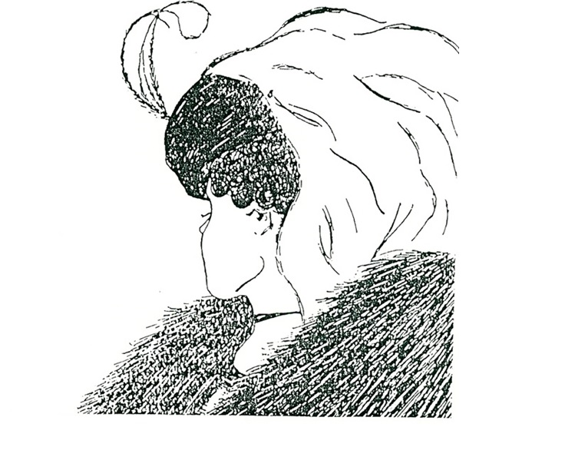

Slide 19
Slumber
Pajamas
Pillow
Nap
Bed
Quiet
Snore
Dream
Blanket
Night

Slide 20
What is Culture? Corporate Culture? Hospital Culture?

Slide 21
Leadership - Definition
“Leaders have trusting followers with aligned values who commit to achieving a vision within a culture of performance ”
-Tom Atchison

Slide 22
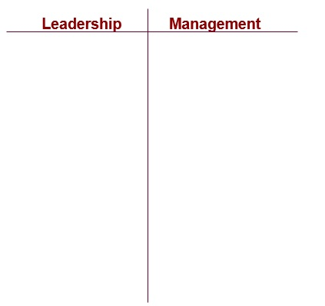
Leadership/Management

Slide 23
Farmer – Soil – Seed

Slide 24
Farmers don’t grow crops.
They create the conditions in which
crops can grow—flourish.
Leaders don’t motivate anyone.
They create cultures that unleash human potential!!

Slide 25
What is Culture? Corporate Culture? Hospital Culture?

Slide 26
Culture--Basics
Evolved from Anthropology to mean all human phenomena that are not genetically determined. It is the way humans represent their lives in symbols, values and behaviors—language, dress, food, religion, commerce--the totality of our “way of life.”
How tradition, values and social practices affect our psyche in ways that unify peoples.
Culture is everything!
Culture is what we do when no one is looking!

Slide 27
USA Culture
Some of the cultural symbols, values and behaviors that define USA’s culture are….Subcultures??

Slide 28
Corporate Culture--Definition
Corporate Culture is the organization’s personality.
It is the behavioral manifestation of an agreed upon set of core values
Makes it possible for trustees, physicians, executives, managers and employees to share the same set of values, and work toward the same goal.
Corporate culture allows a company to capitalize on individuality and create a synergy for the benefit of the customers.

Slide 29
Corporate Culture
Some retail and service organizations that have strong corporate cultures include Starbucks, Zappos, Nordstrom, Ritz, Disney….
Other USA companies….
What values and behaviors make them unique?
What would a company look like if they had a weak corporate culture or multiple subcultures?

Slide 30
Healthcare Culture
A combination of the healthcare organization’s Mission, Values and Vision—held together by trust.
Unique because of the patient and family needs/wants.
Unique because no other industry has physicians.
Remember: Hospitals are not Hotels or amusement parks!!

Slide 31
Culture creation/strengthening is the process of converting Value words to Behaviors.*
It is personality Development—
It takes 3-5 years.
*Note: Words lie—Behaviors never lie!!

Slide 32
Culture Thoughts/Questions
Values and behaviors that define the TeamSTEPPS Corporate Culture are….
How does our Mission and Vision support our Culture of Improved Team Performance?
What symbols/reinforcements are part of our TeamSTEPPS Culture of Performance?

Slide 33
CHANGE=

Slide 34
Dynamics of Change The Easy to Hard Continuum
I want, I understand
I control
I don’t want,
I don’t understand
and
I don’t control

Slide 35
Dynamics of Change The Anxiety/Behavior Continuum
Happy -
individuals
resist change
Angry -
individuals
resist change

Slide 36
Pride Indicators*
1 – Strongly Disagree | 2 – Disagree | 3 – Uncertain | 4 – Agree | 5 – Strongly Agree
I have a sense of loyalty to this company.
I identify with this company.
I think about the future of this company.
I’ve regretted that I chose to work for this company. (reversed scoring)
I do extra work here because I want this company to succeed.
I feel that I share in the success and failure of this company.
I feel a sense of ownership in this company.
It would take very little for me to move to another company.
I take pride in being part of this company.
*Any indicator less than 4.0 needs to be addressed
© MetriTech

Slide 37
Homework Group Exercise: Strengthening TeamSTEPPS
1.What is currently good and needs to continue to strengthen engagement? “Sacred cows”
2. What is good but could be made better easily? “Low fruit”
3. What doesn’t exist, but would help greatly? “Mid-range”
4. What exist but needs to be removed? “Toxins”

Slide 38
Learnings I want to remember….
Application to my current role/responsibilities….
Questions????

Slide 39
References
Basic: Good to Great, Jim Collins
Exceptional Leadership…, Carson Dye
Inside the Physician’s Mind, Joe Bujak, MD
The Checklist Manifesto, Atul Gawande, MD
Patients Comes Second, Spiegelman and Berrett
Intermediate: How the Mighty Fall, Jim Collins
Active Listening, Michael Hoppe
Onward, Howard Schultz
Leadership’s Deeper Dimensions,
Tom Atchison
Advanced: Great by Choice, Jim Collins
The Speed of Trust, Steve Covey, Jr
Let My People Go Surfing, Yvon Chouinard
Emotional Intelligence, Daniel Goldman
The Zappos Miracle, Shinobu Ishizuka
The Advantage, Patrick Lencioni

