Slide 1

Implementation Tricks: From Start-Up to the Tipping Point
^{Ross Ehrmantraut, RN, CCRN}
Jeanie Haggan, RN, MHA, MS, CPHQ
Kathy J. Nunemacher, MSN, RN, CPN, CPHQ

Slide 2

Start With a Focus
Ross Ehrmantraut, RN, CCRN
Patient Safety Officer
Harborview Medical Center – UW Medicine
Seattle, WA

Slide 3

Harborview Medical Center
Harborview Medical Center is owned by King County, governed by the Harborview Board of Trustees, and managed under contract by the University of Washington

Slide 4
WAMI Region
Only Level I adult and pediatric trauma and burn center in region
  Washington, Alaska, Montana and Idaho.

Slide 5
Harborview Medical Center
Licensed beds 413
Employees 4,432
Physicians 1,216
Admissions 19,424
ED visits 65,515
Clinic visits 224,769
Surgery cases 13,455
Approximately $190 million in charity care in 2011

Slide 6
Regional Burn Center
45 bed Burn Center
  18 Critical Care
  27 Acute Care
Approximately 200 staff/MDs
  RNs, Social Work, Residents, Dieticians, pharmacists, PT/OT, housekeepers, CNAs, rehabilitation psychologists

Slide 7
Communication Breakdowns
Culture of Safety identified communication and nonpunitive environment were biggest issues
    Utilized Team Perception Questionnaire
      Further review found a breakdown in communication between disciplines
  Had tried other solutions
    Consulting companies

Slide 8
Will TeamSTEPPS help change the culture?
Medical Director of Burn Center met with PSO, who is a Master Trainer about implementing TeamSTEPPS
After initial discussions, a meeting was set up with Burn Team Leadership along with hospital administration
  The goal was to get commitment from administration and BTL

Slide 9
Development of the Change Team
Staff RNs
Physical Therapist
Occupational Therapist
Pharmacist
MD
Nurse Manager
Nurse Practitioner

Slide 10
SWOT Analysis
STRENGTHS (i.e. Attributes of our team and our systems that should assist in achieving our project goal) | WEAKNESSES (i.e. Attributes of our team and our systems that could deter us in achieving our project goal & may need to be addressed)
“Can do” attitude Rounds 2X per week Familiarity of staff & MDs Clinic > 8E ICU > 8E Expectations of positive patient outcomes International reputation MD buy-in with splinting Patient Advocacy – patients have many strong advocates Interdisciplinary/Multi-disciplinary approach Exposure to Attendings Pride in our work | Stress during wound rounds – difficulty in communication Focus on wounds Effects on patient Discomfort with asking questions Staffing Level & Experience (insufficient critical thinking skills) Openness to new ideas Paternalistic attitudes toward DC – “bomb proof” Inconsistency of treatment providers Unclear expectations during grand rounds Welcomeness of new information during grand rounds RN buy-in – splinting Comparison of MD personality and practice Increased expectations of MDs (due to a lot of presence) Inflexible older staff Feedback perceived as negative – also opportunity Inconsistent practice standards
OPPORTUNITIES (Conditions that can be leveraged to assist in achieving our project goal) | THREATS (Conditions that can deter us in achieving our project goal & may need to be addressed)
RN introduction during wound rounds More team building opportunities Ongoing education – splinting/wound care Improve critical thinking skills Provide feedback to “close the loop” with bedside staff Improve cross discipline communication | Peoples’ (i.e. staffs’) anxiety to get their priorities met – interrupts other priorities brought up with wound rounds Ongoing educational needs Staffing matrix on 8E different Staff worn out - compassion, fatigue, burns/kids is emotionally draining

Slide 11
Burn Center – TeamSTEPPS Implementation Project Goal
To improve trust and communication across disciplines in order to
increase patient safety; improve patient outcomes; and improve patient and staff satisfaction.
Environmental Scan/SWOT Analysis (Focus on Splints and Wound Rounds)
Stress during wound rounds – difficulty in communication
  Focus on wounds
  Effects on patient
  Discomfort with asking questions
STRENGTHS (i.e. Attributes of our team and our systems that should assist in achieving our project goal) | WEAKNESSES (i.e. Attributes of our team and our systems that could deter us in achieving our project goal & may need to be addressed)
“Can do” attitude Rounds 2X per week Familiarity of staff & MDs Clinic > 8E ICU > 8E Expectations of positive patient outcomes International reputation MD buy-in with splinting Wound rounds improved flow and communication over the last few years Patient Advocacy – patients have many strong advocates Interdisciplinary/Multi-disciplinary approach Exposure to Attendings Pride in our work | Stress during wound rounds – difficulty in communication Focus on wounds Effects on patient Discomfort with asking questions Staffing Level & Experience (insufficient critical thinking skills) Openness to new ideas Paternalistic attitudes toward DC – “bomb proof” Inconsistency of treatment providers Unclear expectations during grand rounds Welcomeness of new information during grand rounds RN buy-in – splinting Comparison of MD personality and practice Increased expectations of MDs (due to a lot of presence) Inflexible older staff Feedback perceived as negative – also opportunity Inconsistent practice standards
OPPORTUNITIES (Conditions that can be leveraged to assist in achieving our project goal) | THREATS (Conditions that can deter us in achieving our project goal & may need to be addressed)
RN introduction during wound rounds More team building opportunities Ongoing education – splinting/wound care Improve critical thinking skills Provide feedback to “close the loop” with bedside staff | Peoples’ (i.e. staffs’) anxiety to get their priorities met – interrupts other priorities brought up with wound rounds Ongoing educational needs Staffing matrix on 8E different Staff worn out - compassion, fatigue, burns/kids is emotionally draining
Peoples (i.e. staffs’) anxiety to get their priorities met – interrupts other priorities brought up with wound rounds
RN introduction during wound rounds

Slide 12
Initial Tools implemented
Briefs
Huddles
Debriefs
Call outs
Check backs
Cross checks

Slide 13
With Early Success
The momentum gave us an opportunity to:
  Improve “close the loop” communication and improve splint therapy
    Call out
    Check back
    Cross check
  Implement debriefs for post burn resuscitations
  Include family and patients in TeamSTEPPS training for hand hygiene

Slide 14
Start With A Focus
Identify one area/project and focus with a few tools
  Expand from these successes

Slide 15
Take home message
Utilize culture of safety data to identify specific areas for improvement
Recruit leadership champion (i.e. Medical Director of Burn Center)
Encourage completion of SWOT analysis early on to help establish a focus
Start with a focus and expand out over time

Slide 16
Thank You
Questions?

Slide 17


Quick Steps to Team STEPPS
Jeanie Haggan, RN, MHA, MS, CPHQ
Patient Safety Coordinator
Adult Emergency Department
Yale-New Haven Hospital

Slide 18


Flagship member of the Yale New Haven Health System
Not-for-Profit Hospital Founded in 1826
Located in New Haven, CT
1541 Beds
Primary Teaching Hospital of the Yale School of Medicine
Magnet-Designated by the ANCC

Slide 19
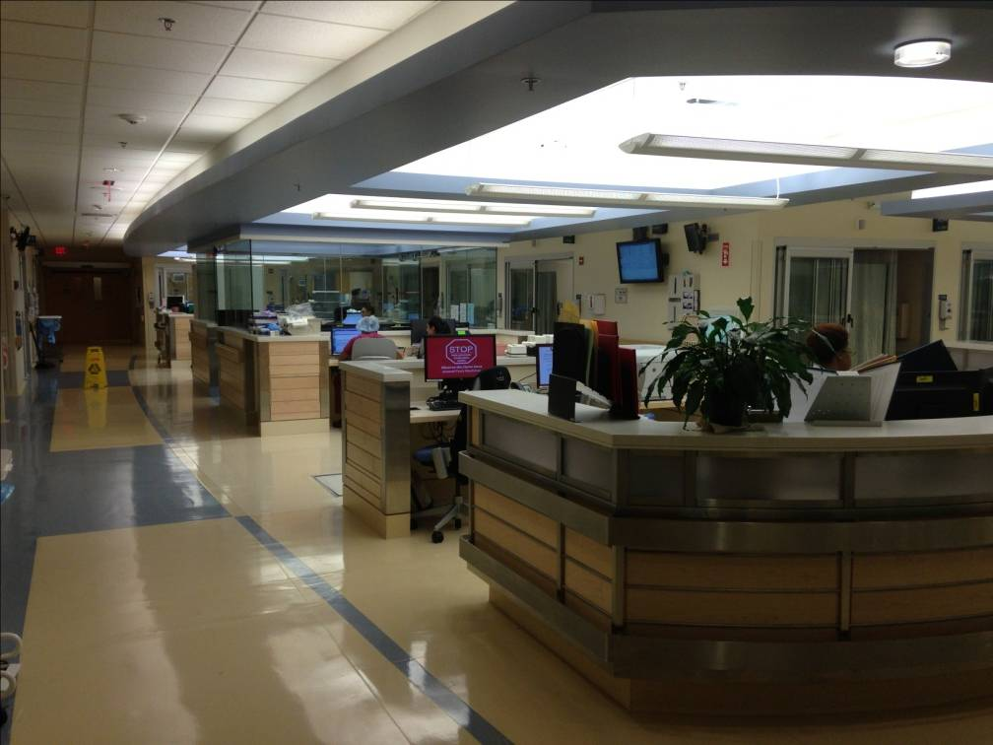

Yale New Haven Hospital
Emergency Department
York Street Campus – Adult ED
  Level I Trauma Center
  85K Visits Annually
  82 Exam Rooms
    4 Resuscitation / Trauma Rooms
    6 Chest Pain Center Beds
    6 Urgent Care Beds
    12 Crisis Intervention Beds
Shoreline Medical Center – Adult & Pediatrics
  25K Visits Annually
  9 Exam Rooms + 4 Fast Track
Get a Yale Emergency Med logo ?

Slide 20
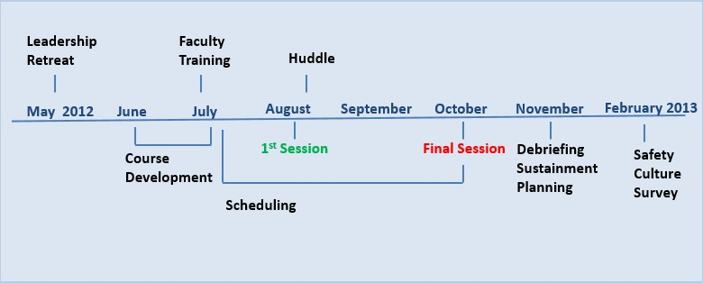
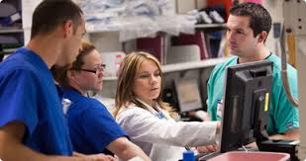
Our Team STEPPS Journey

Slide 21
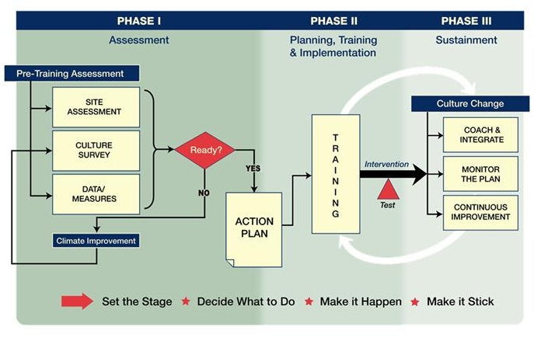
Shift Towards a Culture of Safety in 3 Continuous Phases
Notes:
Initiative occurs in three continuous phases and is based on the principles of improving patient safety and quality of care by improving healthcare processes
A TeamSTEPPS Initiative occurs in three continuous phases:
Phase I — Assessment (Set The Stage)
This phase determines our organizational readiness for the initiative.
Create a change team (the leaders and key staff who will drive the initiative).
Identify a specific opportunity for improvement that could be accomplished through better teamwork.
Formulate a vision for the initiative.
Use site assessment tools to determine if the necessary leadership support, information base, and resources are in place.
[Note: It is important to identify a specific opportunity for implementing TeamSTEPPS (i.e., a problem to fix).]
Phase II — Planning, Training, and Implementation (Decide What To Do and Make It Happen)
This phase is where planning and execution take place.
Develop an Action Plan specifying what will be done during the initiative (based on guidance from the TeamSTEPPS Implementation Guide).
Conduct training, implement the tools and strategies selected, and test the intervention.
Phase III — Sustainment (Make It Stick)
This phase is designed to sustain and spread the improvements in teamwork performance, clinical processes, and outcomes throughout the organization.
Users will integrate teamwork skills and tools into their daily practice.
Monitor and measure the programs ongoing effectiveness.
Develop an approach for continuous improvement and spread the imitative throughout the unit or organization.
TeamSTEPPS is an initiative designed to change how our teams work together on an ongoing basis. It’s not just about the training but about providing sufficient time for teams to continue to practice the teamwork tools and strategies in their daily work. For example, its important to have a change agent who leads periodic meetings for a few months after the training to discuss how the team is performing and using the tools.

Slide 22
Phase I Assessment
Goal - To determine readiness to undertake TeamSTEPPS initiative.
Key Actions
Department Responsibility
Collect data to support the need
  Safety Culture Survey
  Data Measures
    Team Perceptions Questionnaire
    Team Observation Tool
    Dept data - (pt satisfaction scores, LOS, Door to Admission)
Define process(es) to fix
Schedule Retreat for Stakeholders with SYN:APSE
Allocate Resources and Personnel
  Local Leadership & Staff
  Simulation Center Team

Slide 23
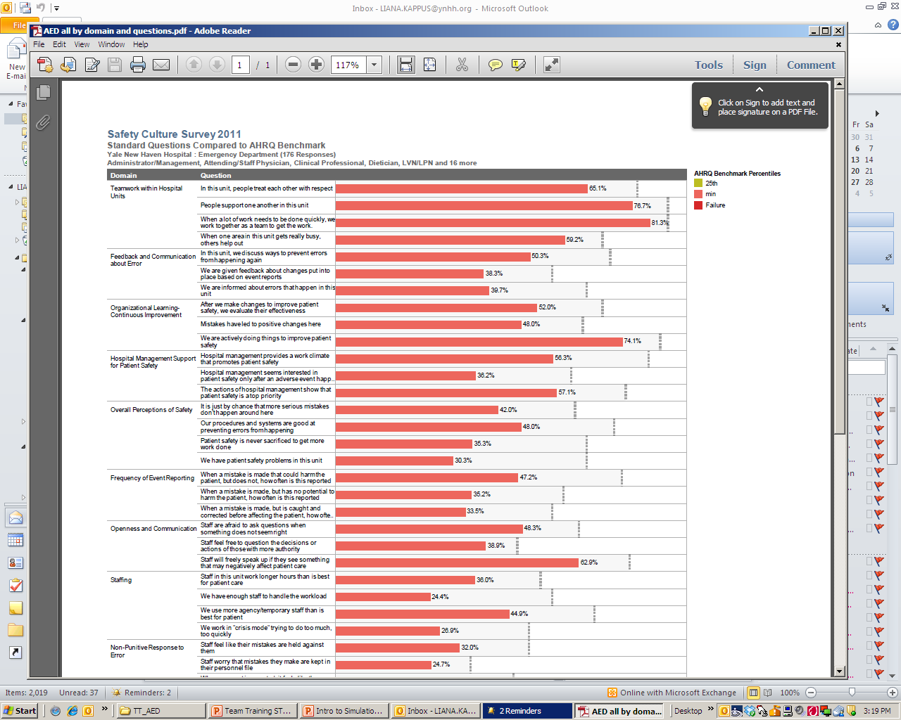
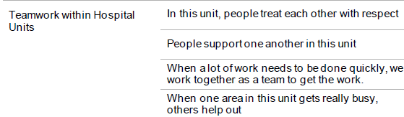
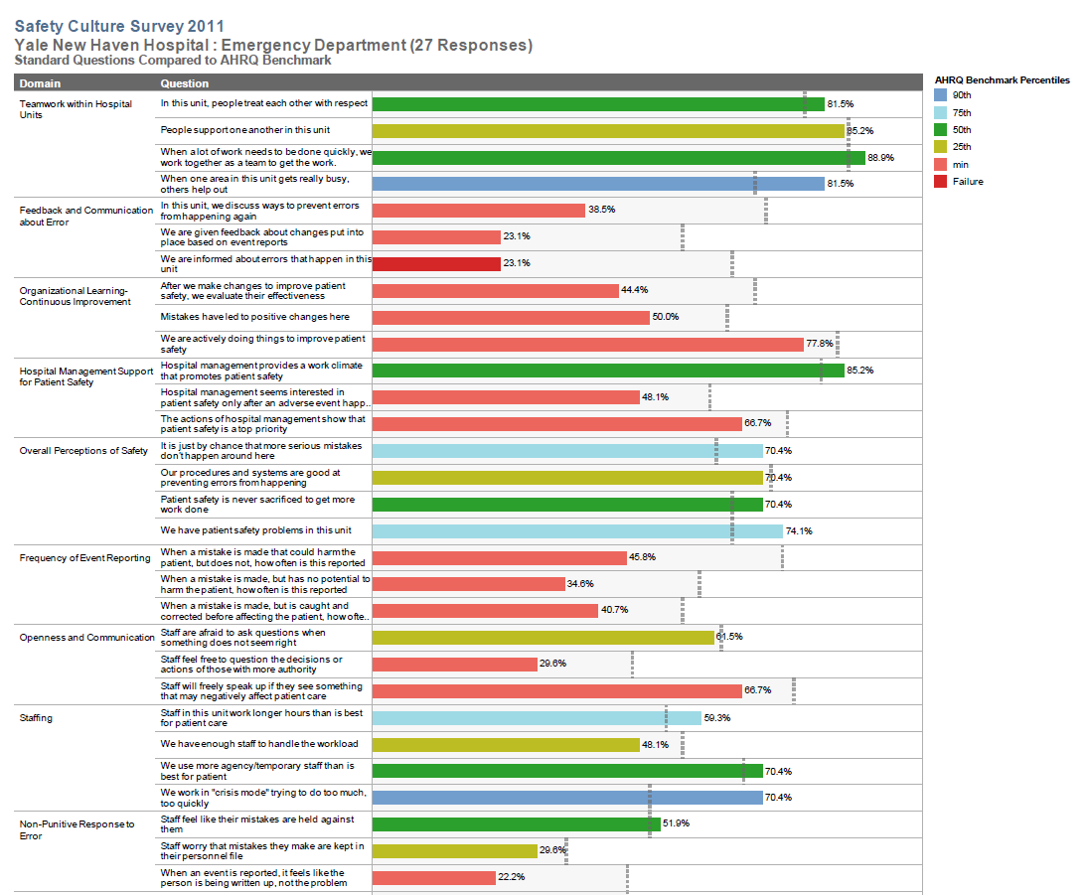
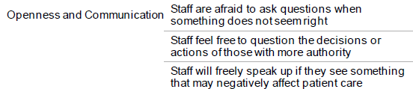
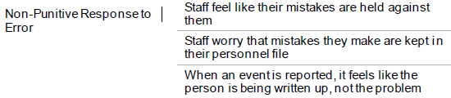
Why Teamwork Training in ED at YNHH?

Slide 24
Leadership Retreat – May 2012
Objectives:
  To provide an historical overview of Teamwork Training
  To Discuss rationale for Teamwork Training in the AED
  To learn & practice specific teamwork tools and strategies
  To prioritize issues using the safety culture survey data and define goals of AED teamwork training initiative
Notes:
Critical component was the Leadership Retreat. SYNAPSE Center requires that the leadership team participate in a retreat to ensure that true commitment is there before proceeding with any planning or training. They will not work with your department if you do not agree to this step.
We had a false start in 2010 – applied for training, were accepted but leadership was not committed to the process at that time – competing priorities - no funding for travel for trainers or training staff on site.

Slide 25
Leadership Retreat
Key Department Leadership & Stakeholders
  Department Chair & Vice Chair
  Medical Director
  Nursing Service Director
  Patient Service Manager
  Service Line Educators
  Patient Safety Coordinator
Notes:
Retreat led by SNAPSE Center at their sim lab
Face to Face commitment – what is expected from the dept & SYNAPSE

Slide 26
Phase II Planning, Training, and Implementation
Goals – (1) to develop an Action Plan for Initiative
Key Actions
Department Responsibility
Identify Target Audience
Create a Change Team
  Leadership
  Identify Faculty
  (1MD/1RN per 80 participants)
  Coordinator / Master Scheduler
Key Actions
Department and SYN:APSE
Communication Plan
Train Faculty
Design the Intervention
Develop Plan for Testing Effectiveness
Develop an Implementation Plan (Department Specific SBTT)
Develop Plan for Sustained Continuous Improvement
Notes:
Create Change Teams
Assemble departmental Change Teams comprised of leaders and staff members with the authority, expertise, credibility, and motivation necessary to drive a successful Teamwork Training Initiative.
Multidisciplinary. Should include physician, nursing, and allied healthcare professionals
Change Team will focus on improving processes within their own clinical workspace.
Clinical content experts who have credibility and direct involvement in the processes that will be affected by the team training intervention
**Must identify a primary local coordinator for overall orchestration, scheduling, logistics etc. (i.e. patient safety RN)

Slide 27
Phase II Planning, Training, and Implementation
Goal – (2) to conduct simulation-based team training (SBTT)
Key Actions
Department and SYN:APSE
Determine Training Strategy
  Determine # of Courses / Frequency
  Design Clinical Scenarios
  Determine Location
  Schedule Interdisciplinary Participants
Notes:
Create Change Teams
Assemble departmental Change Teams comprised of leaders and staff members with the authority, expertise, credibility, and motivation necessary to drive a successful Teamwork Training Initiative.
Multidisciplinary. Should include physician, nursing, and allied healthcare professionals
Change Team will focus on improving processes within their own clinical workspace.
Clinical content experts who have credibility and direct involvement in the processes that will be affected by the team training intervention
**Must identify a primary local coordinator for overall orchestration, scheduling, logistics etc. (i.e. patient safety RN)

Slide 28
Planning Team
MD Champion / Director Patient Safety & Quality
Patient Service Director
Pt Safety Coordinator
Service Line Educator
SYN:APSE Director of Simulation
SNY:APSE Simulation Learning Consultant

Slide 29
Course Development – June 2012
Three Hour Program
  1 hour didactic
  2 Simulated Scenarios
  Video Based Debriefing Sessions
Didactic Section
  Brief history of team training & application in health care / ED setting
  Team STEPPS tools with discussions on applications in our ED
2 Simulated Scenarios
  Utilized event reporting data and peer reviewed cases
  Incorporated opportunities to utilize communication tools

Slide 30

Scenario Design and Trigger Events
Trigger - A prompt to elicit a targeted response by a learner
Embed triggers within a scenario
Allows facilitator to control scenario events to ensure learning objectives are met
Focuses attention on pre-determined critical events and targeted behaviors (Team STEPPS tools)

Slide 31
“William James”
“The patient will initially present with vital signs & history that point to pneumonia. He is actually in early sepsis. During the scenario, he will have a change in status (progressive hypoxia and hypotension with persistent tachycardia). By the end of the scenario, we hope that all staff will have a shared mental model that the patient has early sepsis. Team members will enter and exit at specified times to simulate actual practice. However, a critical lab value will be introduced when the nurse is out of the room. We will observe to see if this data is shared to create a shared mental model of patient’s clinical diagnosis. At the end of the scenario we will introduce a trigger for patient identification related to antibiotic delivery by a confederate RN to assess cross-monitoring and assertion. “

Slide 32
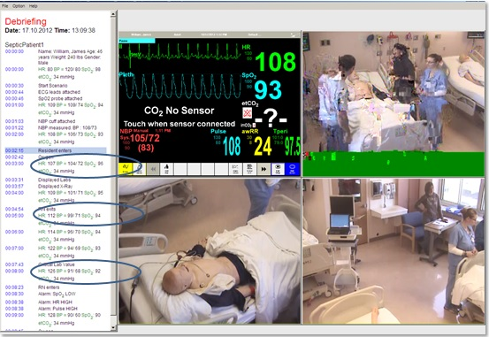
Video-Based Debriefing
Fosters self-reflection
Clarifies what to set the context for why
Allows facilitator to mark video with Trigger events

Slide 33
Faculty (17)
Each Course was taught by RN / MD (PA) pair
  6 Attending MDs
  3 ED Staff RNs
  2 ED Techs
  2 Service Line Educators
  1 PA
  1 Patient Safety Coordinator
  1 Patient Service Director
  1 Patient Service Manager

Slide 34
Faculty Development – July 2012
8 Hour Training Course
  Trainers participated in the 3 hour course as a student
  Walk through of the course content from trainer perspective
    Confirm understanding of materials
  Feedback & Tweaking of Course Materials
Follow Up Practice Sessions / Run Through
Observations (1-2 sessions)
Ongoing mentoring & support
Notes:
Faculty class in early July. Used their feedback to revise the course.
Group practice sessions offered – read through materials, practice in SIM lab – ****Not all instructors had done this so we had to reschedule some of the early classes so they could sit in as an observer first.
It was critical given the short session time that we cover all of the materials and cover them in a standard way.
Perception that MDs didn’t need practice due to teaching that they do & that it was just the non-teaching staff that needed the practice. NOT TRUE! MDs actually wanted the practice time so they were familiar with the material.

Slide 35
Schedule : August – October 2012
12 Weeks - 46 Three Hour Sessions
Monday / Wednesday
Three sessions per day
  08:00 - 11:00
  12:00 – 15:00
  16:00 – 19:00
Required all sessions be multidisciplinary
Notes:
Needed group to work as a team, breaking down silos
First time we had done any interdisciplinary training.
Incorporated all roles in the scenario
All classes were multidisciplinary, desired 10-12 participants per class but varied. Ranged from 4-12.

Slide 36


Scheduling
Coordinated scheduling via:
  Lead PA for Midlevel Providers
  Administrative Assistant for Medical Staff
  Chief Resident - Residents
  Service Line Educator for RNs and EDTAs
Master Schedules for Trainers & Participants
Pre-Cognitive Materials & Welcome Letter
Dropbox.com
Notes:
Lead PA used Survey Monkey & allowed Midlevels – PROBLEM – since PA created the survey poll the proj mgr didn’t receive the updates and had to continuously check back to see if there were changes. Had a few errors when Midlevel staff changed the schedule and a course was canceled due to lack of sign ups, staff weren’t notified.
Errors transcribing info from one schedule to the Master.
All participants received an email 1 week prior to the course reminding them about their course date/time/location, reading materials (staff roles) and asked them to take TPQ online prior to class.
Attempted to use Drop Box for Master Schedule – Not all planning team members had access. Point Person / Project Mgr
Constant cross checking required

Slide 37
Project Coordinator
Master Schedules
  Faculty & Participant
Ensures full complement of caregivers
Sends reminders / confirmations / Pre-cognitive materials
Monitor attendance & rescheduling
Called Huddles & Debriefs with Planning Team
50,000 ft view
Notes:
Other suggestions:
Provide an infrastructure to support training.
Think about Allowing time for staff to attend training (nurses, physicians, key personnel).
Providing time for coaches to meet with staff members on an ongoing basis.
**Must identify a primary local coordinator for overall orchestration, scheduling, logistics etc. (i.e. patient safety RN)

Slide 38
Phase II Planning, Training, and Implementation
Goal – (2) to conduct simulation-based team training (SBTT)
Key Actions
Department & SYN:APSE
Determine Training Strategy
  Determine # of Courses / Frequency
  Design Clinical Scenarios
  Determine Location
  Schedule Interdisciplinary Participants
Notes:
Create Change Teams
Assemble departmental Change Teams comprised of leaders and staff members with the authority, expertise, credibility, and motivation necessary to drive a successful Teamwork Training Initiative.
Multidisciplinary. Should include physician, nursing, and allied healthcare professionals
Change Team will focus on improving processes within their own clinical workspace.
Clinical content experts who have credibility and direct involvement in the processes that will be affected by the team training intervention
**Must identify a primary local coordinator for overall orchestration, scheduling, logistics etc. (i.e. patient safety RN)

Slide 40
Safety Culture Survey SMC 2011 / 2013

Slide 41
Results for SMC 2013
SAQ - Shoreline | 2011 | 2013
In this unit, people treat each other w/ respect | 81.5% 50th | 83.3% 75th
People support one another on this unit | 85.2 % 25th | 95.8% 90th
When a lot of work needs to be done quickly, we work together as a team to get the work done | 88.9% / 50th | 100% Stretch

Slide 42
Safety Culture Survey for AED YSC 2011/2013

Slide 43
Phase II Planning, Training, and Implementation
Goal – (3) implement a TeamSTEPPS Intervention.
Key Actions
Department Responsibility
Implement Improvement Intervention
Tools Adopted by AED
Formal Uninterrupted briefs at change of shift
Debriefing at end of shifts
Problem solving huddles
Communication Tools
  Call-out / check-back (closed loop communication) / 2-Challenge / CUS
Mutual Support / Task Assistance
Notes:
Create Change Teams
Assemble departmental Change Teams comprised of leaders and staff members with the authority, expertise, credibility, and motivation necessary to drive a successful Teamwork Training Initiative.
Multidisciplinary. Should include physician, nursing, and allied healthcare professionals
Change Team will focus on improving processes within their own clinical workspace.
Clinical content experts who have credibility and direct involvement in the processes that will be affected by the team training intervention
**Must identify a primary local coordinator for overall orchestration, scheduling, logistics etc. (i.e. patient safety RN)

Slide 44
Phase III Sustain, Monitor, Coach, Integrate
Goal - to sustain and spread improvements in teamwork behavior and in associated clinical processes and outcomes resulting from the Initiative
Key Actions
Department Responsibility with SYN:APSE Support
Teamwork Coaching
Integration of tools into Existing Processes
Reinforcement and Rewards
Continuous Improvement
Interval simulation practice with SYN:APSE
Notes:
Create Change Teams
Assemble departmental Change Teams comprised of leaders and staff members with the authority, expertise, credibility, and motivation necessary to drive a successful Teamwork Training Initiative.
Multidisciplinary. Should include physician, nursing, and allied healthcare professionals
Change Team will focus on improving processes within their own clinical workspace.
Clinical content experts who have credibility and direct involvement in the processes that will be affected by the team training intervention
**Must identify a primary local coordinator for overall orchestration, scheduling, logistics etc. (i.e. patient safety RN)

Slide 45
Lessons / Key Take Aways
Timing of Program
  Department faced multiple competing major projects
    Implementation of new Hospital-wide electronic medical record (Epic)
    Completion of construction / renovation project & work flow changes
  Not enough time for Team STEPPS Culture to be embedded in the Department way of life

Slide 46
Lessons / Key Take Aways
Importance of Leadership Retreat
Apply Team STEPPS to Team STEPPS planning!
  Project Coordinator role identification
Challenges of Scheduling
  Master Schedule
  Access to Master Schedule
Faculty practice sessions
TPQ Data Collection
  Use Online survey

Slide 47
Questions?
Contact Info:
Jeanie.haggan@ynhh.org
203-688-9215

Slide 49
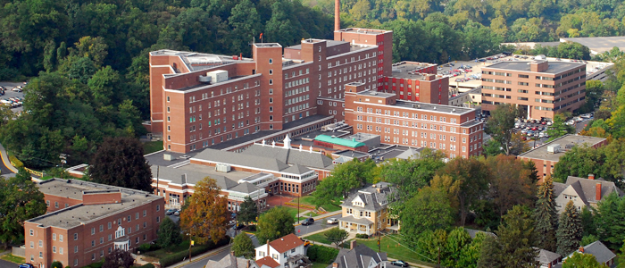

TeamSTEPPS:
From Start up to Tipping Point
Kathy J. Nunemacher, MSN, RN, CPN, CPHQ
Bethlehem, PA
June 12, 2013
Notes:
49
Welcome!

Slide 50
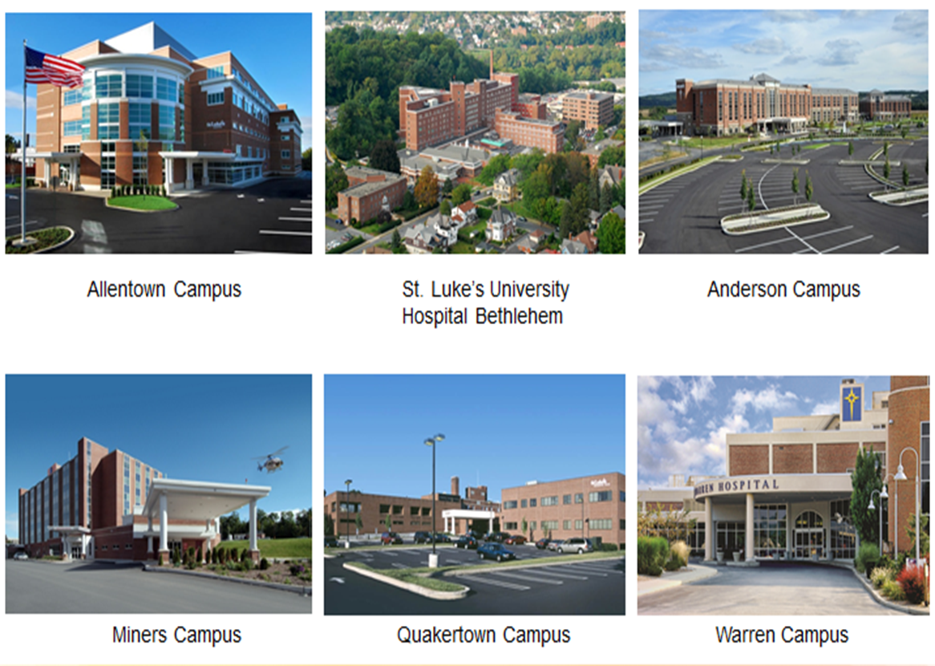
St. Luke’s University Hospital & Health Network
Large academic tertiary care system with six campuses in PA and NJ
Only Medical School in the Region: Temple-St. Luke’s, affiliated with Temple University
Oldest Diploma School of Nursing in Country plus affiliation with Moravian College Department of Nursing

Slide 51
Objectives
The participant will understand the term scalability and it’s application to teaching teamSTEPPS concepts and ideas
The participant will understand how to maintain oversight of the TeamSTEPPS program roll-out and be exposed to strategies to address varying levels of adoption.
The participant will learn how one hospital system leveraged technology to meet the needs for ongoing TeamSTEPPS implementation

Slide 52
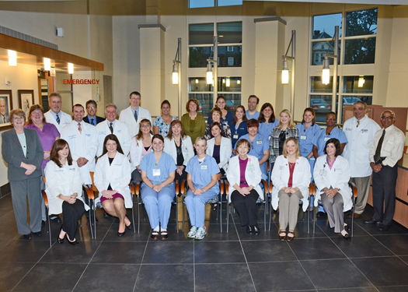
Why TeamSTEPPS?
Potential High Risk Climate for Safety and Liability Claims
Need to get away from time honored medical model
Time is now to CHANGE the way we think about delivering Healthcare with ultimate goal………
A highly reliable TEAM

Slide 53
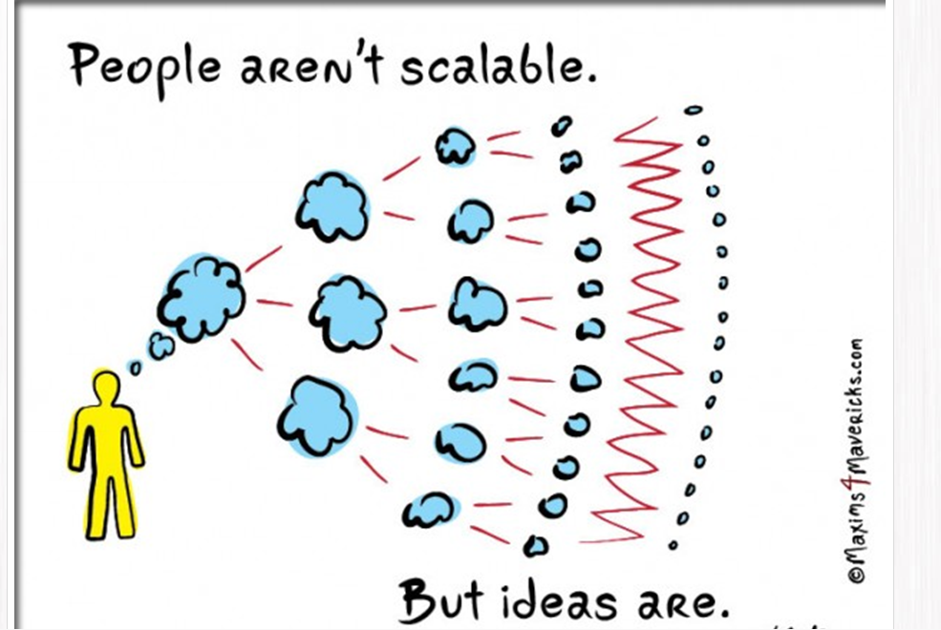
Scaling a Good Idea- Teaching TeamSTEPPS
Ideas are just that ….ideas but Execution matters
Small, simple steps – scaling yourself, your teams and the concept
Scalability is
…a desirable property of a
system, a network or a
process, which indicates its
ability to either handle
growing amounts of work in
a graceful manner, or to be
readily enlarged
Notes:
.

Slide 54

Culture of Learning and Safety

Slide 55
TeamSTEPPS Initial Pilot Project
Started with AHRQ HSOPS Baseline Survey- Nov. 2008
TeamSTEPPS training pilot in Obstetrics 2009
Resurvey: HSOPS - 2010, HSOPS - 2011, smaller home-grown elearning survey 2012
Phased in roll out based
Service Line approach….

Slide 56
Timeline & Main Concepts
Teach
Baseline Culture of Safety Survey
Fundamentals/Train the Trainer Sessions
Spread
Staff Roll out Sessions
Specific Tools Highlighted to make it Stick
Sustain
Re-survey at approx. 18 months after initiation
Develop annual competency – in person for new staff and residents and online for others

Slide 57
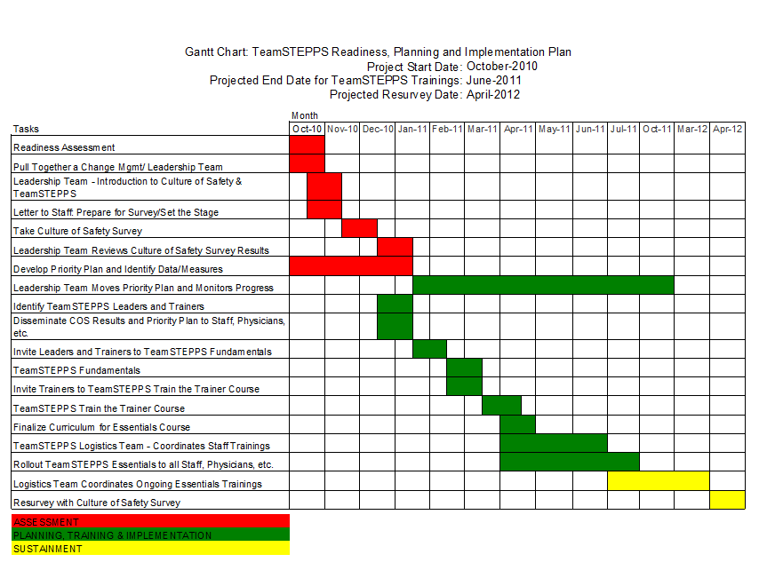

Departmental Gannt Chart
Notes:
Type of chart used for Project Management
Shows start and finish dates and
Summary elements of the project
May have specific start/finish date or projected range for completion

Slide 58
Strategies for Successful Roll Out
Required logistics team on floor for streamlined management of roll-outs
Managers required to develop written action plan and report back
TeamSTEPPS tools practiced - ex. , Briefs, Huddles, and PERRT – perinatal rapid response team
Formal TeamSTEPPS posters ordered and pocket guides on units

Slide 59


Pictures Can Be Memory Aids…
First picture tells one story…..
Team Work & Collaboration

Slide 60
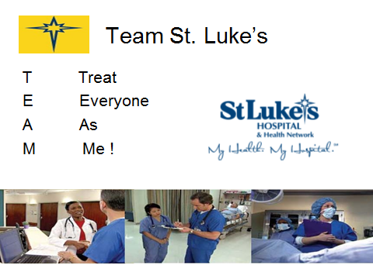
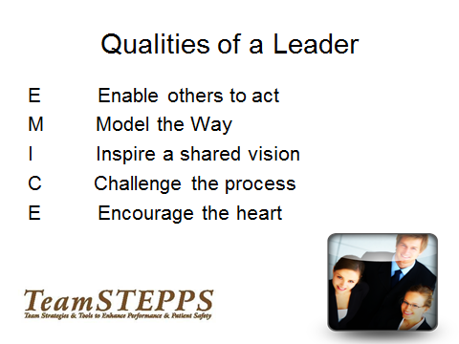
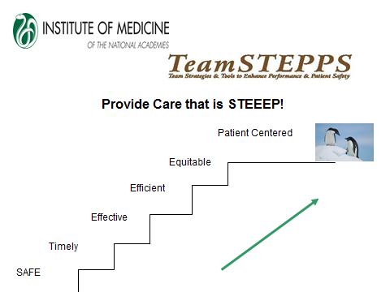
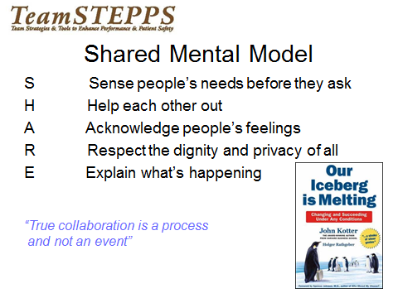
Professional Posters Created

Slide 61
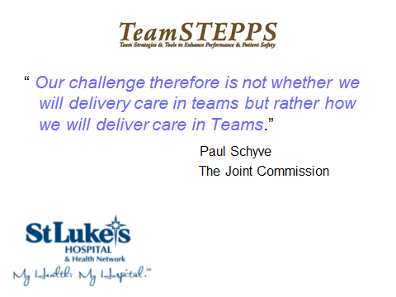
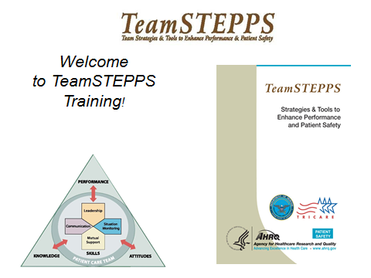

Slide 62
Oversight of programs
TeamSTEPPS consultants= Quality Resources Staff
Face to Face meeting with managers
Q.R. support for Logistics' Team
“Close the Loop” communications
TeamSTEPPS specifics such as SBAR and Huddles as a “Way of Life”
Measure and report your success
mmm…. maybe I should call a Perinatal Rapid Response?
Important!
Mandatory Second Stage of Labor Huddles start
Dec. 15, 2010!

Slide 63

Spreading the Concepts
Tipping Point – (disambiguation)
Malcome Gladwell (2000) defines tipping point as the
“moment of critical mass, the threshold,
the boiling point”
Ideas, processes and even behaviors can spread like viruses --- the law of the few (80/20 principle)
Power of context – “Are you sensitive to what is going on around you”
Need the stickiness factor – those cute penguins!

Slide 64

Tipping Point
Strong Leadership Support - Obstetrics and Vice President of Quality
VP/CQO – decides which high-risk areas go next for TeamSTEPPS training sessions and roll out
Commitment from managers and other inter-professional leaders to make the training happen
Roll-outs – 2-4 months, quick implementation time
Continue to monitor…..

Slide 65
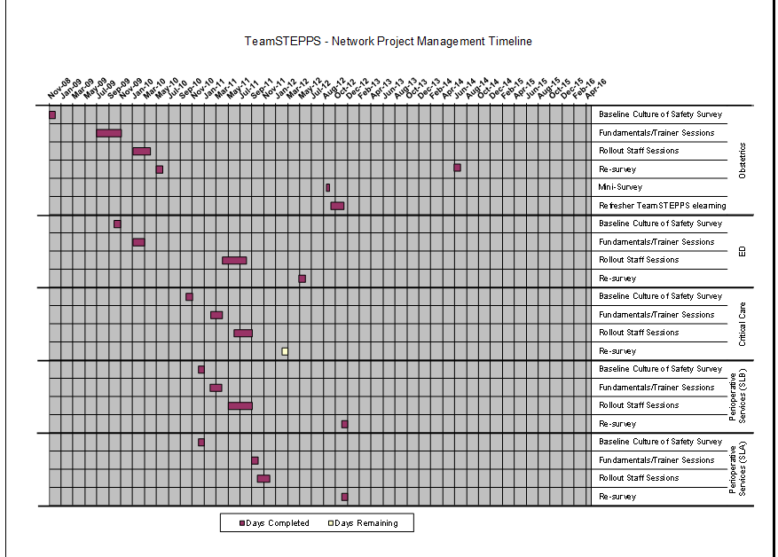
Further Roll-outs Planned

Slide 66
Have we reached the tipping point?
From a Culture of safety to a Just Culture of Safety!
Success of Obstetrics Department year after year, encouraged spread to other departments, campuses etc.
Keep emphasizing Kotter’s Change Management Concepts
Requests from residency program, other departments for training (bottom up requests have started…..)
Plan is in place for train the trainer concepts, pilot in place for online course

Slide 67
Leveraging Technology with E-learning
Idea for e-learning TeamSTEPPS refresher since beginning but timing wasn’t right…
Right people in the right positions – expertise of web designer!
ROI analysis submitted to allow project approval
Meetings to create intranet site for department and network wide education
Presentations customized and recorded by nurse educator/champion, quality improvement coordinator and residency education program director

Slide 68
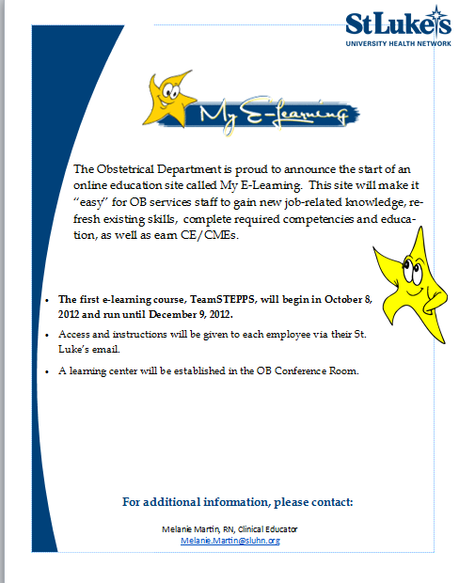
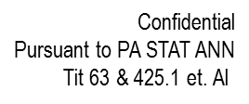
Getting the word out……

Slide 69

Getting Started- Online

Slide 70
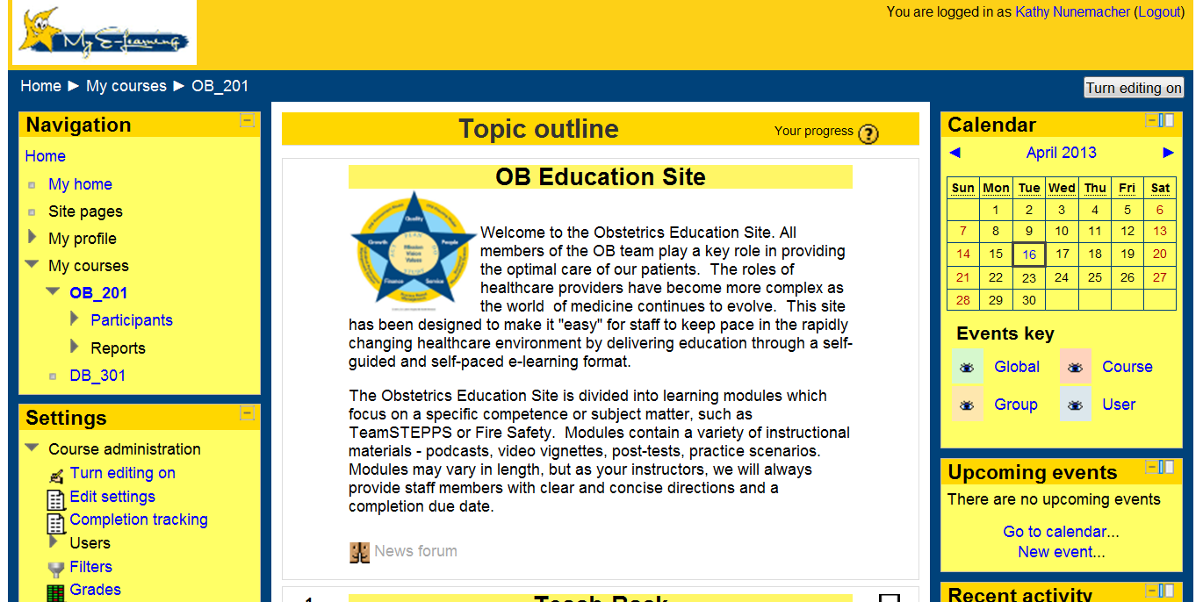
Department Site – My courses
TeamSTEPPS

Slide 71
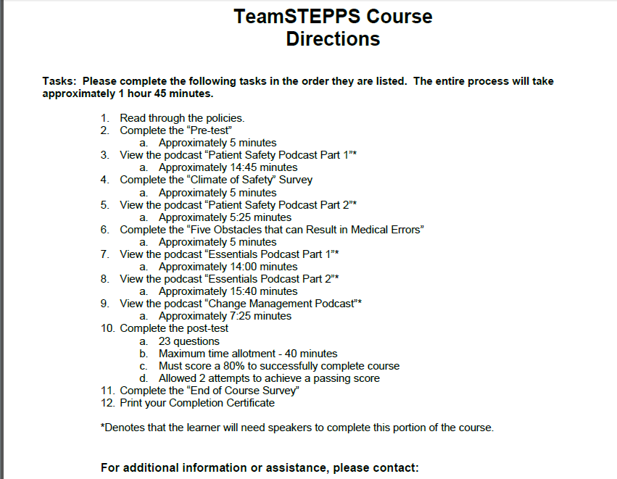
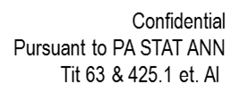
Course Instructions

Slide 72
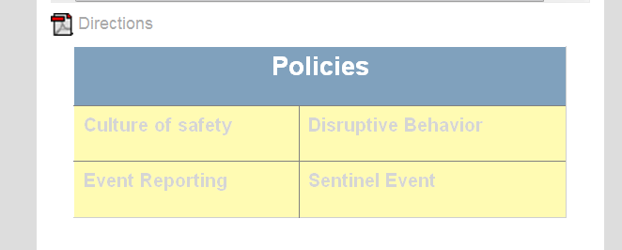
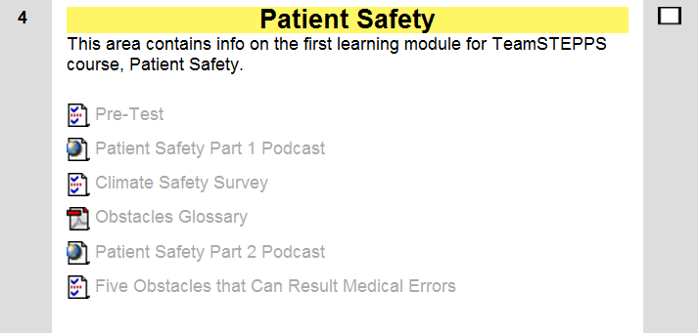
Website Includes Links to Policies

Slide 73
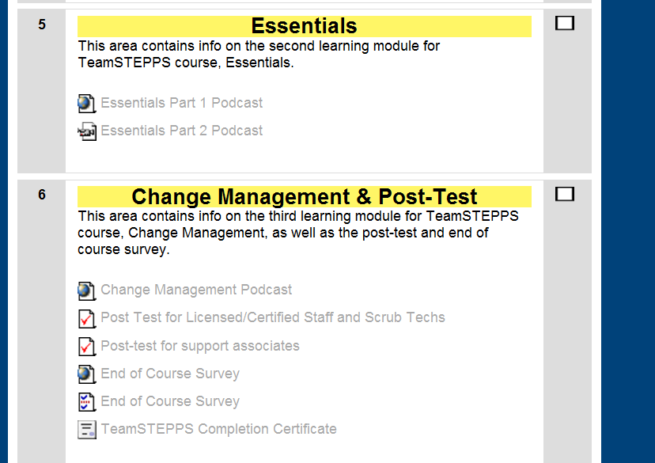
The Essentials and Change Management

Slide 74
Monitoring the Course
Site allows instructors to send and receive emails from participants
Log of communications, reminders and or special concerns
Interactive components allow us to receive feedback on staff’s perceptions as well as see how they are navigating the course
Pre and Post test results and Climate of Safety Survey
Evaluation of the Course

Slide 75
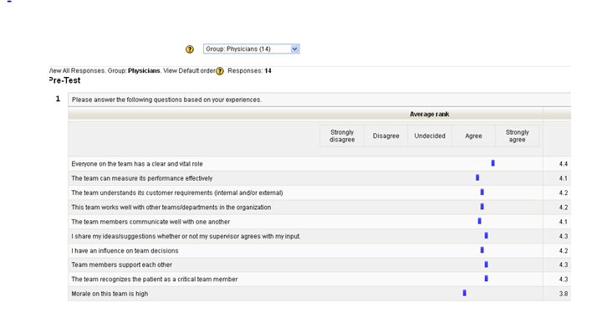
Pre-test results – Able to sort by discipline

Slide 76


Post Test Results
Favorable
Allowed two attempts
Different tests for professional vs. support staff
If unable to pass …………….remediate and re-test
Everyone on the team required to participate!

Slide 77
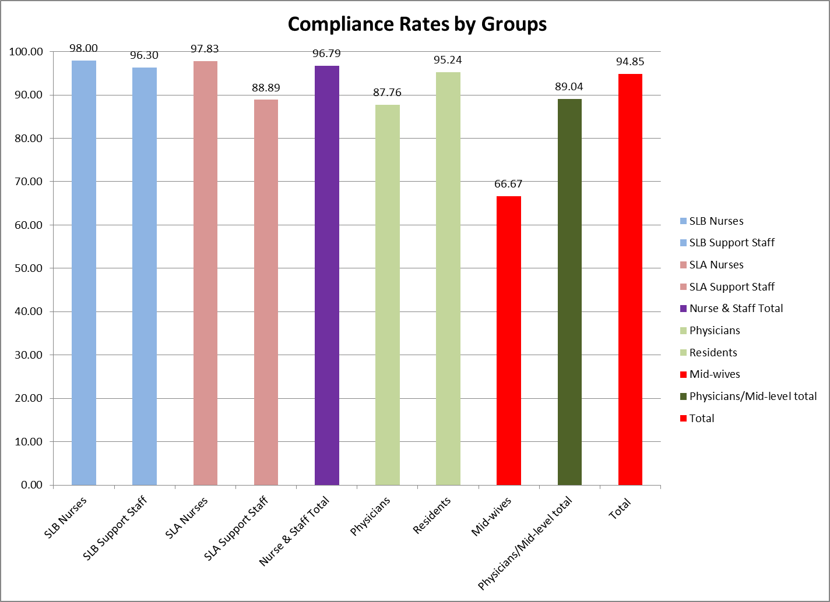
TeamSTEPPS e-learning Compliance
* Midwifery service – staff on FMLA

Slide 78
HSOPS Survey: Obstetrics Department

Slide 79
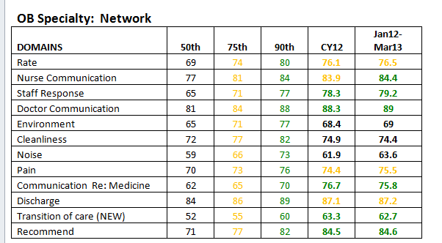
OB Satisfaction Scores
OB units scoring in the 75th and 90th percentiles on most
domains in HCAHPS Survey against OB peer hospitals!
Best Satisfaction Scores in the Network!
Data for CY2012 and past 15 months!

Slide 80

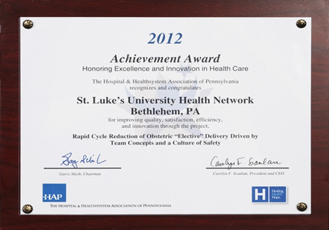

Women’s Service Line Outcomes
HAP AWARD: Pt. Safety
National Presentations
in Obstetrics each Year since 2009
TeamSTEPPS
E-learning Poster
at NAHQ Conference
in October, 2013
Improved Maternal and Neonatal
Outcomes & Reduced
NICU Admissions

Slide 81

Network Outcomes
Seven Hospital and Health System Association of Pennsylvania Achievement Awards in 3 years (2010 – 2012), most ever by one organization.

Slide 82

Striving for Teamwork and Growth?
Innovative?
Appropriate?
Cost-Effective?
Demonstrate Impact?
Sustainability?
Ability to Replicate?

Slide 83
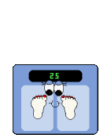
Take Away Message
Change is Hard, so be relentless…
Scaling TeamSTEPPS ideas can work!
- gains should be slow….
Keep a GANNT chart and Quality
Resources Department oversight in place
Leveraging technology can be a timely strategy to keep ideas fresh and ensure continuous learning
Keep a Positive Attitude and others will soon
catch on to the change efforts so you can get to the
Tipping Point……A Team Approach to Safety!

Slide 84
References
Gawande, A. (2010). The checklist manifesto: How to get things right. Profile Books.
Gladwell, M. (2006). The tipping point: How little things can make a big difference. Little, Brown.
Henriksen, K., Battles, J. B., Keyes, M. A., Grady, M. L., King, H. B., Battles, J., ... & Salisbury, M. (2008). TeamSTEPPS™: Team strategies and tools to enhance performance and patient safety.
Kohn LT, Corrigan JM, Donaldson MS. To err is human. Washington, DC: National Academies Press; 1999
Kotter, J. P., & Rathgeber, H. (2006). Our iceberg is melting: Changing and succeeding under any conditions. St Martins Press.
Marx, D. A. (2009). Whack-A-Mole: The price we pay for expecting perfection (p. 54). A. Bray (Ed.). Plano, TX: By Your Side Studios.

Slide 85
Acknowledgements:
I would like to thank the following individuals for their assistance, involvement and support of the TeamSTEPPS elearning pilot program
James Anasti MD – TeamSTEPPS Physician Lead, OB Residency Program Director
Anil Pai – Web Designer, Development Dept.
Melanie Martin BSN, RN – TeamSTEPPS instructor and Educator, Obstetrics.
Joseph CL Merola, MD, MPH – Chief, Obstetrics
Donna Sabol MSN, RN – VP/CQO – Quality Resources

Slide 86
Thank you
Questions?
Kathy J. Nunemacher
St. Luke’s University Health Network
Kathy.Nunemacher@sluhn.org
484-526-4129

