Slide 1
Implementing TeamSTEPPS: Maintaining Early Successes
^{John Nunes, MD}
^{Gina Teeples, RNC BSN}
CPT Gwendolyn Godlock, BSN, CMSRN
^{Amy L. Halverson, MD, FACS}

Slide 2
Team STEPPS… Implementation In a Community Setting

Slide 3
Objectives
Road To Team STEPPS
Impact on Culture of Safety
Beyond Perinatal Services
The Journey Continues…

Slide 4
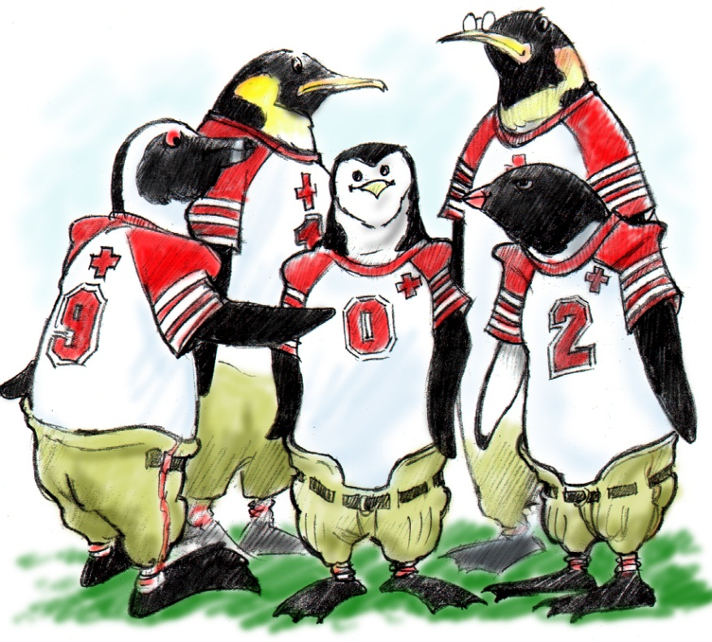
The Road to
Team STEPPS…
Developing Momentum

Slide 5
A Desire to “Do It Better”

Slide 6
Initial Perinatal Rollout
■ Mandatory Team STEPPS Training
■ Mandatory Simulation Training
■ Implementation of Laborist Program
■ Leadership Rounds
■ Quality Initiatives
● Intradepartmental Performance Improvement
● Peer Review
● Case Conferences
■ Briefs and Debriefs

Slide 7
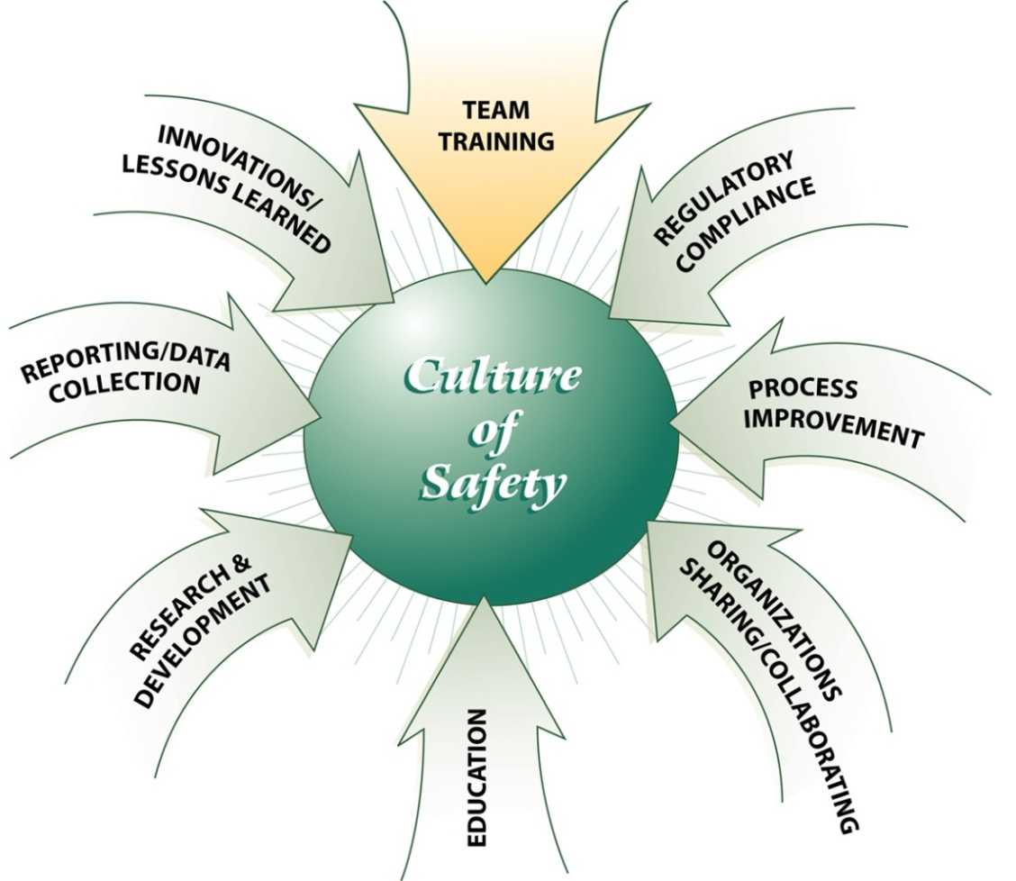
Impact on a
Culture of Safety…

Slide 8
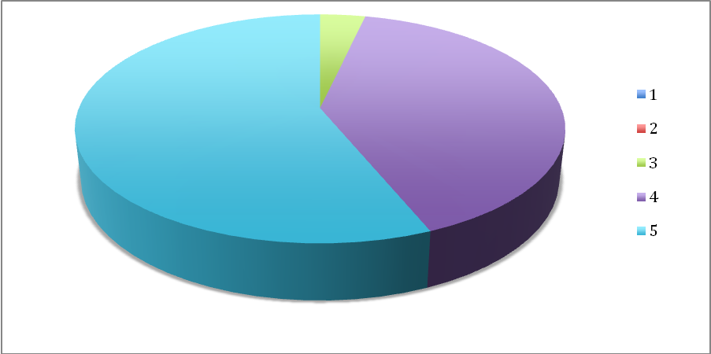
Team STEPPS Team Assessment Questionnaire
“The team is a safety net for patients.”
Pre Team STEPPS training
Post Team STEPPS training

Slide 12
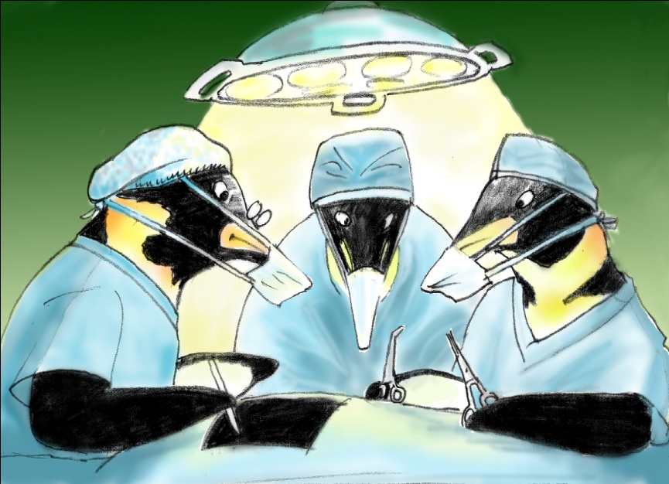
Beyond Perinatal Services…
▪ Hospital-wide Training: Critical Care and beyond
▪ Global Initiatives:
Briefs
Huddles
Debriefs

Slide 13
“What about the doctors?”
Medical School
Fellowship
MD
Residency
13
Notes:
13

Slide 14
Support and Recognition of Trainers
14
Notes:
14
These points represent our vision of how an effective team is conceptualized.

Slide 15
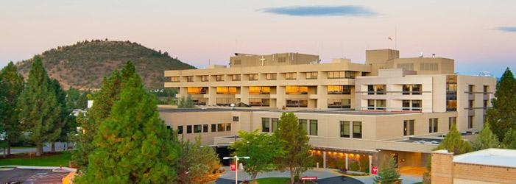
Sustaining the Momentum
▪ Challenges based on setting
▪ Leadership is the key!

Slide 16
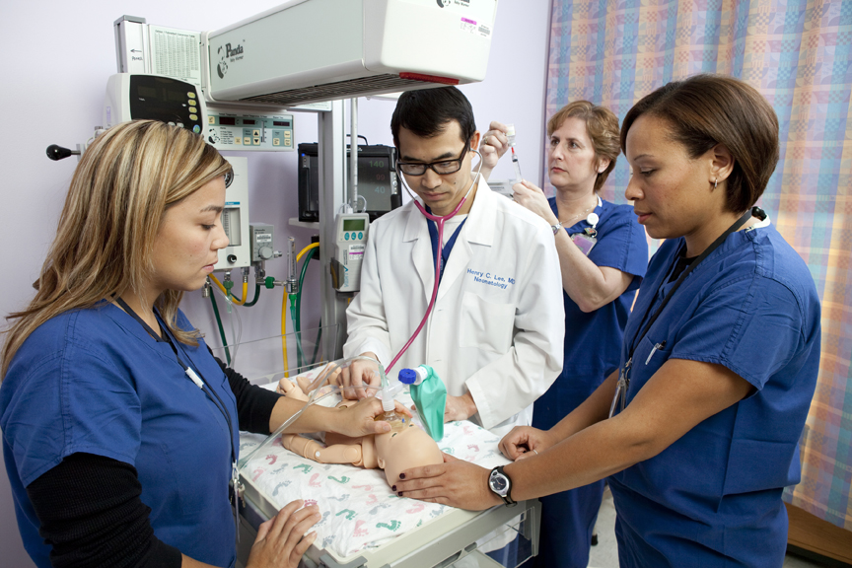
Our Journey Continues…
Integration with Simulation
Integration with Certification Programs
Ongoing Initial Training Sessions
Refresher Education
Hospital-wide Implementation:
Briefs, Huddles, Debriefs
Hospital-wide Simulation
Ongoing Data Collection

Slide 17
ValleyCare’s Key Success Factors
Strong Need for Team Approach Identified
Support From Senior Administration
Support From Department Leadership
Support From Physician Champions
Support From Ancillary Department Leadership
Support From Staff
Multidisciplinary Core Team

Slide 18
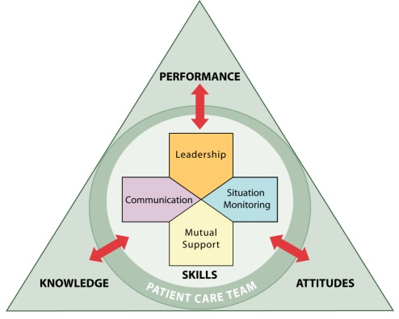
Has Our Culture Changed?

Slide 19
The views expressed herein are those of the authors and do not reflect the official policy or position of Brooke Army Medical Center, the U.S. Army Medical Department, the U.S. Army Office of the Surgeon General, the Department of the Army, the Department of Defense, or the U.S. Government.

Slide 20
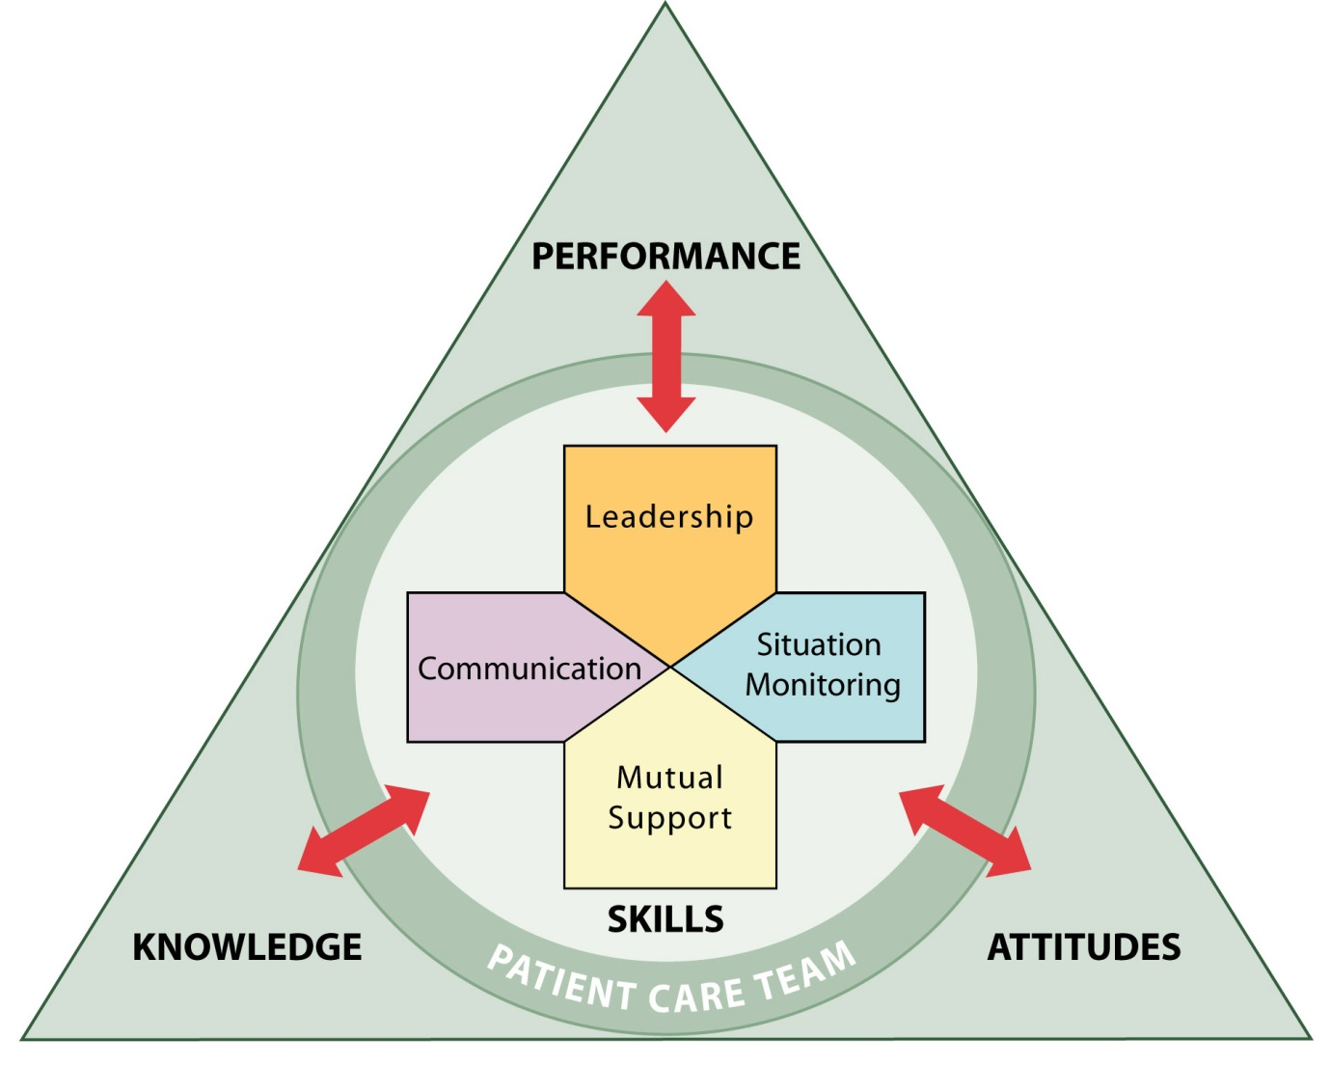
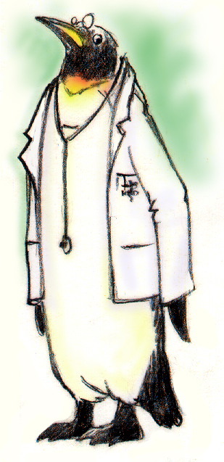
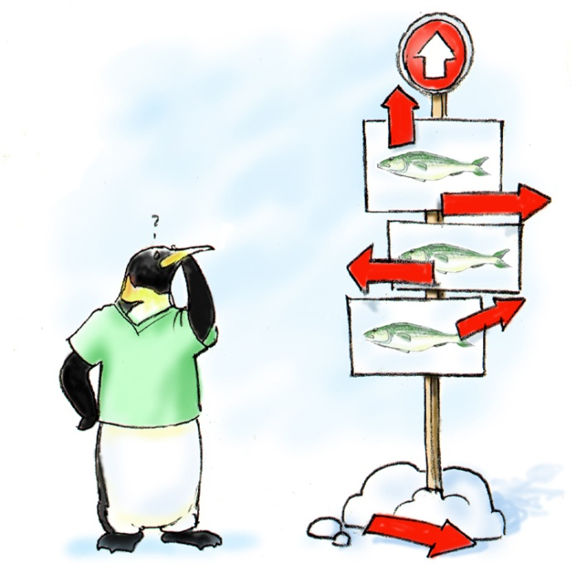
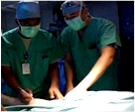
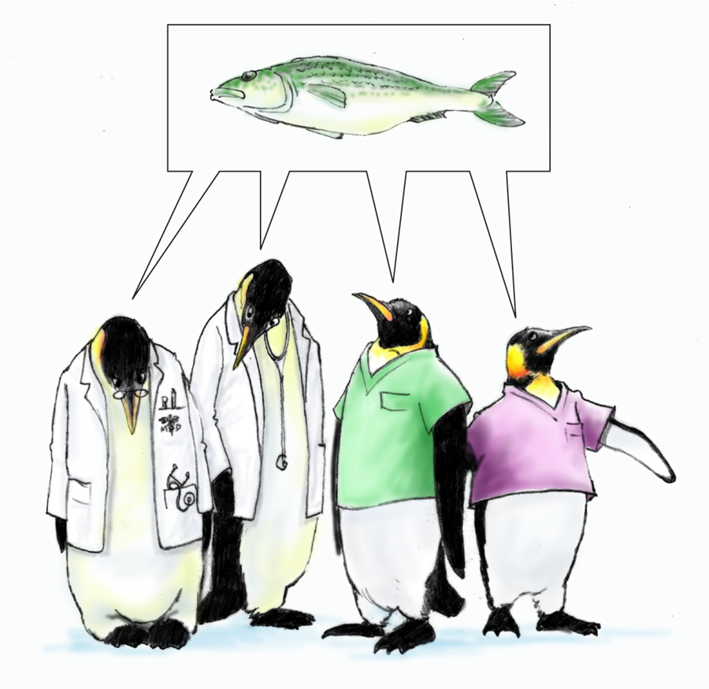
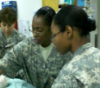
TeamSTEPPS is an evidence-based teamwork system for improving patient safety through better communication and teamwork skills among healthcare professionals.
TeamSTEPPS has 4 primary constructs
Leadership ensures the team is assembled to conduct team events i.e., Brief, Huddle, and Debrief.
Communication and other teamwork failures continue to be the leading cause of adverse events. Ineffective communication is a root cause for nearly 66 percent of all sentinel events reported*
Situation Monitoring is the process of actively scanning behaviors and actions to assess elements of the situation or environment.
Mutual Support the essence of team work.

Slide 21
End goal: A Culture of High Performing Teams
Agency for Health care Research and Quality (AHRQ) and Department of Defense (DOD)
Army Medical Command mandates TeamSTEPPS Implementation
Brooke Army Medical Center mandates TeamSTEPPS Implementation
1
2
3
Developed TeamSTEPPS
Over 25 years of scientific research
> 440 Physicians, Nurses, and technicians became trainers in 2005
Office of the Surgeon General mandates full TeamSTEPPS implementation on 5 May 2011 via Operation Order 11-38
MG Ted Wong, Commander (CEO), Southern Regional Medical Command, Brooke Army Medical Center mandates full facility TeamSTEPPS implementation

Slide 22
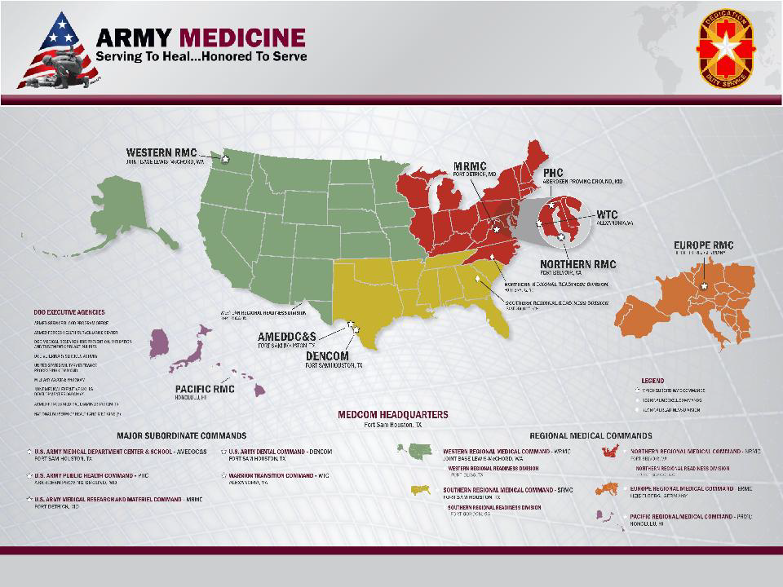

Slide 25
Full Time TeamSTEPPER’

Slide 36
Team Training the Northwestern Experience
Amy L. Halverson, MD, FACS
Associate Professor of Surgery
Northwestern University
Feinberg School of Medicine

Slide 37
Improving Teamwork in the OR
 | Baseline | 6 month follow-up | P
Members of the operating team speak up until there is some clear resolution and decision | 48% | 70% | <0.0001
Halverson, et al. Arch Surg 2009;144:107-112.

Slide 38
Improving Teamwork in the OR
 | Baseline | 6 month follow-up | P
Members of the operating team speak up until there is some clear resolution and decision | 48% | 70% | <0.0001
The leaders of the operating team keep all team members well informed | 46% | 63% | <0.0001
Halverson, et al. Arch Surg 2009;144:107-112.

Slide 39
Improving Teamwork in the OR
 | Baseline | 6 month follow-up | P
Members of the operating team speak up until there is some clear resolution and decision | 48% | 70% | <0.0001
The leaders of the operating team keep all team members well informed | 46% | 63% | <0.0001
I sometimes feel uncomfortable telling others that they need to take some action. | 42% | 30% | 0.0001
Halverson, et al. Arch Surg 2009;144:107-112.

Slide 40
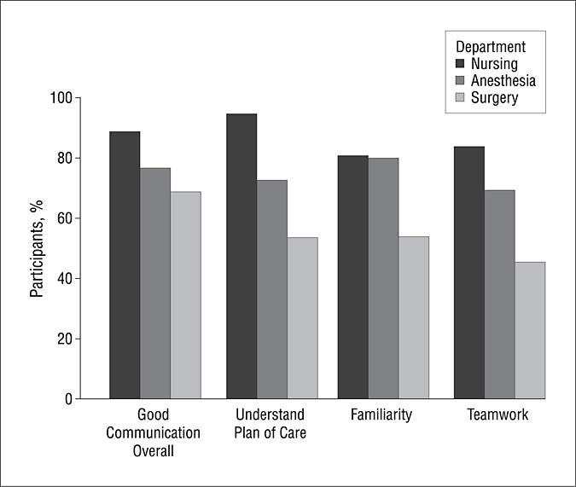
Halverson, et al. Arch Surg 2009;144:107-112.

Slide 41
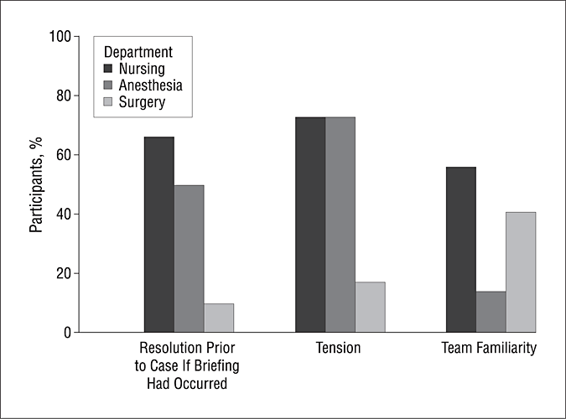
Halverson, et al. Arch Surg 2009;144:107-112.

Slide 42
NMH Observed Effects of Communication Failures
76 Communication failures were observed in over 150 hours of OR observation.

Slide 43
Subject of Communication Errors
Equipment
Progress report
Policy
Medications
Procedure
Personnel
Environmental
Other

Slide 44
Subject of Communication Errors

Slide 45
Subject of Communication Errors

Slide 46
NMH Observed Effects of Communication Failures

Slide 47
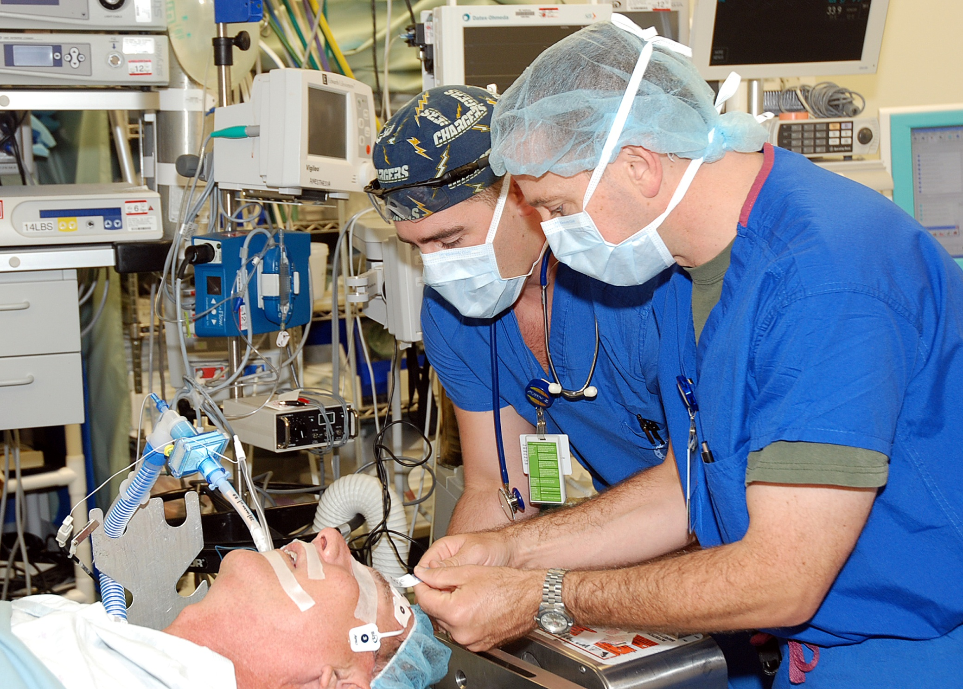
Challenges

Slide 48
Successes

Slide 49
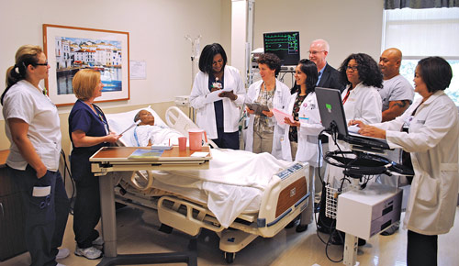
Successes

Slide 50
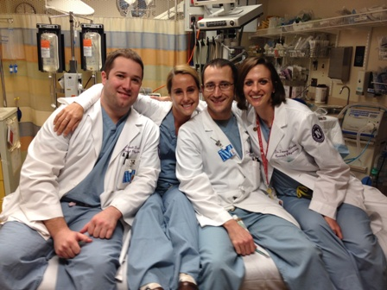
Successes

Slide 51
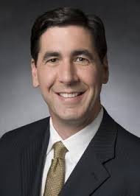
Leadership

Slide 52
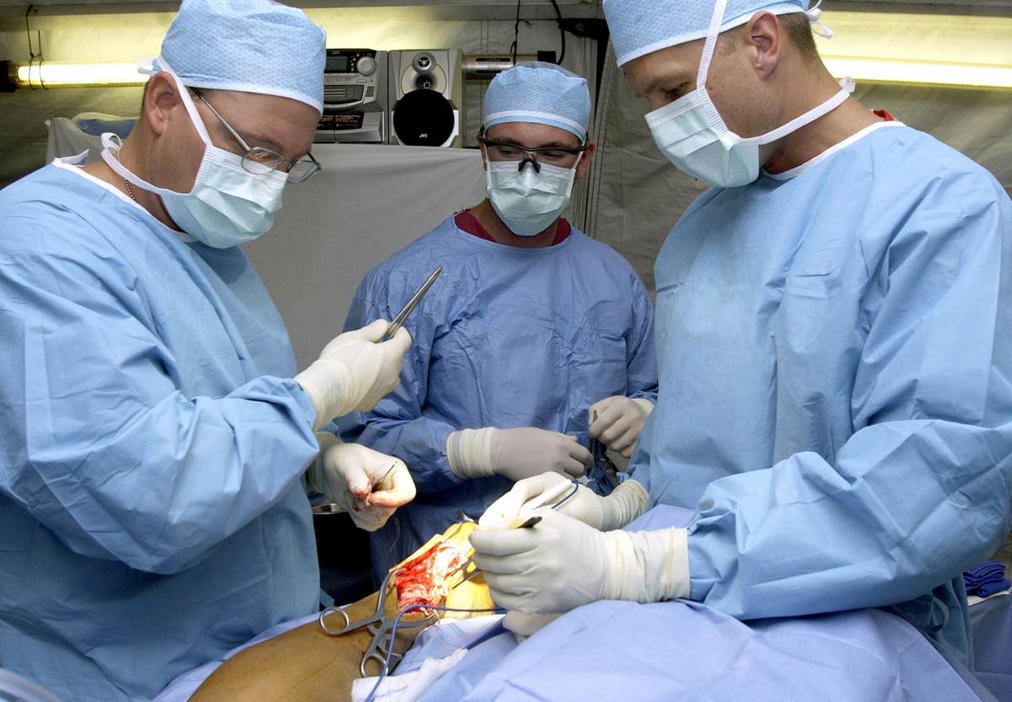
Next Steps

Slide 53
Rural Surgeon’s Needs Assessment
Topic | Response average | Percent of respondents ranking topic 5-7
Endomucosal resection of colonic polyps | 4.6 | 59%
Ureteral stent insertion | 3.7 | 31%
Suprapubic tube insertion | 4.2 | 46%
Urethral dilation | 3.7 | 34%
Management of testicular torsion | 4.2 | 51%
Management of postopartum hemorrhage | 3.8 | 31%
Management of ovarian torsion | 4.1 | 43%
Management of ectopic pregnancy | 3.9 | 36%
Facial laceration repair | 4.6 | 50%
Excision of facial lesion | 4.4 | 42%
Leadership/ Communication in the OR | 4.6 | 47%
Notes:
2
4

Slide 54
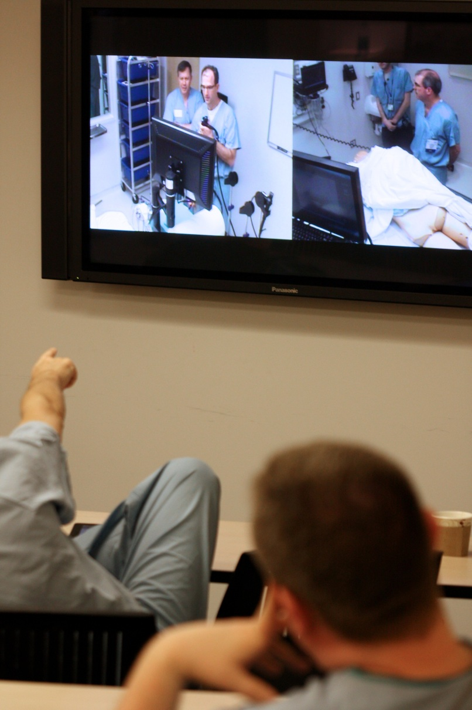
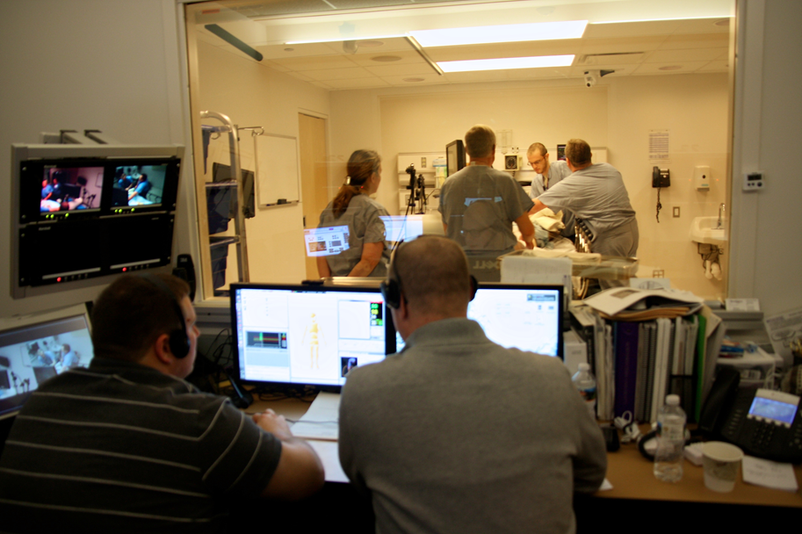
Patient Safety and Quality in Rural Surgery
Notes:
2
4

Slide 55
Common Themes
Developing Momentum
Supporting your Training Team
Align incentives
provide dedicated time to work on implementation
Conducting ‘Refresher’ Trainings
Measuring TeamSTEPPS Success
How do you know when the training is engrained in your culture?

Slide 56
Questions

