Slide 1

The Medical Liability and Risk Management Perspective
David L. Feldman, MD, MBA, CPE, FACS
Matthew Miller, MD
LeWanza M. Harris, MD, MPH

Slide 2
Partnering with Your
Malpractice Insurance Company to Improve Teamwork
David L Feldman, MD MBA CPE FACS
Chief Medical Officer & Senior VP
Hospitals Insurance Company
New York, NY
TeamSTEPPS National Conference
Wednesday, June 13, 2013

Slide 3
Agenda
  The changing focus of our company
  Support for team training in the context of:
    Obstetrics best practices program
    Safe Surgery initiative
    On-line physician education
Partnering with Your Malpractice Insurance Company

Slide 4





Our Hospital Clients

Slide 5
Client Demographics – Hospitals
Beds 5,732
FTEs 43,117
Inpatient days 1,602,267
Deliveries 26,978
ED visits 811,036
Ambulatory visits 5,640,461
Discharges 276,520
Surgical procedures 123,873
Partnering with Your Malpractice Insurance Company

Slide 6
To Reduce Premiums
Spread the cost
Cut the cost
Prevent the cost
Partnering with Your Malpractice Insurance Company

Slide 7
Cost (Open and Closed Claims)
2001-2010
Surgery
(33%)
Other
(30%)
Radiology
(3%)
Anesthesiology
(2%)
Gynecology
(4%)
Obstetrics
(21%)
Emergency
Medicine
(6%)
Partnering with Your Malpractice Insurance Company

Slide 8
Focus
Until 2005: Claims – the Insured
Partnering with Your Malpractice Insurance Company

Slide 9
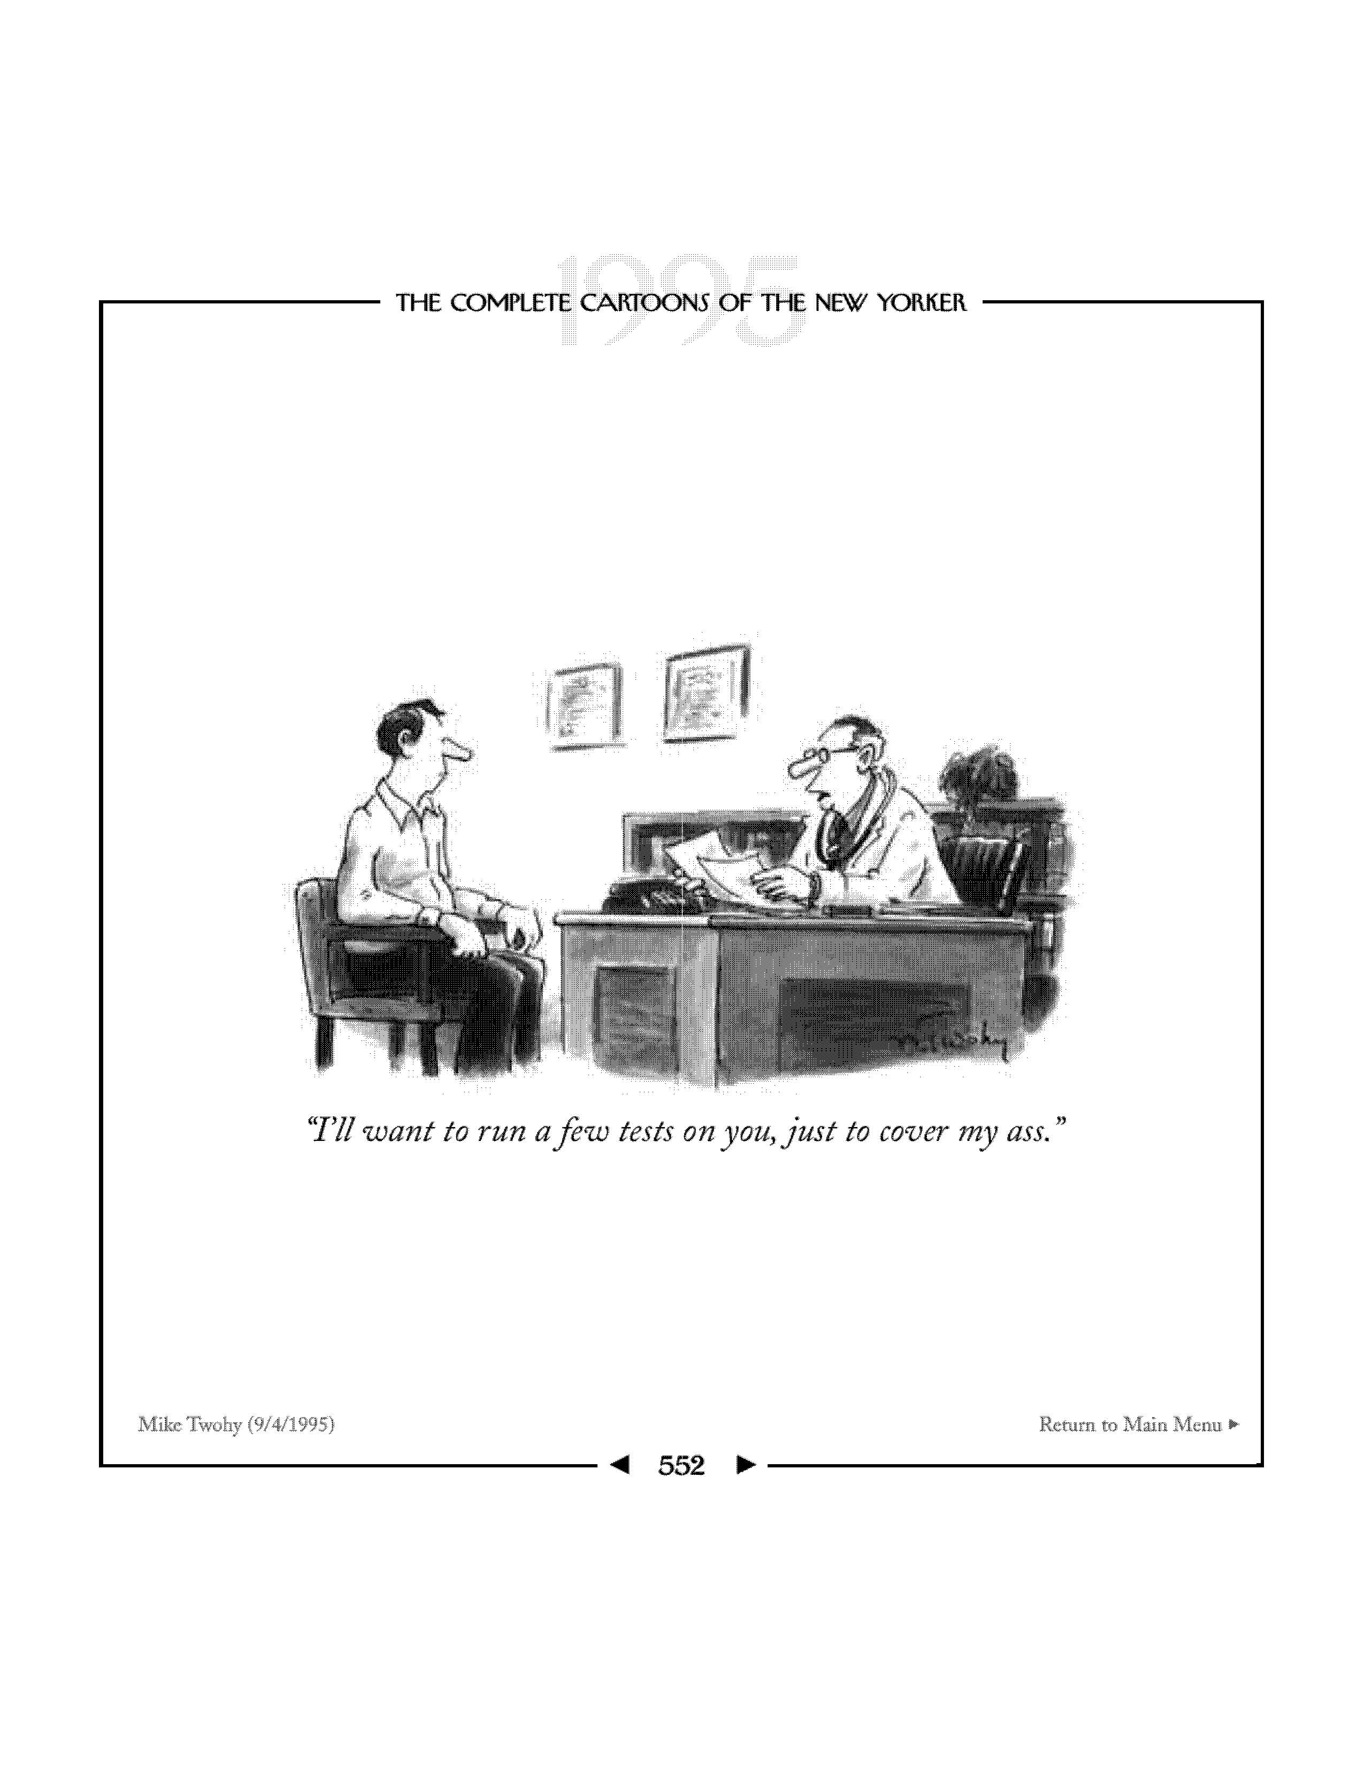

Slide 10
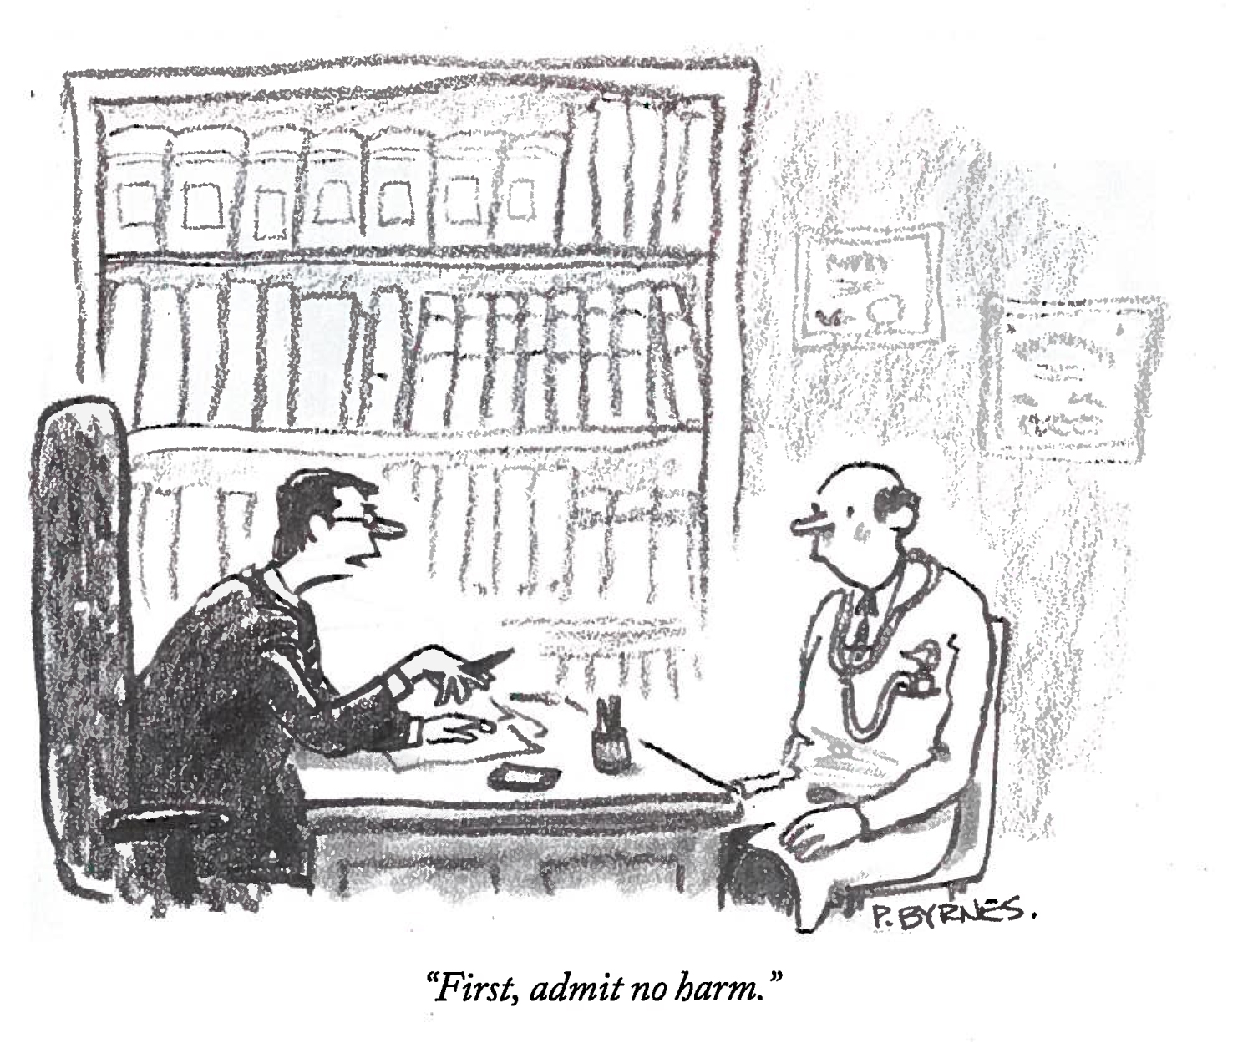

Slide 11
Focus
Post 2005: Quality and Safety – the Patient
Partnering with Your Malpractice Insurance Company

Slide 12
Obstetrics - Best practices
  Created by Chairman consensus
  Adopted and implemented over 2 years
  Audited by HIC research associates
  Quarterly feedback given to Chairman
    Compliance
    Adverse outcomes data
  Fetal heart monitoring course
  Team training using TeamSTEPPS
  Simulation
Partnering with Your Malpractice Insurance Company

Slide 13
Obstetrics – Team Training
  One hospital group master training @ Duke
  Curriculum developed for other hospitals
  1.5 day off-site at a conference center
  Hospital champions returned
    Formal 4 hour training
    Informal focus on one skill
  Continuous coaching real-time on L&D
  Incorporation into simulation programs
  Auditing and monitoring of adverse outcomes
Partnering with Your Malpractice Insurance Company

Slide 14
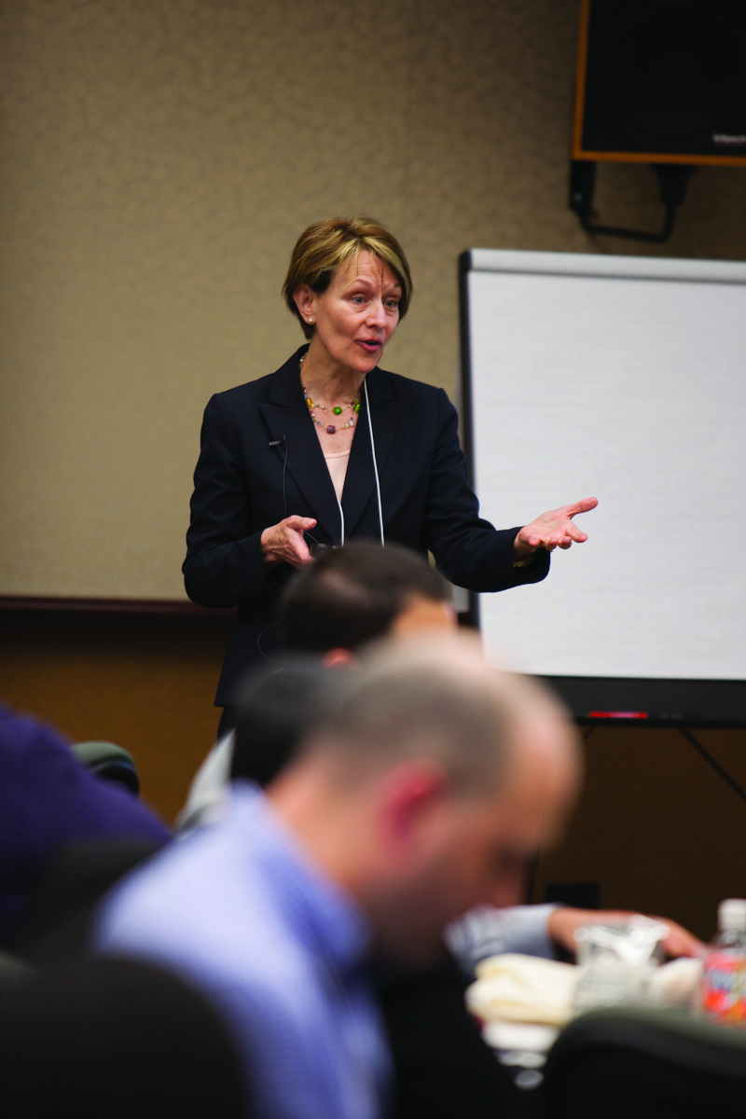
HIC Support - Obstetrics
Premium credits/grants
  TeamSTEPPS Master trainer sessions
  Assistance with full staff rollout
  Attending obstetrician coverage in L&D
Insurance Premium Reductions
  Hospital malpractice costs
  Physician malpractice costs*
    *(required state approval)
Partnering with Your Malpractice Insurance Company

Slide 15
Surgical Safety Initiative
Pre-op medical evaluation
OR team training
Co-management/perioperative medicine
Care of obese surgical patient
Partnering with Your Malpractice Insurance Company

Slide 16
Operating Room – Team Training
  Curriculum developed specifically for ORs
  1.5 day off-site at a conference center
    Live simulated scenarios
    Hospital specific cultural challenges addressed
  Hospital champions returned
    “Late day” training
    1.5 hour v. 4 hour
  Continuous coaching real-time
Partnering with Your Malpractice Insurance Company

Slide 17
Operating Room – Team Training
  To date near complete training of:
    Nursing staff
    Surgeons
    Anesthesiologists
    Residents
  Next phase
    Video recordings in ORs
    Training of internal/external auditors to use Medical Team Performance Assessment Tool (MTPAT)
Partnering with Your Malpractice Insurance Company

Slide 18
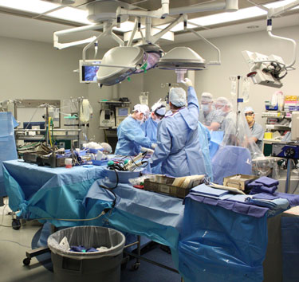
HIC Support - Surgery
Premium credits/grants
  TeamSTEPPS Master trainer sessions
  Assistance with full staff rollout
  NSQIP data collectors
Insurance Premium Reductions
  Hospital malpractice costs
  Physician malpractice costs*
    *(requires state approval)
Partnering with Your Malpractice Insurance Company

Slide 19
Education Program
On-line risk management course
  Required for excess malpractice coverage
  Qualifies for 5% premium discount
Core sections
    Informed Consent and Shared Decision Making
    Communication Styles
    Disclosure and Apology
    TeamSTEPPS in the Office Practice
    Risk Management Review
    EMR Issues
    Infectious Disease Risk Management Strategies
Specialty specific sections
Partnering with Your Malpractice Insurance Company

Slide 20
TeamSTEPPS video applications
On-line risk management course
Use by hospital risk managers
Faculty practices
Specialty societies
Other malpractice insurance companies
Partnering with Your Malpractice Insurance Company

Slide 21
Agenda - Summary
  The changing focus of our company
  Support for team training in the context of:
    Obstetrics best practices program
    Safe Surgery initiative
    On-line physician education
Partnering with Your Malpractice Insurance Company

Slide 22
A Multi-Disciplinary Approach to Shifting the Culture of Safety
Matthew Miller, MD
Chief Medical Officer
St. Joseph Eureka
Redwood Memorial Hospital
TeamSTEPPS National Conference
Wednesday, June 12, 2013

Slide 23
Learning Objectives
Identify strategies for designing a multi-disciplinary change team
Identify tools for ongoing monitoring and sustainment of TeamSTEPPS concepts
Identify the value of linking the TeamSTEPPS process with Quality/Risk Departments to realize change through local data and stories

Slide 24
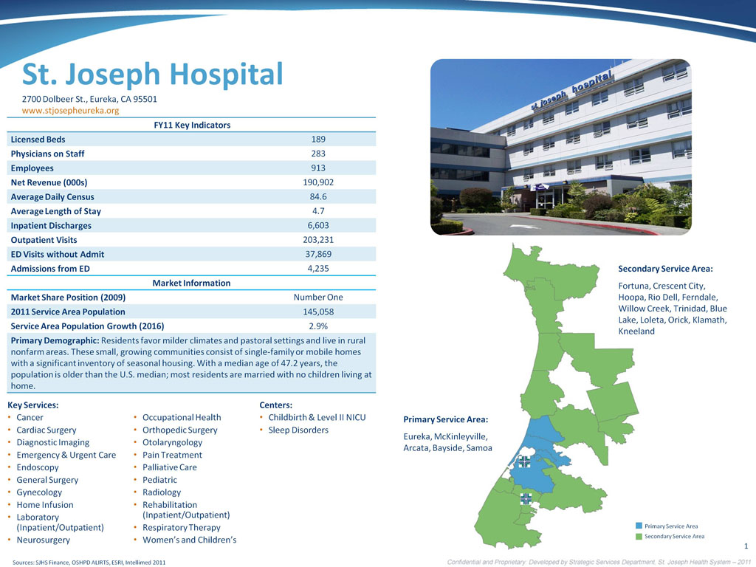
St Joseph Eureka

Slide 25
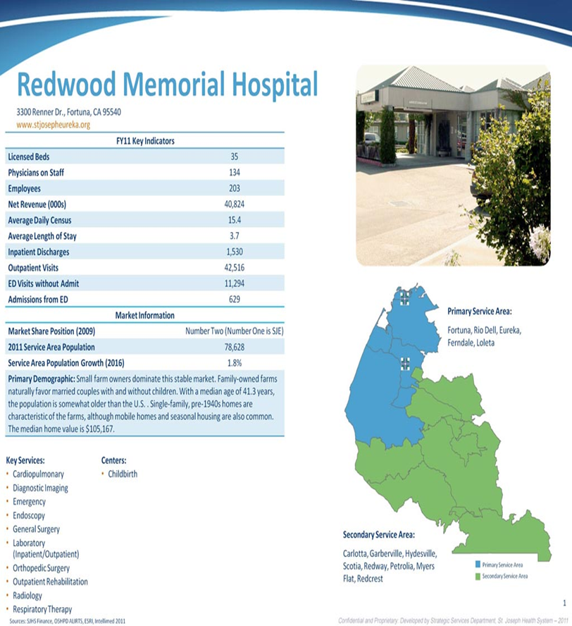
Redwood Memorial Hospital

Slide 26
Background of TeamSTEPPS in Humboldt County
The mandate for training was announced by our Health System’s Executive Leadership in February 2012
Medical and hospital staff in the departments of Surgery, Emergency Medicine, Labor & Delivery, and Cardiac Cath Lab were to have attended by June 30, 2012
Context and purpose for completing training were not clearly communicated

Slide 27
First Steps
Find a Champion; who better than the Patient Safety Officer (me!)
Identify an Executive Sponsor
Begin identifying potential trainers
Sedgwick would assist in education and training the master trainers. Scheduled webinars were planned
“What about the Readiness Assessment?!”
The “Reason for Change/Burning Platform” was still not readily identified.

Slide 28
TeamSTEPPS Readiness Assessment Tool
Have you clearly defined the need that is driving your institution to consider implementing TeamSTEPPS?
Organizational Readiness Score
The number of Yes responses you've recorded is: 6 out of 12
Your responses indicate that your institution may not be ready on one-third to one-half of the factors. This reduces the likelihood that the program will be successful. Take some time to determine if this is the appropriate time to implement TeamSTEPPS. Review the tips and suggestions to enhance readiness and determine if any are appropriate within your institution.

Slide 29
“What Happened To Phase I?”

Slide 30
Formation of the Guiding Team
Quality/Risk Department assembled and coordinated the Guiding Team consisting of:
Administration: The CNO’s at the two local ministries
Seven Physician Leaders (one is also the Patient Safety Officer)
Five Nurse Leaders
Two Surgical Nurses
Area Quality/Risk Director
Quality Manager

Slide 31
The Benefits of integrating Quality/Risk with Clinical and Administrative Team:
Quality/Risk constantly review data on HACs, Adverse Events, and Near Misses
Quality/Risk are best able to share this data with the Guiding Team, who can then share it during training
Quality/Risk write the Plan of Corrections
Quality/Risk are involved in all Site Surveys
Quality/Risk own the AHRQ Patient Safety Culture Survey data

Slide 32
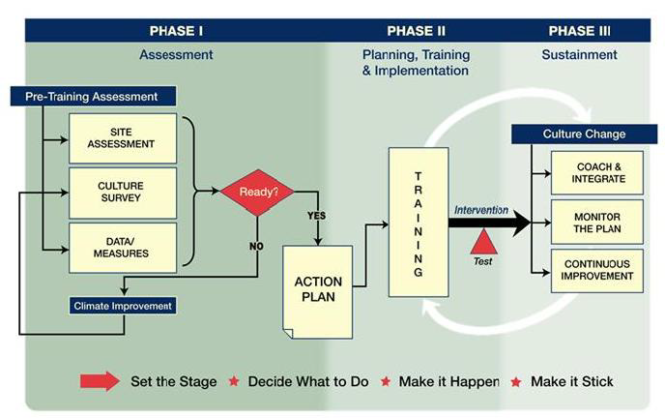
“Then, this all started making sense!”

Slide 33
“Living Better Transparently!”
We built our burning platform by sharing data throughout our organizations in ways in which it had never been before:
Board of Trustees
Medical Executive and Quality Committees
Nursing Leadership
Area Management Team
Medicine and Surgery Department Meetings
Frontline Staff Meetings
Quarterly Medical Staff Meetings

Slide 34
How to Get Buy-in?
Medical Staff would be the greatest challenge
Motivation through “The Carrot” or the “The Stick”
“The Carrot” was patient safety and CME’s
No “Stick” initially
Adverse Event data became a standing agenda item at Medical and Hospital Staff forums
Continual Adverse Event data sharing during TeamSTEPPS classes (educate by immersion)
Sharing successes at meetings and during TeamSTEPPS classes

Slide 35
Training Day(s): May 15 & 16, 2012
Two 8 hour days
Training through Sedgwick
Venue was offsite and catered
Trained 8 Physicians, 2 Surgery Nurses, 6 Nurse Managers, 2 CNOs, and our Quality/Risk Director and Manager

Slide 36
We Demonstrated That Context and Purpose Remained a High Priority:
By creating our own introduction to explain the “what”, “why”, “who”, and “how”
By incorporating into our program a simple slide showing our never events
Telling data-driven stories about HACs and Near-Misses
Sharing data regarding our AHRQ Survey (you asked for it!)

Slide 37
“It Has Happened Here”
2011 – 2 retained foreign bodies
2010 – 1 wrong site surgery
Source: Healthcare Compare HHS.gov May17,2012 | SJE | U.S. National Rate per 1,000 patient days
Falls and injuries | 1.019 | 0.564
Objects accidentally left in the body after surgery | 0.204 | 0.026

Slide 38
Patient Safety Survey Results
% Positive by Dimension | SJE |  | RMH
 | 2011 | 2009 | 2011 | 2009
Teamwork within Units | 82% | 83% | 86% | 86%
Organizational Learning – Continuous Improvement | 69% | 72% | 68% | 77%
Staffing | 44% | 53% | 32% | 61%
Overall Perception of Patient Safety | 64% | 66% | 35% | 76%
Non-punitive Response to Error | 43% | 50% | 31% | 51%
Supervisor / Manager Expectations and Actions Promoting Patient Safety | 70% | 73% | 63% | 79%
Feedback & Communication about Error | 61% | 63% | 54% | 69%
Communication Openness | 60% | 44% | 60% | 67%
Frequency of Events Reported | 60% | 44% | 60% | 67%
Teamwork Across Units | 43% | 49% | 64% | 71%
Handoffs and Transitions | 26% | 32% | 39% | 50%
Management Support for Patient Safety | 54% | 60% | 61% | 57%

Slide 39
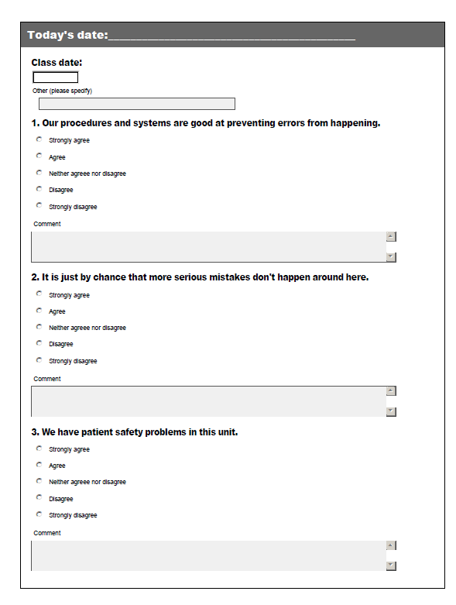
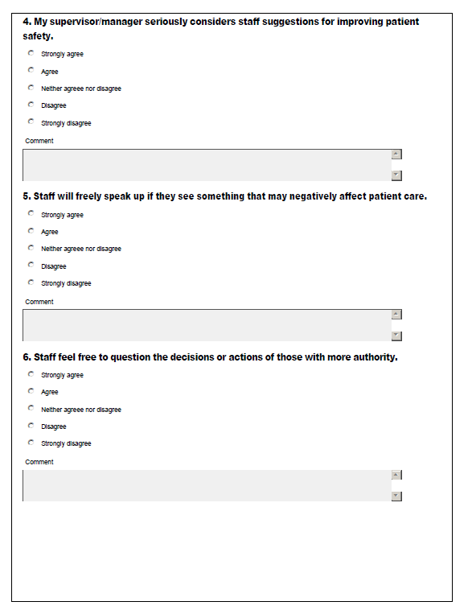
PSC Mini-Survey Tool

Slide 40
PSC Mini-Survey Tool
Our procedures and systems are good at preventing errors from happening.
It is just by chance that more serious mistakes don’t happen around here.
We have patient safety problems in this unit.
My supervisor/manager seriously considers staff suggestions from improving patient safety.
Staff will freely speak up if they see something negatively affect patient care.
Staff feel free to question the decisions or actions of those with more authority.

Slide 41
We Didn’t Know What We Didn’t Know:
Here’s What We Learned From Our Attendees:
Our Just Culture was not perceived as “Just”
Extreme fear of punitive response to error
Poor Time-Out participation
Poor attitude about Time-Out
Poor Time-Out quality
Disconnect between what we heard and what we (Quality) were being told

Slide 42
Time-Out Participation Survey Tool

Slide 43
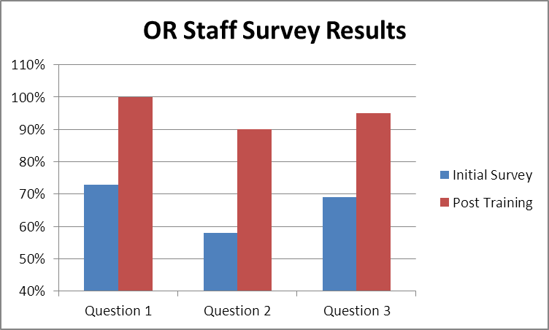
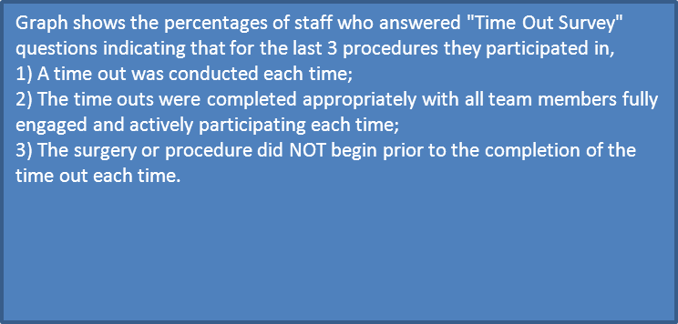
Time-Out Survey Comparison

Slide 44
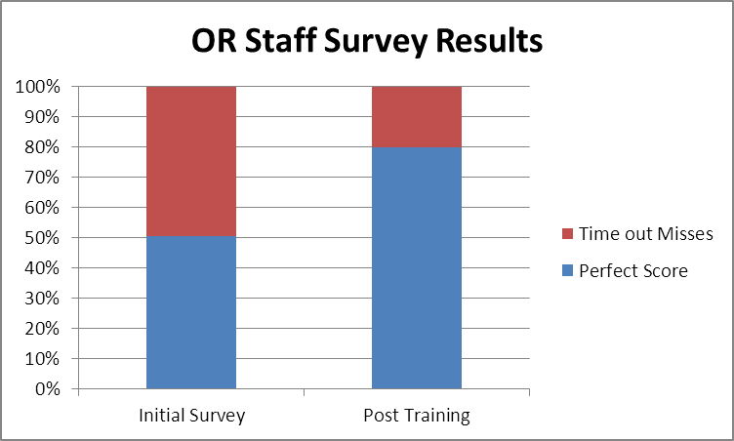
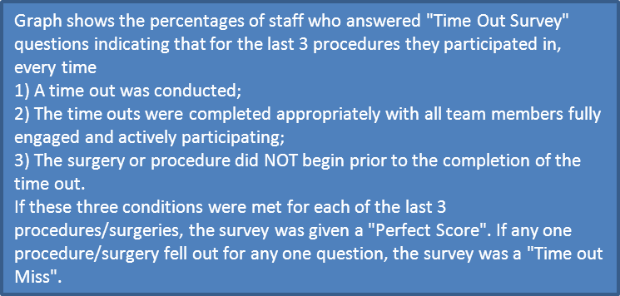
Time-Out Survey Comparison

Slide 45
SUCCESSES from first wave of training completed on June 30, 2012
 | Staff that have completed training | Total staff to be trained | % trained | Physicians/Allied Health Providers completed training | Total Physicians/Allied Health Providers to be trained | % trained
SJE | 248 | 270 | 92% | 90 | 103 | 87%
RMH
QVMC | 81 | 108 | 75% | 21 | 104 | 20%
CMC | 136 | 195 | 70% | 40 | 210 | 19%
Levelland | 4 | 4 | 100% | 2 | 2 | 100%
Plainview | 23 | 24 | 96% | 5 | 8 | 63%
SMMC | 133 | 157 | 85% | 25 | 92 | 27%

Slide 46
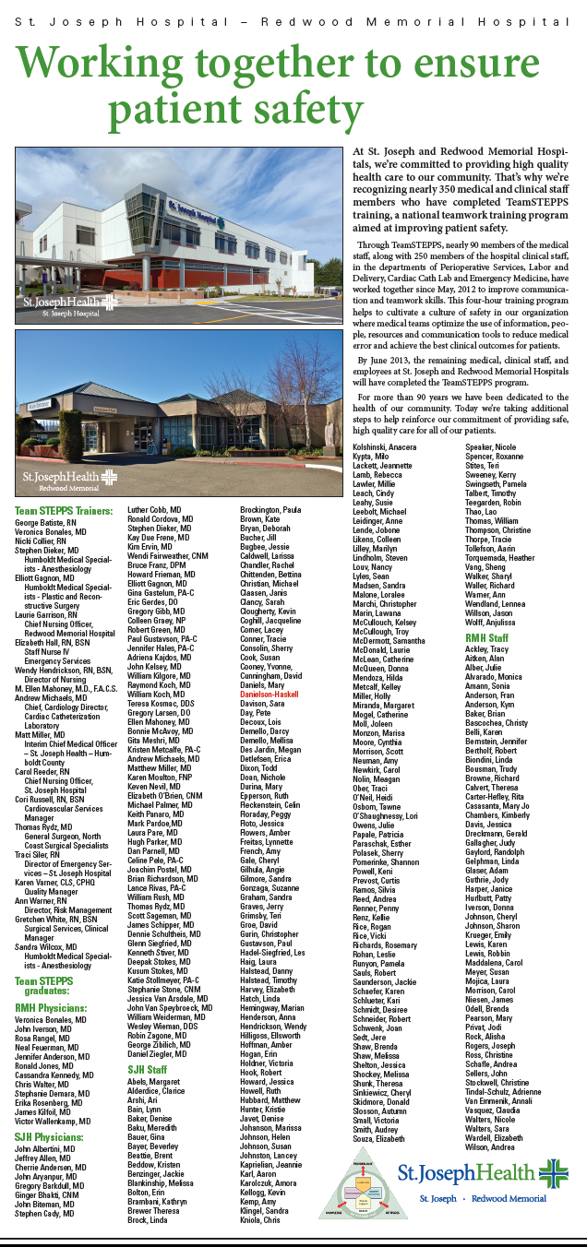

Slide 47
More Successes: TeamSTEPPS written into several Plans of Correction
Debriefs incorporated into Code Blue policy
Post-Fall Huddle Tool
Double checks for IV admixtures
8 Rights for medication administration
Cross Monitoring for Central Venous Catheter guide wire count
OR fire safety training

Slide 48
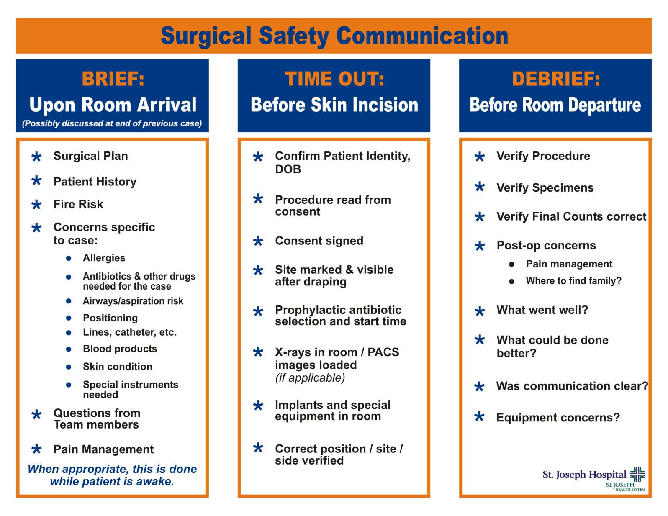
Brief/Time-Out/Debrief Card

Slide 49
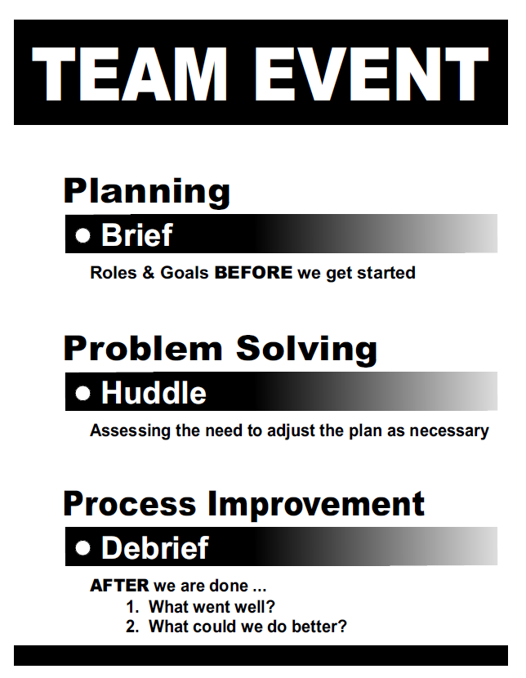
Brief/Huddle/Debrief Poster

Slide 50
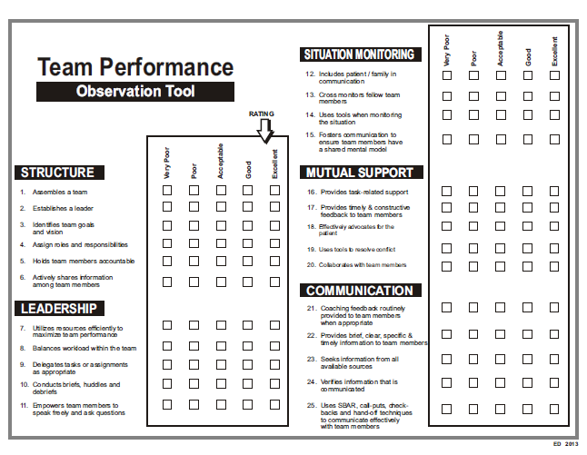
Audit Tool for Codes

Slide 51
Lessons Learned: What we did Well
Quality/Risk were the Drivers of the PROCESS
We were consistent with a DATA-DRIVEN approach
We used our own stories to Build the Burning Platform
Crafted our own INTRODUCTION, using our own stories and stating the WHAT and the WHY to create our Burning Platform
We were transparent with DATA – a big shift in our organizational culture
Had consistent personnel in each class which helped identify patterns of behaviors, concerns, and stories

Slide 52
Lessons Learned: We Didn’t Know What We Didn’t Know:
Focus on the Readiness Assessment
Trainers should take class prior to their training
Better organization around the WHAT and the WHY
Train more trainers!
Be familiar with all tools TeamSTEPPS have for implementation and monitoring
Incorporate more simulation into classes
Hardwiring feedback to staff on reported events, performance is essential

Slide 53
CELEBRATE ALL SUCCESSES

Slide 54
TeamSTEPPS Tools to Improve Feedback on Error and a Safety Culture
LeWanza M. Harris, MD, MPH
Notes:
54

Slide 55
The Joint Commission
Center for Transforming Healthcare
National project of seven peer collaborating hospitals & health systems
Aim
  Maximize behaviors that prevent harm
Objectives
  Encourage staff to speak about risks to staff & patient
  Empower staff to report near-misses & errors
  Improve communication among team members
  Drive improvements
Notes:
Collaborating hospitals include:
1. OSF St Francis Medical Center (Peoria, IL)
2. Kaiser Permanente Fresno (Fresno, CA)
3. Barnes-Jewish Hospital (St. Louis, MO)
4. Wake Forest Baptist Medical Center (Winston-Salem, NC), VA
5. Palo Alto Health Care System (Palo Alto, CA)
6. Froedert Health (Milwaukee, WI)
Center for Transforming Healthcare also ran a handoff communication project (NYP participated)
Safety culture project started in October 2011.
Six Sigma methodology for process improvement
5 stages to a six sigma project: define, measure, analyze, improve, control
Currently in improve phase, so project is nearing completion
Presenter: don’t delve into six sigma

Slide 56
Feedback and Communication about Error
Domain Questions | NYPH | AHRQ
We are given feedback about changes put into place based on event reports. | 58% | 55%
We are informed about errors that happen in this unit. | 64% | 63%
In this unit, we discuss ways to prevent errors from happening again. | 70% | 70%
56

Slide 57
Metric 1: Closed Loop
Percent of reported and reviewed events that make it through resolution
  Closed report: feedback was given, or action plan in place
  Open report: no review or feedback given
  Metric = # closed_____
  # closed + # open
Notes:
7W baseline was 0% (5 open, 0 closed)

Slide 58

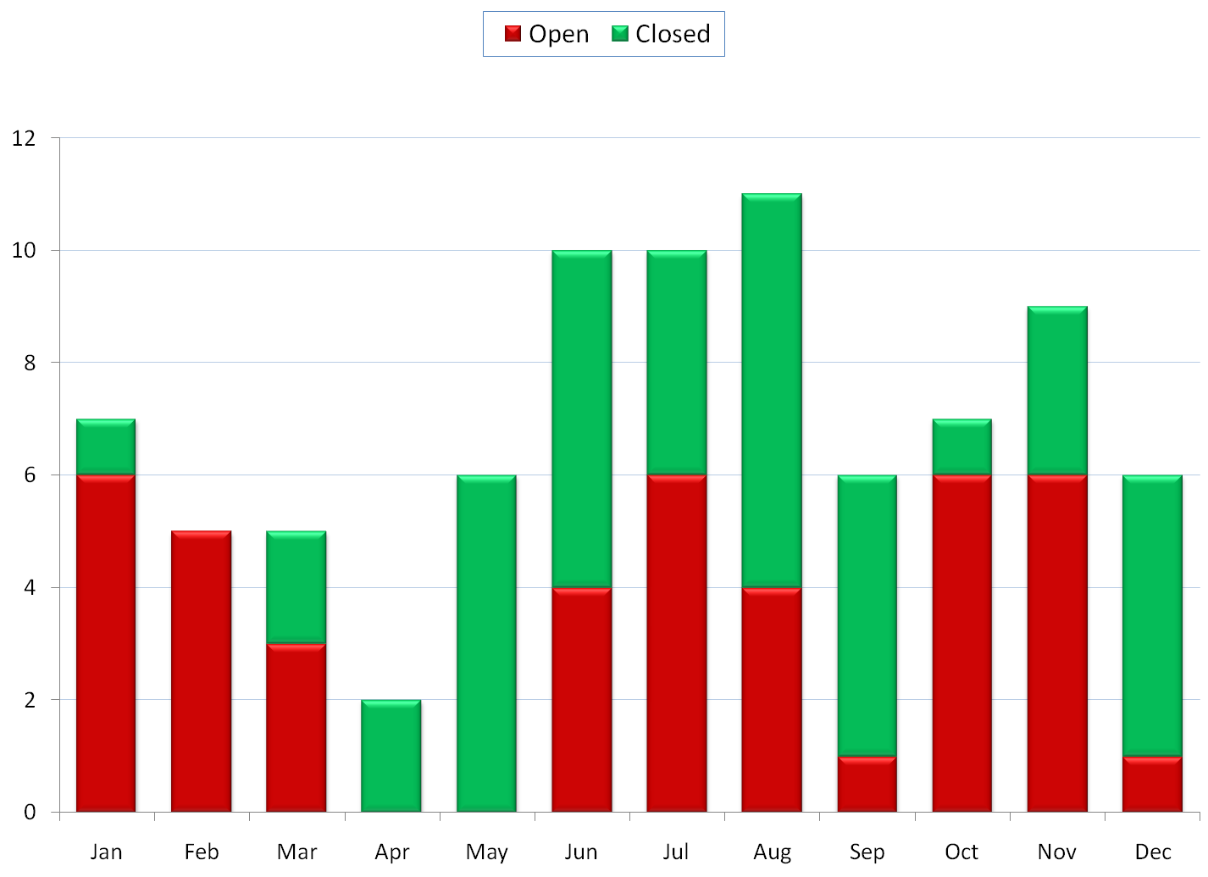
7W Event Reporting 2012

Slide 59
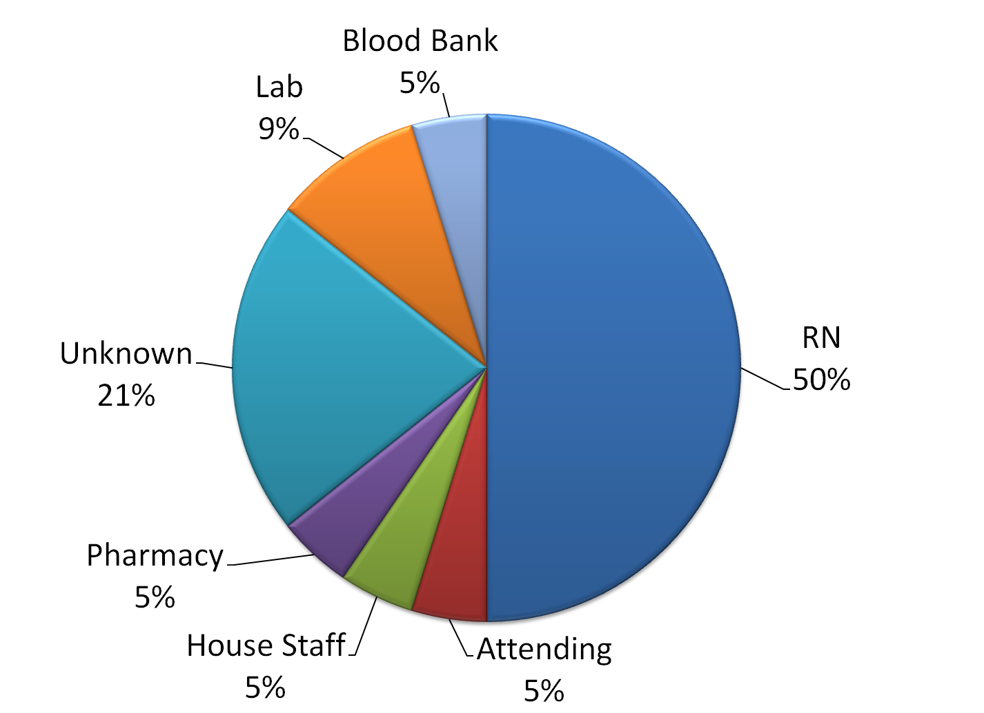
2012 Reporters by Discipline

Slide 60
Metric 2: Quality of Feedback Loop
Baseline n=24

Slide 61
Metric 3: Safety Organizing Scale
Baseline Response (1-7 scale)
When performing handoffs, we usually discuss what to look out for. | 5.05
My workgroup spends time identifying activities we do not want to go wrong. | 4.62
My workgroup discusses alternatives as to how we go about our normal work activities. | 4.29
My workgroup has a good understanding of each other's talents and skills. | 4.67
Members of my workgroup discuss unique skills with each other so we know who on the unit has relevant specialized skills and knowledge. | 4.00
My workgroup talks about mistakes and ways to learn from them. | 4.33
When errors happen, we discuss how we could have prevented them. | 4.62
When attempting to resolve a problem, we take advantage of the unique skills of our colleagues. | 4.24
When a patient crisis occurs, we rapidly pool our collective expertise to attempt to resolve it. | 5.24
Mean Q1-9, all respondents | 4.56
Notes:
Example of display of data.

Slide 62
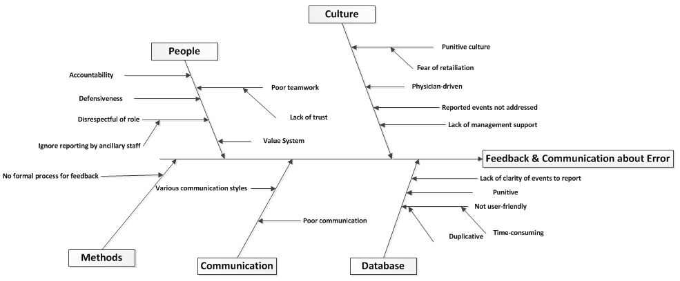
Potential Root Causes: Cause & Effect Diagram
Root Causes
No formal process for feedback
No accountability or follow-up
Lack of management support
Nurse-driven reporting
No standard review process for events reported
Punitive culture/Fear of retaliation
Reporting system lack of ease of use
Reporting system lack of functionality
Poor clarity of events to report
Lack of awareness of unsafe behaviors or conditions
Lack of follow through on improvement/ownership

Slide 63
Improvement Interventions
Fishbone
Brainstorm
Process Map/ Flowchart
Improvements
Notes:
How did your project decide on the Best Solutions to be implemented?
Include tools or strategies used by project team to generate and rank solution ideas, for example Brainstorming, DOE, Solution and Criteria Matrix etc.

Slide 64
Mobilizing Commitment:
Stakeholder Analysis
Role | Resistant | Skeptical | Neutral | Supportive | Enthusiastic
VP Patient Care Services |  |  |  | x
Chairman OB/GYN |  |  |  | x
Medical Director, OB/GYN |  |  |  |  | x
Medical Director/Anesthesiology |  |  |  |  | x
Anesthesiology Attendings, Residents |  |  |  | x
OB/GYN Attendings, Residents |  | x
PCD 7W
PCD 7S |  |  |  |  | x
Clinical Manager, 7S |  |  |  |  | x
Clinical Manager, 7W |  |  |  |  | x
Physician Assistant |  | x
Notes:
Change management strategies:
Stakeholder analysis
Monitoring Progress: Safety Culture Dashboard

Slide 65
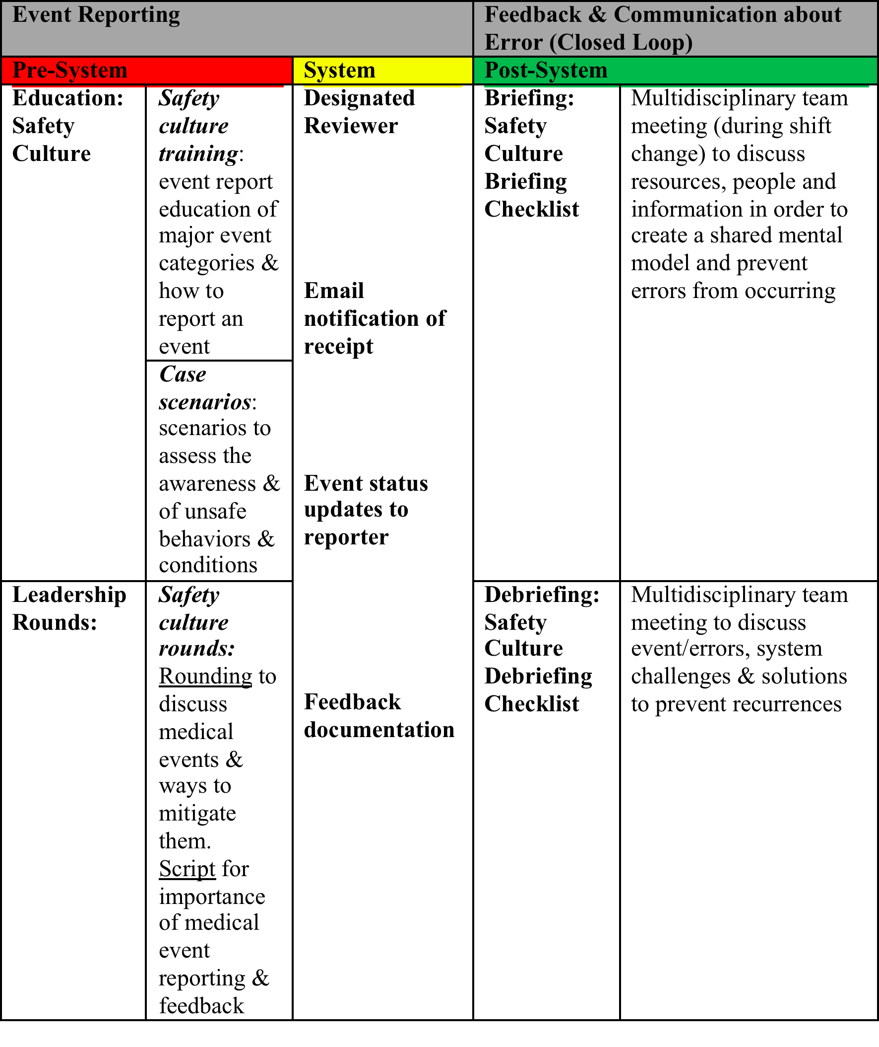
Notes:
What are the specific elements and details of your improvements?
This should include the implementation plan for your improvements.
Start date and anticipated end dates to your improvement strategies.
What are the potential risk points or failures of your solutions?
What are the potential failure modes and impacts of the failures?
What the prevention strategies to make sure the improved process will not fail? How do you plan to validate the solutions and evaluate if the solutions meet the project goal?
Any completed pilot testing-describe
The sample size needed to detect statistical significant improvements.

Slide 66
Intervention-Root Cause Summary
Process | Outcome (Y) Factor (X) | Improvement (s)
Pre-System (Trust) | (Y): Closed Loop (X): Staff fear of reporting | Senior Administrator Safety Session
Pre-System (Trust) | (Y): Closed Loop (X): Lack of management support | Senior Administrator Safety Session
Pre-System (Report) | (Y): Closed Loop (X): Lack of awareness of unsafe conditions/behaviors | Safety Culture Categories/ Definitions
Pre-System (Report) | (Y): Closed Loop (X): Poor clarity of events to report | Event Reporting Framework: Organized Objective Pertinent Summary (OOPS)
System | (Y): Closed Loop (X): Reporting system ease of use | Implement new event reporting system
System | (Y): Closed Loop (X): Reporting system lack of functionality | Implement new event reporting system
Post-system (Improve) | (Y): Closed Loop (X): Follow-through on improvement/ownership | Implement new event reporting system Debriefing/Briefing Vision Board
Post-system (Improve) | (Y): Closed Loop (X): No formal process or accountability for follow-up (leadership) | Implement new event reporting system Debriefing/Briefing Vision Board

Slide 67
Framework for Reportable Events
Categories of Safety Culture definitions
  Communication/Team function
  Medication safety
  Patient flow
  Patient Related: Practice/Policy
  Environment
  Information Technology/Systems
  Near miss
  Adverse medical event
  Workplace violence
Notes:
These are the event categories that we came up with in our group work. This was based on the event categories used for patient safety rounds w/ Dr. Cooke and his group.

Slide 68
Event Reporting Format: OOPS
Organized
Arrange by category of event type
Objective
Depersonalized
Pertinent
Include pertinent positive and negatives findings
Include relevant facts
Summary
Concise brief report

Slide 69
Senior Administrator
Safety Session (SASS)
Leadership safety culture rounds with frontline staff & providers
Assess safety culture, challenges, and discuss possible solutions
Held once per month
  Alternating on day and night shift (2pm & 10pm)

Slide 70
MERS-TH
  Current system
  Homegrown
  Activated in 2000
  15,000 reports/year since 2007
  Brought event reporting into staff consciousness
  Wide usage of data to improve safety
  Outdated question bank (locked in)
  Lack of customizability
  Limited data reporting features
  Lack of feedback tools
  Antiquated info routing/sharing scheme
  Comparatively less user-friendly

Slide 71
RL Solutions (RL6: Risk)
Separating factors
  User experience
  Customizability
  Reporting capabilities
  NewYork-Presbyterian already a client (Feedback module)
  Reputation
  Add on features
    Alerts/feedback
    Single sign on from EMR
15

Slide 72
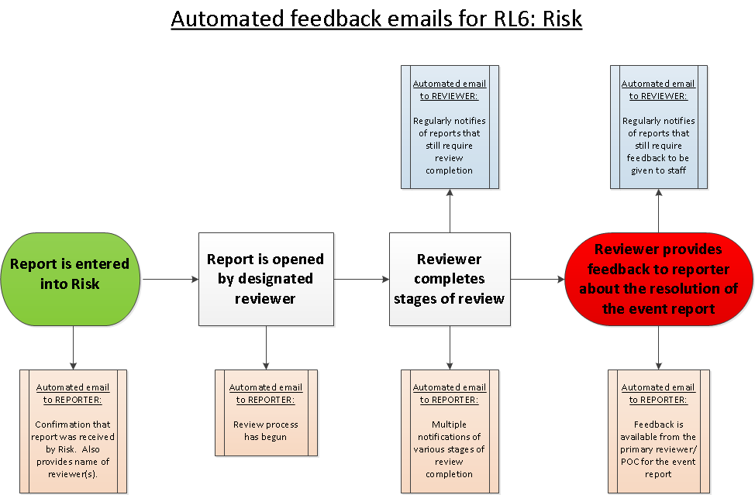

Slide 73
Briefings
Multidisciplinary meeting
Checklist of current status
  Clinical/operational
  Environment/Equipment
  Acknowledgements/announcements/feedback
Held at Tues & Fri signoff rounds (7:30am/pm)

Slide 74
TEAM
Charge Nurse: _________ Baby Nurse:________
OB: Staff Attending, Attending(s), Chief Resident and Residents
Anesthesia: Attending(s)___ Residents___ CRNA____
Chief/Acting-Chief PA and PA’s
Staffing Numbers: RNs__ ORTs___, PCAs____, Registrars____ Orientatee (RN’s)____
Number of staff Short: RNs____, ORTs___ PCAs___ Registrars____
CLINICAL/OPERATIONAL
Inductions:
Number in progress?
Number still expected?
Number on 7 South?
Number in Labor?
C-sections:
Number of C-Sections pending?
Number expected?
Number in PACU?
Triage:
Number patients in Triage?
Number to be admitted?
Number waiting to be seen?
Number of available beds in Postpartum and 7 South?____ 7W___7N____7Central____
ENVIRONMENT/EQUIPMENT
What’s pending repair?
What’s been repaired?
Supply issues?
TEAM ACKNOWLEDGEMENTS/ ANNOUNCEMENTS/FEEDBACK
Special occasions, achievements
Illness, sympathy
Employee Opinion or AHRQ (Safety Culture) Survey, for example
MERS feedback
Social Issues of Importance

Slide 75
Debriefings
All staff & providers
Retrospective look, “vital signs”
  Near miss or event review
  Discuss challenges and possible improvements
  Team acknowledgements
Held during monthly staff meetings
  Scheduled one month during day shift, next month during night shift.

Slide 76
I. “VITAL SIGNS”
How did we do today?
Was communication thorough and clear?
Was situational awareness (state of knowing the conditions that affects one’s work) maintained?
Was workload distribution equitable among available staff?
Was task assistance offered and/or requested?
Were there any errors or near misses? If so were they entered in MERS? *If not yet done, then must be entered before shift’s end.
What should improve?
Where there systems issues that contributed to the near miss or harm?
Were there any environmental issues that contributed to any event or near miss?
Were there any medication safety issues that contributed to any event or near miss?
Were there any information technology/equipment issues that contributed to any event or near miss?
What should be done differently to prevent the near miss or an event from happening again?
What are your suggestions for making and sustaining improvements?
II. TEAM ACKNOWLEDGEMENTS
Please acknowledge behaviors that foster a culture of safety.

Slide 77
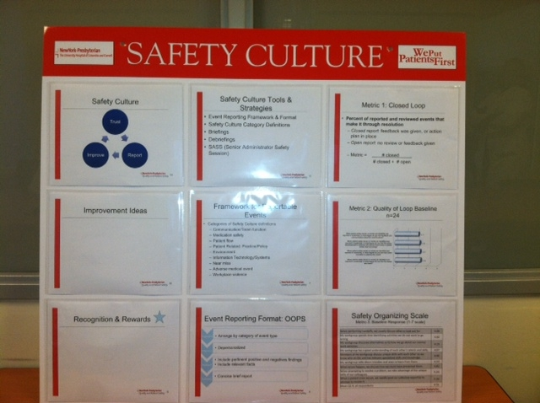
Safety Culture Vision Board

Slide 78
Thank You!
Questions

