Slide 1

TeamSTEPPS and the Changing Face of Healthcare
Abdul Mondul, MD
Mei Kong, RN, MSN
Erin Howe, DNP, RN, ANP-BC

Slide 2
Learning objectives
Discuss how TeamSTEPPS can support teams in the transition to healthcare reform
Explain how TeamSTEPPS can enhance clinician’s joy of work
Discuss how embedding TeamSTEPPS tools in to the electronic medical records can improve communication, patient safety and quality

Slide 3
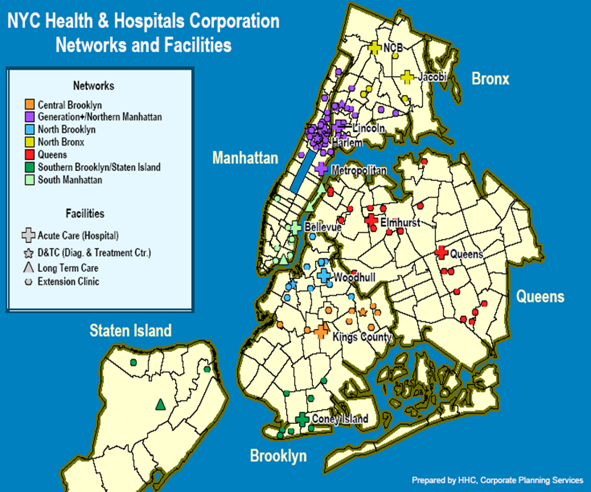
Who we are

Slide 4
The Situation
“The American healthcare system is a dysfunctional mess.”
-Ezekiel Emanuel, MD
Chair, Dept of Bioethics, Clinical Center of the National Institutes of Health
  Impact of Error:
  44,000–98,000 annual deaths occur as a result of errors
  Medical errors are the leading cause, followed by surgical mistakes and complications
  More Americans die annually from medical errors than from breast cancer, AIDS, and car accidents combined
  7% of hospital patients experience a serious medication error
  -Institute of Medicine Report - 1999
Cost associated with medical errors is $8–29 billion annually.

Slide 5
Patient
Satisfaction
QUALITY
SAFETY
COST
Efficiency
OUTCOMES
Access

Slide 6
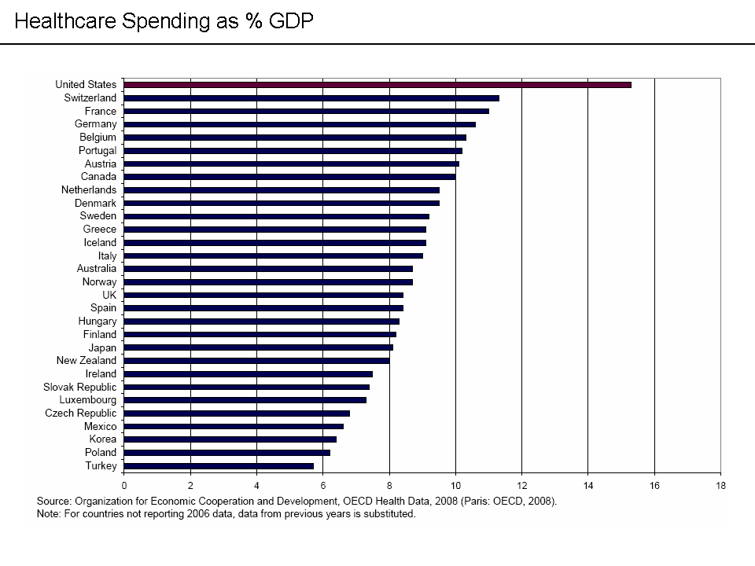
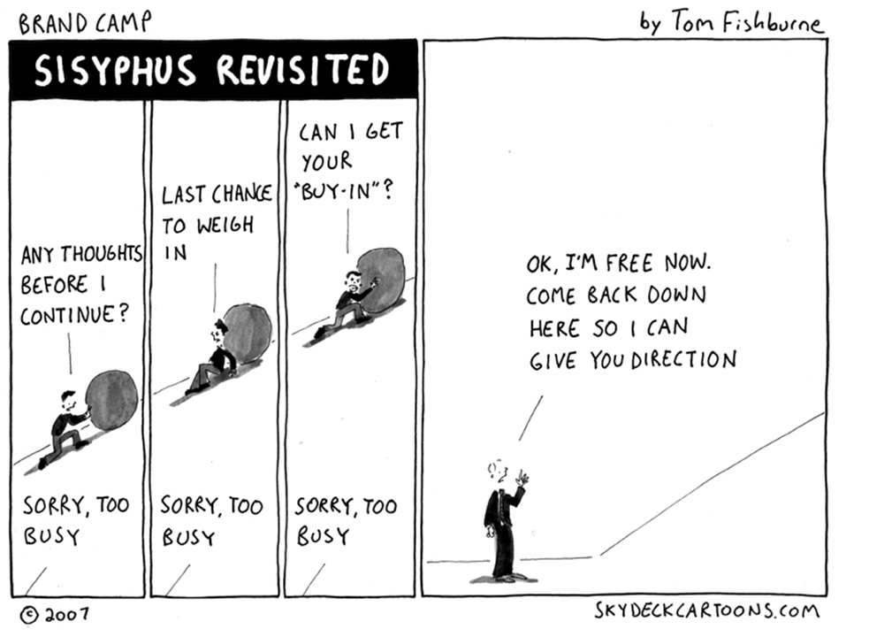

Healthcare is COMPLEX!

Slide 7
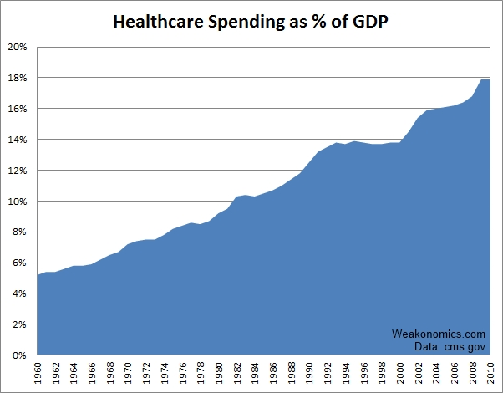

Slide 8
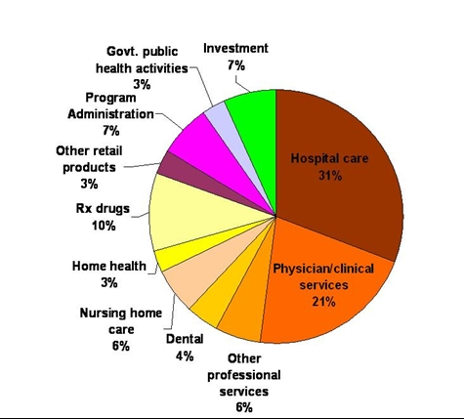
National Health Expenditures, 2008
Hospital care and physician/clinical services combined account
for half (51%) of the nation’s health expenditures.
Total = $2.3 Trillion
Source: Centers for Medicare and Medicaid Services, Office of the Actuary, National Health Statistics Group.

Slide 9
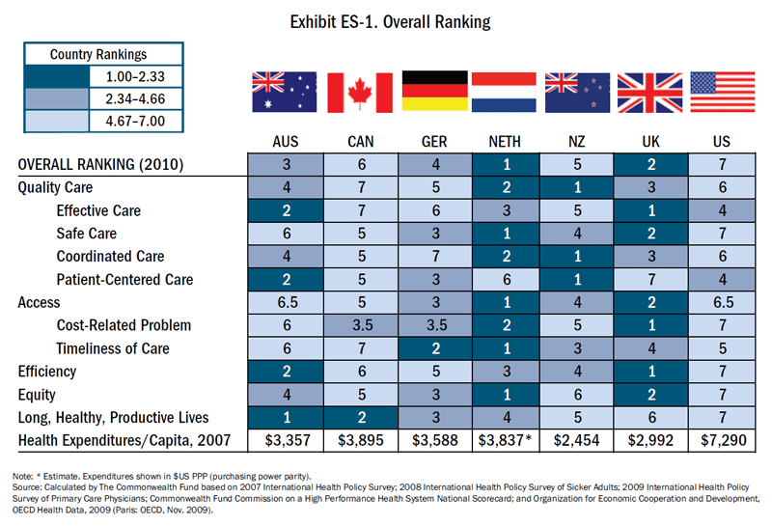

Slide 10
Expectations from REGULATORS
ACGME
Statewide
Perinatal
Data
System
Inpatient
Reporting
System
Outpatient
Reporting
System
Institute
For Safe
Medication
Practices
National
Committee
for Quality
Assurance
National
Patient
Safety
Foundation
9” Scope
of Work
Oasis
Centers for
Medicare and
Medicaid
Services
HQA
Data
Collection
HCAHPS
HHQI
Accreditation
Safe Practices
Advancing
Excellence
NHQI
The Joint
Commission
NPSGs
SCIP
ACE
MDS
NYS Influenza –
Pneumonia
Reporting
Ambulatory
Care
Sentinel Event
Reporting
Managed
Care Bridges
to Excellence
NYPORTS
NYS
SPARCS
IMPACTs
Hospitals
Institute for
Healthcare
Improvement
Emergency
Departments
Infections
100K/5 Million
Lives
Campaigns
Safe
Practices
National
Quality
Forum
Serious
Reportable
Events
Nursing Homes
Home Care
NYS
Potentially
Preventable
Complications
Experience
of Care
Home
Health
Patient
Hospital
Measures
Partnership
For Patient
Safety
NYS Criminal History
Record Checks
Ambulatory
Quality
Alliance
NYS
Registries
Home
Health
Compare
Private
Collaborative
Agency for
Healthcare
Research
And Quality
KEY
Nursing
Home
Compare
Leapfrog
Group
PSOs
State
NYS Quality and
Surveillance
NYS Hospital
Acquired Infection
Reporting
Federal
Hospital
Rewards
Program
Safe
Practices
HCUP
Quality
and Safety
Indicators
Third-Party

Slide 11


IHI: Triple Aim
CMS: “Better Health, Better Care, Lower Cost”
Improve the Health of the Population
Enhance Patient Experience (quality, access, reliability)
Reduce (or at least) Control Costs
Uncoordinated
Providers
ACO
Improving
Value and Care
Yes
Receive Financial Incentive
No
Subject to Financial Penalty
Notes:
7/29/2013 9:53 AM
© 2007 Microsoft Corporation. All rights reserved. Microsoft, Windows, Windows Vista and other product names are or may be registered trademarks and/or trademarks in the U.S. and/or other countries.
The information herein is for informational purposes only and represents the current view of Microsoft Corporation as of the date of this presentation. Because Microsoft must respond to changing market conditions, it should not be interpreted to be a commitment on the part of Microsoft, and Microsoft cannot guarantee the accuracy of any information provided after the date of this presentation.
MICROSOFT MAKES NO WARRANTIES, EXPRESS, IMPLIED OR STATUTORY, AS TO THE INFORMATION IN THIS PRESENTATION.
11

Slide 12
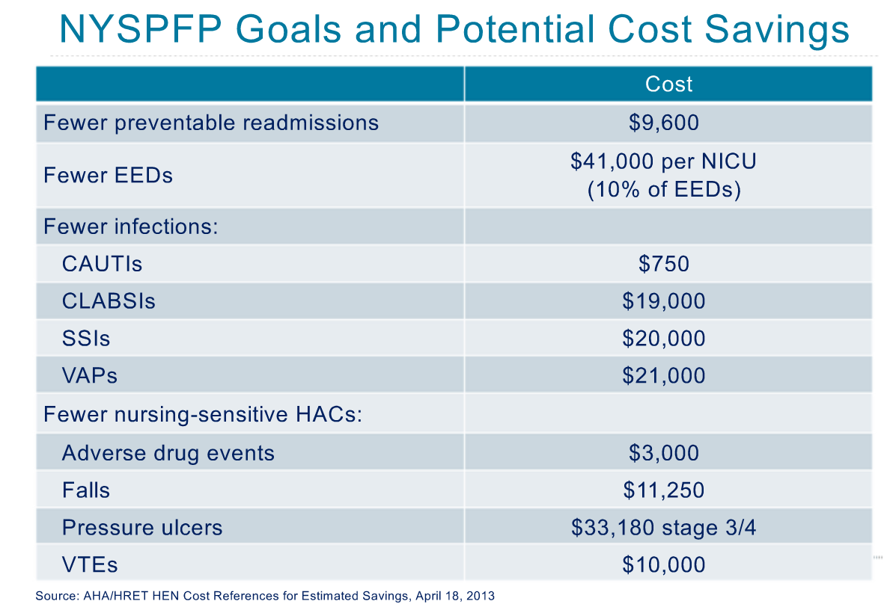

Slide 13
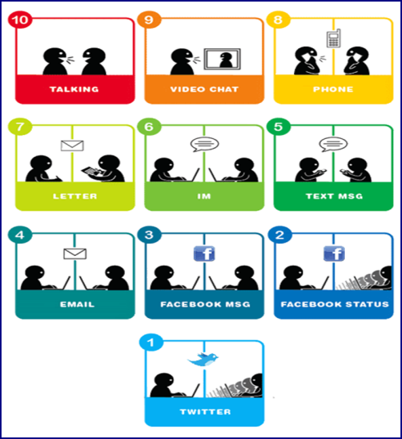
Communication Challenges in Healthcare
Professionals from a variety of disciplines involved in providing care that have different perceptions and personalities
Hierarchical organization
Culture, language, and channel barriers
Differences in education and training among professions
Health care professionals curricula focus primarily on individual technical skills, neglecting teamwork and communication skills

Slide 14
“Incompetent people are, at most 1% of the problem. The other 99% are good people trying to do a good job who make very simple mistakes and it’s process that set them up to make these mistakes.”
Dr. Lucian Leape, Harvard School of Public Health

Slide 15

Error is Inevitable Because of
Human Limitations
Limited memory capacity – 5-7 pieces of information in short term memory
Negative effects of stress – error rates
  - Tunnel vision
Negative influence of fatigue and other physiological factors
  -Cognitive performance after 24 hrs. without sleep equivalent to blood alcohol of .10 !
  Dawson et al, Nature, 1997
Limited ability to multitask – cell phones and driving
Reference:
J. Bryan Sexton, Ph.D.
Johns Hopkins University

Slide 16
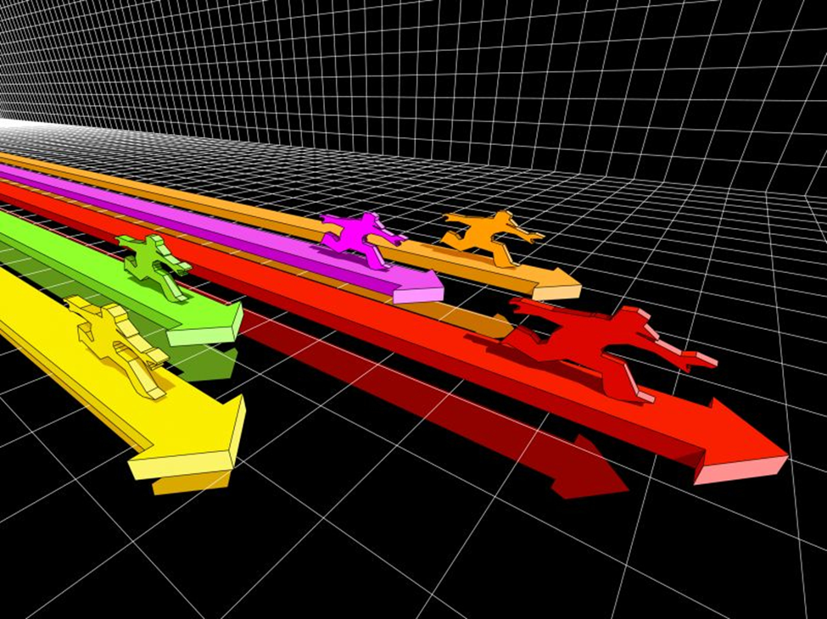
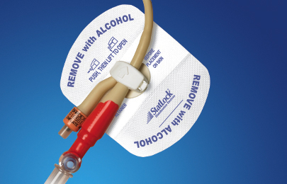

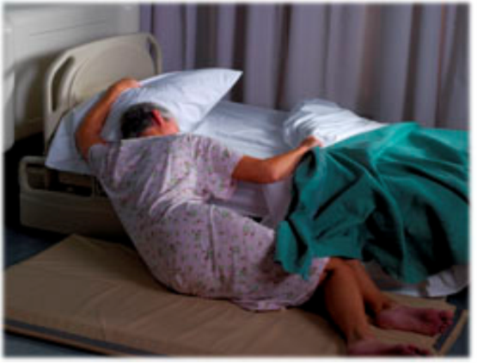
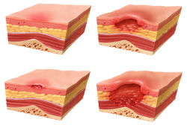
The Challenges

Slide 18
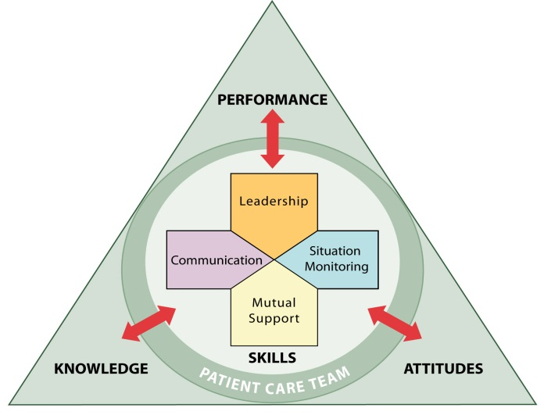
How can we manage all these changes?
    Begin with our people!
    Our TEAMS are our greatest asset and they can make the most impact in patient safety!

Slide 19
TeamSTEPPS Principles in action
Leadership
- Sense of urgency / Planning
- Team Selection / Best practices
- Support and role modeling
Situation Awareness
- Education
- Process hardwiring – Monitoring data
- Shared mental model
Mutual Support
- Empower staff
- Team cross monitoring
Communication
- Tools to support Briefs / Handoffs / Huddle
- Transparency

Slide 20
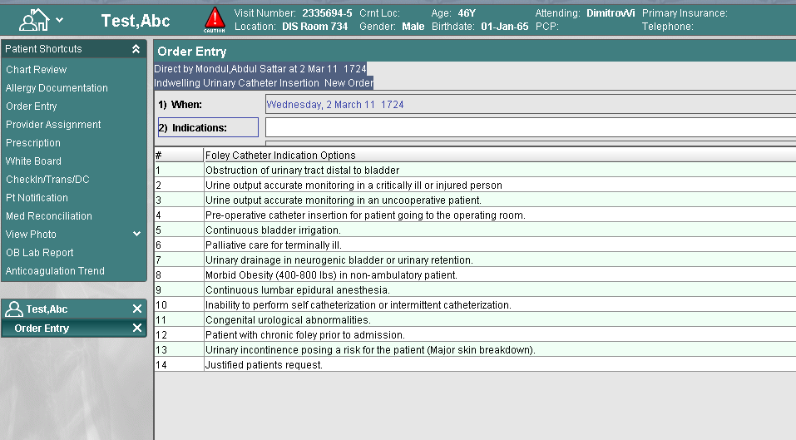
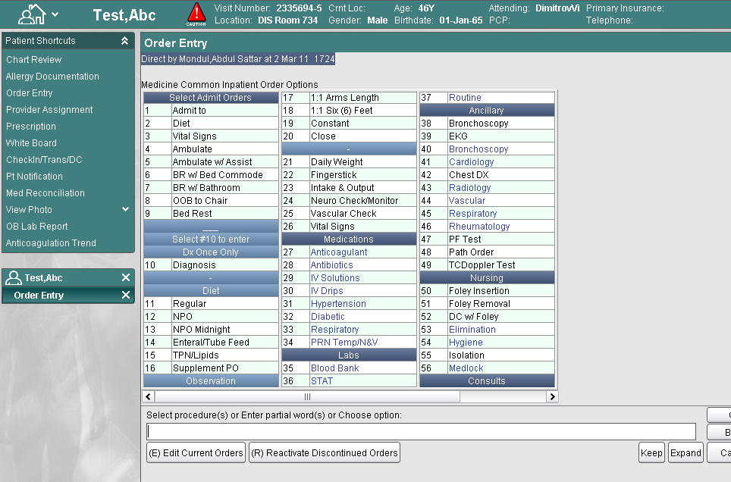
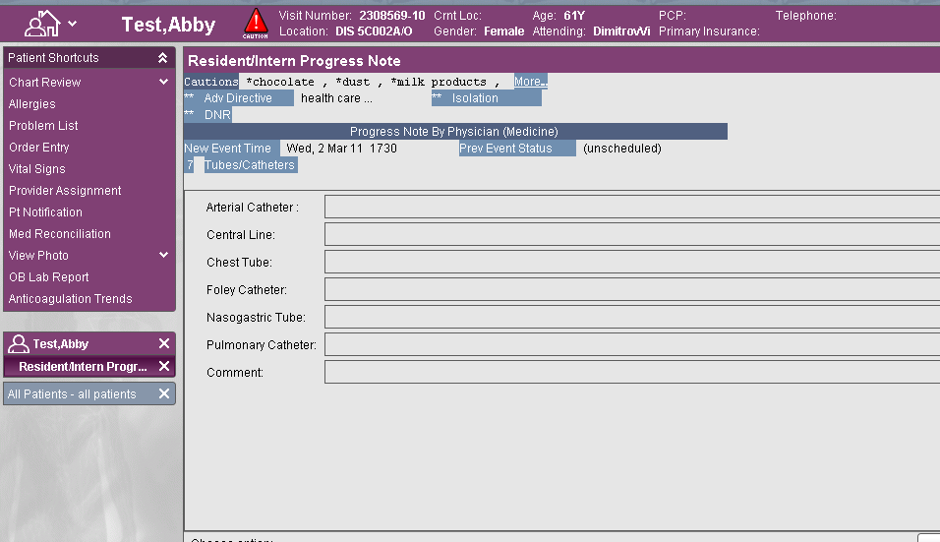
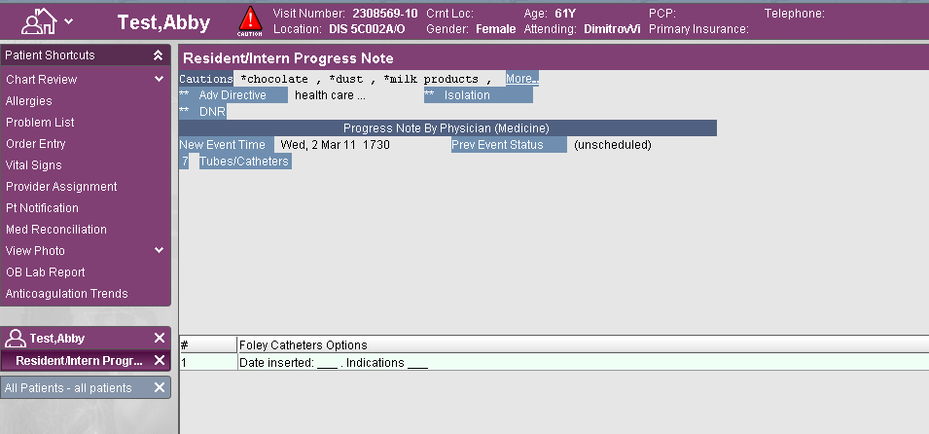
CAUTI’s: Situation Awareness / Mutual Support
Easy access
to order
Indication for Insertion
and continuation
Progress Note
Document Tubes Lines
Indications / Dates

Slide 21
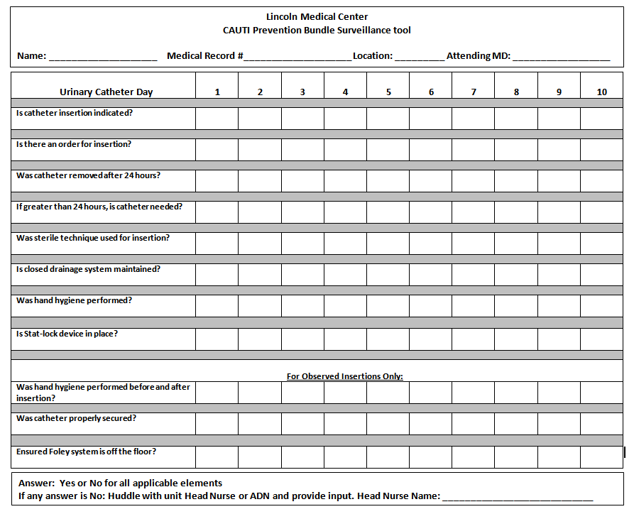
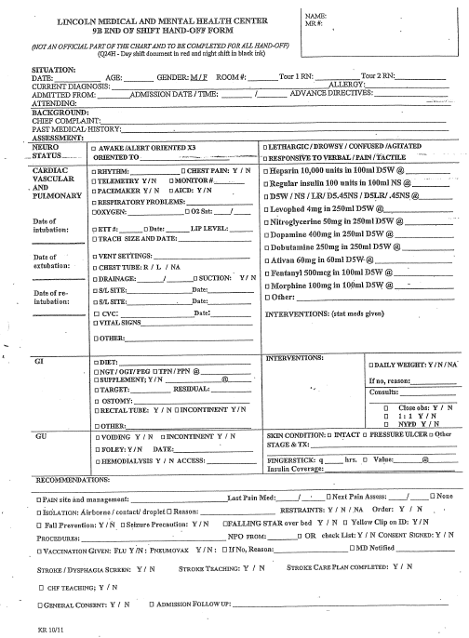
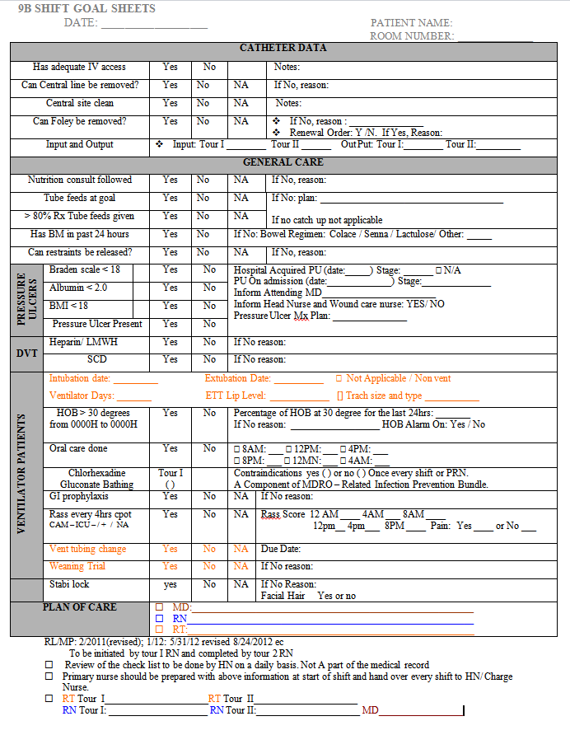
CAUTI’s: Communication Tools

Slide 22
CAUTI rates 9B - Step Down unit
# per 1,000 Catheter days
Notes:
Reduction in CAUTI’s
40% between 2009 - 2010
80% between 2010 - 2011
Overall 98% between 2009 - 2011
Removal of indwelling urinary catheters in the post operative period increased from 82% to 100%
Key elements: Communication tools, IT Support and Interdisciplinary teamwork
Moving Forward:
Sustain outcomes
Surveillance rounds
Ongoing education to staff

Slide 23
Impact on Patient Safety Culture Survey

Slide 24
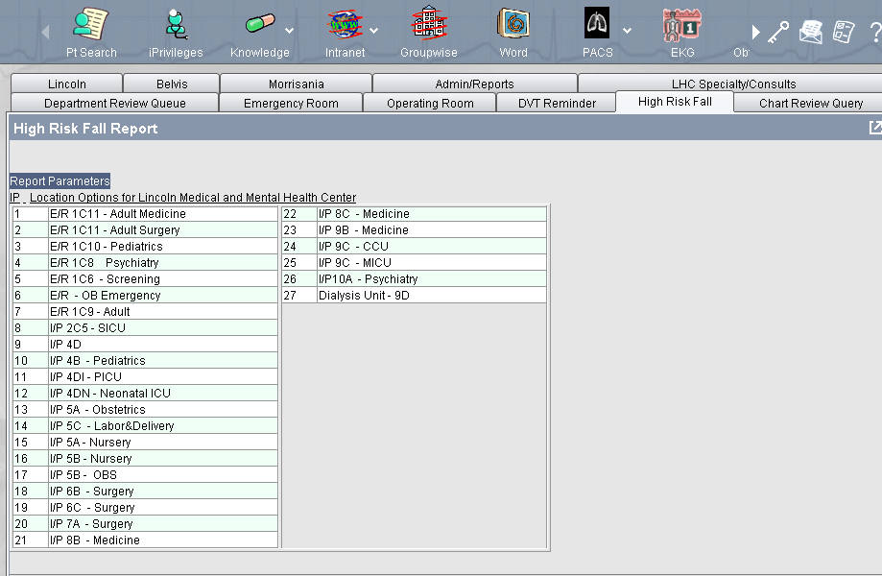
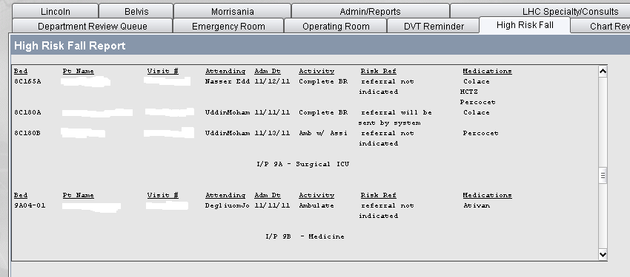
Falls Program Huddle Tools

Slide 25
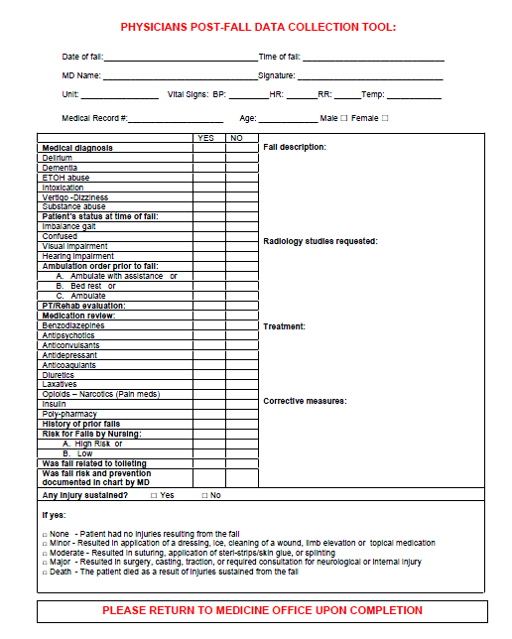
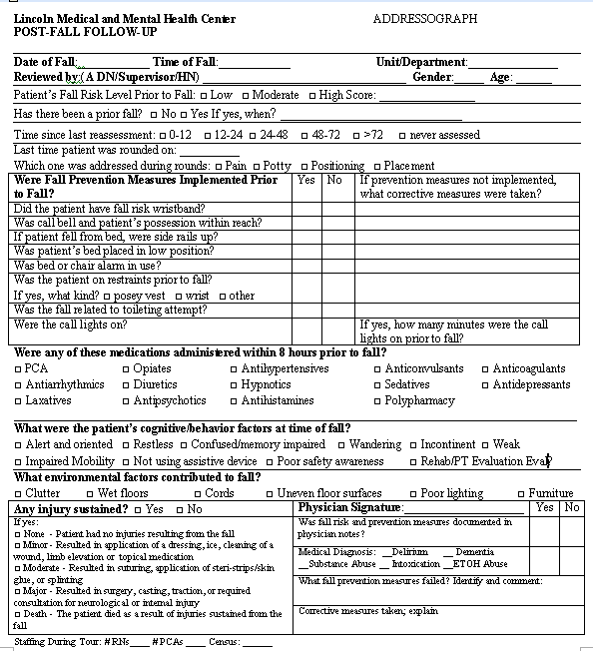
Falls Program Debrief Tools

Slide 26
Fall Rates Per 1000 Patient Days

Slide 27
Falls With Moderate / Severe Injury
Notes:
Over all reduction in falls rate from 2.15 in 2011 to 1.7 per 1000 patient days in 2012
Injury rate reduced from 0.36 to 0.28 per 1000 patient with only 1 severe injury
Distribution of falls hospital wide remains the same with increase in falls in surgery and psychiatry units

Slide 28
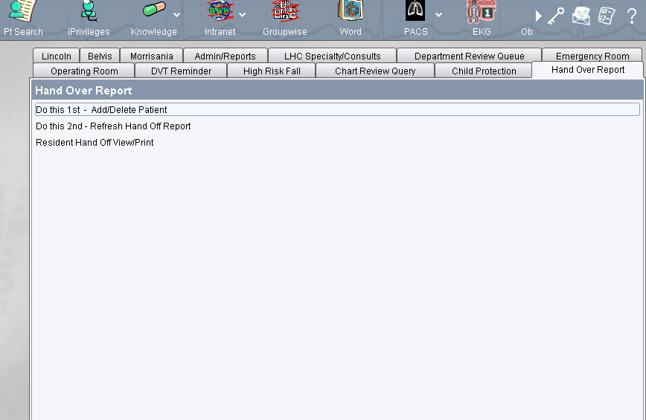
Hand-Offs

Slide 29
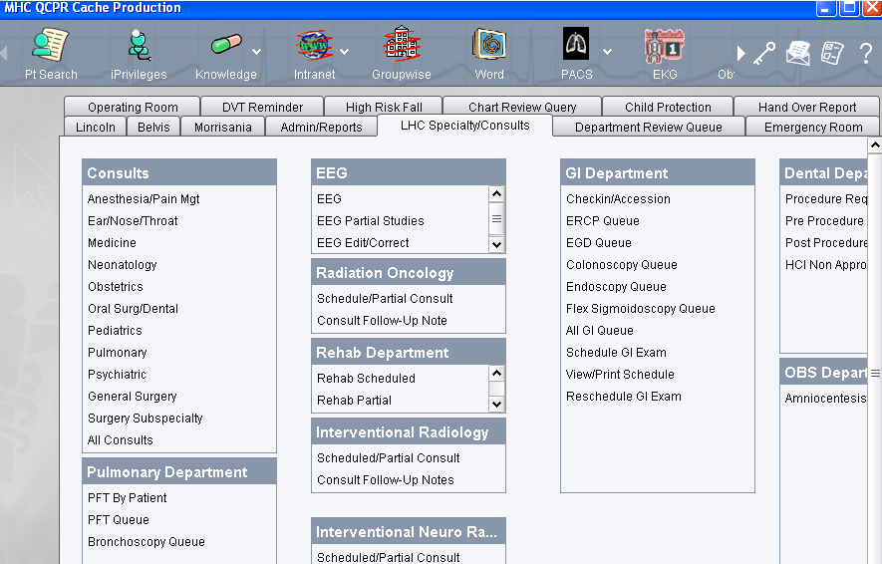

Slide 30
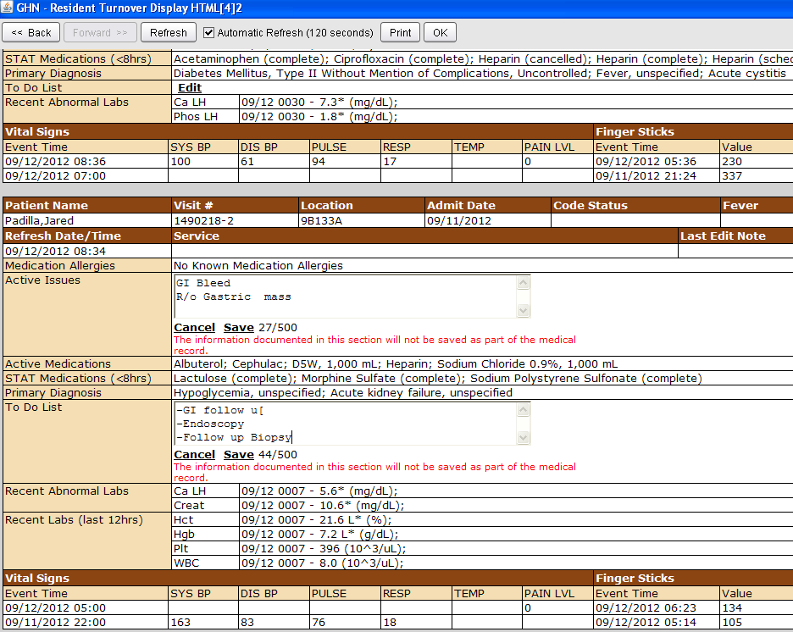
Notes:
Introduction: Introduce yourself and your role/job (include patient)
Patient: Identifiers, age, sex, location
Assessment: Present chief complaint, vital signs, symptoms, and
diagnosis
Situation: Current status/circumstances, including code status,
level of uncertainty, recent changes, and response to treatment
Safety: Critical lab values/reports, socio-economic factors, allergies, and alerts
(falls, isolation, etc.)
THE
Background: Co-morbidities, previous episodes, current medications, and family history
Actions: What actions were taken or are required? Provide brief rationale
Timing: Level of urgency and explicit timing and prioritization of actions
Ownership: Who is responsible (nurse/doctor/team)?
Include patient/family responsibilities
Next: What will happen next? Anticipated changes?
What is the plan? Are there contingency plans?

Slide 31
Safe Transitions
Care coordination
Decrease readmissions
Portable medical records
E-Prescribing
Comprehensive Primary care

Slide 32
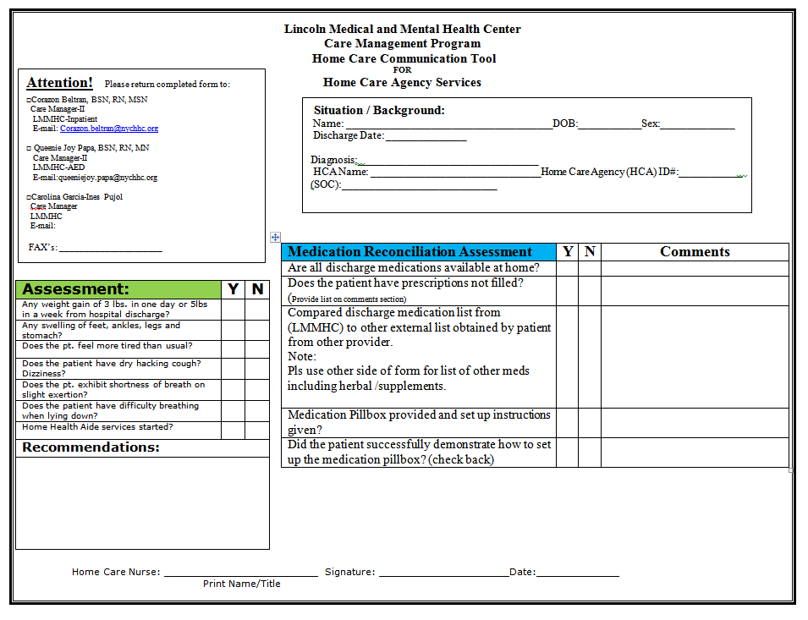
Care Management

Slide 33
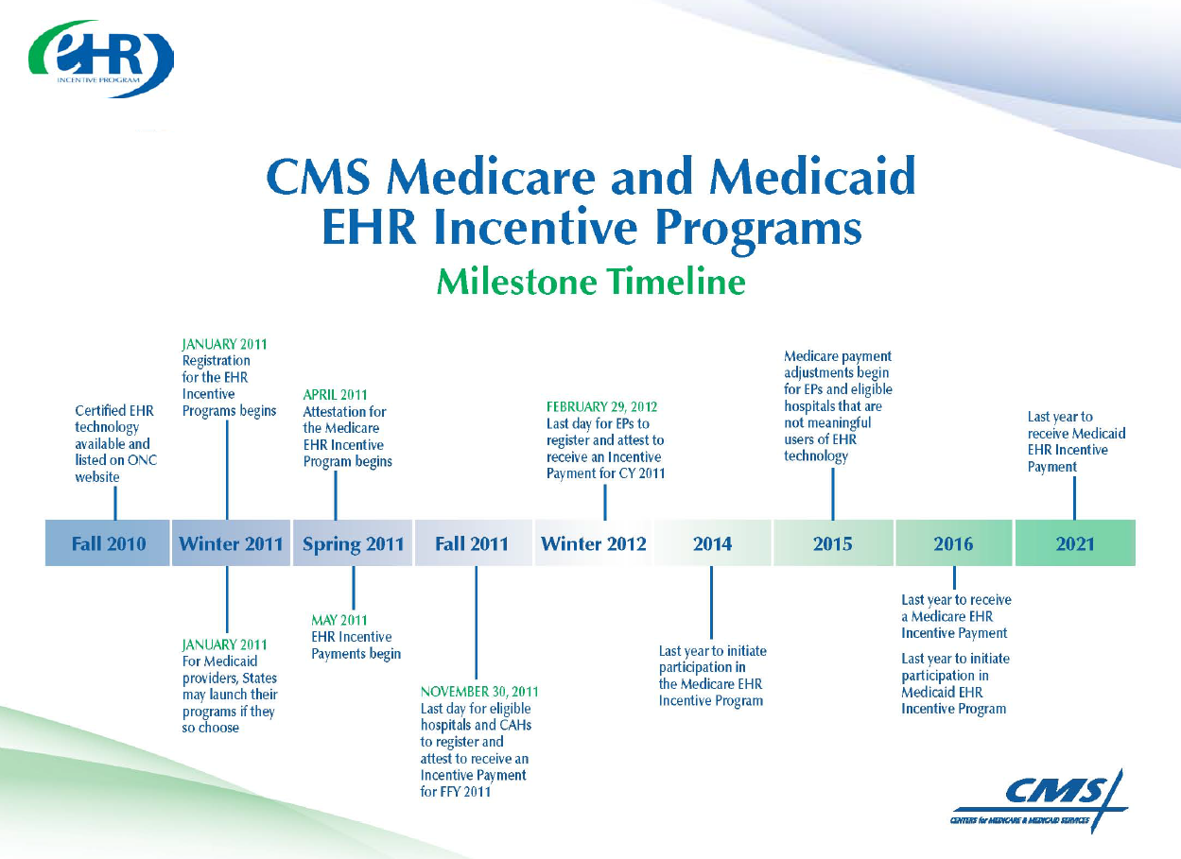

Slide 34
Meaningful Use
MANDATED IN LAW TO RECEIVE INCENTIVES
Use a Certified Electronic Health Record (EHR) in a Meaningful way
Use an HER that can exchange information with other systems electronically
Submit reports to CMS that include performance measures providing meaningful use

Slide 35
Meaningful Use
Improve quality, safety, efficiency, and reduce health disparities
Engage patients and families in their health care
Improve care coordination
Improve population and public health
Ensure privacy and security protections for personal health information

Slide 36
Three Stages of Meaningful Use
Stage 1: Data capture and sharing
Stage 2: Advanced clinical processes
Stage 3: Improved outcomes

Slide 37
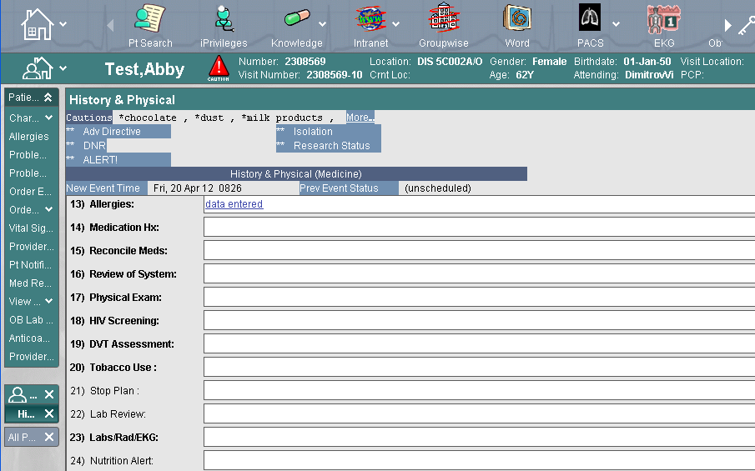
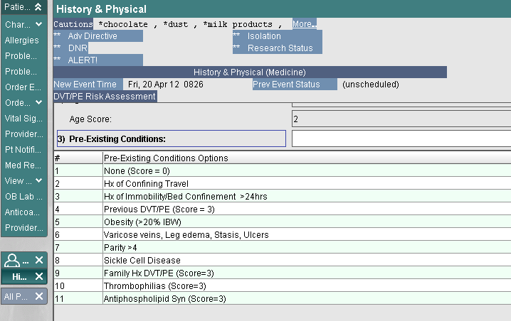
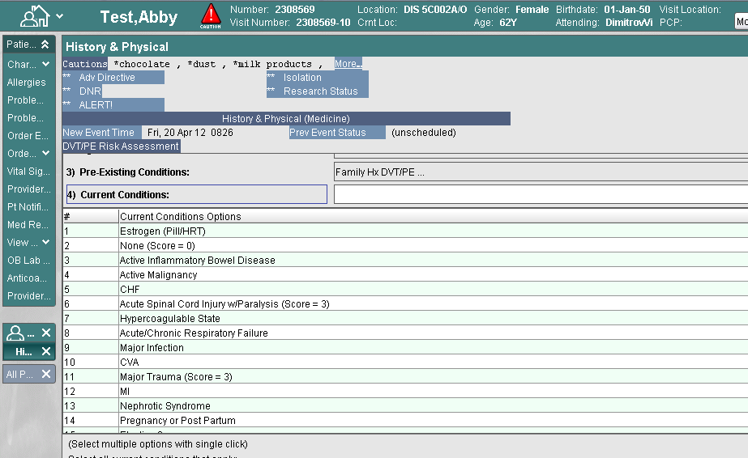
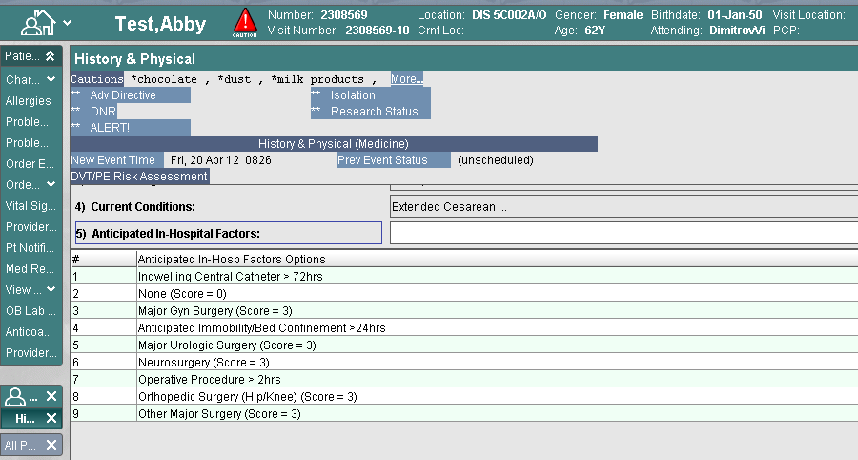
SBAR : DVT Prophylaxis

Slide 38
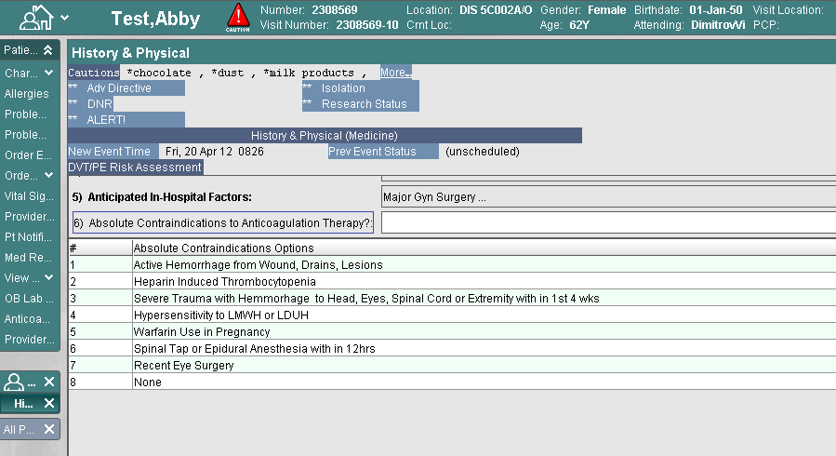
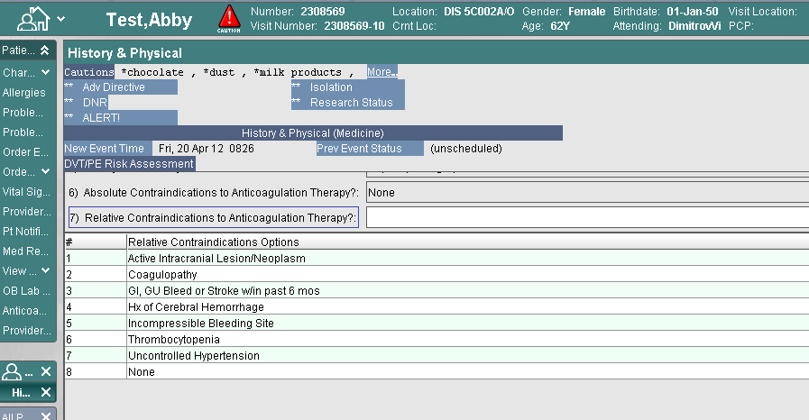
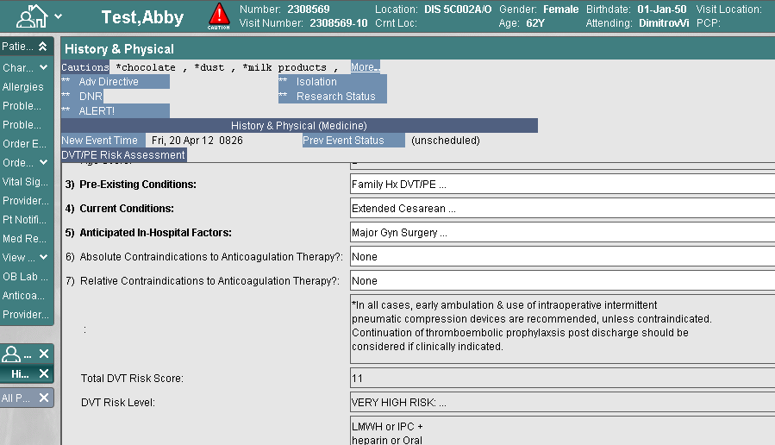
SBAR : DVT Prophylaxis

Slide 39
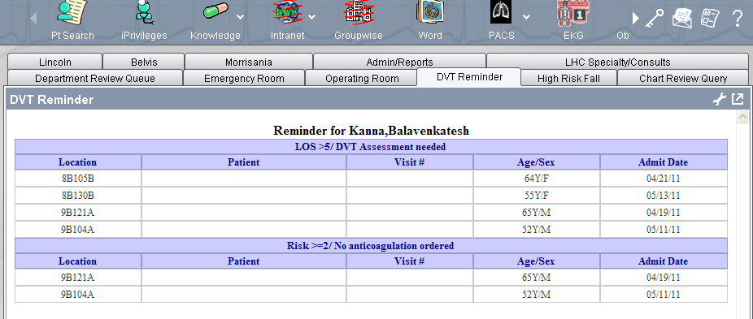
Check back – Situation Recommendation DVT Prophylaxis

Slide 40

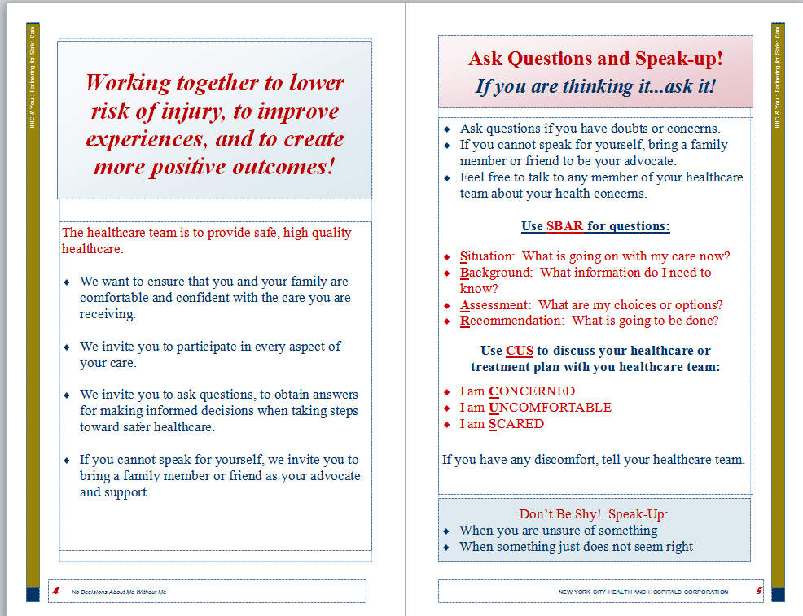
Patient Involvement

Slide 41
TeamSTEPPS and Palliative Care
Conduct briefs, huddles, and debriefs
Cross monitor and provide mutual support to team members, patients and families
Provide timely and constructive feedback
Actively share information among team members, patients and families
Ensure that all members of the team, patients and families have a shared mental model
COMMUNICATE
TeamSTEPPS tools and strategies are meant to promote an environment of open communication where everyone is made to feel comfortable speaking up, regardless of the situation or the complexity of the procedure.

Slide 42

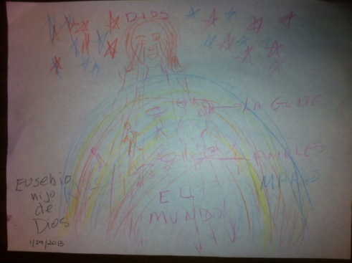

A Day in A Healing Heart
Palliative Care Volunteers - TeamSTEPPS

Slide 43
How Does Teamwork Change Culture?
Change your culture one behavior at a time
  Change Reaction
  Change Performance
  Produce Better Outcomes
  Improve Efficiency
  Improve Safety
  Increase Joy

Slide 44
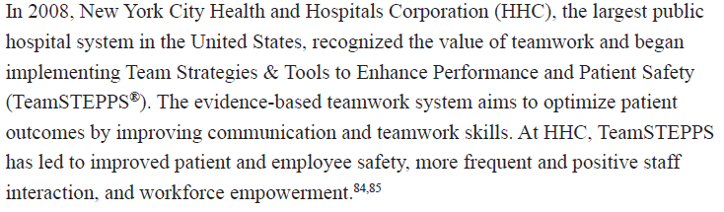
Creating the culture

Slide 45

Joy of work
“Work Would Be Great If It Weren’t for the People”
Ronna Lichtenberg

Slide 46
Joy of work
Am I treated with dignity and respect by everyone?
Do I have what I need so I can make a contribution that gives meaning to my life?
Am I recognized and thanked for what I do?
Paul O’Neill, Former CEO Alcoa
Through the Eyes of the Workforce
Creating Joy, Meaning, and Safer Health Care
Lucian Leape Institute

Slide 47
Joy at work
“The secret of joy in work is contained in one word – excellence. To know how to do something well is to enjoy it”
Pearl Buck

Slide 48
Summary
Healthcare delivery is becoming more and more complex…a wrong turn or a missed opportunity can result in a medical error and/or even death!
Our greatest asset and liability are our people!
We must utilize technology effectively to prevent errors and design systems that address human factors
TeamSTEPPS is a great foundation for a safe culture and can help us avert some of the landmines we are encountering in the changing face of healthcare

Slide 49

“We are being judged by a new yardstick; not just how smart we are, or by our training and expertise, but also how well we handle ourselves and each other.”
Daniel Goleman, Ph.D.
Working with Emotional intelligence
Notes:
Mei

Slide 50

“With great power comes great responsibility”

Slide 51


Slide 52
Cna Empowerment through a teamwork & communication Program in the nursing home setting
Erin Howe, DNP, RN, ANP-BC
University of Rochester

Slide 53
Teamwork…means never having to take all the blame yourself

Slide 54
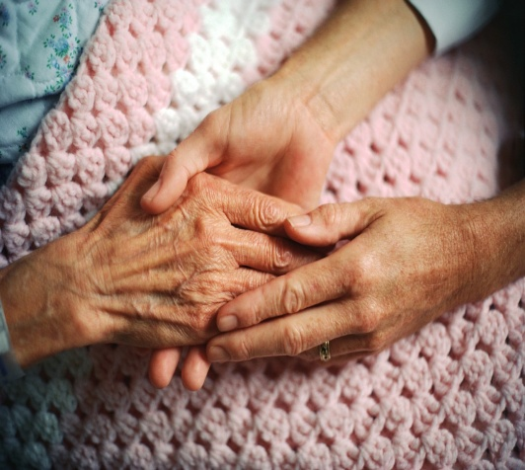
The Long Term Care Dilemma
Oldest old (85 +): fastest growing segment of population:
    By 2050: number 19 million
    Comprise 24% of elderly Americans
Highest utilization of health care dollars
    2009: Medicare spent $54.4 billion on post-acute care
    29% increase compared to 2005 expenditures
Nursing Home costs
    2000: $195 billion
    2040: projected $540 billion

Slide 55
The Cost of Turnover
7 out of 10 care providers in long-term care (LTC) are CNAs (Certified Nurse’s Aides)
8 out of 10 hours of care provided in LTC by CNAs
Over next decade, demand for CNAs will 35%
BUT this labor pool will only 2%
CNA turnover in a facility can be > 100%
Replacing a CNA may cost > $4,000

Slide 56
Impact of CNA Turnover in LTC
CNA Turnover
Reduced patient satisfaction
Loss continuity of care
Impaired team cohesion
Reduced family satisfaction
Safety issues r/t staff shortages

Slide 57
WHY IS CNA EMPOWERMENT SO VITAL IN LONG-TERM CARE?
CNA IN LONG-TERM CARE
PHYSICAL DEMANDS
ROLE IN DECISION MAKING
LEVEL OF POSITIVE CHALLENGE
SENSE OF CONTROL
EXPOSURE TO VIOLENCE & ROLE CONFLICT
Eriksen, 2006

Slide 58
Job Dissatisfaction Characteristics
Lack coworker/supervisor support | Heavy workload
Poor communication & teamwork | Limited time to accomplish tasks
Restricted autonomy | Inadequate compensation
Lack involvement in team decisions | Limited or no benefits
Limited advancement opportunities | Staff shortages
Castle, Degenholtz, Rosen, 2006; Cherry, Ashcraft, & Owen, 2007

Slide 59
CNA Empowerment Model
Physical activities
Competence
Positive challenge
Meaning
Sense of control
Autonomy
Role in Decision- making
Impact

Slide 60
TeamSTEPPS
Team Strategies and Tools to Enhance Performance and Patient Safety
Primarily: acute care settings
Appropriate long-term care settings?
Environmental similarities
  Hierarchical authority structure
  Top → down communication
  Multi-disciplinary team

Slide 61
The Program
Regularly scheduled debriefing: <6 minutes at end day shift
CNAs develop debriefing logistics
Each debriefing will be facilitated by rotating CNAs
Facilitation involves asking three questions:
  1) What went well today?
  2) What can we improve on?
  3) What do we need in order to improve?
Mid-way point brainstorming session
Focus groups/interviews post-program

Slide 62
Specific Aims
The process of CNAs developing and implementing a communication program on the Jewish Home Transitional Care Unit will lead to:
  Improved CNA empowerment
  Improved quality of work life
  Reduced intent to leave job in following 3 months

Slide 63
The QWL Survey
QWL=Quality of Work Life
45-item Likert scale
Used in several studies to examine perceived quality of work life of CNAs and nurses
Captures components of empowerment
  Competence, meaning, impact, autonomy
Cronbach alpha coefficient (reliability score) for subscales ranged: .69-.94 (>.7 ideal)
Krueger, et al. (2002)

Slide 64
Intervention
Location: Jewish Home Transitional Care Unit
Two sub-acute rehabilitation wings
  NE: 35 beds
  SW: 33 beds
Participants: CNAs and nurses
Project duration 16 weeks: November-February
Pre-posttest design with built-in replication
  NE wing: 8 weeks: training, program, evaluation
  SW wing: 8 weeks: replicated

Slide 65
Demographics
15 Program participants
  93% Female (n=14 (females): n=1(male)
  53% CNAs (n=8)
  47% Nurses (n=7)
 | Age/Years Employed Participant Demographics
 | SW CNA | NE CNA
Mean years old | 30 | 46
Mean years in facility | 2.8 | 14.3

Slide 66
Debriefing Themes

Slide 67
Climate Change: Debriefings
“We’re meeting AGAIN?”
“Are we meeting today?”
“Can we meet today?!”

Slide 68
RESULTS SUMMARY
SUBSCALE SECTIONS | MEAN SCORE CHANGE PRE→POSTTEST
 | NE WING | SW WING
COWORKER/SUPERVISOR SUPPORT | → | →
TEAMWORK/COMMUNICATION | → | →
JOB DEMANDS | → | →
UNIT CHARACTERISTICS | → | →
INTENT TO LEAVE JOB | → | →

Slide 69
The Impact: Effect Size
Cohen’s d Effect size:
  0.2=small 0.5=moderate >0.8=large
 | Coworker/ Supervisor Support | Team-work/ Communic-ation | Job Demands/ Authority | Unit Character- istics | Job Intent
SW | 1.5 | 1.4 | 2.5 | 1.2 | 1.6
NE | .69 | .39 | .23 | .39 | .14

Slide 70
QWL Survey Likert Scale
Never | Seldom | Sometimes | Often | Always
Very Dissatisfied | Dissatisfied | Not Sure | Satisfied | Very Satisfied
sw
NE

Slide 71
CNA Focus Group Responses
“I have more control over my day and that makes me feel like more a part of a team and less like a little piece of dust!”
“The environment is getting better for me…[I]t feels less stressful.”
“It’s nice to vent and not worry you’re going to get in trouble for complaining.”
“It’s easier to talk to each other about issues when they come up during the day because we know we’ll be talking about it at 1:30 anyway!”

Slide 72
Program Implications
Relationship: staff empowerment & communication/teamwork?
Involvement of CNAs in program design & implementation to enhance sense of impact
Program generalizable to other LTC settings
  Hierarchical nature of nursing home setting
  Custom design by CNAs
  Requires minimal resources/time

Slide 73
Discussion
TeamSTEPPS not previously studied in LTC
Introductory training
  Started a dialogue
  Provided a framework
  Created a roadmap
  Promoted culture change
Debriefing strategy
  Functional
  Adaptable
  Sustainable

Slide 74
Thank You!

Slide 75
References
Barry, T., Brannon, D., & Mor, V. (2005). Nurse aide empowerment strategies and staff stability: Effects on nursing home resident outcomes. The Gerontologist, 45, 309-317.
Castle, N. G., Degenholtz, H., & Rosen, J. (2006). Determinants of staff job satisfaction of caregivers in two nursing homes in Pennsylvania. Health Services Research, 6, doi:10.1186/1472- 6963-6-6
Cherry, B., Ashcraft, A., & Owen, D. (2007). Perceptions of job satisfaction and the regulatory environment among nurse aides and charge nurses in long-term care. Geriatric Nursing, 28, 183-191.
Dawson, S. (2007). Recruitment and retention of paraprofessionals. A presentation to the Institute of Medicine’s Committee on the Future Health Care Workforce for Older Americans. Bronx, NY: Paraprofessional Health Care Institute.
Eskildsen, M. & Price, T. (2009). Nursing home care in the USA. Geriatric Gerontology International, 9, 1-6.
Eriksen, W. (2006). Practice area and work demand in nurses’ aides: A cross-sectional study. BMC Public Health, 6(97), 97-105.
Kanter, R. M. (1977). Men and women of the corporation. New York: Basic Books.
Koren, M. J. (2010). Predictable scheduling. Modern Healthcare, 40, 21-22.

Slide 76
References
King, H. B., Battles, J., Barker, D. P., Alonso, A., Salas, E., Webster, J., Toomey, L., & Salisbury, M. (2008). TeamSTEPPS: Team strategies and tools to enhance performance and patient safety. In Henriksen, K, Battles J. B., Keyes, M. A., Grady, M. L. (Eds.), Advances in Patient Safety: New Directions and Alternative Approaches (Vol. 3: Performance and Tools). Rockville (MD): Agency for Healthcare Research and Quality.
Krueger, P., Brazil, K., Lohfeld, Lynne, Edward, H. G., Lewis, D., & Tjam, E. (2002). Organization specific predictors of job satisfaction: findings from a Canadian multi-site quality of work life cross-sectional survey. BMC Health Services Research, 2, doi: 10.1186/1472-6963-2- 6.
Manser, T. (2009). Teamwork and patient safety in dynamic domains of healthcare: A review of
the literature. Acta Anaesthesiologica Scandinavica, 53, 143-151.
Piven, M. L., Ammarell, N., Lekan-Rutledge, D., Utley-Smith, Q., Corazzini, K. N., Colon-Emeric, C. S., Bailey, D. & Anderson, R. A. (2007). Paying attention: A leap toward quality care. Director, 15, 58-63.

Slide 77
References
Spreitzer, G. M. (1995). Psychological empowerment in the workplace: Dimensions, measurement and validation. Academy of Management Journal, 38, 1442-1465.
Thomas, K. W. & Velthouse, B. A. (1990). Cognitive elements of empowerment: An
“interpretive” model of intrinsic task motivation. Academy of Management Review, 15, 666-681.
Wiener, J. M., Squillace, M. R., Anderson, W. L., & Khatutsky, G. (2009). Why do they stay? Job tenure among certified nursing assistants in nursing homes. The Gerontologist, 49, 198-210.
Yeatts, D. E., & Cready, C. M. (2007). Consequences of empowered CNA teams in nursing home settings: A longitudinal assessment. The Gerontologist, 47, 323-339.

