Slide 1

^{TeamSTEPPS Coaching Workshop}
Carolyn Davidson, RN, BC, MS
James Pappas, MD, MBA
Renae Reiswig, RN, MS, CCM
Helen Staples-Evans, RN, MS, BC-NE

Slide 2
TeamSTEPPS Coaching Workshop
June 12, 2013
Notes:
Dr. Pappas Opens and speaks thru to slide 10. At slide 10 (Agenda slide) Stop point for table discussion opener

Slide 3
Agenda
Introduction
Innovating Excellence
In-Situ Coaching
Simulation Training
  Team Situational Awareness
  How we train physicians
Conclusion

Slide 4
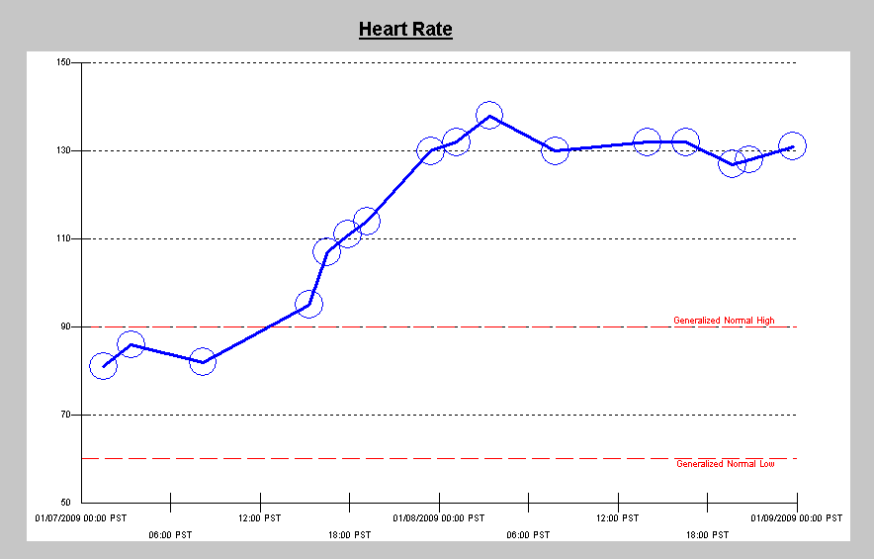
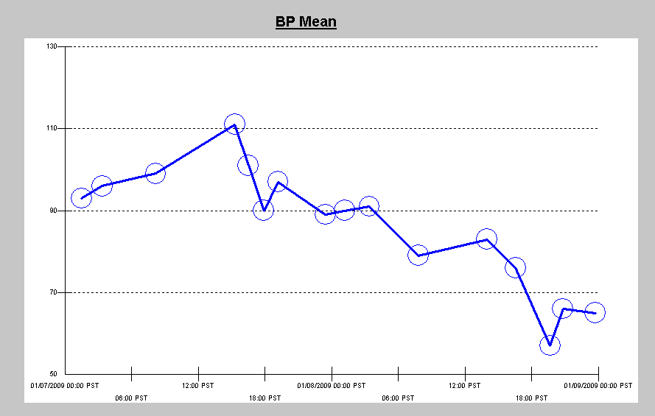
A Young Man With Trauma

Slide 5
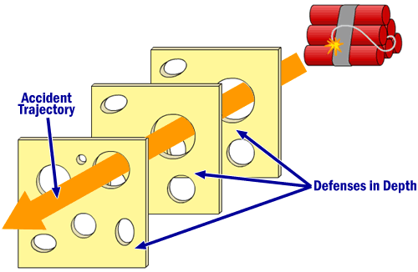
A Young Man With Trauma
A Classic Example of Swiss Cheese

Slide 6
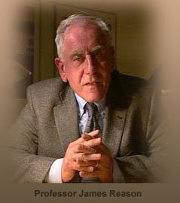
Attending oversight
Anchoring…
James Reason
A very busy unit; charge nurse oversight
A young nurse with no T&C training
The wrong mental model

Slide 7
What is Anchoring?
Anchoring or focalism –
  The tendency to rely too heavily, or "anchor," on a past reference or on one trait or piece of information when making decisions
Also…
Confirmation bias –
  The tendency to search for or interpret information or memories in a way that confirms one's preconceptions

Slide 8
Attending oversight
Anchoring…
James Reason
A very busy unit; charge nurse oversight
A young nurse with no T&C training
The wrong mental model

Slide 9
Most Frequently Identified Root Causes of Sentinel Events Reviewed by The Joint Commission by Year

Slide 10
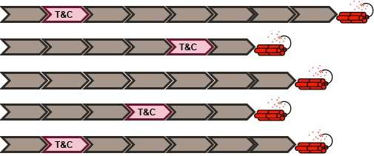
Teamwork and Communication as a Leverage Point
“These are places within a complex system…where a small shift in one thing can produce big changes in everything.” Donella Meadows

Slide 11
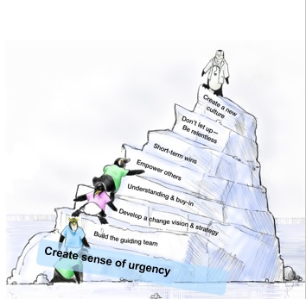
Agenda
Introduction
Innovating Excellence
In-Situ Coaching
Simulation Training
  Team Situational Awareness
  How we train physicians
Conclusion
Notes:
Dr. Pappas: At slide 10 (Agenda slide) Stop point for table discussion opener
No Intro – Switch
Helen takes floor and runs thru slides 11 thru 17

Slide 12
Gallup Patient Loyalty Survey
Inpatient Percentile Rank, 2006-2009
Notes:
Helen Begins slide 11 thru 17

Slide 13
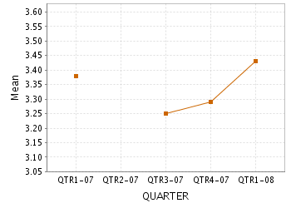
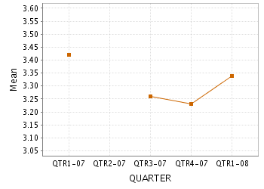
7300 is Innovating Excellence!
The instructions given by staff
about how to care for
(yourself/the patient) after
leaving the hospital
                The nurses provide sufficient
                explanations about medications,
                procedures, and routines
Notes:
“Comprehensive” – looking at all processes & systems to make patient care better
“Good to Great” – Strategic Plan fits with this project
Different Financial Position
Challenge Organization to Change – Not A Point in Time – Moving The Bar
Everyone Working Together Will Remove Barriers/Resistance
Dedicated leadership who is inspiring others
The Process – It’s Not People Issues but Process Issues that need attention
We have the opportunity to build on the positive
We are Making it Work for Tomorrow

Slide 14
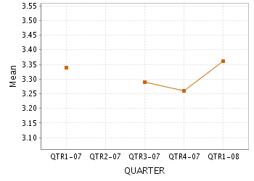
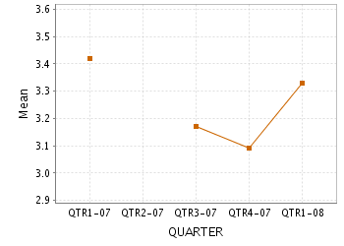
7300…The Results Are In!
The educational and informational material provided regarding the hospital stay and treatment
        The hospital's assistance in planning
        for care after discharge
Notes:
“Comprehensive” – looking at all processes & systems to make patient care better
“Good to Great” – Strategic Plan fits with this project
Different Financial Position
Challenge Organization to Change – Not A Point in Time – Moving The Bar
Everyone Working Together Will Remove Barriers/Resistance
Dedicated leadership who is inspiring others
The Process – It’s Not People Issues but Process Issues that need attention
We have the opportunity to build on the positive
We are Making it Work for Tomorrow

Slide 15
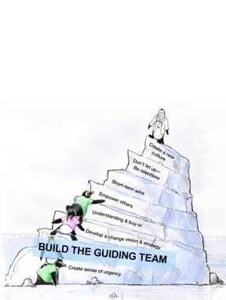
Step 2. “Build the Guiding Team”
Staff from across continuum
Planning day (Hilton)
House wide initiative
Focus on patient experience from pre admission to discharge
CEO and senior leadership

Slide 16
Why are we changing--again?
1. To provide faithful patient centered care
2. To continue our journey to excellence
3. To streamline processes and to be cost effective

Slide 17
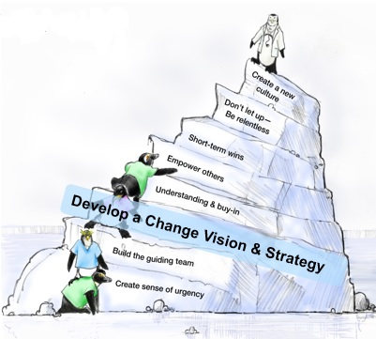
Step 3. “Develop a Change Vision & Strategy”
Innovating Excellence
Improve care and Patient Satisfaction Scores → Patient Safety
Change management - John Kotter model
“Our Iceberg is Melting”
TeamSTEPPS
Notes:
Define: What is your Iceberg?
Assess: Where are we in our change process
Analyze: What does it mean?
Focus: What do we do next

Slide 18
Innovating Excellence – Change Management
TeamSTEPPS provided the foundation for training over the next year for all existing staff and incorporated into onboarding for new staff
Introduced change through a readers theatre format (Fred, Alice, Birds 1, 2, 3, Louis, Jordan , Buddy a Narrator and the colony, audience)
First series of classes generated rave reviews for the “Readers Theatre” but then it became a focus for complaint so we reverted to straight lecture
Notes:
Helen last slide – prepare to exit – No intro – Renae begins at next slide

Slide 19
Our Mission
The mission of Loma Linda University Medical Center is to continue the healing ministry of Jesus Christ, to make man whole, in a setting of advancing medical science and to provide a stimulating clinical and research environment for the education of physicians, nurses, and other health professionals.
Our Vision
Innovating excellence in Christ-centered health care.
Notes:
Renae begins with Mission/Values – Slide 18
No introduction – take the podium

Slide 20
Our Values
COMPASSION
  Reflecting the love of God through caring, respect and empathy.
INTEGRITY
  Ensuring our actions are consistent with our values.
EXCELLENCE
  Providing care that is safe, reliable, efficient and patient centered.
TEAMWORK
  Collaborating to achieve a shared purpose.
WHOLENESS
  Embracing a balanced life that integrates mind, body and spirit.
Notes:
TWICE or CIETW (Can I Expect to Win)

Slide 21
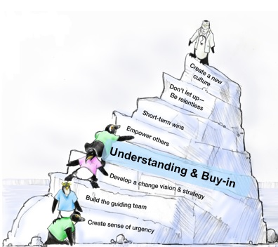
Step 4. “Communicate for Understanding & Buy-in”
Staff Education
Clinical Staff
8-hour day
ce’s
Lunch included
Interactive
Open forum before/during lunch
Non-Clinical Staff
4-hour day
Notes:
Question 2 for group inter action here -

Slide 22
TeamSTEPPS Introduction
Tools emphasized:
Leadership:
Brief Huddle Debrief
Communication:
SBAR Hand-off Call-Out Read-Back
Mutual Support:
CUS DESC
Situation Monitoring:
Situation awareness Shared mental model

Slide 23
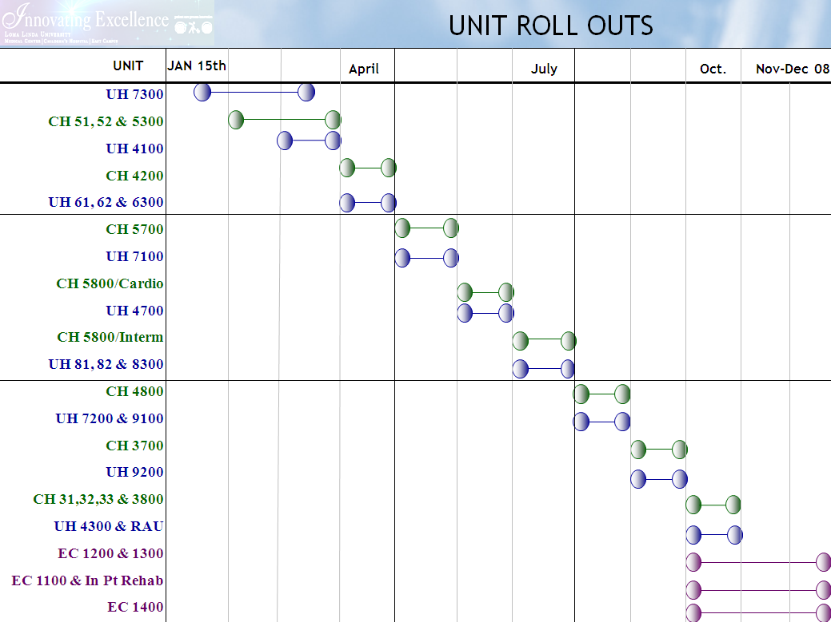

Slide 24
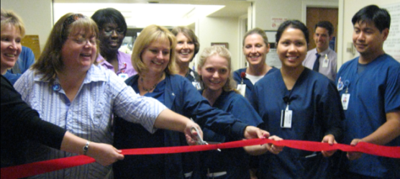
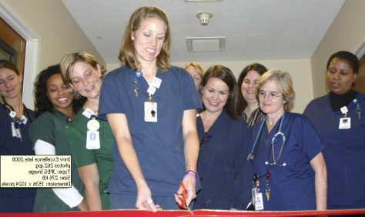
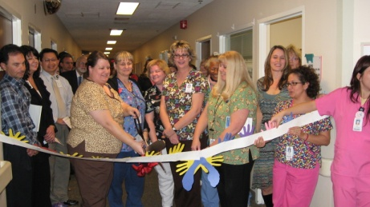
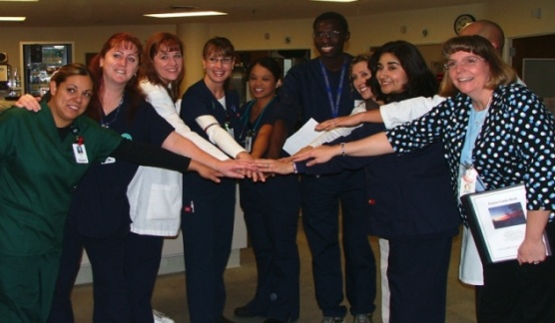
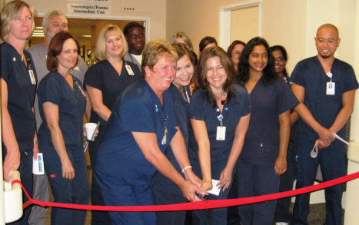
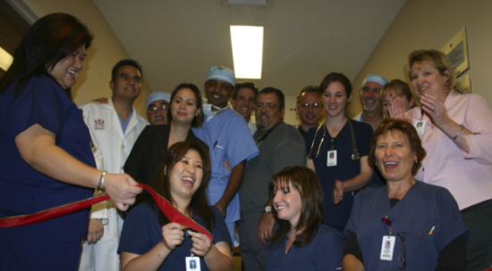
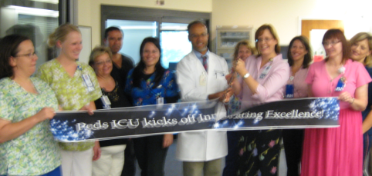
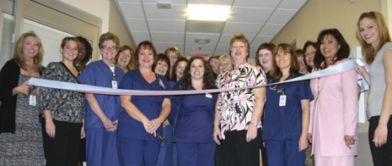
TeamSTEPPS
Unit ceremonies
Incorporated into
General Orientation
General Clinical Orientation
Unit/department orientation
Patient Safety into Gallup Scores
Hardwired into the organization

Slide 25
The Process of Change
First Unit to go-live (7300)
High-lights of specific popular changes included:
  Quiet time, coffee (juice) carts
  Environmental designs of areas -Planetree
  “My Chart” for patients and families
  Huddles including team and patients
  Bus stops for Lab draws
Notes:
Quiet time and coffee juice carts were so popular staff wanted to extend the time…..

Slide 26
7300 is Innovating Excellence!
The instructions given by staff
about how to care for
(yourself/the patient) after
leaving the hospital
                The nurses provide sufficient
                explanations about medications,
                procedures, and routines
Notes:
“Comprehensive” – looking at all processes & systems to make patient care better
“Good to Great” – Strategic Plan fits with this project
Different Financial Position
Challenge Organization to Change – Not A Point in Time – Moving The Bar
Everyone Working Together Will Remove Barriers/Resistance
Dedicated leadership who is inspiring others
The Process – It’s Not People Issues but Process Issues that need attention
We have the opportunity to build on the positive
We are Making it Work for Tomorrow

Slide 27
7300…The Results Are In!
The educational and informational material provided regarding the hospital stay and treatment
        The hospital's assistance in planning
        for care after discharge
Notes:
“Comprehensive” – looking at all processes & systems to make patient care better
“Good to Great” – Strategic Plan fits with this project
Different Financial Position
Challenge Organization to Change – Not A Point in Time – Moving The Bar
Everyone Working Together Will Remove Barriers/Resistance
Dedicated leadership who is inspiring others
The Process – It’s Not People Issues but Process Issues that need attention
We have the opportunity to build on the positive
We are Making it Work for Tomorrow

Slide 28
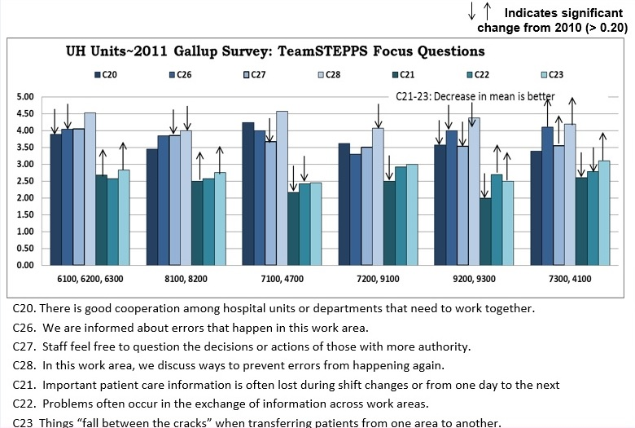

Slide 29
“The only way to make sense out of change is to plunge into it, move with it, and join the dance.”
Alan Watts

Slide 30
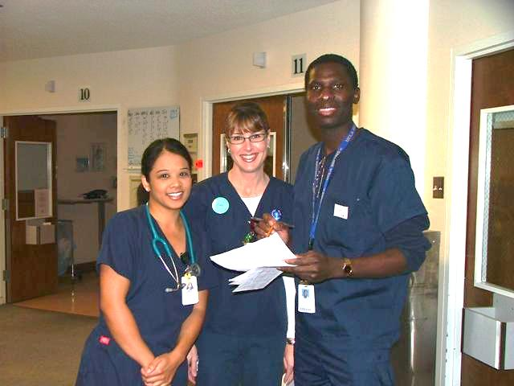
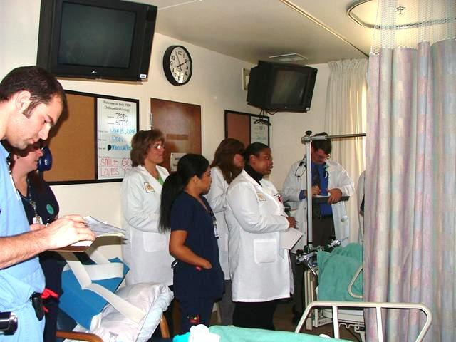
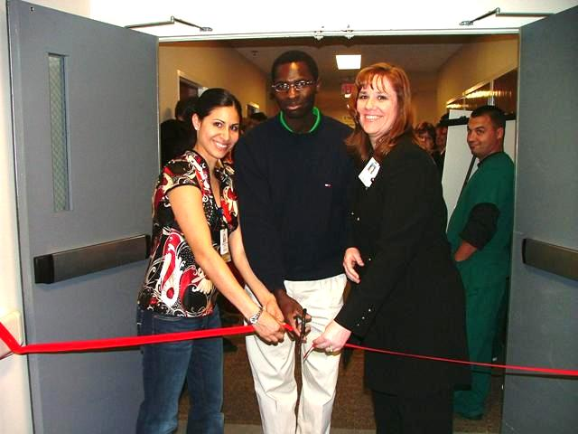
Designs implemented
Handoff walk rounds
Team huddles
Interdisciplinary care-planning rounds
TLC position
Standard uniform colors for patient facing staff
Quiet time
(1 hr in AM, 4 hr in NOC)
“Bus Stop” phlebotomy
24 hour visitation partnership
Notes:
Question 3 Interactive Set – “How do you sustain change”
Renae Final slide – Carolyn up next no introduction needed, she will take podium as you exit.

Slide 31
Agenda
Introduction
Innovating Excellence
In-Situ Coaching
Simulation Training
  Team Situational Awareness
  How we train physicians
Conclusion
Notes:
Carolyn takes podium – no introduction

Slide 32
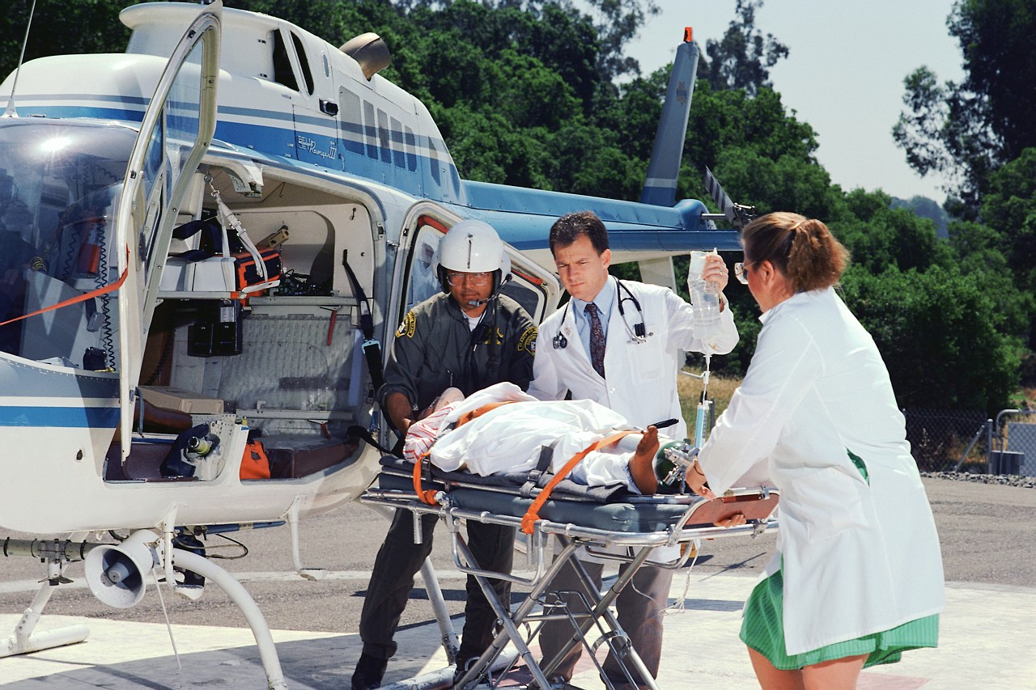
Wicked problem:
A young man with trauma cared for by a new RN
Wicked problem:
The new RN attended core curriculum training into which TeamSTEPPS were woven
  Why didn’t this nurse “get it?”
  Was this an isolated case?
Notes:
Question 4 – Group Interaction
Role play regarding the slide questions

Slide 33

For some, it just comes naturally…
Some concepts within TeamSTEPPS are natural for some folks
  HOWEVER when training,
  frame the tools & strategies to a deliberate focus on patient safety

Slide 34

Common sense
“The sun rises in the East and sets in the West”
Fact: The earth rotates and the sun therefore neither rises nor falls
Lesson: When one memorizes content, one often fails to understand the concept.
Notes:
Story of Residents who could write out what CUS and SBAR stand for, but unable to define them.
Add story of nurse with the SBAR but still missed…

Slide 35
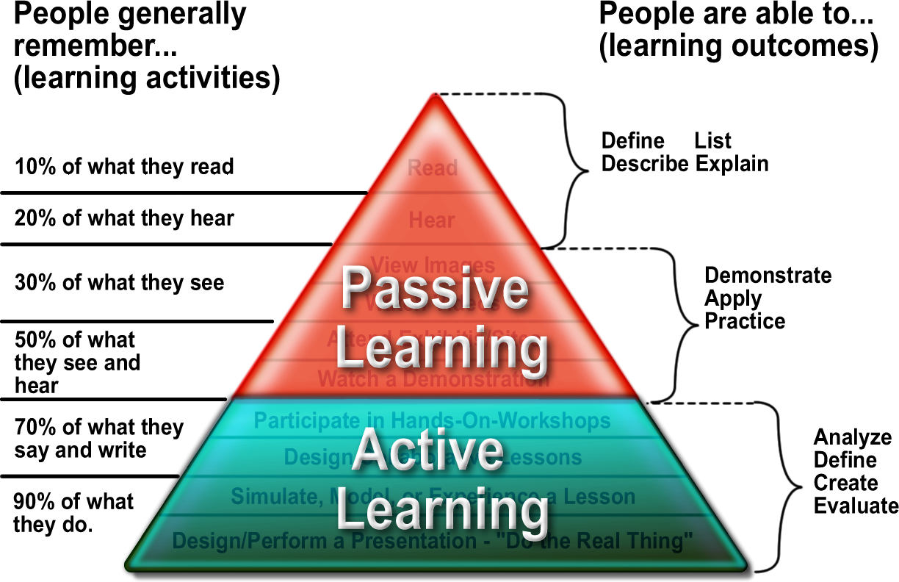
Notes:
Graphic from:
http://altersiego.blogspot.com/2011/05/learning-cone.html
Edgar Dale’s Cone of Learning

Slide 36
The solution: In Situ Coaching
1. Identify that there is an opportunity to further grow TeamSTEPPS
2. Select coaches (i.e. “Empower Others to Act”)
3. Train the coaches
4. In Situ training on the units for all employees

Slide 37
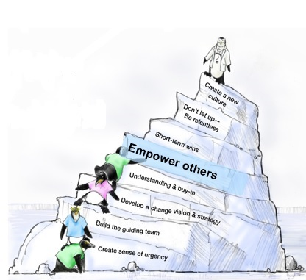
Step 5. “Empower Others to Act” Kotter 2005
  Staff meetings:
      reinforced rationale for use of TeamSTEPPS
      clarified expectations
      introduced purpose of coaching
  Multi-disciplinary Champions/coaches in
  every department identified:
      Physicians
      Nurses
      Therapists
Notes:
Admit that we still have opportunities

Slide 38
Train the Coaches
  Classroom training
    Review TeamSTEPPS (many admitted they hadn’t heard the material before…)
    Creation of pocket cards
    Use of TeamSTEPP’s Coaching module
    Practice, practice, practice
      Stretch: in the moment role-playing
  Unit training
    Train-the-trainer
      Review concepts
      Role model use of tools & strategies

Slide 39
Pocket Cards
Front
Back
SBAR – Communicating critical information that requires immediate attention and action. S: Situation - what is currently happening with the patient? “I am calling about Mrs. Jones in room 4 bed 2. Chief complaint is shortness of breath of new onset. B: Background – what is the pertinent background? “Patient is a 62 year old female post-op day one from abdominal surgery. No prior history of cardiac or lung disease.” A: Assessment – what do you think the problem is? “Breath sounds are decreased on the right side with acknowledgement of pain. Would like to rule-out pneumothorax.” R: Recommendation/Request – what would you suggest happen and how/when does it need to be completed? “I feel strongly the patient should be assessed now; are you available?” | Hand-off The transition of information along with authority and responsibility Occurs after an event or shift, includes the opportunity to ask questions, clarify & confirm Call-Out Communicate important or critical information Informs all team members in emergency situations Anticipate next steps and direct responsibility specifically Read-Back Verify and Validate information exchanged Closed loop communication Sender initiates message Receiver accepts message and provides feedback Sender verifies message was received
L E A D E R S H I P Brief - Short sessions prior to start to discuss team formation; assign essential roles; establish expectations & climate, anticipate outcomes & likely contingencies Huddle - Ad hoc planning to regain situation awareness; reinforcing plans already in place; and assessing the need to adjust the plan Debrief - Informal information exchange & feedback session designed to improve team performance and effectiveness. “What happened, what went well, what didn’t go well, what we could do differently” | S I T U A T I O N M O N I T O R I N G Situation Monitoring – Individual Skill The process of continually scanning and assessing what’s going on around you to maintain situational awareness Situation Awareness – Individual Outcomes Knowing what is going on around you, Ability to anticipate & support other team members’ needs through accurate knowledge about their responsibilities and workload Shared Mental Model – Team Outcomes All team members are “on the same page”
M U T U A L S U P P O R T C U S C I am Concerned I would like some clarity about… Would you like some assistance? U I am Uncomfortable This is why I am not comfortable S This is a Safety Issue! Discuss why the concern relates to safety. | Used to discuss delicate situations affecting staff; use “I” statements to minimize defensiveness; avoid blaming statements, critique is not criticism. Focus on what is right not – who. D E S C Describe the event Express concerns & feelings Suggest alternatives, seek agreement Consequences & concerns for the team

Slide 40
And then we discovered…
Not all coaches are created equal!
Characteristics of a great coach:
  Knowledgeable – about TeamSTEPPS and unit processes
  Contextual – see the big picture
  Observant – look for opportunities to coach
  Good listener
  Approachable: friendly & well liked
  Articulate
  Persuasive
  Assertive – jump into a situation, coach during a code blue; not afraid to challenge team mates
  Gifted: Remains well liked
  This person is not a direct Supervisor nor are they an Educator for a unit (these folks should already be reinforcing TeamSTEPPS in all interactions.)

Slide 41
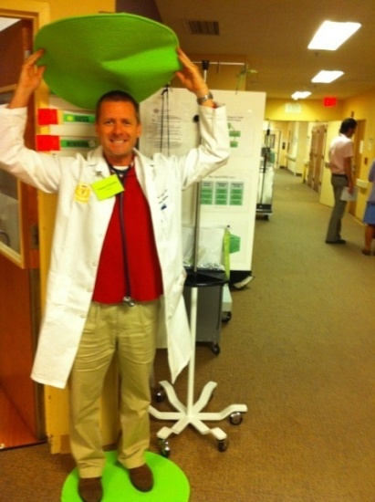
In Situ Training on the Unit
Coaches created a presence:
  Spot, literally
  Poster Board:
    TeamSTEPPS tools
    Time frame for tool use
    Practice scenarios
  Candy

Slide 42
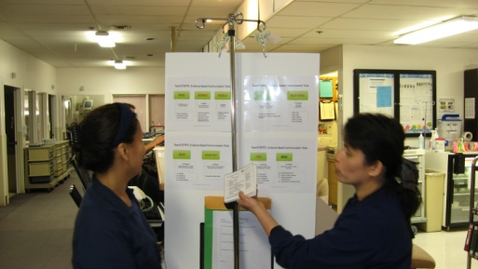
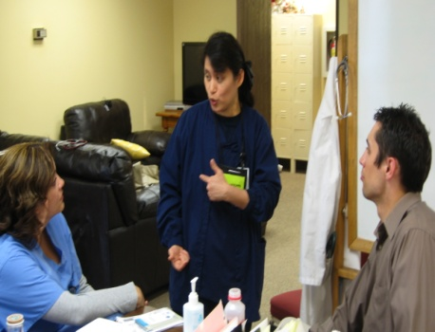
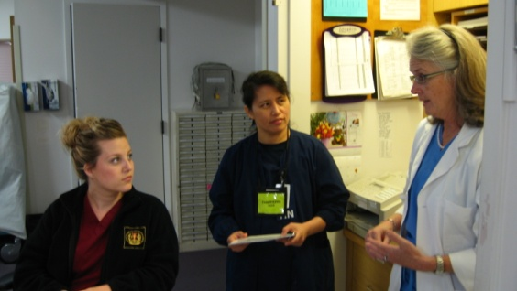
In Situ Training on the Unit
  Assess opportunities for tool use
    No patient care
  Diagnose issue with a particular interaction
  Intervene (i.e. make suggestions, role model)
  Stand back
Notes:
Question 5 – Group “Role Play” break
The coach:
Listens
Focuses on behavior – “tough on issue, tender on people,” EA.
I messages

Slide 43
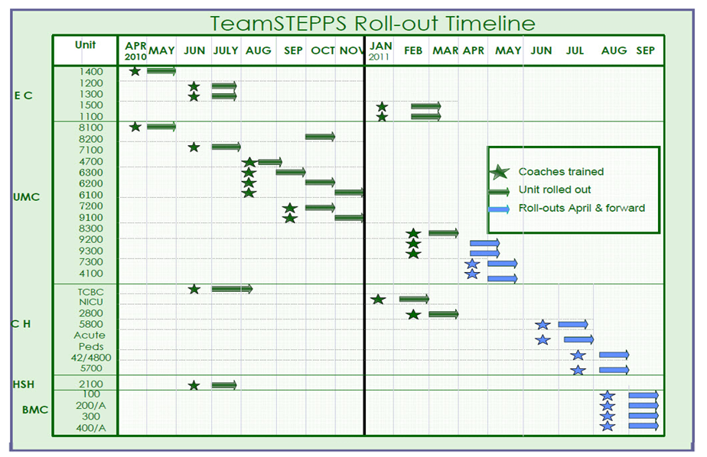

Slide 44
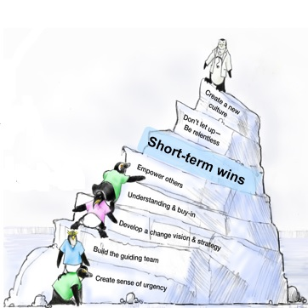
Step 6. Short-term Wins
Celebrate use of TeamSTEPPS!
    Stories
    Initial Data
    Always look for opportunities, even if folks don’t recognize them:
      Example:
      So…what’s the situation
      …Can you give me a little background info?
      Assessment: What do you think is happening?
      What’s your recommendation?
      I hear you saying you are Concerned, is this correct?
      Can you Read this back for me?
      Let’s huddle about this!

Slide 45
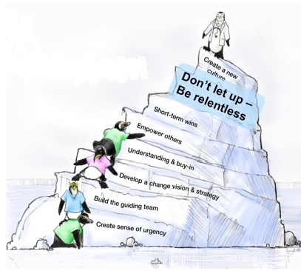
Step 7. “Don’t Let Up – Be Relentless”
Leadership:
  Presence during coaching
  E-mails disseminated in SBAR format

Slide 46
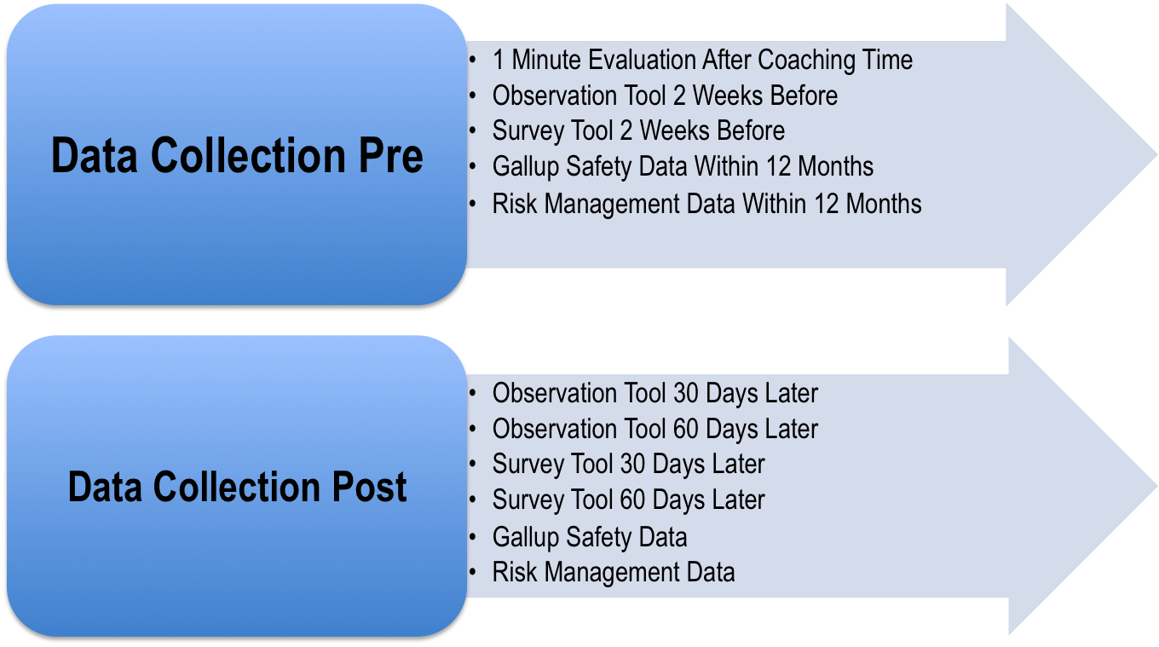
Evaluation Process
Notes:
Reinforcing our methods of evaluation
1 minute evaluation provided important feedback: will make some changes for the next group

Slide 47

Measuring our outcomes
Gallup Safety Question Focus
Current
Approximated
Percentile
C03 We have enough staff to handle the workload. 31st
C07 Staff feel like their mistakes are held against them. 45th
C15 Problems often occur in the exchange of information
across work areas 66th
C16 Things “fall between the cracks” when transferring
patients from one area to another. 76th
C20 Staff feels free to question the decisions or actions
of those with more authority. 58th
The Percentile ranks are estimated based on the AHRQ’s 2009 HSOPSC database.
The database is comprised of n=622 participating hospitals nationwide.
Approximated Percentile is “Overall” for a combined UMC, CH, EC & HSH.
Notes:
Based on the most current results of our Gallup Safety questions, we have selected these questions that we believe will impact the bulk of communication opportunities.
The results of these percentiles for the recent reporting period is our baseline. We will measure future results as recommended by AHRQ to be a valid measure for the success of implementing TeamSTEPPS tools.

Slide 48
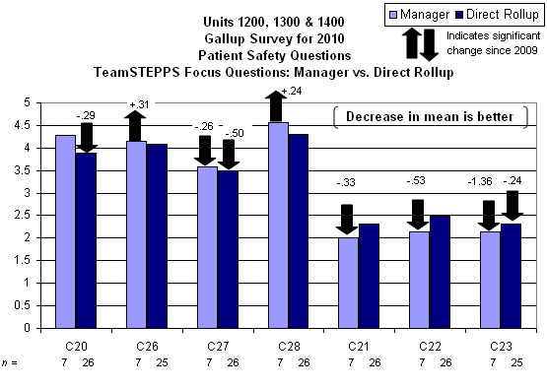
C20. There is good cooperation among hospital units or departments that need to work together.
C26. We are informed about errors that happen in this work area.
C27. Staff feel free to question the decisions or actions of those with more authority.
C28. In this work area, we discuss ways to prevent errors from happening again.
C21. Important patient care information is often lost during shift changes or from one day to the next.
C22. Problems often occur in the exchange of information across work areas.
C23. Things "fall between the cracks" when transferring patients from one area to another.

Slide 49

Step 8. “Create a New Culture”
Hiring
Orientation checklists
Classes
Evaluation Process
Staff Meetings – call for stories & share stories of use of the TeamSTEPPS
On-going training – CASE Days (rolled into each module F2F)
Part of our everyday language

Slide 50
Agenda
Introduction
Innovating Excellence
In-Situ Coaching
Simulation Training
  Team Situational Awareness
  How we train physicians
Conclusion

Slide 51
Partnering with Medical Simulation Center
TeamSTEPPS 2011-2012
Since joining efforts with the Medical Simulation Center a total of 531 have been trained using simulation as the method.
1st Year MD Residents #302
Faculty Physicians #124
RN Residents # 77
Other MD Residents (2nd/3rd year) # 16
Nurse Practitioners # 12

Slide 52
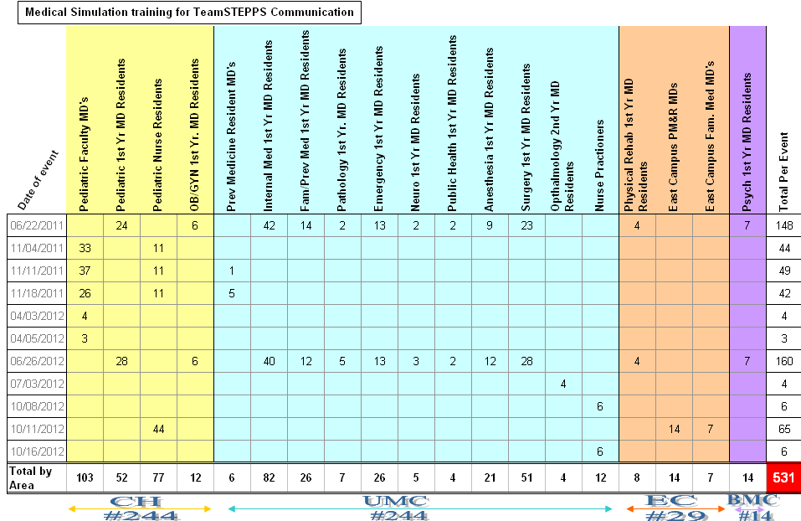

Slide 53
Coaching Recap for LLU
Prior to joining with the Medical Simulation Center (MSC):
Staffing from five Facilities (UMC, CH, EC, HSH & BMC) have received Team STEPPS Coach training.
  Hundreds more nursing and ancillary staff were trained during unit roll outs via the trained TeamSTEPPS coaches.
  Hundreds of physicians have been exposed to the TeamSTEPPS concepts via lecture.
Since joining with the Medical Simulation Center:
MSC has incorporated TeamSTEPPS concepts & tools into all simulation scenarios to further ingrain into the culture.
  This means that even when PSR/PI is not coordinating a TS training event, the tools are being used for other trainings that flow out of MSC.

Slide 54
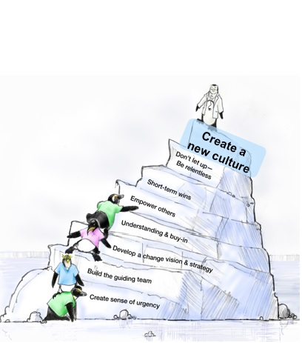
Agenda
Introduction
Innovating Excellence
In-Situ Coaching
Simulation Training
  Team Situational Awareness
  How we train physicians
Conclusion

Slide 55
Trends in Adverse Events Over Time: why are we not improving? (Shojania KG, et al.)
“…sustained attention to patient safety has failed to produce widespread reductions in rates of harm…”
  Landrigan CP, et al. Temporal trends in rates of patient harm resulting from medical care. N Engl J Med 2010;363:2124-34
  Classen DC, et al. ‘Global trigger tool’ shows that adverse events in hospitals may be ten times greater than previously measured. Health Aff (Milwood) 2011;30:581-9
  Baines RJ, et al. Changes in adverse event rates in hospitals over time: a longitudinal retrospective patient record review study. BJM Qual Saf 2013;22:290-298
Why?
Shojania, et al. Quality and Safety in Health Care 2013;22:273-277

Slide 56
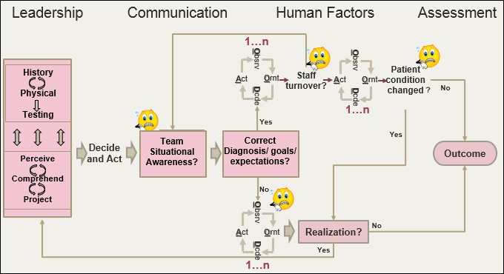
Serious Harm at LLUMC

Slide 57
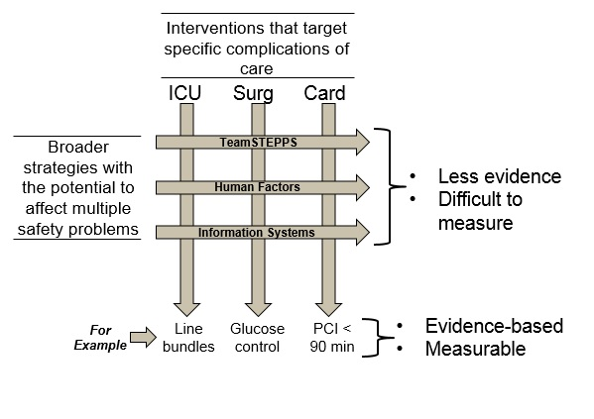
There is an unanswered question…

Slide 58
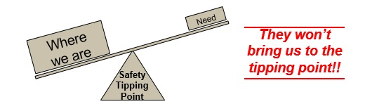
Don’t know for sure, but…
Interventions that target specific complications of care (e.g., UTI, line infection) are important and must be done, but…
Broader strategies” that permeate an organization (e.g., T&C, IS, human factors) have the potential to do this, but…
  Challenging to implement
  Difficult to show cause and effect
    Difficult to show measurable outcomes and ROI

Slide 59
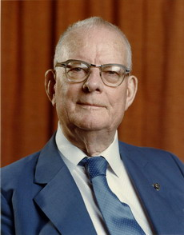
Deming sheds light.
“One can not be successful on visible figures alone….he that would run his company on visible figures alone will in time have neither company nor figures.”
Actually, the most important figures one needs for management are unknown or unknowable (Lloyd S Nelson)
Examples (from Deming):
  Multiplying effect on sales of a happy customer
  Improvement of quality and productivity from CQI
And I would (humbly) suggest:
  The improvement in patient safety that will come from better T&C

Slide 60
Teamwork and Communication as a Leverage Point
“These are places within a complex system…where a small shift in one thing can produce big changes in everything.” Donella Meadows

Slide 61
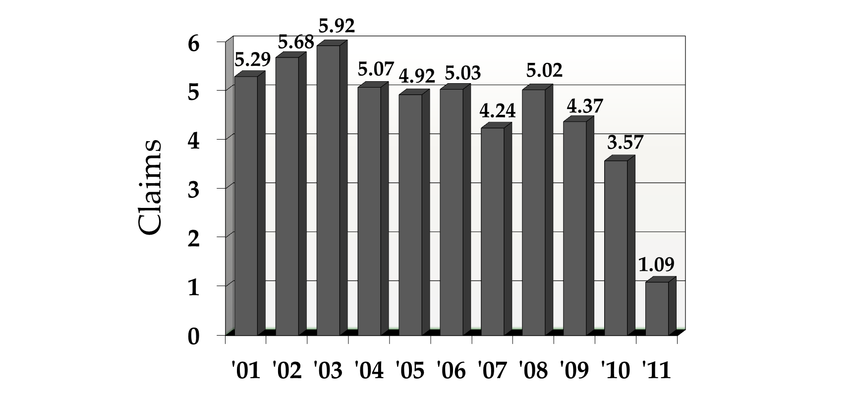
Professional Liability Claims Per 100 Occupied Bed Equivalents

Slide 62
THANK YOU

