Slide 1



Chronic Conditions Chartbook
Multiple
2010 MEDICAL EXPENDITURE PANEL SURVEY DATA

Slide 2
All of the information included in this chartbook is freely available for reproduction. Permission from the authors for the use the charts or graphics contained in this report is not necessary.

Slide 3
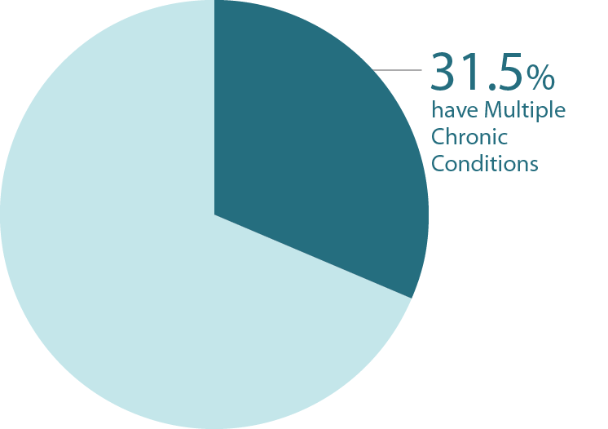
Percentage of All Americans with Multiple Chronic Conditions – 2010
Data Highlight
In 2010, over a half (51.7%) of all Americans had at least one chronic condition and almost 1/3 (31.5%) of all Americans had multiple chronic conditions.
Source: Medical Expenditure Panel Survey, 2010

Slide 4
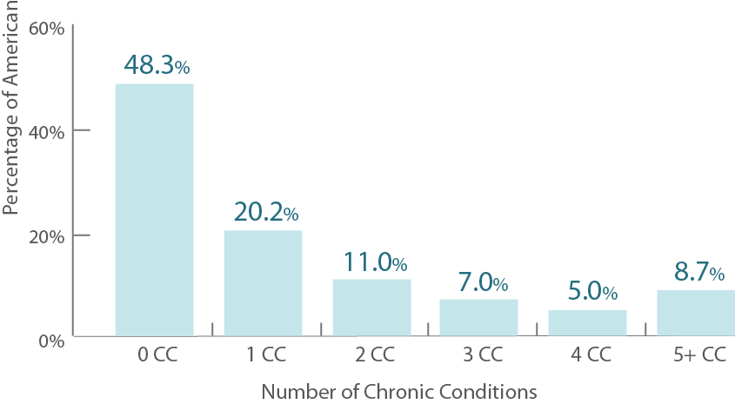
Percentage of All Americans with Chronic Conditions, by Number of Chronic Conditions – 2010
Source: Medical Expenditure Panel Survey, 2010

Slide 5
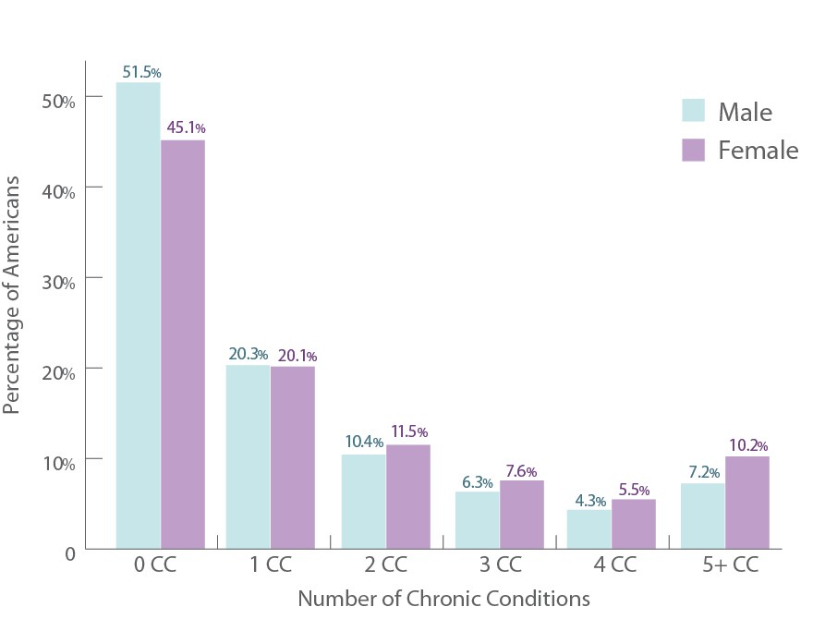
Percent of All Americans with Chronic Conditions, by Number of Chronic Conditions and Gender – 2010
Data Highlight
Women were more likely than men to report multiple chronic conditions (34.7% for women compared to 28.2% for men).
Source: Medical Expenditure Panel Survey, 2010

Slide 6
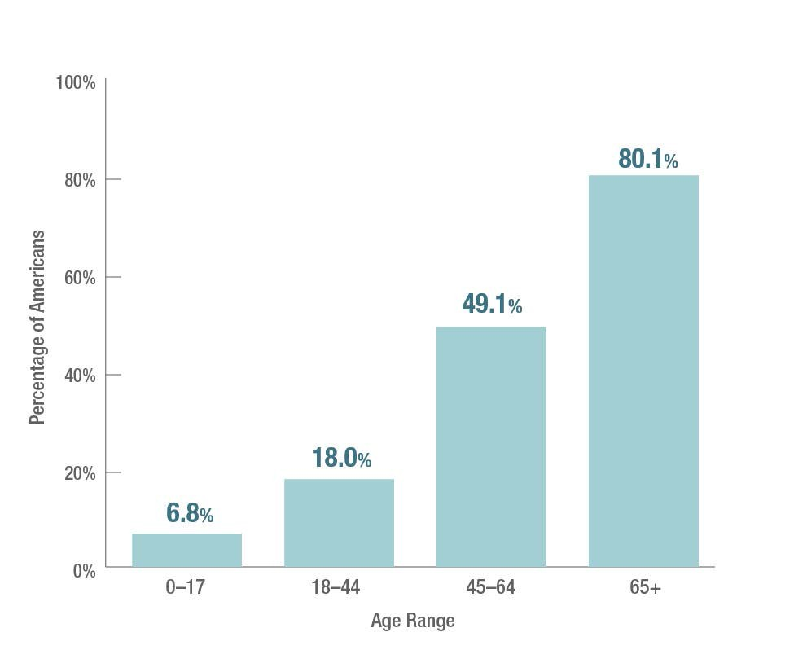
Percent of All Americans with Multiple Chronic Conditions, by Age Group – 2010
Data Highlights
The prevalence of multiple chronic conditions increases dramatically with age.
Almost half of all people aged 45-64, and 80% of those 65 and over, have multiple chronic conditions.
Source: Medical Expenditure Panel Survey, 2010

Slide 7
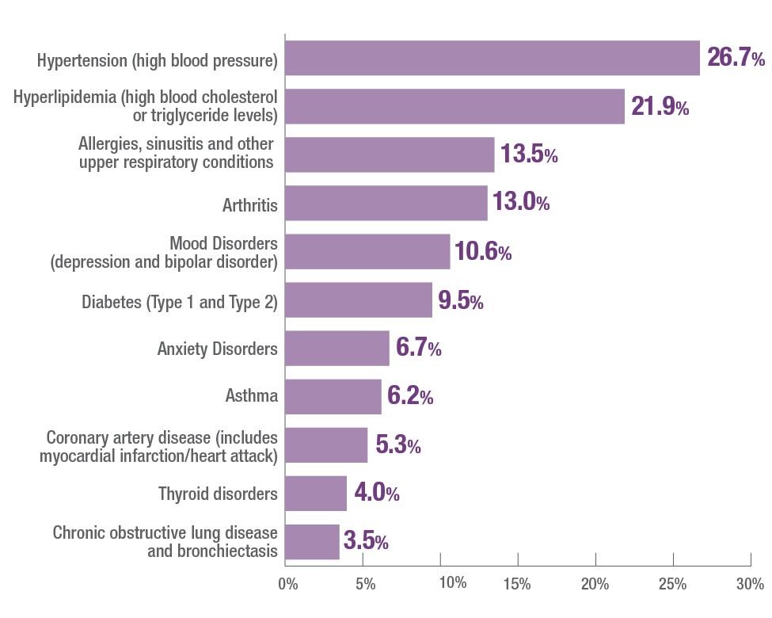
Most Prevalent Chronic Conditions in Adults (18 and older) – 2010
Source: Medical Expenditure Panel Survey, 2010

Slide 8
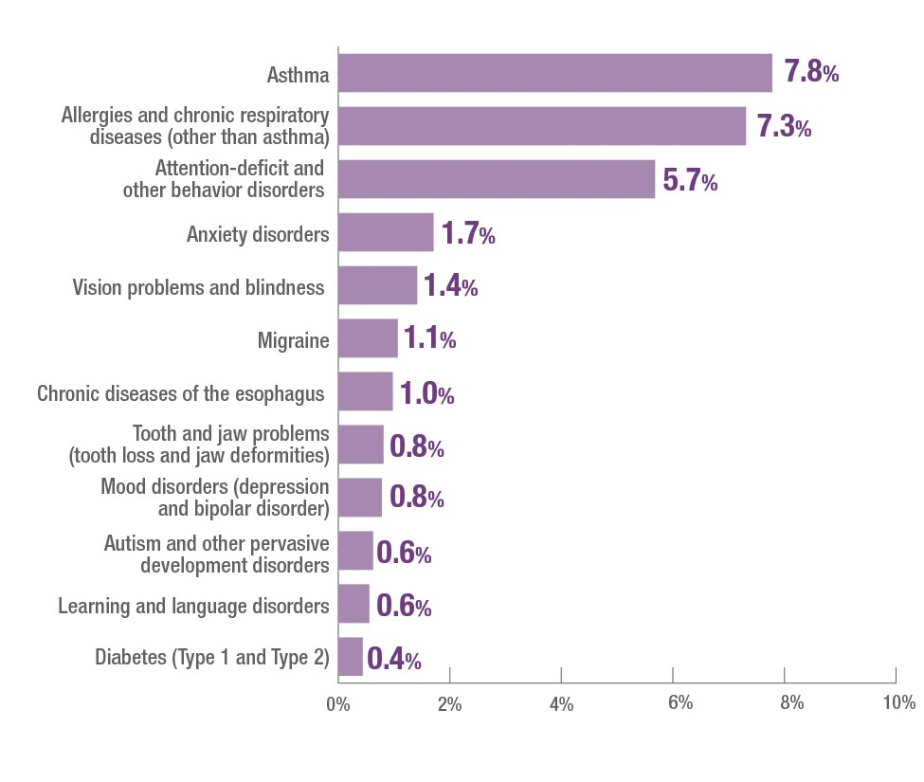
Most Prevalent Chronic Conditions in Children (17 and younger) – 2010
Source: Medical Expenditure Panel Survey, 2010

Slide 9
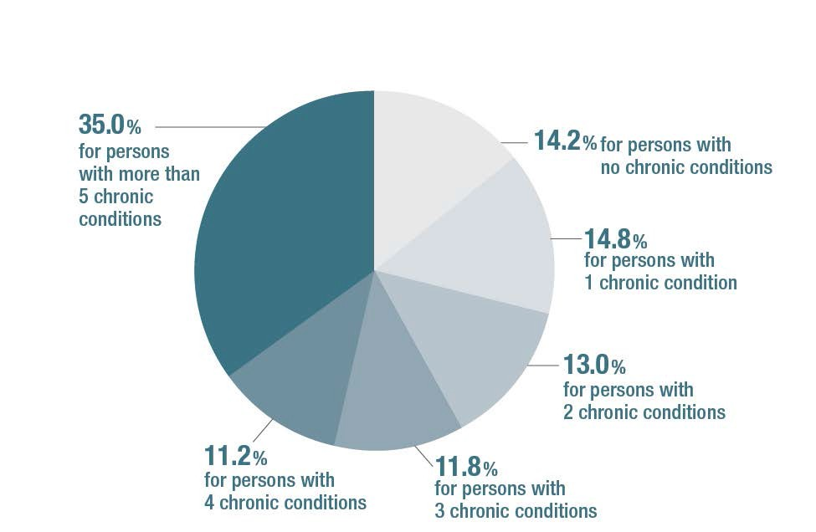
Total U.S. Healthcare Spending by Number of Chronic Conditions in 2010
Data Highlights
86% of healthcare spending is fo patients with one or more chro conditions.
71% of healthcare spending is fo patients with multiple chronic conditions
Said another way, 71¢ of every dollar of healthcare spending goes to treating people with multiple chroni conditions.
r nic
r
c
Source: Medical Expenditure Panel Survey, 2010

Slide 10
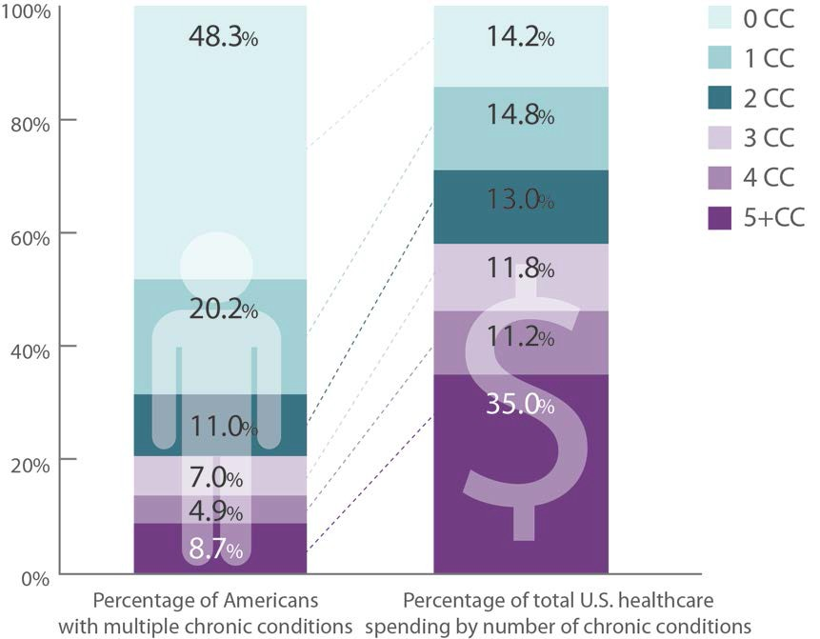
US Healthcare Spending Associated with Percent of Population by Number of Chronic Conditions – 2010
Data Highlight
35% of healthcare spending is for the 8.7% of people with five or more chronic conditions.
Source: Medical Expenditure Panel Survey, 2010

Slide 11
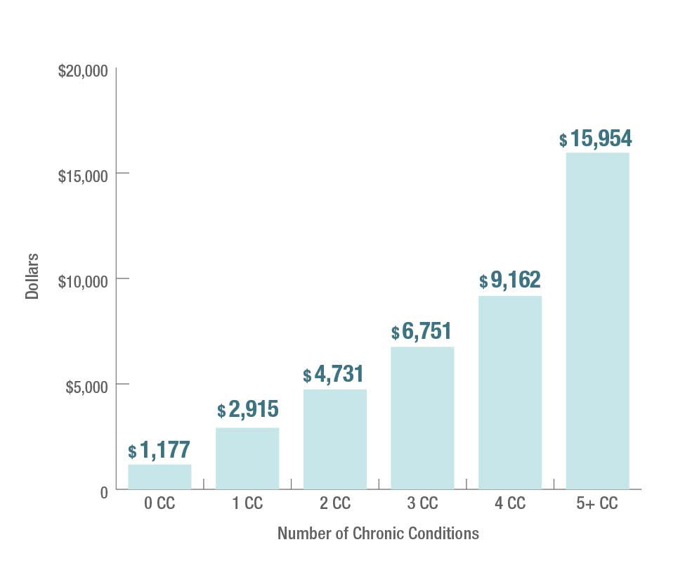
Average Healthcare Spending Per Capita, by Number of Chronic Conditions – 2010
Data Highlights
Compared to those without any chronic conditions:
Spending is almost 2.5 times more for those with one chronic condition.
Spending is almost 6 times more for those with three chronic conditions.
Spending is 13.5 times more for those with five or more chronic conditions.
Source: Medical Expenditure Panel Survey, 2010

Slide 12
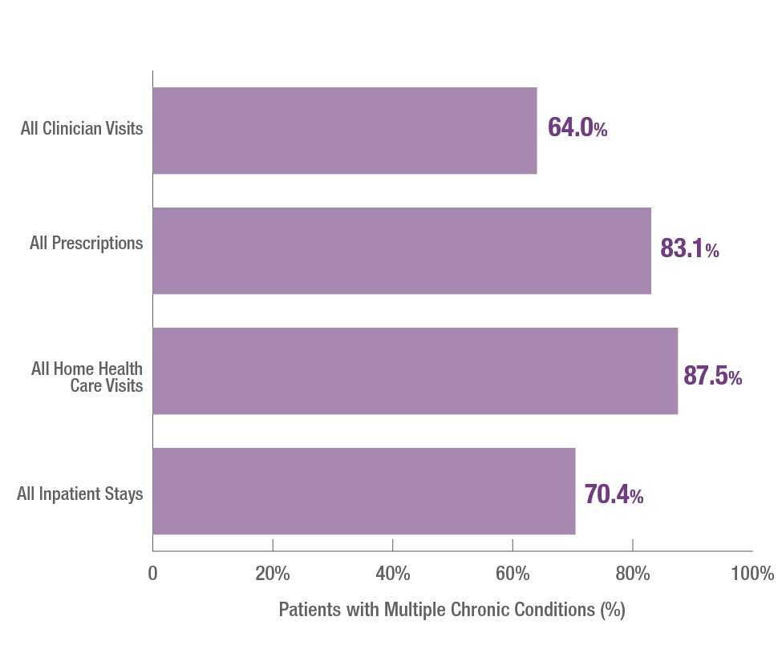
Percent of Healthcare Services Used by People with Multiple Chronic Conditions – 2010
Data Highlight
People with multiple chronic conditions account for the majority of clinician visits, prescriptions, home health visits and inpatient stays.
Source: Medical Expenditure Panel Survey, 2010

Slide 13
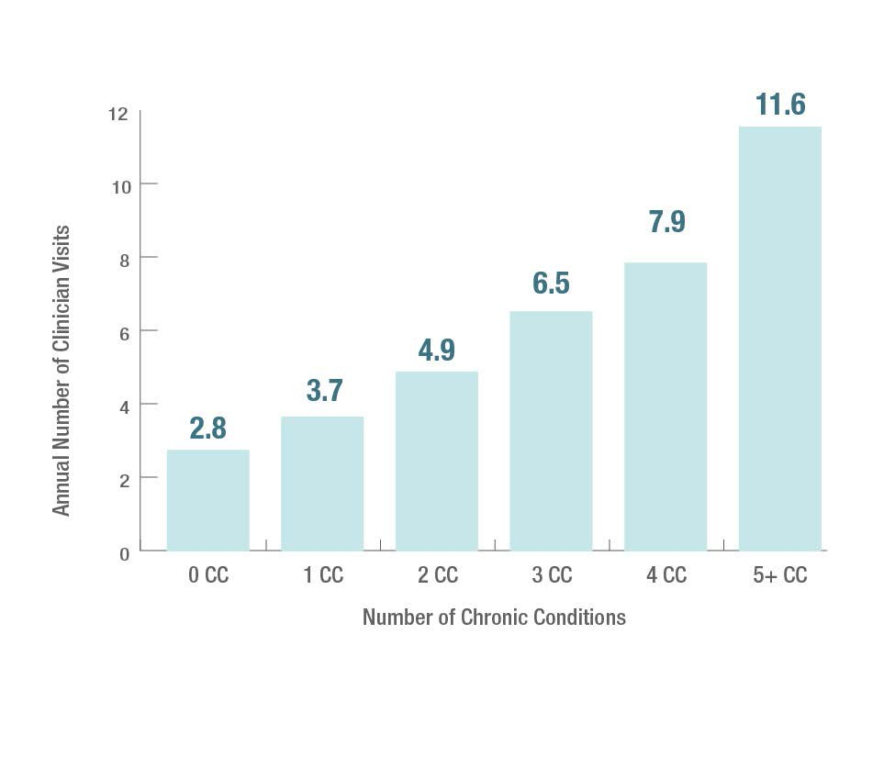
Average Annual Number of Clinician Visits Per Capita, by Number of Chronic Conditions – 2010
Source: Medical Expenditure Panel Survey, 2010

Slide 14
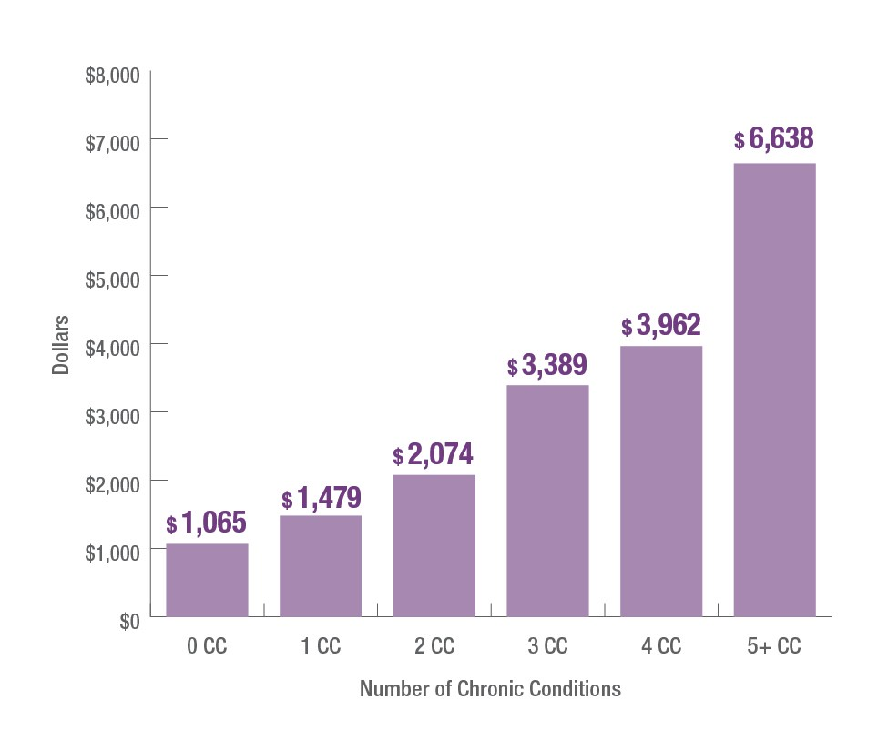
Average Annual Spending on Clinician Visits Per Capita, by Number of Chronic Conditions – 2010
Data Note
Spending here includes all payer including patients and insurance companies.
s,
Source: Medical Expenditure Panel Survey, 2010

Slide 15
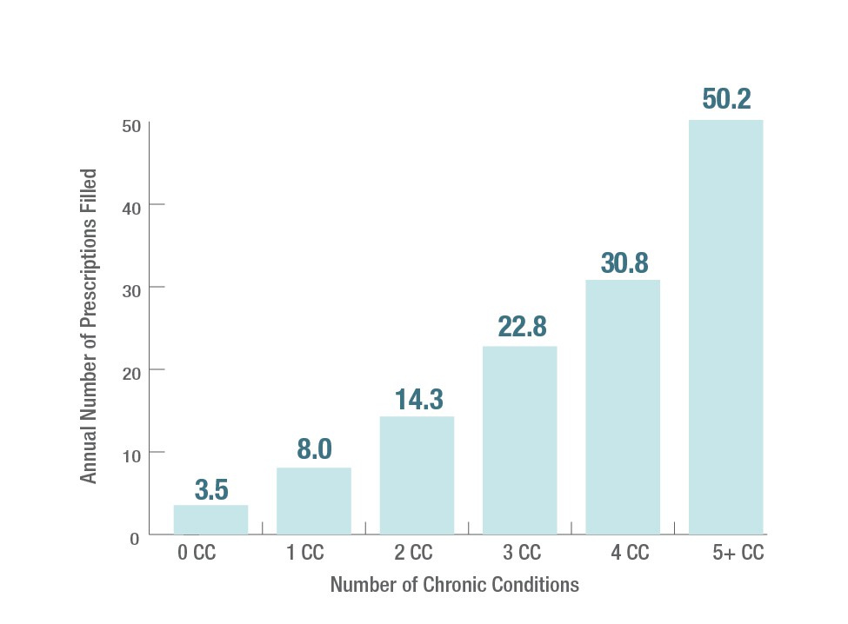
Average Annual Number of Prescriptions Filled Per Capita, by Number of Chronic Conditions – 2010
Source: Medical Expenditure Panel Survey, 2010

Slide 16
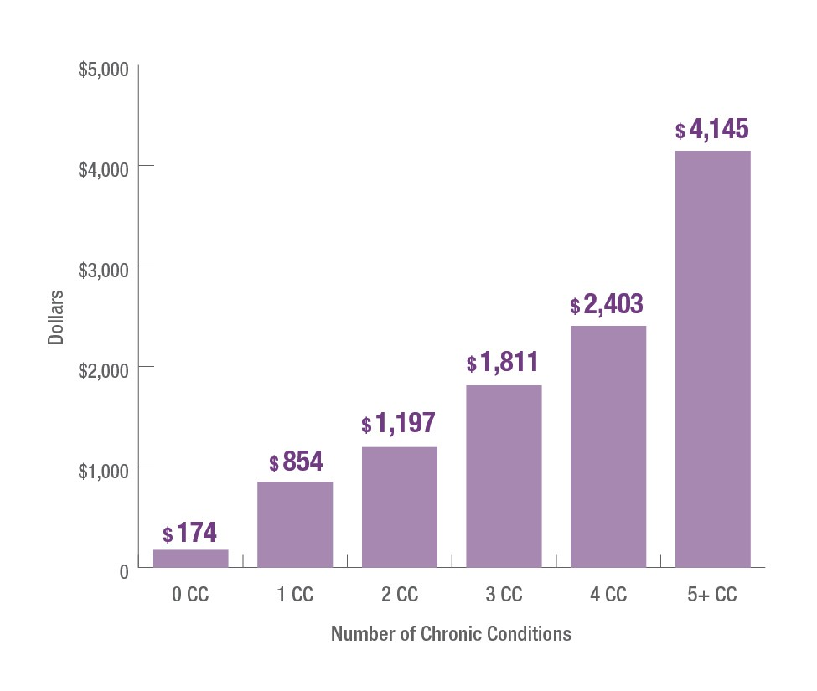
Average Annual Spending on Prescriptions Filled Per Capita, by Number of Chronic Conditions – 2010
Data Note
Spending here includes all paye including patients and insuran companies.
rs, ce
Source: Medical Expenditure Panel Survey, 2010

Slide 17
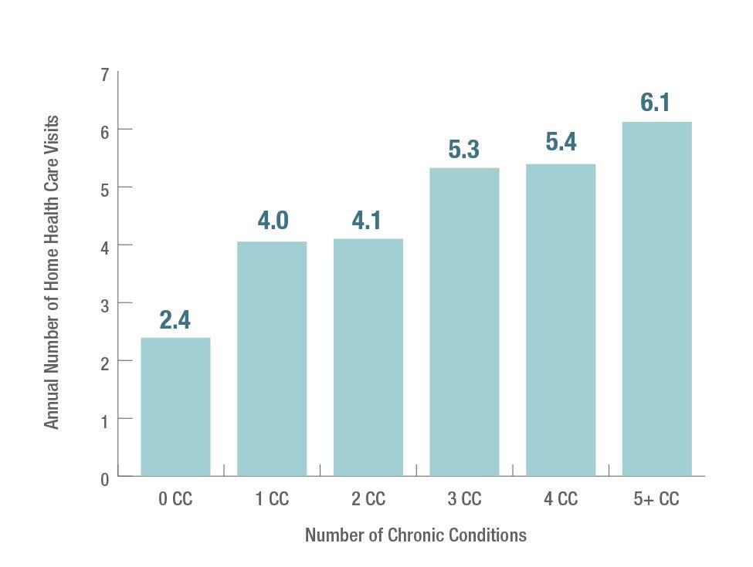
Average Annual Number of Home Health Visits Per Capita, by Number of Chronic Conditions – 2010
Source: Medical Expenditure Panel Survey, 2010

Slide 18
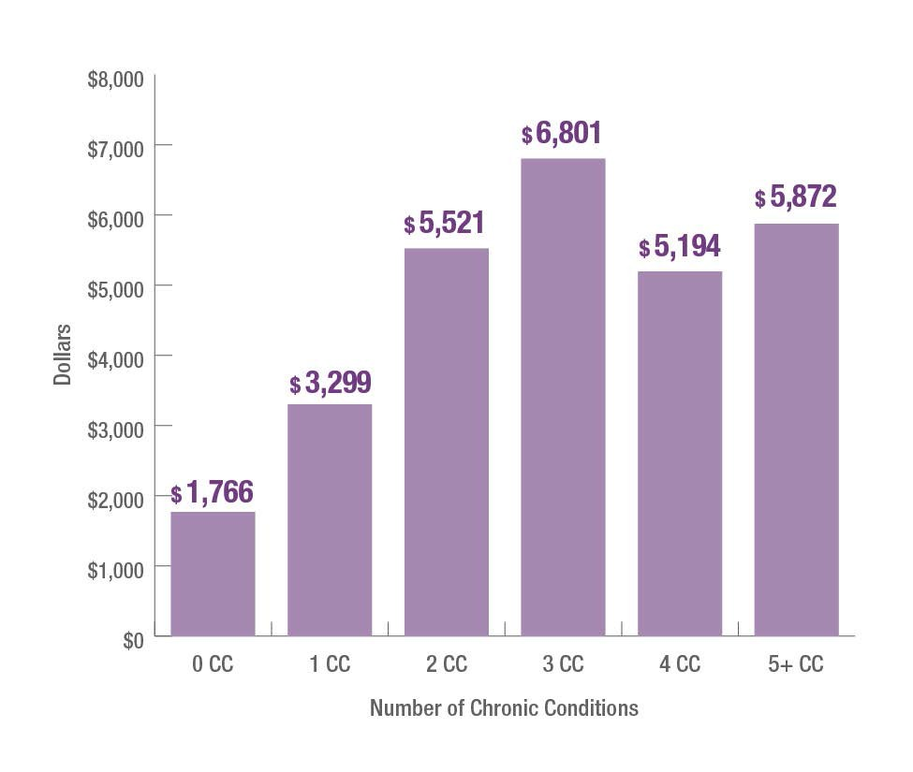
Average Annual Spending on Home Health Visits Per Capita, by Number of Chronic Conditions – 2010
Data Note
Spending here includes all payers, including patients and insurance companies.
Source: Medical Expenditure Panel Survey, 2010

Slide 19
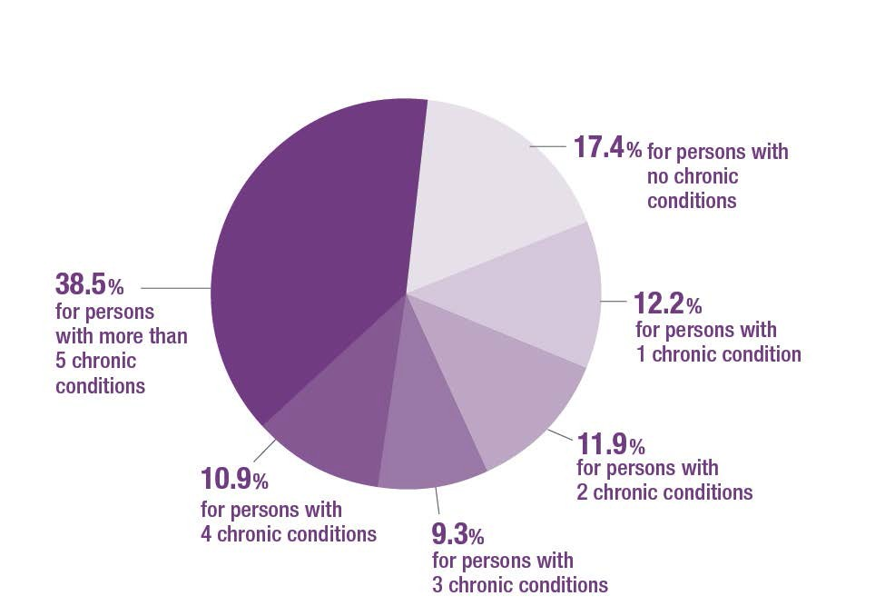
Percent of All Inpatient Stays, by Number of Chronic Conditions – 2010
Data Highlight
38.5% of all inpatient hospital stays are for people with five or more chronic conditions.
Source: Medical Expenditure Panel Survey, 2010

Slide 20
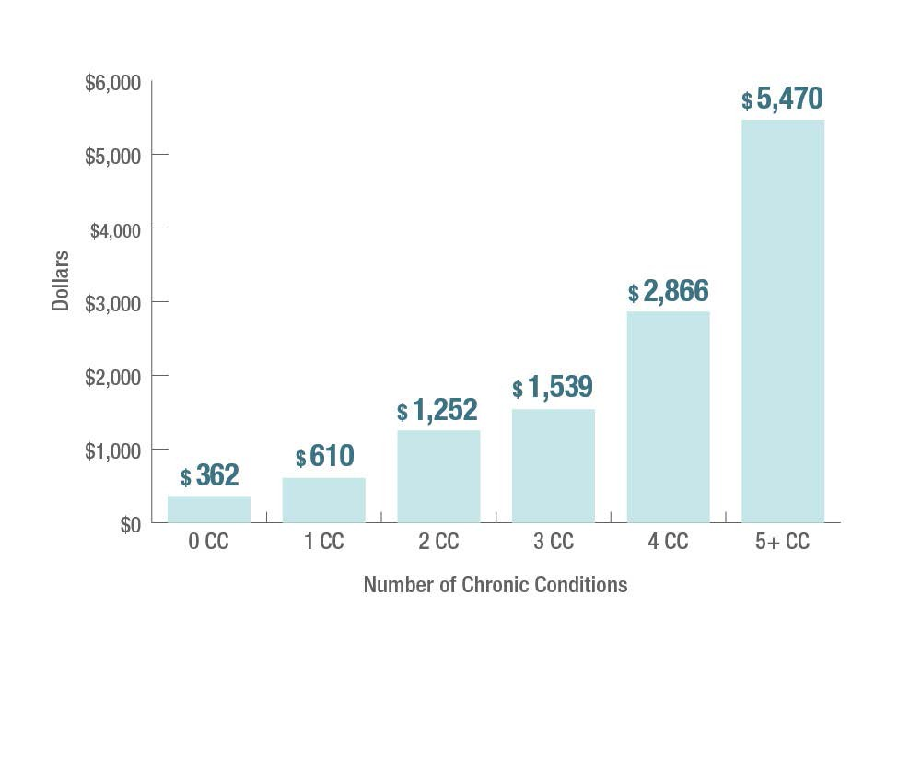
Average Annual Spending on Inpatient Care Per Capita, by Number of Chronic Conditions – 2010
Data Note
Spending here includes all payers, including patients and insurance companies.
Source: Medical Expenditure Panel Survey, 2010

Slide 21
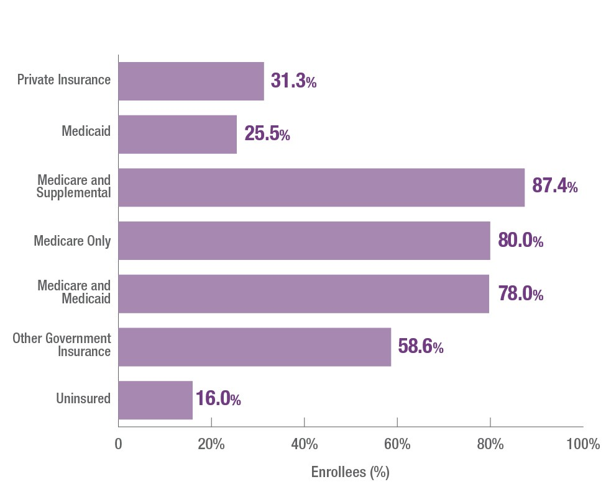
Percent of Enrollees with Multiple Chronic Conditions, by Insurance Type – 2010
Source: Medical Expenditure Panel Survey, 2010

Slide 22
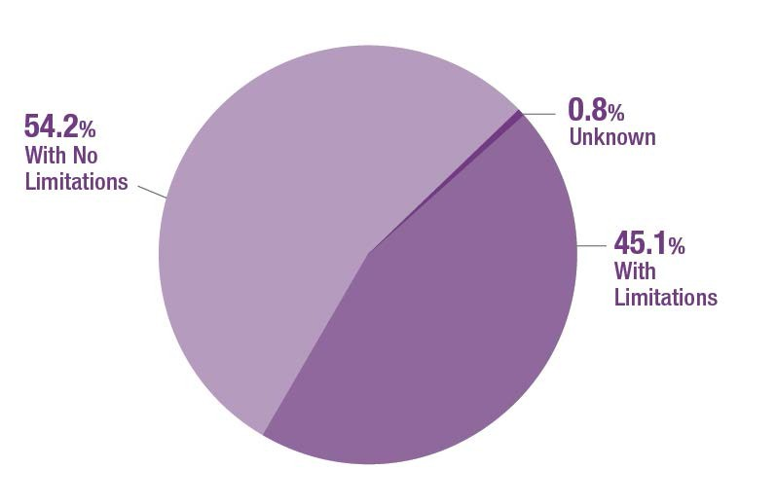
Percent of People with Multiple Chronic Conditions Who Have Activity Limitations – 2010
Data Note
Activity limitations here include limitations to activities of daily living (e.g., bathing, dressing, eating) and instrumental activities of daily living (e.g., housework, shopping, taking medications), as well as any functional, activity or sensory limitations.
Source: Medical Expenditure Panel Survey, 2010

Slide 23
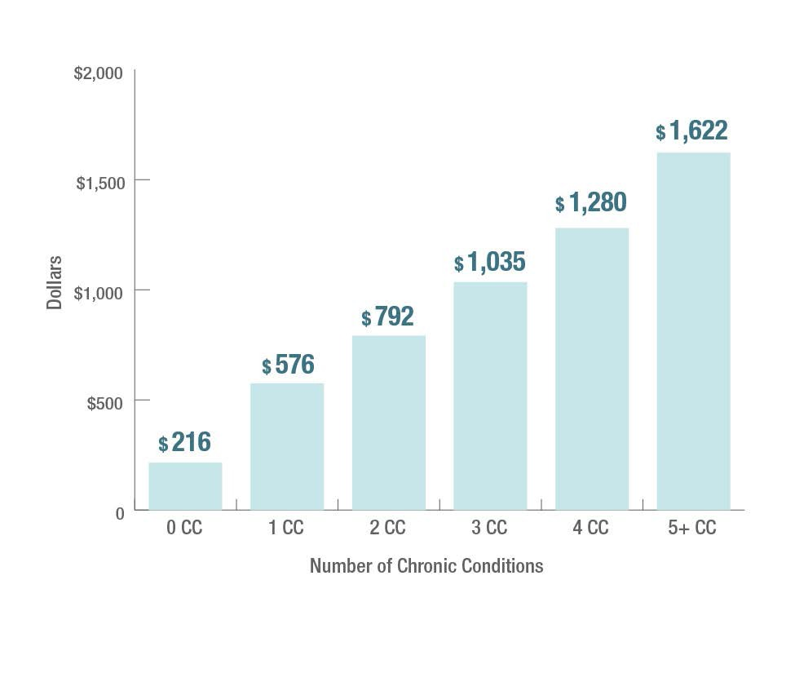
Average Annual Out-of-Pocket Expenditure Per Capita, by Number of Chronic Conditions – 2010
Data Note
Out-of-pocket healthcare spending increases with the number of chronic conditions.
Source: Medical Expenditure Panel Survey, 2010

Slide 24
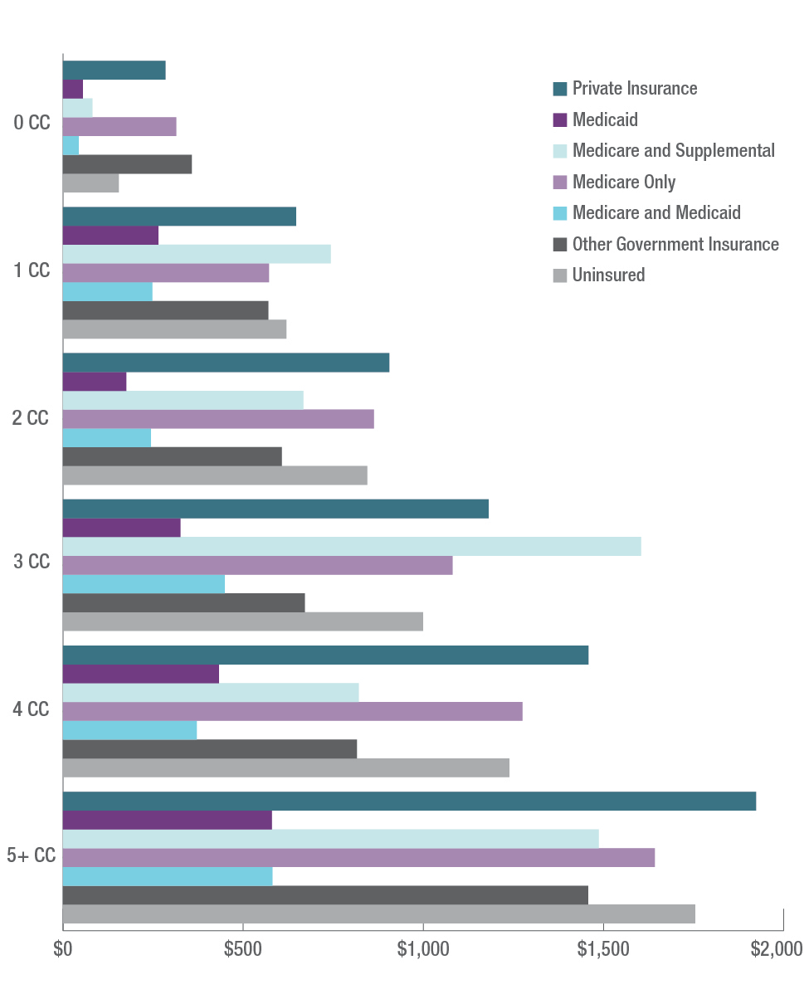
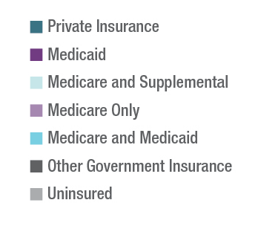
Average Annual Out-of-Pocket Expenditure Per Capita, by Insurance Type – 2010
Source: Medical Expenditure Panel Survey, 2010

Slide 25
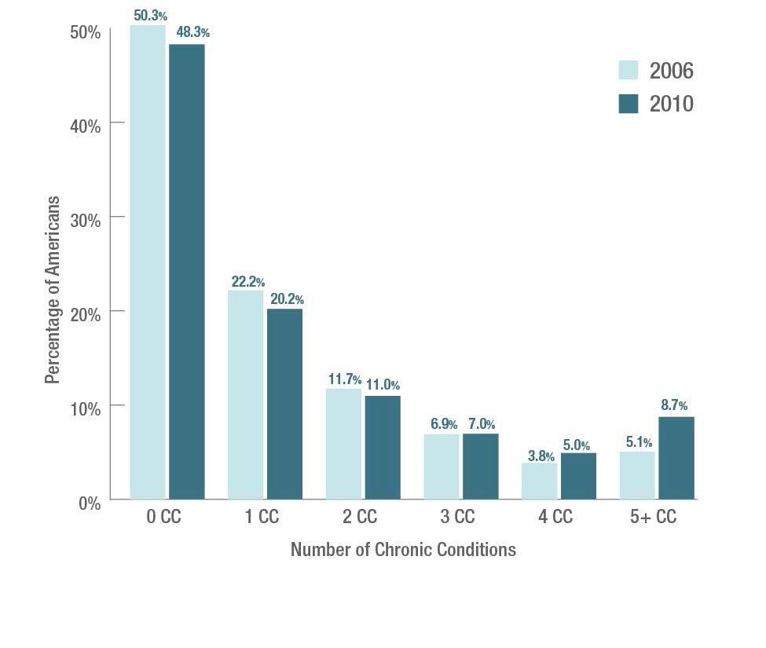
Percent of All Americans with Chronic Conditions, by Number of Chronic Conditions – 2006 and 2010
Data Highlights
Between 2006 and 2010, the percentage of people with chronic conditions increased from 49.7% to 51.7% and the percentage of people with multiple chronic conditions increased from 27.5% to 31.5%.
While the percentage of people living with one or two chronic conditions went down slightly between 2006 and 2010, the percentage of people with five or more chronic conditions increased from 5.1% in 2006 to
8.7% in 2010.
Source: Medical Expenditure Panel Survey, 2006 and 2010

Slide 26
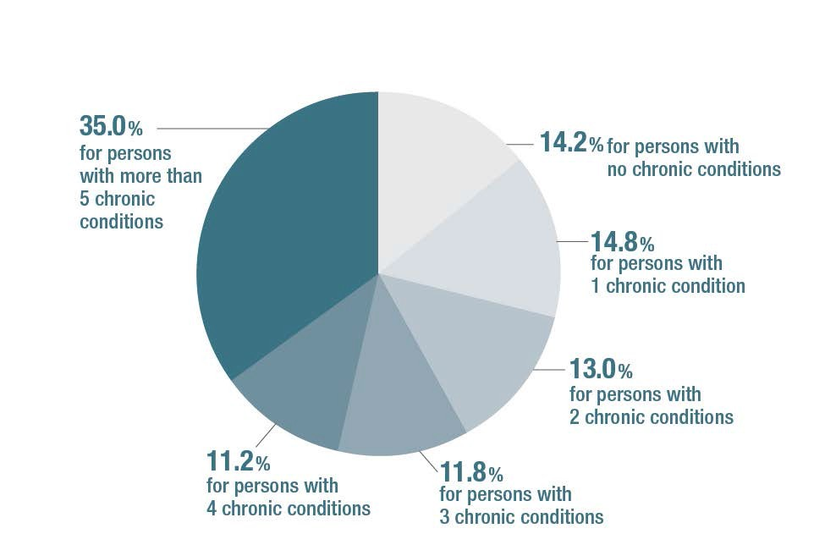
Total U.S. Healthcare Spending by Number of Chronic Conditions in 2010
Data Highlight
The percentage of healthcare spending that goes towards cari for people with five of more chronic conditions increased fr 22% in 2006 to 35% in 2010.
ng om
Source: Medical Expenditure Panel Survey, 2010

Slide 27
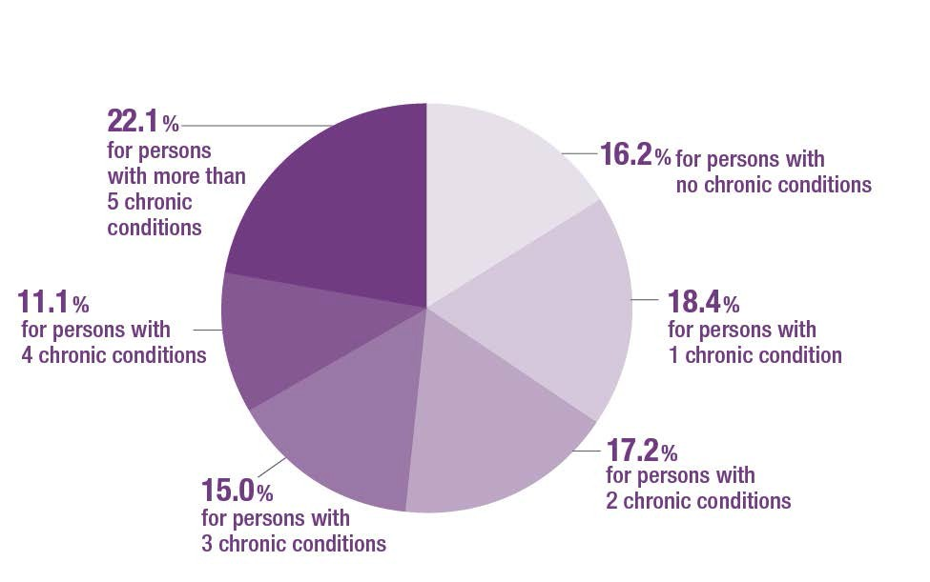
Total U.S. Healthcare Spending by Number of Chronic Conditions in 2006
Source: Medical Expenditure Panel Survey, 2006

Slide 28
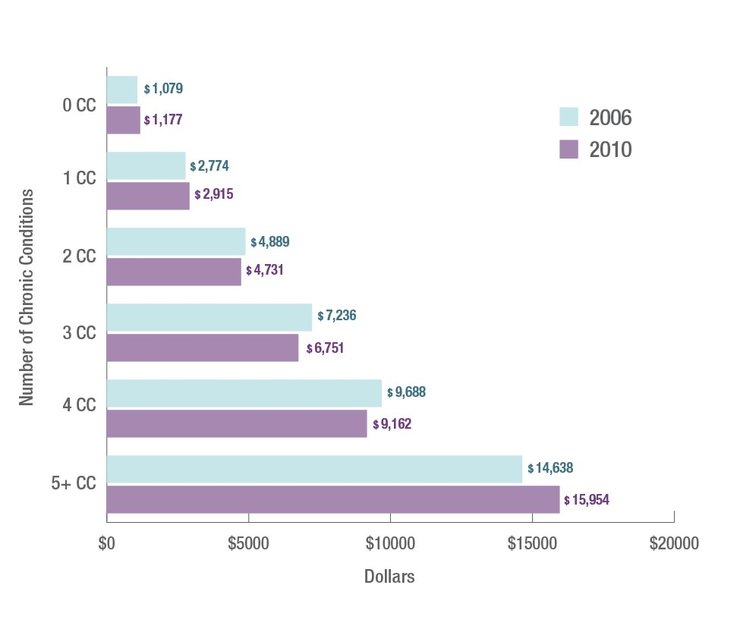
Average Annual Healthcare Spending Per Capita, by Number of Chronic Conditions – 2006 and 2010
Data Highlights
The average annual expenditure per patient increased for patients with zero, one and five or more chronic conditions between 2006 and 2010, but decreased for those with two, three and four chronic conditions.
Source: Medical Expenditure Panel Survey, 2006 and 2010

