Slide 1
A Guide on Workflow Mapping
LA Net Community Health Resource Network
A Practice Based Resource Network
Notes:
This is an introductory course on workflow mapping. This session is meant to provide basic knowledge in workflow mapping, while demystifying the process.

Slide 2
Learning Objectives
Identify the three types of flowcharts
Explain the use for flowcharts
Apply the 6 steps used to produce a flowchart
Evaluate an organizational process using your flowchart

Slide 3
Workflow Mapping
Workflow maps are also referred to as flowcharts, flow maps, flow diagrams, flow sheets, and process maps
A workflow map is defined as a visual representation of a process
A process considers a sequence of operations with a start and end point

Slide 4
Use for Workflow Maps
To map current practice flow
Are we really doing what we say we do?
Begin to identify areas for process improvement
Visual aid and representation of roles and responsibilities
Add-on to an organization’s policies and procedures
Process maintenance

Slide 5
Types of Flowcharts
High-Level flowchart: is a diagram that provides a brief overview of a process only highlighting major events in the process
Detailed flowchart: is a map that marks every step in a process, which includes decision points, waiting periods, and feedback loops
Swimlane flowchart: is a map that displays processes carried out for multiple roles across multiple stages

Slide 6
Common Symbols
Start/End
Operation
Decision
Delay
Direction
Connection
Notes:
Become familiar with the following symbols. Your team will want to construct its workflow diagram to include these. The symbols offer an immediate visual representation of: start/end, decision point, delay, and direction.
Indicates the start or end of a process
A specific task or activity performed
A point in the process where a decision needs to be made to determine the path in the process
Indicates a point in the process where there is delay or wait in line
Arrows indicate the direction of flow
Use this as a cross reference from a process on another page

Slide 7
What it looks like Example: The process of buying a box of cereal.
High-Level Flowchart
Arrive at the grocery store
Walk to the cereal aisle
Pick up a box of cereal
Walk to cashier with cereal
Pay for the box of cereal
Detailed Flowchart
Corn Flakes
Arrive at the grocery store
Walk to cashier with cereal
Pick up a box
Pay for the box of cereal
Decide on cereal
Walk to the cereal aisle
Pick up a box
Walk to cashier with cereal
Give cashier coupon
Honey Oats

Slide 8
What it looks like Example: The process of buying a box of cereal.
Swimlane Map
Arrive at the grocery store
Corn Flakes
Pick up a box of corn flakes
Customer
Walk to cashier with cereal
Place box on belt
Give cashier cash
Decide on cereal
Walk to the cereal isle
Pick up a box of honey oats
Walk to cashier with cereal
Place box on belt
Give cashier coupon and cash
Honey Oats
Cashier

Slide 9
What it looks like Example: The process of buying a box of cereal.
Swimlane Map
Cashier
Cashier takes box from belt
Cashier scans box code
Cashier states final price
Cashier receives cash and coupon
Cashier gives customer change

Slide 10
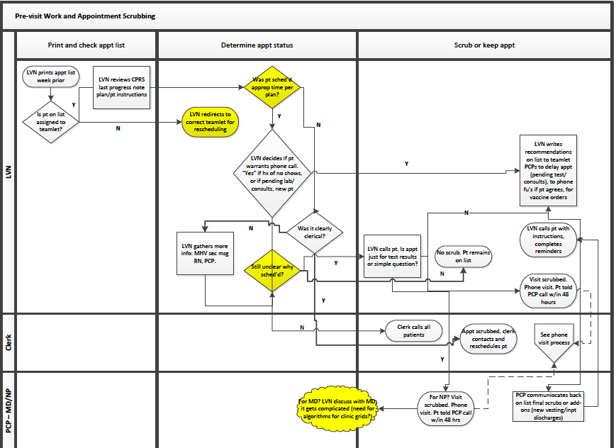
Notes:
This is an example of what is referred to as a “swim lane map.” A swim lane map displays processes that are carried out for multiple roles across multiple stages.
Each swim lane is representative of a role, in this case: PCP, Clerk, LVN.
The stretch of each lane is marked by the stages in the process. Here they are marked in the following order: 1) Appointment list review, 2) Appointment status, 3) scrubbing

Slide 11
Who is involved?
Involve all those who play a part in the process.
Tips:
Start with a small group if it’s a challenge to start with the entire group
Pick a champion for this group
Be sure to have all materials on-hand
Provide the team with an overview of what the mapping process looks like
Clearly state the objective and process selected for this exercise

Slide 12
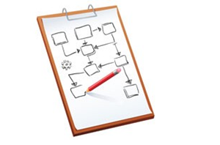
The 6-Step Process
Step 1: Identify a process to map (use the Know Your Process template)
Step 2: Begin with a high-level flowchart
Step 3: Move into a detailed flowchart
Step 4: Walk through the process once or twice
Step 5: Validate the maps to ensure they truly reflect the current process
Step 6: Identify quick fixes and distinguish them from larger fixes (use LA Net’s Impact & Complexity Grid)
(REMEMBER: A flowchart captures the process AS IS, not how it is supposed to be)
Notes:
After Step 6 Your next step will be to PDSA one of the identified fixes for improvement
Step 1: agree on a process to map: (HAVE A PLAN) Consider surveying your staff, patients, or others on which processes are the biggest problems Process that are the most time consuming, most labor-intensive, have the most complaints, etc.
Refer to your “Know Your Processes” assessment template for guidance.
Step 2: agree on a beginning and end IMPORTANT when you start high-level flowchart

Slide 13
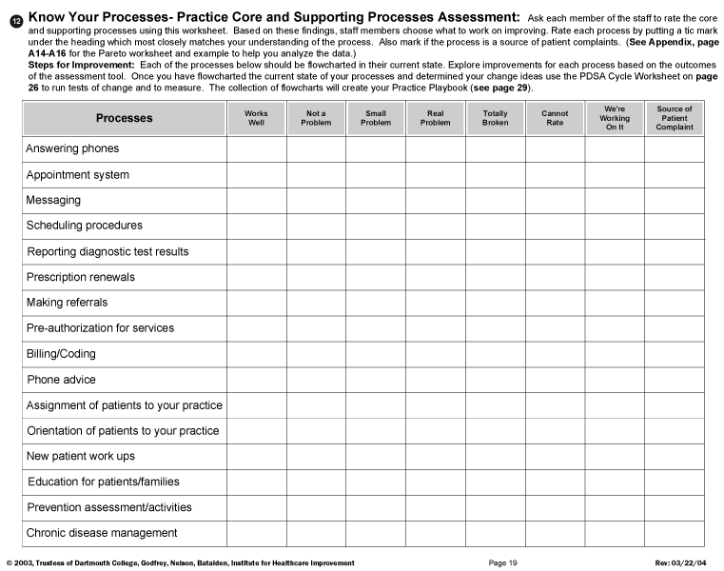
Know Your Process Template
Notes:
Ask each member of the staff to rate the core and supporting processes using this worksheet.
Based on these findings, staff members chose what to work on improving.
Rate each process by putting a tic mark under the heading which most closely matches your understanding of the process.

Slide 14
Impact & Complexity Grid
Build Complexity:
Low Complexity/High Impact
Low Complexity/Low Impact
Next Stage:
High Complexity/High Impact
Avoid Option #4:
High Complexity/Low Impact
 | Low Impact | High Impact
High Complexity | High Complexity/Low Impact (Option #4) | High Complexity/High Impact (Option #3)
Low Complexity | Low Complexity/Low Impact (Option #2) | Low Complexity/High Impact (Option #1)
Notes:
Give 2 examples from needs assessment to conduct
DO NOT USE WITH TEAMLET. Only one right answer. The reason we are showing this to you, is for you to use it and select low complexity processes. If for some reason, you have a highly functional team, then you might consider jumping into a higher complexity process. But what you do not want is taking on if not ready. Digest this.
To be successful, build hope that they can change something. IC should know that not all processes are created equal. Your job as an IC is to help teams

Slide 15
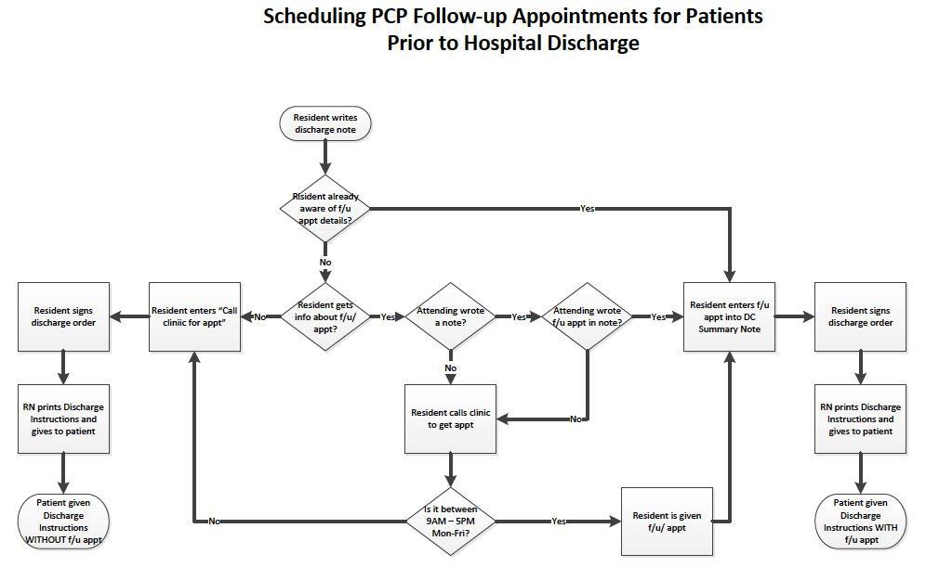

Slide 16
How to Analyze my Map
You can use your process map to assess problem areas or potential areas for improvement by examining some of the following:
Bottlenecks and other sources of delay
Rework due to errors
Role ambiguity
Duplicated efforts
Unnecessary steps
Sources of waste
Variation
Hand-offs

Slide 17
Tips on Mapping
Be sure to map current process
Get key players involved and their input
Recognize that any flowchart will take multiple attempts to complete
Leverage existing experts and experiences

Slide 18
Workflow Mapping Exercise
Break into groups of 5 to 6
Be sure to have:
Poster board paper
Post-its (or 5x6 index cards)
Marker
Pick a leader and a scribe
Ground rules:
State process: Making coffee
Define beginning and end points
Assumptions: you already have coffee, a coffee pot, and you do not have a Keurig

Slide 19
Questions to Ask
Who knows what a workflow map is?
Who has experience in workflow mapping?
Did you consider your start and end points? What were they and how did your team come to this conclusion?
How did you deal with process agreements/disagreements?
Did everyone have input? If not, why?

Slide 20
In Conclusion
The 3 types of flowcharts include: High-level, Detailed, and Swimlane flowcharts
Flowcharts are used to map current processes, identify barriers and opportunities to increase efficiency, and to train newly hired staff of a process
There are 6 major steps in mapping a flowchart
There are a series of questions that need to be discussed after you develop your map that ask about repetition, role maximization, and decision points

Slide 21
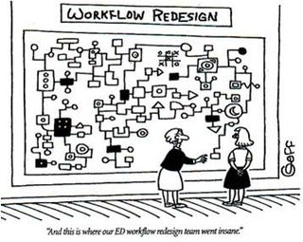
Remember
Workflow maps serve as a tool to improve care for patients, improve efficiency in practice, and redistribute work and job responsibilities.

Slide 22
Thank You!
LA Net Community Health Resource Network
3940-B East Broadway, Long Beach, CA 90803
Phone: 562.434.2000
www.lanetpbrn.net

