Slide 1
Implementation and Impacts of Lean Redesigns in Primary Care
October 28, 2016
Presenter: Dorothy Hung, Ph.D., Associate Scientist
Palo Alto Medical Foundation Research Institute
Moderator: Michael Harrison, Ph.D., Senior Social Scientist
Center for Delivery, Organization, and Markets, AHRQ
Discussant: Arlene Bierman, M.D., M.S., Director
Center for Evidence and Practice Improvement, AHRQ

Slide 2
Project Team:
Carrie Gray, Ph.D., Su-Ying Liang, Ph.D.,
Meghan Martinez, M.P.H., Hal Luft, Ph.D.,
Deanne Wiley, C.R.A., Julie A. Schmittdiel, Ph.D.
This study was supported by a task order under AHRQ’s
ACTION II contract. Its findings do not reflect the view of
AHRQ or any federal agency.

Slide 3


Palo Alto Medical Foundation (PAMF)
Multispecialty, not-for-profit ambulatory care delivery system
Serves nearly 1 million patients
Spans 4 counties in San Francisco Bay Area
1500 physicians, 6700 non-MD staff
Majority fee-for-service:
- 70% commercial FFS
- 12% commercial HMO
- 13% Medicare/Medicaid
- 5% Self-pay or Other

Slide 4



What is “Lean”?
Set of principles, practices, and problem-solving tools that aim to improve efficiency and quality
Founded on 2 basic principles
  Respect for people
  Continuous improvement (PDSA)
Key practices and tools:
Daily Management
Cross-Functional Management
Strategic Deployment

Slide 5
Implementation of Lean in Primary Care
Sequence of spread across primary care clinics
1 “pilot” clinic
in 1 region
3 “beta” test clinics in 3 regions
13 remaining clinics across all 4 regions
Value Stream Mapping
5S of Workspace
Call Management
Workflow (“Flow”) Redesign
“Flow” Redesigns:
Co-location of MD/MA dyads
Daily huddles
Agenda setting
In-basket management
Lean-based
improvements

Slide 6
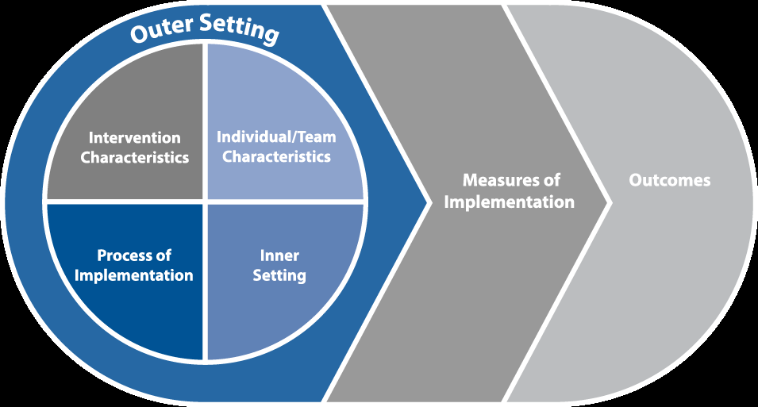
Conceptual Framework
Identify contextual factors impacting frontline acceptance and reported adoption of Lean redesigns in primary care
  Examples of CFIR-PR domains
  1. Outer Setting: external pressures and policy changes
  2. Intervention Characteristics: co-location, standardizations of tasks
  3. Individual/Team Characteristics: physician and staff roles/scope of work
  4. Inner Setting: networks and communications, culture
  5. Process of Implementation: implementation style, execution, employee engagement
  6. Measures of Implementation: acceptance, adoption, appropriateness,
  fidelity, adaptability, cost
  7. Outcomes: efficiency, clinical quality, physician productivity, workforce and patient satisfaction
Consolidated Framework for Implementation Research modified for studying Process Redesign (CFIR-PR)
Source: Rojas Smith L, Ashok M, Dy SM, Wines RC, Teixeira-Poit S. Contextual Frameworks for Research on the Implementation of Complex System Interventions. Methods Research Report. (Prepared by the RTI International—University of North Carolina at Chapel Hill Evidence-based Practice Center under Contract No. 290-2007-10056-I). AHRQ Publication No. 14-EHC014-EF. Rockville, MD: Agency for Healthcare Research and Quality; March 2014. www.effectivehealthcare.ahrq.gov/reports/final.cfm.

Slide 7

Qualitative Data Sources
In-depth interviews (N=113)
- Physicians
- Clinic leaders
Focus Groups (N=11 groups, 3-6 members each)
- Medical Assistants
Observations (N=20)
- Events
- Workflows
In-depth Interviews by Professional Role
 | Contacted | Interviewed
Frontline Physicians
Family Practitioners | 72 | 26
Internists | 58 | 19
Pediatricians | 47 | 24
Organizational Leaders
Physician Leaders | 21 | 21
Operations Leaders | 24 | 23
Total interviews | 222 | 113

Slide 8

Qualitative Analytic Methods
Coding of fieldnotes and transcripts
- Codes emerged from data
- Refined codes to align with CFIR-PR domains
Focused analysis on CFIR-PR Measures of Implementation: Acceptance, reported Adoption of Lean redesigns
- Categorized interviews according to implementation
- Compared differences between context, acceptance, adoption
Atlas.ti software used to manage data and facilitate analysis

Slide 9

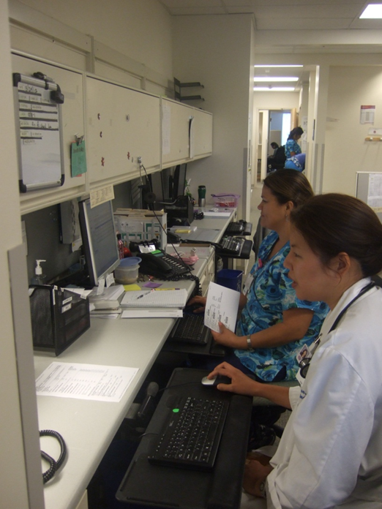
Measures of Implementation
Study results focused on two
implementation measures:
  Acceptance – Degree to which those impacted by the Lean change effort viewed the changes as acceptable in principle
  Adoption – The reported adoption, attempt to adopt, or conversely, abandonment of Lean redesigns in practice

Slide 10


Outer Setting
External pressures and policy changes influenced the acceptance of Lean as a solution for primary care.
  “Burning platform,” “Hamster health care”
“Just grinding out patients as a primary care doc…it feels like emptying the ocean with a teaspoon. The psyche of being a primary care doctor these days has got to get better…” “It’s hard to be on a treadmill…” – Physician
“The burning platform was really our affordability targets and how are we going to weather [the year] when we come upon it.” – Clinic Leader

Slide 11
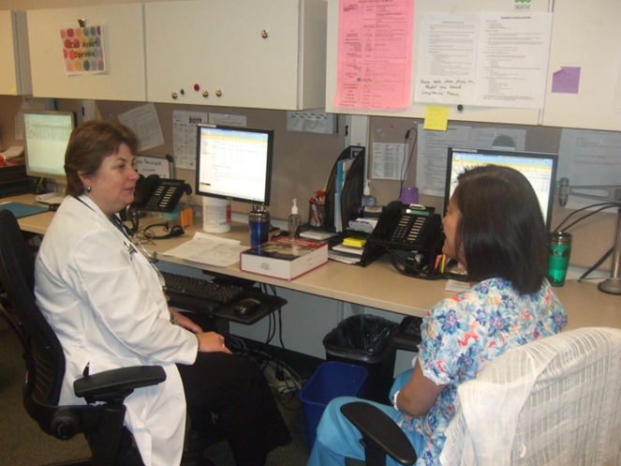
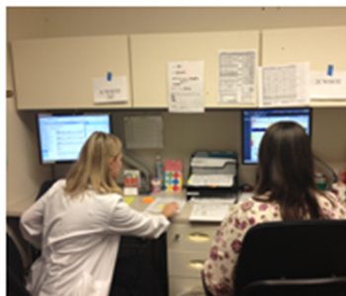
Intervention Characteristics
Co-location of care teams had a positive impact on frontline experiences with Lean redesigns.
  Physician-Medical Assistant (MA) dyad now sit side-by-side to facilitate communication, patient care workflows.
“It’s really a teachable moment too…we’re finding that the physicians are saying, ‘Oh, you know that patient that had X, Y, and Z…this is what the diagnosis is and this is what it means,’ or ‘Here are some symptoms to look out for.’ So, it’s a really good opportunity for that dyad to have teaching.”
- MA Supervisor

Slide 12


Intervention Characteristics
There were challenges to accepting Lean standardization of
some workflows and care processes.
“You have to say please trust me because if we all do it the same way and we all follow the same rules…then the whole team can perform at an optimum level from the patient service representative, to the doctor and everyone in between, and you not only get back more time, you build a better care, you can see more patients, and you feel better about coming to work.” – Clinical Director

Slide 13


Process of Implementation
Engaging frontline employees in developing Lean redesigns is a critical step.
“[I think for Lean to be successful] …make sure that the doctors and the staff continue to have a say in what happens. That's always a big concern is that… people are worried things just happen from above and we're losing control.” – Internist
When participants were involved in developing new work processes or had greater flexibility in adapting redesigns, they reported being more willing to at least “try out” Lean redesigns.

Slide 14


Inner Setting
Matching implementation style to existing organizational cultures:
  Top-down style not as effective in clinics with “democratic, non-hierarchical” cultures.
Micro-cultures, largely fostered by local leadership, can powerfully affect implementation efforts.
Even when highly skeptical of Lean, faith in the department’s leadership, and leaders’ willingness to be flexible and open, provided an environment where members felt that they should at least “give Lean a chance.”

Slide 15


Characteristics of Individuals and Teams
Work roles and relationships between care team members were dramatically changed.
  Required skillsets, competence of MA as newly designated “Flow Manager”
  MD compliance with Lean redesigns affected team’s ability to adopt the new workflows.

Slide 16

Characteristics of Individuals and Teams
Physician autonomy and adherence:
  Those most resistant to Lean believed they were already highly efficient.
  Some were concerned that Lean threatens their autonomy; others acknowledged they still had authority where it matters most (in exam room):
  “I don't feel like my work has changed so much that I'm not in control. I still decide what I'm doing with my patients. It's just that Lean presents my patients to me in a nicer way so that I can do my work better.” – Physician

Slide 17
Summary of Qualitative Findings on Implementation
Outer setting had most impact on frontline acceptance of Lean in principle:
  Market pressures, Overwhelming demand in primary care
Other contextual factors played critical roles in adoption of Lean in practice:
Hung DY, Gray CP, Martinez MC, Schmittdiel J, Harrison MI. Acceptance of Lean Redesigns in Primary Care: A Contextual Analysis. Health Care Management Review. 2016 Mar 2. [Epub ahead of print]
Intervention characteristics
Co-location
Process of Implementation
Top-down vs. Bottom-up
Inner setting
Organizational culture
Standardization
Local leadership
Employee engagement
Physician autonomy
Work roles & relationships
Individuals and Teams

Slide 18

Impact of Lean on System Performance
Quantitative analysis of operational metrics indicating Lean’s impact in primary care
Performance areas examined:
  Workflow Efficiency (“Flow” metrics)
  Physician Productivity
  Operating Expenses
  Clinical Quality
  Patient Satisfaction
  Physician and Staff Satisfaction

Slide 19
Quantitative Methods
Data sourced from dashboards, billing, quality reports, Experience of Work, AMGA, and Press-Ganey surveys
Generalized linear mixed models with physician-month as unit of observation (N=328 MDs employed from 2011-2014)
Estimated overall impacts over time using interrupted time series analysis, non-randomized stepped wedge design
Phased implementation of Lean:
  Projected values (“counterfactual” in the absence of Lean) vs. Observed values after Lean redesigns were implemented in all clinics across the system

Slide 20
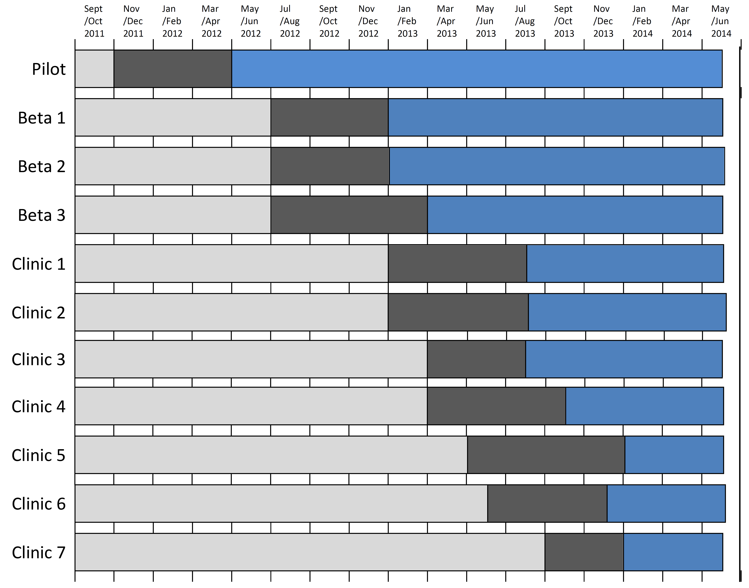
Phased Implementation of Lean Redesigns

Slide 21
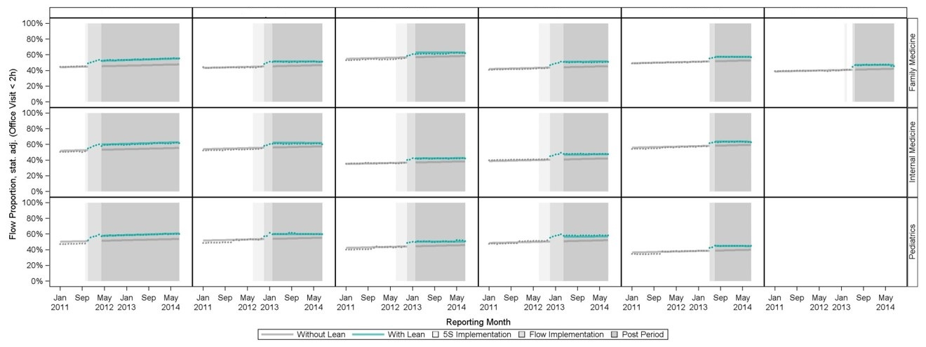
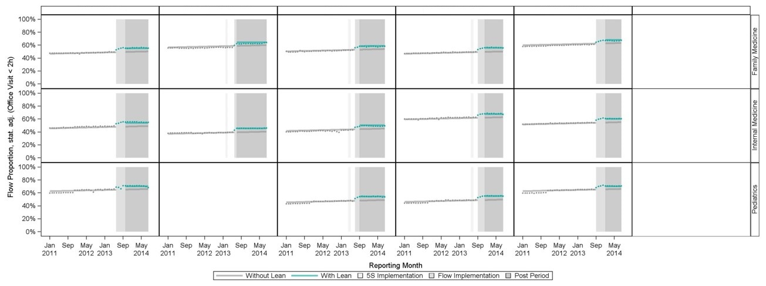
Workflow Efficiency (Office Visit Charts Closed < 2 hours)
Pilot
Beta 1
Beta 2
Beta 3
Clinic 1
Clinic 2
Clinic 3
Clinic 4
Clinic 5
Clinic 6
Clinic 7

Slide 22
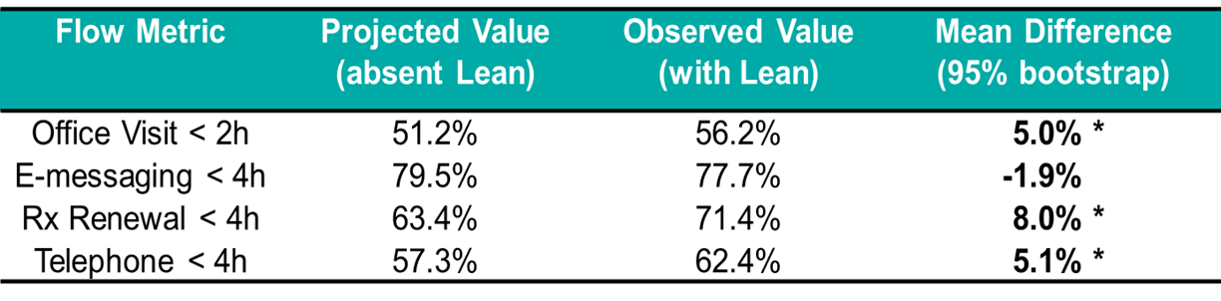
Workflow Efficiency
*p<0.05
  Flow Metrics
  Office visit charts closed within 2 hours
  Electronic patient messages responded within 4 hours
  Prescription refills renewed within 4 hours
  Telephone encounters closed within 4 hours

Slide 23
Physician Productivity
RVU Metric | Projected Value (absent Lean) | Observed Value (with Lean) | Mean Difference (95% bootstrap)
wRVU/cFTE | 252.3 | 265.0 | -13.9*
wRVU/visit | 1.5 | 1.5 | 0.0
wRVU: work Relative Value Unit
cFTE: clinical Full-Time Equivalent
*p<0.05
  RVUs restated to CMS 2014 v2 valuation
  wRVU/cFTE: Production per clinical FTE
  wRVU/visit: Service intensity per office visit

Slide 24
Clinical Quality Metrics
Pay for performance clinical quality metrics for each physician over time
Interrupted time series analysis on metrics that had an initial statistical difference pre- vs. post-Lean:
  Coordinated Diabetes Care: A1c < 8.0%
  Coordinated Diabetes Care: A1c < 7.0%
  Coordinated Diabetes Care: LDL-c < 100 mg/dL
  Coordinated Diabetes Care: Nephropathy Screening
  Cervical Cancer Screening, Asymptomatic Women
  Chlamydia Screening in Women (16-20 yo)
  Adolescent Immunizations: Meningococcal

Slide 25
Clinical Quality Metrics
Quality Metric | Projected Value (absent Lean) | Observed Value (with Lean) | Mean difference (95% bootstrap)
Diabetes: A1c Control < 7.0% | 64.5% | 67.9% | 3.4%*
Diabetes: A1c Control < 8.0% | 35.5% | 39.4% | 3.9%*
Diabetes: LDL < 100 mg/dL | 48.1% | 53.1% | 5.0%*
Diabetic Nephropathy Monitoring | 75.7% | 79.9% | 4.2%*
Cervical Cancer Screening | 71.9% | 71.1% | -0.8%*
Chlamydia Screening 16-20 | 61.7% | 60.7% | -1.0%*
Immunizations - Meningococcal | 77.9% | 69.0% | -8.9%*
*p<0.05

Slide 26
Patient Satisfaction
For each physician, examined proportion of satisfaction scores > 90% for each domain and for composite overall score
Patient satisfaction domains:
  Access
  Care Provider
  Moving Through the Visit
  Nurse/Medical Assistant
  Handling of Personal Issues
  Composite Overall Score

Slide 27
Patient Satisfaction
Domain (proportion of 90% satisfied or higher) | Project Value (absent Lean) | Observed Value (with Lean) | Mean difference (95% bootstrap)
Composite Score | 49.1% | 63.2% | 14.1% *
Access | 37.4% | 55.4% | 18.1% *
Care Provider | 79.0% | 69.8% | -9.2% *
Moving through Visit | 50.9% | 49.3% | -1.6%
Nurse/MA | 66.2% | 68.0% | 1.7%
Personal Issues | 69.0% | 74.5% | 5.5% *
*p<0.05

Slide 28
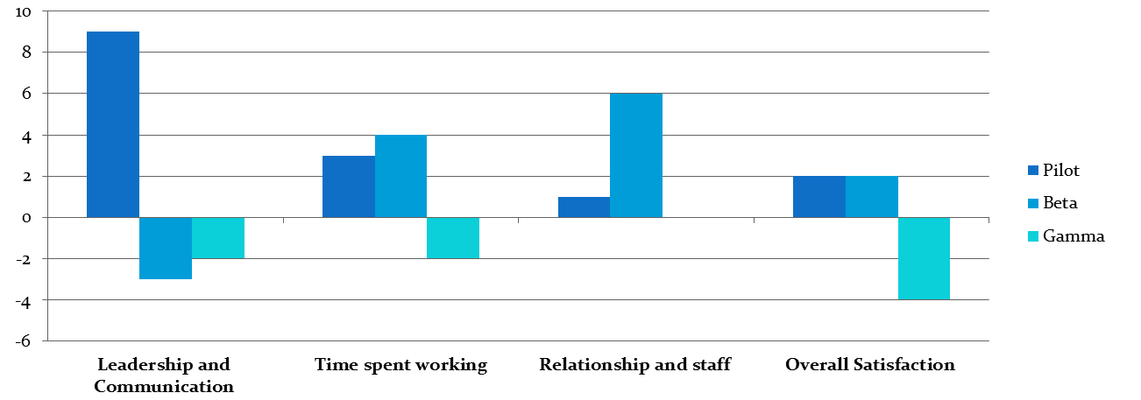
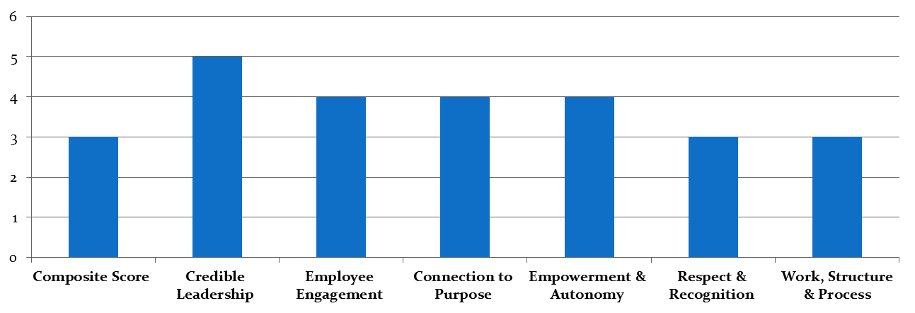
Physician Satisfaction % Differences (2011 vs. 2014)
By phase of implementation
Lean Implementation Phase
(Time since completion of Lean redesigns)
Pilot (25 months)
Beta (13-15 months)
All remaining (4-11 months)
Staff Satisfaction % Differences (2011 vs. 2014)
All primary care clinics system-wide

Slide 29
Summary of Lean Impacts
Topic | Conclusions
Workflow Efficiency | Increase in timeliness of completing 3 of 4 workflow measures: office visit chart closures, medication renewals, telephone responses.
Physician Productivity | Higher wRVUs generated per physician per month. No change in wRVUs per office visit (service intensity)
Operating Expenses | Lower total operating expenses (including staff compensation, and drugs and supply costs) standardized per tRVU. Not significant at p<0.05.
Clinical Quality | Improvements in coordinated diabetes care metrics, no change in preventive screening metrics, and decreased meningococcal immunization among adolescents.
Patient Satisfaction | Higher satisfaction overall and in specific domains, including access to care and handling of personal issues. Lower satisfaction with interactions with care providers.
Physician Satisfaction | In pilot and beta clinics: Higher satisfaction overall and in specific domains, including time spent working and relationships with staff. Lower satisfaction overall in last phase of gamma clinics to implement Lean.
Staff Satisfaction | Higher satisfaction overall and in specific domains, including credible leadership, employee engagement, growth / development, connection to purpose, healthy partnerships, empowerment and autonomy.
Hung DY, Harrison MI, Martinez MC, Luft HS. Scaling Lean in Primary Care: Impacts on System Performance. American Journal of Managed Care, Forthcoming March 2017.

Slide 30

Conclusions
Implementation context matters
- Process of scaling across multiple sites
- Frontline engagement
- Alignment with internal clinic environments
Overall, beneficial effects of Lean redesigns on performance without harm to clinical quality
Using Lean techniques to redesign care delivery
- Attention to “flow”
- Change management: involve providers in design and also results
Conclusions
Findings from this study add to a sparse knowledge base as Lean is rapidly being adopted as a vehicle for reducing waste and maximizing value in health care.
Lean redesigns can benefit patients, physicians, and staff without negatively impacting the quality of clinical care.
Satisfaction declines among physicians in gamma sites, who had as few as 4 months of Lean implementation prior to being surveyed, may reflect more recent transitions and also lower engagement.
Our study underscores the need for careful analysis of both desired effects and potential unintended consequences of implementing Lean to improve value in health care.

