Slide 1
Implementation Planning

Slide 2
Objectives
Implementation Planning
Describe the steps involved in implementing TeamSTEPPS
Develop a TeamSTEPPS Implementation Plan

Slide 3
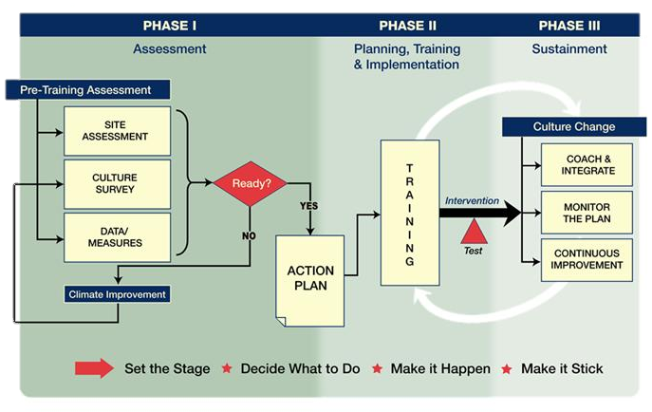
Shift Toward a Culture of Safety

Slide 4
Key Principles of Implementation
The Implementation Guide is based on the principle of improving resident safety and quality of care by improving health care team processes.
Key activities include:
  Identifying a recurring problem or opportunity for improvement
  Developing a flowchart or map of the process
  Studying the process to identify risk points
  Implementing interventions aimed at eliminating the risk points
  Testing the intervention
  Sustaining positive changes

Slide 5
10 Steps of Implementation Planning
Create a Change Team
Define the problem, challenge, or opportunity for improvement
Define the aim(s) of your TeamSTEPPS intervention
Design a TeamSTEPPS intervention
Develop a plan for testing the effectiveness of your TeamSTEPPS intervention
Develop an implementation plan
Develop a plan for sustained continuous improvement
Develop a communications plan
Develop a TeamSTEPPS Implementation Plan timeline
Review your TeamSTEPPS Implementation Plan with key stakeholders and modify according to input

Slide 6
Describe the Targeted Unit/Department/
Work Area
Name of targeted unit, department, or work area:
Size of unit, department, or work area:
Number of staff within unit, department, or work area:
  Registered Nurses:
  Licensed Practical Nurses:
  Certified Nurses Aides:
  Other:
Key Actions:
Describe the targeted unit, department, or work area
  Unit/Department/Work area name
  Size in terms of number of beds or admissions
  Number of staff by profession

Slide 7
Step 1: Create a Change Team
Key Actions:
Select a multidisciplinary Change Team
Ensure representation from different leadership levels
Ensure at least one member has completed TeamSTEPPS Master Training
Ensure one member has experience in performance improvement
Team Member | Role | TeamSTEPPS Trained?

Slide 8
Step 2: Define the Problem or Opportunity for Improvement
Key Actions:
Review unit/department/work area performance and safety data
  Incident reports
  AHRQ Nursing Home Survey on Patient Safety
  Clinical process and outcome measures
Ask frontline staff
Conduct the Magic Wand exercise
Refer to the teamwork issue you identified on the TeamSTEPPS Implementation Worksheet as a starting point, if applicable
What existing information will you review?
1.
2.
3.
What new information will you collect?
1.
2.
3.
What are the main problems and opportunities?
1.
2.
3.

Slide 9
Example: Problem Definition
Problem:
Suboptimal communication among nurses and dietary staff
Team Process:
What: Communication of critical information about the residents’ dietary needs and restrictions for the day
Who: All nursing staff, dieticians, and activities staff
When: At the start of each nursing shift
Where: At the shift change meeting

Slide 10
Step 3: Define the Aims of TeamSTEPPS Intervention
Key Actions:
Develop one to three measurable aims
  What do you hope to achieve?
  Who will be involved?
  When and where will the improvements occur?
Consider including team process, team outcome, and clinical outcome aims
Team Process Aim(s)
1.
2.
3.
Team Outcome Aim(s)
1.
2.
3.
Clinical Outcome Aim(s)
1.
2.
3.

Slide 11
Step 4: Design a TeamSTEPPS Intervention
Key Actions:
Flowchart or map the process during which the target problem/ challenge/opportunity occurs
Identify risk points
Determine which TeamSTEPPS tools or strategies would work best to eliminate the process risk points
State what tools and strategies will be implemented; who will use them, when and where (Refer to your responses on the TeamSTEPPS Implementation Worksheet, if applicable)
Evaluate your TeamSTEPPS intervention for potential benefits and negative effects
List the risk points you intend to address
1.
2.
3.
List the TeamSTEPPS tools and strategies that will be implemented
1.
2.
3.
List the order in which the tools and strategies will be implemented
1.
2.
3.

Slide 12
Step 5: Develop a Plan for Testing Your TeamSTEPPS Interventions
Key Actions:
Identify who on your Change Team will be responsible for data collection, analysis, and presentation (generation of graphs and charts)
Identify a measure and define target ranges for that measure
Measure before and after you implement TeamSTEPPS
Consider Kirkpatrick’s taxonomy when selecting measures
Who is responsible?
At what level will you measure and what measures will you use?
1. Level I Reactions
2. Level II Learning
3. Level III Behavior
4. Level IV Results

Slide 13
Step 6. Develop an Implementation Plan
Key Actions:
Determine who needs to be trained on what TeamSTEPPS skills and by when
Develop a training plan for each audience
Determine if refresher training is required
Create training timelines
      Who will attend the training sessions?
      What skills will you train?
      When will the training sessions occur and for how long?
      Where will the sessions occur?
      How will you train (method of presentation, tools, supplies)?
      What are the logistics to consider?

Slide 14
Determine How Coaches May Be Used
Key Actions:
Determine whether coaches will be used to facilitate sustainment
If coaches will be used, determine:
  How many are needed
  When and how they will be trained
  How they will be used
  Expectations for the role of coaches
      Will coaches be used?
      If Yes:
      Number required:
      When will coaches be trained?
      How will coaches be trained?
      How will coaches be used?
      What are the expectations for the role of coaches?

Slide 15
Step 7: Develop a Sustainment Plan
Key Actions:
For your monitoring plan, determine:
          Measures and target outcomes
          Data source (e.g., existing QI database)
          Resources required (money, time, equipment, personnel, expertise)
          Person(s) responsible for implementation and oversight
Determine how data from your monitoring plan will be used to continually improve processes and performance
Identify Components of a Monitoring Plan:
1. Measures and Targeted Outcomes
2. Data Sources
3. Resource Requirements
4. Individual Responsible

Slide 16
Step 8: Develop a Communications Plan
Key Actions:
Develop a communication plan:
      Identify goals for communication with this group. What do you want to achieve?
      Who will receive the information?
      What information will you communicate?
      When and how often will you communicate?
      How will you communicate (e.g., reports, presentations, emails)?
Who are the stakeholders?
1.
2.
What do you want to achieve?
1.
2.
What information will you communicate?
1.
2.
When will you communicate?
1.
2.
How will you communicate?
1.
2.

Slide 17
Step 9. Develop an Implementation
Plan Timeline
Step | Lead | Completion Date | Resources Required
1. Identify the Change Team
2. Define the Main Problems
3. Define TeamSTEPPS Aims
4. Describe the Intervention
5. Develop a Test Plan
6. Develop an Implementation Plan
7. Develop a Monitoring Plan
8. Develop a Communication Plan

Slide 18
Change Team Meetings
Purpose | Lead | Meeting Date
Notes:
18

Slide 19
Step 10: Review Your Plan With Key Stakeholders
Key Actions:
Identify stakeholders who could contribute significantly to the Implementation Plan
Ask key stakeholders to review your Action Plan and to provide input
Modify your Action Plan based on their input, if needed
Who are the key stakeholders that need to review the plan?
1.
2.
3.
4.
5.

Slide 20

TeamSTEPPS
Implementation Planning Exercise
Break into working groups by unit, department, or work area, or by best alignment of common issues
Develop your Action Plan based on the 10-step process
Be ready to present and discuss your Action Plan with the larger group

