Slide 1
Module 10: Measurement
Welcome to the
Office-Based Care Online Course
Notes:
Welcome to the TeamSTEPPS for Office-Based Care Online Course. This is Dr. Brigetta Craft. This presentation will cover Module 10, Measurement, that you, as a practice facilitator, will review.

Slide 2
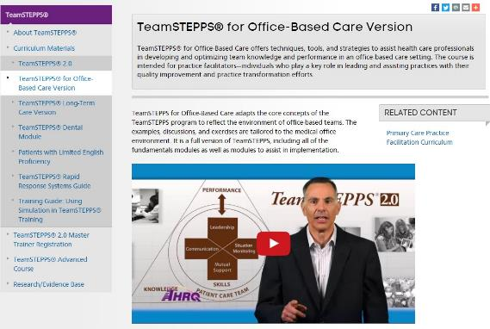
The Materials You Will Use
The Participant Workbook:
Exercises
Video reflections
Scenarios
AHRQ TeamSTEPPS website:
Classroom slides
Instructor Guide (select to view)
Videos
Ancillary materials
Notes:
During this course, the Participant Workbook will be your primary tool for completing all the learning activities, such as exercises, video reflections, and case-based scenarios. These will help shape your implementation plan in addition to providing content, discussion questions, and other activities for your change team. Select the link to download the Participant Workbook.
You can also visit the AHRQ TeamSTEPPS website to access the entire TeamSTEPPS for Office-Based Care curriculum. This includes the PowerPoint classroom slides and instructor guides for each module, along with videos and ancillary materials, such as handouts and exercises. Select the link to open the AHRQ TeamSTEPPS website.

Slide 3
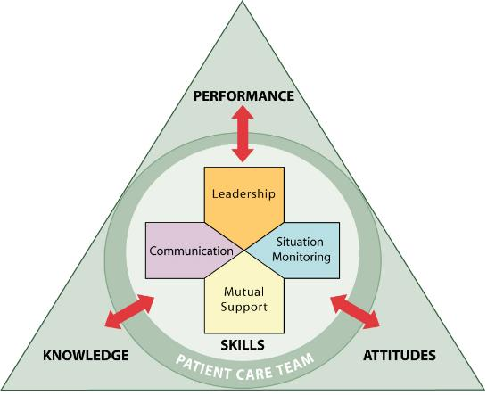
Module Objectives
After completing this module, you will be able to:
Describe the importance of measurement
Describe the Kirkpatrick model of training evaluation
Identify measures that can be used to assess the impact of TeamSTEPPS for Office-Based Care
Describe the AHRQ Medical Office Survey on Patient Safety Culture
Prepare a plan for determining if TeamSTEPPS worked
Your host for this module:
Margaret Sturdivant
Notes:
Upon completion of this module, you will be able to:
Describe the importance of measurement.
Describe the Kirkpatrick model of training evaluation.
Identify measures that can be used to assess the impact of TeamSTEPPS for Office-Based Care.
Describe the AHRQ Medical Office Survey on Patient Safety Culture.
And prepare a plan for determining if TeamSTEPPS worked.
To begin our discussion on measurement, I would like to introduce your host for this module, Margaret Sturdivant.

Slide 4
Introduction
In this module, we will present information about how to measure the impact of TeamSTEPPS in medical offices and the tools that are available to support it.
It is important that you learn how to assess the effects of TeamSTEPPS implementation to help guide and ensure success.
Results gathered during the evaluation will help inform you about how effective you are at training staff on TeamSTEPPS.
Notes:
My name is Margaret Sturdivant. I am the Administrative Director of the Duke University Health System Patient Safety Office. I'm a master TeamSTEPPS trainer with a nursing background.
In this module, we will present information about how to measure the impact of TeamSTEPPS in medical offices and the tools that are available to support it. It is important that you, as practice facilitators, learn how to assess the effects of TeamSTEPPS implementation to help guide and ensure success within the office. Further, results gathered during the evaluation will help inform you about how effective you are at training staff on TeamSTEPPS.

Slide 5
Resources
This module presents a well-established approach for conducting training evaluation.
There will be an exercise at the end of this module for you to apply what you have learned.
The following resources contain additional information:
Evaluating Training Programs: The Four Levels by D.L. Kirkpatrick
What are the critical success factors for team training in health care? by Salas, Almeida, and Salisbury
Twelve best practices for team training evaluation in health care by Weaver, Salas, and King
Notes:
This module presents a well-established approach for conducting training evaluation and describes the available measures and their uses. At the conclusion of this module, there'll be an exercise for you to apply what you have learned. The following resources contain additional information on measurement:
Evaluating Training Programs: the Four Levels, by Donald Kirkpatrick, gives us an indepth perspective on what is quality training. Additional slides will go into more detail of the four levels.
Order of Critical Success Factors for Team Training and Health Care, by Salas and others, really gives us the emphasis and the importance of aligning our training objectives to the organization goals and outlines the need for organization support, how application is relevant to on-the-job expectations, and how are you measuring the effectiveness of that training.
The Twelve Best Practices for Team Training Evaluation in Health Care is another wonderful resource that looks at the multi-dimensions of training and leads through the three different phases of planning, implementation, and followup.

Slide 6
Measurement Answers Critical Questions
Measuring the impact of TeamSTEPPS enables you to answer questions such as:
Did TeamSTEPPS work?
Did TeamSTEPPS produce the expected outcomes?
Was TeamSTEPPS worth implementing?
If TeamSTEPPS did not produce the expected outcomes, why not?
You need to know how effective your work was in training staff on TeamSTEPPS and also your effectiveness in assisting them with implementing TeamSTEPPS.
Notes:
Measuring the impact of TeamSTEPPS is critical and enables you to answer questions such as: 1) Did TeamSTEPPS work? 2) Did TeamSTEPPS produce the expected outcomes? 3) Was TeamSTEPPS worth implementing in my unit? 4) If TeamSTEPPS did not work or did not produce the expected outcomes, why not?
As a practice facilitator, you need to not only know how effective your work was in training staff on TeamSTEPPS, but your effectiveness in assisting them with implementing TeamSTEPPS into their day-to-day activities to improve the delivery of care within a practice.

Slide 7
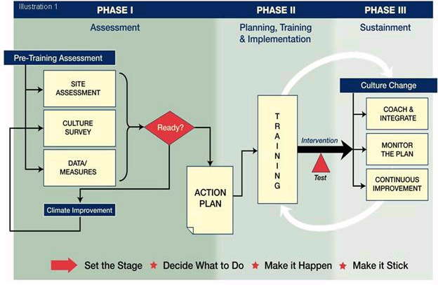
Measurement During the TeamSTEPPS Phases
Requires
Measurement
Notes:
As shown on the slide, measurement is important across all the phases of the TeamSTEPPS implementation process. The results of the measurement provide many benefits, including helping you to identify the quality improvement needs in your area, looking at the data in your measurements. Also, it helps you to provide that data to help generate the leadership support or your staff buy-in on your efforts. It assesses what training needs you might have, providing information to drive the plan on how you will use and implement TeamSTEPPS.
Also, as you move across that implementation phase and then going into phase two, you'll see that the measurement is also critical to evaluating the effectiveness of the TeamSTEPPS training and assessing how TeamSTEPPS has affected the staff attitudes, the patient perceptions, and the organization culture in your area. Looking at the data and measuring the effectiveness of the training can help you in identifying where your successes have been, and where are there areas for continued improvement, which is important for adapting the implementation plan.
I like to think of the phase three sustainment plan as ongoing—that it's a journey that we're on for continuous improvement. We're continuing to refine and enhance our effectiveness as a team.

Slide 8
How To Measure - Kirkpatrick
M
U
L
T
I
L
E
V
E
L
A
P
P
R
O
A
C
H
Level IV – Results
Organizational results
Level III – Behavior
Transfer to the job
Level II – Learning
Think, Do, Feel
Level I – Reactions
Like it and useful
Notes:
In 1967, Kirkpatrick defined a multilevel model for evaluating the impact of training programs. This model continues to be widely used today and is regarded as a practical approach to training evaluation. When determining the effectiveness of any training intervention, Kirkpatrick advocated for examining four different outcomes of training:
Level one are reactions. They're defined as the participants' perception of the training. How well did they like the training? Did they relate to whether the participants found the training useful?
Level two is learning, and learning is really defined in three levels of: attitude, or how the people felt; knowledge—what people know; and skills—what did the people do with the information.
Moving up into level three is the behavior. Behavior is defined as to whether the new attitudes, knowledge, and skills are transferred to the job—in other words, are the behaviors assessed—whether the participants used what they learned in the training on the job, and whether that produced an improved job performance for the individual.
And level four: results, the highest level. The results are defined as the organization's benefits that are produced from the training. In the case of TeamSTEPPS, the results include patient outcome, such as a reduction in infection rates or an improvement in the patient perceptions of care; process outcomes could be the increase in the number of structured handoffs used or staff perception of patient safety. It could be the number of calls answered within a timeline period that you're looking for. The types of results depend on what TeamSTEPPS intervention you've targeted and trained as well.

Slide 9
Available Measures
Reactions
TeamSTEPPS for Office-Based Care Course Evaluation Form
Learning
TeamSTEPPS Teamwork Attitudes Questionnaire (T-TAQ) for Office-Based Care
TeamSTEPPS for Office-Based Care Knowledge Test
Team Performance Observation Tool for Office-Based Care
TeamSTEPPS Teamwork Perceptions Questionnaire (T-TPQ) for Office-Based Care
Behavior
Team Performance Observation Tool for Office-Based Care
TeamSTEPPS Teamwork Perceptions Questionnaire (T-TPQ) for Office-Based Care
AHRQ Medical Office Survey on Patient Safety Culture
Results
Patient outcome and clinical process measures
AHRQ Medical Office Survey on Patient Safety Culture
Consumer Assessment of Healthcare Providers and Systems for Patient-Centered Medical Homes
Notes:
There are a number of useful measures for evaluating the impact of TeamSTEPPS that are also aligned with the Kirkpatrick model of training evaluation. These measures include:
For reactions, the TeamSTEPPS for Office-Based Care course evaluation form.
For learning, the TeamSTEPPS Teamwork Attitudes Questionnaire (or T-TAQ) for office-based care, TeamSTEPPS for Office-Based Care knowledge test, the Team Performance Observation Tool for office-based care, or the TeamSTEPPS Teamwork Perceptions Questionnaire (or T-TPQ) for office-based care.
For behavior, we have the Team Performance Observation Tool for office-based care, the TeamSTEPPS Teamwork Perceptions Questionnaire (or T-TPQ) for office-based care, and the AHRQ Medical Office Survey on Patient Safety Culture.
Ways to measure results include patient outcome and clinical process measures, the AHRQ Medical Office Survey on Patient Safety Culture, and the CAHPS survey for patient-centered medical homes.
These measures will be reviewed in more detail as we progress through the module and will include information about where they can be accessed.

Slide 10
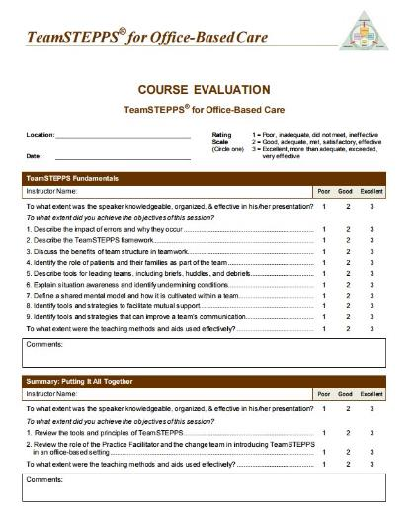
Reactions: Course Evaluation Form
Level I - Reactions
Includes evaluation questions for all components of the TeamSTEPPS for Office-Based Care
Customizable
Provides information about what trainees thought about the training
Download from AHRQ Web site
Notes:
Participant reactions tell you whether participants liked the course, the facilities, and the instructor, among other things. As mentioned earlier, these types of reactions are referred to as “affective reactions.”
In addition, participant reactions can tell you whether participants found TeamSTEPPS useful, and if they believe that they can apply the information that they have learned to their primary care office. These types of reactions are referred to as “instrumentality reactions.” Research has shown that participants who find training useful and report that they will use it on their jobs are more likely to actually do so.
Participant reactions also provide information regarding what participants will say about the course to others, who may attend in the future, and where the course could be improved in terms of what is taught and how it's taught.
If you plan to use a course evaluation form for continuing education credit purposes, please check with your continuing education provider to make sure that the form meets the specific requirements of the respective accrediting organization. For assessing participant reactions, a customizable TeamSTEPPS for Office-Based Care course evaluation form can be found online in the materials for this program. This form captures both affective and instrumentality reactions.

Slide 11
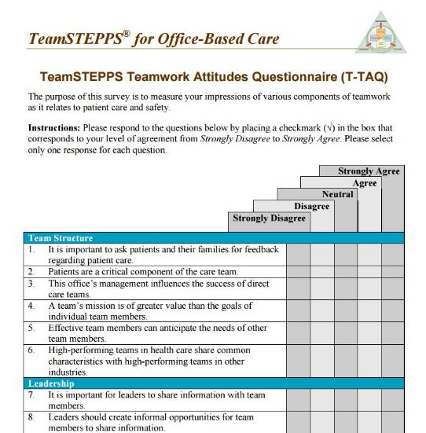
Learning: Teamwork Attitudes Questionnaire
Level II - Learning
30-item self-report tool
Respondents rate their agreement with items on a 5-point Likert scale
Measures attitudes toward:
Team Structure
Leadership
Situation Monitoring
Mutual Support
Communication
Download from AHRQ website
Notes:
As noted, the evaluation of learning accomplished through training can be in the form of assessing attitudes, knowledge, and skills. One indication that training is effective is that participants' attitudes about the importance of teamwork change as a result of attending TeamSTEPPS training.
To identify changes in attitudes, participants' attitudes should be measured both before and after TeamSTEPPS training, with the expectation that participants' scores will be higher after training. This could be an indication of improved attitudes toward teamwork as a result of TeamSTEPPS training.
The TeamSTEPPS Teamwork Attitudes Questionnaire was designed to measure the participant attitudes about the teamwork skills and behaviors taught in TeamSTEPPS.
It's important to note that, with the explosion of patient safety movement and the growing acceptance of the importance of teamwork in the delivery of safe care, health care professionals are likely to report positive attitudes toward teamwork, regardless of whether they've attended the TeamSTEPPS training. Therefore, TeamSTEPPS recommend that you do not rely solely on measuring the participants' attitudes as an indication of learning.

Slide 12
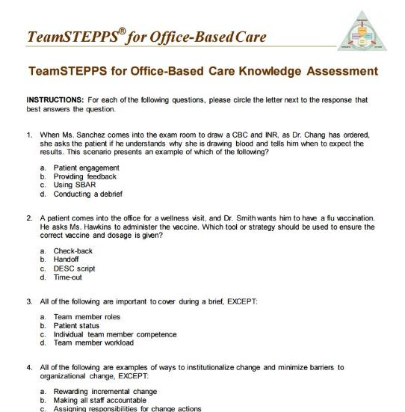
Learning: Office-Based Care Knowledge Test
Level II – Learning
TeamSTEPPS for Office-Based Care Knowledge Test
Multiple-choice test
Uses:
To assess knowledge of teamwork
To measure changes in knowledge
Caution
Items tend to be too easy
Download from AHRQ website
Notes:
Another indication that training was effective is that participants know something new after participating in training. Similar to measuring attitude changes, measurement of the participants' knowledge would take place both before and after TeamSTEPPS training using a knowledge test.
The expectation would be that participants would score higher on the test after the training. The TeamSTEPPS for Office-Based Care knowledge test —found online—can be used for this purpose. The test is a short, multiple-choice exam that measures participants' knowledge of the teamwork principles taught in TeamSTEPPS.
As with the attitude measures, knowledge measures should not be used alone. Items on such tests tend to be easy, and many individuals can answer the items correctly without participating in TeamSTEPPS training.

Slide 13
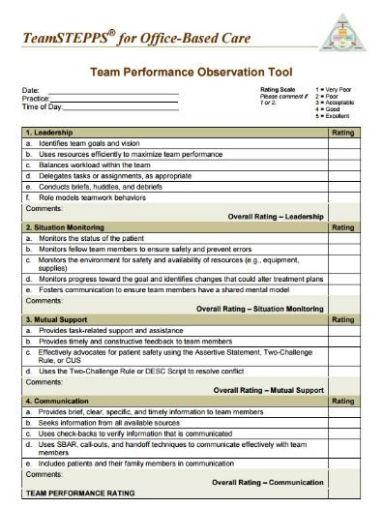
Learning & Behavior: Performance Observation Tool
Level II - Learning and Level III - Behavior
Tool for observing team performance
Site assessment
Measure of training effectiveness
Observers should practice using the tool
Can be adapted to a particular practice type
Download from AHRQ website
Notes:
The third indication that training was effective in terms of participant learning is that participants can do something new after participating in the training. Similar to measuring attitudes and knowledge, you should expect that if you observe participant behavior in a simulation before and after TeamSTEPPS training, the participants would behave quite differently.
For example, if you trained and implemented briefs and check-backs as your TeamSTEPPS intervention, you might test the office staff by developing scenarios that could be played out to determine if learning occurred. Observing the staff on the job as they conduct a daily team briefing prior to opening the practice would also be an indication of learning. Please note that under Kirkpatrick's hierarchy, this is considered a measure of behavior—learning that's transferred to the actual job setting.
The Team Performance Observation Tool for office-based care is a customizable tool. That is, it's not designed to focus on any particular type of practice. Therefore, TeamSTEPPS recommends: that individuals customize the observation tool to the practice type of interest; that you use the tool as a guide when observing team performance on the job; and you practice using the tool before conducting the observations. It's important that everyone that's acting as an observer uses the tool in the same way, so that observations are accurate. You can also revise the observation tool as needed so that the information is clear to all the observers.

Slide 14
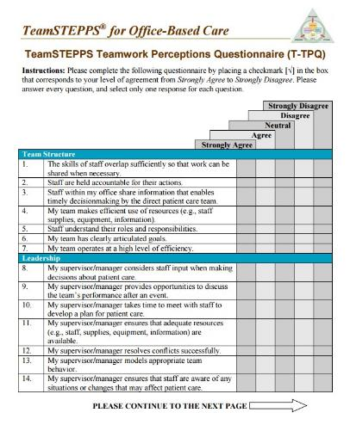
Learning & Behavior: Teamwork Perceptions Questionnaire
Level II - Learning and Level III - Behavior
35-item self-report tool
Respondents rate their agreement with items on a 5-point Likert scale
Measures staff perceptions of:
Team Structure
Leadership
Situation Monitoring
Mutual Support
Communication
Download from AHRQ website
Notes:
The TeamSTEPPS Teamwork Perception Questionnaire can also be used to measure the learning of skills by training participants.
The perceptions questionnaire is completed by individual members of the team. In this measure, individuals report their perceptions regarding the effectiveness of teamwork within their office setting. This tool measures staff perceptions of team structure, leadership, situational monitoring, mutual support, and communication.
A version of the perceptions questionnaire can be found online.

Slide 15
Behavior
Measure whether the information learned during training is transferred to the job
Two important factors in transfer are:
Whether there is an opportunity to use the new TeamSTEPPS tools or strategies on the job
Whether use of the TeamSTEPPS tools and strategies is valued and reinforced
Notes:
It is important to measure whether the information learned during training is transferred to the job. Two important environmental factors for producing transfer are whether there's an opportunity to use the TeamSTEPPS tools and strategies on the job and whether the use of the tools and strategies is valued and reinforced. The timing of your training is often important to make sure that these factors help in the transfer of the information.

Slide 16
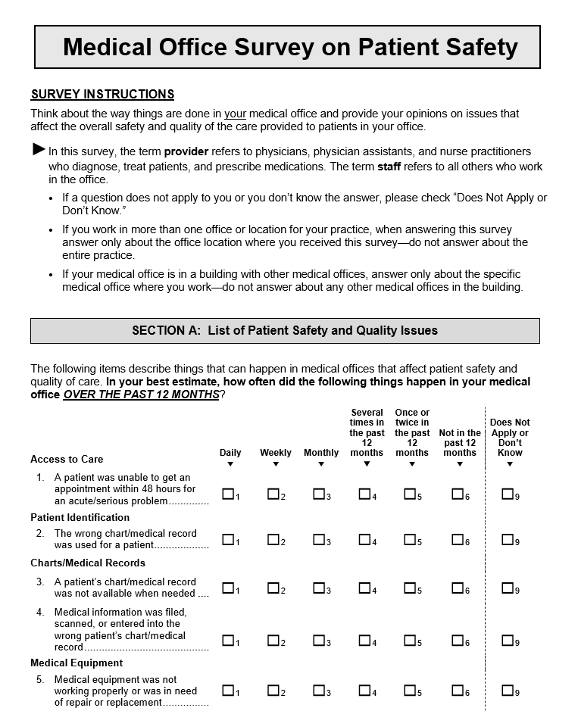
Behavior: Tools to Measure
Level III - Behavior
Team Performance Observation Tool for Office-Based Care
Teamwork Perceptions Questionnaire (T-TPQ) for Office-Based Care
AHRQ Medical Office Survey on Patient Safety Culture
Download from AHRQ website
Notes:
Various tools are available for assessing the transfer of the participants' learning to their jobs, including the three that you see listed here: The Team Performance Observation Tool, the TeamSTEPPS Teamwork Perceptions Questionnaire, and the AHRQ Medical Office Survey for Patient Safety Culture.
We have already discussed the Team Performance Observation Tool for office-based care and the Teamwork Perceptions Questionnaire (or TPQ) for office-based care, as these can be used to measure learning of the new teamwork skills. The AHRQ Medical Office Survey on Patient Safety Culture can be used to assess behavior and results.
We'll first discuss a few other results measures, and then we'll focus our attention on a more detailed discussion of the patient safety culture survey.

Slide 17
Results: Measures
Level IV - Results
Patient outcome measures
Examples: Complication rates, infection rates, measurable medication errors, patient experience measures
Clinical process measures
Examples: Length of patient wait time, number of required patient appointments made and completed, percentage of lab results communicated to patients, staff perceptions of safety
Notes:
The final level of training evaluation in Kirkpatrick's hierarchy is results. As we discussed earlier, this level of the evaluation provides an assessment of the organizational benefits produced from the training. It's important to note that this level of evaluation is difficult to assess, and that any number of organizational changes, initiatives, or interventions could contribute to the organizational results.
However, for evaluating TeamSTEPPS, selecting measures that align with the teamwork issue being addressed by TeamSTEPPS will help make sure that the results can be linked to the training intervention.
Results measures include patient outcome measures—measures such as measurable medication errors—as well as patient experience measures such as the CAHPS survey for the patient-centered medical homes.
Result measures also include the clinical process measures. Examples could include the length of patient wait time, compliance with preventive screenings, the number of misdiagnoses, number of required patient followup appointments made and completed, the percentage of lab results communicated to patients, and staff perceptions of safety as measured by the AHRQ Medical Office Survey on Patient Safety Culture.

Slide 18
AHRQ Medical Office Survey on Patient Safety Culture
Designed specifically for outpatient medical office providers and staff
Designed for medical offices with at least three providers
Not recommended for use in solo practitioner or two-provider offices to protect confidentiality
Can be used to facilitate dialogue about patient safety and quality in small offices
Medical Office Survey on Patient Safety
Notes:
In response to medical offices' interest in a survey that focuses on patient safety culture in their context, AHRQ sponsored the development of the Medical Office Survey on Patient Safety Culture. This survey is designed specifically for outpatient medical office providers and staff, and asks for their opinions about the culture of patient safety and health care quality in their medical offices.
The Medical Office Survey on Patient Safety Culture was designed for medical offices with at least three providers. "Providers" refer to the physicians—either MD or DO—physician assistants, nurse practitioners, or other providers licensed to diagnose medical errors, treat patients, and prescribe medications. Survey administration in solo practitioner or two-provider offices is not recommended, because it would not be possible to maintain the confidential nature of individual responses. In small offices, rather than administering the survey, it can be used as a tool to initiate open dialogue or discussion among providers and staff about patient safety and quality issues.
This survey is available on the AHRQ Web site. Consider the following questions or discuss them if you're watching this with others: Have any of your practices used the Medical Office Survey on Patient Safety Culture? Can you describe how your practice used the survey and its results? What lessons learned do you have from the process of using the survey and its results?
And I would just highlight the importance of your response rate. As you're administering the survey, you really want a response rate of around 60 to 80 percent. A response rate's critical to having meaningful data to be able to interpret how your team is responding. Response rates of less than 60 percent? You may be hearing from those that are extremely pleased with the performance or those that are extremely not pleased. So you need to find a high response rate, and I would encourage you to also discuss strategies for getting that 60 to 80 percent response rate.

Slide 19
AHRQ Medical Office Survey on Patient Safety Culture Uses
Raise awareness about patient safety issues
Assess patient safety culture
Track changes in patient safety culture over time
Evaluate the impact of patient safety interventions (e.g., TeamSTEPPS)
Notes:
The Medical Office Survey on Patient Safety Culture has a number of uses, including raising awareness about patient safety issues, assessing patient safety culture, tracking changes in the patient safety culture over time, and evaluating the impact of patient safety interventions.
The survey can be used to assess whether TeamSTEPPS has a positive impact on the medical office’s patient safety culture. If TeamSTEPPS is effective, survey scores should increase after the TeamSTEPPS tools and strategies have been implemented. Such a result would be considered an organization outcome or a result of the training.

Slide 20
Survey Measures: 12 Dimensions and 2 Overall Items
Survey Dimensions:
Communication about error
Communication openness
Information exchange with other settings
Office processes and standardization
Organizational learning
Overall perceptions of patient safety and quality
Owner/managing partner/leadership support for patient safety
Patient care tracking/follow-up
Patient safety and quality issues
Staff training
Teamwork
Work pressure and pace
Overall Items:
How they would rate this medical office on five different areas of health care quality (patient centered, effective, timely, efficient, and equitable)
How they would rate this medical office on patient safety
Notes:
The Medical Office Survey on Patient Safety Culture includes 51 items and requires 15 minutes to complete. The 51 items measure the following dimensions: communication about error, communication openness, information exchange with other settings, office processes and standardization, organizational learning, overall perceptions of patient safety and quality, the owner or managing partner or leadership support for patient safety, patient care tracking and followup, patient safety and quality issues, staff training, teamwork, and work pressure and pace.

Slide 21
What Support Is Available?
Survey Toolkit
Survey forms
Survey items and dimensions
Survey User’s Guide
Comparative Database and Reports
Data Entry and Analysis Tool
E-mail questions to:
SafetyCultureSurveys@westat.com
Notes:
The Medical Office Survey on Patient Safety Culture has an accompanying toolkit that contains the following materials: the survey forms; the survey items and dimensions; and a survey user's guide that provides the step-by-step instructions on how to select a sample, how to administer the survey, strategies for attaining that high response rate that we were discussing, and how to analyze and report the results.
Comparative databases and reports are also available, as well as a data entry and analysis tool that works with Microsoft Excel and makes it easy to input individual-level data from the survey. The tool then automatically creates tables and graphs to display survey results. To request the tool, email the email address that you see here on your screen. If you have questions about the medical office survey or you need technical assistance, you can also request help by emailing the safetyculturesurveys@westat.com.

Slide 22
Evaluating TeamSTEPPS in Office-Based Care Scenario
Consider the following scenario:
You have been asked to work with a fairly large primary care office that has been struggling with its management of Type 2 diabetes patients. In particular, you observed that a high rate of diabetic patients are not achieving the treatment goals that have been recorded in the patients’ charts to manage this chronic condition. Follow-up visits for HbA1c testing are notoriously unreliable, and poor HbA1c control has led to serious kidney disease for some of this office’s patients. Your observations of the primary care office suggest that it has yet to develop an effective system for managing these patients. Follow-up visits, while ordered by the physician, often fall through the cracks.
You recently met with staff from the primary care office and recommended that the office adopt briefings prior to the office opening and debriefs after the office closes each day to ensure that patient follow-ups improve.
Notes:
Now that we've reviewed the four levels of Kirkpatrick's model of training evaluation and discussed available resources for each, we will use a scenario to apply what we've learned. Consider the following scenario: You have been asked to work with a fairly large primary care office that has been struggling with its management of type 2 diabetes patients. In particular, you observe that a high rate of diabetic patients are not achieving their treatment goals that have been recorded in the patients' charts to manage this chronic condition.
Follow-up visits for the hemoglobin A1C testing are notoriously unreliable, and poor hemoglobin A1C control has led to serious kidney disease for some of this office’s patients. Your observations of the primary care office suggest that it has yet to develop an effective system for managing these patients. Followup visits, while ordered by the physician, often fall through the cracks.
You recently met with the staff from the primary care office and recommended that the staff adopt briefings prior to the office opening and debriefs after the office closes each day to ensure that the patient followups improve. Now take a moment to consider and answer the questions on the following slide.

Slide 23
Evaluating TeamSTEPPS in Office-Based Care Scenario
Based on the scenario, answer the following questions:
Which measure or measures would you use to assess whether instruction about briefings transferred to this office’s work environment?
Why did you choose the identified measure(s)?
What organizational barriers might interfere with successful training transfer and how can these barriers be addressed?
Which measure or measures would you use to determine whether briefings affected patient safety outcomes?
Why did you choose the identified measure(s)?
Record your answers to these questions on page 57 of your Workbook
Notes:
Based on the scenario, take a moment to answer the following questions:
Which measure or measures would you use to assess whether instruction about briefings transferred to this environment? Would you potentially use the observation tool? Why did you choose your identified measure?
What organizational barriers might interfere with successful training transfer, and how can these barriers be addressed? Do staff receive support to practice the tools they've learned in training? Is training scheduled close enough to the implementation of TeamSTEPPS so staff will remember the tools?
Which measure or measures would you use to determine whether the briefings affected the patient safety outcome, and why did you choose the identified measure?

Slide 24
Module 10 Summary
In this module, you learned to:
Describe the importance of measurement
Describe the Kirkpatrick model of training evaluation
Identify measures that can be used to assess the impact of TeamSTEPPS for Office-Based Care
Describe the AHRQ Medical Office Survey on Patient Safety Culture
Prepare a plan for determining if TeamSTEPPS worked
Notes:
In this module, you learned to:
Describe the importance of measurement.
Describe the Kirkpatrick model of training evaluation.
Identify measures that can be used to assess the impact of TeamSTEPPS for Office-Based Care.
Describe the AHRQ Medical Office Survey on Patient Safety Culture.
And prepare a plan for determining if TeamSTEPPS worked.

