Slide 1
What Is MONAHRQ?
July 2016
Note: This is one of eight slide sets outlining MONAHRQ and its value,
available at www.ahrq.gov/professionals/systems/monahrq/resources/

Slide 2
What Is MONAHRQ?
Windows-based software from the Agency for Healthcare Research and Quality (AHRQ) that can help you and your organization create your own website-based, comparative health care performance reports.
Evidence-based – uses measures, data sources, and reporting techniques that are based on the latest research
Quick – generates websites and reports in hours or days, not months
Easy – designed to be intuitive so no training is needed to use it
Flexible – allows customization to ensure that the websites and reports are relevant
Free – provided at no cost to anyone who wants to produce health care performance websites and reports
The purpose of MONAHRQ is to help increase transparency by disseminating evidence-based information that is understandable and useful for improving health care safety, quality, and affordability.

Slide 3
Who Uses MONAHRQ?
Who uses MONAHRQ to create websites and reports?
Hospitals, health systems, and associations
Nursing homes and nursing home organizations
State agencies
Public health departments
Business, community, or multistakeholder alliances
Others who are involved in health care quality improvement
Who is likely to use websites and reports created with MONAHRQ?
Consumers, patients, and the general public, including media
Providers, such as hospitals, nursing homes, medical groups, and others
State and local agency staff and others involved in public policy
Researchers and analysts
Private and public sector purchasers and payers, including health plans and self-insured employers and union trusts

Slide 4
What Does MONAHRQ Do?
MONAHRQ takes health care data and helps you turn it into actionable information for consumers or professionals.
Examples of data and information that can be used in MONAHRQ:
Your own Inpatient Hospital Discharge data
Your own hospital Emergency Department (ED) data
AHRQ Quality Indicator™ results
Medicare Provider Utilization and Payment Data
CMS measure results and other information:
CMS Hospital Compare data
CMS Nursing Home Compare data
CMS Physician data
Other data using MONAHRQ’s Open Source Framework
For a list of measure topics included in MONAHRQ, see the slide set, “What Types of Websites and Reports Can MONAHRQ Generate?”

Slide 5
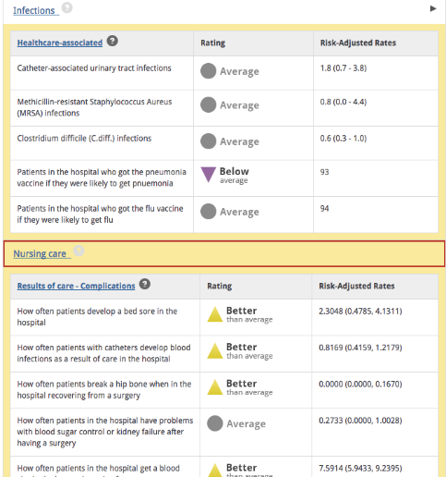
MONAHRQ Websites
MONAHRQ can generate two types of websites designed for specific audiences.
For use by medical clinicians, administrators, policymakers, researchers, and analysts, with detailed statistics
For use by consumers and the general public, with infographics and guided education

Slide 6
Examples of MONAHRQ Reports
Individual hospital profiles, with an overall patient experience rating and a list of the highest cost DRGs
Quality of care comparisons across hospitals, including patient experience ratings
Emergency department (ED) utilization
Potentially avoidable hospitalizations by county
Hospital use rates for conditions and procedures, by county and/or region
Estimated cost savings by reducing avoidable hospital stays
Hospital utilization and costs for top diagnosis related groups
Physician profiles, with hospital affiliation and medical group ratings based on patient experience surveys
Nursing home profiles, plus reports on quality of care, inspection results, and staffing, and patient experience
Annual and quarterly trending reports on utilization, showing changes over time

Slide 7
What’s New in MONAHRQ 7?
ICD-10 compatibility — ability to import datasets with ICD-10 diagnosis codes
Refined trending reports — show quarterly trends for nursing home utilization and hospital utilization and quality
CABG cost and quality report for consumers — show cost, utilization, and quality side-by-side regarding coronary artery bypass grafting
New reports on medical groups — new reports can include CG-CAHPS (Clinician and Group Consumer Assessment of Healthcare Providers and Systems) and HEDIS results
Expanded nursing home reports — new reports can include NH-CAHPS (Nursing Home Consumer Assessment of Healthcare Providers and Systems) results
More infographic reports — several new options for consumer-friendly reports on nursing home quality and a range of hospital topics; each includes facts, tips, and results
Ability to further customize the generated website by managing webpage content within MONAHRQ
Updated measures and datasets, embedded content management capabilities, and improved software performance

Slide 8
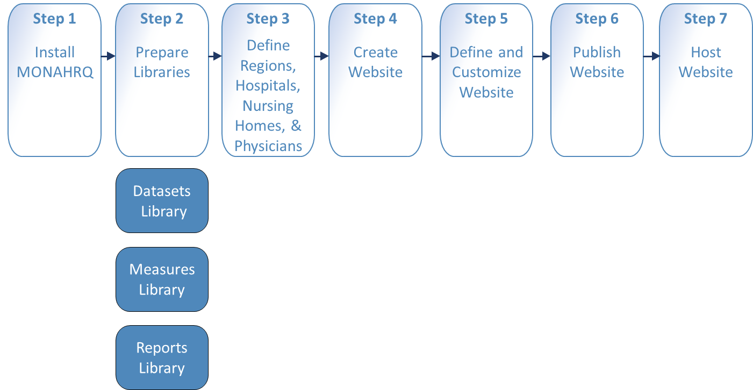
Setting Up MONAHRQ
There are seven main steps to using MONAHRQ:

Slide 9
Setting Up MONAHRQ (Cont.)
Step 1: Install MONAHRQ
Prepare your environment with required software and MONAHRQ 7
Step 2: Prepare Libraries
Datasets: Import and manage multiple versions of the same data file
Measures: Customize measure attributes (title, description, etc.)
Reports: Select and customize reports for the website you will generate
Step 3: Define Regions, Hospitals, Nursing Homes, and/or Physicians
Edit and manage provider type attributes and assign to regions
Step 4: Create Website
Use the Website Generation wizard to create and customize

Slide 10
Setting Up MONAHRQ (Cont. 2)
Step 5: Define and Customize Website
Customize the website theme and website page content to be displayed on your generated website
Step 6: Publish Website
Use the Wizard ensure your website configurations and datasets are complete and then save the website files to your local system
Step 7: Host Website
Upload and host your new or updated MONAHRQ-generated website

Slide 11
For Further Information
Visit http://www.ahrq.gov/professionals/systems/monahrq/resources/ to access these additional slide sets:
What is the Value of Health Care Measurement and Reporting?
Why Use MONAHRQ for Health Care Reporting?
How To Get Started With MONAHRQ
What Types of Websites and Reports Can MONAHRQ Generate?
Who Can Use MONAHRQ?
Using MONAHRQ’s Open Source Framework
Future Plans for MONAHRQ and How To Get Involved
To receive updates about MONAHRQ, ask to join our listserv by emailing monahrq@ahrq.gov

