Slide 1
Improving Skin Care and Multidrug-Resistant Organisms Prevention in Long-Term Care
Improving Skin Care and Multidrug-Resistant Organisms Prevention in Long-Term Care
AHRQ Safety Program for MRSA Prevention
IDWeek
October 21, 2025

Slide 2
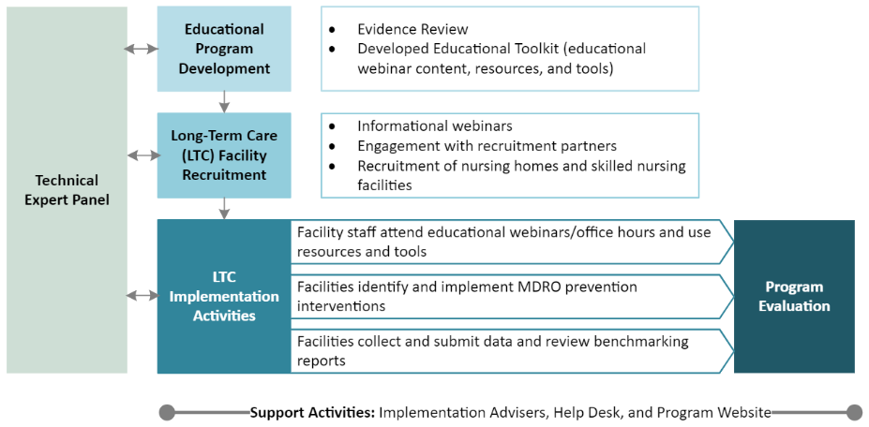
Overall Program and Long-Term Care Cohort
18-month Quality Improvement Initiative
Funded and Guided by AHRQ, Led by Johns Hopkins Medicine and NORC at the University of Chicago
Program Objective:
To prevent methicillin-resistant Staphylococcus aureus (MRSA) infection and transmission among ICU, non-ICU, high-risk surgical, and long-term care patients.

Slide 3
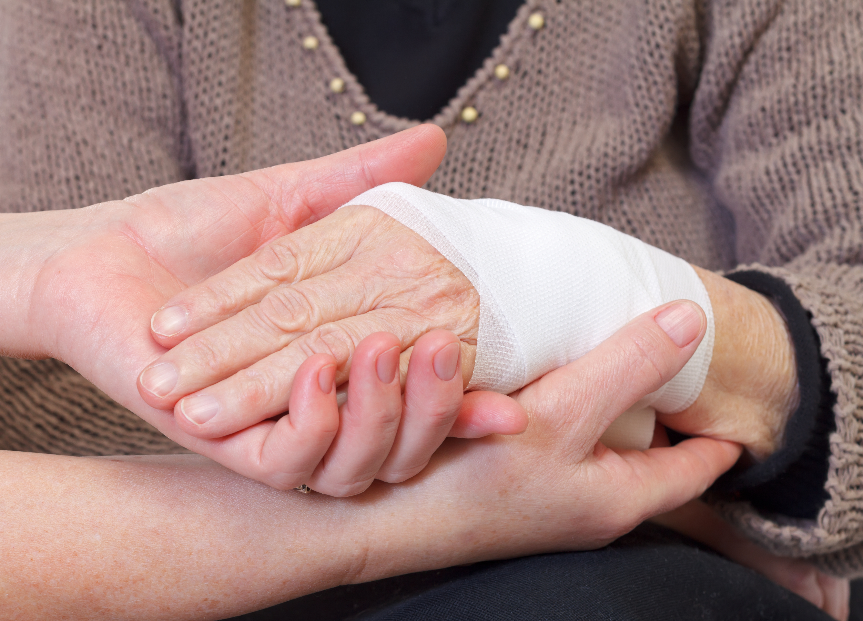
Why Focus on Skin for the Long-Term Care Component?
Skin integrity is our primary defense against infection
Individuals with immobility or incontinence (i.e., nursing home residents) are at increased risk for developing skin problems, including pressure injuries
Pressure injuries provide ideal environment for bacterial growth and are particularly susceptible to infection
Colonization rates for MDROs are as high as 65% in nursing home residents, the majority of which are MRSA.
Risk of infection with MRSA as high as 40% after 1 year in a nursing home
Nursing homes already collect data about pressure injuries and skin conditions
BUT little data on colonization rates for MDROs
Bradley SF, Terpenning MS, Ramsey MA, et al. Methicillin-resistant Staphylococcus aureus: colonization and infection in a long-term care facility. Ann Intern Med 1991;115:417-22.
Miller, McKinnel, Singh et al. Decolonization in nursing homes to prevent infection and hospitalization. N Engl J Med. 2023 Nov 9;389(19):1766-77.

Slide 4

Impact of Pressure Injuries on Healthcare
Pressure injury rates in nursing homes range from 20-30%.
Over 2.5 million people develop pressure injuries annually, costing the health system $26.8 billion dollars per year. The cost to manage a severe pressure injury in one patient ranges from $75,000-$150,000.
Pressure Injuries have been associated with:
57% longer length of stay in hospitals
22% higher rate of hospital readmission
3% higher mortality rate vs. those without pressure injuries
https://www.cdc.gov/nchs/products/databriefs/db14.htm
https://cdn.ymaws.com/npiap.com/resource/resmgr/public_policy_files/npiap_word_fact_sheet_08mar2.pdf

Slide 5
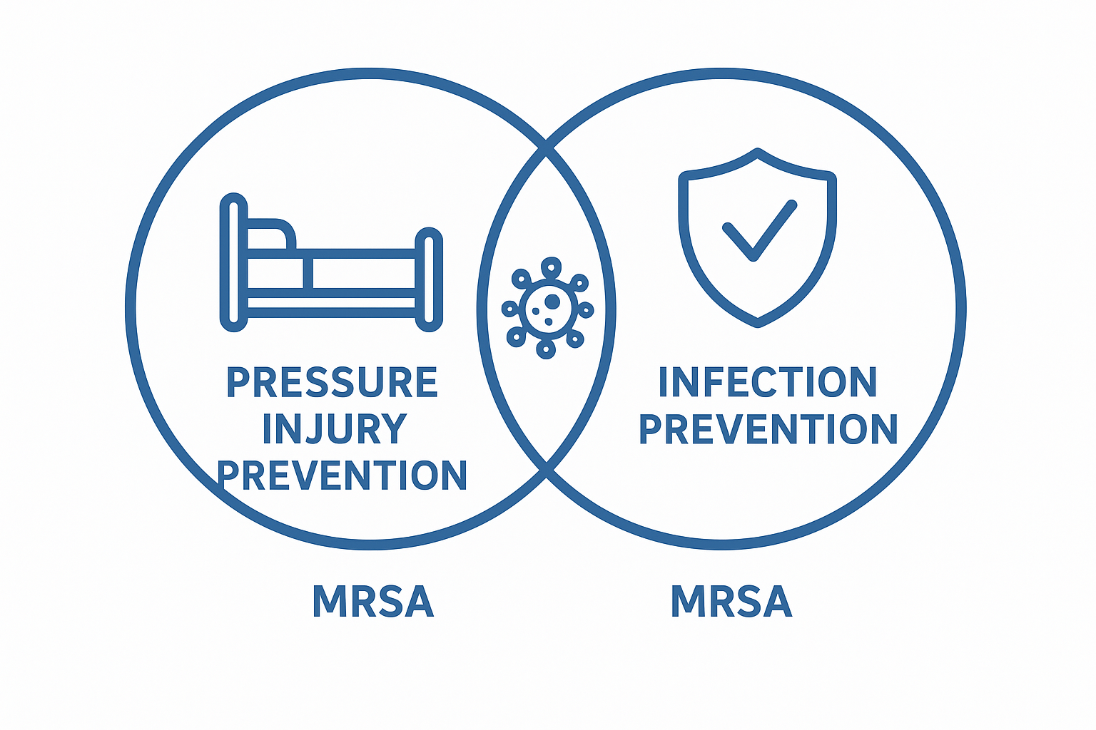

Preventing pressure injuries also reduces infection risk
Preventing pressure injuries also reduces infection risk:
Maintaining skin integrity eliminates portal of entry
Skin care, PPE and hand hygiene reduces bacterial burden
Adherence to infection control precautions during wound care prevents cross-contamination with MDROS including MRSA
Focus on skin care and pressure injury prevention to reduce MRSA transmission

Slide 6
Safety Program Components
Implementation Advisers (IAs) to provide one-on-one implementation support and technical assistance to LTC facilities
Educational materials that deliver both adaptive and technical content
25-minute webinars directed towards IPs and nurse educators, each paired with “teachable moments” directed towards front line staff (CNAs, RNs)
On-demand access to educational materials including
Recorded webinars
Teachable moments and other resources
Office hours to ask questions of clinical experts and share lessons learned with peers
Continuing education credits for participating staff
Benchmarking reports to support facilities’ efforts to monitor progress
Help desk to answer questions and requests via email

Slide 7
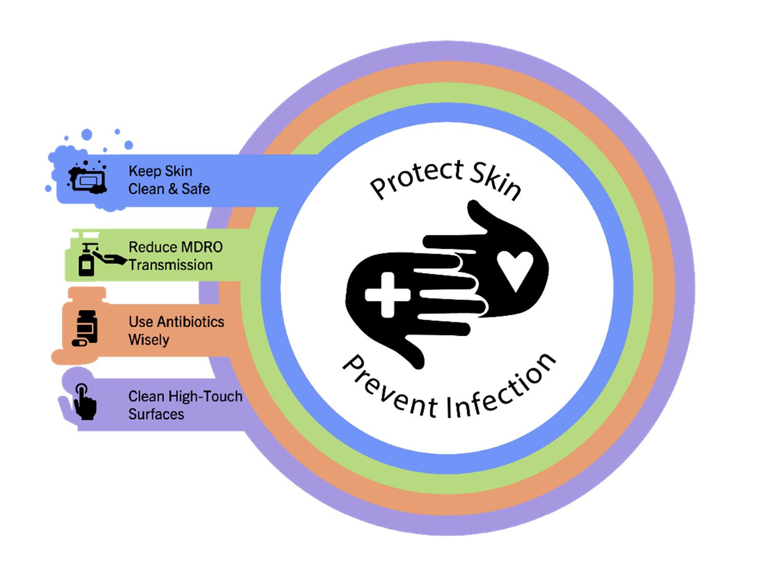
Educational Content
Bathing
Hand Hygiene
Enhanced-Barrier and Contact Precautions
Personal Protective Equipment
Evidence-Based Infection Prevention
Skin Assessment & Care
Comprehensive Unit-based Safety Program (CUSP)
Implementation

Slide 8
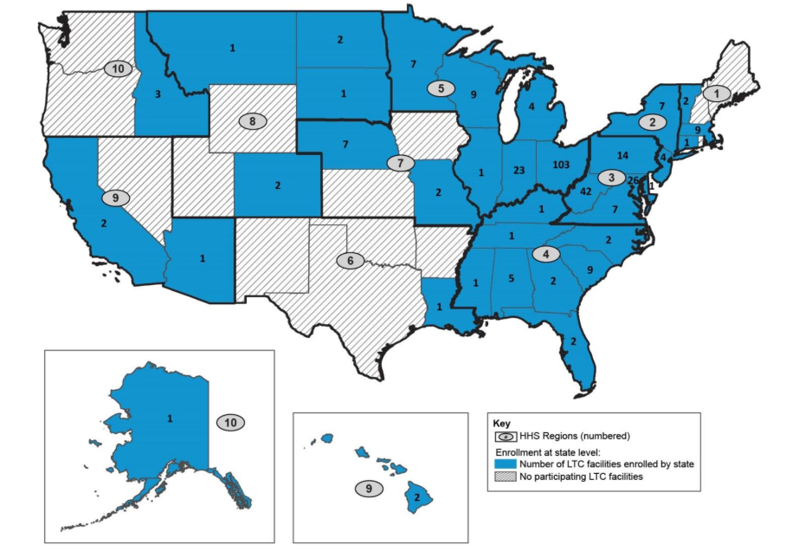
Enrollment & Implementation
Recruitment started in January 2023
Included recruitment of a large, corporate nursing home chain
Program enrolled 318 LTC facilities, total of 309 facilities completed the 18-month program from June 2023 - November 2024
Withdrawal reasons included staffing concerns (6) and other priorities (3)
Program retention rate of 97%

Slide 9
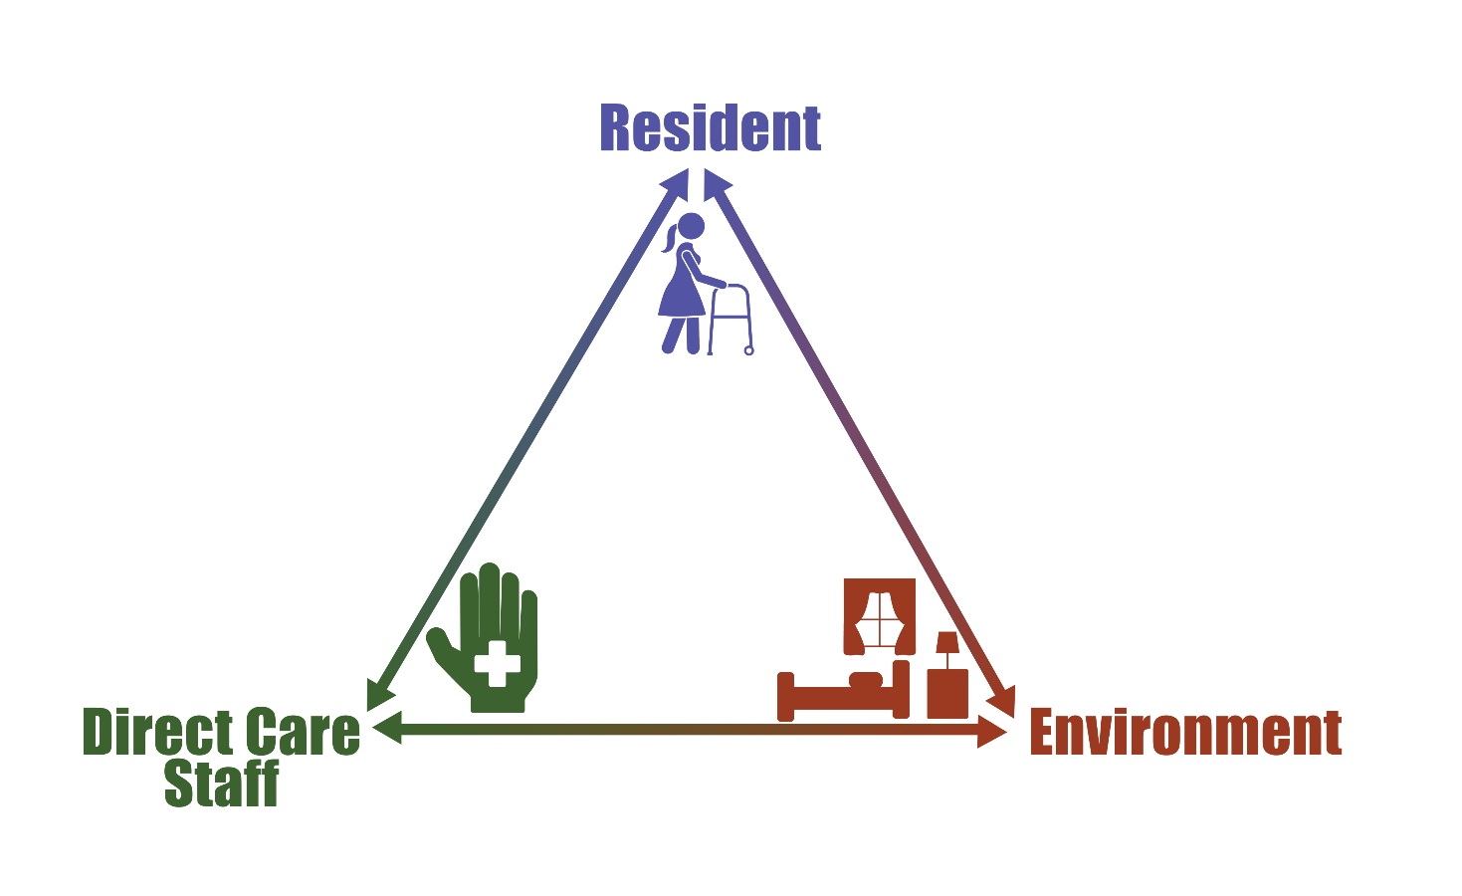
Triangle of Transmission
Triangle of Transmission: Focus on Direct Care Provider Impact on Resident Outcomes
Hand hygiene
Keep skin clean and healthy
Use antibiotics wisely
Use appropriate Personal Protective Equipment (PPE)
Hand hygiene
Surface disinfection
Equipment cleaning
Prevent MDRO Transmission
Hand hygiene
Frequent cleaning of high-touch surfaces
Awareness of surface contamination
Limit surface contact

Slide 10
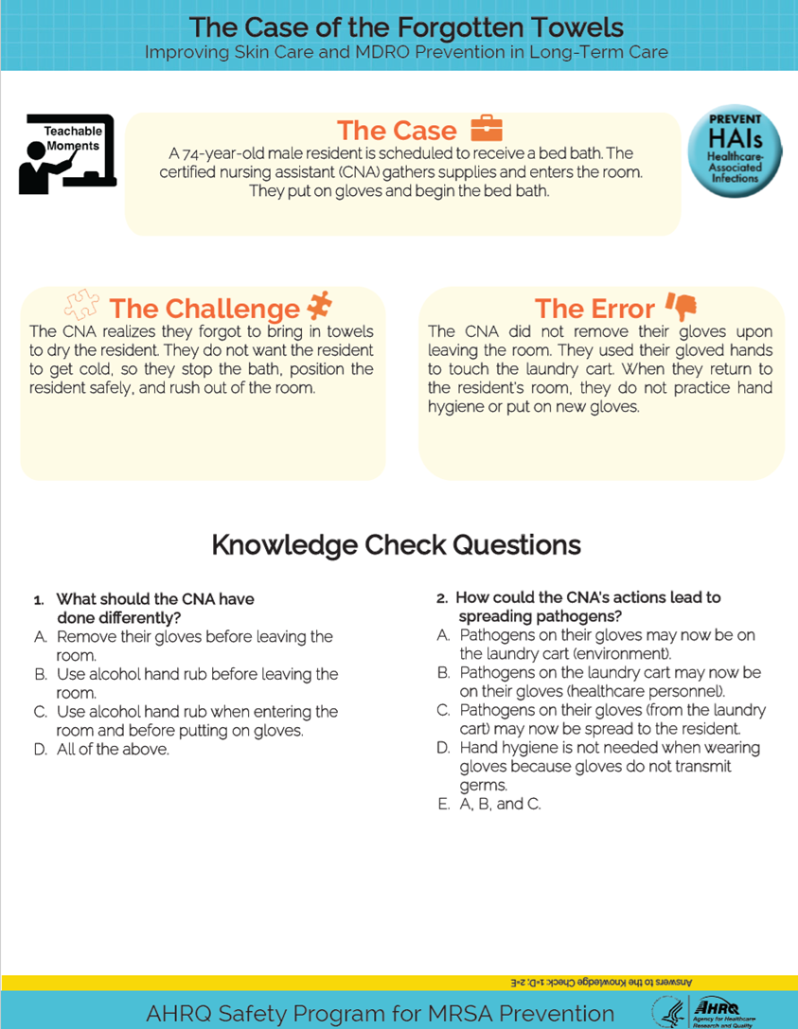
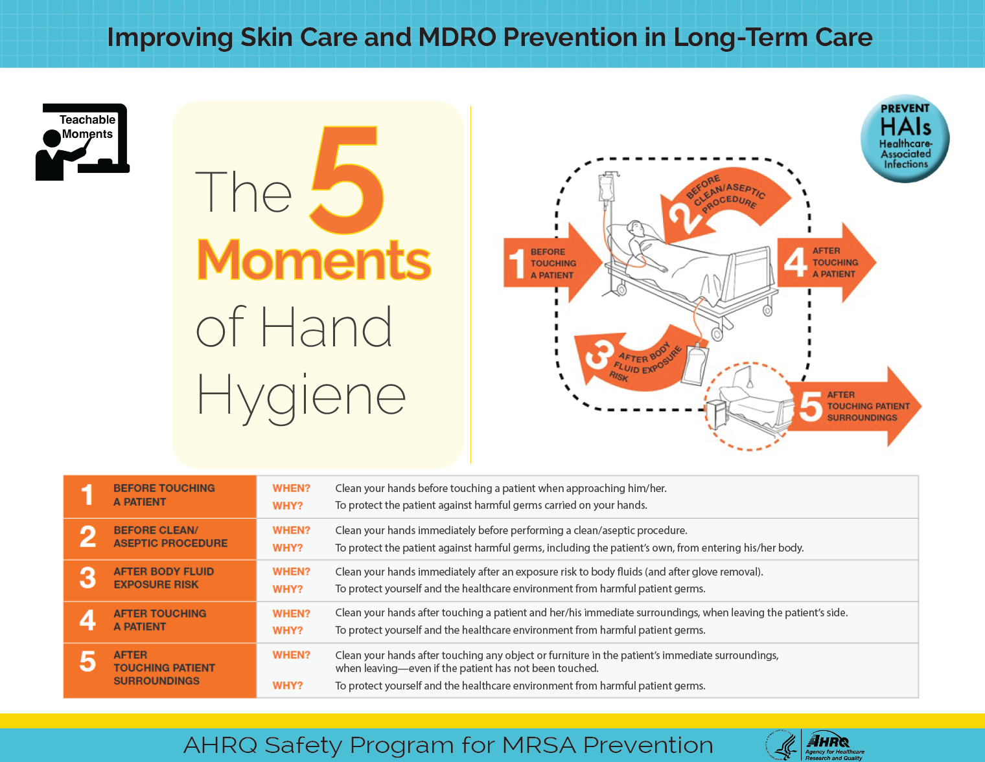
Teachable Moments

Slide 11
Data Collection and Evaluation
The program used a pre-post evaluation design, comparing data from participating facilities between baseline (pre) and implementation (post) periods.
Data Collection Tool | Information Collected | Frequency
Clinical Outcomes: MDS 3.0 Section M data | Monthly data on pressure injuries, skin tears, and moisture-associated skin damage | 30 months of data from June 2022 - November 2024
Clinical Outcome: Survey on Hospital Transfers | Monthly data on resident transfers to hospitals due to infection and reasons other than infection | Baseline data for the 12 months prior to program (June 2022 - May 2023) and monthly data for the 18-month program (June 2023 - November 2024)
Team Checkup Tool | Use of safety guidelines, tools, and resources to assess implementation progress | Monthly during the 18-month program
Gap Analysis | Infection prevention program structure, activities, and resources related to skin care and MDRO prevention | Twice – at the beginning and end of the 18-month program
AHRQ’s Nursing Home Survey on Patient Safety Culture (NHSOPS) | Patient safety issues, medical error, and event reporting | Twice – at the beginning and end of the 18-month program

Slide 12
Clinical Outcomes: Findings from MDS analysis
% Residents with unhealed pressure injuries | Quarterly average |  | Change between Periods
 | Pre | Post | Absolute Change (95% CI) | Relative Difference
Stage 2,3,4 or unstageable, nosocomial | 3.8% | 3.2% | -0.59% (-0.74%, -0.44%) *** | -15.7%
Stage 2, nosocomial | 1.2% | 0.9% | -0.35% (-0.44%, -0.26%) *** | -28.3%
Stage 3, nosocomial | 1.0% | 1.0% | -0.04% (-0.12%, 0.04%) | -4.2%
Stage 4, nosocomial | 0.5% | 0.5% | -0.002% (-0.05%, 0.05%) | -0.4%
Unstageable, nosocomial​ | 1.7%​ | 1.3%​ | -0.34% (-0.44%, -0.23%) ***​ | -19.9%
Stage 1-4 or unstageable, total | 8.7% | 8.2% | -0.54% (-0.76%, -0.31%) *** | -6.2%
Stage 2,3,4 or unstageable, total | 8.3% | 7.7% | -0.52% (-0.73%, -0.31%) *** | -6.3%
Stage 2,3,4 or unstageable, present at admission | 5.3% | 5.3% | -0.03% (-0.2%, 0.14%) | -0.6%
% Residents with other injuries, wounds, and skin problems | Quarterly average |  | Change between Periods
 | Pre | Post | Absolute Change (95% CI) | Relative Difference
Skin tear(s) | 4.4% | 4.8% | 0.4% (0.1%, 0.69%) ** | 9.0%
Moisture associated skin damage | 6.7% | 6.0% | -0.7% (-1.12%, -0.27%) ** | -10.3%
**p<0.01, ***p<0.001
Data NOT for distribution.

Slide 13
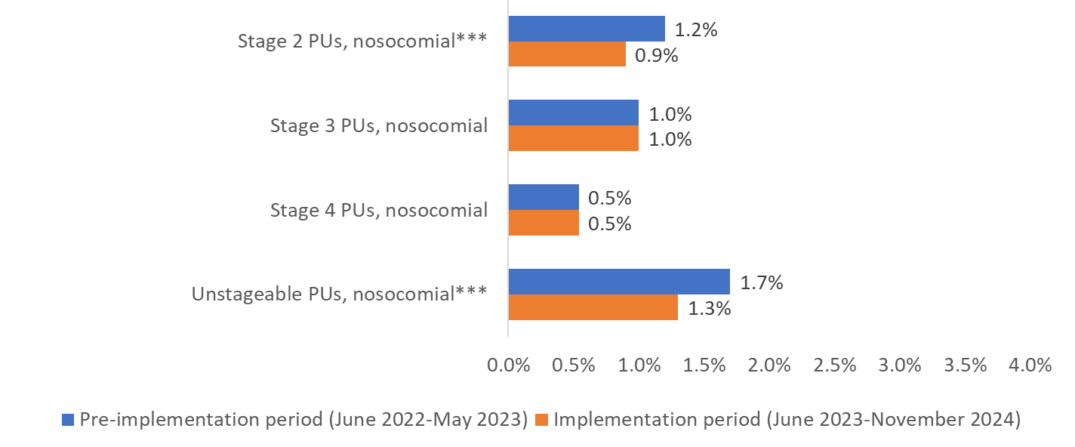
Specific Areas of Improvement
Average % of Residents With Pressure Injuries per Quarter
Stage 2 PIs, nosocomial***
Improved care!
Stage 3 PIs, nosocomial
Underlying medical issues likely too severe
Stage 4 PIs, nosocomial
Unstageable PIs, nosocomial***
Improved care and/or knowledge/identification
Nosocomial: Developed while at the nursing home
Present on admission: Developed before admission to the nursing home
NOTE: ***p<0.001; PIs= pressure injuries
Data NOT for distribution.

Slide 14
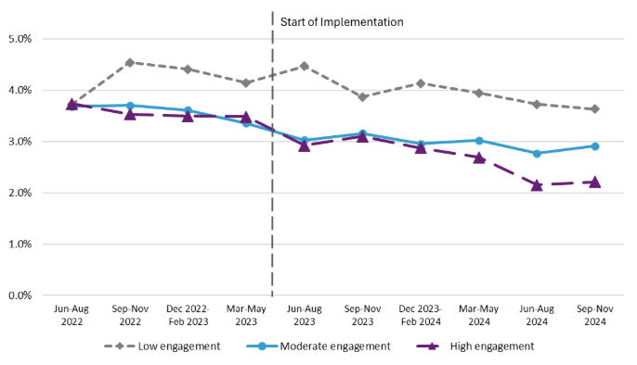
More Engaged Facilities Saw Greatest Impact
Percent of Residents With Nosocomial Unhealed Pressure Ulcers at Stage 2,3,4, or Unstageable from Baseline Period to Implementation Period by Facility Engagement Level (Entire Cohort)
*Engagement measured by percent of monthly TCTs submitted throughout implementation period
Data NOT for distribution.

Slide 15
Findings on Monthly Hospital Transfers by Reason From June 2022 to November 2024, Entire Cohort
Start of Implementation
Data NOT for distribution.

Slide 16
Improvements in Select Self-Reported Infection Prevention Practices
Transmission-Based Precautions
Hand Hygiene
Personal Protective Equipment
Bathing
NOTE: **p<0.01, ***p<0.001
Data NOT for distribution.

Slide 17
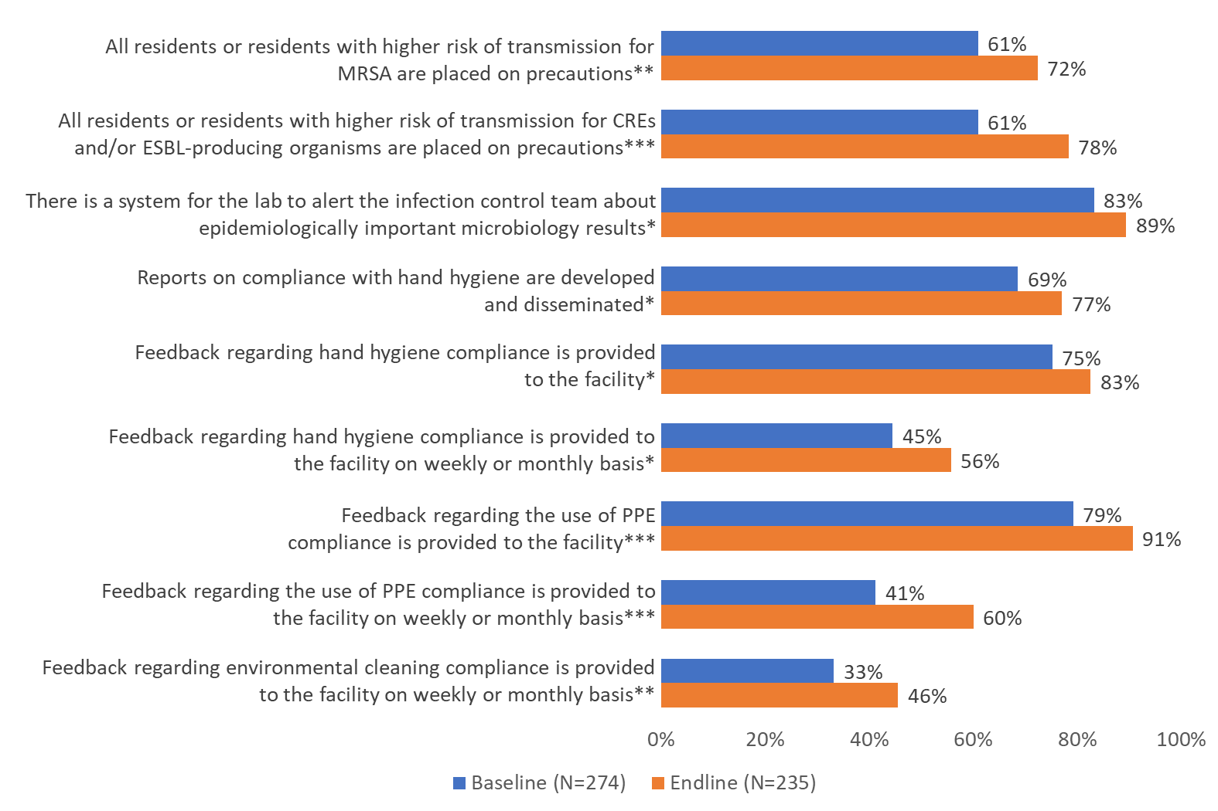
Additional Improvements in Self-Reported Infection Prevention Practices
Transmission-Based Precautions
Hand Hygiene
PPE
NOTE: *p<0.05, **p<0.01, ***p<0.001; PPE, Personal Protective Equipment
Data NOT for distribution.

Slide 18
Key Factors for Implementation Success
Team Capacity
Involved several diverse team members in intervention team
Infection Preventionist and Director of Nursing (DON) and Minimum Data Set (MDS) Coordinator
Leadership engagement set the tone for rest of facility
Preparation for staff turnover
Nursing homes may undergo 100% turnover in staff annually
Implementation Advisors (IAs) supported teams through turnover and provided tailored technical assistance based on needs
Sites that were more prepared for turnover were more successful
Focus on infection prevention basics and facility needs
Focus on fundamentals, urgent needs/requests from facilities (i.e., EBP training)

Slide 19

Long-Term Care Evaluation Summary
Significant reductions in pressure injuries acquired at the nursing home → improved care!
No change in hospital transfer rates due to infections or other causes
Increase in self-reported evidence-based practices around
Transmission-based precautions
Hand hygiene
Use of PPE
Gains in patient safety culture

Slide 20

Access FREE Content From Toolkit
Thank you to the Project Team and Participating Facilities:
NORC
Johns Hopkins University team
University of Pittsburgh team
Technical Expert Panel Members
IA Organizations:
Health Services Advisory Group
HQI Solutions
Stratis Health
CDC
CMS

