Slide 1
Improving Skin Care and MDRO Prevention in Long-Term Care
Implementation and Sustainability of Interventions To Improve Skin Care and Prevent MDRO Infections in Long-Term Care Facilities
AHRQ Safety Program for MRSA Prevention
AHRQ Pub. No. 25(26)-0066
October 2025

Slide 2

All Staff Support Resident Care and Safety
The information provided in this presentation is important in the care of Long-Term Care (LTC) residents. In LTC facilities each member of the facility’s staff supports resident care and safety.
Some actions described in these presentations may not be in your scope of practice, but it is important to learn how all staff contribute to resident care and safety.

Slide 3
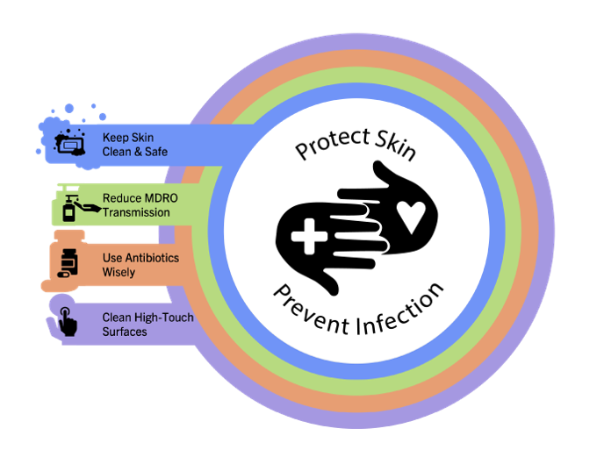
Educational Objectives
Provide key principles and information about this toolkit
Discuss a plan for implementing the suggested skin care and infection prevention strategies from this toolkit
Offer a plan for ongoing evaluation and sustainability of efforts
Describe data sources that can be used to inform the team of progress

Slide 4
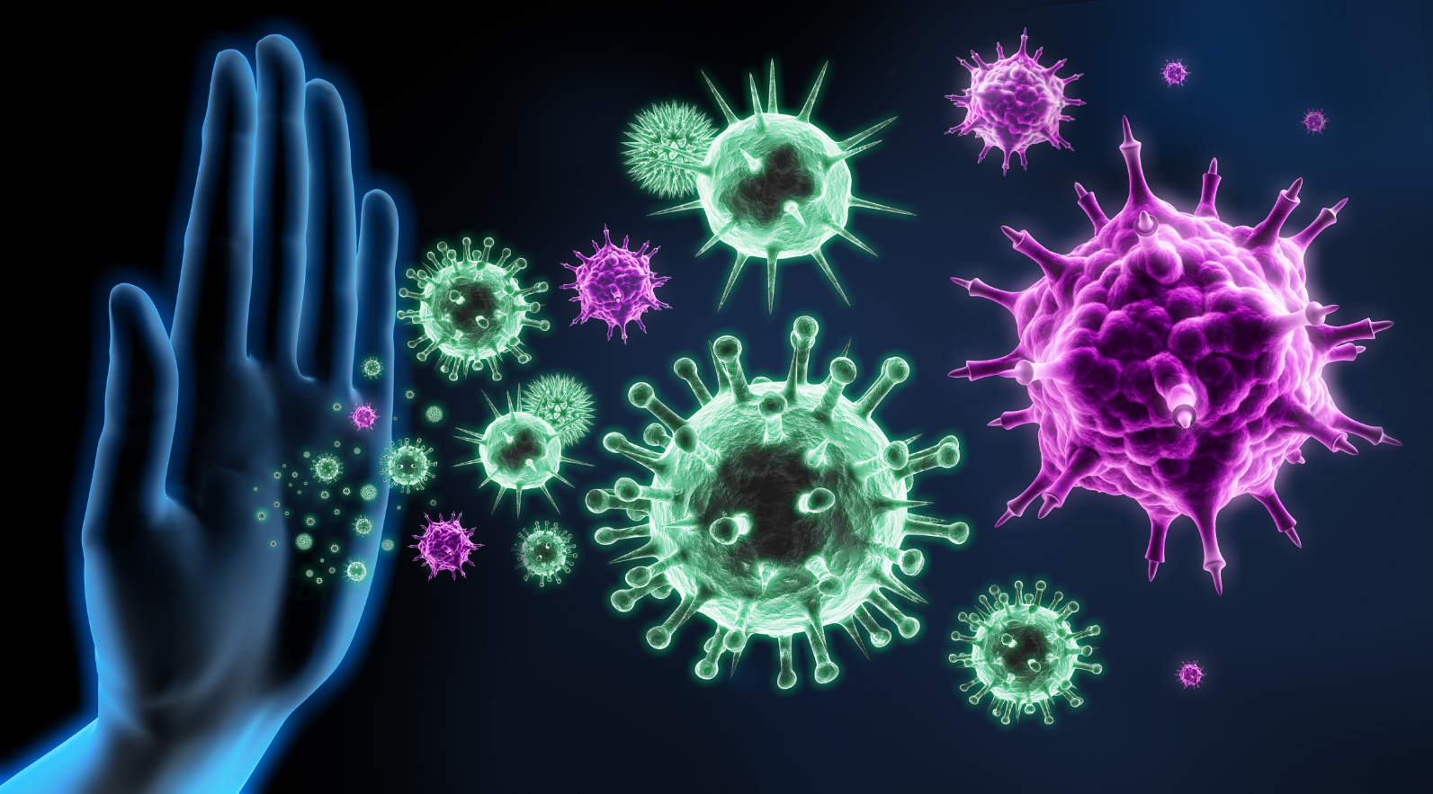
AHRQ Safety Program for MRSA Prevention—Improving Skin Care and MDRO Prevention in Long-Term Care
The purpose of this toolkit is to reduce infections, including those caused by MDROs, and promote quality skincare.
One of the most common ways infections can occur is by entering the body through damaged skin.

Slide 5
Four Key Strategies to Protect Skin and Prevent Infection
This toolkit focuses on 4 key strategies to protect skin and prevent infection. The strategies include:
Reduce MDRO transmission
Keep Skin Clean and Safe
Use Antibiotics Wisely
Clean High-Touch Surfaces

Slide 6
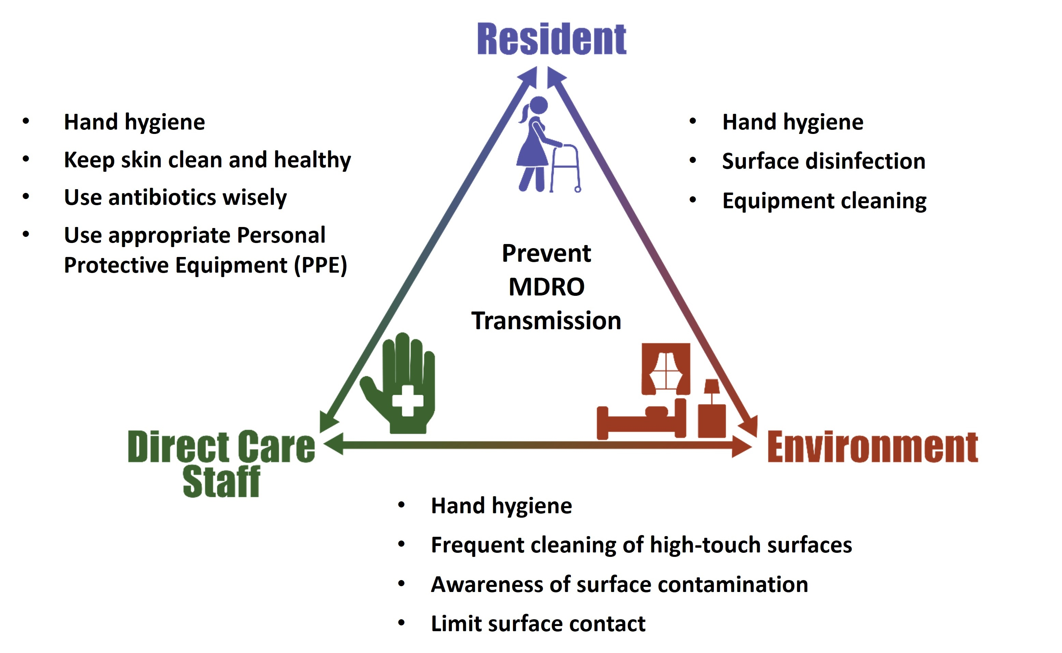
Triangle of Transmission

Slide 7

The 3 Cs of Healthcare
The 3 Cs of Healthcare:¹
Connection
Communication
Collaboration
The interpersonal relationships of the healthcare team influence the care provided for residents
Technical interventions
Evidence based recommendations
Largely rooted in educational materials such as teachable moments and supporting materials
Adaptive interventions
Improving teamwork and communication to create lasting change
Empowering staff of all levels to communicate with one another to prevent harms

Slide 8

Presentation Structure and Content
The topics in this toolkit are covered in presentations that are case-based and provide ‘teachable moments’ to share with all members of the long-term care staff.
Each topic has action items directed towards:
Direct-care staff
Infection Preventionist
Long-term changes for senior executives
* Please be mindful that though items in these presentations are often catered towards a specific member of the long-term care staff, these topics are educational for and can be shared with all members of the care team.

Slide 9
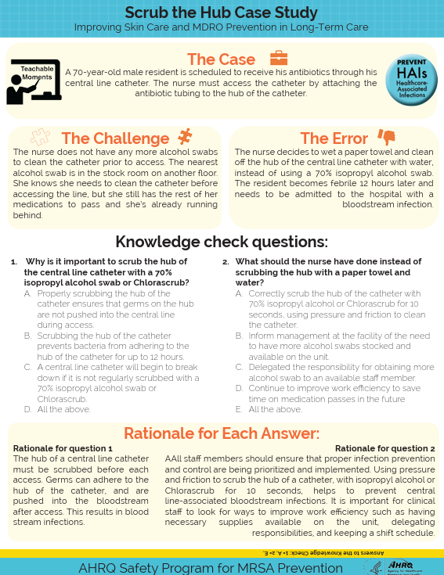
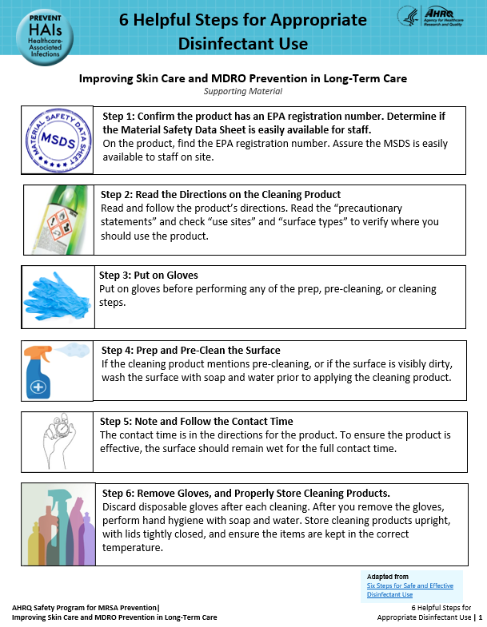
Teachable Moments and Supporting Materials
Teachable Moments
Handouts that provide a brief lesson about topics such as skin care, infection prevention, patient safety and other information key to prevent infection
Most have one to two multiple-choice questions
Questions are not meant to be graded but simply to reinforce the material
Supporting Materials
Most of the topics also have other supporting materials
These may include checklists, posters, or similar materials designed to reinforce the important messages from each presentation.

Slide 10
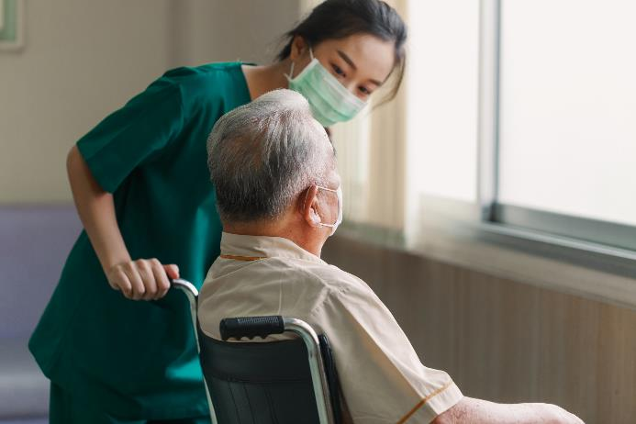
Honoring Resident Preferences
Assess resident preferences for bathing on admission and at regular intervals, particularly if there is any pushback to bathing
Resident Bathing Preference Menu
Train staff on ways to promote privacy and comfort during bathing and skin assessments
Low lighting
Use of draping
Familiar staff

Slide 11
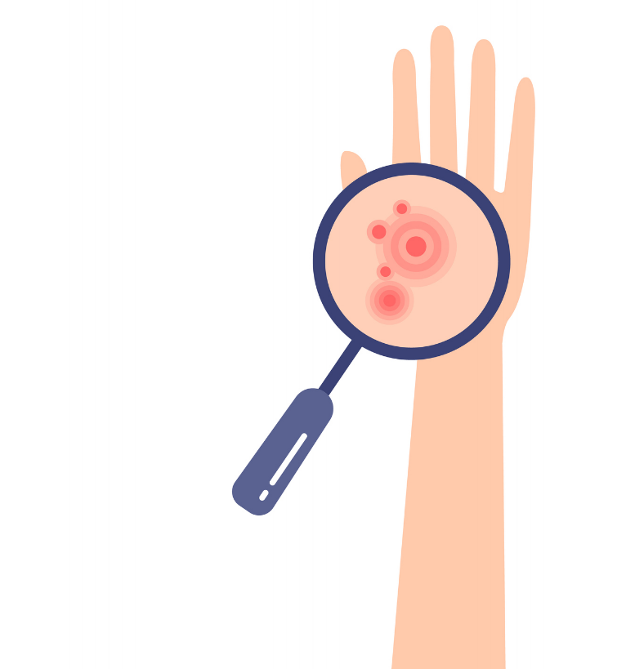
MDRO Infection Prevention Bundle
Infection Prevention requires multiple layers, and cooperation from various roles
We can’t see germs and often can’t see the immediate impact of our efforts
Core activities for prevention include:
Hand hygiene
PPE
Skin assessments and care
Communication and Proper Documentation
Re-center healthcare goals around the importance of patient safety to improve teamwork

Slide 12


Sustainability: Keeping Your Efforts Alive
What is going on?
How are staff communicating?
How is compliance with infection prevention practices?
Are residents happy with the bathing process?
Is staff happy with the bathing process?
Check your data!

Slide 13

Defining Your Team
Teams can be customized based on interested and engaged individuals in your facility.
We recommend including a few core members in this initiative:
Infection preventionist
Staff Champion (CNA, RN, LPN, others)
Environmental services
Clinical lead based on interest/availability
Director or assistant director of nursing
Medical director

Slide 14

Delegation of Tasks
Clear delegation of roles for environmental cleaning and device care
Discuss ambiguity
Who is responsible for picking up towels after a resident’s shower?
Who is responsible for cleaning up food on the tray table?
Who is responsible for cleaning the area around a PEG entry site?
Who cleans the IV poles, vitals machines, wheelchairs?

Slide 15

Consistent Monitoring and Feedback
Identify areas of concern in your facility (e.g., poor hand hygiene, unnecessary antibiotic use)
Monitor areas of concern and target interventions/education to these areas
Choose a monitoring method (e.g. silent observers) and measure on a regular basis (at least quarterly)
Provide feedback on changes related to intervention
To all staff
Compliance with protocols
Overall rates
To individuals
Pair feedback with appropriate education

Slide 16

Data Sources
Audits
Hand hygiene
PPE compliance
Environmental cleaning
Device days
Transfer rates
Pressure Injury rates
Antibiotic use
Skin/soft tissue infection rates
Staff surveys on communication, collaboration, and connection

Slide 17

Audits and Feedback in LTC
Audits and feedback are two of the most helpful ways to implement and sustain good practice.
This should be done at every level
Informal processes
Peer to Peer- it's ok to remind someone they forgot to wash their hands!
Make this part of the culture
Formal processes
Supervisor/IP rounds
Silent observers with data tracking

Slide 18

Share Successes and Incentivize Improvement
When you see improvement, celebrate it!
Incentivize staff
Lunch for the units with the highest compliance rates
Employee of the month

Slide 19

Time to Reboot!
Plan a Reboot
Consider the format
Escape Room game
Make it fun
Celebrate your past successes
Refresh on purpose
Empower the team
Re-circulate teachable moments

Slide 20
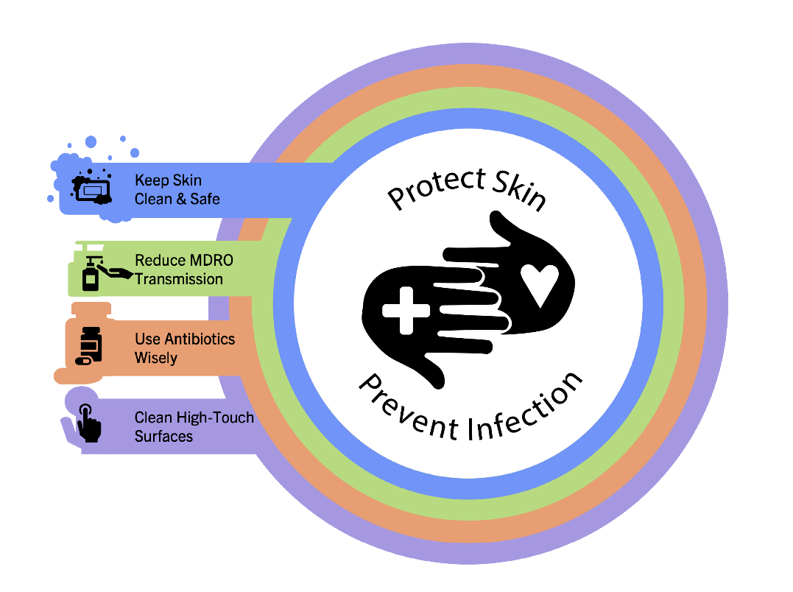
Supporting Materials
Teachable Moments:
Communication, Collaboration, and Connection in Healthcare
Cutting Corners and Workarounds
Why We Wear Gloves
Mistakes Happen!
The Triangle of Transmission: Understanding Sources and Pathways of Germ Transmission
Other materials:
The Four Key Strategies to Protect Skin and Prevent Infection
Multidrug-Resistant Organisms (MDROs): Education for Patients and Families
Centers for Disease Control and Prevention MDRO Prevention Strategies Webpage²

Slide 21
Key Takeaways
This material in this toolkit intends to:
Reduce skin and soft tissue infections
Reduce pressure injuries and skin tears
Reduce MDRO infections
Improve team-based infection prevention practices
Enhance communication and teamwork regarding proper skin care
Increase staff, resident and family satisfaction

Slide 22
Disclaimer
The findings and recommendations in this presentation are those of the authors, who are responsible for its content, and do not necessarily represent the views of AHRQ. No statement in this presentation should be construed as an official position of AHRQ or of the U.S. Department of Health and Human Services.
Any practice described in this presentation must be applied by healthcare practitioners in accordance with professional judgment and standards of care in regard to the unique circumstances that may apply in each situation they encounter. These practices are offered as helpful options for consideration by healthcare practitioners, not as guidelines.

Slide 23
References
Saunders, H. The 3 C’s: Connection. https://www.infectioncontroltoday.com/view/the-3-c-s-connection. Accessed July 22, 2025.
Centers for Disease Control and Prevention. MDRO Prevention Strategies. https://www.cdc.gov/healthcare-associated-infections/php/preventing-mdros/mdro-prevention-strategies.html. Accessed July 22, 2025.

