Slide 1
Improving Skin Care and MDRO Prevention in Long-Term Care
Aging Skin: The Importance of Care and Assessment
AHRQ Safety Program for MRSA Prevention
AHRQ Pub. No. 25(26)-0066
October 2025

Slide 2
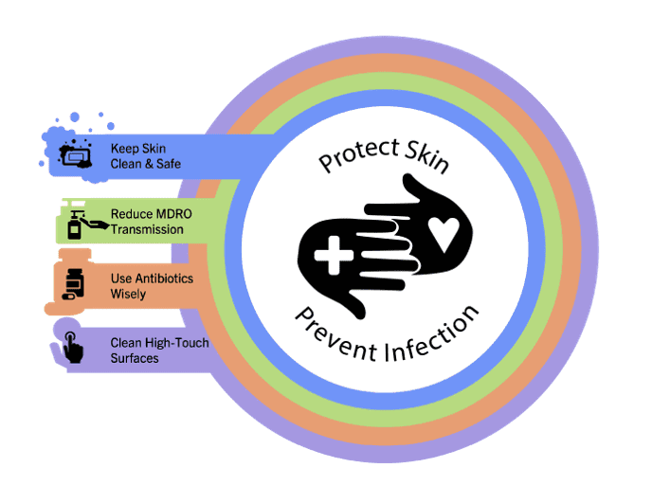
Educational Objectives
Learn why aging skin is different
Describe how to care for aging skin
Understand skin assessment

Slide 3
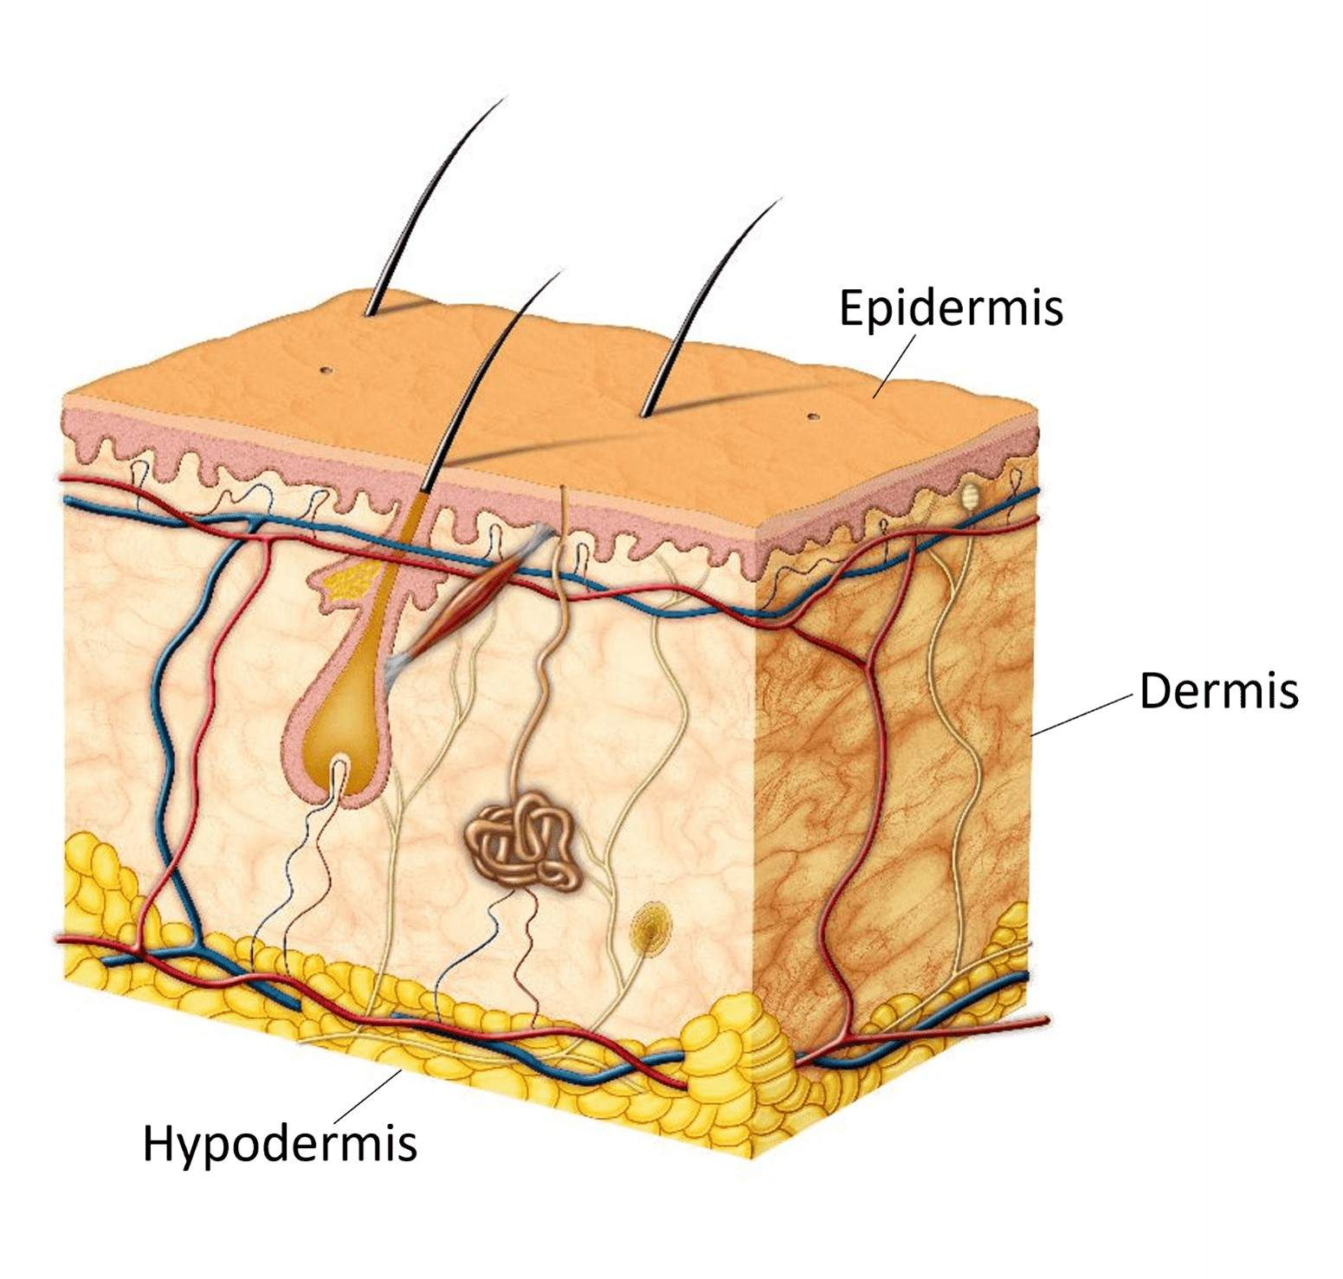
Why Is Our Skin Important?¹
Largest organ in the body, covering the body’s entire external surface
Body’s first defense, protecting it from germs and regulating body temperature
Protects vital organs and prevents water loss

Slide 4
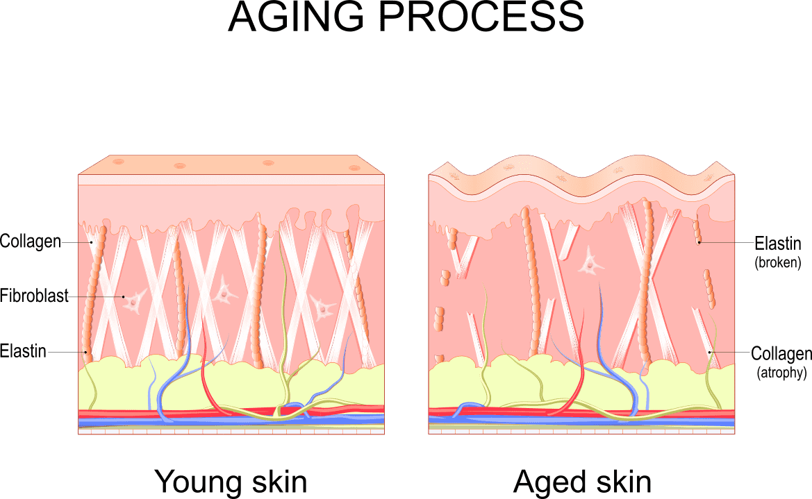
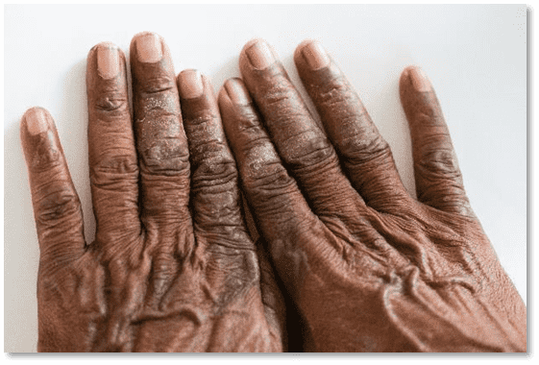
Aging Skin^{1,2}
Changes to aging skin are visible and extend to deeper tissue layers.

Slide 5

How Is Aging Skin Different?²
Develops age spots, wrinkles, and creases
Becomes drier and itchy
Begins to thin
Is more prone to injury and infection

Slide 6
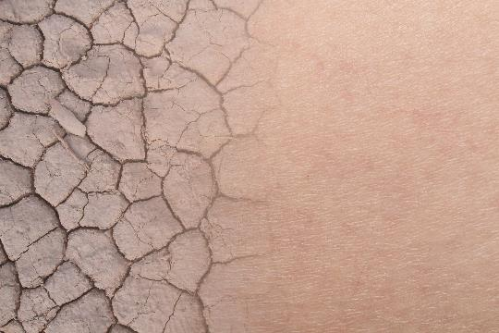

Key Ideas for Staff³⁻⁹
Individuals with immobility or incontinence are at risk for developing skin problems:
Pressure injuries⁵
Incontinence-associated dermatitis^{6,7}
Skin tears⁸
Intertrigo⁹
These risks increase with age.
Proper skin assessments and bathing are vital to resident health and comfort.

Slide 7

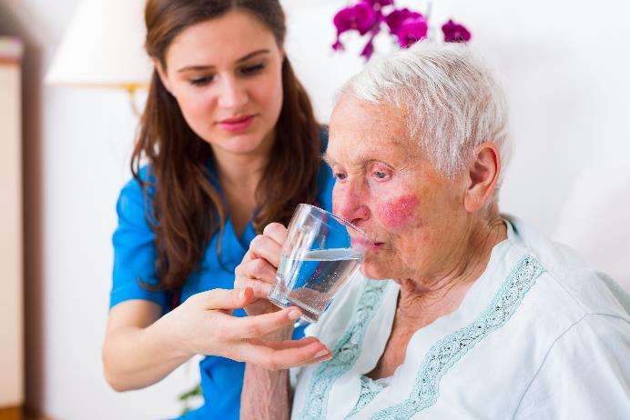
Additional Skin Care Interventions
Safer, healthier skin:
Avoid fragrances.
Protect skin from the sun.
Increase moisture in the air with humidifiers.
Keep residents hydrated.

Slide 8

Good Bathing Practices: Taking Care of Residents’ Skin¹⁰
Bathe regularly.
Use warm water—not hot.
Use gentle, fragrance-free, moisturizing soap.
Use a soft cloth or sponge.
Pat skin dry—don’t rub.
Apply moisturizers after the bath or shower.
Use creams and lotions—bath oils increase risks of falls.

Slide 9
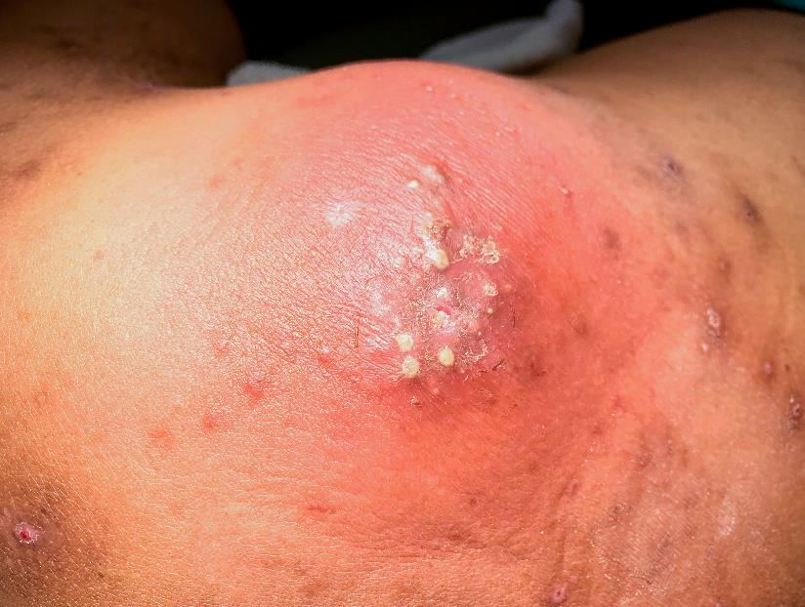
Aging Skin Damages Easily
Aging skin damages easily and is at an increased risk of skin and soft-tissue infections (SSTIs).
SSTIs result from the microbial invasion of skin and surrounding tissues.
SSTIs are the third most common infection among residents nationally.
Prevalence rate of SSTIs in nursing homes varies between 1 percent and 9 percent.¹¹

Slide 10
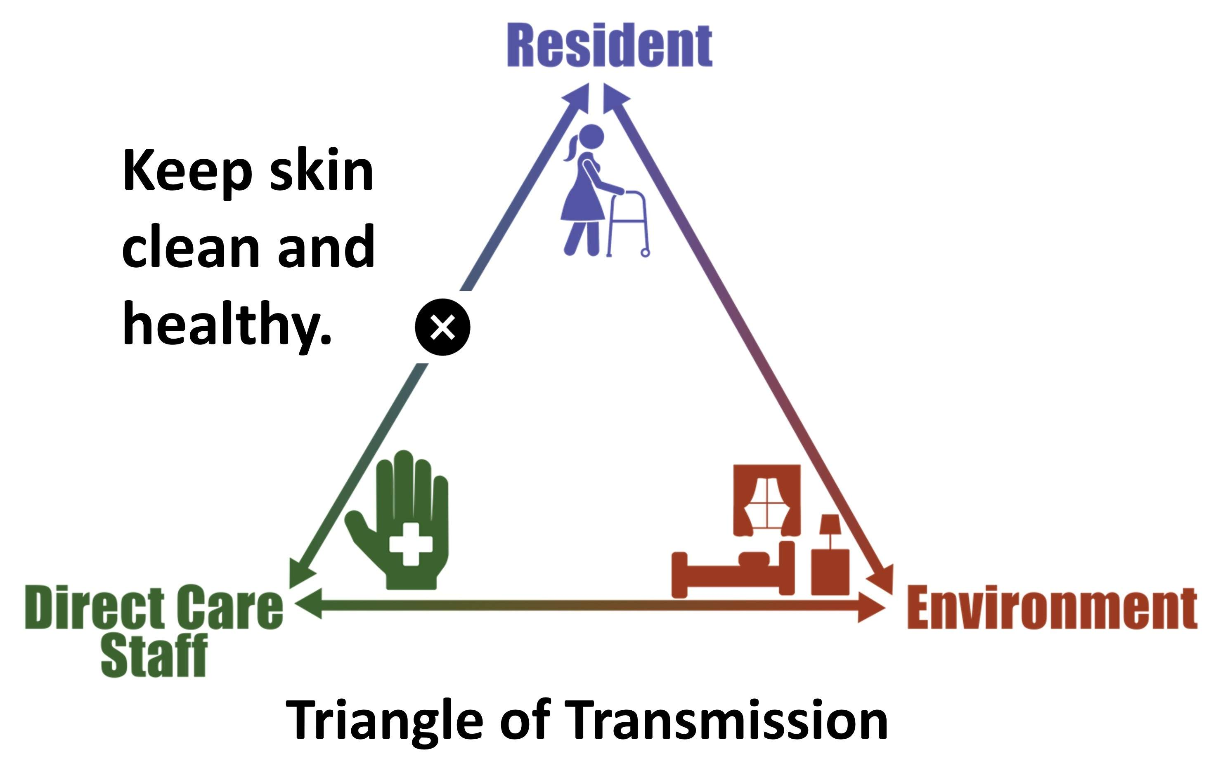
Prevent MDRO Transmission^{12,13}

Slide 11
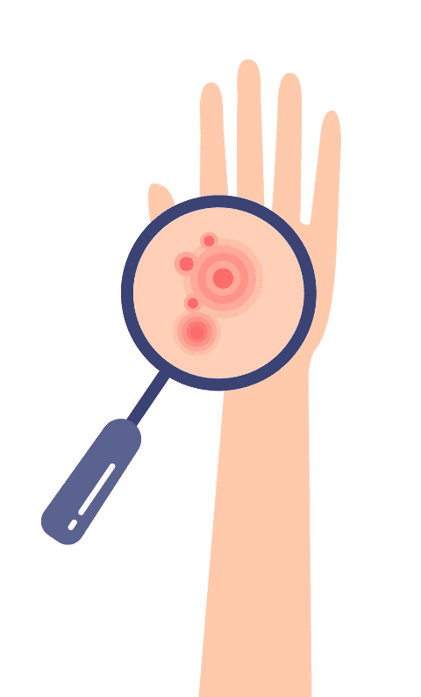
Skin Assessment
The Importance of Skin Assessments and How To Do Them

Slide 12
Objectives Of Skin Assessment
Determine how and when to perform a skin assessment
Differentiate between “dry” areas and “humid” areas
Correctly assess and report the condition of medical device insertion sites
Correctly identify and assess skin rashes

Slide 13
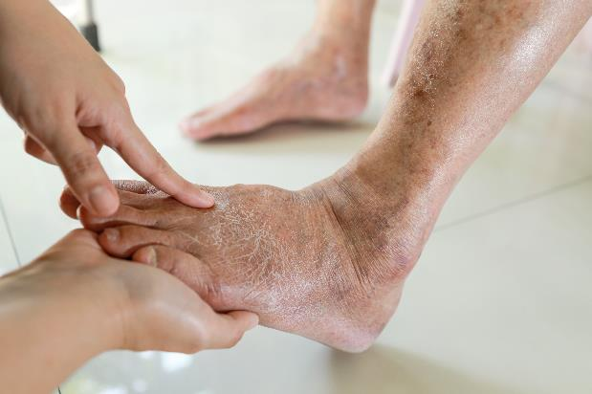
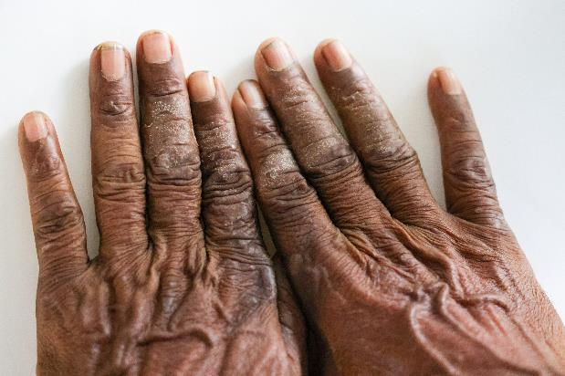
Basic Skin Assessment^{3,14-16}
Dry
Moist
Change in color
Swelling
Painful areas
Damaged or broken
Openings for medical devices

Slide 14
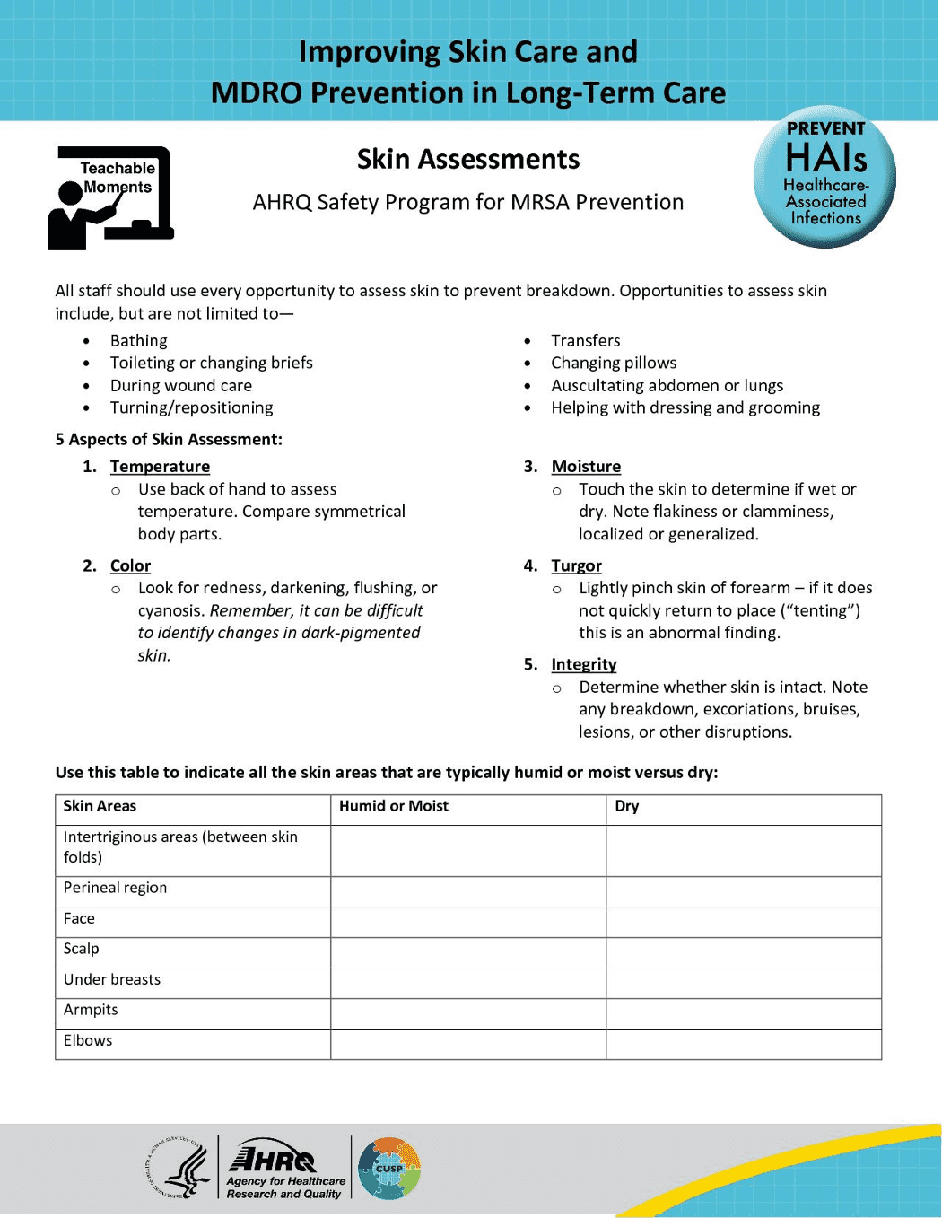
Skin Assessment Steps^{3,14-16}
Explain to the resident and family that the resident’s skin will be assessed from head to toe.
Perform the assessment in a private place and ensure the resident is comfortable.
Perform hand hygiene.
Hand sanitize again, don, and change gloves with any exposure to bodily fluids.
Minimize body exposure—use towel or sheet for privacy.
Ask for help to turn the resident as needed.
Touch skin gently to assess for differences in temperature, blanching, and swelling.
Document any and all findings.
Access the Skin Assessment Teachable Moment on the toolkit website.

Slide 15
Dry Versus Humid Skin¹⁷⁻¹⁹
Typical “dry” skin areas:
Hands, feet, forearms, lower legs, elbows, knees
Face, scalp
Signs of dry skin:
Scaling
Itching
Roughness
Cracks/fissures
Treatment:
Maximum cleansing once/day, apply ointments
Typical “humid” skin areas:
Skin on skin (e.g., abdominal skin folds)
Anogenital area
Between toes
Signs of humid skin:
Moist to touch
Fungal rash
Treatment:
Frequent cleansing, (showering preferred), mild soap, dry skin carefully after washing

Slide 16
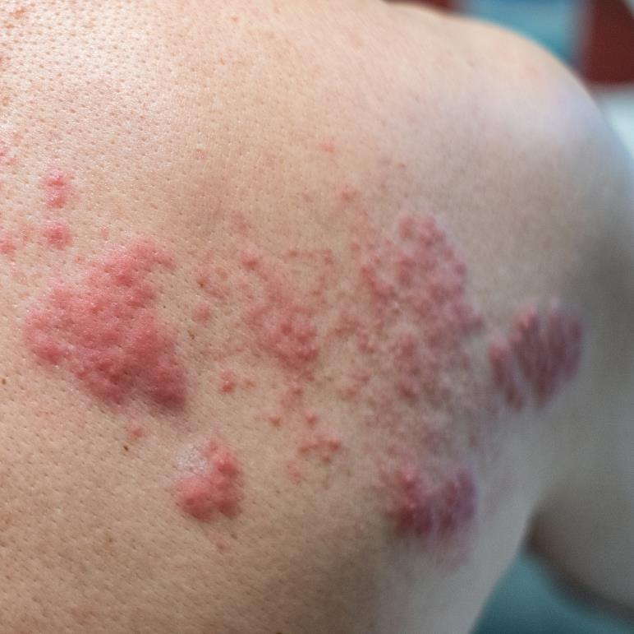
Identifying and Assessing Rashes
Varied Appearance
Change in color
Change in texture
Change in sensation
Multiple causes
Allergic
Autoimmune
Infectious
Inflammatory

Slide 17
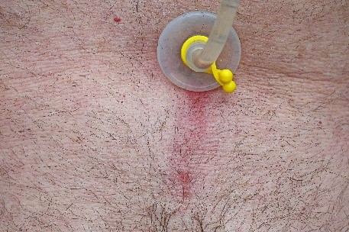
Medical Devices and Resident Skin
Medical devices can cause damage to the skin, particularly aging skin.
It’s important to properly care for and clean around medical devices.
Assess the skin and insertion point for signs of infection or skin breakdown.
Early intervention is key—report changes in skin to prevent infection and skin breakdown.

Slide 18
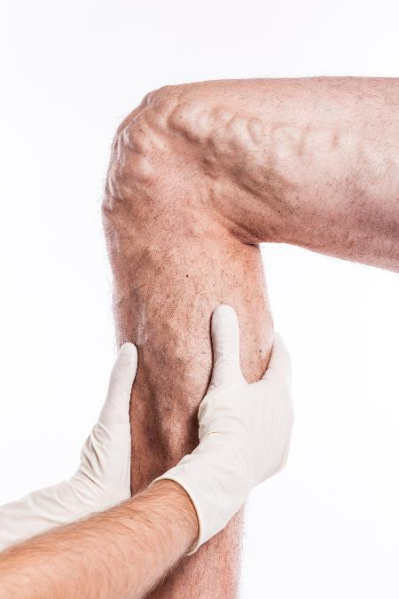
Find Opportunities To Assess Skin and Document^{3,14-16}
Skin assessments should be made on a daily basis.
Use every opportunity to assess skin to prevent breakdown.
Bathing
Toileting or changing briefs
During wound care
Turning/repositioning
Transfers
Changing pillows
Auscultating abdomen or lungs
Help with dressing and grooming

Slide 19
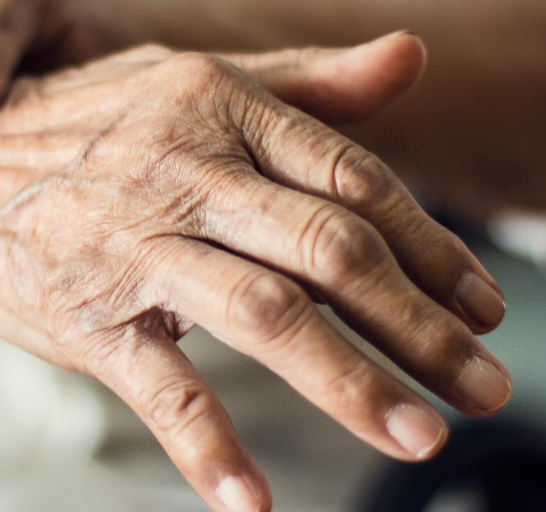
Remember: Regularly Assess Skin
Inspect skin on admission and daily.
Assess pressure points, temperature, and the skin beneath and around medical devices.
Good skin care for all nursing home residents is everyone’s responsibility.

Slide 20
Teachable Moment
Questions to consider:
How do insertion site assessments protect residents’ skin?
How can all staff members protect residents’ skin?

Slide 21
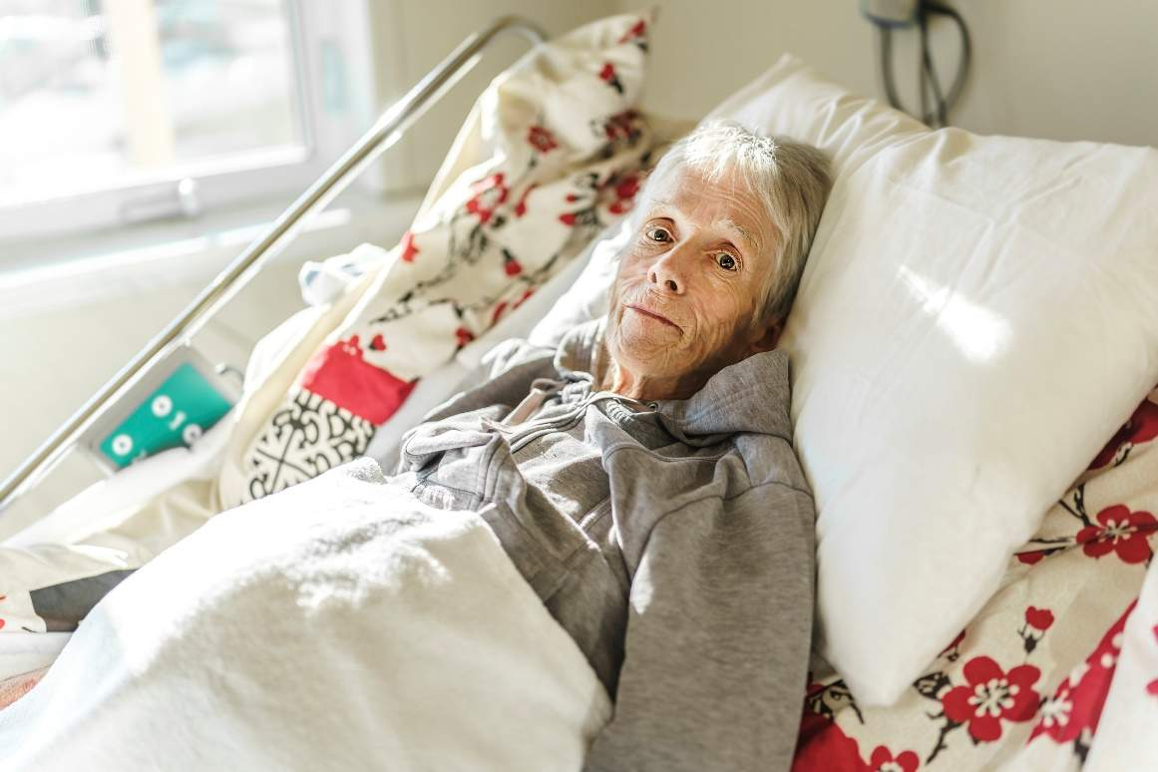
The Case
Certified nursing assistant (CNA) assisting 79-year-old resident with bathing.
The resident just returned from the hospital after percutaneous
endoscopic gastrostomy (PEG) tube placement. She usually receives a shower on her bathing days.

Slide 22

The Challenge
The resident has a new PEG tube and is weak after her hospitalization.

Slide 23

Knowledge Check
Is it more appropriate for the resident to receive a shower, bed bath, or tub bath?

Slide 24
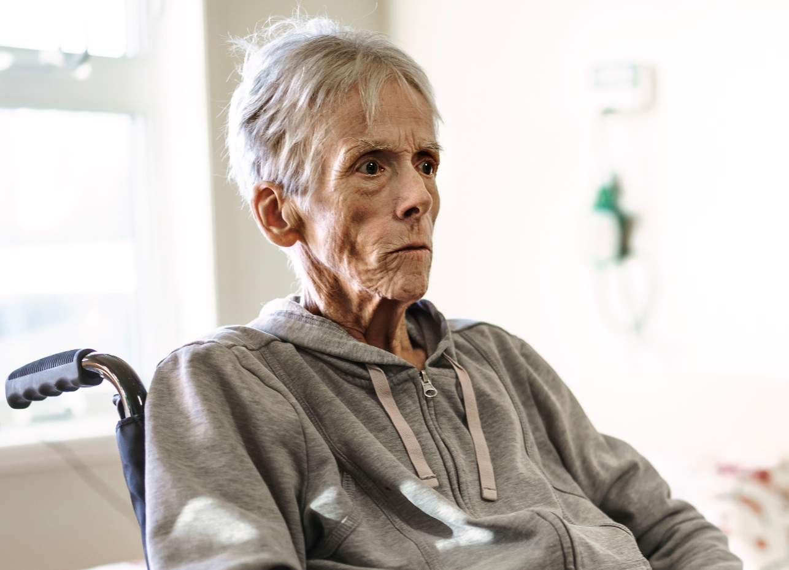
The Error
The CNA—
Misses the new order for a bed bath
Proceeds with a shower for the resident instead
Avoids the PEG tube site, not cleaning the skin around the site
Dries the resident with a towel—using friction and causing small skin tears in the resident’s skin
Does not assess the PEG tube site and misses signs of infection

Slide 25


The Consequence
What challenges might this error lead to in the future?

Slide 26

Patient Safety in the Moment
What should the CNA have done that could have led to quicker treatment of the PEG tube infection and prevention of skin ulcers?
The CNA should have looked at the resident’s orders to see that bed baths need to be used.
The skin surrounding the PEG tube should have been cleaned and the insertion site assessed.

Slide 27

Preventing the Next Harm
What can be done to keep the same error from happening again?
In-service trainings about bathing around invasive medical devices, skin assessments, and care of invasive medical devices.
Empower CNAs to visually assess resident insertion sites and report abnormalities.

Slide 28

System-Based Safety Changes
Empower all clinical support staff in the visual assessment and care of residents’ skin.
Provide education to staff on the care of invasive medical devices.
Provide staff with supplies to care for residents’ skin (e.g., lotions, gentle soaps, etc.).

Slide 29
Supporting Materials
Teachable Moments:
The Case of the Resident With a PEG Tube
Enteral Tube Care and Management
AHRQ’s Safety Program for Nursing Homes: On-Time Pressure Ulcer Prevention²⁰
3M’s Pressure Ulcer/Injury (PU/I) Staging Guide²¹

Slide 30
Key Takeaways
All staff caring for residents should know how to care for and assess aging skin.
Care and appropriate bathing of aging skin can prevent SSTIs and injury.
Insertion sites of invasive medical devices are a greater risk factor in aging skin. Care and observation of these devices and the surrounding skin can prevent complications.

Slide 31
Disclaimer
The findings and recommendations in this presentation are those of the authors, who are responsible for its content, and do not necessarily represent the views of AHRQ. No statement in this presentation should be construed as an official position of AHRQ or of the U.S. Department of Health and Human Services.
Any practice described in this presentation must be applied by healthcare practitioners in accordance with professional judgment and standards of care in regard to the unique circumstances that may apply in each situation they encounter. These practices are offered as helpful options for consideration by healthcare practitioners, not as guidelines.

Slide 32
References—1
Grice EA, Segre JA. The skin microbiome. Nat Rev Microbiol. 2011 Apr;9(4):244-53. PMID: 21407241.
Quan T. Molecular insights of human skin epidermal and dermal aging. J Dermatol Sci. 2023 Nov;112(2):48-53. PMID: 37661473.
Lichterfeld-Kottner A, El Genedy M, Lahmann N, et al. Maintaining skin integrity in the aged: A systematic review. Int J Nurs Stud. 2020 Mar;103:103509. PMID: 31945604.
Völzer B, El Genedy-Kalyoncu M, Fastner A, et al. Prevalence and associations of xerosis cutis, incontinence-associated dermatitis, skin tears, pressure ulcers, and intertrigo in aged nursing home residents: a representative prevalence study. Int J Nurs Stud. 2023 May;141:104472. PMID: 36898269.
Lindgren M, Unosson M, Fredrikson M, et al. Immobility—a major risk factor for development of pressure ulcers among adult hospitalized patients: a prospective study. Scand J Caring Sci. 2004 Mar;18(1):57-64. PMID: 15005664.
Gray M, Beeckman D, Bliss DZ, et al. Incontinence-associated dermatitis: a comprehensive review and update. J Wound Ostomy Continence Nurs. 2012 Jan-Feb;39(1):61-74. PMID: 22193141.
Beele H, Smet S, Van Damme N, et al. Incontinence-associated dermatitis: pathogenesis, contributing factors, prevention and management options. Drugs Aging. 2018 Jan;35(1):1-10. PMID: 29243033.

Slide 33
References—2
Rayner R, Carville K, Leslie G, et al. A review of patient and skin characteristics associated with skin tears. J Wound Care. 2015 Sep;24(9):406-14. PMID: 26349021.
Gabriel S, Hahnel E, Blume-Peytavi U, et al. Prevalence and associated factors of intertrigo in aged nursing home residents: a multi-center cross-sectional prevalence study. BMC Geriatr. 2019 Apr;19(1):105. PMID: 30987588.
American Academy of Dermatology Association. How To Care for Your Skin in Your 60s and 70s. https://www.aad.org/public/everyday-care/skin-care-basics/care/skin-care-in-your-60s-and-70s. Accessed July 21, 2025.
Pennsylvania Patient Safety Advisory. Skin and Soft- Tissue Infections in Long-Term Care. https://patientsafety.pa.gov/ADVISORIES/Pages/201103_34.aspx. Accessed July 21, 2025.
Dumyati G, Stone ND, Nace DA, et al. Challenges and strategies for prevention of multidrug-resistant organism transmission in nursing homes. Curr Infect Dis Rep. 2017 Apr;19(4):18. PMID: 28382547.
Kanamori H, Rutala WA, Sickbert-Bennett EE, et al. Role of the contaminated environment in transmission of multidrug-resistant organisms in nursing homes and infection prevention. Am J Infect Control. 2023 Nov;51(11S):A151-A157. PMID: 37890946.
Völzer B, El Genedy-Kalyoncu M, Fastner A, et al. Enhancing skin health and safety in aged care (SKINCARE trial): A cluster-randomised pragmatic trial. Int J Nurs Stud. 2024 Jan;149:104627. PMID: 37956524.

Slide 34
References—3
Kottner J, Surber C. Skin care in nursing: A critical discussion of nursing practice and research. Int J Nurs Stud. 2016 Sep;61:20-8. PMID: 27267180.
Lichterfeld A, Hauss A, Surber C, et al. Evidence-based skin care: a systematic literature review and the development of a basic skin care algorithm. J Wound Ostomy Continence Nurs. 2015 Sep-Oct;42(5):501-24. PMID: 26165590.
White-Chu EF, Reddy M. Dry skin in the elderly: complexities of a common problem. Clin Dermatol. 2011 Jan-Feb;29(1):37-42. PMID: 21146730.
Amin R, Völzer B, Genedy-Kalyoncu ME, et al. The prevalence and severity of dry skin and related skin care in older adult residents in institutional long-term care: a cross-sectional study. Geriatr Nurs. 2023 Nov-Dec;54:331-40. PMID: 37950968.
Norman RA. Geriatric dermatology. Dermatol Ther. 2003;16(3):260-8. PMID: 14510883.
Agency for Healthcare Research and Quality. AHRQ’s Safety Program for Nursing Homes: On-Time Pressure Ulcer Prevention. https://www.ahrq.gov/patient-safety/settings/long-term-care/resource/ontime/pruprev/index.html. Accessed July 21, 2025.
3M. Pressure Ulcer/Injury (PU/I) Staging Guide. https://multimedia.3m.com/mws/media/1841749O/pressure-injury-staging-card-for-ipad-anz.pdf. Accessed July 21, 2025.

