Slide 1
Improving Skin Care and MDRO Prevention in Long-Term Care
“This Is the Way We Wash Our Hands”
Hand Hygiene
AHRQ Safety Program for MRSA Prevention
AHRQ Pub. No. 25(26)-0066
October 2025

Slide 2

All Staff Support Resident Care and Safety
The information provided in this presentation is important in the care of Long-Term Care (LTC) residents. In LTC facilities each member of the facility’s staff supports resident care and safety.
Some actions described in these presentations may not be in your scope of practice, but it is important to learn how all staff contribute to resident care and safety.

Slide 3
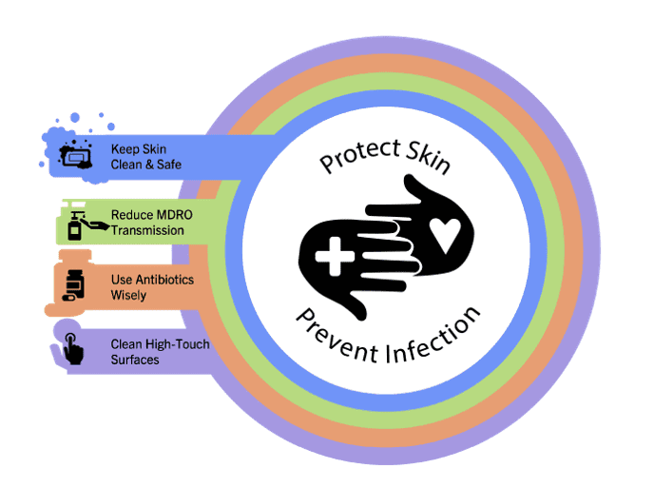
Educational Objectives
Describe when to perform hand hygiene using alcohol-based hand rub or using soap and water
Recognize the 5 Moments for Hand Hygiene during resident care
Discuss systems-based solutions for improving hand hygiene

Slide 4
Poor Hand Hygiene in Nursing Homes¹
4,325 visits observed across eight Veterans Affairs (VA) nursing homes
Overall Compliance by Healthcare Personnel
Hand Hygiene Practice | Compliance Rate
Hand Hygiene, Entry | 45%
Gloves | 58%
Gowns | 34%
Hand Hygiene, Exit | 66%

Slide 5
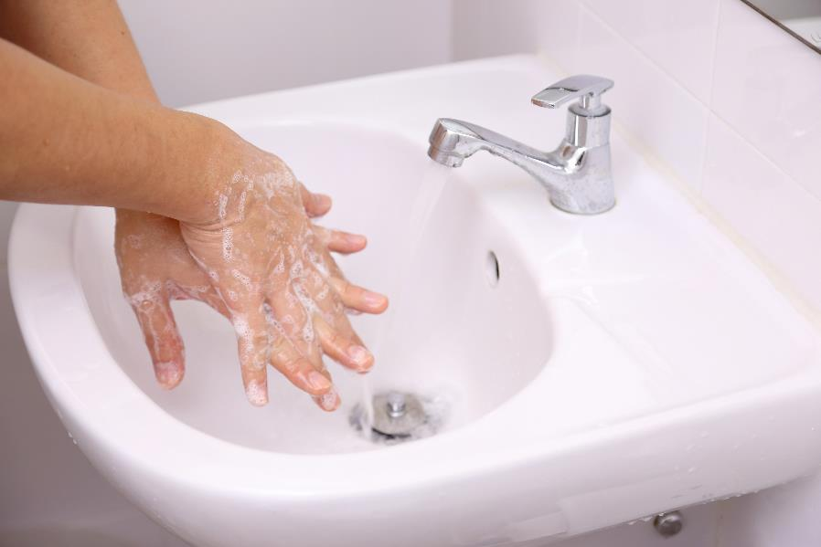
Key Ideas for Staff
Clean hands save lives
5 Moments for Hand Hygiene
Incorporating hand hygiene into daily workflow

Slide 6
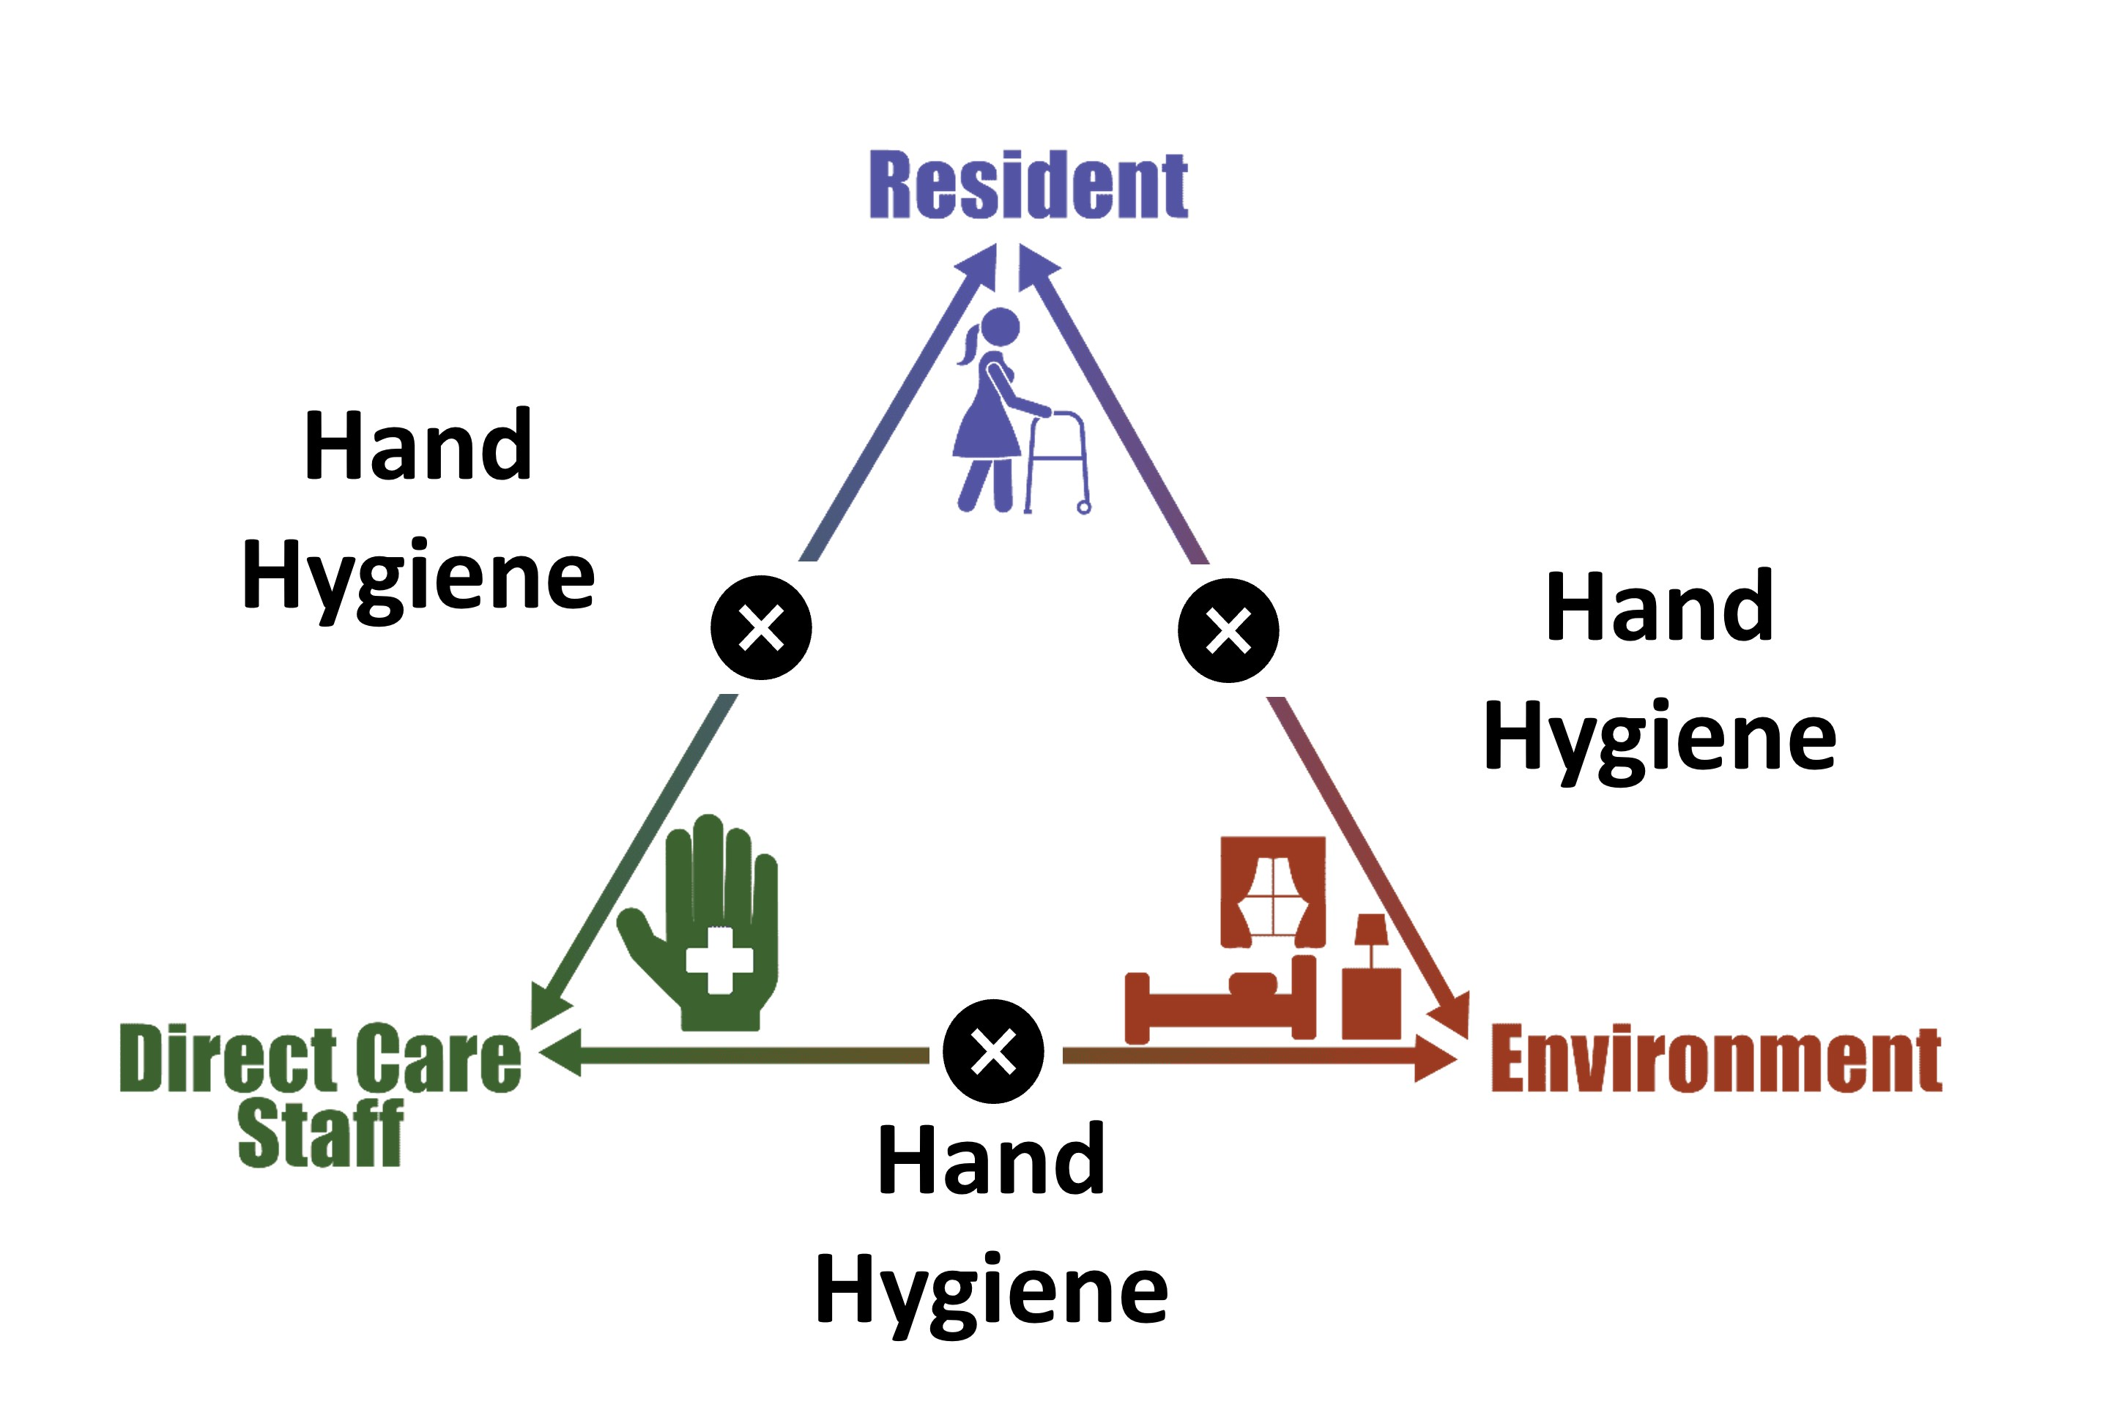
Triangle of Transmission

Slide 7
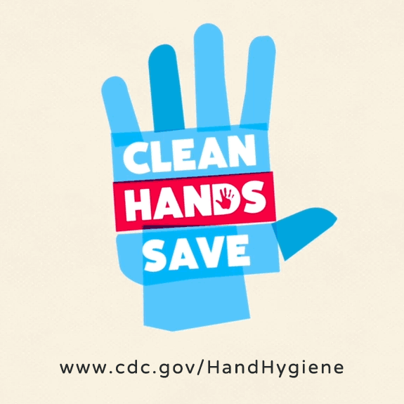
Who Does Hand Hygiene Protect?²
Residents during direct care
Other residents at the facility
Visitors
Family and friends
You
Source: Centers for Disease Control and Prevention. March 2024. https://www.cdc.gov/clean-hands/hcp/clean-hands-count/index.html. Accessed July 20, 2025.

Slide 8


Moments for Hand Hygiene in Everyday Life
Before, during, and after preparing food
Before and after eating food
After using the toilet
After blowing your nose, coughing, or sneezing
After touching an animal, animal feed, or animal waste
After handling pet food or pet treats
After touching garbage

Slide 9
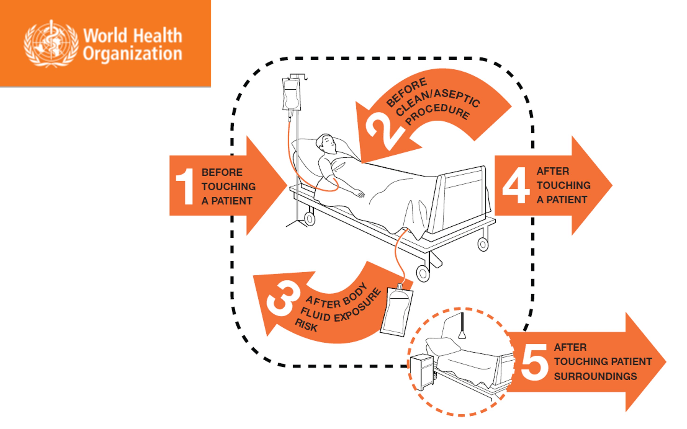
5 Moments for Hand Hygiene in Healthcare³

Slide 10
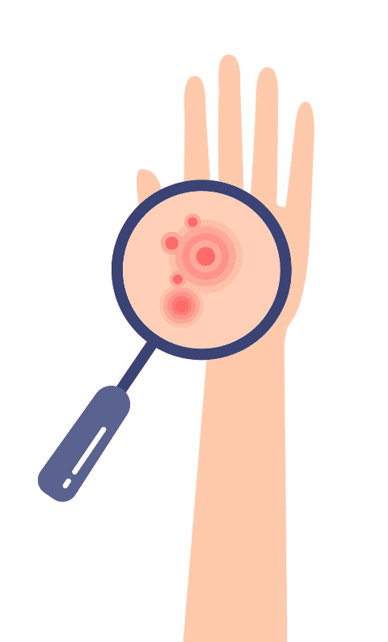
What Do I Use To Clean My Hands?⁴
Alcohol-based hand rub is the preferred method for cleaning your hands.
However, soap and water should be used—
When hands are visibly dirty
After using the restroom
Before eating
After caring for someone with infectious diarrhea or vomiting (i.e., known or suspected infection with C. difficile or norovirus infection)

Slide 11
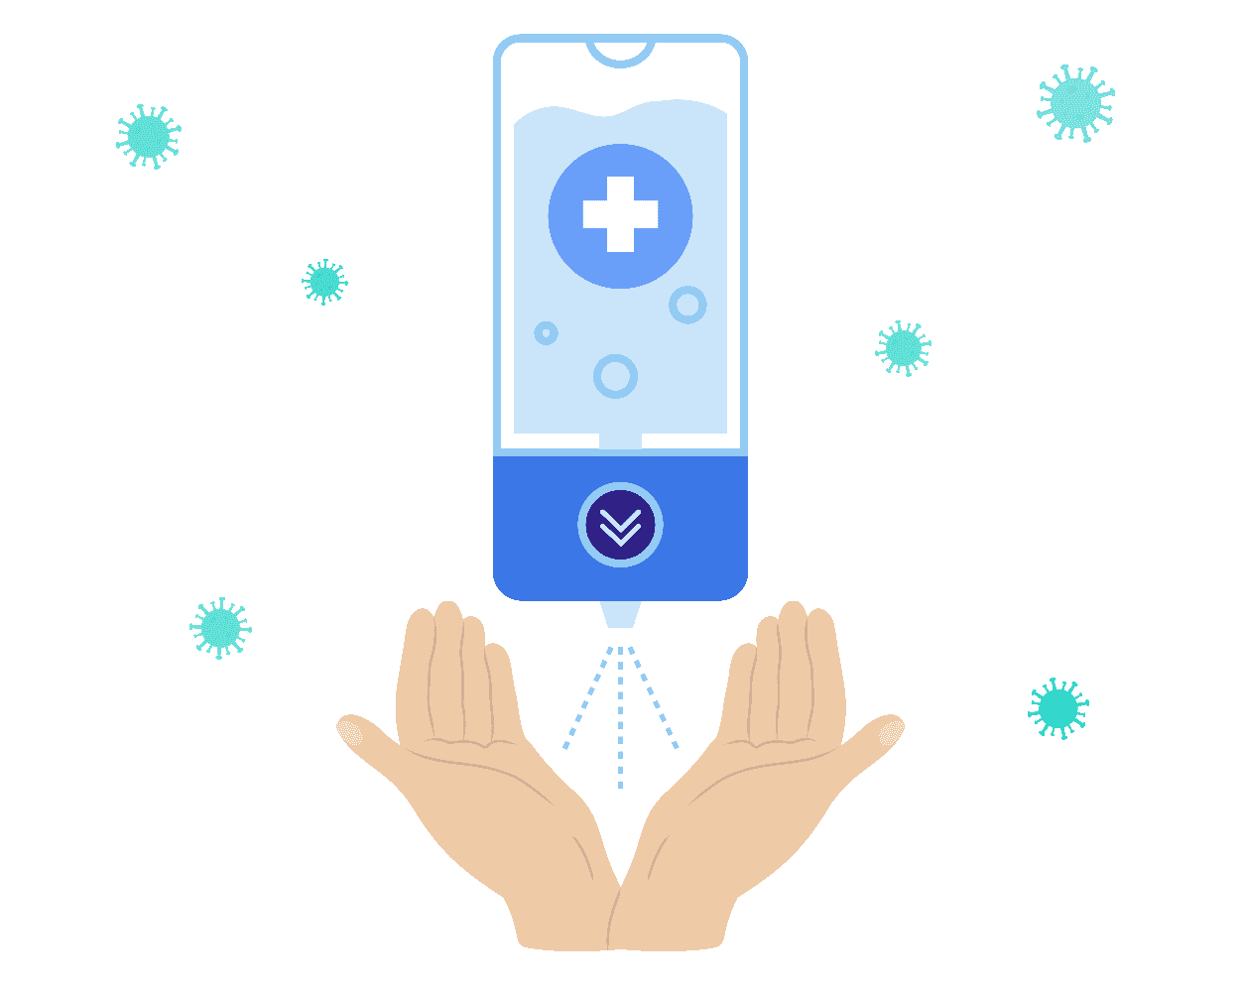

Is There an Easy Rule?⁴
Rub hands for hand hygiene
Wash hands when visibly dirty

Slide 12


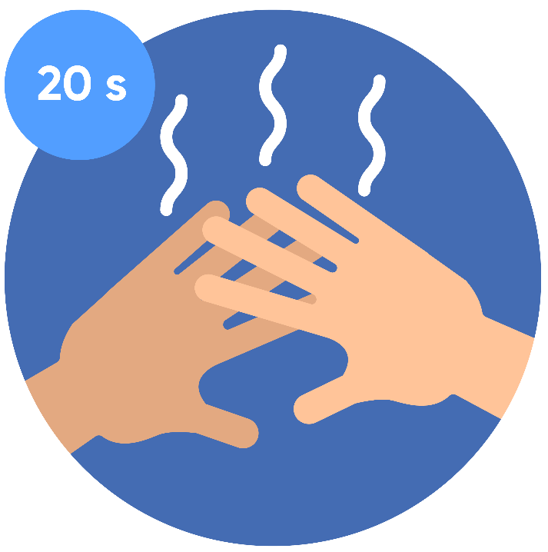
How To Use Alcohol-Based Hand Rub⁴
Use enough product to ensure hands are fully covered.
Rub hands together, covering all surfaces of the hands and fingers, until the hands feel dry.
This should take approximately 20 seconds.

Slide 13
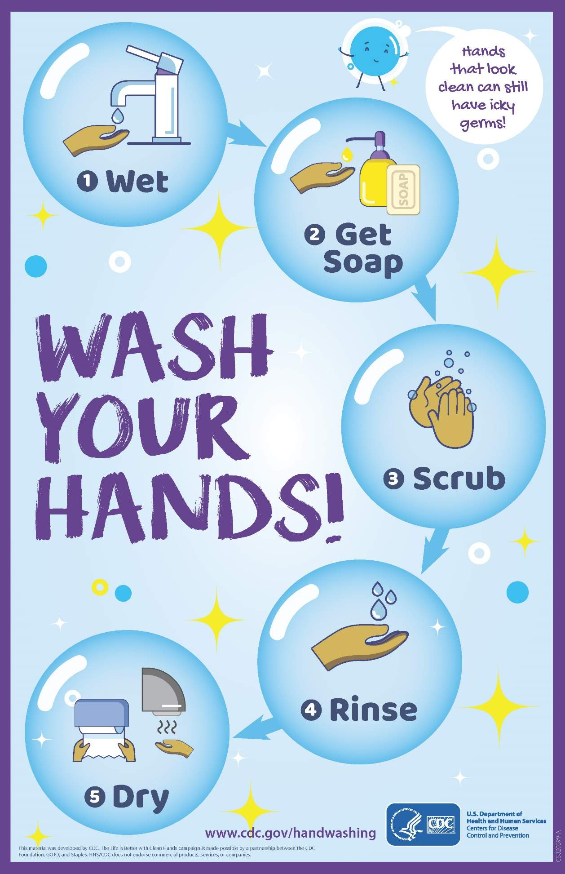
How To Wash With Soap and Water⁵
Wet your hands with clean, running water
Apply soap
Scrub your hands by rubbing them together with the soap
Rinse your hands with clean, running water
Dry your hands using a clean paper towel
Poster available in several languages: https://www.cdc.gov/natural-disasters/communication-resources/wash-your-hands-poster.html

Slide 14
Correct Glove Use Saves Lives⁶
Remove gloves and perform hand hygiene in these cases:
Gloves become damaged
Gloves are visibly soiled after a task (like cleaning up stool or changing a dressing)
Moving from a soiled site to a clean task (like cleaning up stool and then helping someone dress)
Moving from care of one patient to another patient
Gloves look dirty of have blood or body fluids on them after completing a task
Before exiting a resident’s room
Always perform hand hygiene before putting on gloves
Always perform hand hygiene immediately after removing gloves
*Never wear the same pair of gloves in the care of more than one resident!*

Slide 15
Teachable Moment
Questions to consider:
Is it OK to leave a resident’s room without removing gloves and performing hand hygiene?
What are some of the consequences of not removing gloves and performing hand hygiene when you leave a resident’s room?

Slide 16
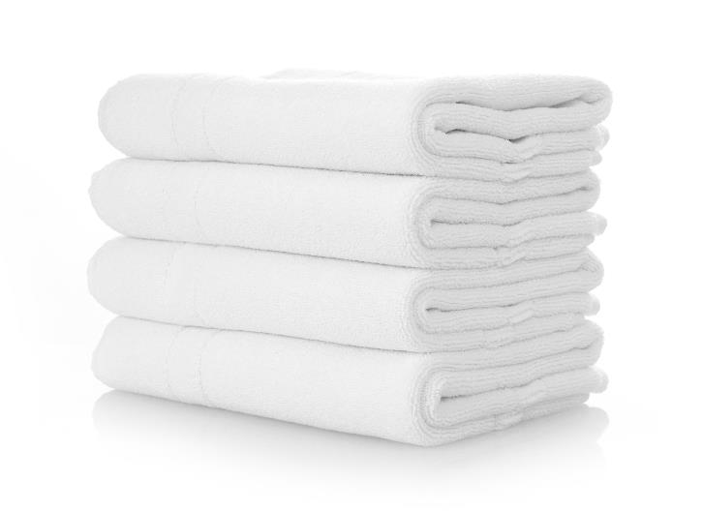
The Case of the Forgotten Towels
74-year-old resident is receiving a bed bath.
The nurse forgot the towels for the bed bath.
He leaves the room to retrieve the towels.

Slide 17
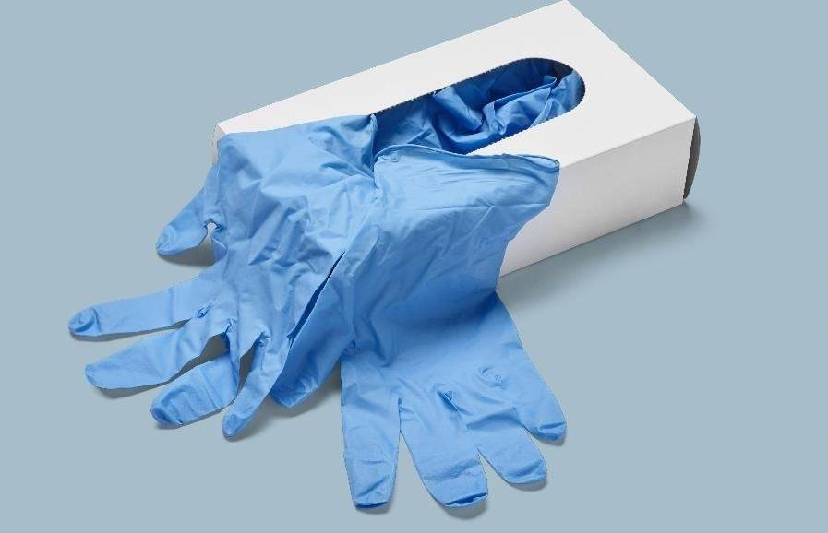
The Error
The nurse left the room without removing his gloves or gown.
He touched the laundry cart.
Then he fell and touched the floor.
He did not change gloves or gown before resuming the bed bath.

Slide 18
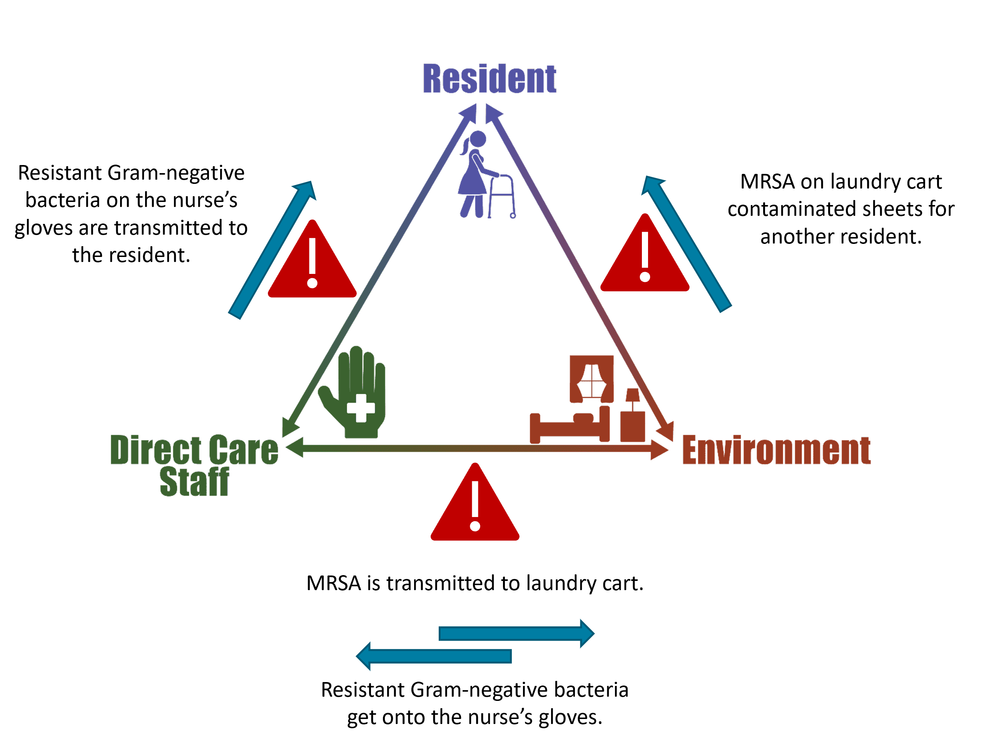
Potential for Resident Harm

Slide 19
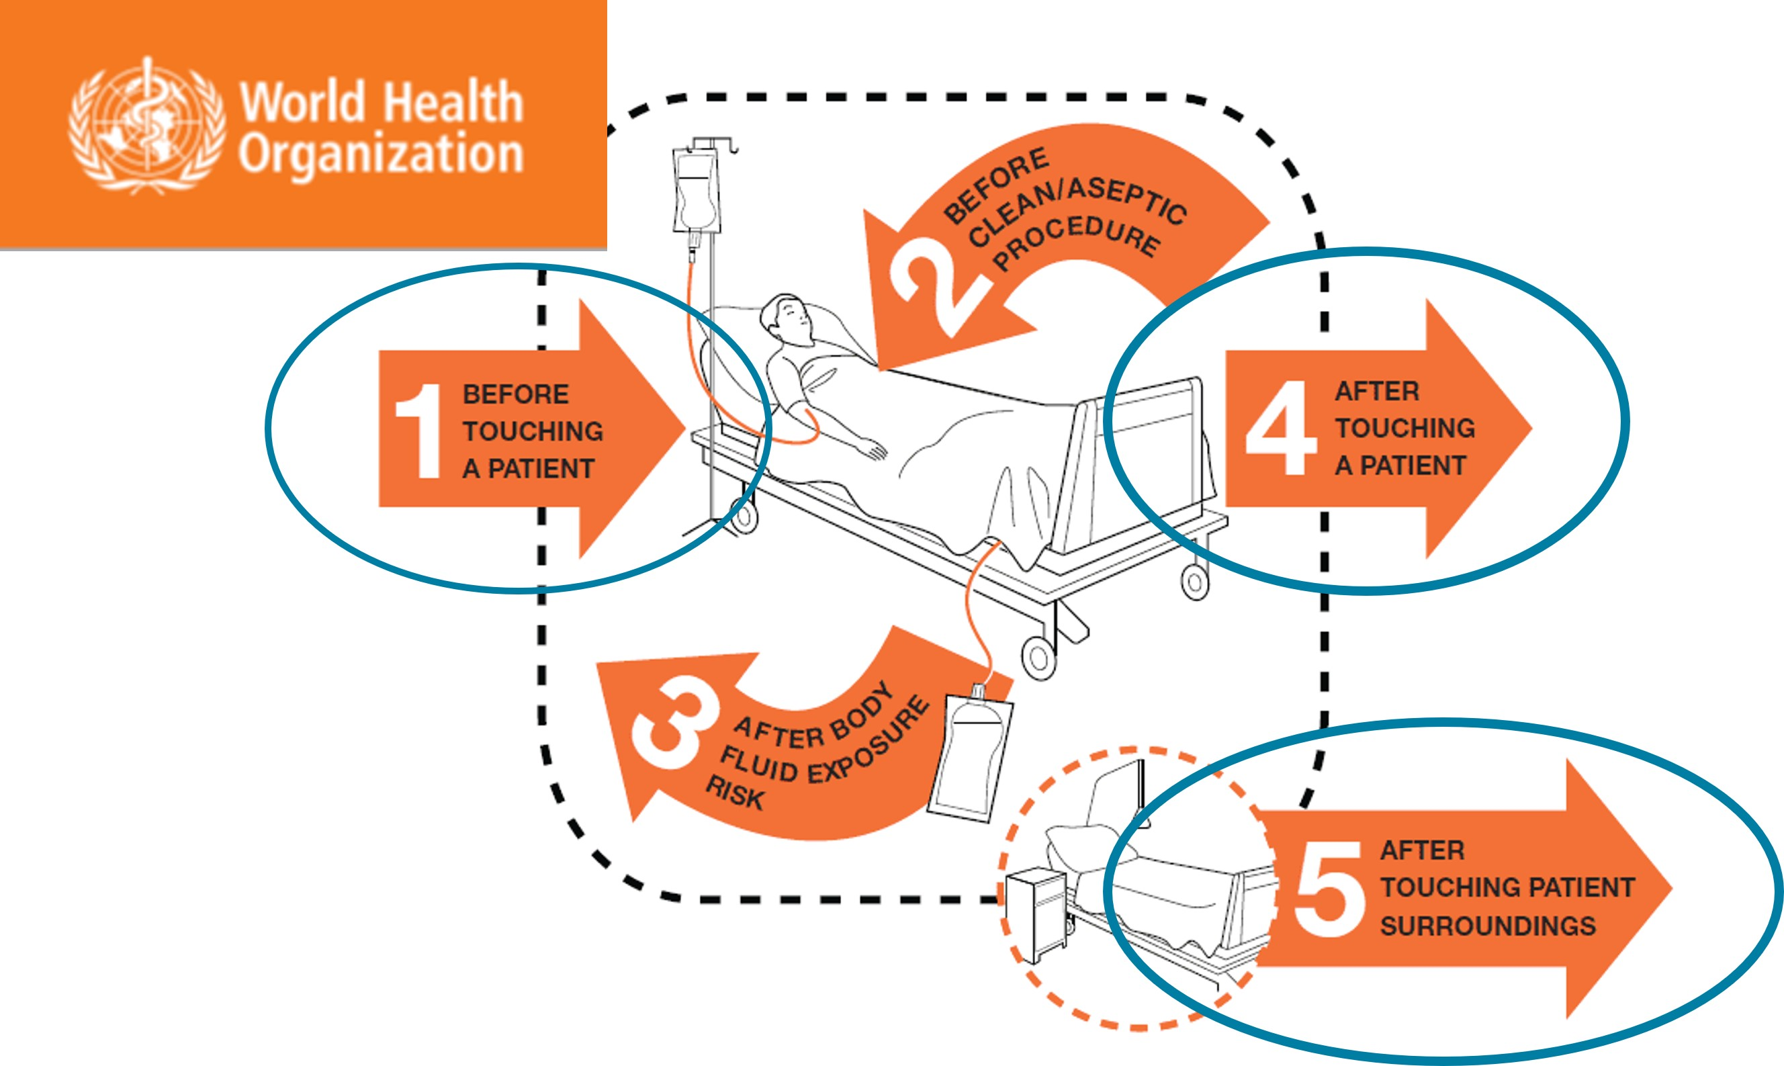
Patient Safety In the Moment³
What could the nurse have done instead?

Slide 20

Preventing the Next Harm
What can be done to avoid the same error happening again?
Use checklist for bathing supplies
Use posters about hand hygiene
Offer hand hygiene-focused “Teachable Moments” and Hand Hygiene Observational Tool
Monitor compliance
Feedback compliance based on findings

Slide 21

System-Based Safety Changes
Place alcohol hand rub dispensers outside every resident room.
Make sure the sinks and alcohol hand rub dispensers get restocked.
Ask for staff input on selecting hand hygiene products.
Make sinks easy to access for hand washing.
Install portable sinks or hand washing stations.

Slide 22
Key Takeaways
Good hand hygiene is essential to preventing the spread of pathogens
When there are errors or problems, think about solutions to help prevent the next harm
Some solutions are technical; some are more systems based

Slide 23
Supporting Materials
Teachable Moments
When To Perform Hand Hygiene
Catch Me if You Can!
The Case of the Forgotten Towels
When You Should Use Alcohol-Based Hand Rub or Soap and Water
Checklist of supplies needed for a bed bath
WHO 5 Moments of Hand Hygiene poster
Hand Hygiene Observational Tool
CDC Clean Hands Count Campaign

Slide 24
Disclaimer
The findings and recommendations in this presentation are those of the authors, who are responsible for its content, and do not necessarily represent the views of AHRQ. No statement in this presentation should be construed as an official position of AHRQ or of the U.S. Department of Health and Human Services.
Any practice described in this presentation must be applied by healthcare practitioners in accordance with professional judgment and standards of care in regard to the unique circumstances that may apply in each situation they encounter. These practices are offered as helpful options for consideration by healthcare practitioners, not as guidelines.

Slide 25
References
Pineles L, Petruccelli C, Perencevich EN, et al. The impact of isolation on healthcare worker contact and compliance with infection control practices in nursing homes. Infect Control Hosp Epidemiol. 2018 Jun;39(6):683-7. PMID: 29606163.
Centers for Disease Control and Prevention. Hand Hygiene in Healthcare Settings. Clean Hands Count Campaign. Promotional materials. Last reviewed March 15, 2016. https://www.cdc.gov/clean-hands/hcp/clean-hands-count/index.html. Accessed June 30, 2025.
World Health Organization. Campaigns. World Hand Hygiene Day. Save Lives: Clean Your Hands. Last reviewed 2023. https://www.who.int/campaigns/world-hand-hygiene-day. Accessed June 30, 2025.
Centers for Disease Control and Prevention. Clean Hands: Clinical Safety: Hand Hygiene for Healthcare Workers. Last reviewed: February 27, 2024. https://www.cdc.gov/clean-hands/hcp/clinical-safety/index.html. Accessed: July 1, 2025.
Centers for Disease Control and Prevention. Natural Disasters and Severe Weather. Wash Your Hands (Poster). Last updated: April 24, 2024. https://www.cdc.gov/natural-disasters/communication-resources/wash-your-hands-poster.html. Accessed: June 30, 2025.
Centers for Disease Control and Prevention. Clean Hands. Clinical Safety: Hand Hygiene for Healthcare Workers. Updated: February 27, 2024. https://www.cdc.gov/clean-hands/about/hand-hygiene-for-healthcare.html. Accessed: June 30, 2025.

