Slide 1
Enhanced Barrier Precautions and Multidrug-Resistant Organism Prevention in Long Term Care
AHRQ Safety Program for MRSA Prevention
AHRQ Pub. No. 25(26)-0066
October 2025

Slide 2
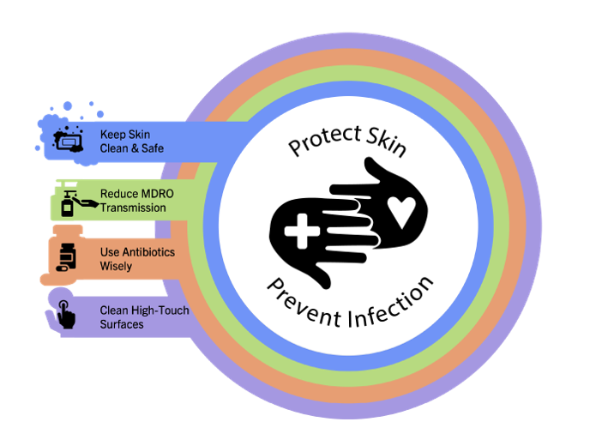
Educational Objectives
Differentiate colonization from infection
Identify novel/ emerging multidrug-resistant organisms (MDROs)
Describe enhanced barrier precautions
Review strategies to prevent MDROs

Slide 3


Infection Versus Colonization¹
Infection
Person has a pathogen that is causing an active, symptomatic infection
Requires treatment
The pathogen can be spread to others
Colonization
Person has a pathogen but does not have any signs or symptoms
Does not require treatment
The pathogen can be spread to others
At risk for developing infections with that pathogen

Slide 4

Tip of the Iceberg¹
Infection
Identified from clinical cultures
Once the infection is treated, the person will likely remain colonized
Colonization
Usually identified by surveillance cultures in the hospital, or records from prior (resolved) infections
Colonization may last for years
We do not always know which patients are colonized

Slide 5

MDROs in Nursing Homes
An MDRO is an organism that has become resistant to several antibiotics that would typically be used to kill the organism.²
The spread of MDROs is common in LTC facilities.
More than 50 percent of nursing home residents have an MDRO.¹
MDRO transmission contributes to resident morbidity and mortality and increased healthcare costs.

Slide 6
Challenges With Detection of MDROs
The prevalence of residents colonized with MDROs is often greatly underestimated.
Tracking MDRO colonization status is a challenge for nursing homes.
Information about colonization status is lost between transfers to and from hospitals and other facilities.

Slide 7
Risks for MDRO Colonization and Acquisition
Inadequate infection control practices
Lack of hand hygiene
Poor use of isolation precautions
Inadequate use of personal protective equipment (PPE)
Inadequate cleaning and disinfection of surfaces and equipment
Presence of indwelling medical devices (urinary catheter, PEG tubes, central lines)
Presence of wounds or decubitus ulcers
Inappropriate antibiotic use
Recent hospitalization and prolonged length of stay

Slide 8
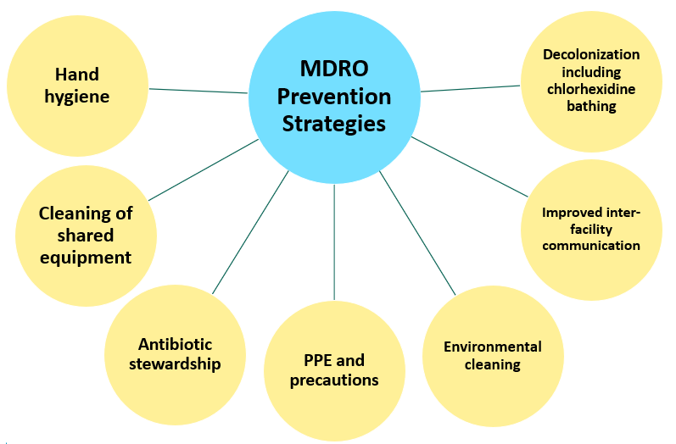
MDRO Prevention: Novel and Core Strategies

Slide 9
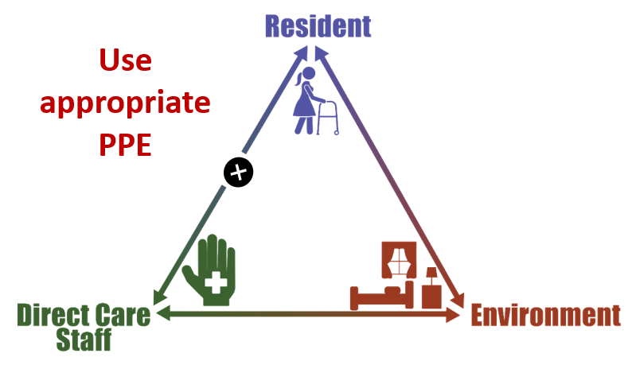
Triangle of Transmission

Slide 10
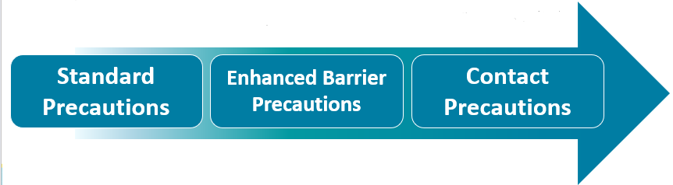
Spectrum of Precautions²
NO history of MDRO colonization, open wounds, or indwelling devices
Patient not isolated
Gloves for direct care
Resident with history of MDRO colonization, contained wound, or indwelling device
Resident not isolated
Gown/gloves for high-risk activities
Resident colonized or infected with an MDRO AND have an open/draining wound or infectious diarrhea
Resident isolated
Gown/gloves +/- mask/eye shield to enter room

Slide 11
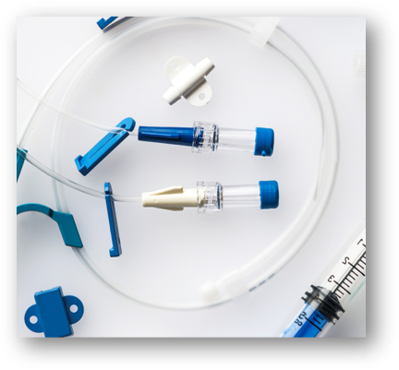


Enhanced Barrier Precautions²
Resident with MDRO colonization or infection, or at risk for having or acquiring such, due to a contained wound, or indwelling device
Resident not isolated
Gown/gloves for high-risk activities

Slide 12

Why Are Enhanced Barrier Precautions Important?²
Helps balance infection prevention and staff/resident quality of life
Reduces isolation and stigma that can be associated with contact precautions
Uses precautions for activities or contact shown to be high risk for spreading MDROs

Slide 13

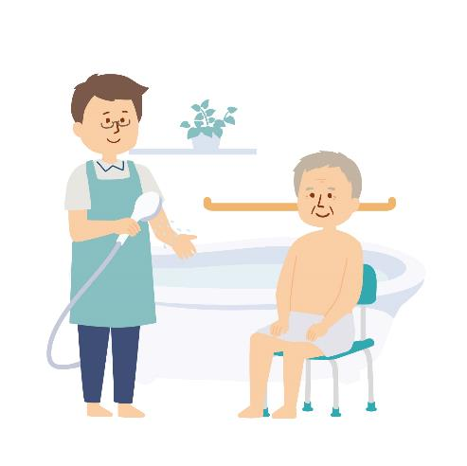
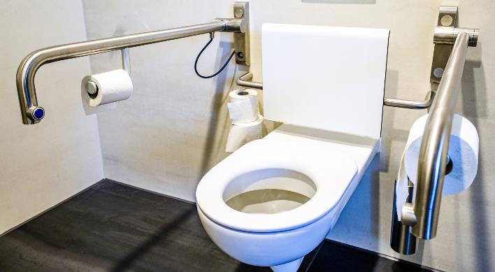

Activities With a High Risk for MDRO Transmission^{2,3}

Slide 14
Teachable Moment
Questions to consider:
What type of precautions should the resident be on?
What PPE should the CNA wear?
What are the consequences of not wearing a gown?

Slide 15

The Case
Mr. Gonzalez is a 66-year-old resident recovering from a MRSA prosthetic joint infection
Received vancomycin through a PICC line twice daily
Needs daily care of the surgical wound

Slide 16

Knowledge Check
Standard Precautions
Enhanced Barrier Precautions
Contact Precautions
What type of precautions is the best for Mr. Gonzalez?

Slide 17
Knowledge Check: Answer
Mr. Gonzalez has a history of an MDRO infection (MRSA)
He has an indwelling device (PICC) line
He has a contained wound
Enhanced Barrier Precautions

Slide 18


The Choice of PPE
The CNA is getting ready to enter the room to flush the PICC line and change Mr. Gonzalez’s PICC line dressing.
What PPE should the CNA wear?

Slide 19
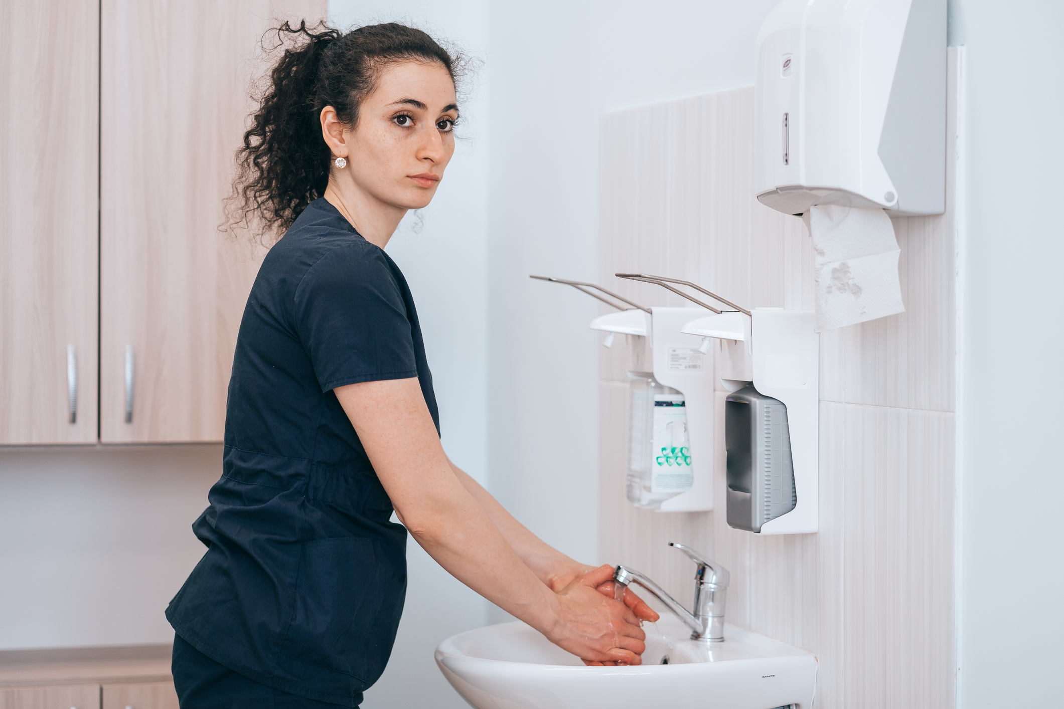

The Error
The resident needs device care and wound care
The CNA performs hand hygiene
There are gloves but not gowns by the resident’s door
The CNA is behind in her work and only puts on gloves
The CNA rationalizes that gloves are enough PPE because she is only using her hands to flush the PICC line and change the dressing

Slide 20
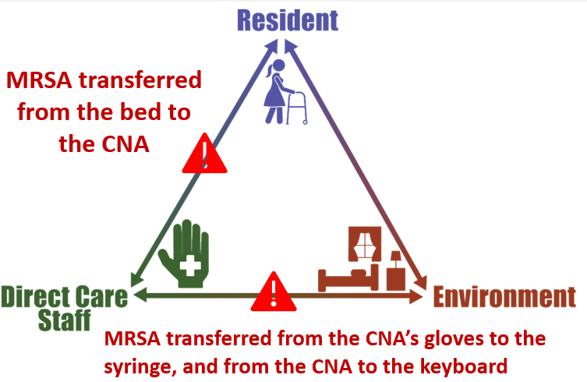
Potential for Patient Harm

Slide 21
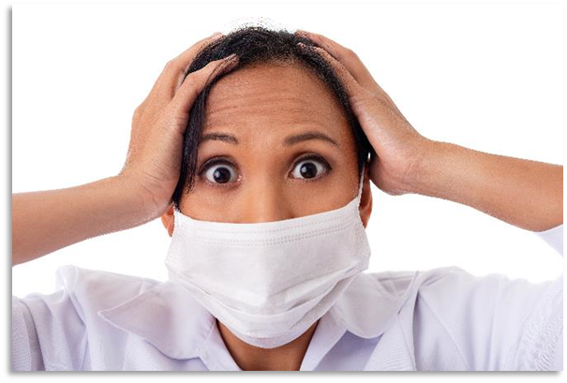
Patient Safety in the Moment
What could the CNA have done instead?
Restock gowns from clean supply
Grab an isolation gown from a nearby room
Use the call button to ask for help restocking the resident’s room
Bottom line: Take time to don proper PPE

Slide 22

Preventing the Next Harm
What can be done to keep the same error from happening again?
Designate one person on every shift whose job is to stock and refill PPE
Designate a backup person, in case the first person is out or otherwise occupied
Take responsibility to ensure the correct PPE is worn for every resident interaction

Slide 23

System-Based Safety Changes
Why was the CNA behind in work?
Was the facility understaffed so everyone was taking on extra work?
Does the administration need to look at staffing issues?

Slide 24

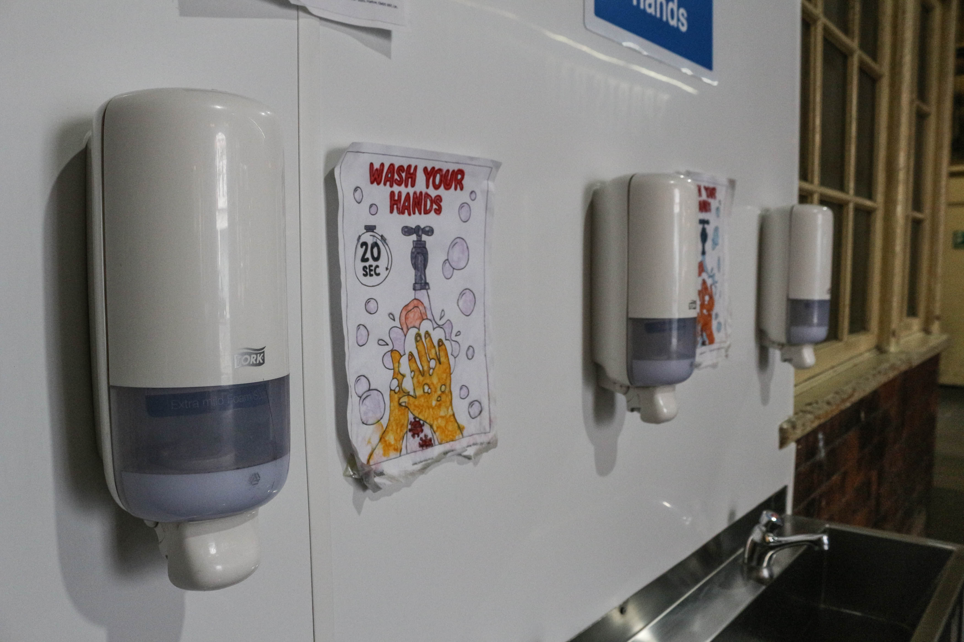
Key Takeaways
Residents with an MDRO or at high risk of an MDRO (wounds or indwelling medical devices) should be on enhanced-barrier precautions.
Enhanced-barrier precautions allows some residents with MDROs to leave their rooms.
Proper use of PPE is an important part of resident safety.

Slide 25
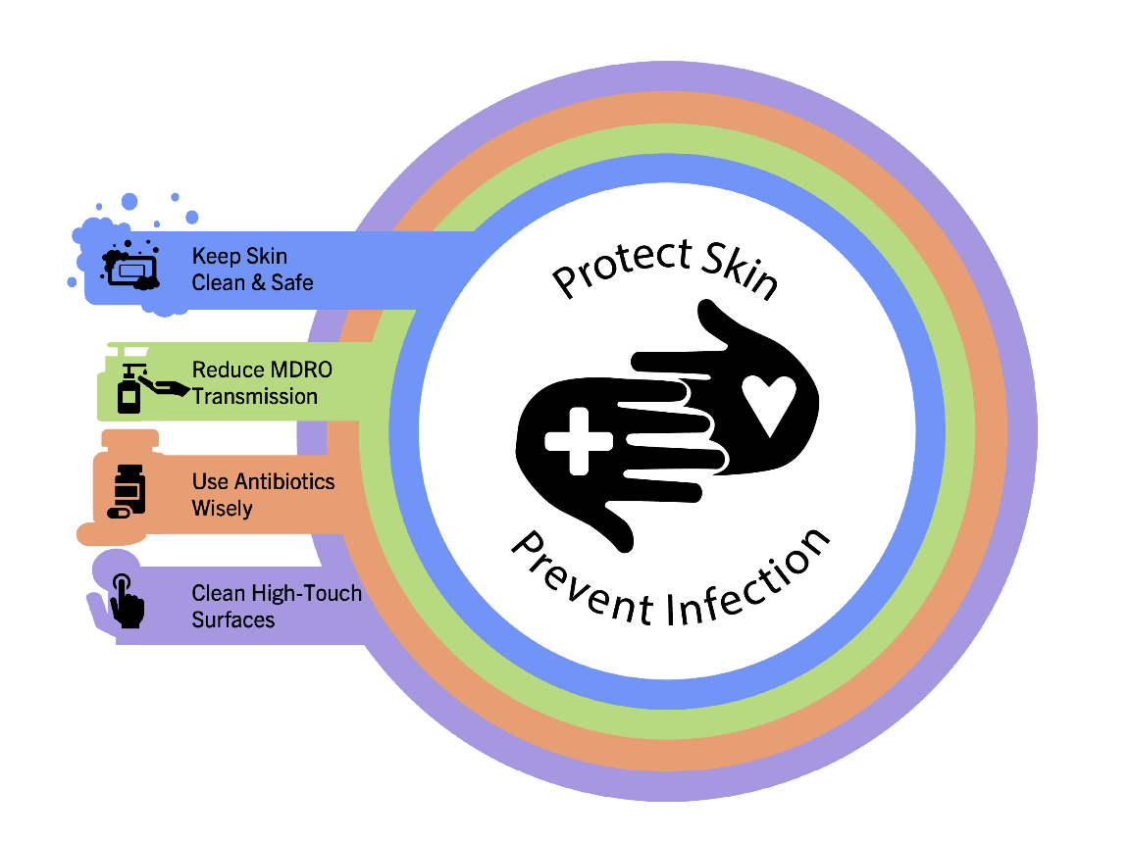
Supporting Materials
Teachable Moments:
Implementing Enhanced Barrier Precaution
The Triangle of Transmission: Residents as Reservoirs for MDROs
The Triangle of Transmission: Norovirus
Clinical Criteria and Surveillance Definitions of Infections in Nursing Home Residents
Comparing Clinical and Surveillance Definitions of Urinary Tract Infections in Nursing Homes
The Case of Insufficient PPE
The Case of EBP and the Laundry Bag
Supporting Materials
EBP Tracker Tool
CDC Resources

Slide 26
Disclaimer
The findings and recommendations in this presentation are those of the authors, who are responsible for its content, and do not necessarily represent the views of AHRQ. No statement in this presentation should be construed as an official position of AHRQ or of the U.S. Department of Health and Human Services.
Any practice described in this presentation must be applied by healthcare practitioners in accordance with professional judgment and standards of care in regard to the unique circumstances that may apply in each situation they encounter. These practices are offered as helpful options for consideration by healthcare practitioners, not as guidelines.

Slide 27
References
Connecticut State Department of Public Health. Multidrug-Resistant Organisms (MDROs): What Are They? https://portal.ct.gov/DPH/HAI/MultidrugResistant-Organisms-MDROs-What-Are-They. Accessed July 29, 2025.
Centers for Disease Control and Prevention. Implementation of Personal Protective Equipment (PPE) Use in Nursing Homes to Prevent Spread of Multidrug-resistant Organisms (MDROs). https://www.cdc.gov/long-term-care-facilities/hcp/prevent-mdro/ppe.html?CDC_AAref_Val=https://www.cdc.gov/hai/containment/PPE-Nursing-Homes.html. Accessed July 29, 2025. ​
Roghmann MC, Johnson JK, Sorkin JD, et al. Transmission of Methicillin-Resistant Staphylococcus aureus (MRSA) to healthcare worker gowns and gloves during care of nursing home residents. Infect Control Hosp Epidemiol. 2015 Sep;36(9):1050-7. PMID: 26008727. ​

