Slide 1
Down and Dirty With Stool:
Enteric Pathogens
AHRQ Safety Program for MRSA Prevention
AHRQ Pub. No. 25(26)-0066
October 2025

Slide 2

All Staff Support Resident Care and Safety
The information provided in this presentation is important in the care of long-term care (LTC) residents. In LTC facilities, each member of the facility’s staff supports resident care and safety.
Some actions described in these presentations may not be in your scope of practice, but it is important to learn how all staff contribute to resident care and safety.

Slide 3
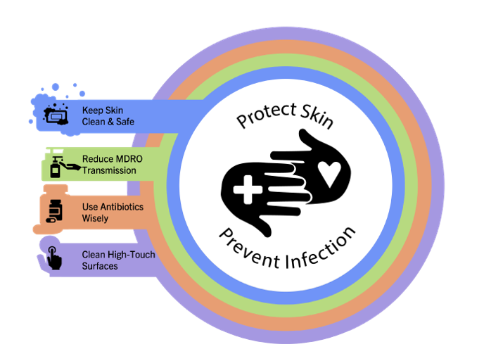
Educational Objectives
Discuss what bacteria are commonly found in stool
Review how bacteria in the stool are spread and can cause infections in other parts of the body
Learn what precautions are necessary to control the spread of gram-negative enterics

Slide 4
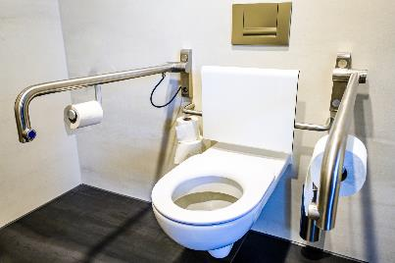
Normal Human Poop¹
More than half the dry weight of stool is bacteria²
Enterococci: Normal gram-positive enteric bacteria
Enterobacterales: Normal gram-negative enteric bacteria that live in our intestines
  E.coli
  Klebsiella
  Proteus
  Enterobacter

Slide 5
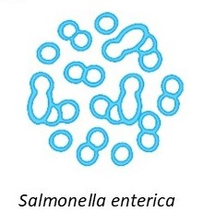
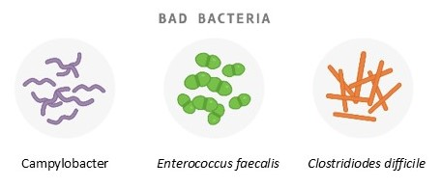
Pathogens in Our Poop³
Bacteria that cause gut or intestine infections
Usually come from contaminated food
  Salmonella
  Shigella
  Yersinia
  Campylobacter jejuni
Clostridioides difficile
  Can stay on surfaces for months
  Gets onto hands and then accidentally into mouth
  Antibiotic use is the biggest risk factor

Slide 6
Resistant Bacteria in Stool
Some bacteria found in stool have become resistant to antibiotics: MDROs
Nursing home residents have increased rates of MDROs in stool
  High healthcare exposure
  Repeated antibiotic use
Transmission is hard to control in nursing homes
  Incontinent residents (rely on staff to clean stool)
  Poor hand hygiene, non-adherence to precautions, and insufficient environmental cleaning
  Shared bathrooms
Common resistant enteric bacteria in nursing homes
  Fluroquinolone-resistant bacteria
  ESBL-producing Enterobacterales (resistant to penicillins and cephalosporins)
  Carbapenem-resistant Enterobacteriaceae (CRE)
  Vancomycin-resistant Enterococcus (VRE)

Slide 7


Transmission of Enteric Bacteria
Fecal-oral transmission example
  Resident is incontinent of stool
  Staff member assists with cleaning resident after stooling
  Improper/inadequate hand hygiene
  Hands of staff member are contaminated
  Staff members touches the environment
  Bacteria remain on environment
  Resident or another staff member touch the environment prior to eating
Wound contamination example
  Resident is incontinent
  Bacteria from stool seeps into sacral wound (mucosal site)
    Improper barrier between stool and wound, infrequent or inadequate cleaning
  Bacteria causes wound infection

Slide 8
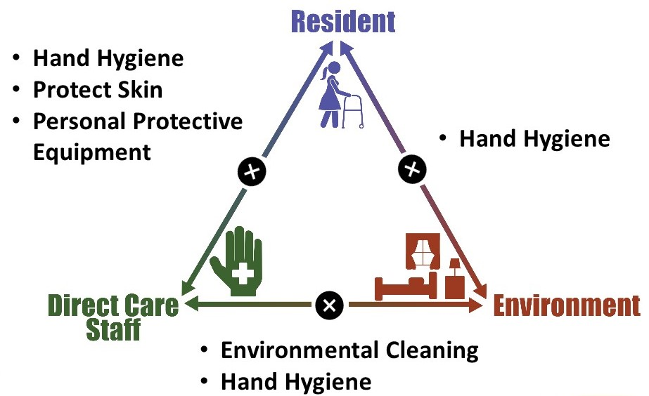
Triangle of Transmission

Slide 9
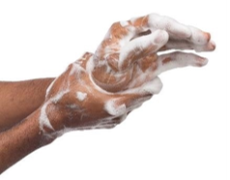

Key Infection Prevention Knowledge for Staff
Hand hygiene after dealing with stool is essential (even if you were wearing gloves!)
Resistant organisms can remain in stool and be transmitted through the stool for months to years. Use EBP!
Bacteria in the stool can contaminate pressure injuries (sacral wounds) and lead to severe infections.
Residents with new-onset diarrhea should be on contact precautions (gown and gloves for any room entry).

Slide 10
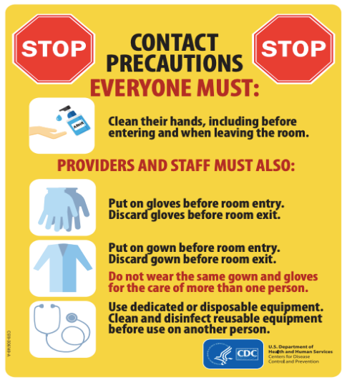
Contact Precautions⁴
Used for patients with infections that are spread by touching the patient or items in the room
  Ex: residents with—
    Diarrheal illnesses (C. difficile, norovirus, E coli, etc.)
    Scabies
Requires gown AND gloves to enter room (not just during direct care)
  This is because touching the environment can lead to transmission.
Image source: https://www.cdc.gov/infection-control/media/pdfs/contact-precautions-sign-P.pdf
Check out the Enhanced barrier precautions page of this toolkit

Slide 11
Teachable Moment
Questions to consider:
What problems would have been avoided with proper PPE use?
How can your facility make sure hand hygiene products are easily accessible?

Slide 12
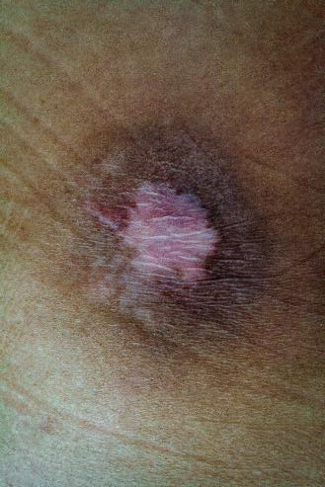
Wound Care and the Incontinent Resident
Mr. Jones is an 82-year-old resident with a history of a stroke, with limited mobility as a result
Chronic stage 2 sacral decubitus wound
Develops new-onset diarrhea and is incontinent of stool four to eight times a day

Slide 13

The Challenge
Mr. Jones is due for his dressing change when the nurse notices he's been incontinent of stool.
The nurse assists the CNA with cleaning up after the incontinence before performing the dressing change. Neither the nurse nor the CNA use a gown.
As the nurse removes her gloves, she cannot see that stool bacteria, some of which are resistant, contaminate her hands.

Slide 14
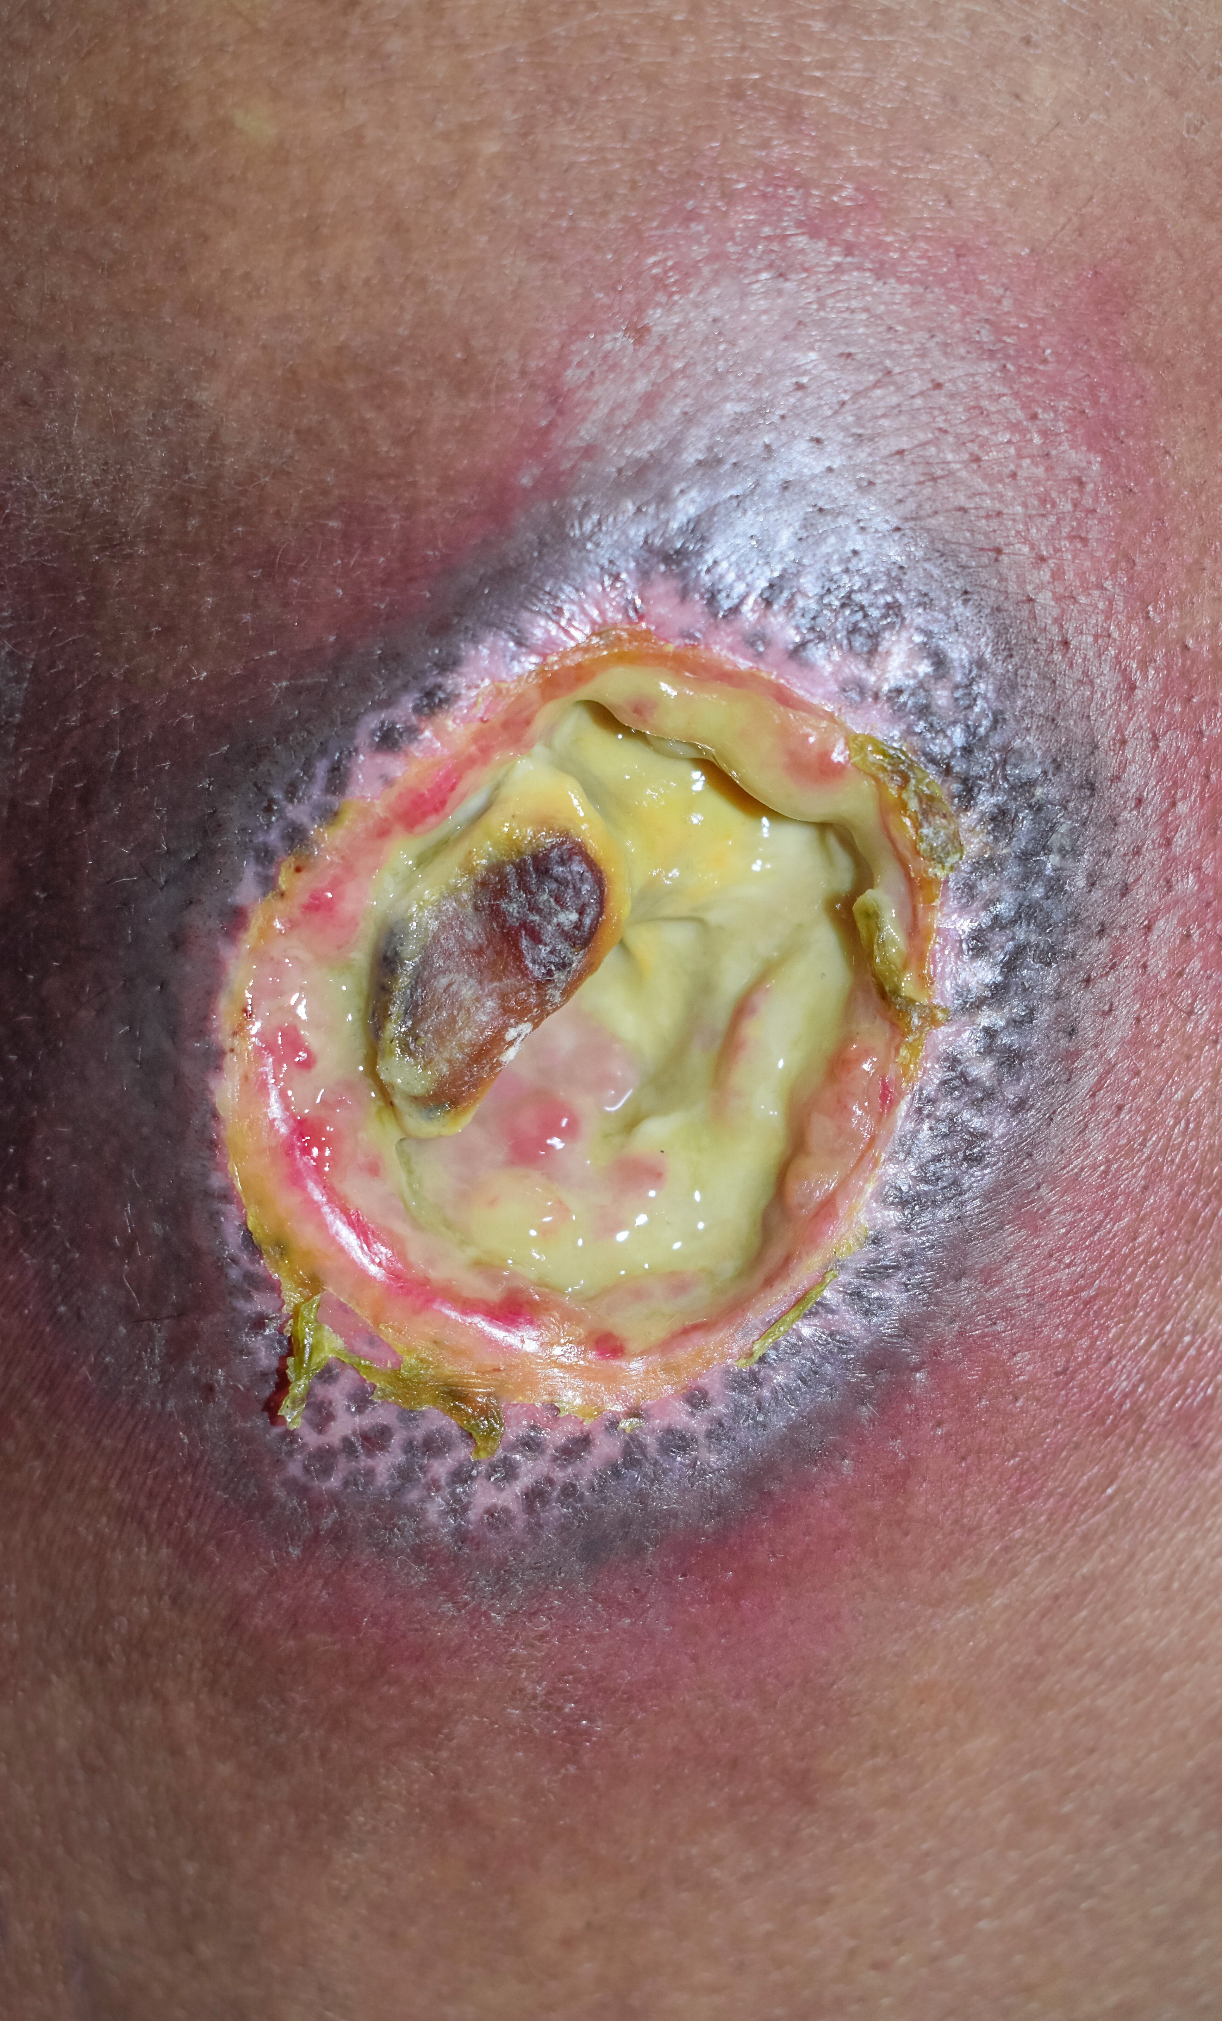
The Error
The nurse fails to perform hand hygiene before the dressing change.
Some of the resistant bacteria is transferred from her hands to the clean dressing.
Wound culture taken one week later grows an antibiotic-resistant E coli.
Because wound supplies were contaminated, more residents develop infections caused by the same resistant E. coli

Slide 15
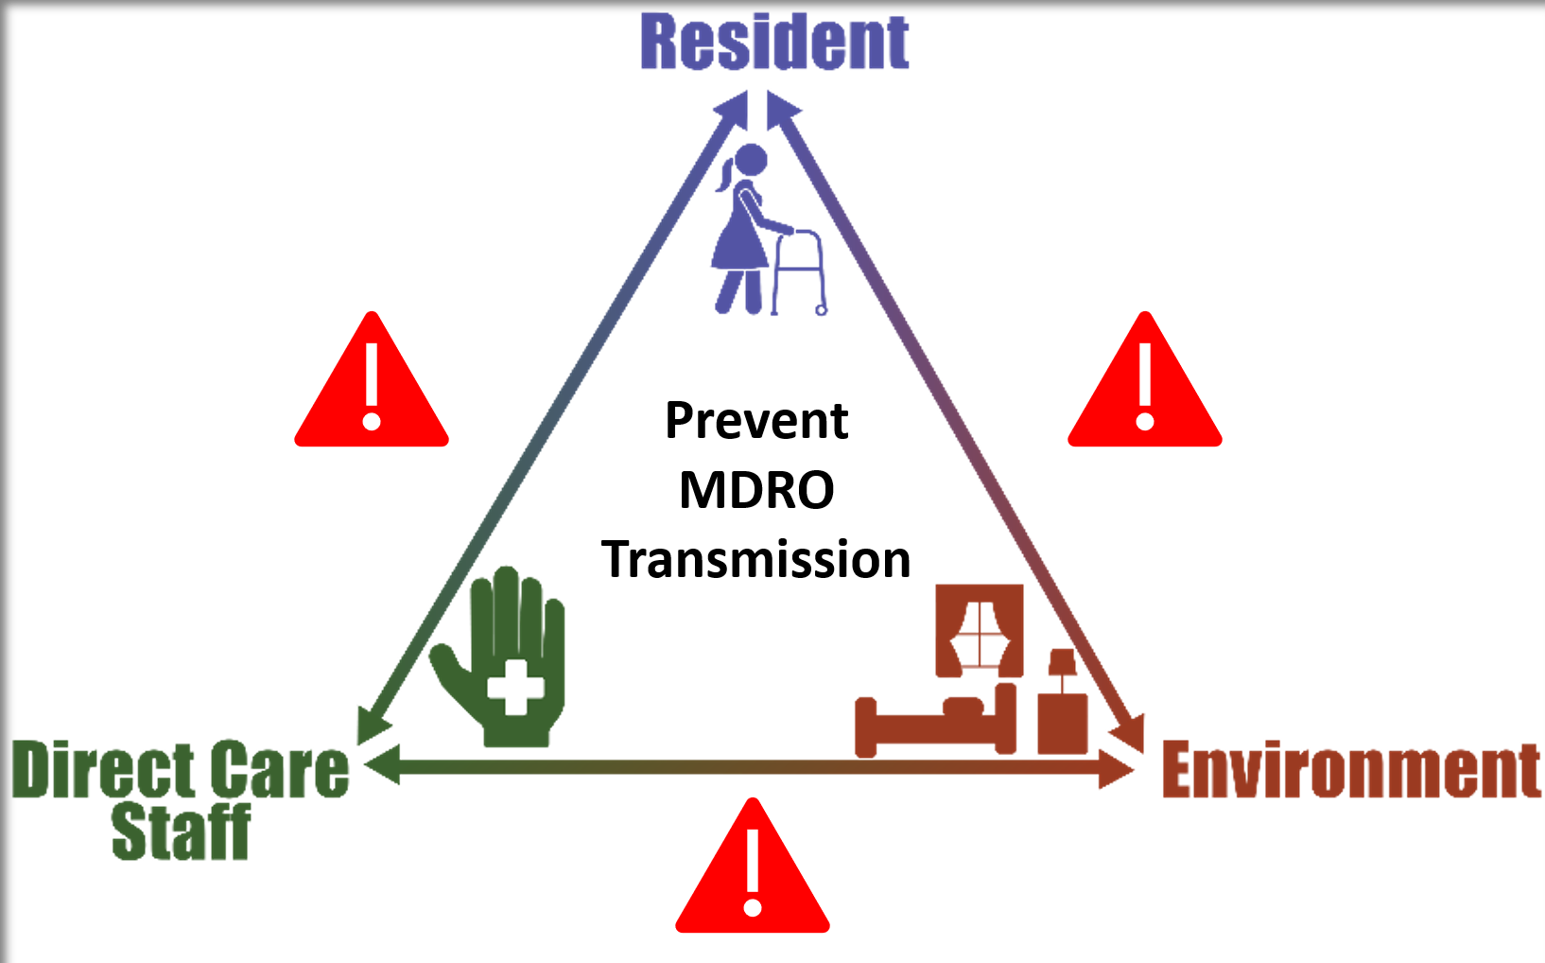
Potential for Patient Harm

Slide 16
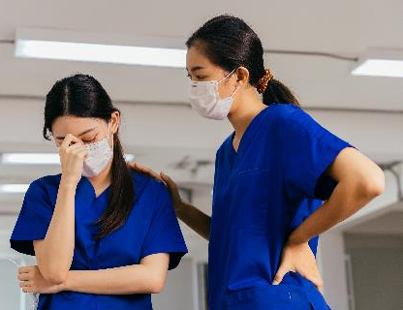
Patient Safety in the Moment
What could the nurse and CNA have done instead?
Used appropriate PPE (contact precautions) for a resident with new-onset diarrhea.
Performed hand hygiene after cleaning up stool incontinence and before wound care.

Slide 17

Preventing the Next Harm
What can be done to avoid the same error from happening again?
Have supplies readily available to encourage the use of infection prevention measures.
Regularly review status of patients who require contact precautions, with appropriate signage.

Slide 18
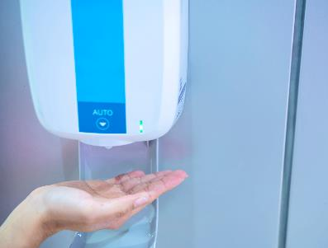
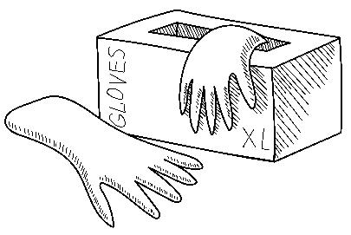
System-Based Safety Changes
Invest in over-the-door PPE holders to make PPE more visible and accessible for staff.
Have hand hygiene supplies available at the point of care.
Avoid using wound care carts with communal supplies.

Slide 19
Key Takeaways
Resistant organisms can live in the stool and survive in the environment for prolonged periods.
Contact precautions are used for all residents with active infections.
Proper PPE, hand hygiene, and disinfection are key to prevent transmission of enteric bacteria.

Slide 20
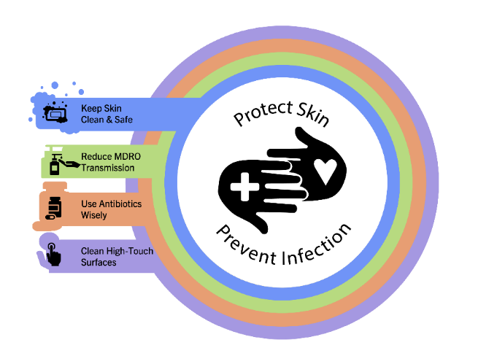
Supporting Materials
Teachable Moments:
Contact Precautions Quiz
The Case of the Resident With A Chronic Wound and Diarrhea
External Supporting Material:
CDC – C. difficile Informational Poster⁵

Slide 21
Disclaimer
The findings and recommendations in this presentation are those of the authors, who are responsible for its content, and do not necessarily represent the views of AHRQ. No statement in this presentation should be construed as an official position of AHRQ or of the U.S. Department of Health and Human Services.
Any practice described in this presentation must be applied by healthcare practitioners in accordance with professional judgment and standards of care in regard to the unique circumstances that may apply in each situation they encounter. These practices are offered as helpful options for consideration by healthcare practitioners, not as guidelines.

Slide 22
References—1
Harrison’s Manual of Medicine. Gram-Negative Enteric Bacteria. General Considerations. McGraw Hill Education. Unbound Medicine. https://harrisons.unboundmedicine.com/harrisons/view/Harrisons-Manual-of-Medicine/623660/all/GRAM_NEGATIVE_ENTERIC_BACTERIA#:~:text=Gram%2Dnegative%20bacilli%20(GNB),care%20facilities%20and%20hospital%20settings. Accessed July 29, 2025.
Rose C, Parker A, Jefferson B, et al. The characterization of feces and urine: a review of the literature to inform advanced treatment technology. Crit Rev Environ Sci Technol. 2015 Sep 2;45(17):1827-1879. PMID: 26246784.
Centers for Disease Control and Prevention. About C diff. https://www.cdc.gov/c-diff/about/index.html. Accessed July 29, 2025.
Centers for Disease Control and Prevention. Contact Precautions- Example Sign. https://www.cdc.gov/infection-control/media/pdfs/contact-precautions-sign-P.pdf. Accessed July 29, 2025.
Centers for Disease Control and Prevention. C. diff Infection: Am I At Risk? C. diff infection: Am I at risk?. Accessed July 29, 2025.

