Slide 1
Where Do Germs Live?
Environmental Cleaning
AHRQ Safety Program for MRSA Prevention
AHRQ Pub. No. 25(26)-0066
October 2025

Slide 2

All Staff Support Resident Care and Safety
The information provided in this presentation is important in the care of long-term care (LTC) residents. In LTC facilities, each member of the facility’s staff supports resident care and safety.
Some actions described in these presentations may not be in your scope of practice, but it is important to learn how all staff contribute to resident care and safety.

Slide 3
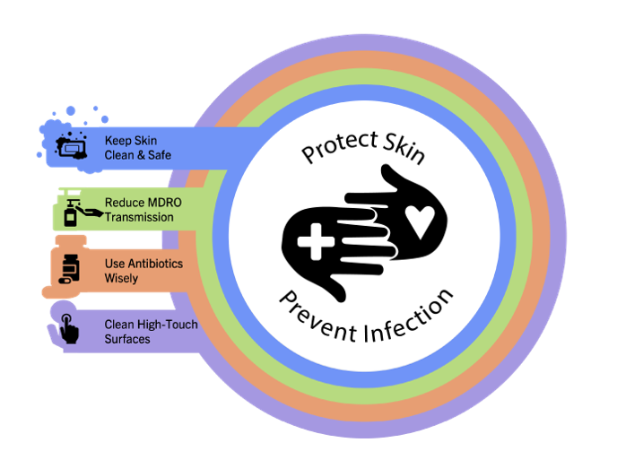
Educational Objectives
Recognize the role of environmental cleaning in the prevention and control of infections
Discuss barriers to proper environmental cleaning
Discuss strategies to overcome those barriers

Slide 4
MDRO Contamination of the Environment in LTC
Organisms recovered from sampling of high-touch surfaces across 28 nursing homes¹
Room Type | Any MDRO | MRSA | VRE | ESBL | CRE
Common room | 93% | 89% | 61% | 7% | 0%
Resident room | 74% | 55% | 38% | 11% | 1%
CRE = carbapenem-resistant Enterobacterales; ESBL = extended-spectrum beta-lactamase; MDRO = multidrug-resistant organism; MRSA = methicillin-resistant Staphylococcus aureus; VRE = vancomycin-resistant Enterococcus
Challenges to proper environmental cleaning in LTC
Common dining/activity rooms
Resident belongings
Desire to maintain a homelike environment
Ambiguity in responsibility

Slide 5
Key Ideas for Staff²⁻⁴
Frequent cleaning and disinfection of high-touch surfaces reduces healthcare-associated infections.
Cleaning the nursing home environment helps protect residents from infections.
Methods to improve environmental cleaning include—
Use a list or checklist to emphasize cleaning of high-touch surfaces
Assign cleaning/disinfection responsibilities among healthcare staff
Educate staff on impact of environmental cleaning on infection control

Slide 6
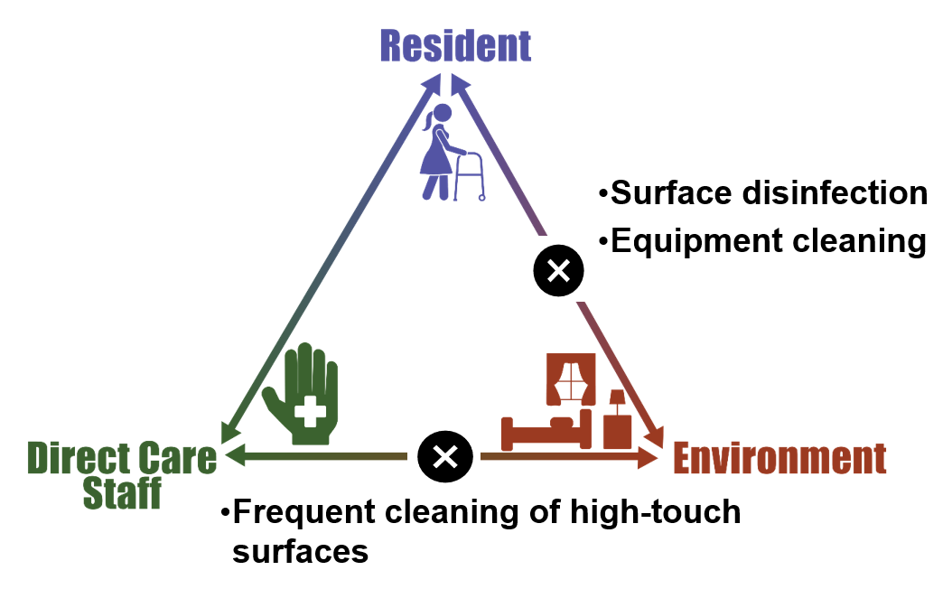
Triangle of Transmission

Slide 7
Why Is Environmental Cleaning Important?
Environmental contamination has been associated with many outbreaks of healthcare infections
Pathogens spread when…
Cleaning or disinfection is performed incorrectly
The wrong disinfectant or cleaning products are used
Environmental cleaning or disinfection is not done
Pathogens on surfaces can be picked up by hands and spread to other people or surfaces

Slide 8
Cleaning Versus Disinfecting
Cleaning
Physical removal of visible soil.
Necessary step before disinfection.
If no physical soil present, cleaning/disinfection may be simultaneous.
Disinfecting
Uses chemicals to kill germs.
Takes place after removing visible soil.
Requires product to remain wet on surface for a specific time to kill germs.
Reusable equipment needs to be disinfected between residents.

Slide 9

Cleaning and Disinfection Challenges
“I didn’t know that it was my responsibility to clean that.”
“I didn’t know that dwell time meant it was supposed to be wet on the surface for 3 minutes.”
“I’m just too busy to take the time for cleaning.”
“I didn’t know how important it was, so I didn’t prioritize it.”
“The resident asked me not to touch her stuff.”

Slide 10
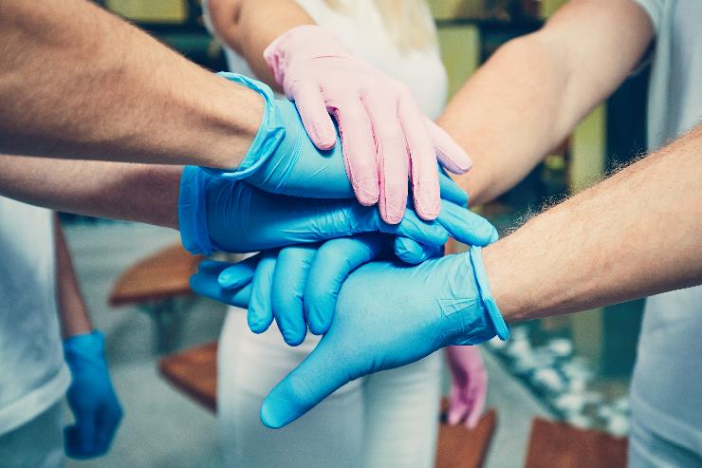
Who Is Responsible?
Housekeeping and environmental services do most of the cleaning and disinfection.
Everyone is responsible for helping keep the building and equipment clean and disinfected, especially high-touch surfaces.
Cleaning is part of patient safety.

Slide 11
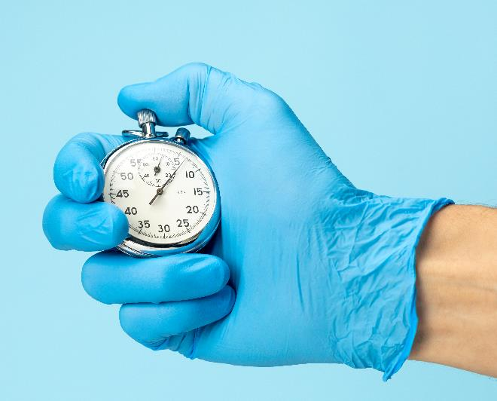
How Do We Clean or Disinfect?
There’s a correct way to clean and disinfect!
Remove soil before disinfecting
Know the contact time
Time a surface must remain wet to effectively kill germs.
Clean areas/equipment for residents on isolation for an infectious organism last
Specific techniques may be needed for some germs
Example: Clostridioides difficile – requires friction and a sporicidal product. Handwashing with soap and water is required.

Slide 12
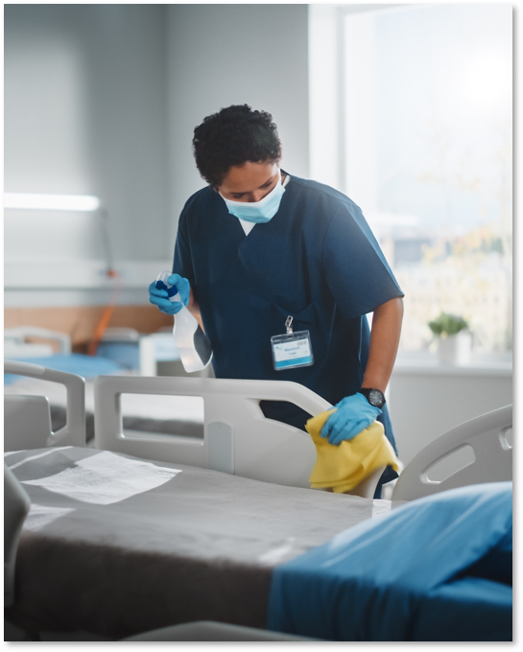
Standardize the Cleaning Process
Always work from clean to dirty (e.g., clean bathroom last)
Work from top to bottom (high surfaces less likely to be contaminated)
Don’t forget shared equipment
Designate specific providers to clean this equipment
Prevent recontamination
Change cleaning materials frequently

Slide 13
Teachable Moment
Questions to consider:
What should the CNA do before entering a room with a resident who has an active C. difficile infection?
What steps should the CNA follow before leaving the room?

Slide 14
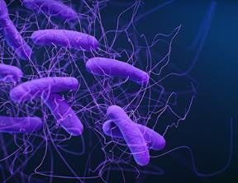
The Case⁵
The Resident With C. difficile
82-year-old resident receiving a bed bath
On contact precautions for C. difficile

Slide 15

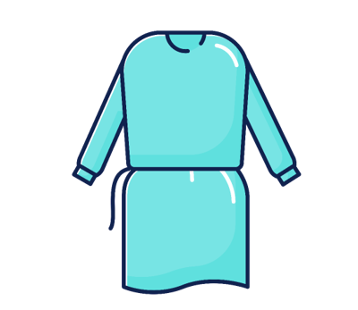

Knowledge Check–1
What should the CNA do before entering Mr. Lee's room?

Slide 16
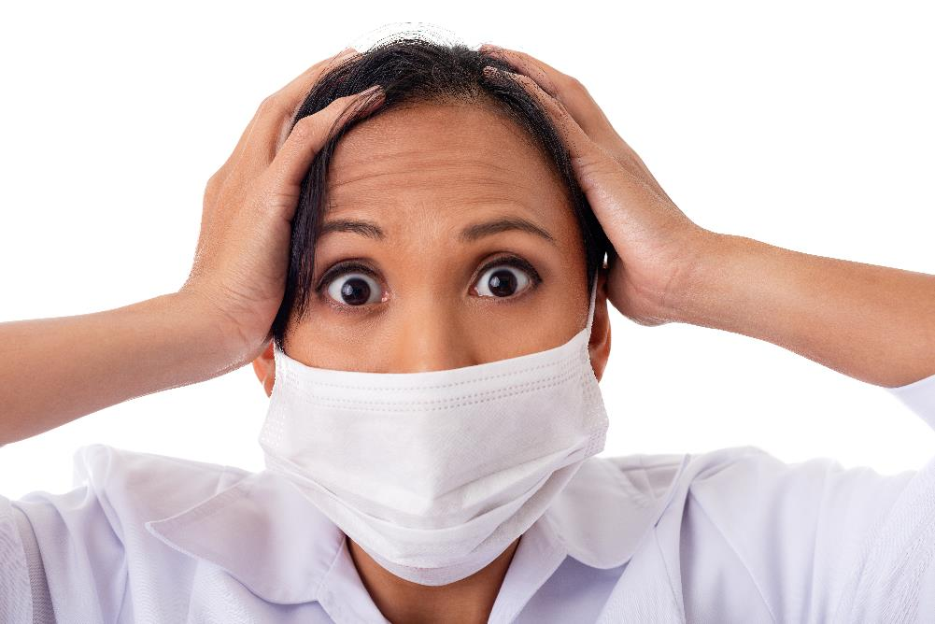
The Challenge
The resident is incontinent during his bed bath.
The bedside table is contaminated.

Slide 17

Knowledge Check–2
Who is responsible for cleaning the bedside table?
Nurse
EVS
CNA
Supervisor
The resident

Slide 18
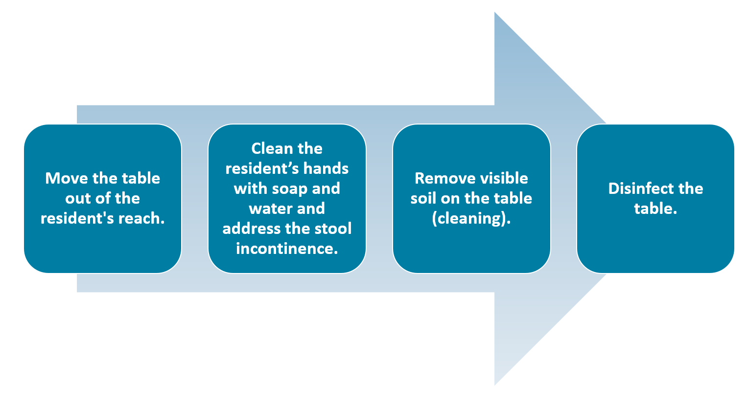
Steps for Cleaning the Table⁶

Slide 19
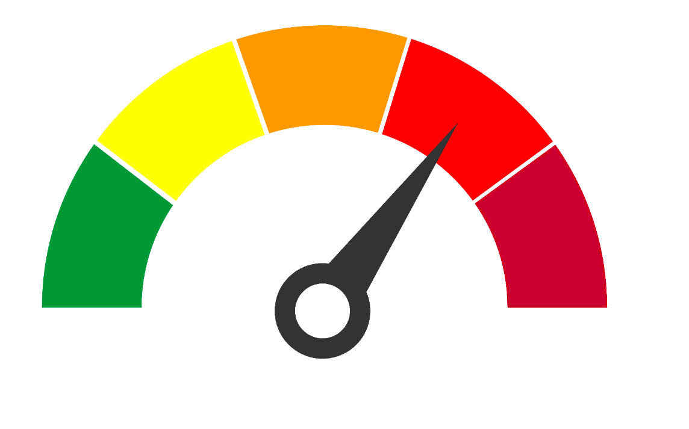
The Error
The CNA doesn’t allow the product to remain wet for the required amount of time.
Does not remove gloves and perform hand hygiene with soap and water.

Slide 20
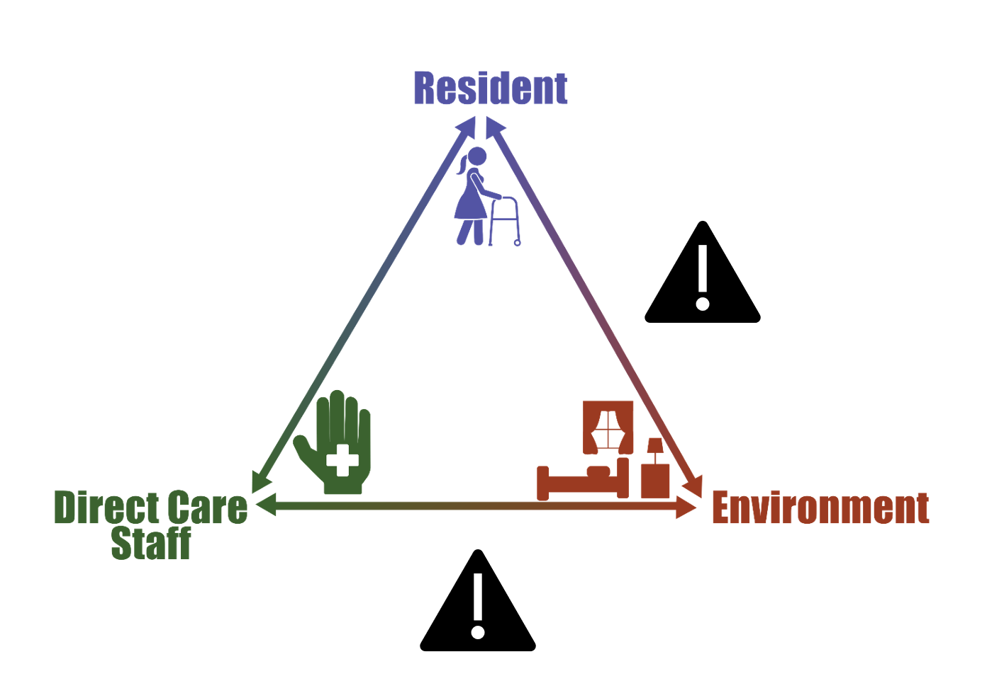
Potential for Patient Harm

Slide 21
Patient Safety in the Moment
What should the CNA have done instead?
Requested assistance during challenging situations.
Remembered the importance of cleaning before disinfecting​.
Washed her hands after cleaning up the feces.
Used enough product to ensure surfaces remain wet for the recommended amount of time.

Slide 22

Preventing the Next Harm
What can be done to keep the same error from happening again?
Use targeted education for staff caring for residents with specific pathogens ​
C. difficile​, norovirus, scabies, Candida auris, influenza, COVID-19, RSV
Share handouts at staff meetings describing the delegation of roles/responsibilities for cleaning different materials
Contact times displayed on each cleaning agent
Improve communication and scheduling of terminal cleans

Slide 23
System-Based Safety Changes
What suggestions can be shared with senior executives?
Invest in cleaning products with shorter contact times and comparable efficacy
Switch to microfiber cloths and mops
Improve communication and scheduling of terminal cleans

Slide 24
Key Takeaways⁷
Everyone is responsible for helping keep the building and equipment clean and disinfected – ensure that staff understand their roles and responsibilities.
Cleaning involves removing dirt and visible soil, while disinfection involves removing microscopic pathogens.
Be methodical with cleaning and disinfection. Work from the clean to dirty areas, top to bottom.
Education about specific pathogens should be incorporated into infection prevention and control protocols.
Make products readily available, like replacing the usual wipes with sporicidal wipes in the rooms of residents with C. difficile.

Slide 25
Supporting Materials
Teachable Moments
The Case of the Resident With a Chronic Wound and Diarrhea
Cleaning and Disinfection Teachable Moment
Environmental Cleaning of High-Touch Surfaces
Disinfection at the Bedside
How Long Do Pathogens Live on Environmental Surfaces?
Supporting Materials
6 Steps for Safe and Effective Disinfectant Use
Environmental Cleaning in Global Healthcare Facilities With Limited Resources (CDC)⁸
Cleaning Chemicals (in four languages) (OSHA)⁹
Environmental Cleaning and Disinfecting Basics for Health (AHRQ)¹⁰
AHRQ Module 11B—Environmental Cleaning—Nursing Home Infection Preventionist Training Course¹¹

Slide 26
Disclaimer
The findings and recommendations in this presentation are those of the authors, who are responsible for its content, and do not necessarily represent the views of AHRQ. No statement in this presentation should be construed as an official position of AHRQ or of the U.S. Department of Health and Human Services.
Any practice described in this presentation must be applied by healthcare practitioners in accordance with professional judgment and standards of care in regard to the unique circumstances that may apply in each situation they encounter. These practices are offered as helpful options for consideration by healthcare practitioners, not as guidelines.

Slide 27
References—1
McKinnell JA, Miller LG, Singh RD, et al. High prevalence of multidrug-resistant organism colonization in 28 nursing homes: an "iceberg effect." J Am Med Dir Assoc. 2020 Dec;21(12):1937-43.e2. PMID: 32553489.​
Saeb A, Mody L, Gibson K. How are nursing homes cleaned? Results of a survey of 6 nursing homes in Southeast Michigan. Am J Infect Control. 2017 Nov 1;45(11):e119-22. PMID: 28958448.​
Donskey CJ. Does improving surface cleaning and disinfection reduce health care-associated infections? Am J Infect Control. 2013 May;41(5 Suppl):S12-9. PMID: 23465603.​
Murphy CR, Eells SJ, Quan V, et al. Methicillin-resistant Staphylococcus aureus burden in nursing homes associated with environmental contamination of common areas. J Am Geriatr Soc. 2012 Jun;60(6):1012-8. PMID: 22670708.​
Centers for Diseases Control and Prevention. CDC. Healthcare-associated Infections (HAI). Diseases and Organisms. Clostridioides difficile Infection. Last reviewed November 19, 2019. https://www.cdc.gov/c-diff/about/?CDC_AAref_Val=https://www.cdc.gov/hai/organisms/cdiff/cdiff_infect.html. Accessed July 07, 2025.
Environmental Protection Agency. Pesticide Registration. List K: EPA’s Registered Antimicrobial Products Effective Against Clostridiodes difficile (C. diff) Spores. Last updated February 3, 2025. https://www.epa.gov/pesticide-registration/epas-registered-antimicrobial-products-effective-against-clostridioides. Accessed July 07, 2025.
Centers for Disease Control and Prevention. Global Health. Our Newsletter. October 13, 2020: Clean Hands Save Lives. Last reviewed: October 14, 2020. https://archive.cdc.gov/#/details?url=https://www.cdc.gov/globalhealth/newsletter/2020/october-13-2020.html. Accessed July 07, 2025.

Slide 28
References—2
Centers for Disease Control and Prevention. CDC. Healthcare-associated Infections (HAI). Preventing HAIs. Environmental Cleaning in Resource- Limited Settings. Best Practices for Environmental Cleaning in Healthcare Facilities: in RLS (Resource-Limited Settings). Reviewed March 19, 2024. https://www.cdc.gov/healthcare-associated-infections/hcp/cleaning-global/?CDC_AAref_Val=https://www.cdc.gov/hai/prevent/resource-limited/index.html. Accessed July 07, 2025.
United States Department of Labor. Occupational Safety and Health Administration. Cleaning Chemicals: Protect Yourself—Cleaning Chemicals and Your Health Poster. OSHA 3569-2021. https://www.osha.gov/publications/bytopic/cleaning-chemicals. Accessed July 07, 2025.
Environmental Cleaning and Disinfecting Basics for Health. Agency for Healthcare Research and Quality, Rockville, MD. https://www.ahrq.gov/nursing-home/resources/environmental-cleaning-disinfecting.html. Accessed July 07, 2025.
Module 11B—Environmental Cleaning and Disinfection—Nursing Home Infection Preventionist Training Course. Content last reviewed May 2022. Agency for Healthcare Research and Quality, Rockville, MD. https://www.ahrq.gov/nursing-home/resources/module-11b-environmental-cleaning.html. Accessed July 07, 2025.

