Slide 1
Caring for Residents With Central Lines: Preventing CLABSI
AHRQ Safety Program for MRSA Prevention
AHRQ Pub. No. 25(26)-0066
October 2025

Slide 2

All Staff Support Resident Care and Safety
The information provided in this presentation is important in the care of long-term care (LTC) residents. In LTC facilities, each member of the facility’s staff supports resident care and safety.
Some actions described in these presentations may not be in your scope of practice, but it is important to learn how all staff contribute to resident care and safety.

Slide 3
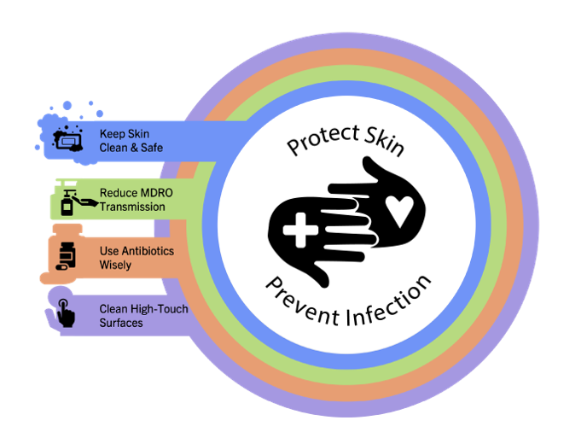
Educational Objectives
Recognize the role of central line care in the prevention of bloodstream infections
Learn best practices in the care of central lines
Discuss challenges around bathing and central line care

Slide 4
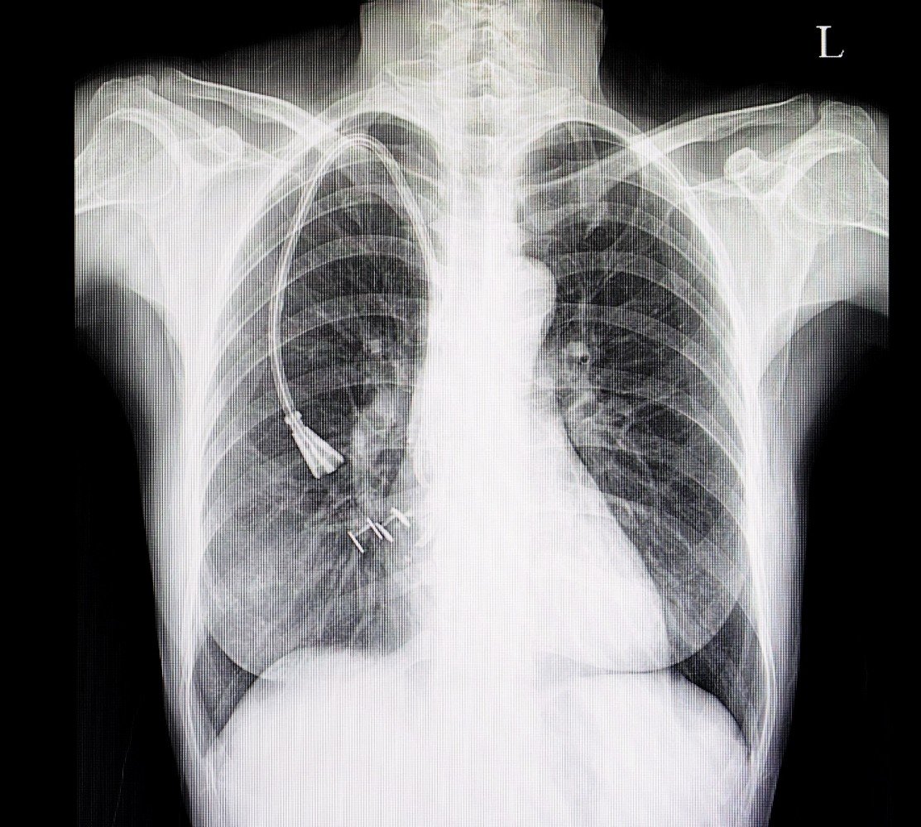
What Are Central Lines?
Dialysis catheter or tunneled dialysis catheter
PICC line (PICC = peripherally inserted central catheter) or mid-line
Hickman
Port-a-cath or subcutaneous port
Triple-lumen catheter or central line

Slide 5
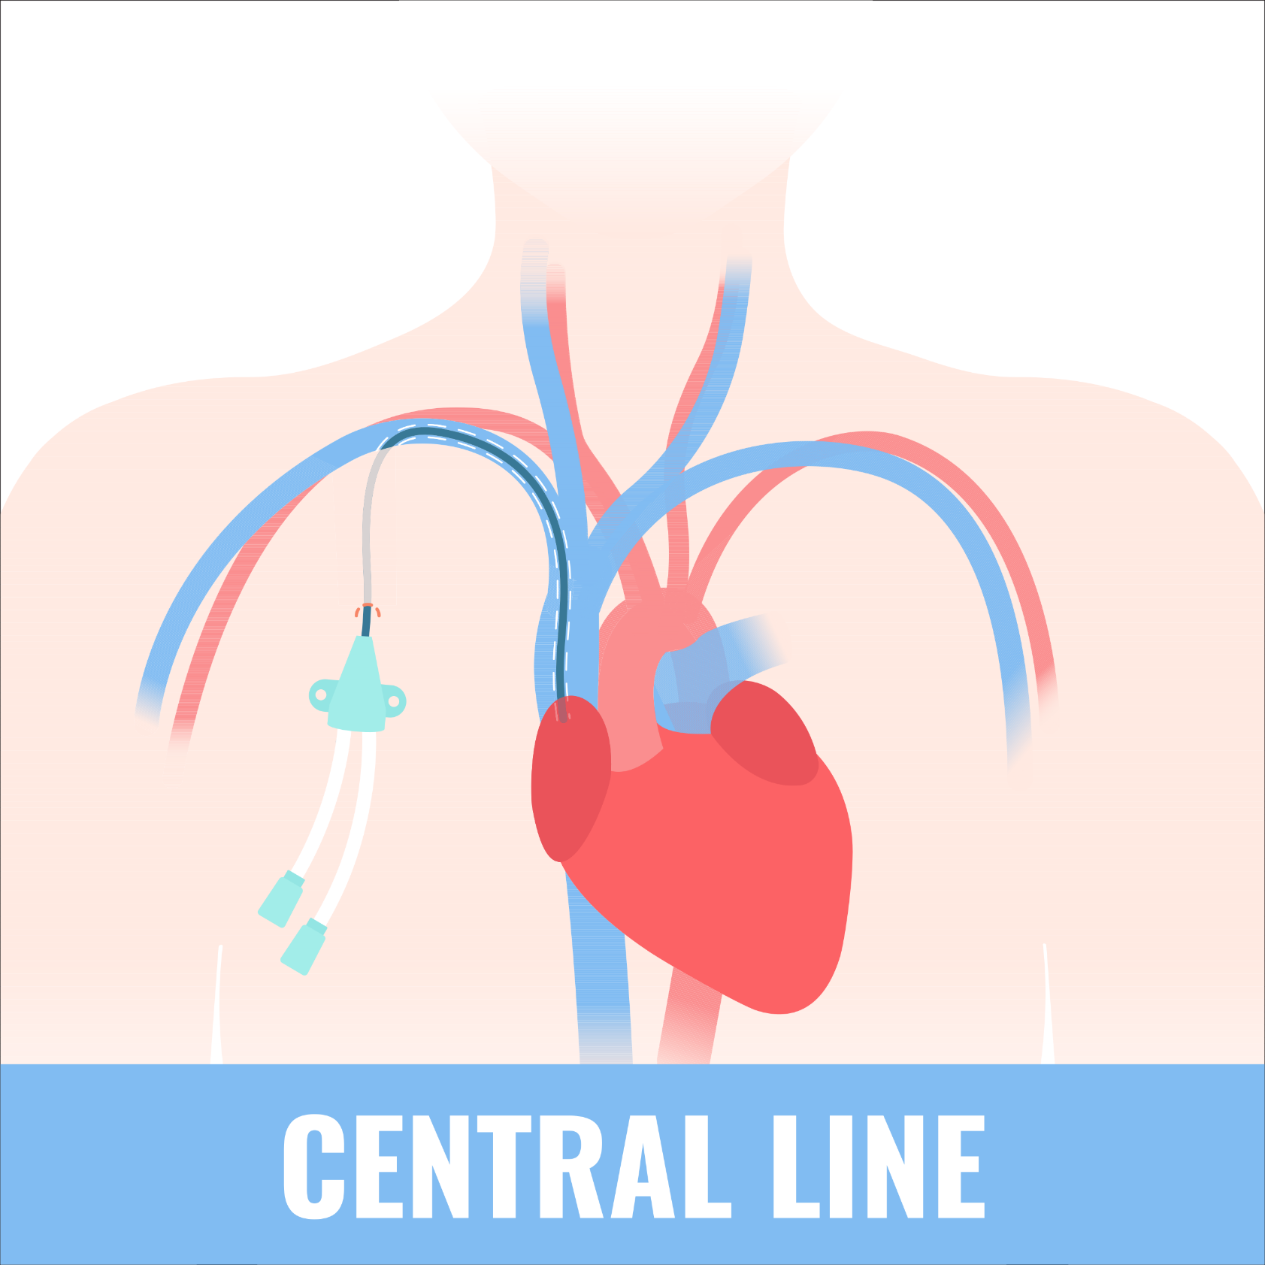
What Is CLABSI?¹
CLABSI = central line- associated bloodstream infection
Diagnosing CLABSI
  Clinical signs of infection (e.g., fever)
  Positive blood culture
  No alternate source of infection
  Central line

Slide 6
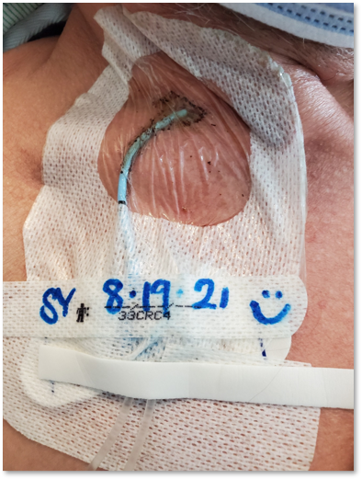
Why Is CLABSI Prevention Important?
CLABSIs have a 15–20 percent mortality rate.²
MRSA bloodstream infections have a 15–60 percent mortality rate.³
CDC estimates approximately 30,000 CLABSIs yearly.⁴
CLABSIs are associated with increased hospital stays and healthcare costs.
Data are scarce on CLABSI in LTC facilities.

Slide 7
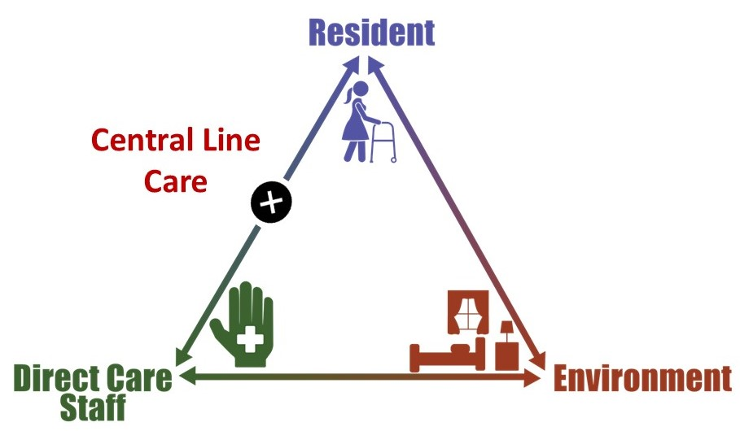
Triangle of Transmission

Slide 8
How Do CLABSIs Develop?^{1,5}
During Insertion of Central Line | During Care of Central Line
Poor sterile technique Poor skin prep Poor adherence to safe insertion practices Choice of insertion site Patient characteristics (e.g., immunocompromised, burn patient, etc.) | Poor adherence to scrubbing the hub Lapses in dressing maintenance and changes Failure to remove unnecessary central lines Reason for use (e.g., TPN)

Slide 9

How Can Long-Term Care Professionals Prevent CLABSI?
Focus on adherence to best practices in central line care.
Educate staff on CLABSI prevention techniques.
Conduct audits and provide feedback to ensure best practices continue.

Slide 10

Focusing on Central Line Care⁶
Perform hand hygiene
Keep the dressing site clean, dry, and intact.
Practice sterile or clean technique for dressing changes.
Scrub the hub prior to infusions. (See examples)
Label tubing with date of last change.
Remove unnecessary central lines.

Slide 11


Educate Staff on Central Line Care⁶
Do hands-on education
Have staff “teach-back” central line care practices
Focus on best practices in central line maintenance
  Scrub the hub
  Dressing maintenance
  Bathing residents with central lines

Slide 12

Central Line Care Checks
Observe and provide feedback on—
  Dressing changes
  Central line access
  Central line care during bathing or showering
  Ask for feedback from frontline staff

Slide 13
Teachable Moment
Questions to consider:
How should the CNA keep the PICC line dry during the shower?
What steps should the nurse follow if the dressing is compromised during the shower?

Slide 14

The Case
CNA assisting 69-year-old resident with a shower
Recently discharged from hospital with a PICC line

Slide 15
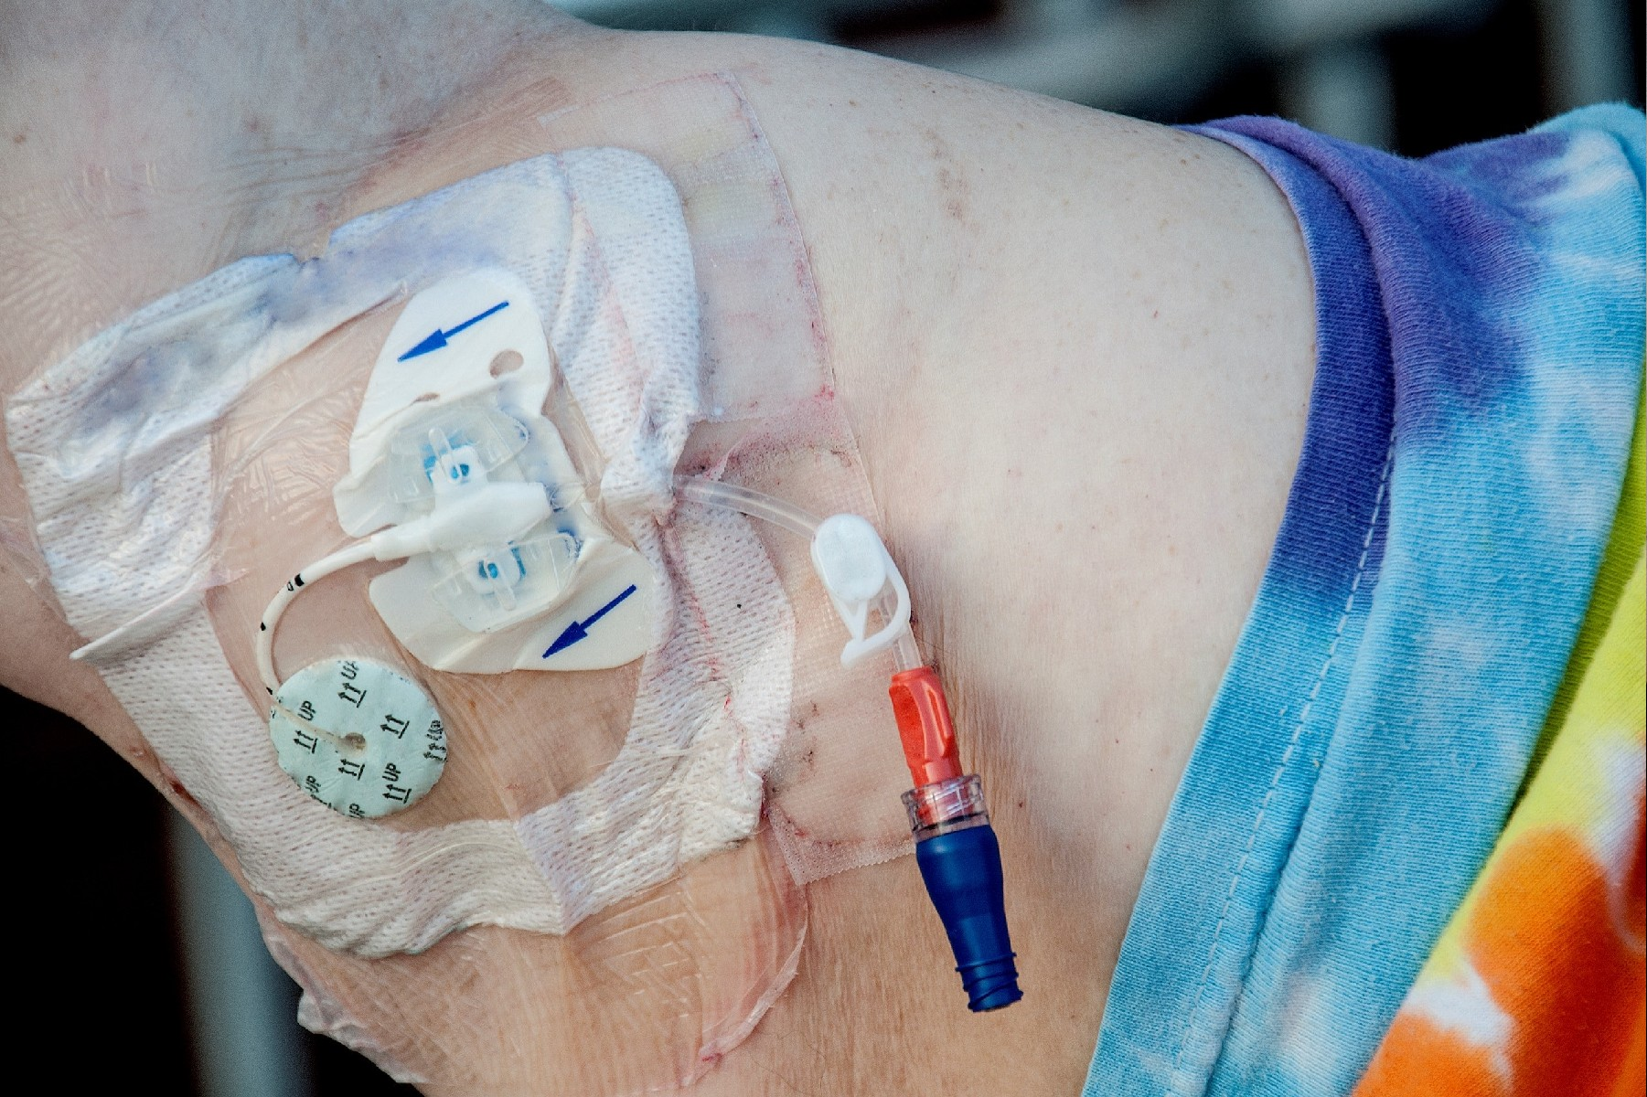
The Challenge
CNA needs to keep PICC line dressing dry

Slide 16

Knowledge Check
How might the CNA assist with the shower while keeping the PICC line dressing clean, dry, and intact?

Slide 17

The Error
The CNA decides to cover the PICC line with a grocery bag, but it falls off in the shower.
The PICC line dressing is wet and begins to peel off.

Slide 18


The Consequence
What challenges might this lead to in the future?

Slide 19

Preventing the Next Harm
What can be done to prevent the same error from happening again?
Available products for protecting central line dressings
In-service trainings about central line care
Schedule a review or stop date for residents with PICC lines or midline

Slide 20
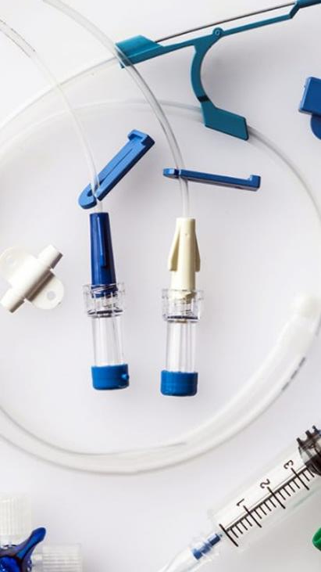
System-Based Safety Changes
Use products that assist with keeping dressing site dry during bathing/showers.
Engage leadership to ensure that products are readily available and replaced when restocking is needed.
Ensure hand hygiene products are readily available throughout the unit.

Slide 21

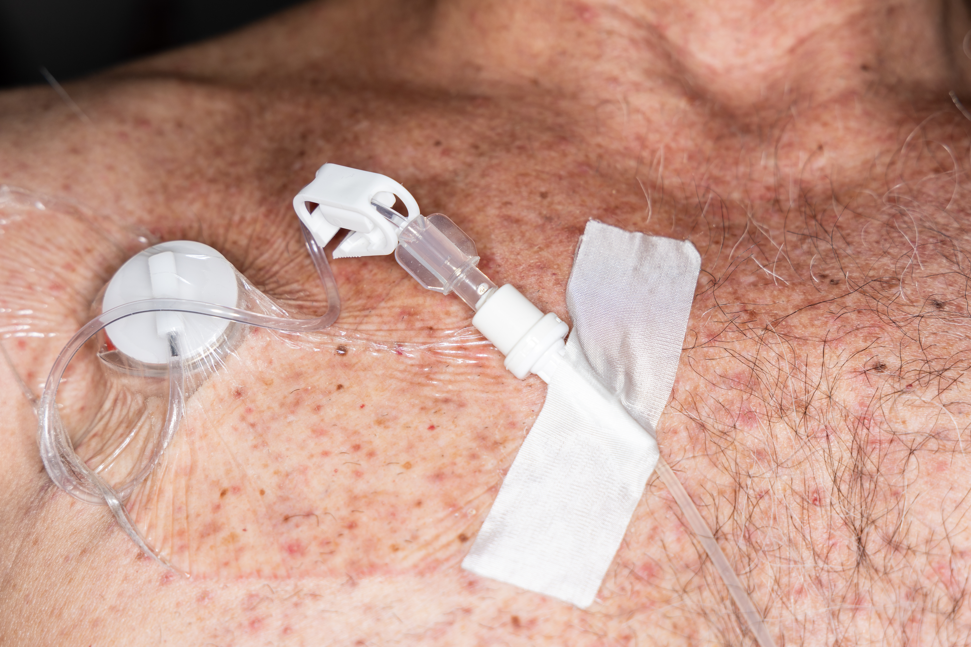
Key Takeaways
Careful central line care prevents infections from central line catheters.
When there are errors or problems, think about solutions to help prevent the next harm.
Some solutions are technical; some are more systems based.

Slide 22
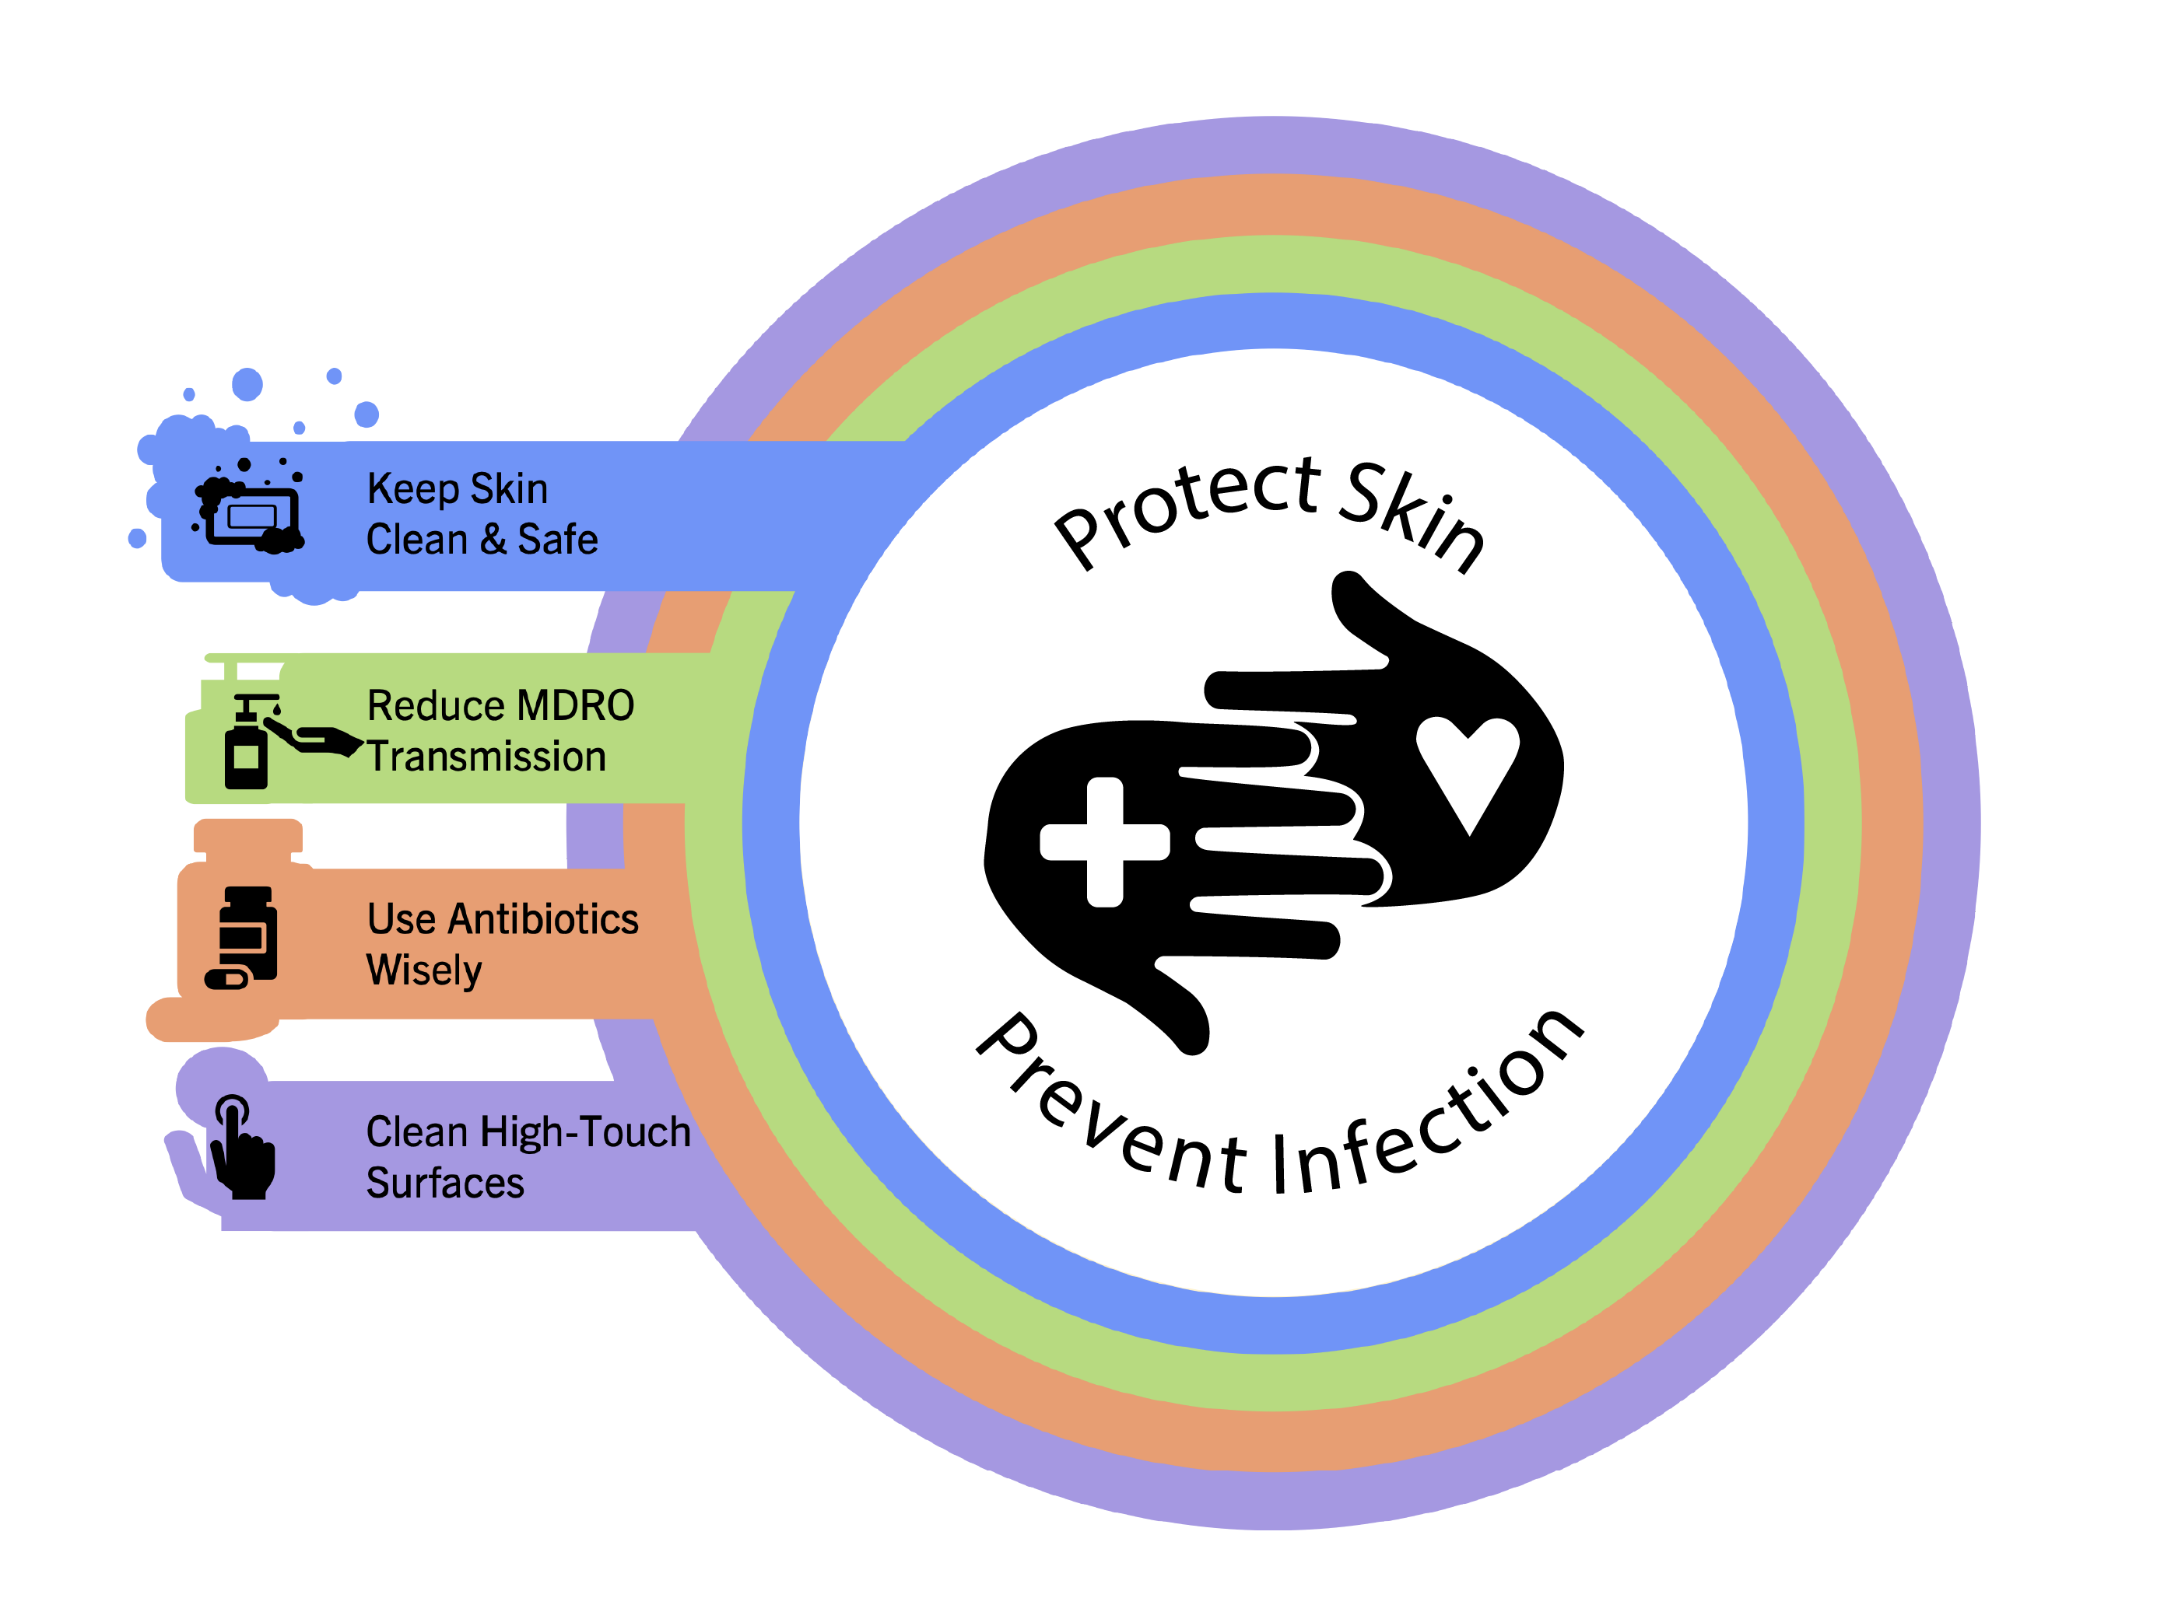
Supporting Materials
Hand Hygiene Observational Tool
Name That Tube!
Interactive Scrub the Hub Activity
The Case of the Resident With a PICC Line
The Case of an Inappropriate Scrub of the Hub

Slide 23
Disclaimer
The findings and recommendations in this presentation are those of the authors, who are responsible for its content, and do not necessarily represent the views of AHRQ. No statement in this presentation should be construed as an official position of AHRQ or of the U.S. Department of Health and Human Services.
Any practice described in this presentation must be applied by healthcare practitioners in accordance with professional judgment and standards of care in regard to the unique circumstances that may apply in each situation they encounter. These practices are offered as helpful options for consideration by healthcare practitioners, not as guidelines.

Slide 24
References—1
Centers for Disease Control and Prevention. CLABSI: An Introduction. https://www.cdc.gov/infection-control/media/pdfs/Strive-CLABSI101-508.pdf. Accessed July 15, 2025.
Ziegler MJ, Pellegrini DC, Safdar N. Attributable mortality of central line associated bloodstream infection: systematic review and meta-analysis. Infection. 2015 Feb;43(1):29-36. PMID: 25331552.
Siddiqui AH, Koirala J. Methicillin-Resistant Staphylococcus aureus. Treasure Island: StatPearls Publishing; 2023.
Centers for Disease Control and Prevention. Bloodstream Infections (BSI) Events. https://www.cdc.gov/nhsn/psc/bsi/index.html. Accessed July 15, 2025.
Haddadin Y, Annamaraju P, Regunath H. Central Line-Associated Blood Stream Infections. Treasure Island: StatPearls Publishing; 2022.
Agency for Healthcare Quality and Research. Appendix 3. Guidelines to Prevent Central Line-Associated Blood Stream Infections. https://www.ahrq.gov/hai/clabsi-tools/appendix-3.html#sl1. Accessed July 15, 2025.

