Slide 1
Go With the Flow:
Preventing Urinary Tract Infections
AHRQ Safety Program for MRSA Prevention
AHRQ Pub. No. 25(26)-0066
October 2025

Slide 2

All Staff Support Resident Care and Safety
The information provided in this presentation is important in the care of long-term care (LTC) residents. In LTC facilities, each member of the facility’s staff supports resident care and safety.
Some actions described in these presentations may not be in your scope of practice, but it is important to learn how all staff contribute to resident care and safety.

Slide 3
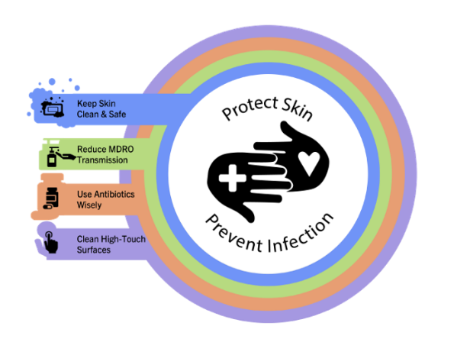
Educational Objectives
Discuss the importance of preventing UTIs in LTC
Learn best practices in UTI prevention
Discuss challenges around bathing for people with urinary catheters

Slide 4
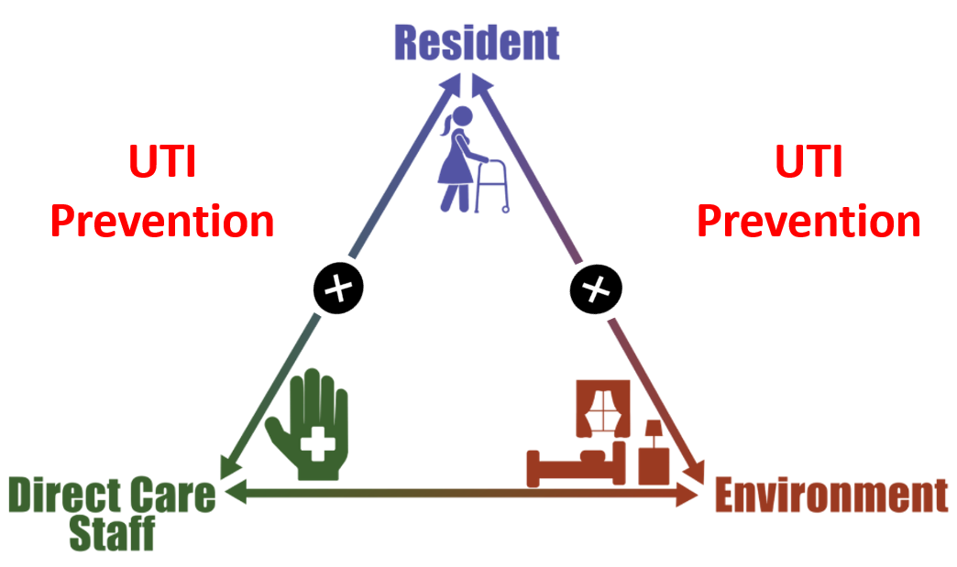
Triangle of Transmission

Slide 5
What Are UTIs and CAUTIs¹
For Residents Without a Urinary Catheter
Dysuria
OR
Fever (>100°F or >2°F above baseline)
AND at least one of the following new or worsening symptoms:
Urgency
Frequency
Suprapubic pain
Gross hematuria
Costovertebral angle tenderness
Urinary incontinence
For Residents With a Urinary Catheter or if Nonverbal
One or more of the following without another recognized course:
Fever (>100°F or >2°F increase from baseline)
New costovertebral angle tenderness
Rigors
New-onset delirium*
*If adequate workup for other causes of delirium has been performed and no other cause for delirium is identified

Slide 6

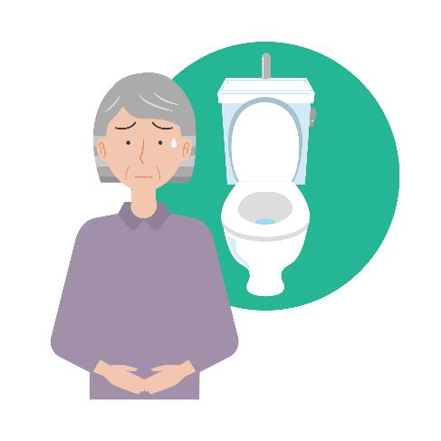
Asymptomatic Bacteria Versus UTI
Asymptomatic Bacteriuria
Positive urinalysis and urine culture
No signs or symptoms that localize to the urinary tract (noncatheterized residents)
UTI
Positive urinalysis and urine culture
Dysuria or fever and other signs and symptoms that localize to the GU tract

Slide 7
When NOT To Send Urine Culture¹
Do Not Send – If urine is foul smelling or cloudy, without other urinary symptoms
Do Not Send – Routinely after catheter change
Do Not Send – Routinely upon admission
Do Not Send – After UTI treatment to "test for cure"
Do Not Send – For mental status changes without a change in vital signs or that are not delirium

Slide 8
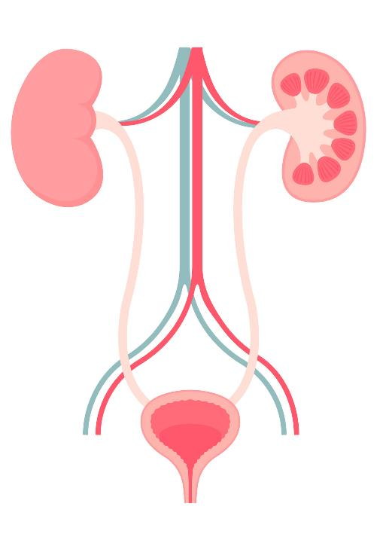
Why Is UTI Prevention Important?
Account for 20–30 percent of all infections reported from LTCF²
Most frequent cause of hospitalization for infection³
~75 percent of UTIs are associated with a urinary catheter⁴
~50 percent of catheterized residents develop symptomatic UTI⁵

Slide 9
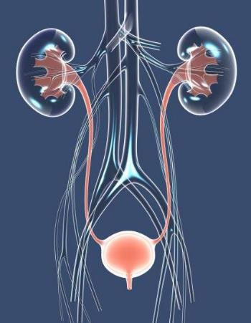
Risk Factors for UTIs in Nursing Home Residents⁶
Older adults are more vulnerable to UTIs
Females are more at risk than males
Stool incontinence increases risk
Use of catheters increases risk for UTIs
Dehydration
Needing help with ADL, poor bathing techniques, and missed perineal care

Slide 10
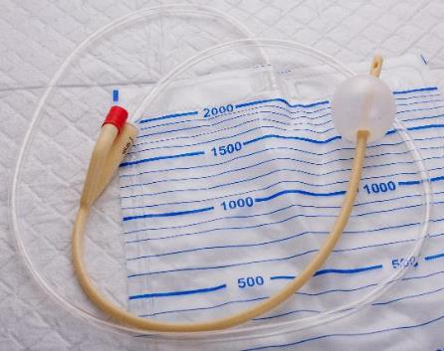

Best Practices in Urinary Catheter Insertion⁷
Only insert catheters when necessary.
Only trained staff should insert catheters.
Insert appropriate catheter size.
Obtain assistance to maintain sterilization and proper insertion technique.
Perform perineal care prior to insertion.
Perform hand hygiene before resident contact and immediately before insertion.
Check for urine flow before inflating catheter balloon.
Secure catheter and place below the level of the bladder but off the floor.

Slide 11

Best Practices in Urinary Catheter Care⁸
Perform hand hygiene.
Keep drainage bag below bladder.
Do not allow drainage bag to become full.
Perform regular, routine bathing and perineal care.
Keep urinary catheter system closed.
Encourage hydration.
Remove unnecessary urinary catheters.

Slide 12

Urinary Catheter Checklist
Observe and provide feedback on⁹—
Urinary catheter care
Urinary catheter insertion
Manipulation and care of urinary catheter during bathing or showering
Ask for feedback from frontline staff

Slide 13
Teachable Moment
Questions to consider:
Does the resident need the catheter?
How might the CNA prevent the loose stool from reaching the catheter, increasing the risk of catheter-associated UTI?

Slide 14

The Case
Nurse assisting 69-year-old female resident with a bed bath
Resident with a urinary catheter due to urinary incontinence

Slide 15

The Challenge
Resident is also incontinent of stool and needs assistance after recent incontinence

Slide 16

Knowledge Check
How should the CNA care for the resident's indwelling catheter after the stool incontinence?

Slide 17

The Error
When cleaning the resident, the CNA wipes stool toward the urethral opening (meatus) instead of away.
The CNA cleans the catheter by wiping toward the meatus.
The CNA does not bring their concerns about the catheter use to the attention of the nurse or provider.

Slide 18


The Consequence
What consequences might this lead to in the future?

Slide 19

Preventing the Next Harm
What can be done to avoid the same error happening again?
Educate CNAs on importance of wiping stool away from the urethral opening
Provide in-service trainings about urinary catheter care
Use products to protect urinary catheters from stool incontinence
Consider alternate options to indwelling urinary catheters

Slide 20

System-Based Safety Changes
Reframe ongoing monitoring and feedback about urinary catheter care practices as coaching.
Create an environment where staff are encouraged to speak up.

Slide 21

Key Takeaways
Careful urinary catheter care prevents UTIs
When there are errors or problems, think about solutions to help prevent the next harm
Some solutions are technical; some are more systems based

Slide 22
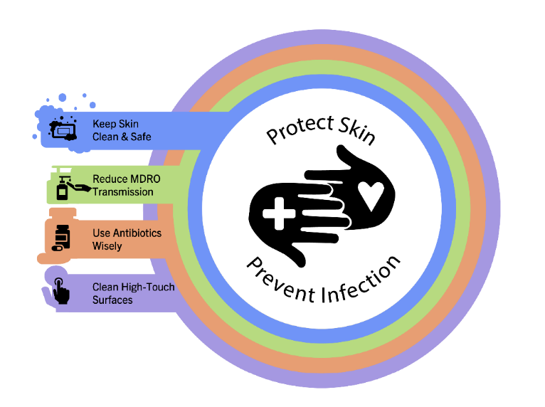
Supporting Materials
Teachable Moments
Indications for Indwelling Urinary Catheters
The Case of a Resident With a Foley Catheter Who Had a Bowel Movement
Preventing CAUTI
AHRQ Indwelling Urinary Catheter Maintenance Checklist tool⁹
AHRQ Indwelling Urinary Catheter Insertion Checklist¹⁰
LTC Urinary Catheter Maintenance Checklist
One-pagers and pocket cards from the AHRQ Antibiotic Stewardship Toolkit⁷

Slide 23
Disclaimer
The findings and recommendations in this presentation are those of the authors, who are responsible for its content, and do not necessarily represent the views of AHRQ. No statement in this presentation should be construed as an official position of AHRQ or of the U.S. Department of Health and Human Services.
Any practice described in this presentation must be applied by healthcare practitioners in accordance with professional judgment and standards of care in regard to the unique circumstances that may apply in each situation they encounter. These practices are offered as helpful options for consideration by healthcare practitioners, not as guidelines.

Slide 24
References—1
Agency for Healthcare Research and Quality. Assessment and Management of the Resident With a Suspected Urinary Tract Infection. https://www.ahrq.gov/antibiotic-use/long-term-care/best-practices/uti-assess.html. Accessed July 28, 2025.
Centers for Disease Control and Prevention. Urinary Tract Infections (UTI). https://www.cdc.gov/nhsn/ltc/uti/index.html. Accessed July 28, 2025.
Genao L, Buhr GT. Urinary tract infections in older adults residing in long-term care facilities. Ann Longterm Care. 2012 Apr;20(4):33-8. PMID: 23418402.
Centers for Disease Control and Prevention. Catheter-Associated Urinary Tract Infections Basics. https://www.cdc.gov/uti/about/cauti-basics.html. Accessed July 28, 2025.
Meddings J, Saint S, Krein SL, et al. Systematic review of interventions to reduce urinary tract infection in nursing home residents. J Hosp Med. 2017 May;12(5):356-68. PMID: 28459908.
Centers for Disease Control and Prevention. Catheter-Associated Urinary Tract Infections (CAUTI) Prevention Guideline. https://www.cdc.gov/infection-control/hcp/cauti/?CDC_AAref_Val=https://www.cdc.gov/infectioncontrol/guidelines/cauti/index.html. Accessed June 28, 2025.

Slide 25
References—2
Agency for Healthcare Research and Quality. Toolkit for Reducing Catheter-Associated Urinary Tract Infections in Hospital Units: Implementation Guide. https://www.ahrq.gov/hai/cauti-tools/guides/implguide-pt3.html. Accessed July 28, 2025.
Centers for Disease Control and Prevention. Strategize Initiatives You Can Incorporate Into Your Program. https://www.cdc.gov/uti/hcp/clinical-guidance/culture-stewardship-strategize.html?CDC_AAref_Val=https://www.cdc.gov/hai/prevent/cauti/indwelling/strategize.html. Accessed July 28, 2025.
Agency for Healthcare Research and Quality. Appendix H. Indwelling Urinary Catheter Maintenance Checklist. https://www.ahrq.gov/hai/quality/tools/cauti-ltc/modules/resources/tools/prevent/maintenance-checklist.html. Accessed July 28, 2025.
Agency for Healthcare Research and Quality. Appendix G. Indwelling Urinary Catheter Insertion Checklist. https://www.ahrq.gov/hai/quality/tools/cauti-ltc/modules/resources/tools/prevent/insertion-checklist.html. Accessed July 28, 2025.

