Slide 1
Skin Under Pressure: Preventing Pressure Injury
AHRQ Safety Program for MRSA Prevention
AHRQ Pub. No. 25(26)-0066
October 2025

Slide 2

All Staff Support Resident Care and Safety
The information provided in this presentation is important in the care of long-term care (LTC) residents. In LTC facilities each member of the facility’s staff supports resident care and safety.
Some actions described in these presentations may not be in your scope of practice, but it is important to learn how all staff contribute to resident care and safety.

Slide 3
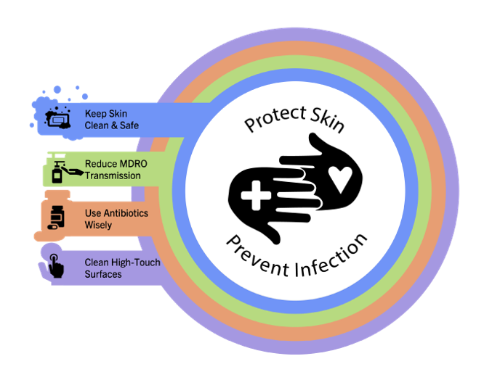
Educational Objectives
Learn what pressure injuries are and how to prevent them
Review staging for pressure injuries
Discuss how pressure injuries can lead to infections

Slide 4
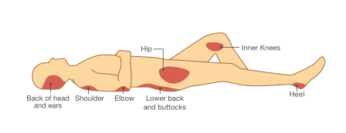
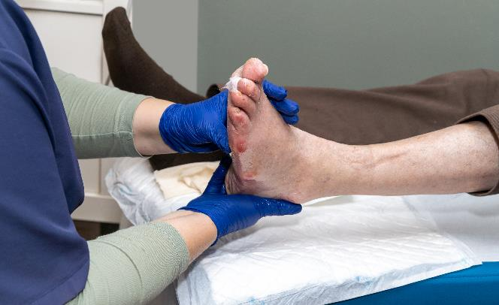
What Are Pressure Injuries?¹
Were previously called “pressure ulcers” or “bedsores”
The breakdown of skin from a lack of blood flow caused by a combination of pressure, friction, and shear to the area
Four stages of pressure injuries, ranging from early warning stage to severe

Slide 5
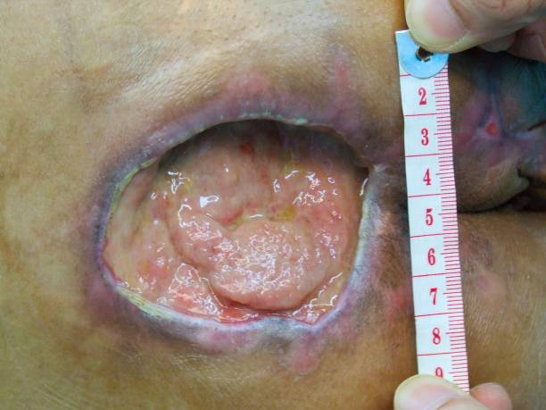
Pressure Injuries in Long-Term Care
At any given time, more than 1 in 10 (11%) nursing home residents have a pressure injury²
Pressure injuries are estimated to cost 33 billion healthcare dollars every year³
Pressure injuries predispose residents to MDRO wound infections, bone infections, and sepsis⁴

Slide 6
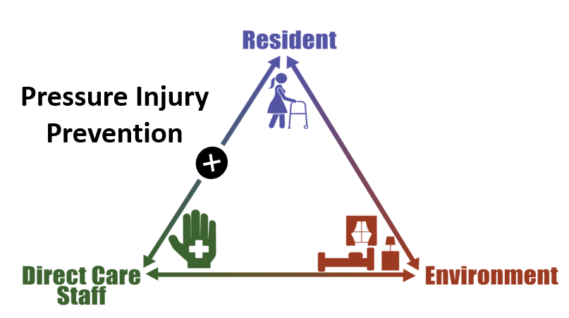
Triangle of Transmission

Slide 7
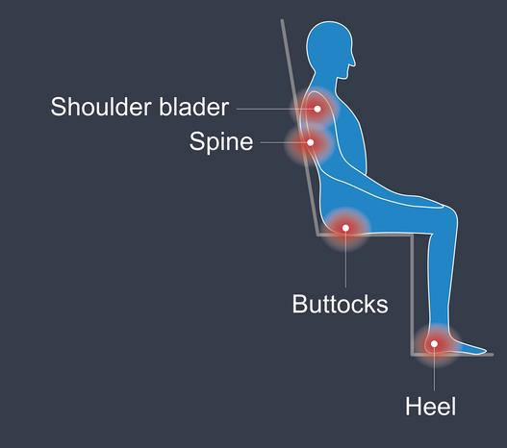
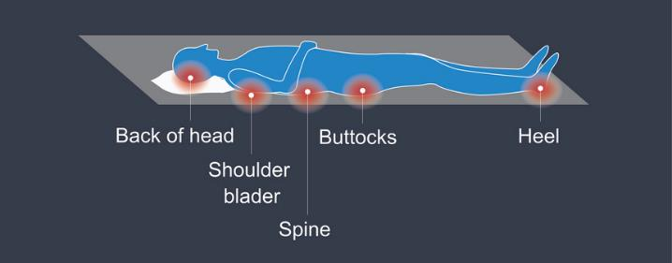
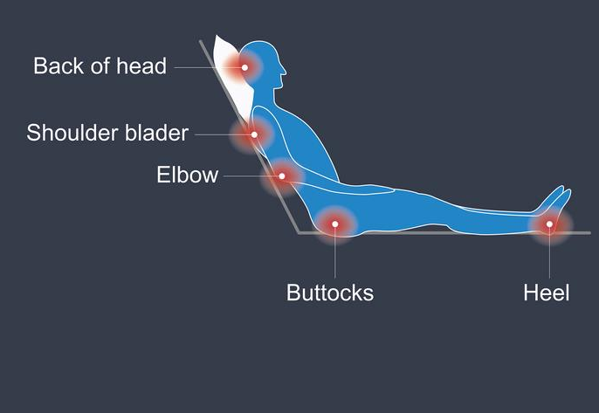
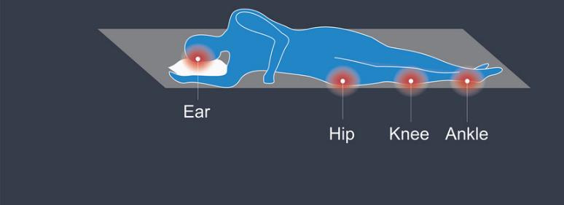
How Do Pressure Injuries Develop?
Pressure
Friction
Shear

Slide 8

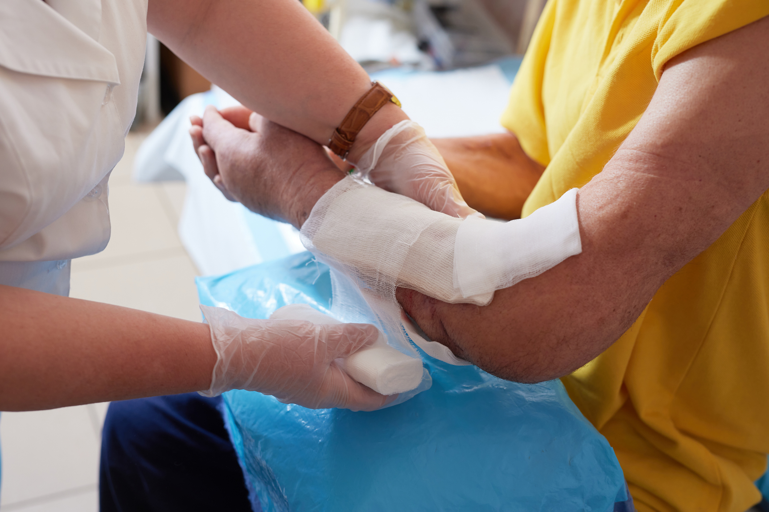
Pressure, Friction, and Shear
Sustained pressure occurs when mobility is an issue.
Friction occurs when the body moves back and forth along a surface.
Shear involves pressure and friction and causes damage to epidermis and dermis.
Pressure injuries develop due to any combination of these factors.

Slide 9
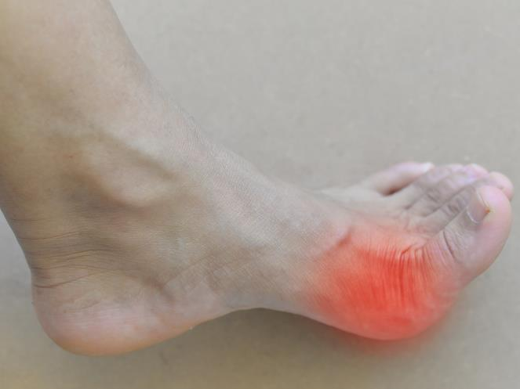
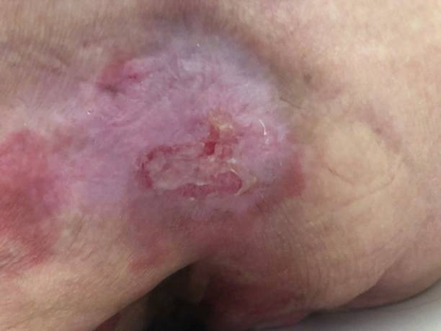
The Stages of Pressure Injuries
Stage 1
Nonblanchable erythema of intact skin
Stage 2
Partial-thickness skin loss with exposed dermal layer

Slide 10
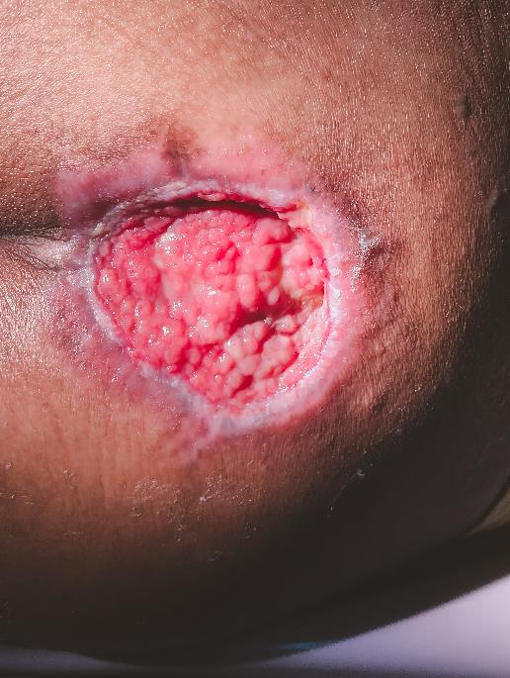
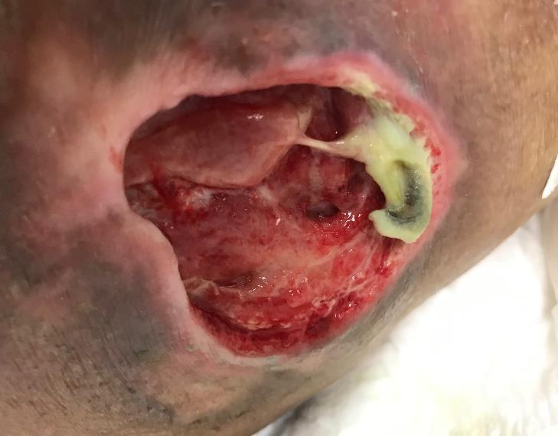
The Stages of Pressure Injuries (continued)
Stage 3
Full-thickness skin loss
Stage 4
Full-thickness skin and tissue loss (bone exposed or tracks to bone)

Slide 11


How Can We Prevent Pressure Injuries?⁵
Pressure Injury Prevention Points⁶
Risk assessment
Skin care
Skin assessment
Nutrition
Positioning and mobilization
Monitoring, training, and leadership support

Slide 12

Assessing the Risk for Pressure Injuries
Identify risk factors, such as poor mobility or diabetes, using a standardized assessment tool⁷
Repeat risk assessments on a regular basis
Braden scale
Norton scale
Waterlow scale
Develop a plan of care based on risk

Slide 13
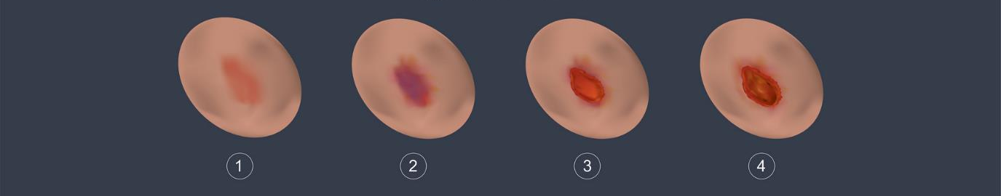
Caring for At-Risk Skin⁵
Pressure Injury Stages
Inspect skin on admission and daily for signs of pressure injuries.
Assess pressure points, temperature, and the skin beneath medical devices.
Clean the skin promptly after incontinence and use skin moisturizers.
Avoid positioning the patient on an area of pressure injury.

Slide 14

Nutrition and Pressure Injury Prevention
Assess resident’s risk for malnutrition
Refer at-risk residents to dietician or nutritionist
Regularly assess resident’s intake and weight
Provide supplemental nutrition, as needed

Slide 15

Positioning and Mobility
Turn and reposition at-risk patients at a scheduled frequency
Use pressure-relieving devices such as splints, pillows, and special mattresses for at-risk residents

Slide 16
Teachable Moment
Questions to consider:
How does pressure injury prevention prevent skin infections?
How can all staff members help prevent pressure injuries?

Slide 17

The Case
CNA is assisting 54-year-old resident with turning and repositioning in the bed.
The resident has a spinal cord injury. He has limited use of his arms and no use of his legs.

Slide 18
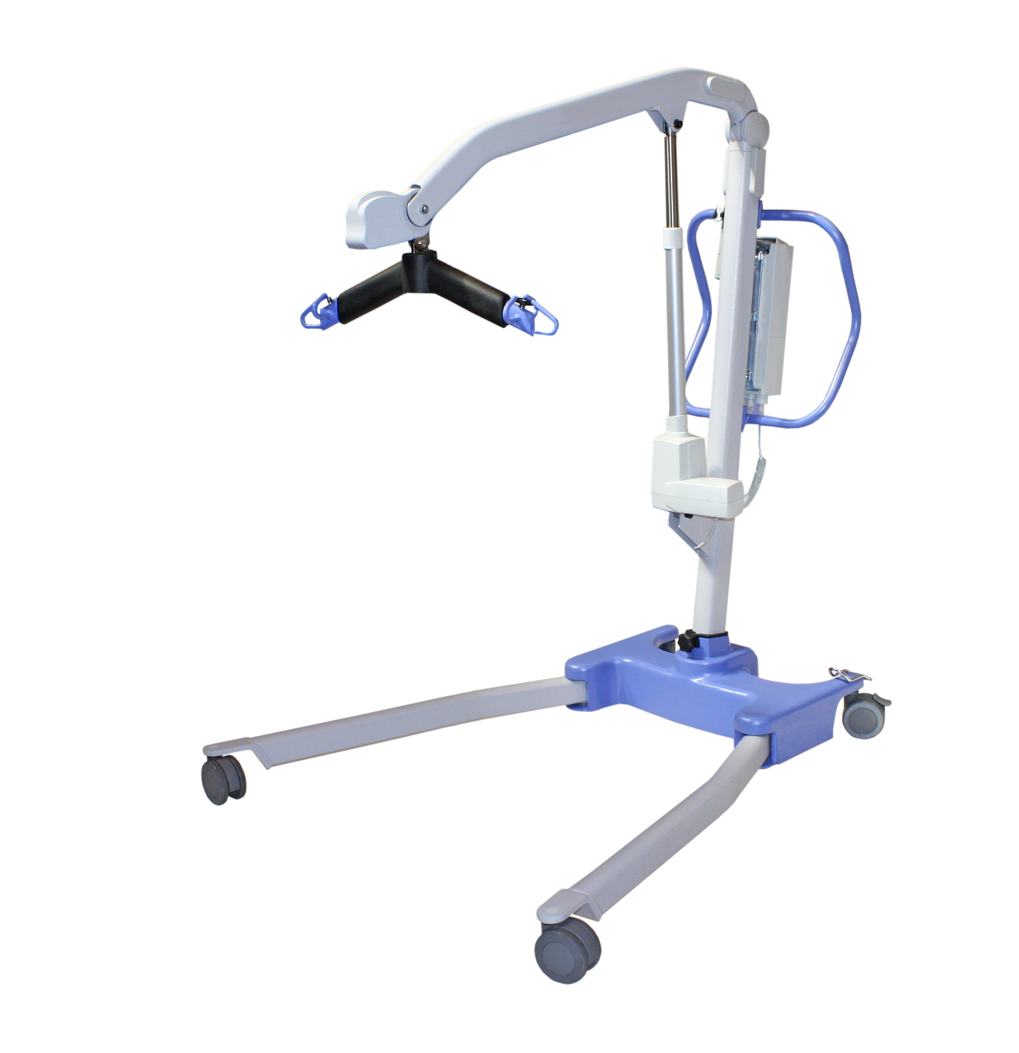
The Challenge
The resident is completely immobile and difficult to reposition.

Slide 19

Knowledge Check
How might the CNA reduce the risk of friction and shearing while repositioning the resident?

Slide 20

The Error
The CNA forgets to disinfect the Hoyer lift prior to use
She also moves him onto and off the sling without assistance
The transfer leads to a skin tear on the resident’s leg
The resident slips from the chair after transfer and sits on bunched up sheets for hours, leading to a sacral pressure injury

Slide 21


The Consequence
What challenges might this lead to in the future?

Slide 22

Patient Safety in the Moment
What could the CNA have done to prevent skin tear leading to a MRSA infection? And what could the CNA have done to prevent the resident slipping in the chair and sitting in bunched up sheets, leading to a pressure injury?
Both skin injuries could have been avoided if the CNA had assistance when she transferred the resident to his chair.

Slide 23

Preventing the Next Harm
What can be done to keep the same error from happening again?
In-service trainings about pressure injury prevention – create a system to identify clean and dirty medical equipment, and delegate who is responsible for cleaning equipment
Empower staff to ask for help
Perform and reinforce regular assessments to evaluate resident risk for developing pressure injuries

Slide 24

System-Based Safety Changes
Ensure staffing allows for two-person assist for turning and repositioning
Engage leadership to ensure products are available to assist with turning and repositioning
Create a culture where staff work together to complete tasks, regardless of their roles

Slide 25
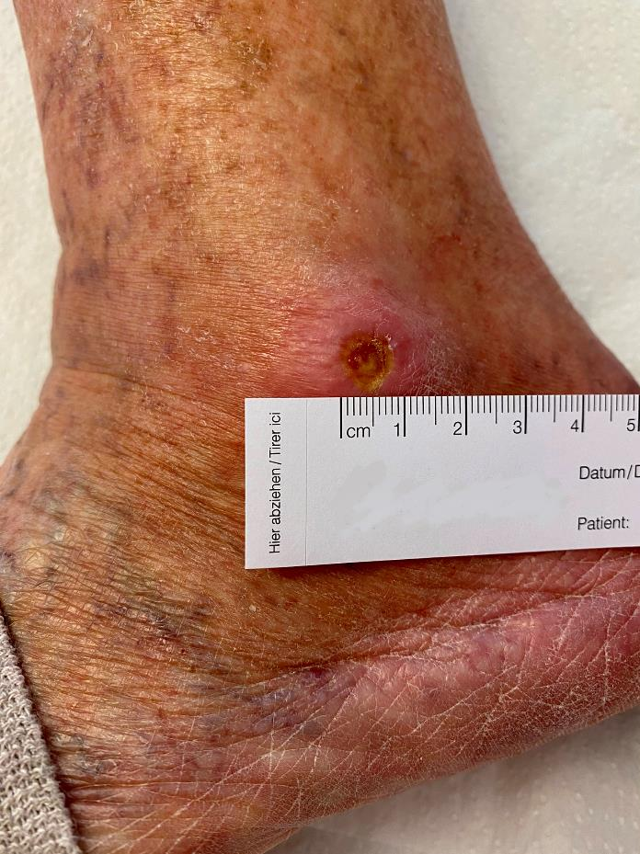
Key Takeaways
Regular assessments and proactive pressure injury prevention is key to reducing development of pressure injuries
Any break in the skin can lead to infection or worsening of pressure injuries
Facility culture should support collaboration between roles to reduce mistakes during repositioning or transferring

Slide 26
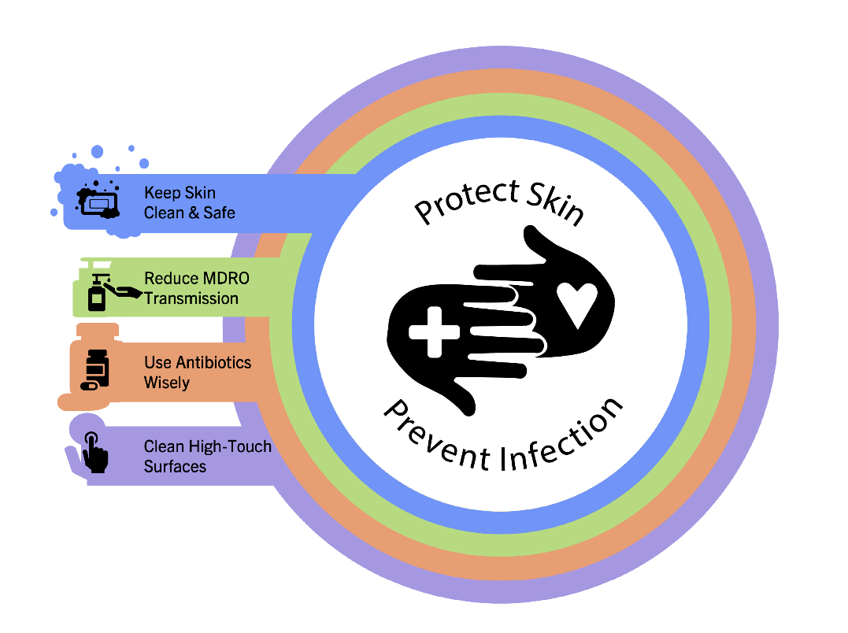
Supporting Materials
Teachable Moments:
The Case of the Resident Who Needs To Be Repositioned
The Case of the Hoyer Lift That Was Not Disinfected
Pressure Injury Prevention—Fill in the Blank
AHRQ's Safety Program for Nursing Homes: On-Time Pressure Ulcer Prevention³
Pressure injury staging guide

Slide 27
Disclaimer
The findings and recommendations in this presentation are those of the authors, who are responsible for its content, and do not necessarily represent the views of AHRQ. No statement in this presentation should be construed as an official position of AHRQ or of the U.S. Department of Health and Human Services.
Any practice described in this presentation must be applied by healthcare practitioners in accordance with professional judgment and standards of care in regard to the unique circumstances that may apply in each situation they encounter. These practices are offered as helpful options for consideration by healthcare practitioners, not as guidelines.

Slide 28
References—1
Johns Hopkins Medicine. Pressure Injuries. https://www.hopkinsmedicine.org/health/conditions-and-diseases/pressure-injuries. Accessed August 8, 2025.
Centers for Disease Control and Prevention. Pressure Ulcers Among Nursing Home Residents: United States, 2004. https://www.cdc.gov/nchs/products/databriefs/db14.htm#:~:text=Pressure%20ulcers%20were%20more%20common,length%20of%20stay%20(7%25). Accessed August 8, 2025.
Agency for Healthcare Research and Quality. AHRQ’s Safety Program for Nursing Homes: On-Time Pressure Ulcer Prevention. https://www.ahrq.gov/patient-safety/settings/long-term-care/resource/ontime/pruprev/index.html. Accessed August 8, 2025.
Centers for Medicare and Medicaid Services. Home Health Quality Measures. Last reviewed October 04, 2023. https://www.cms.gov/medicare/quality/home-health/home-health-quality-measures. Accessed August 8, 2025.
The Joint Commission. Quick Safety 25: Preventing Pressure Injuries. https://www.jointcommission.org/resources/news-and-multimedia/newsletters/newsletters/quick-safety/quick-safety-issue-25-preventing-pressure-injuries/preventing-pressure-injuries/. Accessed August 8, 2025.
National Pressure Injury Advisory Panel. Pressure Injury Prevention Points. https://npiap.com/page/PreventionPoints. Accessed August 8, 2025.

Slide 29
References—2
Agency for Healthcare Research and Quality. Preventing Pressure Ulcers in Hospitals. https://www.ahrq.gov/patient-safety/settings/hospital/resource/pressureulcer/tool/pu7b.html. Accessed August 8, 2025.

