Slide 1
Keep the Bugs Out! Preventing Surgical Site Infections
AHRQ Safety Program for MRSA Prevention
AHRQ Pub. No. 25(26)-0066
October 2025

Slide 2

All Staff Support Resident Care and Safety
The information provided in this presentation is important in the care of long-term care (LTC) residents. In LTC facilities each member of the facility’s staff supports resident care and safety.
Some actions described in these presentations may not be in your scope of practice, but it is important to learn how all staff contribute to resident care and safety.

Slide 3
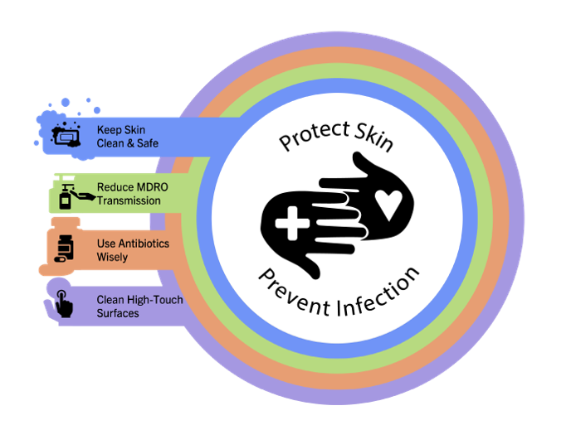
Educational Objectives
Review how to care for surgical wounds
Review how to correctly assess and document surgical wounds
Review how to culture wounds
Discuss strategies for improving SSI prevention in long-term care facilities.

Slide 4
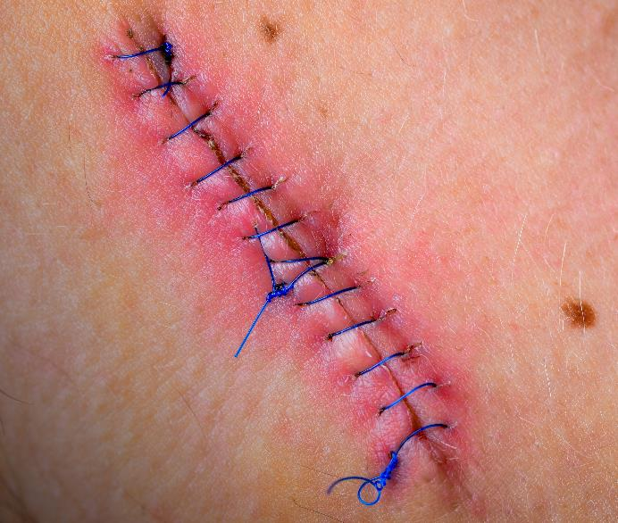
What Are Surgical Site Infections?¹
CDC definition: A type of healthcare-associated infection that takes place in a part of the body where a surgery took place²
Surgical site infection (SSI) classifications:
  Superficial incisional SSI
  Deep incisional SSI
  Organ space SSI
Wound dehiscence: partial or total separation of wound edges due to inflammation and improper wound healing³

Slide 5
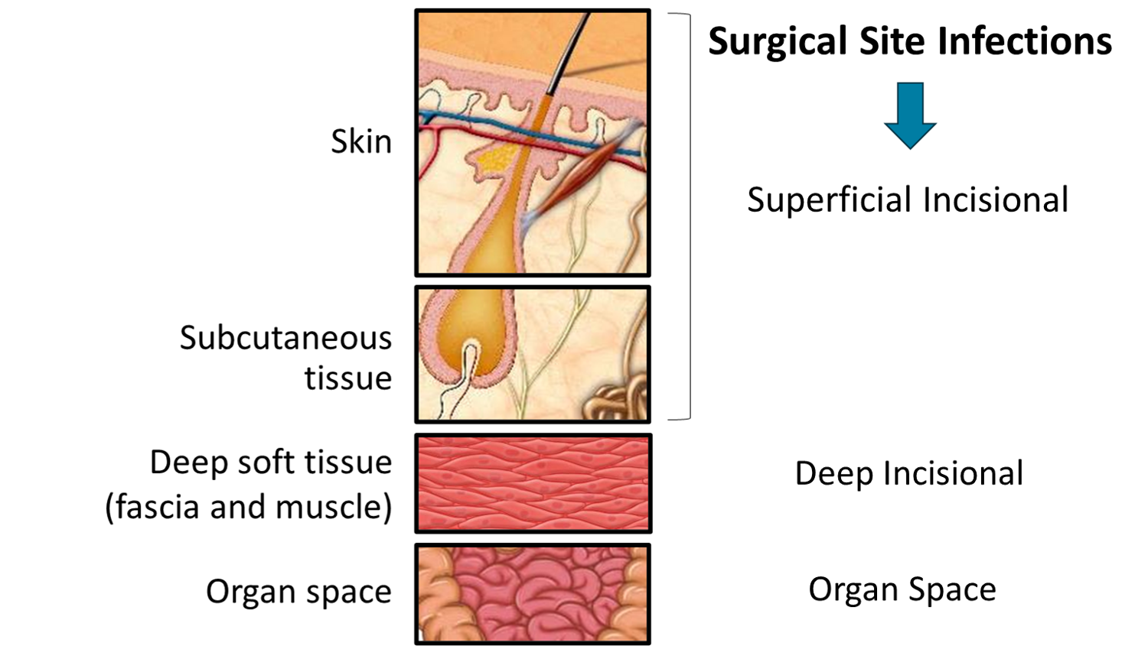
Surgical Site Infection Classification

Slide 6

Impact of Surgical Site Infections^{1,4}
The CDC healthcare-associated infection (HAI) prevalence survey found that there were an estimated 110,800 SSIs associated with inpatient surgeries in 2015.¹
SSIs account for 20 percent of all HAIs and are associated with a 2- to 11-fold increase in the risk of mortality.¹
SSIs are the costliest type of HAI with an estimated annual cost of $3.3 billion.¹

Slide 7
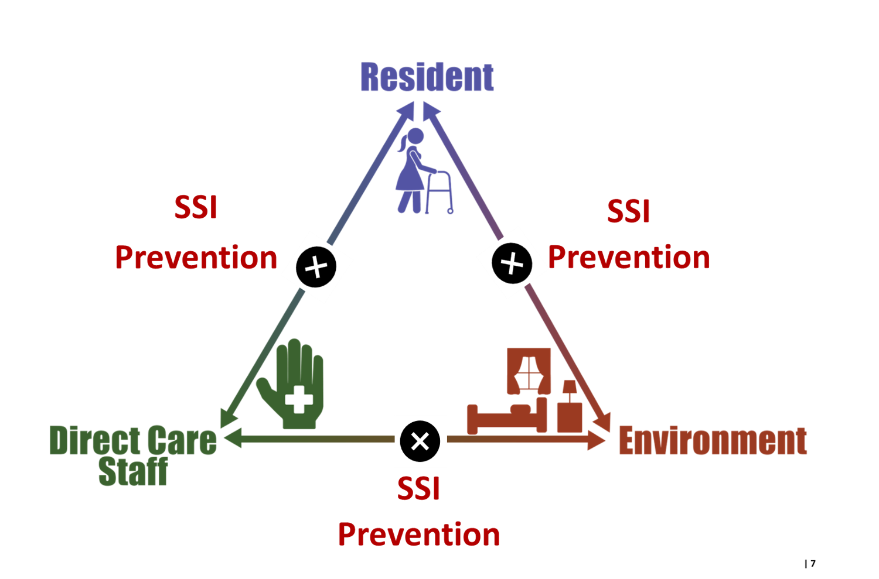
Triangle of Transmission

Slide 8
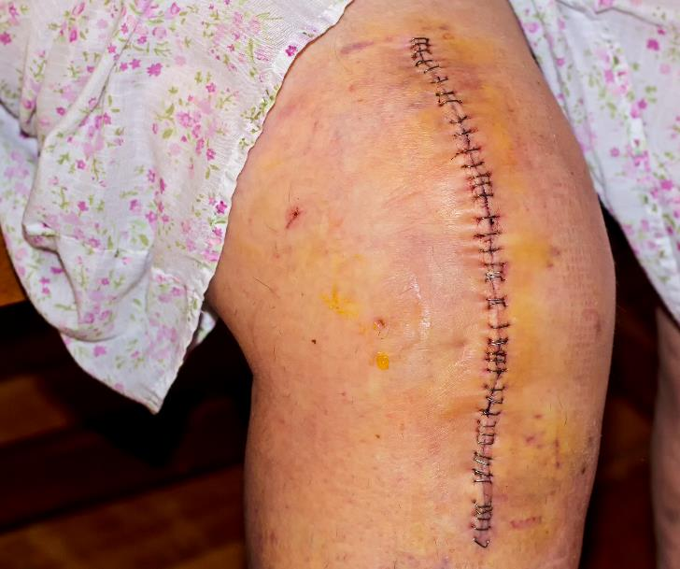
Understanding Surgical Wounds⁵
Surgical wound definition: A cut or incision through the skin that is made during surgery
Surgical wound classifications
  Clean
  Clean-contaminated
  Contaminated
  Dirty

Slide 9
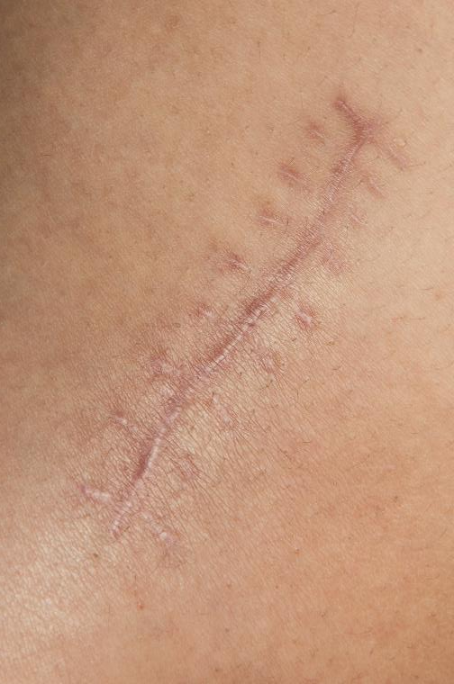
Stages of Wound Healing
Resident characteristics that influence wound healing
  Age
  Nutritional status
  Pre-existing conditions (e.g., diabetes, smoking, and obesity)
Surgical wound healing generally follows three distinct phases
  Inflammation
  Proliferation
  Remodeling (tissue has about 80% of the strength of the original tissue that was there)^{6,7}

Slide 10
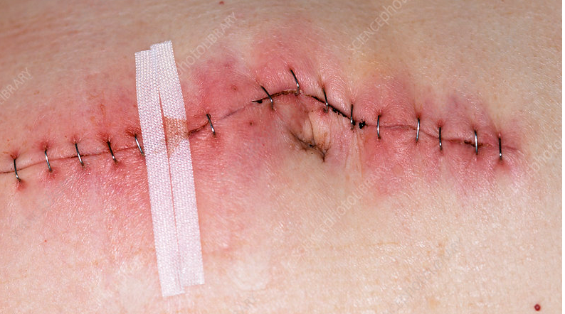
Signs and Symptoms of SSI
Redness and pain around surgical site
Purulent drainage
Fever
Warmth
Swelling
Tenderness
Red streaks

Slide 11
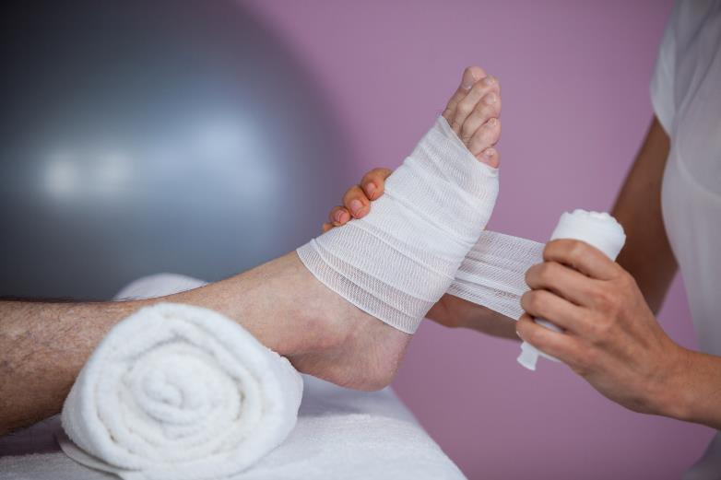
Assessing and Documenting Surgical Wounds
Wound assessment should be performed at every dressing change
Assess, document, and describe—
  Location, size, closure method
  Wound appearance (e.g., tissue color, type)
  Signs of infection
  Pain level
  Other factors
Note: Staff should operate within their scope of practice and receive proper training to assess and manage wounds.

Slide 12
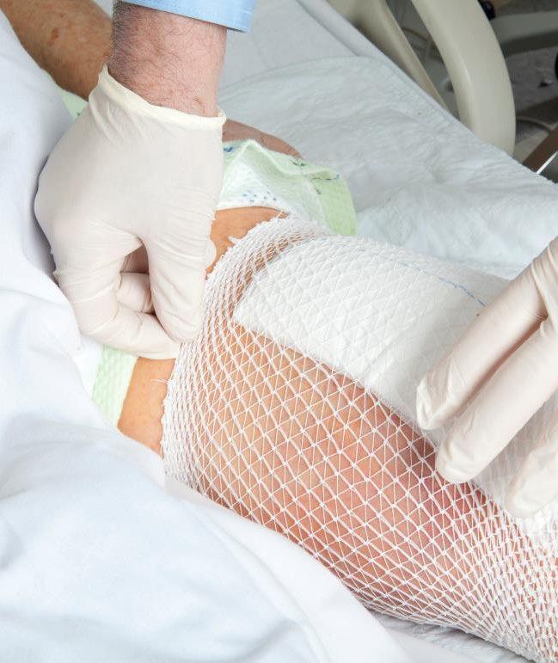
A Note on Dressing Changes
High risk for postoperative infections
Application and dressing adherence matters
Follow surgeon's instructions
  Keep dressing in place for a specific period and then follow plan for routine dressing changes

Slide 13

Culturing Surgical Wounds
Clean the wound and surrounding skin
Remove gloves, perform hand hygiene, and put on fresh gloves
Use the Levine Technique to culture the wound bed
  Apply the swab to the wound surface for 5 seconds and use gentle pressure to obtain fluid from the wound
Avoid the wound edges
Avoid exudate, eschar, and necrotic material

Slide 14
Teachable Moment
Questions to consider:
What is your role in SSI prevention?
How can staff assisting with bathing aid in preventing SSIs?

Slide 15
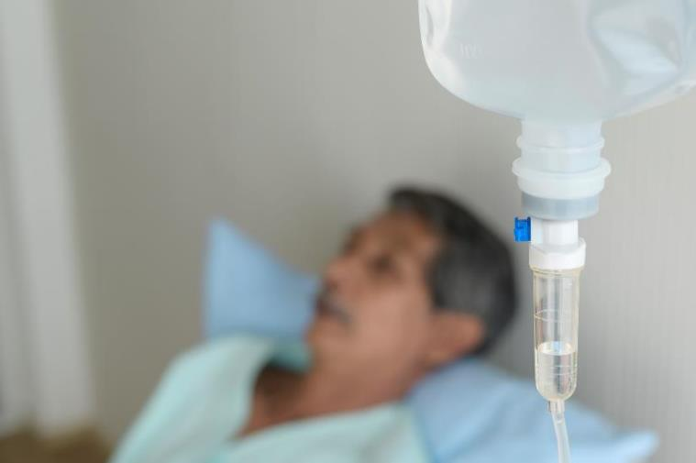
The Case
The CNA is assisting a 65-year-old with their bed bath.
The resident recently had hip surgery and has daily wound assessments and dressing changes.

Slide 16

The Challenge
The resident has a fresh surgical dressing that can’t get wet.

Slide 17

Knowledge Check
How might the CNA prevent the dressing from becoming wet during the bed bath?

Slide 18
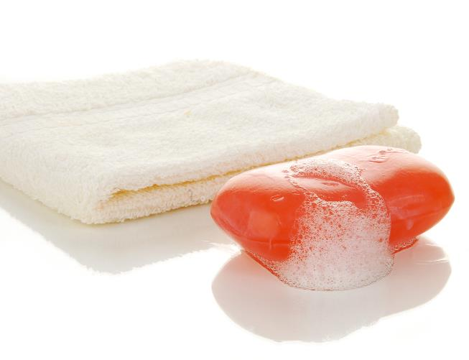
The Error
The CNA doesn’t wring out the soapy washcloth and water drips down the resident’s leg, saturating the surgical site dressing.
The CNA is embarrassed by their mistake and is afraid to tell the nurse about the saturated dressing. It goes undiscovered until the next dressing change.

Slide 19


The Consequence
What challenges might this lead to in the future?

Slide 20

Patient Safety in the Moment
What could the CNA have done before and after the resident’s dressing became wet?
The CNA could have avoided soiling the dressing by shielding the dressing with a towel and wringing out the washcloth. They also should have followed up with the LVN to inform them of the wet dressing.

Slide 21

Preventing the Next Harm
What can be done to keep the same error from happening again?
  Provide in-service trainings on bathing residents with surgical wounds
  Offer premoistened cloths or wipes for use when bathing residents with open wounds
  Perform regular dressing checks and follow scheduled dressing changes

Slide 22

System-Based Safety Changes
Ensure staff receive training on the care of surgical wounds.
Engage leadership to create a culture of safety where staff speak up when errors are made or problems are recognized.
Empower staff to speak up when they see problem or make an error.

Slide 23
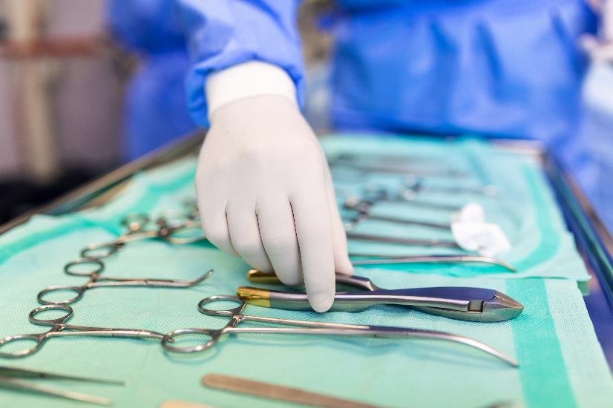
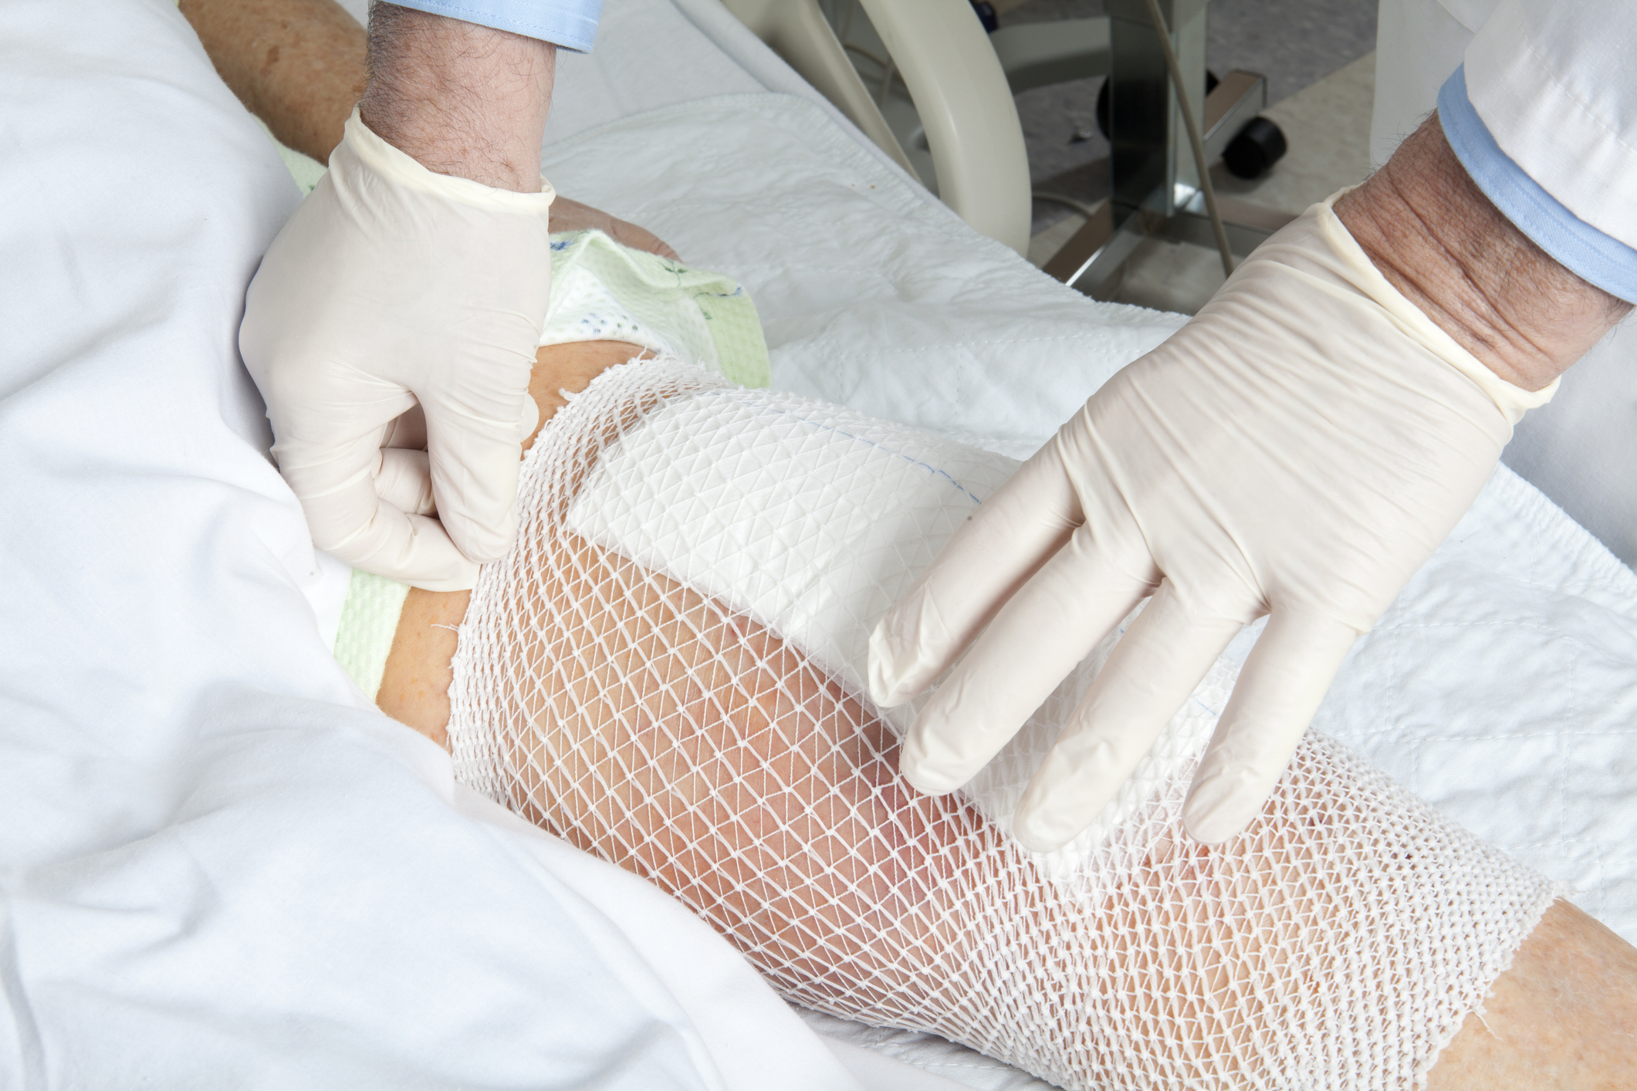
Key Takeaways
Proper care of surgical wounds prevent SSIs.
Frequent dressing checks and proper dressing changes aid in the prevention of SSIs.
Staff should be encouraged to speak up and say something when errors are made.

Slide 24
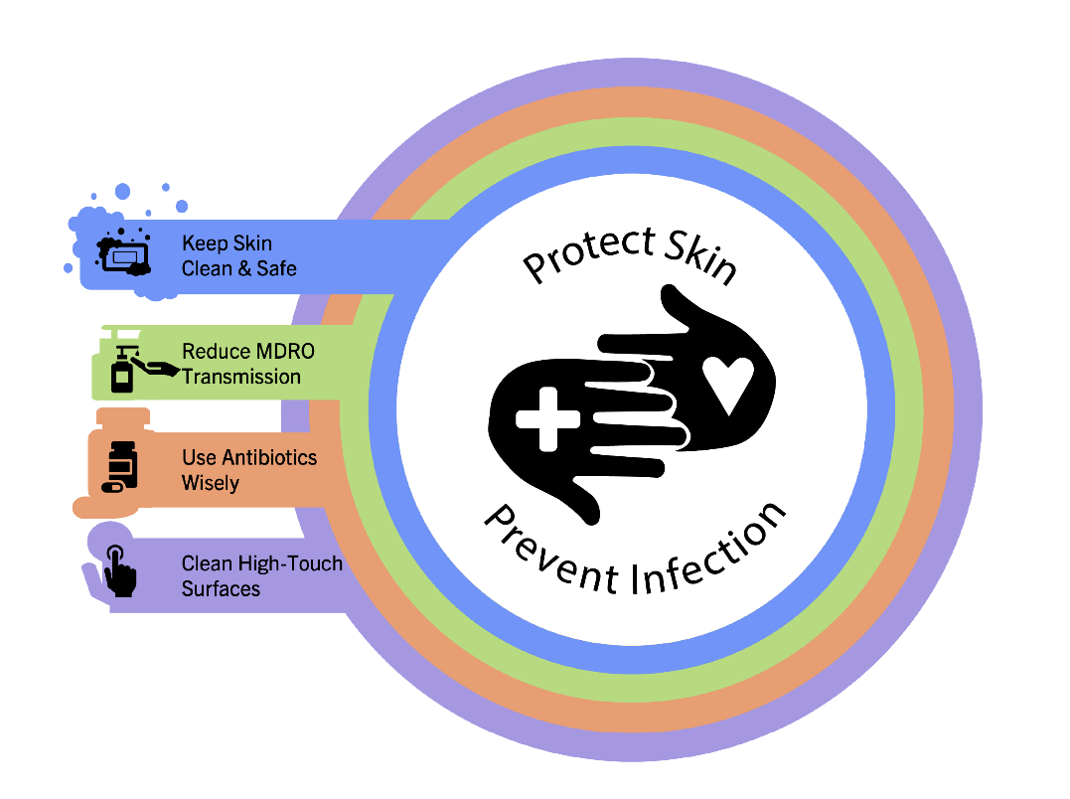
Supporting Materials
Teachable Moments
  The Case of Insufficient Communication Between Care Teams
  The Case of the Wet Surgical Dressing
Levine Technique document – How to Collect a Wound Culture

Slide 25
Disclaimer
The findings and recommendations in this presentation are those of the authors, who are responsible for its content, and do not necessarily represent the views of AHRQ. No statement in this presentation should be construed as an official position of AHRQ or of the U.S. Department of Health and Human Services.
Any practice described in this presentation must be applied by healthcare practitioners in accordance with professional judgment and standards of care in regard to the unique circumstances that may apply in each situation they encounter. These practices are offered as helpful options for consideration by healthcare practitioners, not as guidelines.

Slide 26
References
Centers for Disease Control and Prevention National Healthcare Safety Network. Surgical Site Infection (SSI) Event. https://www.cdc.gov/nhsn/pdfs/pscmanual/9pscssicurrent.pdf. Accessed July 09, 2025.
Centers for Disease Control and Prevention. Surgical Site Infection Basics. https://www.cdc.gov/surgical-site-infections/about/index.html#:~:text=A%20surgical%20site%20infection%20(SSI,risk%20of%20contracting%20an%20SSI. Accessed July 09, 2025.
Rosen RD, Manna B. Wound Dehiscence. Treasure Island, FL: StatPearls Publishing; 2024.
Abd El Aziz MA, Grass F, Behm KT, et al. How skilled are skilled facilities? Post-discharge complications after colorectal cancer surgery in the U.S. Am J Surg. 2021 Jul;222(1):20-6. PMID: 33341235.
Sherman Oaks Hospital. Surgical Wounds. https://shermanoakshospital.org/surgical-wounds/#:~:text=A%20surgical%20wound%2C%20also%20known,nature%20of%20the%20wound%20itself. Accessed July 09, 2025.
Wallace HA, Basehore BM, Zito PM. Wound Healing Phases. Treasure Island, FL: StatPearls Publishing; 2024.
Schultz GS, Chin GA, Moldawer L, et al. Principles of wound healing. Principles of Wound Healing. In: Mechanisms of Vascular Disease: A Reference Book for Vascular Specialists. Adelaide, AU: University of Adelaide Press; 2011:chapter 23.

