Slide 1
Choosing the Right Drug for the Bug: Antibiotic Stewardship for Skin and Soft Tissue Infection
AHRQ Safety Program for MRSA Prevention
AHRQ Pub. No. 25(26)-0066
October 2025

Slide 2

All Staff Support Resident Care and Safety
The information provided in this presentation is important in the care of long-term care (LTC) residents. In LTC facilities, each member of the facility’s staff supports resident care and safety.
Some actions described in these presentations may not be in your scope of practice, but it is important to learn how all staff contribute to resident care and safety.

Slide 3
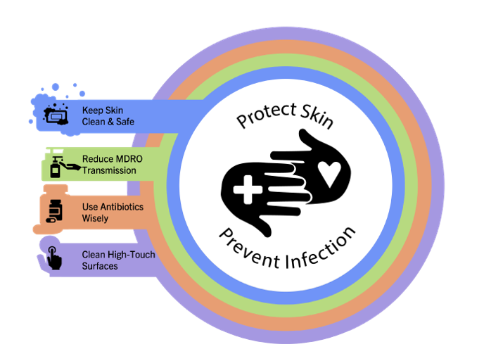
Educational Objectives
Define antibiotic stewardship and its impact on nursing home residents
Distinguish when antibiotics are indicated for skin and soft tissue infections
Discuss the diagnostic approach and empiric management of skin and soft tissue infections

Slide 4

What Is Antibiotic Stewardship?
Antibiotic Stewardship is a coordinated effort that ensures every patient who needs antibiotics receives the optimal drug while minimizing adverse events.
Appropriate use of antibiotics equals—
  Right drug
  Right dose
  Right indication
  Right duration

Slide 5

Potential Consequences¹
  Allergic reactions
  Loss of appetite
  Diarrhea
  Kidney or liver damage
  Confusion or mental
  status changes
  Seizures, cardiac arrhythmias
  Increased risk for Clostridioides difficile infection or other drug-resistant bacterial infection
  And more…

Slide 6
Antibiotic Overuse in Nursing Homes
Up to 75 percent of antibiotics prescribed in nursing homes are considered inappropriate or unnecessary.²
Older adults are more likely to receive antibiotics than their younger counterparts (over 50% per capita more).³
Older women are more likely to receive antibiotics than older men (62% vs. 38%).⁴
In nursing homes, inappropriate or unnecessary antibiotic use is often in response to a positive urinalysis or urine culture.³
  Adults living with dementia are more likely to receive antibiotics despite not meeting criteria for treatment⁵

Slide 7

Treating Older Adults Is Complicated
Clinical uncertainty is common.
Older patients are more likely to present with atypical symptoms, frailty, and multiple medical problems.
  Keep an eye out for changes in patients who cannot express specific symptoms
Older adults with infections are at higher risk for adverse outcomes.²
Older adults have lower baseline body temperature, which makes it difficult to recognize fever.

Slide 8
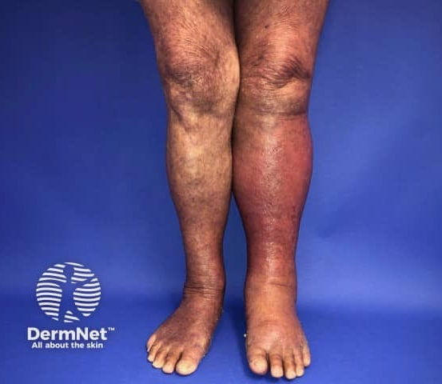
Distinguishing When a Patient Needs Antibiotics
Presumed skin and soft tissue infections are among the most common reasons for antibiotic prescriptions in the long-term care setting
Red Legs = NOT ALWAYS CELLULITIS⁶
Deep venous thrombosis
Venous stasis dermatitis
Peripheral arterial disease
Lymphedema
Image source: DermNet. https://dermnetnz.org/imagedetail/6036-cellulitis-of-the-left-leg. Used under the Creative Commons Attribution-NonCommercial-NoDerivatives 4.0 International License: https://creativecommons.org/licenses/by-nc-nd/4.0/deed.en.

Slide 9
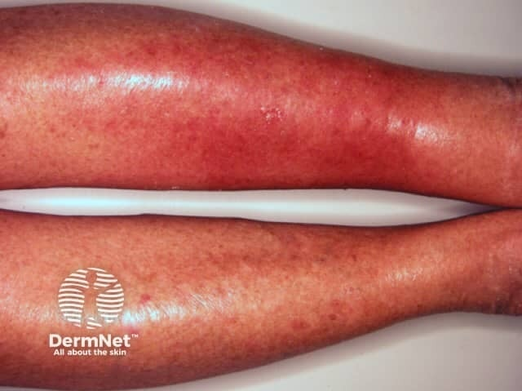
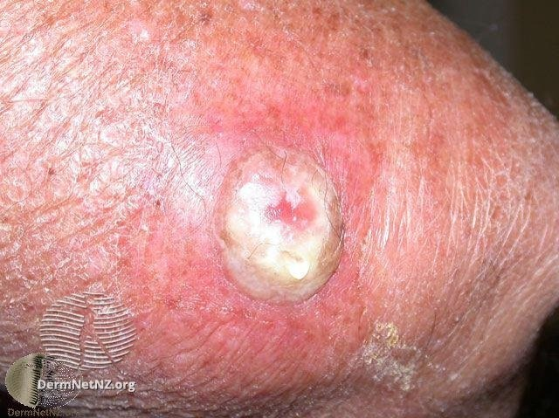
Empiric Therapy Based on Clinical Presentation
Nonpurulent
Purulent
Image source: DermNet. https://dermnetnz.org/imagedetail/8051-cellulitis. Used under the Creative Commons Attribution-NonCommercial-NoDerivatives 4.0 International License: https://creativecommons.org/licenses/by-nc-nd/4.0/deed.en.
Image source: DermNet. https://dermnetnz.org/imagedetail/21473-wound-infection-after-cryotherapy. Used under the Creative Commons Attribution-NonCommercial-NoDerivatives 4.0 International License: https://creativecommons.org/licenses/by-nc-nd/4.0/deed.en.

Slide 10
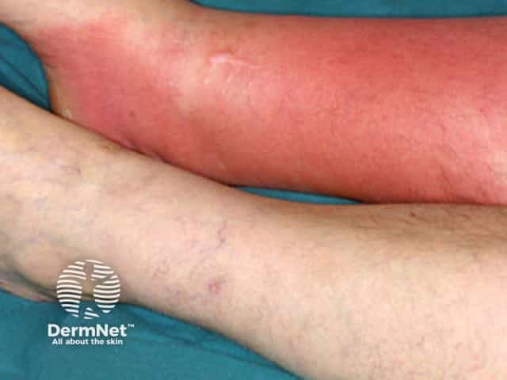
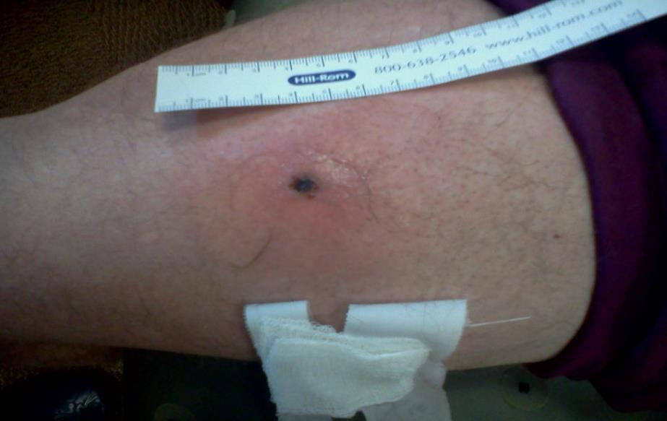
Empiric Therapy for Cellulitis⁶
Purulent Cellulitis
Usually caused by staphylococcal species
Nonpurulent Cellulitis
Usually streptococcal species
Treat with penicillin or cephalexin*
  Treatment = drain, send abscess fluid for culture
  Treat empirically with TMP-SMX, linezolid, or doxycycline*
Image source: https://dermnetnz.org/topics/cellulitis. Used under the Creative Commons Attribution-NonCommercial-NoDerivatives 4.0 International License: https://creativecommons.org/licenses/by-nc-nd/4.0/deed.en.
Photo courtesy of Dr. Robin Jump
*Consider your local antibiotic resistance patterns, the resident's allergy history, and interactions with other medications.

Slide 11
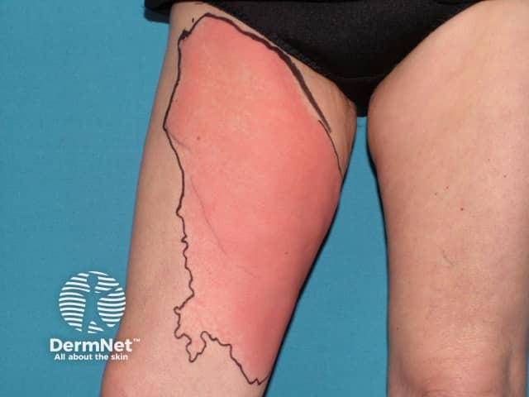
Duration of Therapy for Cellulitis⁶
5–7 days of antibiotic therapy is appropriate
  Not inferior to longer courses of therapy unless infection is complicated
Redness and tenderness may not completely resolve in 5 days, but should show improvement
Signs of improvement include—
  Receding erythema
  Improvement in pain
  Resolution of fever, leukocytosis
Image source: https://dermnetnz.org/imagedetail/8061-cellulitis. Used under the Creative Commons Attribution-NonCommercial-NoDerivatives 4.0 International License: https://creativecommons.org/licenses/by-nc-nd/4.0/deed.en.

Slide 12
Preventative and Supportive Measures
Minimize tissue edema
  Leg elevation
  Compression stockings
  Diuretics as tolerated
Treat fungal foot infections
  Topical antifungals can treat tinea pedis and reduce risk of recurrence
Reduce scaling/skin breakdown
  Hydrating emollient lotions
  Unna boots for significant venous stasis

Slide 13
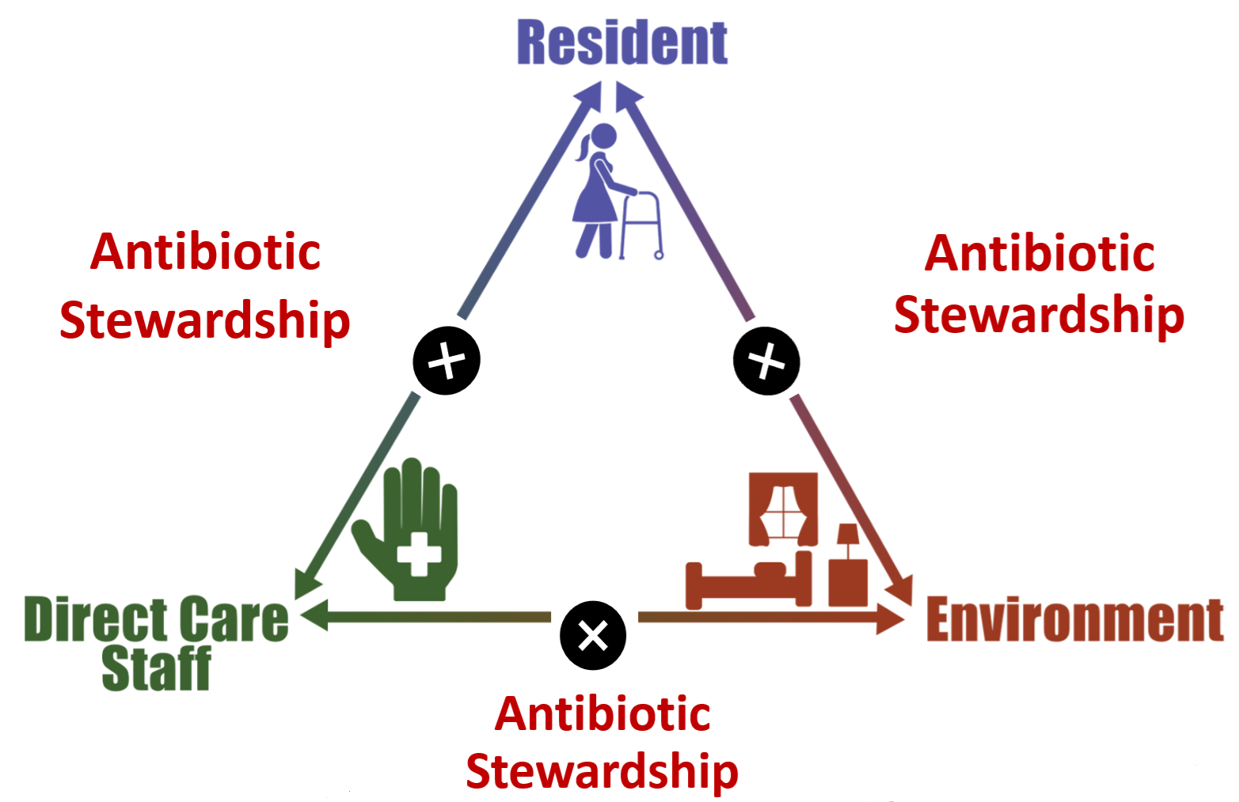
Triangle of Transmission

Slide 14
Teachable Moment
Questions to consider:
What is each healthcare provider’s role in antibiotic stewardship? How does each person impact decisions about starting or stopping antibiotics?
How can staff help identify and monitor skin and soft tissue infections for when they may or may not need antibiotics?

Slide 15
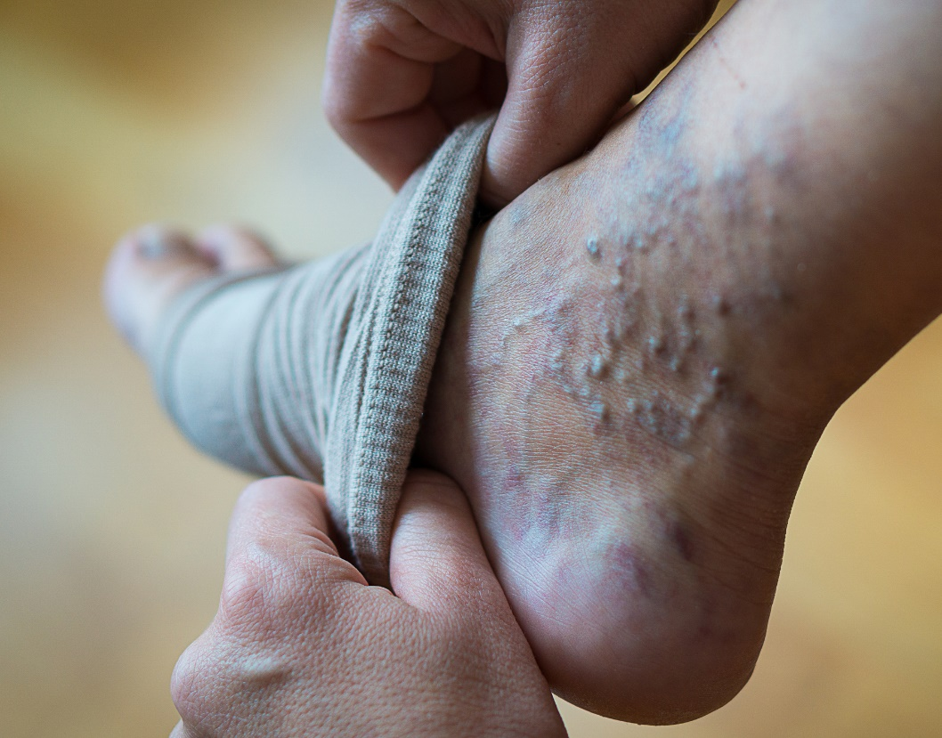
The Case: The Resident
75-year-old resident with congestive heart failure and chronic lower extremity swelling and discoloration
Went to an outdoor BBQ at the facility, ate many salty meats, and was standing on his feet all day the day before
Vitals: T: 98.7° F, HR 65, BP 138/74, RR 18, Pulse ox 98% on room air.
Complains of some soreness in his legs, but not particularly worse than usual.

Slide 16
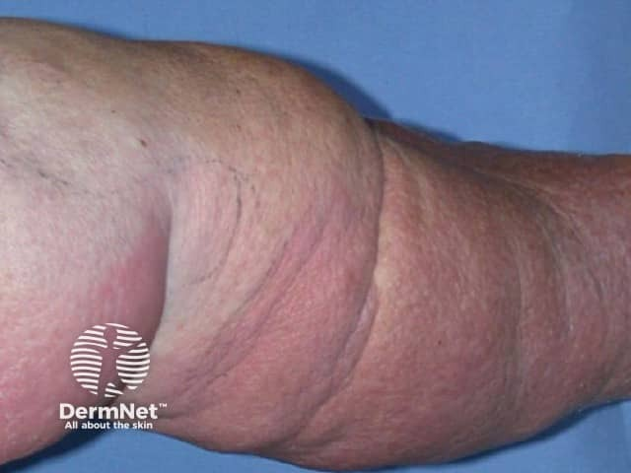

The Case: A Request for Antibiotics
His daughter, who is from out of town and has not seen her father in months, visits and tells the nurse she is concerned about the swelling and discoloration of her father’s lower legs.
She asks for antibiotics to treat the infection.
Image source: https://dermnetnz.org/imagedetail/9483-cellulitis-and-lymphoedema. Used under the Creative Commons Attribution-NonCommercial-NoDerivatives 4.0 International License: https://creativecommons.org/licenses/by-nc-nd/4.0/deed.en.

Slide 17
The Challenge
His daughter insists that he be treated with antibiotics. The nurse does not see a change in the appearance of his legs, but pages the covering doctor and asks for the antibiotics because his daughter requested them.
The doctor is covering overnight and is not familiar with the patient. He gives the nurse an order for a 7-day course of cephalexin.
The resident later develops stomach upset due to the cephalexin, and a urine culture obtained 2 months later grows E. coli resistant to cephalexin.

Slide 18

Knowledge Check
How might the nurse have addressed this differently?
What about the prescriber?

Slide 19
The Error
The nurse did not educate the daughter or the covering provider about the chronic nature of the patient’s lower extremities
The provider did not ask questions about changes in the resident’s physical exam and prescribed antibiotics for a prolonged course without reassessing the need for antibiotics
There was no discussion about alternative supportive therapies to address the resident’s chronic leg swelling.

Slide 20


The Consequence
What challenges might this lead to in the future?

Slide 21

Patient Safety in the Moment
What could the nurse have done when the resident’s daughter asked about her father’s condition?
Educated his daughter on the chronic nature of the appearance of his legs
Implemented supportive measures to improve symptoms
  Salt reduction
  Leg elevation
  Compression stockings
  Lotions

Slide 22

Preventing the Next Harm
What can be done to keep the same error from happening again?
Empower staff to be part of the antibiotic stewardship process.
Use dialogue to help educate family members on the risks of unnecessary antibiotics.
Implement SBAR forms to improve communication between nursing and providers.
Document chronic skin changes and implement supportive care.

Slide 23

System-Based Safety Changes
Provide funding and support for antibiotic stewardship efforts, including tracking antibiotic use and sharing data on use.
Engage leadership to create a culture of safety where staff feel comfortable discussing the need for antibiotics with prescribers.

Slide 24
Key Takeaways
Antibiotic stewardship helps ensure residents get the correct antibiotic, only when it is indicated.
Older adults are at risk for significant side effects of antibiotics, yet they are still overused in this population.
Empowering all levels of staff to take part in all moments of the antibiotic prescribing decision process can help protect residents from unnecessary exposure to antibiotics.

Slide 25
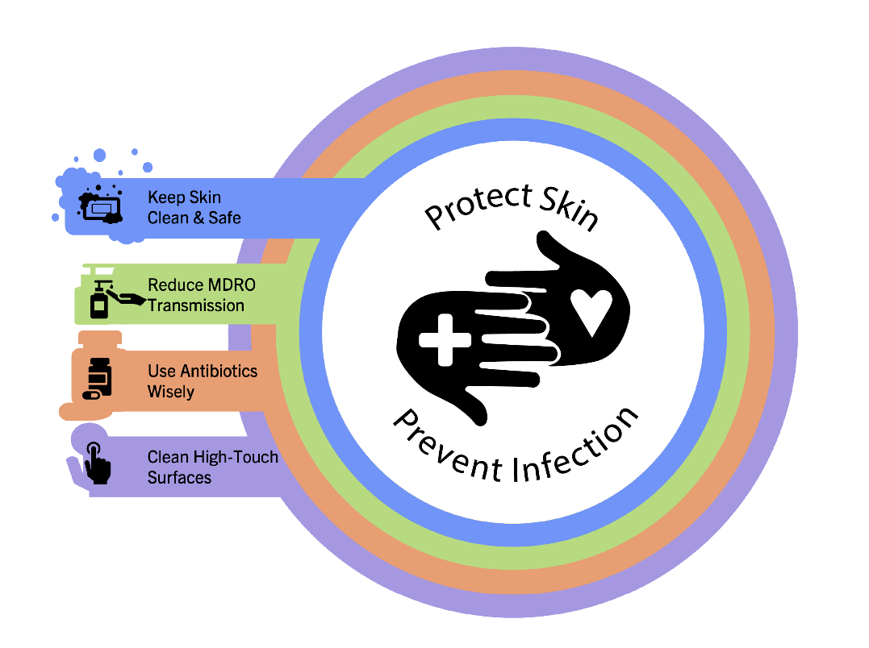
Supporting Materials
The Case of the Resident Who Attended the BBQ
AHRQ Safety Program for Antibiotic Use in LTC toolkit⁷
AHRQ skin/soft tissue infection pocket cards for nursing in LTC⁸
The Four Moments of Antibiotic Decision-Making Posters for LTC⁹

Slide 26
Disclaimer
The findings and recommendations in this presentation are those of the authors, who are responsible for its content, and do not necessarily represent the views of AHRQ. No statement in this presentation should be construed as an official position of AHRQ or of the U.S. Department of Health and Human Services.
Any practice described in this presentation must be applied by healthcare practitioners in accordance with professional judgment and standards of care in regard to the unique circumstances that may apply in each situation they encounter. These practices are offered as helpful options for consideration by healthcare practitioners, not as guidelines.

Slide 27
References—1
Kabbani S, Palms D, Bartoces M, et al. Outpatient antibiotic prescribing for older adults in the United States: 2011 to 2014. J Am Geriatr Soc. 2018 Oct;66(10):1998-2002. PMID: 30221746.
Centers for Disease Control and Prevention. Core Elements of Antibiotic Stewardship for Nursing Homes. https://www.cdc.gov/antibiotic-use/hcp/core-elements/nursing-homes-antibiotic-stewardship.html#:~:text=Similar%20to%20the%20findings%20in,receiving%20care%20in%20nursing%20homes. Accessed July 23, 2025.
Cruz SP, Cebrino J. Prevalence and determinants of antibiotic consumption in the elderly during 2006-2017. Int J Environ Res Public Health. 2020 May 6;17(9):3243. PMID: 32384740.
Smith DRM, Dolk FCK, Smieszek T, et al. Understanding the gender gap in antibiotic prescribing: a cross-sectional analysis of English primary care. BMJ Open. 2018 Feb 22;8(2):e020203. PMID: 29472269.
D'Agata E, Mitchell SL. Patterns of antimicrobial use among nursing home residents with advanced dementia. Arch Intern Med. 2008 Feb 25;168(4):357-62. PMID: 18299489.
Hepburn MJ, Dooley DP, Skidmore PJ, et al. Comparison of short-course (5 days) and standard (10 days) treatment for uncomplicated cellulitis. Arch Intern Med. 2004 Aug 9-23;164(15):1669-74. PMID: 15302637.
Agency for Healthcare Research and Quality. Toolkit to Improve Antibiotic Use in Long-Term Care. https://www.ahrq.gov/antibiotic-use/long-term-care/index.html. Accessed July 23, 2025.

Slide 28
References—2
Agency for Healthcare Research and Quality. Skin and Soft Tissue Infection in Nursing Home Residents. https://www.ahrq.gov/sites/default/files/wysiwyg/antibiotic-use/long-term-care/pocket-cards-4x6-skin-infections.pdf. Accessed July 23, 2025.
Agency for Healthcare Research and Quality. The Four Moments of Antibiotic Decision Making Posters. https://www.ahrq.gov/antibiotic-use/long-term-care/four-moments/posters.html. Accessed July 23, 2025.

