Slide 1
Improving Skin Care and MDRO Prevention in Long-Term Care
The 3 Cs of Healthcare: Working Together To Prevent Infection
AHRQ Safety Program for MRSA Prevention
AHRQ Pub. No. 25(26)-0066
October 2025

Slide 2

All Staff Support Resident Care and Safety
The information provided in this presentation is important in the care of long-term care (LTC) residents. In LTC facilities, each member of the facility’s staff supports resident care and safety.
Some actions described in these presentations may not be in your scope of practice, but it is important to learn how all staff contribute to resident care and safety.

Slide 3
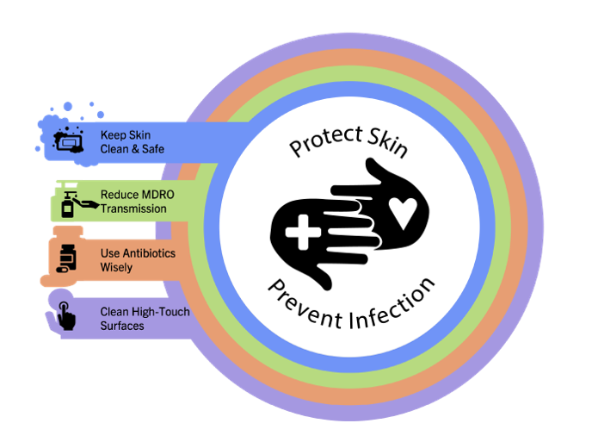
Educational Objectives
Discuss the importance of communication, collaboration, and connection (3 Cs) in providing safe, quality healthcare
Promote strategies for using the 3 Cs in the care of residents
Review a case that uses the 3 Cs to facilitate safe, quality resident care

Slide 4

What Are the 3 Cs of Healthcare?
“A team is defined as a group of people who perform interdependent tasks to work toward accomplishing a common mission or specific objective.”¹
The interpersonal relationships of the healthcare team influence the care provided to residents.
The 3 Cs:²
Connection
Communication
Collaboration

Slide 5
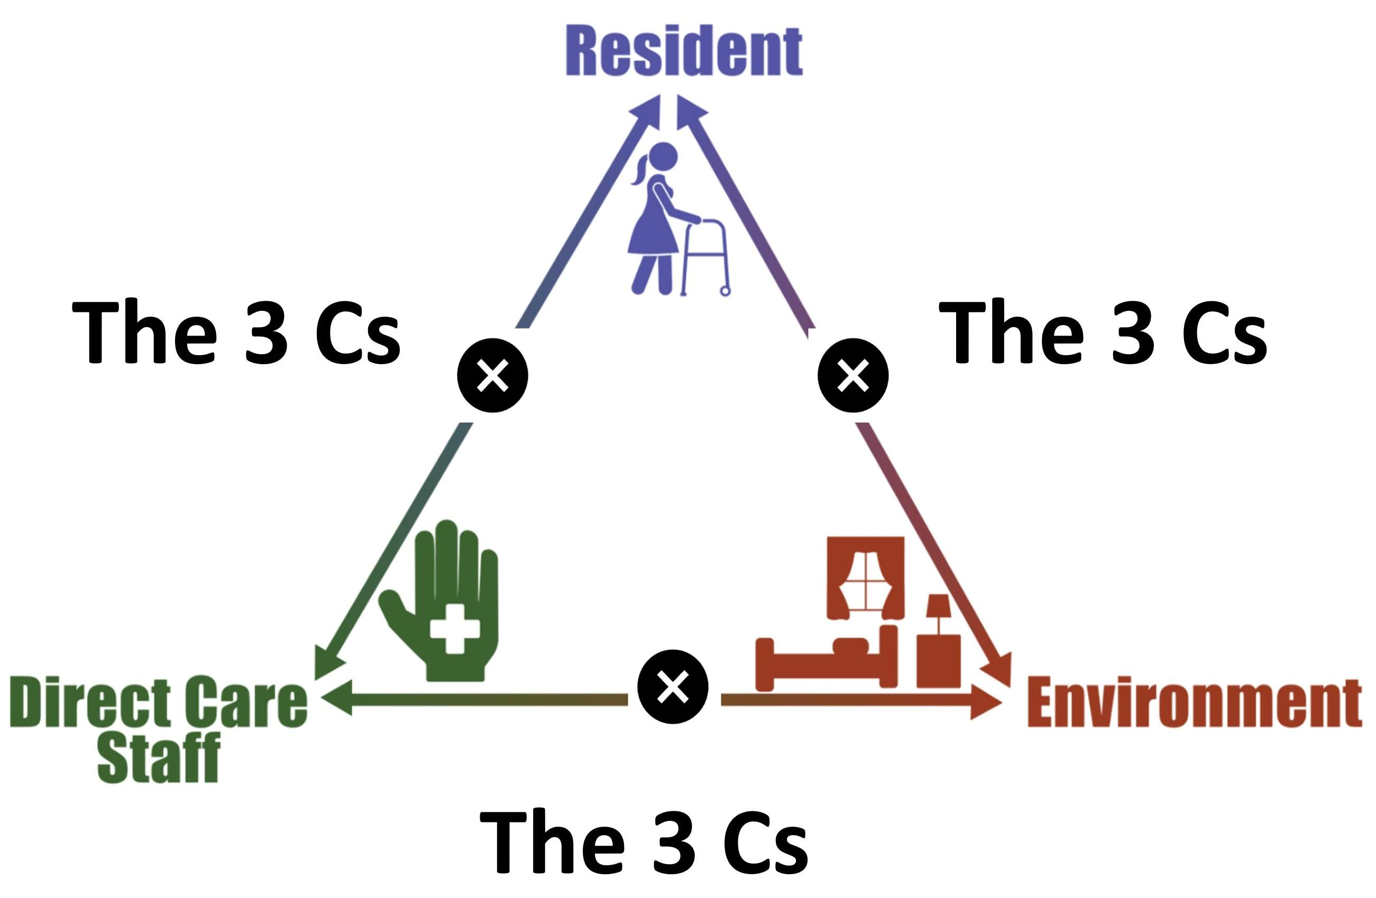
Triangle Of Transmission

Slide 6

Communication: An Exchange of Information²
Communication: “an exchange of information, thoughts, and feelings through a variety of mechanisms”³
Different routes of communication
Verbal
Nonverbal
Remote
Healthy communication versus unhealthy communication

Slide 7

Collaboration: Reaching Toward a Common Goal
Collaboration: “efforts between various independent teams or groups” to achieve a goal⁴
Benefits of collaboration
Increased assistance and resources
Safer, higher quality care

Slide 8

Connection: Bringing It All Together
Connection: “the state of being related to someone or something”⁵
Ways of establishing connection, in person or remotely
Team-building exercises
Personal highlights

Slide 9

Barriers to the 3 Cs
Unclear, incomplete, or untimely communication
Cultural or language barriers
Lack of training or education on teamwork in the healthcare environment
Staffing ratios and turnover
Poor organizational culture

Slide 10

Overcoming Barriers
Training and education on teamwork skills, such as the 3 Cs
Promoting cultural competence and language support to the healthcare team
Modeling healthy communication, collaboration, and connection
Identifying and addressing problematic employees

Slide 11

3 Cs Tools and Resources
Checklists and goal worksheets
Communication aids
Daily huddles
Safety teams
Use of shared technologies (e.g., SharePoint)

Slide 12

Team Member Shadowing
Fosters empathy by helping team members understand other roles
Assists in the identification of barriers and solutions to challenges in the workplace
Who should shadow?
Nursing shadowing environmental services (EVS)
Certified nursing assistants (CNAs) shadowing nursing
Any role with poor collaboration between disciplines

Slide 13

Teachable Moment
Questions To Consider
Where are opportunities for each of the 3 Cs?
How could staff have better communicated, collaborated, or connected to improve resident outcomes?

Slide 14

The Case
Ms. Daniels is a 65-year-old postoperative admission.
She was discharged to the facility with a wound vacuum-assisted closure postoperative dressing.

Slide 15


The Challenge
The resident needs frequent nursing checks and dressing changes that disrupt environmental cleaning.

Slide 16

Knowledge Check
How might EVS and nursing work together to ensure daily cleaning is taking place as well as proper wound care?

Slide 17

The Error
Nursing continues to tell EVS to come back later, and the resident’s room doesn’t get its daily cleaning.
As a result, methicillin-resistant Staphylococcus aureus lingers on the surfaces of the bedside table, resulting in a hip wound infection.
Nursing and EVS should have worked together to accomplish the daily clean.

Slide 18


The Consequence
What challenges might this lead to in the future?

Slide 19

Patient Safety in the Moment
What could nursing and EVS have done to accomplish resident care and keep the room clean?
Could have understood the importance of each other’s roles in providing care to the resident
Could have worked together to develop a schedule for the day that allowed for both the dressing changes and the room cleaning

Slide 20

Preventing The Next Harm
What can be done to keep the same error from happening again?
Scheduled daily cleanings
Education on the 3 Cs with the healthcare team
Use of checklists and daily goals sheets
Including EVS in daily huddle

Slide 21

System-Based Safety Changes
Create EVS and nursing shadow days to foster empathy for each other’s roles.
Engage a culture that adopts the 3 Cs.
Model healthy communication, collaboration, and connection for the healthcare team.

Slide 22
Supporting Materials
Communication, Collaboration, and Connection in Healthcare Teachable Moment
The Case of the Inappropriate Communication Between Care Teams

Slide 23
Key Takeaways
Communication, collaboration, and connection (3 Cs) are important to the implementation of safe healthcare practices.
The healthcare environment contains barriers to the adoption of the 3 Cs.
Leadership should create an environment that supports and encourages the 3 Cs.

Slide 24
Disclaimer
The findings and recommendations in this presentation are those of the authors, who are responsible for its content, and do not necessarily represent the views of AHRQ. No statement in this presentation should be construed as an official position of AHRQ or of the U.S. Department of Health and Human Services.
Any practice described in this presentation must be applied by healthcare practitioners in accordance with professional judgment and standards of care in regard to the unique circumstances that may apply in each situation they encounter. These practices are offered as helpful options for consideration by healthcare practitioners, not as guidelines.

Slide 25
References
American Society for Quality. What Is a Team? https://asq.org/quality-resources/teams. Accessed July 16, 2025.
Saunders, H. The 3 C’s: Connection. https://www.infectioncontroltoday.com/view/the-3-c-s-connection. Accessed July 16, 2025.
American Association of Colleges of Nursing. Communication Concept. https://www.aacnnursing.org/essentials/tool-kit/domains-concepts/communication. Accessed July 16, 2025.
Regis College. The Importance of Teamwork and Collaboration in Nursing. https://online.regiscollege.edu/online-masters-degrees/online-master-science-nursing/resources/the-importance-of-teamwork-and-collaboration-in-nursing/. Accessed July 16, 2025.
Cambridge Dictionary. Connection. https://dictionary.cambridge.org/us/dictionary/english/connection. Accessed July 16, 2025.

