Slide 1
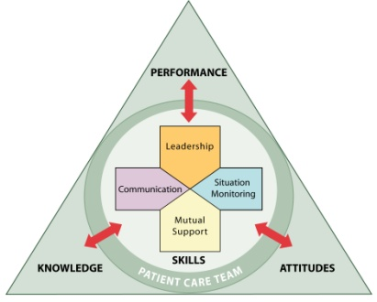
Identifying TeamSTEPPS Skills Supplement
Strategies and Tools to Enhance Performance and Patient Safety
TIME: 30 minutes
Notes:
Cover needs to be updated.

Slide 2
Quality Improvement in Nursing Homes
SAY:
Now that you’ve learned about TeamSTEPPS skills, you’ll want to put those skills to work to improve resident safety and quality of care. In addition to using your new skills in your everyday work, you may have the opportunity to participate in a quality improvement project and use your TeamSTEPPS skills there as well.
All nursing homes engage in quality improvement projects. Sometimes they are called quality assurance or continuous quality improvement. Regardless of the name, quality improvement starts with the identification of a problem or situation that needs improvement, the development of a plan to achieve that improvement, and then monitoring of the problem or situation to ensure that it continues to improve. Decreasing pressure ulcers, falls, and restraint use are goals that many nursing homes have adopted as a focus of their quality improvement projects. Improving resident outcomes, regardless of the problem, cannot be done by one person alone. It takes a whole team of people working together and communicating effectively to accomplish these important goals. TeamSTEPPS skills can be instrumental as nursing home staff identify areas for improvement and begin to work together to improve the quality and safety of nursing home residents’ lives.
Many types of quality improvement programs are available for nursing homes to use. One example is the On-Time Quality Improvement Program. Developed with funding and support from the Agency for Healthcare Research and Quality (AHRQ), On-Time uses electronic reports to provide timely information to frontline (or direct care) staff about residents who might be at risk for a bad outcome, such as pressure ulcers or falls. Specialized reports indicate which residents are at increased risk based on various factors, such as a new red area, decreased meal intake, or new incontinence. Subtle changes are noted early and the resident’s care plan is updated to include interventions to address and minimize the risk. The On-Time program helps staff integrate the use of these reports into their daily work routines.
Let’s watch a video that illustrates the use of one type of On-Time report. See if you can spot TeamSTEPPS skills in use.
.
VIDEO TIME:
8:10 minutes
MATERIALS:
On-Time Quality Improvement Nutrition Report Video
Continued…

Slide 3
Quality Improvement (continued)
DO: Play the video by clicking on the director icon on the slide
DISCUSSION:
Which TeamSTEPPS skills did you see the team members using in the Nutrition Report Video?
Possible answers:
Huddle: Lucy (Nursing Assistant) and Rose (Dietitian) meet briefly to discuss Mrs. Jones’ progress with eating breakfast foods. Huddles provide team members with an opportunity to update each other on emerging or significant changes in the status of the environment so all team members can adapt appropriately.
Debrief: Gayle (Nurse Manager) facilitates a discussion by asking questions related to team performance, i.e., “What did we do well? What isn’t going well?” Debriefs recap the situation, background, and key events that occurred.
Feedback: Rose (Dietitian) provides positive feedback to Lucy the nursing assistant about providing promised and specific information about Mrs. Jones. Gayle (Nurse Manager) provides feedback about the process as well. Feedback is a type of mutual support and is information provided for the purpose of improving team performance.
Let’s watch another video. Can you identify the TeamSTEPPS skill used here?
.

Slide 4
Quality Improvement (continued)
DO: Play the second video by clicking on the director icon on the slide
DISCUSSION:
Which TeamSTEPPS skills did you see the team members using in the Trigger Report Video?
Possible answer:
Huddle: Gayle (Nurse Manager) and Mary (Rehabilitation Director) meet briefly to discuss the latest On-Time report, directing their attention to specific residents showing changes. Huddles provide team members with an opportunity to update each other on emerging or significant changes in the status of the environment so all team members can adapt appropriately.
VIDEO TIME:
3:37 minutes
MATERIALS:
On-Time Quality Improvement Trigger Report Video

