Slide 1
Monitoring Ventilator-Associated Events
AHRQ Safety Program for Mechanically Ventilated Patients
AHRQ Pub. No. 16(17)-0018-26-EF
January 2017

Slide 2
Learning Objectives
After this session, you will be able to—
Describe the impact of mechanical ventilation and ventilator-associated events (VAE)
Identify the definitions of VAE
Recognize the need for an accurate objective outcome measure for VAE
Correctly apply VAE diagnostic criteria to determine if a VAE has occurred

Slide 3
Impact of Mechanical Ventilation
Affects 800,000 hospitalized patients in the United States each year¹
Five to 10 percent of ventilated patients develop a VAE^{2,3}
1. Carson SS, Cox CE, Homes GM, et al. The changing epidemiology of mechanical ventilation: a population-based study. J Intensive Care Med. 2006; 21(3):173-82. PMID: 16672639.
2. Klompas M, Kleinman K, Murphy MV. Descriptive epidemiology and attributable morbidity of ventilator-associated events. Infect Control Hosp Epidemiol. 2014; 35(5):502-510. PMID: 24709718.
3. Klein Klouwenberg PM, van Mourik, Ong DS, et al: Electronic implementation of a novel surveillance paradigm for ventilator-associated events: feasibility and validation. Am J Respir Crit Care Med. 2014 Apr 15;189(8):947-55. PMID: 24498886.

Slide 4
Impact of Mechanical Ventilation
Historically, ventilator-associated pneumonia (VAP) was considered one of the most lethal healthcare-associated infections⁴
35% mortality rate for ventilated patients⁵
24% for patients 15–19 years
60% for patients 85 years and older
4. Safdar N, Dezfullian C, Collard HR, et al. Clinical and economic consequences of ventilator–associated pneumonia: a systematic review. Crit Care Med. 2005; 33(10):2184-93. PMID: 16215368.
5. Wunsch H, Linde-Zwirble WT, Angus DC, et al. The epidemiology of mechanical ventilation use in the United States. Crit Care Med. 2010; 38(10):1947-53. PMID: 20639743.

Slide 5
Possible Complications of Mechanical Ventilation
VAE
Ventilator-associated condition (VAC)
Infection-related ventilator-associated condition (IVAC)
VAP
Acute Respiratory Distress Syndrome (ARDS)
Sepsis
Pulmonary embolism
Pulmonary edema
Barotrauma
And more

Slide 6
Understanding the Impact of VAC
Impact of Ventilator-Associated Conditions
VAC is typically attributable to pneumonia, pulmonary edema, atelectasis, or acute respiratory distress syndrome (ARDS)²
VAC has a strong association with prolonged mechanical ventilation, length of stay, and mortality⁶
2. Klompas M, Khan Y, Kleinman K, et al. Multicenter evaluation of a novel surveillance paradigm for complications of mechanical ventilation. PLoS ONE. 2011 Mar 22;6(3):e18062. PMID: 21445364.
6. Hayashi Y, Morisawa K, Klompas M, et al. Toward improved surveillance: the impact of ventilator-associated complications on length of stay and antibiotic use in patients in intensive care units. Clin Infect Dis. 2013; 56(4):471-7. PMID: 23118272.

Slide 7
Understanding the Impact of VAP
Impact of Ventilator-Associated Pneumonia^{4,7-12}
Crude mortality rate 30–50%
Attributable mortality rate 8–12%
Adds $10,000 to $50,000 to cost of hospital stay
Increases intensive care unit length of stay by 4–7 days
Increases hospital length of stay by 14 days
4. Safdar N, Dezfullian C, Collard HR, et al. Clinical and economic consequences of ventilator–associated pneumonia: a systematic review. Crit Care Med. 2005; 33(10):2184-93. PMID: 16215368.
7. Medicare Program: Proposed changes to the hospital inpatient prospective payment systems and fiscal year 2008 rates. CMS-1533-P. Baltimore, MD: Centers for Medicare and Medicaid Services. May 2007. https://www.cms.gov/Medicare/Medicare-Fee-for-Service-Payment/AcuteInpatientPPS/downloads/cms-1533-p.pdf. Accessed July 2015
8. Tejerina E, Frutos-Vivar F, Restrepo MI, et al. Incidence, risk factors, and outcome of ventilator-associated pneumonia. J Crit Care. 2006 Mar;21(1):56-65. 16616625.
9. Muscedere JG, Martin CM, Heyland DK. The impact of ventilator-associated pneumonia on the Canadian health care system. J Crit Care. 2008 Mar;23(1):5-10. PMID: 18359415.
10. Eber MR, Laxminarayan R, Perencevich EN, et al. Clinical and economic outcomes attributable to health care-associated sepsis and pneumonia. Arch Internal Med. 2010 Feb 22;170(4):347-53. PMID: 20177037.
11. Nguile-Makao M, Zahar JR, Français A, et al. Attributable mortality of ventilator-associated pneumonia: respective impact of main characteristics at ICU admission and VAP onset using conditional logistic regression and multi-state models. Intensive Care Med. 2010 May;36(5):781-9. PMID: 20232046.
12. Beyersmann J, Gastmeier P, Grundmann H, et al. Use of multistate models to assess prolongation of intensive care unit stay due to nosocomial infection. Infect Control Hosp Epidemiol. 2006 May;27(5):493-9. PMID: 16671031.

Slide 8
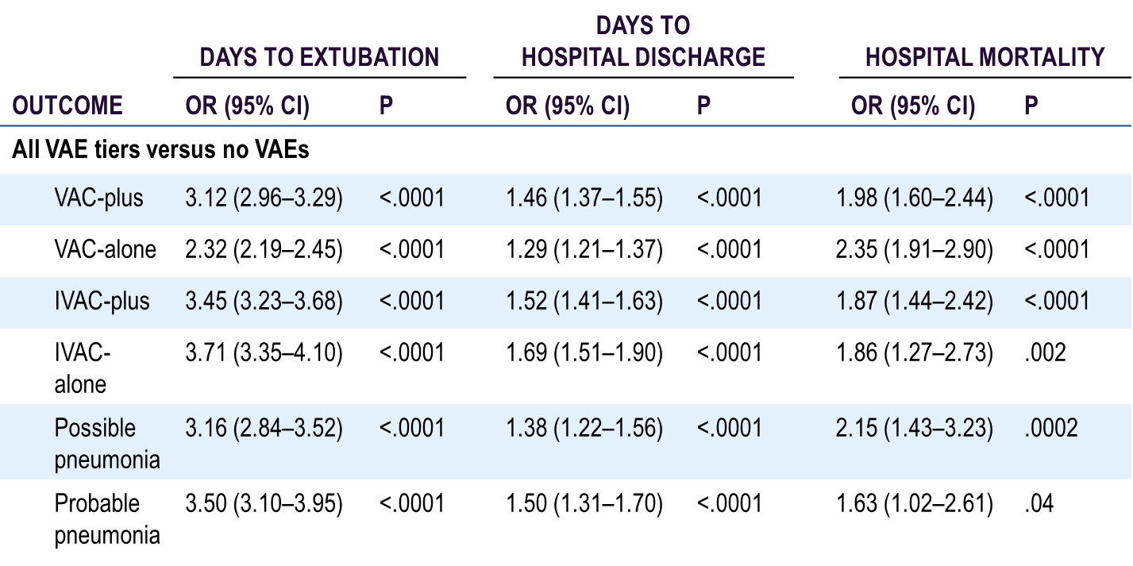
Why Is This Work Important?
VAE Attributable Hospital Mortality²
OR = Odds ratio; CI = Confidence interval, P = P-value
2. Klompas M, Khan Y, Kleinman K, et al. Multicenter evaluation of a novel surveillance paradigm for complications of mechanical ventilation. PLoS ONE. 2011 Mar 22;6(3):e18062. PMID: 21445364.

Slide 9
National Health Safety Network VAE Definition
Objective
Streamlined
Potentially automatable
Defines a broad range of conditions and complications occurring in mechanically ventilated patients

Slide 10
What Types of Mechanical Ventilation Are Included?
All types of mechanical ventilation, except—
High-frequency ventilation
Extracorporeal membrane oxygenation
Lung expansion devices, such as—
Intermittent positive pressure breathing
Nasal positive end-expiratory pressure (PEEP)
Nasal continuous positive airway pressure
Airway pressure release ventilation (APRV) and related modes are included but only fraction of inspired oxygen (FiO₂) values are used

Slide 11
VAE Definition Tiers¹³
Patient on mechanical ventilation > 2 days
Baseline period of stability or improvement, followed by sustained period of worsening oxygenation
VAC
IVAC
General evidence of infection/inflammation
Positive results of microbiological testing
Possible or Probable VAP
Respiratory status component
Infection / inflammation component
Additional evidence
13. Device-associated module: ventilator-associated event. Atlanta, GA: Centers for Disease Control and Prevention. January 2014. http://www.cdc.gov/nhsn/PDFs/pscManual/10-VAE_FINAL.pdf. Accessed September 21, 2015.

Slide 12
VAC – Definition Criteria
Patient intubated for >2 calendar days (earliest day of event is calendar day 3)
Baseline stability
Stable or improving baseline period
The 2 calendar days immediately preceding the first day of increased oxygen requirement, defined as an increased daily minimum PEEP or FiO₂

Slide 13
VAC – Determination
After period of stability or improvement on the ventilator, the patient exhibits at least one of these indicators of worsening oxygenation:
Daily minimum PEEP values increase ≥ 3 cm H₂O over daily minimum for the preceding 2 calendar days
Daily minimum FiO₂ values increase ≥ 0.20 over daily minimum for preceding 2 calendar days
PEEP or FiO₂ must be maintained for ≥ 1 hour (two consecutive hour readings) (see next slide for exceptions to this rule)

Slide 14
VAC – Exceptions to 1-Hour Rule
If PEEP or FiO₂ values are not recorded hourly, use lowest value
If PEEP or FiO₂ values are not stable for at least 1 hour, use the lowest value
Patient extubated early in the day
Patient admitted late in the day

Slide 15
IVAC – Criterion 1
Patient meets criteria for VAC (VAC must be determined before IVAC can be considered)
The patient must meet BOTH of the following criteria on or after calendar day 3 of mechanical ventilation AND within 2 calendar days before or after the onset of worsening oxygenation:
Criterion 1
Temp > 38ºC (100.4ºF) or < 36ºC (96.8ºF), OR
White blood cell count ≥ 12,000 cells/cubic millimeter (mm³), OR
White blood cell count ≤ 4,000 cells/cubic millimeter (mm³)
Criterion 2
A new antimicrobial agent(s) is started and continued for ≥ 4 calendar days

Slide 16
IVAC – Criterion 2
Patient meets criteria for VAC (VAC must be determined before IVAC can be considered)
The patient must meet BOTH of the following criteria on or after calendar day 3 of mechanical ventilation AND within 2 calendar days before or after the onset of worsening oxygenation:
Criterion 1
Temp > 38ºC (100.4ºF) or < 36ºC (96.8ºF), OR
White blood cell count ≥ 12,000 cells/cubic millimeter (mm³), OR
White blood cell count ≤ 4,000 cells/cubic millimeter (mm³)
Criterion 2
A new antimicrobial agent(s) is started and continued for ≥ 4 calendar days

Slide 17
IVAC Antimicrobial Criteria
Standardizes assessment method of antimicrobial therapy without the need for specific information, such as—
Drug dosing
Renal function
Indication for therapy

Slide 18
IVAC – Antimicrobials Included
Current
Antibacterials
Antifungals, limited antivirals
Former
Broad range of agents for healthcare-associated infections, not just respiratory infections
Listed in the CDC’s VAE Manual
http://www.cdc.gov/nhsn/PDFs/pscManual/10-VAE_FINAL.pdf

Slide 19
IVAC – Antimicrobials NOT Included
Anti-HIV agents
Anti-tuberculosis agents
Agents used to treat viral hepatitis
Agents used to treat herpes virus infection
Anti-parasitics

Slide 20
Definition – New Antimicrobial Agent
Any agent listed on slide 18 that is initiated in the VAE window period—
Was not given on either of the 2 days preceding the current start date
Must be continued for ≥ 4 consecutive days
Does not need to be the same antimicrobial agent for the 4 days
Can be considered continuous if a single day is skipped between two doses of the same agent
Must be administered intravenously, intramuscularly, via digestive tract, or via respiratory tract

Slide 21
IVAC – New Antimicrobials NOT Included
Amantadine
Chloramphenicol
Daptomycin
Erythromycin
Erythromycin/
sulfisoxazole
Fidaxomicin
Nitrofurantoin
Oral cephalosporins
Oral vancomycin
Rimantadine
Tinidazole

Slide 22
VAE: AN OBJECTIVE OUTCOME MEASURE
AHRQ Safety Program for Mechanically Ventilated Patients

Slide 23
Diagnostic Criteria for VAP¹⁴
 | High Temperature | Low Temperature | High White Blood Cell Count (WBC) | Low WBC | Low Partial Pressure of Oxygen: FiO² ratio | Increased vent settings | Purulent secretions | Gram stain neutrophils | New antibiotic start | Infiltrate
Centers for Disease Control (CDC): Old Definition | ✓ | ✓ | ✓ | ✓ | ✓ |  | ✓ |  |  | ✓
Centers for Disease Control (CDC): New Definition | ✓ | ✓ | ✓ | ✓ |  | ✓ |  | ✓ | ✓
Hospitals in Europe Link for Infection Control Through Surveillance (HELICS) Criteria | ✓ |  | ✓ |  | ✓ |  | ✓ |  |  | ✓
American College of Chest Physicians (ACCP) Criteria | ✓ |  | ✓ | ✓ |  |  | ✓ |  |  | ✓
Clinical Pulmonary Infection Score (CPIS) | ✓ | ✓ | ✓ | ✓ | ✓ |  | ✓ |  |  | ✓
Johanson Clinical Criteria | ✓ |  | ✓ |  |  |  | ✓ |  |  | ✓
14. Ego A, Preiser JC, Vincent JL. Impact of diagnostic criteria on the incidence of ventilator-associated pneumonia. Chest. 2015; 147(2):347-55. PMID: 25340476.

Slide 24
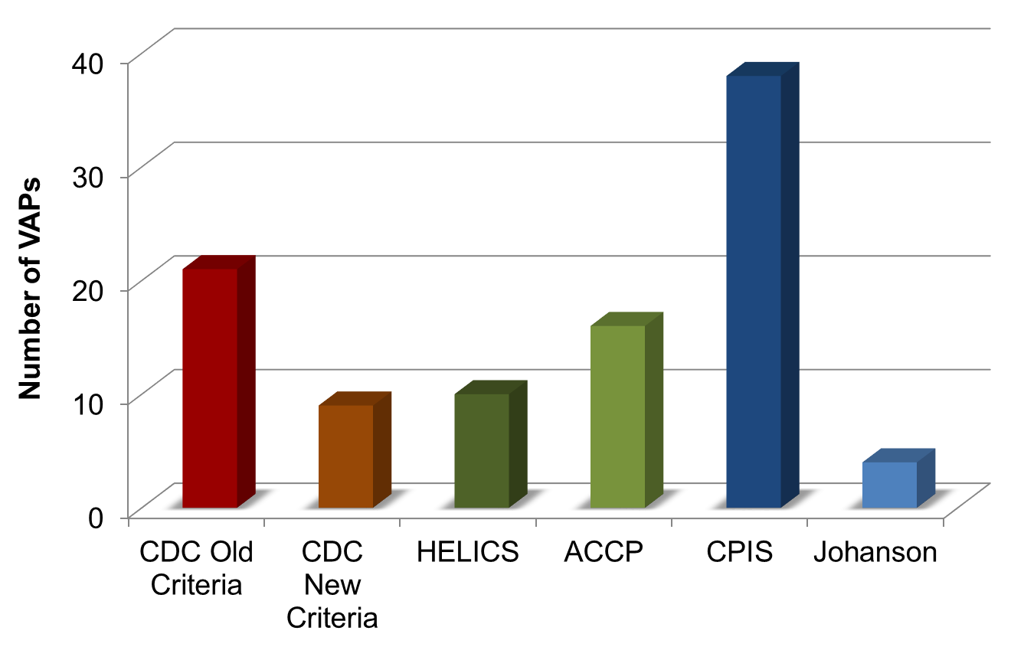
Impact of Diagnostic Criteria on VAP Prevalence¹⁴
ACCP = American College of Chest Physicians; CDC = Centers for Disease Control and Prevention; CPIS = Clinical Pulmonary Infection Score; HELICS = Hospitals in Europe Link for Infection Control through Surveillance; Johanson Clinical Criteria
14. Ego A, Preiser JC, Vincent JL. Impact of diagnostic criteria on the incidence of ventilator-associated pneumonia. Chest. 2015; 147(2):347-55. PMID: 25340476.

Slide 25
Inconsistency in VAP Diagnoses¹⁵
84 ICU patients with abnormal chest x rays and purulent sputum
Evaluated by seven physicians for VAP
Establish objective diagnosis by histology
or quantitative bronchoscopy cultures
32% of patients diagnosed with VAP
15. Fagon JY, Chastre J, Hance AJ, et al. Evaluation of clinical judgment in the identification and treatment of nosocomial pneumonia in ventilated patients. Chest. 1993; 103(2):547-53. PMID: 8432152.

Slide 26
Inconsistency in VAP Diagnoses¹⁵
42%
of physicians disagreed on presence or absence of VAP in 35/84 of patients
28%
of the MOST accurate doctors missed
true VAPs
20%
of patients misdiagnosed with VAP from both groups
50%
of the LEAST accurate
doctors missed true VAPs
15. Fagon JY, Chastre J, Hance AJ, et al. Evaluation of clinical judgment in the identification and treatment of nosocomial pneumonia in ventilated patients. Chest. 1993;103(2):547-53. PMID: 8432152.

Slide 27
DIAGNOSING A POTENTIAL VAC
AHRQ Safety Program for Mechanically Ventilated Patients

Slide 28
Let’s Find a VAC
Daily minimum PEEP values increase ≥ 3 cm water over daily minimum for the preceding 2 calendar days
Daily minimum FiO₂ values increase ≥ 0.20 over daily minimum for preceding 2 calendar days

Slide 29
Example 1 – PEEP
Two days of stable PEEP, followed by a change in PEEP of ≥ 3.
The change is maintained or worsens for ≥ 2 days.
MV Day | Min PEEP | Min FiO₂
1 | 8 | 100
2 | 7 | 70
3 | 6 | 50
4 | 6 | 70
5 | 5 | 60
6 | 5 | 50
7 | 8 | 70
8 | 9 | 80
9 | 6 | 50
10 | 7 | 50
Is this a VAC?
MV = Mechanical Ventilation, Min = Minimum

Slide 30
Example 1 – PEEP
Two days of stable PEEP, followed by a change in PEEP of ≥ 3.
The change is maintained or worsens for ≥ 2 days.
MV Day | Min PEEP | Min FiO₂
1 | 8 | 100
2 | 7 | 70
3 | 6 | 50
4 | 6 | 70
5 | 5 | 60
6 | 5 | 50
7 | 8 | 70
8 | 9 | 80
9 | 6 | 50
10 | 7 | 50
Is this a VAC?
YES!
This is a VAC!

Slide 31
Example 2 – FiO₂
Two days of stable FiO₂, followed by a change in FiO₂ of ≥ 0.20.
The change is maintained or worsens for ≥ 2 days.
MV Day | Min PEEP | Min FiO₂
1 | 8 | 100
2 | 7 | 70
3 | 6 | 50
4 | 6 | 50
5 | 5 | 70
6 | 5 | 70
7 | 6 | 70
8 | 6 | 80
9 | 6 | 50
10 | 7 | 50
Is this a VAC?

Slide 32
Example 2 – FiO₂
Two days of stable FiO₂, followed by a change in FiO₂ of ≥ 0.20.
The change is maintained or worsens for ≥ 2 days.
MV Day | Min PEEP | Min FiO₂
1 | 8 | 100
2 | 7 | 70
3 | 6 | 50
4 | 6 | 50
5 | 5 | 70
6 | 5 | 70
7 | 6 | 70
8 | 6 | 80
9 | 6 | 50
10 | 7 | 50
Is this a VAC?
YES!
This is a VAC!

Slide 33
Example 3
Examine the PEEP and FiO₂ values…
Is this a VAC?
MV Day | Min PEEP | Min FiO₂
1 | 8 | 100
2 | 7 | 70
3 | 6 | 55
4 | 6 | 50
5 | 5 | 70
6 | 5 | 70
7 | 6 | 70
8 | 6 | 80
9 | 6 | 50
10 | 7 | 50

Slide 34
Example 3
NO!
This is not
a VAC!
MV Day | Min PEEP | Min FiO₂
1 | 8 | 100
2 | 7 | 70
3 | 6 | 55
4 | 6 | 50
5 | 5 | 70
6 | 5 | 70
7 | 6 | 70
8 | 6 | 80
9 | 6 | 50
10 | 7 | 50
Why not?
There is no increase of ≥ 3 for the minimum PEEP at any time.
There is no 2-day stability period in FiO₂ before the .20 increase.

Slide 35
Questions?

Slide 36
References
Carson SS, Cox CE, Homes GM, et al. The changing epidemiology of mechanical ventilation: a population-based study. J Intensive Care Med. 2006; 21(3):173-82. PMID: 16672639.
Klompas M, Kleinman K, Murphy MV. Descriptive epidemiology and attributable morbidity of ventilator-associated events. Infect Control Hosp Epidemiol. 2014; 35(5):502-510. PMID: 24709718.
Klein Klouwenberg PM, van Mourik, Ong DS, et al: Electronic implementation of a novel surveillance paradigm for ventilator-associated events: feasibility and validation. Am J Respir Crit Care Med. 2014 Apr 15;189(8):947-55. PMID: 24498886
Safdar N, Dezfullian C, Collard HR, et al. Clinical and economic consequences of ventilator-associated pneumonia: a systematic review. Crit Care Med. 2005; 33(10):2184-93. PMID: 16215368.

Slide 37
References
Wunsch H, Linde-Zwirble WT, Angus DC, et al. The epidemiology of mechanical ventilation use in the United States. Crit Care Med. 2010; 38(10):1947-53. PMID: 20639743.
Hayashi Y, Morisawa K, Klompas M, et al. Toward improved surveillance: the impact of ventilator-associated complications on length of stay and antibiotic use in patients in intensive care units. Clin Infect Dis. 2013; 56(4):471-7. PMID: 23118272.
Medicare Program: Proposed changes to the hospital inpatient prospective payment systems and fiscal year 2008 rates. CMS-1533-P. Baltimore, MD: Centers for Medicare and Medicaid Services. May 2007. https://www.cms.gov/Medicare/Medicare-Fee-for-Service-Payment/AcuteInpatientPPS/downloads/cms-1533-p.pdf. Accessed July 2015.

Slide 38
References
Tejerina E, Frutos-Vivar F, Restrepo MI, et al. Incidence, risk factors, and outcome of ventilator-associated pneumonia. J Crit Care. 2006 Mar;21(1):56-65. 16616625.
Muscedere JG, Martin CM, Heyland DK. The impact of ventilator-associated pneumonia on the Canadian health care system. J Crit Care. 2008 Mar;23(1):5-10. PMID: 18359415.
Eber MR, Laxminarayan R, Perencevich EN, et al. Clinical and economic outcomes attributable to health care-associated sepsis and pneumonia. Arch Internal Med. 2010 Feb 22;170(4):347-53. PMID: 20177037.
Nguile-Makao M, Zahar JR, Français A, et al. Attributable mortality of ventilator-associated pneumonia: respective impact of main characteristics at ICU admission and VAP onset using conditional logistic regression and multi-state models. Intensive Care Med. 2010 May;36(5):781-9. PMID: 20232046.

Slide 39
References
Beyersmann J, Gastmeier P, Grundmann H, et al. Use of multistate models to assess prolongation of intensive care unit stay due to nosocomial infection. Infect Control Hosp Epidemiol. 2006 May;27(5):493-9. PMID: 16671031.
Device-associated module: ventilator-associated event. Atlanta, GA: Centers for Disease Control and Prevention. January 2014. http://www.cdc.gov/nhsn/PDFs/pscManual/10-VAE_FINAL.pdf. Accessed September 21, 2015.
Ego A, Preiser JC, Vincent JL. Impact of diagnostic criteria on the incidence of ventilator-associated pneumonia. Chest. 2015; 147(2):347-55. PMID: 25340476.
Fagon JY, Chastre J, Hance AJ, et al. Evaluation of clinical judgment in the identification and treatment of nosocomial pneumonia in ventilated patients. Chest. 1993; 103(2):547-53. PMID: 8432152.

