Slide 1
Urinary Catheter Types and Being Part of the Insertion Team
AHRQ Pub. No. 16(17)-0003-7-EF
March 2017
Notes:
Welcome to today’s session on being a part of the urinary catheter insertion team. This training is part of the Agency for Healthcare Research and Quality’s (or AHRQ’s) Safety Program for Long-term Care that addresses healthcare-associated infections (or HAIs) and catheter-associated urinary tract infections (or CAUTI).

Slide 2
Learning Objectives
Upon completion of this session, licensed staff who insert or assist in the insertion of urinary catheters will be able to—
explain the similarities and differences between the four different types of urinary catheters;
prepare for and insert an indwelling urinary catheter using aseptic technique; and
summarize effective strategies in preventing CAUTIs.
Notes:
Today we’re going to talk about different types of urinary catheters, how to prepare for inserting an indwelling urinary catheter and the proper technique for aseptic insertion. We’re going to go over some strategies you can use to prevent catheter-associated urinary tract infections. From here on, we’ll refer to those infections as CAUTIs.
This session will help you understand how you, regardless of your role, can make a difference in the safety and quality of care for the residents we serve. So let’s get started.

Slide 3
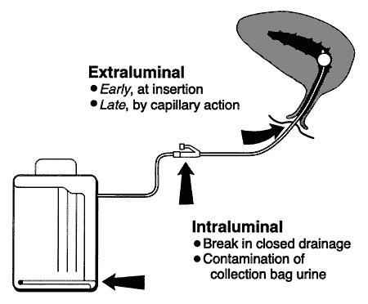
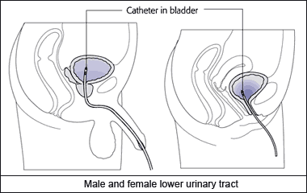
Indwelling Urinary Catheters¹
Bladder
Indwelling Urinary Catheter
Urethra
(Urinary tract entrance)
Photograph from National Healthcare Safety Network, Centers for Disease Control and Prevention
Urine Collection Bag
Source: Maki DG, Tambyah PA. Engineering out the risk of infection with urinary catheters. Emerg Infect Dis. 2001 Mar-Apr;7(2):342-7.
http://wwwnc.cdc.gov/eid/article/7/2/70-0342_article.
*CMS, State Operations Manual, 2014.
Notes:
You are all familiar with urinary catheters. An indwelling catheter (often referred to as a Foley) is a drainage tube that is inserted into the bladder through the urethra in order to drain urine from the bladder. It is connected by tubing to a bag used to collect and measure urine and is a closed system usually kept in place for a period of time.
Take note of some of the ways and times catheters can act as a portal of entry for microbes. Infectious microbes can travel along both the inside and outside catheter tubing. For instance, microbes can enter the bladder through capillary action, which is the movement of a liquid through or along a surface of another material in spite of another force, such as gravity. That’s why the way YOU insert and care for catheters is so important!
____________
Additional Notes
Remind staff that the primary focus of this project is to prevent CAUTIs based on the National Healthcare Safety Network (NHSN) criteria, which only counts indwelling urinary catheters.

Slide 4
Alternative Catheter Types
Straight Catheters
Suprapubic Catheters
External “Condom”
Catheters for Men
Inserted directly into the urethra and bladder
Removed after insertion and drainage of bladder
Used intermittently
Placed surgically directly through skin into the bladder
Connected by tubing to a bag used to collect and measure urine
Does not enter the bladder
Four different types to adhere to the penis
Connected by tubing used to collect and measure urine output
Cannot be used to treat acute urinary retention
Notes:
In addition to an indwelling catheter here are some alternatives to consider. These are good to keep in mind during resident assessments.
Straight catheters are one-time use catheters and used for a number of reasons. A resident may not be completely emptying their bladder when voiding or perhaps not able to void at all.
Suprapubic catheters are surgically placed through the skin into the bladder, and also connect to a collection bag by tubing.
And finally, external condom catheters attach over the penis using an adhesive. Because they are used for residents who can void they are not appropriate for treating urinary retention.

Slide 5
Quiz²
Which of the following are appropriate indications for placing an indwelling urinary catheter?
Bladder outlet obstruction
Urinary incontinence
Incontinence and sacral wound
Resident’s request for end-of-life
Transferred from hospital with catheter
Notes:
Before we begin talking about proper insertion technique, let’s pause here for a little quiz.
Which of these reasons do you think are appropriate indications for placing an indwelling catheter?
Bladder outlet obstruction
Urinary incontinence
Incontinence and sacral wound
Resident’s request (end-of-life)
Transferred from hospital with catheter
[PAUSE for 30 seconds]
Well, b) urinary incontinence alone is not sufficient reason for an indwelling catheter.
E) being transferred from the hospital to your facility with a catheter is also not correct. The resident should be assessed to be sure there is a need to keep that catheter in.
So, the correct answers are: a) bladder obstruction; c) an incontinent resident with a sacral wound; and d) at the resident’s request during end-of-life care.

Slide 6
Preparing to Place an Indwelling Urinary Catheter
Review the doctor’s order and verify that the catheter is clinically indicated
Gather your catheter insertion kit and other supplies
Use the buddy system—get a second pair of hands to help!
Notes:
It is important that nurses look for an indication of continued use of an indwelling catheter and that regular periodic assessments are done. Share the assessments and your thoughts with the physician. A resident’s condition can certainly change, and at some point another option may be more appropriate. Maybe an external or straight catheter can be used, or a toileting program would now be beneficial for that resident.
If you get an order to place a new catheter, review it, and verify that it’s clinically indicated. And remember to get your supplies together and find someone to assist you before you start.

Slide 7
Catheter Insertion Kit Contents³
Drape with opening, sterile gloves
Antiseptic solution for periurethral cleaning before insertion, swabs and tongs to use for applying antiseptic solution
Single-use packet of lubricant
Single-use dose of topical lidocaine jelly
Sterile urinary catheter, of smallest size effective for patient (14 or 16 French) connected to tubing and bag
Catheter securing device
Notes:
As you know most kits, if not all, contain these contents:
A drape with an opening, a pair of sterile gloves.
Antiseptic solution, swabs, and tongs to use for applying the solution.
A single-use package of lubricant and a single-use dose of topical lidocaine jelly.
A sterile urinary catheter, collection bag and tubing, and a catheter securing device.
These are the things you’re going to need, so be sure to have them all before you begin.
_______________________________________
Additional Notes
Research has shown that residents with a urinary catheter have a higher chance of having multi-drug resistant organisms in their groin. By using gowns and gloves during intimate ADLs such as AM and PM care, LTC providers can avoid contaminating their own hands and clothing due to splashing, and therefore minimize the risk of infecting others with multi-drug resistant organisms.

Slide 8
Prepping for Catheter Insertion Procedure³
Cleanse hands and don gloves
Get your buddy to help at the bedside
Place resident in the supine position
For a female—apply topical lidocaine jelly if needed for comfort
For a male—if uncircumcised, retract foreskin. Inject 10-15 mL of topical lidocaine into urethral meatus; gently pinch tip of penis for several minutes to retain lidocaine
Inspect catheter kit and remove it from its outer packaging to form a sterile field
Remove gloves and wash hands!
Notes:
In preparation, have your resident in supine position. Get your buddy to help you at the bedside, making sure that he or she has washed their hands and put on their personal protective equipment (PPE).
By using a gown during the preparation and the procedure you can avoid contaminating your clothing due to any splashing that may occur, and it will also minimize the risk of transmission of any multi-drug resistant organisms (or MDROs) that might be present.
For female residents, apply topical lidocaine for comfort, if needed. For a male resident who is uncircumcised, retract the foreskin. Inject 10-15 mL of topical lidocaine into the urethral meatus and gently pinch the tip of the penis for several minutes to retain the lidocaine.
Inspect catheter kit and remove it from its outer packaging. Open inner paper wrapping to form a sterile field on a bedside table or other flat surface. Don’t use the residents bed. Then, remove your gloves and cleanse your hands.

Slide 9
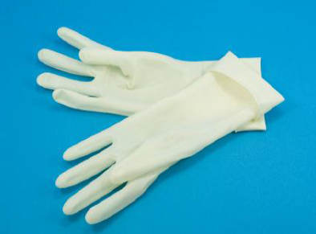
Hygiene and Standard Precautions Catheter Insertion Procedure^{2,3}
Don sterile gloves
Cover resident’s lower abdomen and upper thighs with dignity cover
Organize contents of tray on sterile field
Pour antiseptic solution over swabs in tray compartment
Squeeze sterile catheter lubricant onto tray
Notes:
To help prevent CAUTIs and the spread of MDROs to residents with urinary catheters, be sure to clean your hands again, and you can now put on a gown. Put on your sterile gloves and remove the absorbent pad, placing it under the resident’s buttocks with the plastic side down. Cover the resident’s lower abdomen and upper thighs with the drape, with the opening placed to expose the urethra. Then, organize contents of the tray on the sterile field. Keep in mind, you’ll need things within easy reach! Pour the antiseptic solution over swabs in the tray and squeeze the sterile lubricant onto the tray.
The key here is preparation. The more you have prepared and ready to use, the less likely you are to make a mistake. And, it is more likely that the procedure will go quickly, smoothly and that you will keep things aseptic.

Slide 10
Male Catheter Insertion Procedure
Using gloved nondominant hand, grasp penis taut and perpendicular to the plane of the resident’s body.
Cleanse the glans of penis using the antiseptic soaked swabs using tongs, in expanding circular motion. Discard used swabs away from sterile field.
Keep nondominant hand in this position, do not remove!
Lubricate tip of catheter with sterile lubricant jelly.
Holding the coiled catheter in dominant hand, gently introduce the catheter tip into the urethral meatus.
If using coude catheter, point catheter tip upward to 12 o’clock position.
Slowly advance the catheter through the urethra into the bladder. If substantial resistance is met, do not force the catheter!
If tip of catheter is accidentally contaminated by touching anything that is not sterile, discard, and get a new one.
Notes:
We’ll begin with male insertion. Using your non-dominant hand, hold the penis taut and perpendicular to the plane of the resident’s body. Be sure to keep your non-dominant hand in this position—don’t switch hands, because it would now be considered unsterile. With your dominant hand, use the tongs to pick up the antiseptic soaked swabs, and in an expanding circular motion, cleanse the glans of the penis. Be sure to discard the swabs away from your sterile field.
Lubricate the tip of the catheter with the jelly and again; using your “sterile” dominant hand, gently insert the catheter tip in to the urethral meatus. Then, advance the tube slowly into the bladder. Don’t force the catheter if you meet with substantial resistance. And if you do accidentally contaminate the catheter tip by touching anything that is not sterile, discard the catheter and get a new one.
_______________________
Additional Notes
If you’re using a slightly curved or coude catheter you’re going to point it upward to the 12 o’clock position. These catheters are designed to allow for navigation past obstructions in the urinary tract, such as a swollen prostate in men.

Slide 11
Female Catheter Insertion Procedure
Using gloved nondominant hand, identify urethra by spreading the labia
Spread inner labia slightly with gentle traction and pull upwards toward resident’s head
Clean periurethral area and urethral opening using antiseptic soaked swabs using tongs, in expanding circular motion. Discard used swabs away from sterile field.
Lubricate tip of catheter with sterile lubricant jelly
Holding the coiled catheter in dominant hand, gently introduce the catheter tip into the urethral meatus
Slowly advance the catheter through the urethra into the bladder. If substantial resistance is met, do not force the catheter!
If catheter is accidentally contaminated by touching anything that is not sterile, discard, and get a new one
If catheter is accidentally inserted in to vagina, discard, and get a new one
Notes:
For a female, again, you’re going to use your gloved, non-dominant hand to spread the labia and identify the urethra. Slightly spread the inner labia gently pulling upwards. Do not remove that hand. Using your dominant hand and the tongs, cleanse the area and the opening using the prepared swabs and discard them away from your sterile field. Lubricate the tip of the catheter and, holding it in your dominant hand, gently introduce the tip into the urethral meatus. Slowly advance the catheter through the urethra and into the bladder. Again, if you meet substantial resistance, do not force the catheter, as you may cause trauma or injury. If the catheter becomes contaminated by touching anything not sterile, discard it and get a new one. If you should accidentally begin to insert it into the vagina, do the same.

Slide 12
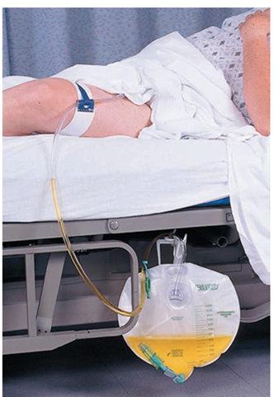
Securing Drainage Bag
Advance tubing another 3-5 cm once you see urine in the tubing
Inflate balloon with 10 cc sterile water
Once inflated, pull gently on catheter to make sure it’s secure
Secure catheter to medial thigh
Place drainage bag below the level of the bladder
Remove personal protective equipment and wash hands immediately
Notes:
With proper insertion, you should see urine in the tubing, and only then should you advance the catheter another 3-5 centimeters and inflate the balloon with 10cc of sterile water. Then, tug gently on the catheter to make sure it’s secure. Secure the tubing to a medial thigh and place the drainage bag below the level of the bladder. Roll up the contents of the catheter kit and wrappings, and discard them. Finally, remove your personal protective equipment and immediately wash your hands.

Slide 13
Insertion Avoiding Common Mistakes⁴
Wash hands BEFORE and AFTER procedure
Put on your sterile gloves after opening catheter kit
If sterile, gloved hand gets contaminated or glove rips, then remove glove, wash hands, and don NEW sterile gloves
Sterile urinary catheters can get contaminated by touching labia, being inserted into vagina, or touching any other part of body besides cleansed urethra
If this happens, STOP procedure and get NEW sterile catheter to use
Use tongs to cleanse the urethral area with your sterile hand
Do not switch hands
Notes:
Now that we’ve reviewed how to properly insert an indwelling urinary catheter, using aseptic technique, let’s go over some things to avoid common mistakes.
Cleanse your hands before and after prepping, and before and after the procedure.
Put on your STERILE gloves after opening and preparing the catheter kit.
Catheters become contaminated by touching the labia, insertion into the vagina, or by touching any other part of the body other than the cleansed opening. If this should happen, stop, and get a new sterile catheter.
Use tongs to cleanse the urethral area with your sterile hand and do not switch hands
And remember what I mentioned earlier—that the key to proper aseptic insertion is to prepare as much as possible.

Slide 14
References
Maki DG, Tambyah PA. Engineering out the risk for infection with urinary catheters. Emerg Infect Dis. 2001;7(2):342-7. http://wwwnc.cdc.gov/eid/article/7/2/70-0342_article.. PMID: 11294737.
Gould CV, Umscheid CA, Agarwal RK, et al. Centers for Disease Control and Prevention. Guidelines for prevention of catheter-associated urinary tract infections 2009. Atlanta, GA: US Department of Health and Human Services, CDC; 2009. http://www.cdc.gov/hicpac/pdf/cauti/cautiguideline2009final.pdf. Accessed January 28, 2016.
Willson M, Wilde M, Webb M, et al. Nursing interventions to reduce the risk of catheter‐associated urinary tract infection: part 2: staff education, monitoring, and care techniques. J Wound Ostomy Continence Nurs. 2009;36(2):137-54. PMID: 19287262.
Manojlovich M, Saint S, Meddings J, et al. Indwelling urinary catheter insertion practices in the emergency department: an observational study. Infect Control Hosp Epidemiol. 2016;37(1):117-9. PMID: 26434781.

