Slide 1
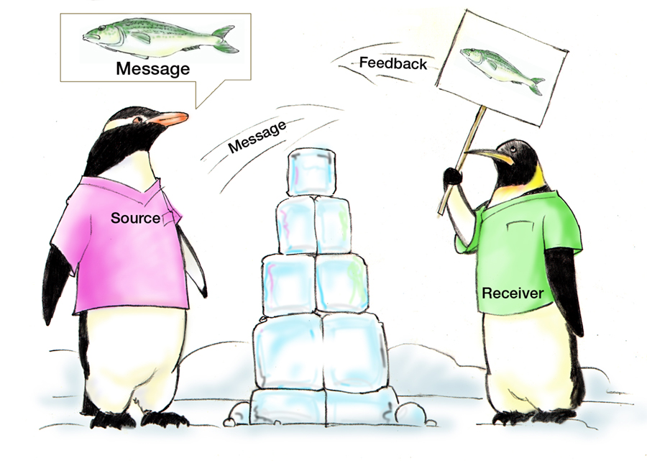
Communication
Assumptions
Fatigue
Distractions
HIPAA

Slide 2
Objectives
Describe how communication affects team processes and outcomes
Define effective communication
Identify communication challenges
Identify TeamSTEPPS tools and strategies that can improve a team’s communication

Slide 3
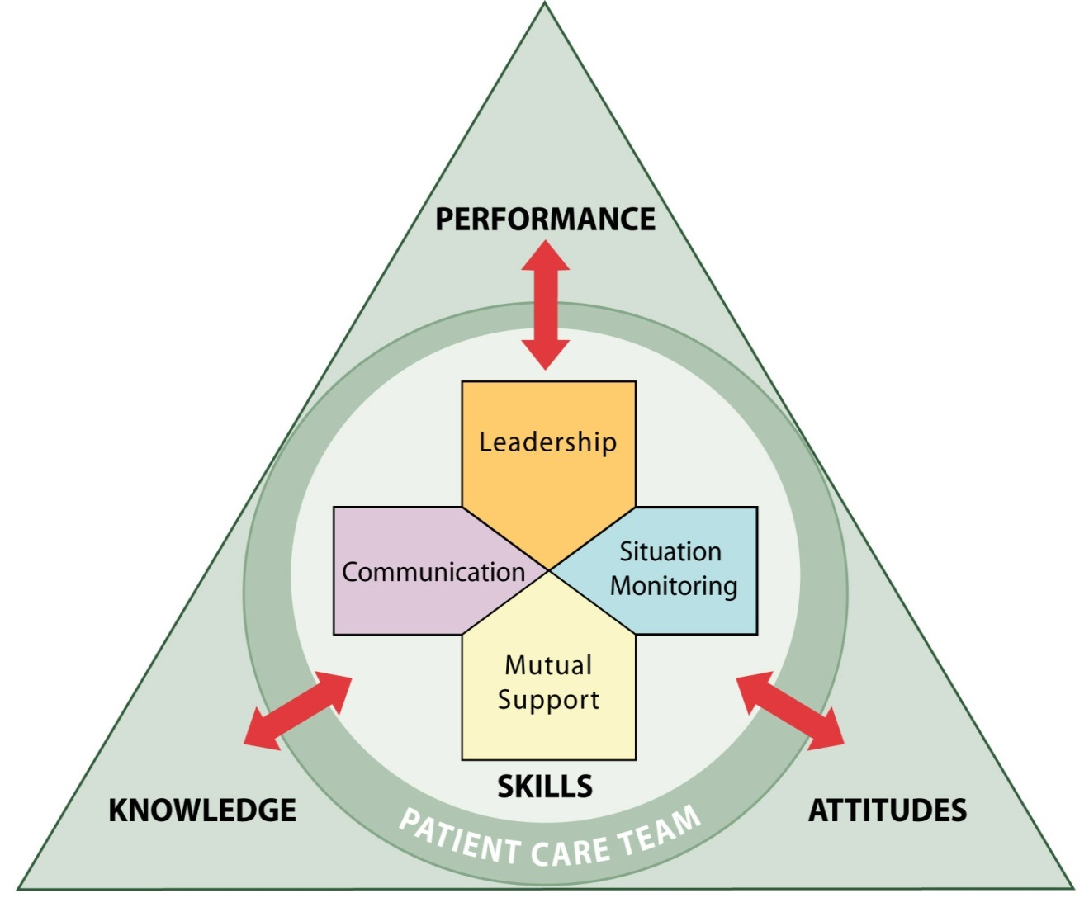

Communication
Effective communication skills are vital for resident safety
Enables team members to effectively relay information
The mode by which most TeamSTEPPS strategies and tools are executed

Slide 4
Importance of Communication
Joint Commission data continues to demonstrate the importance of communication in patient safety
  1995 - 2005: Ineffective communication
  identified as root cause for nearly 66 percent of all reported sentinel events*
  2010 - 2013: Ineffective communication among top 3 root causes of sentinel events reported**
  * (JC Root Causes and Percentages for Sentinel Events (All Categories) January 1995−December 2005)
  ** (JC Sentinel Event Data (Root Causes by Event Type) 2004-2012)

Slide 5
Communication is…
The process by which information is exchanged between individuals, departments, work areas, or organizations
The lifeline of the
Core Team
Effective when it
permeates every
aspect of an
organization
Assumptions
Fatigue
Distractions
HIPAA

Slide 6
Standards of Effective Communication
Complete
  Communicate all relevant information
Clear
  Convey information that is plainly understood
Brief
  Communicate the information in a concise manner
Timely
  Offer and request information in an appropriate timeframe
  Verify authenticity
  Validate or acknowledge information

Slide 7
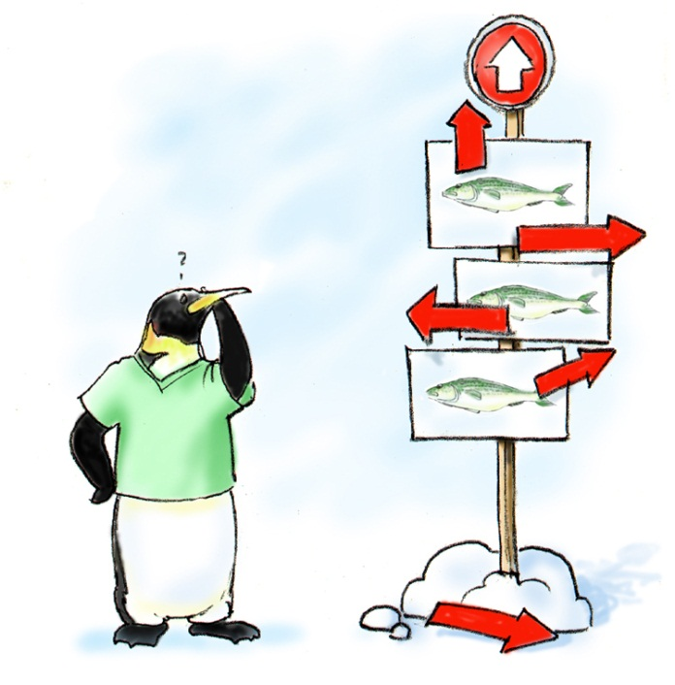
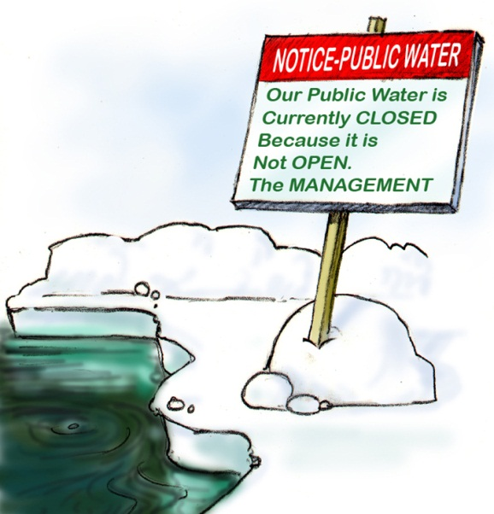
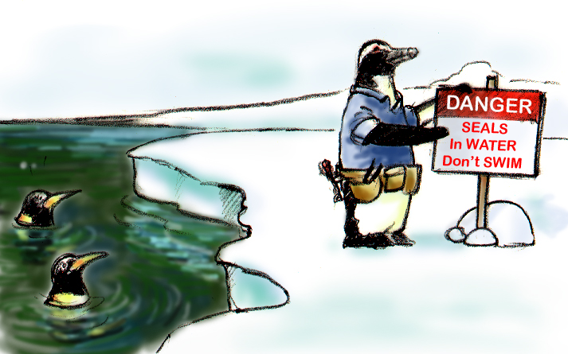
Brief
Clear
Timely

Slide 8
Communication Challenges
Language barrier
Distractions
Physical proximity
Personalities
Workload
Varying communication styles
Conflict
Lack of information verification
Shift change

Slide 9
Information Exchange Strategies
Situation – Background – Assessment – Recommendation (SBAR)
Call-Out
Check-Back
Handoffs

Slide 10
SBAR Provides…
A framework for team members to effectively communicate information to one another
Communicate the following information:
  Situation―What is going on with the resident?
  Background―What is the clinical background or context?
  Assessment―What do I think the problem is?
  Recommendation―What would I recommend?

Slide 11


SBAR Video

Slide 12

SBAR Exercise
Create an SBAR example based on your role.

Slide 13


Call-Out is…
A strategy used to communicate
important or critical information
  It informs all team members
  simultaneously during
  emergency situations
  It helps team members
  anticipate next steps

Slide 14
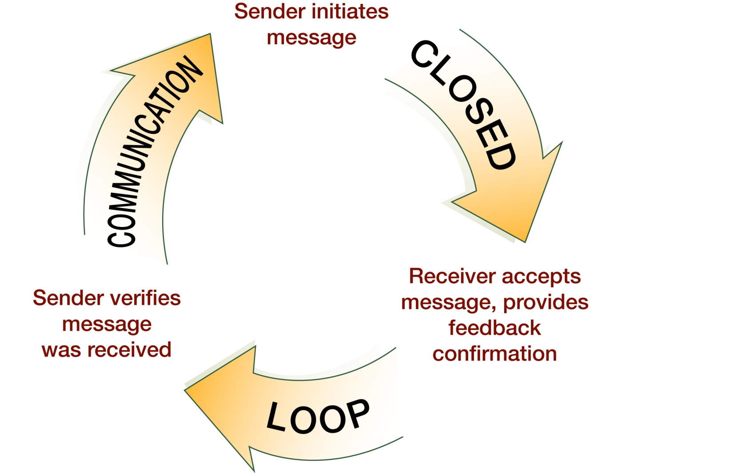

Check-Back is…

Slide 15
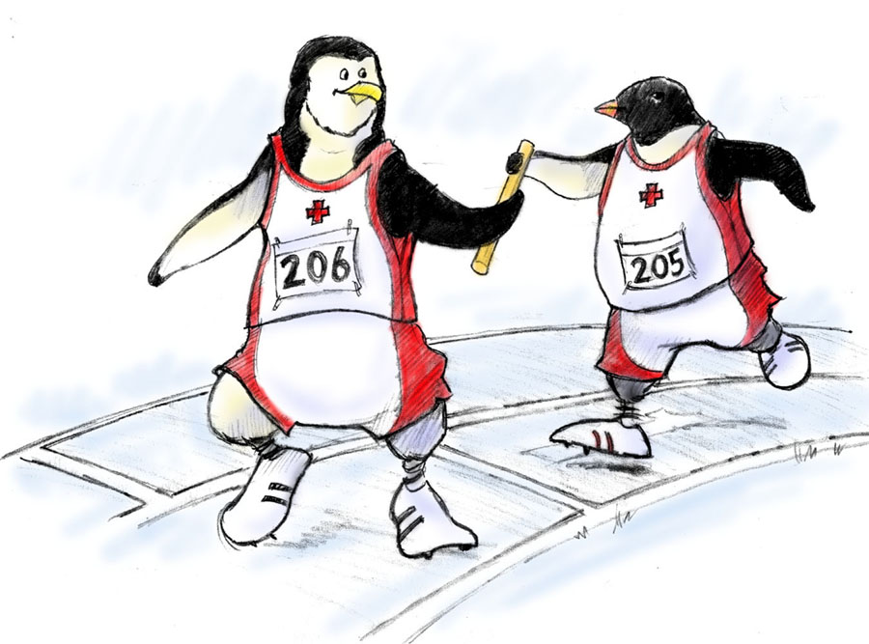
Handoff is…
The transfer of information during transitions in care across the continuum
  Includes an opportunity to ask questions, clarify, and confirm

Slide 16

Handoff Consists of…
Transfer of responsibility and accountability
Clarity of information
Verbal communication of information
Acknowledgment by receiver
Opportunity to review

Slide 17


“I PASS THE BATON”
Introduction: Introduce yourself and your role/job (include resident)
Patient/Resident: Identifiers, age, sex, location
Assessment: Present chief complaint, vital signs, symptoms, and
diagnosis
Situation: Current status/circumstances, including code status,
level of uncertainty, recent changes, and response to treatment
Safety: Critical lab values/reports, socioeconomic factors, allergies, and alerts
(falls, isolation, etc.)
THE
Background: Comorbidities, previous episodes, current medications, and family history
Actions: What actions were taken or are required? Provide brief rationale
Timing: Level of urgency and explicit timing and prioritization of actions
Ownership: Who is responsible (nurse/doctor/team)?
Include resident/family responsibilities
Next: What will happen next? Anticipated changes?
What is the plan? Are there contingency plans?

Slide 18
Other Example Handoff Tools
I PASS
  Illness severity; Patient/Resident Summary; Action list for the new team; Situation awareness and contingency plans; Synthesis and “read back” of the information
HAND-IT
  Handoff Intervention Tool

Slide 19
Tools & Strategies Summary
BARRIERS
Inconsistency in Team Membership
Lack of Time
Lack of Information Sharing
Hierarchy
Defensiveness
Conventional Thinking
Complacency
Varying Communication Styles
Conflict
Lack of Coordination and Followup with Coworkers
Distractions
Fatigue
Workload
Misinterpretation of Cues
Lack of Role Clarity
TOOLS and STRATEGIES
  Communication
  SBAR
  Call-Out
  Check-Back
  Handoff
OUTCOMES
Shared Mental Model
Adaptability
Team Orientation
Mutual Trust
Team Performance
Resident Safety!!

Slide 20

Applying TeamSTEPPS Exercise
Is your teamwork issue related to communication?
If yes, what is the communication issue?
Which TeamSTEPPS tools and/or strategies might you consider implementing to address the issue?

