Slide 1


Team Training in Healthcare and TeamSTEPPS at Johns Hopkins
December 11, 2013

Slide 2
Acknowledgements
Project Sponsors
  Jim Battles, PhD (AHRQ)
  Heidi King, MS (DoD)
Project Team
  Health Research & Educational Trust (HRET)
    Barb Edson (Project Director)
    Chris Hund (Project Manager)
  IMPAQ International
    David Baker (Team Lead)

Slide 3
TeamSTEPPS Master Training
Two-day training course
Train-the-trainer approach
Prepares you to serve as a TeamSTEPPS Master Trainer by
  Providing instruction on TeamSTEPPS tools and strategies
  Providing an opportunity to develop and plan your TeamSTEPPS implementation
Prepares you to serve as a leader for implementing TeamSTEPPS within your organization

Slide 4
Upcoming TeamSTEPPS Events
Monthly Webinars
  Scheduled through September 2014
  Topics, speakers, and registration information will be posted on the website
Annual Conference
  June 11-12, 2014 in Minneapolis, MN
  Call for presenters has been released
    January 10, 2014 due date

Slide 5
Help Line (312) 422-2609
Or email: AHRQTeamSTEPPS@aha.org

Slide 6
Rules of Engagement
Written questions are encouraged throughout the presentation and will be answered during the Q&A session
A Q&A session will be held at the end of the presentation
The lines will open for call-in questions during the Q&A session

Slide 7
Today’s Webinar Presenters
Michael Rosen, PhD and Sallie J. Weaver, PhD
  Assistant Professors, Department of Anesthesiology and Critical Care Medicine and Armstrong Institute for Patient Safety and Quality, Johns Hopkins University School of Medicine

Slide 8
Goals of this Webinar
Provide a review of the current state of team training in healthcare
Discuss TeamSTEPPS’ role in the current state of team training in healthcare
Share examples of the implementation of TeamSTEPPS at Johns Hopkins

Slide 9
Team-Training Science:
Where are We Now?
Sallie J. Weaver, PhD
Assistant Professor
Dept. of Anesthesiology & Critical Care Medicine,
& Armstrong Institute for Patient Safety and Quality,
Johns Hopkins University School of Medicine

Slide 10
Disclosures
Portions of my work are funded by:
  ARHQ
  The Johns Hopkins Institute for Clinical & Translational Research
  Veterans Administration
  VHA, Inc. Foundation
No other relationships to disclose

Slide 11
Thought Question
How are you integrating elements of what we know from the science of team-training into your implementation of TeamSTEPPS?
(or how might you be planning to)

Slide 12
Cooperative Science
“…It has become necessary to develop medicine as a cooperative science; the clinician, the specialist, and the laboratory workers uniting for the good of the patient, each assisting in elucidation of the problem at hand, and each dependent upon the other for support.”
  –William J. Mayo, Commencement
  speech at Rush Medical College
  1910

Slide 13
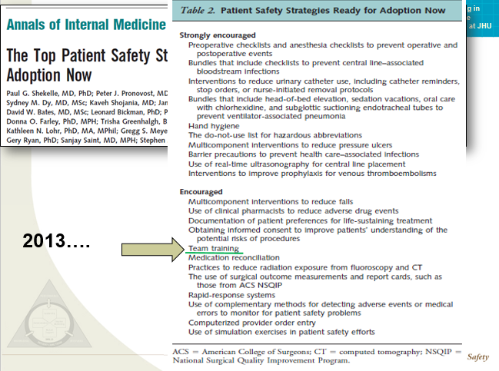

Slide 14
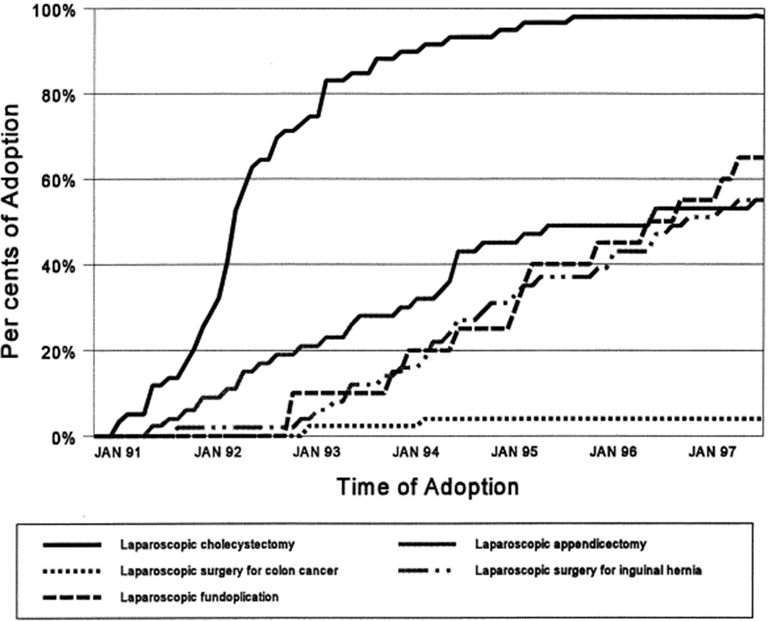
Diffusion of Laparoscopic Technology Example
“…if [people] accept the need to adopt a particular practice, implementation should occur non-problematically”
Poulsen PB, Adamsen, S, Vondeling H, Jorgensen, T. Diffussion of laparoscopic technologies in Denmark. Health Policy. 1998; 45(2): 149-167.

Slide 15
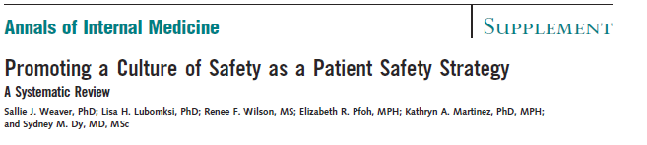
Systematic Review
3,679 articles → 33 studies included (reported in 35 papers)
57% = Multi-faceted interventions
  60% included team-training
  24% included executive walkrounds
  24% included comprehensive unit based safety program (CUSP)
72% significantly improved safety culture survey scores
11 studies also reported patient outcomes
  55% sig. improvement
    Rates of reported errors resulting in pt. harm (Abstoss et al., 2011)
    Rates of RRS activations that resulted in codes (Donahue, 2011)
    Adverse outcomes (Riley, et al., 2011)

Slide 16
What We Know
Team-training can improve patient safety, but…
  Implementation strategy matters
  Sustainment/continuous improvement strategy matters
  Context matters

Slide 17

Team-Training as a Patient Safety Practice (Weaver & Rosen, 2013)
Moderate to high quality evidence that systematic team-training programs can meaningfully improve:
Care processes
  Use of evidence-based practice
  Handoffs
Efficiency
  Reduced care delays
  Decision time
Safety outcomes
  Adverse events with teamwork and communication related root causes
  Infection rates
  Other harm related outcomes
Occupational health
  Needlesticks
  Patient care experience

Slide 18
Programs That Demonstrate Such Effects Share Several Characteristics…
Systematic, mindful approach to implementation
  Train-the-trainer is common model
Part of the “big picture”
  Woven into fabric of organization’s or team’s approach to improvement
Leadership and peer support
  Time to participate for both implementation team and all team members
Investment in transferring training into practice
  Coaching
    Frontline focused & implementation team focused support
  Training plus…
    Support tools & reminders
    Structures that reinforce good teamwork (e.g., briefings & debriefings as an organizational habit)

Slide 19
Team Training Experiences at Johns Hopkins
Michael A. Rosen, PhD
Assistant Professor
Dept. of Anesthesiology & Critical Care Medicine,
& Armstrong Institute for Patient Safety and Quality,
Johns Hopkins University School of Medicine

Slide 20
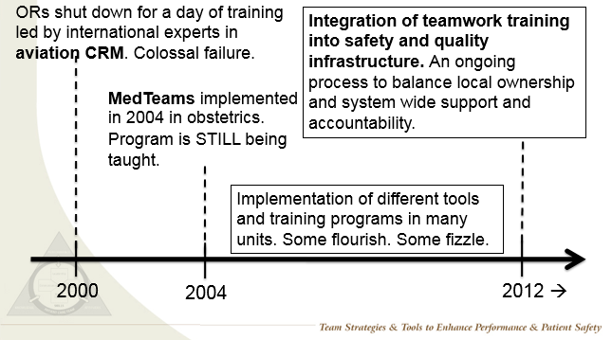
Abbreviated Timeline of Team Training at Johns Hopkins

Slide 21
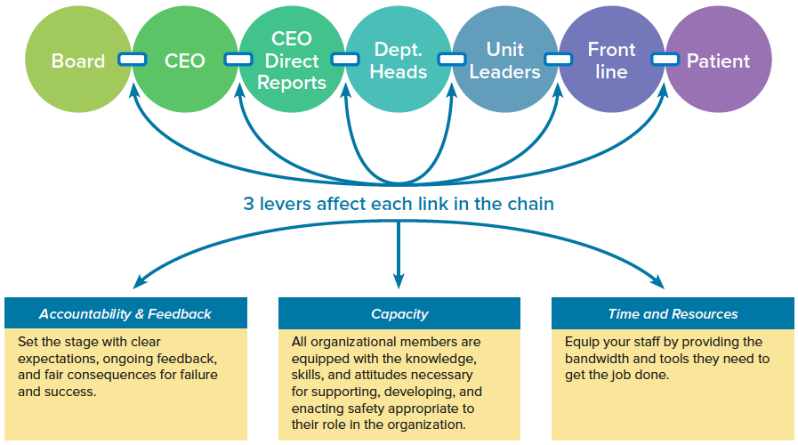
Model of Leadership Accountability

Slide 22
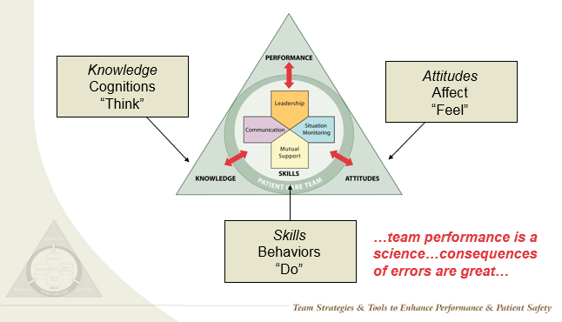
What Comprises Team Performance?

Slide 23
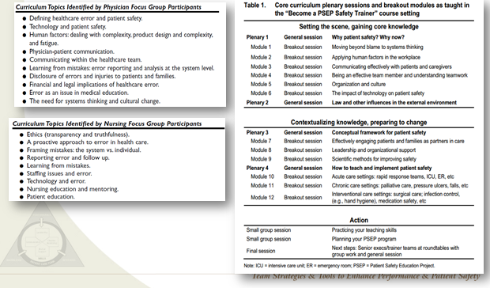
Examples of Key Topics Have Been Identified

Slide 24
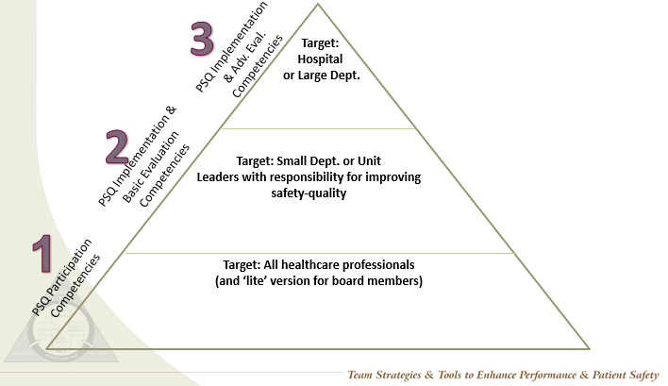
Armstrong Institute Framework for Building Patient Safety & Quality Capacity Across JHMI

Slide 25
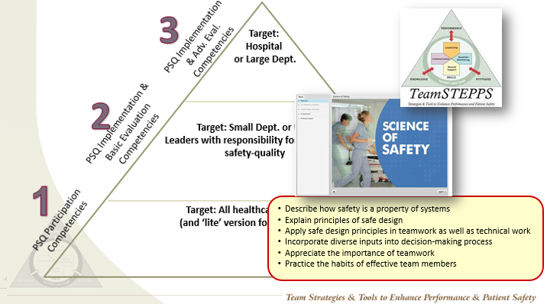
Armstrong Institute Framework for Building Patient Safety & Quality Capacity Across JHMI

Slide 26
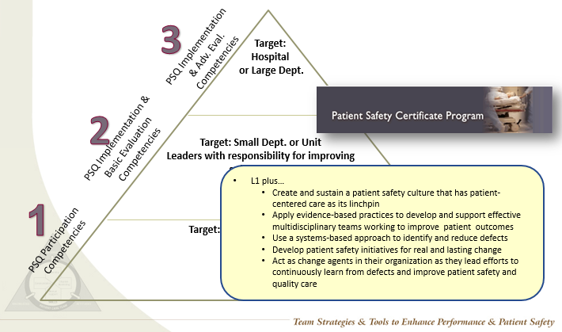
Armstrong Institute Framework for Building Patient Safety & Quality Capacity Across JHMI

Slide 27
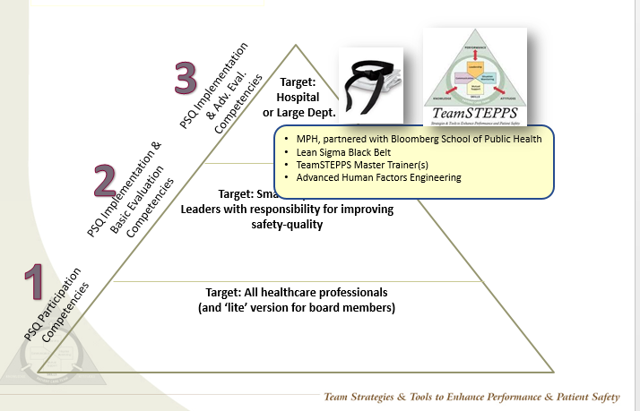
Armstrong Institute Framework for Building Patient Safety & Quality Capacity Across JHMI

Slide 28
Integrating TeamSTEPPS with Accountability Systems
Structural approaches
  Do you have a team of Master Trainers? Enough to support your training needs?
  Do you have dedicated training time for TeamSTEPPS?
  What proportion of staff have received training?
  Is TeamSTEPPS integrated with orientation?
Process approaches
  Targeting TeamSTEPPS related process metrics for improvement
    E.g., the quality of pre-operative briefings

Slide 29
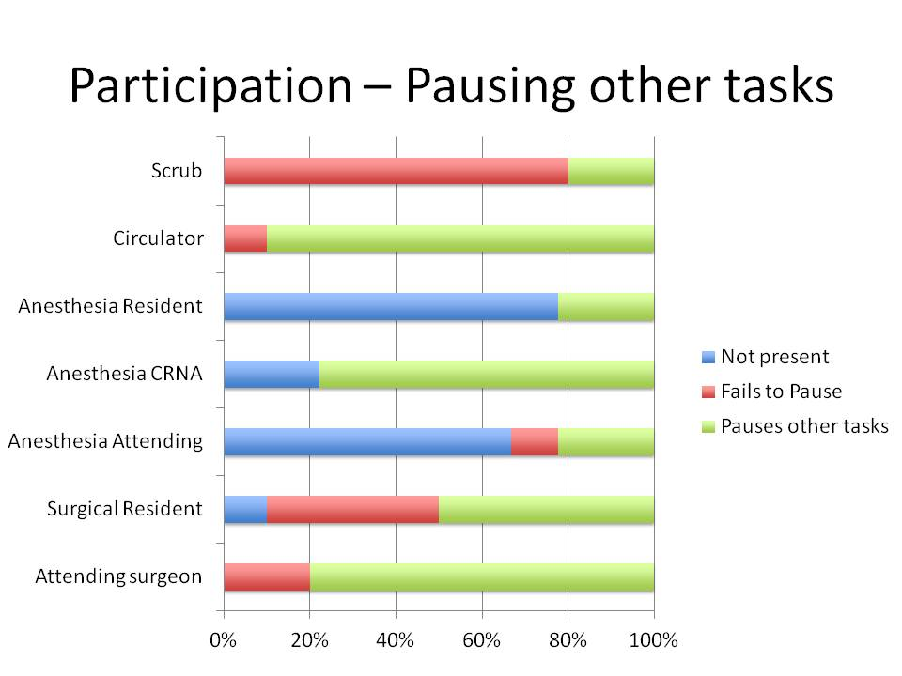
Example of Accountability for TeamSTEPPS: Briefing Audit Tool
Simple (and reliable) data collection
Focuses on quality of briefing
Chosen as a performance metric for FY 2014 in surgical department
Details of briefing audit tool:
Johnston, F. M., Tergas, A. I., Bennett, J. L., Valero, V., Morrissey, C. K., Fader, A. N., ... & Wick, E. C. (2013). Measuring Briefing and Checklist Compliance in Surgery A Tool for Quality Improvement. American Journal of Medical Quality, 1062860613509402.

Slide 30
Summary
What’s the most effective way to build capacity for TeamSTEPPS in your organization?
How do you create accountability for TeamSTEPPS implementation and good team behavior?
How do you allocate time and resources for implementing and sustaining TeamSTEPPS?

Slide 31
Questions and Answers

Slide 32
Thank You!
For more information, please contact our team at:
AHRQTeamSTEPPS@aha.org

