Slide 1
TeamSTEPPS for Patients
and Patient Engagement
March 13, 2013

Slide 2
Acknowledgements
Project Sponsors
Jim Battles, PhD (AHRQ)
Heidi King, MS (DoD)
Project Team
Health Research & Educational Trust (HRET)
Barb Edson (Project Director)
Chris Hund (Project Manager)
IMPAQ International
David Baker (Team Lead)

Slide 3
TeamSTEPPS Master Training
Two-day training course
Train-the-trainer approach
Prepares you to serve as a TeamSTEPPS Master Trainer by
Providing instruction on TeamSTEPPS tools and strategies
Providing an opportunity to develop and plan your TeamSTEPPS implementation
Prepares you to serve as a leader for implementing TeamSTEPPS within your organization

Slide 4
TeamSTEPPS Portal
http://www.teamsteppsportal.org/
Please register and create an account!
TeamSTEPPS User Support
Webinars
Tools and resources for use
Implementation stories
Discussion forums
Matchmaking

Slide 5
7th Annual National Conference
Will highlight :
Innovations in delivery of TeamSTEPPS
Program models from across the clinical spectrum
Sessions focused on liability/risk management
Specific, practical solutions
Networking opportunities
Date: June 12 - 13, 2013
Location: The Fairmont Dallas, Dallas, TX
Registration: Visit the portal and click on “National Conference” tab

Slide 6
Help Line (312) 422-2609
Or email: AHRQTeamSTEPPS@aha.org

Slide 7
Rules of Engagement
Written questions are encouraged throughout the presentation and will be answered during the Q&A session
A Q&A session will be held at the end of the presentation
The lines will open for call-in questions during the Q&A session

Slide 8
Today’s Webinar Presenters
Tiffany Christensen
Duke University Hospital Patient Advocate
Team Lead for new Duke PAC Training Center
Author and life-long patient
Karen Frush, MD
Professor of Pediatrics, Duke University School of Medicine
Clinical Professor of Nursing, Duke University School of Nursing
Chief Patient Safety Officer, Duke University Health System

Slide 9
TeamSTEPPS for Patients (and Patient Engagement)

Slide 10
Goals of this Webinar
Discuss Patient Safety from a Patient’s Perspective
Describe how to create a “safe place” for patients and families in order to strengthen the patient-provider partnership
Discuss TeamSTEPPS tools that can facilitate patient engagement

Slide 11
From a Patient’s Perspective

Slide 12
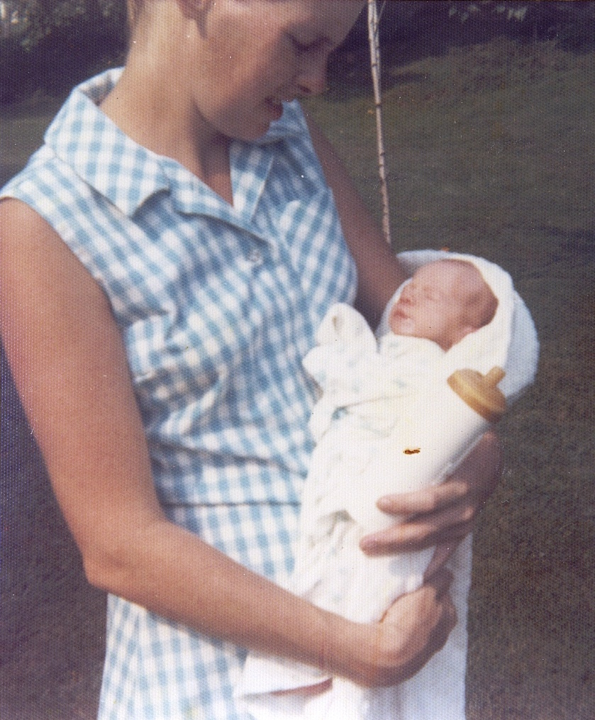
Diagnosed at 6 months old with the gift of cystic fibrosis

Slide 13
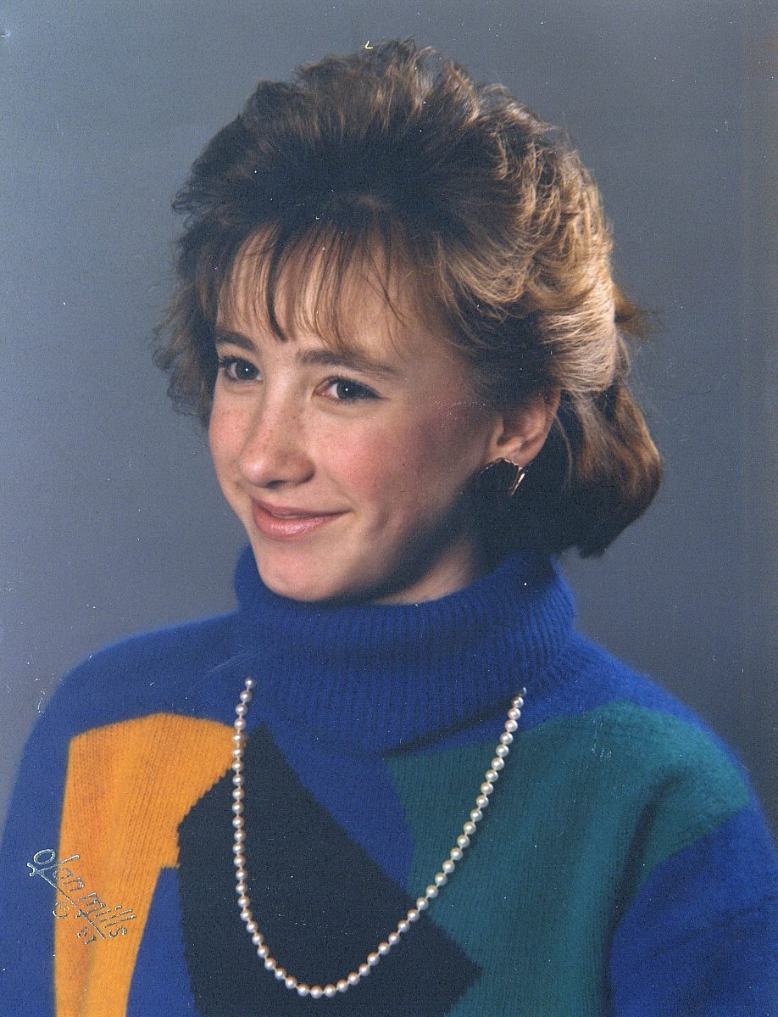
I had my first hospital stay at Age 12 My first experience with “walking the fine line”

Slide 14
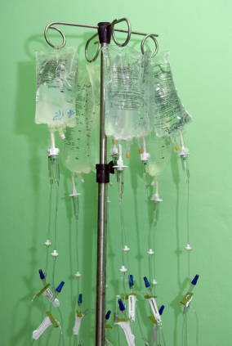
This was just the beginning… There would be countless more days spent in the hospital during my lifetime

Slide 15
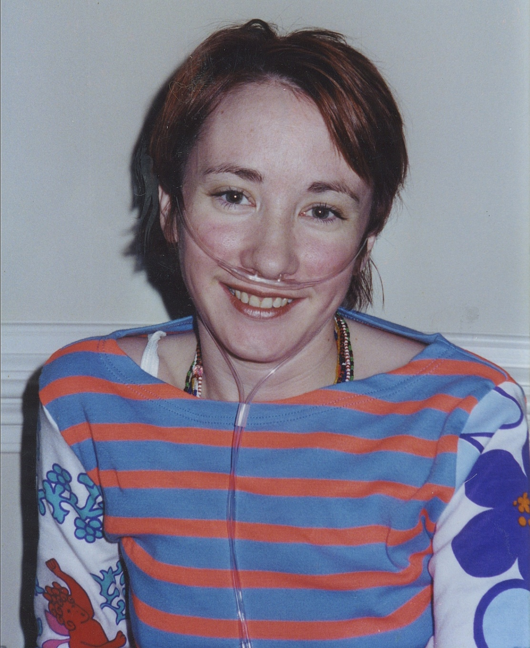
The doctors put me on the list for a bilateral lung transplant.

Slide 16
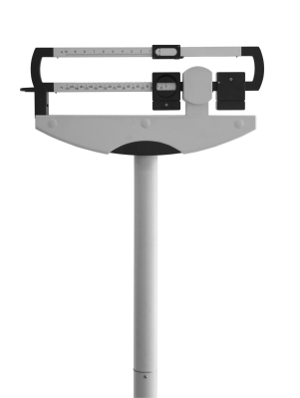
I waited 4 years for my “call”
I was 95 pounds and my lung function was
25% of capacity

Slide 17
Facing Medical Error
Surgical Error:
“Wet Run” and an apology
Ripple Effect of Reactions:
In the OR
In the Transplant Protocols
In Safety Procedures Hospital Wide

Slide 18
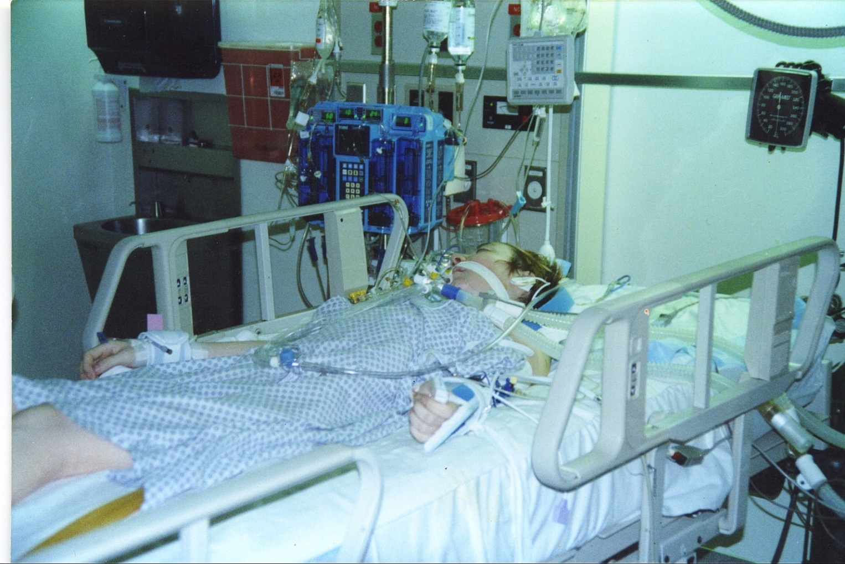
April 4th, 2000

Slide 19
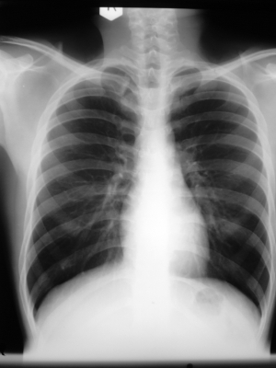
In June of 2002, my lung function started to drop. I was diagnosed with my second terminal illness 6 months later. I had Chronic Rejection.

Slide 20
The Deafening Diagnosis

Slide 21
Within a year, my lung function had dropped to 10% of capacity. I was 73 pounds. I was dying and the doctors gave me 6 more months to live.

Slide 22
I asked my doctors if I could have a second lung transplant. They said no.

Slide 23
After the stages of grief…the soft arms of acceptance

Slide 24
We got a new transplant coordinator. She wanted to help. She fought for me and got me on the transplant list again.

Slide 25
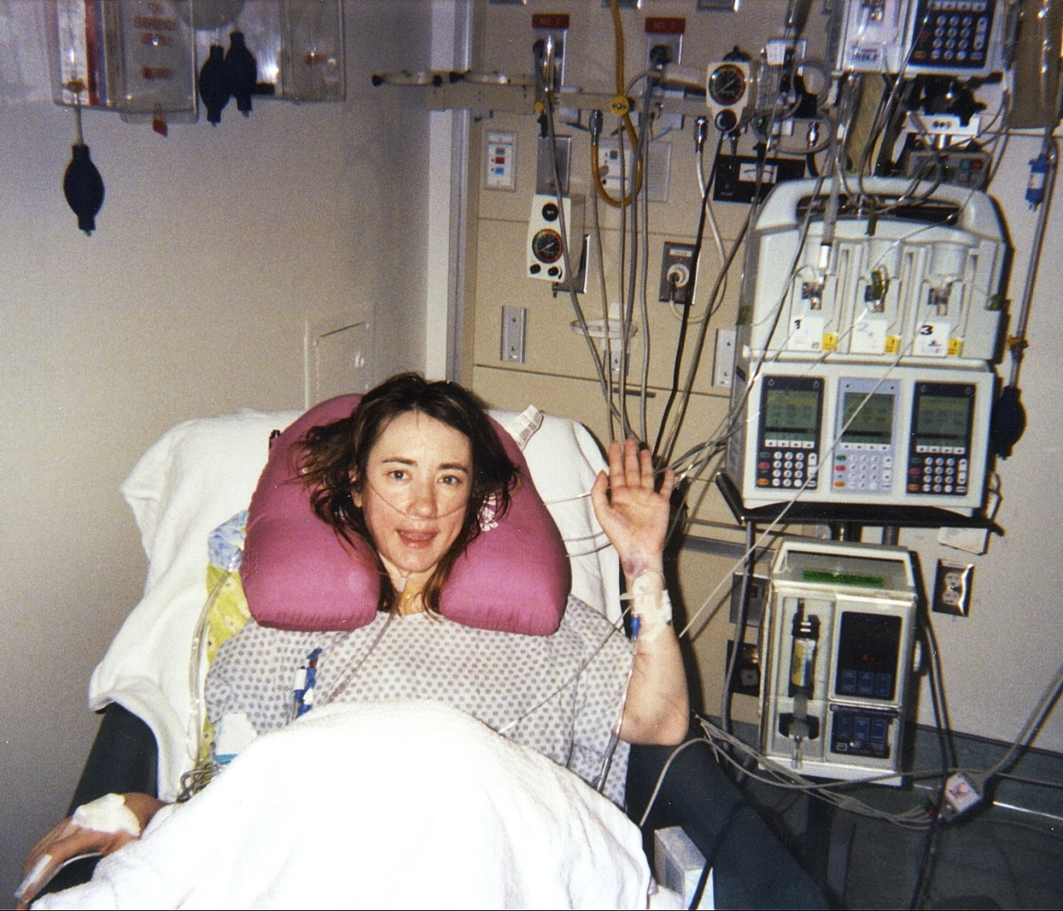
Despite my team’s concern, the recovery was easier than the first time.

Slide 26
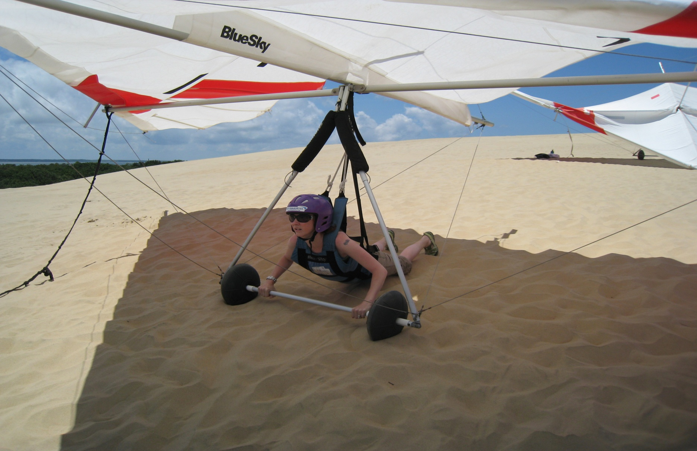
Today!

Slide 27
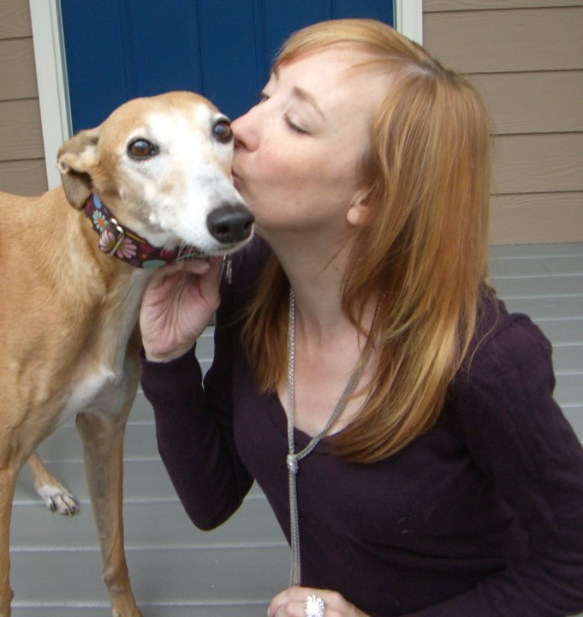
Loved and Lost

Slide 28
Love…again

Slide 29
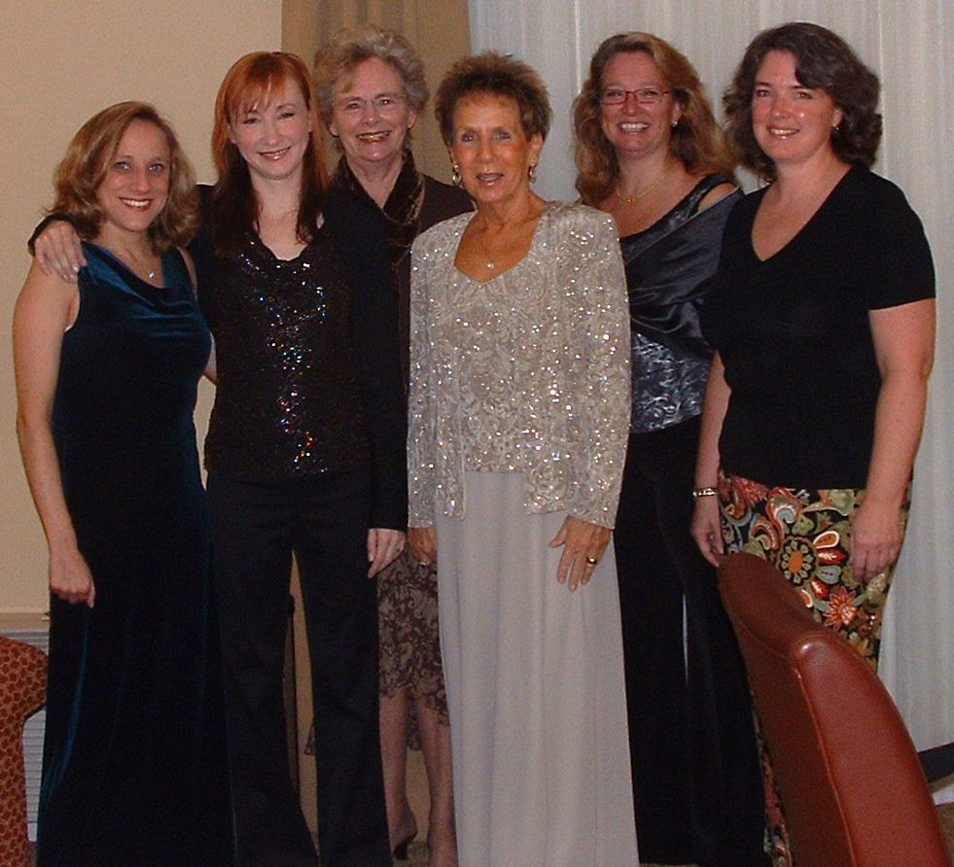
Sister, Daughter, Friend

Slide 30
Grateful for “the village”

Slide 31
Patient Safety
Circa 2000: “efforts to prevent unintended harm to patients”
Circa 2010: “a discipline that utilizes a systems approach to improving healthcare processes and outcomes”
Complexity of modern healthcare has surpassed the capability of any single provider; patient safety “requires shift from a focus on individual performance to high performing teams”
Essential to this shift is inclusion of patients/families in all aspects of care
Leape L, Burwick D, Clancy C, et al. in Qual Saf Health Care. Dec;18(6):424-8, 2009

Slide 32
The Role of Patients in Patient Safety
Most patient safety strategies are focused on error prevention and mitigation from a healthcare provider and system perspective
Some organizations (WHO Patients for Patient Safety) have begun to highlight role that patients can play in improving safety and quality
being knowledgeable about treatment plans
asking for clarification when they don’t understand
Understanding role of patients in patient safety, as well as barriers to engaging patients, can help reduce adverse events and improve quality of care
Scobie and Persaud. Patient Engagement in Patient Safety. PSQH March/April 2010
Notes:
And what about the role of patients in patient safety?
Most of our pt safety strategies…
…To understand the role of patients, we really need to “hear the issues” from patients’ perspective.
I know any of us are patients at any given time, but we’re “tainted”.
Want to share Tiffany’s story.

Slide 33
What is the Role of Patients at Duke?
Challenge ourselves to think differently about “partnering with patients”
Encourage patients to take an active role
Facilitate opportunities for patients to “speak up” and share their ideas about reducing harm, improving care
Sometimes it’s humbling, but patients are helping us with this
Notes:
And what about the role of patients in patient safety?
Most of our pt safety strategies…
…To understand the role of patients, we really need to “hear the issues” from patients’ perspective.
I know any of us are patients at any given time, but we’re “tainted”.
Want to share Tiffany’s story.

Slide 34
Guiding Principles for Patient/Family Centered Care at Duke
Patients and families will be recognized and welcomed as important members of the health care team
PAC, Patient and family-centered rounding
Patients and families will be engaged, educated and empowered to easily access information and participate in care and decision-making opportunities at their level of comfort
The core principles of PFCC will guide our quality and patient safety improvement efforts and our communications.

Slide 35
“Actualizing” our Principles: History of the PAC
Established in 2005 by Chancellor of Health Affairs, as a patient forum to advise DUHS on patient-centered care initiatives and culture
Subcommittee of the Patient Safety & Clinical Quality Executive Committee; minutes and activities reviewed by Patient Safety and Clinical Quality Committee of the DUHS Board of Directors
Represents vision and goals of DUHS Core Value and priorities of the Five Year Plan for Quality and Patient Safety
“To provide every patient with the best healthcare experience”

Slide 36
PAC Structure
Standard Screening, Interview, and Approval Process
Duke Health System Orientation and Training
Confidentiality , HIPAA, and Conflict of Interest
PAC Governance/Charter
Monthly 2-hour Council Meetings
Special topic/program, Council Business
Focus Group Opportunities
Project Opportunities
Committee Participation
Including PAC members in TeamSTEPPS training

Slide 37
TeamSTEPPS Tools for Patients
In our TeamSTEPPS for Patients workshop, we learned that many TeamSTEPPS tools can be applied to patient engagement.
The three “most accessible” are:
SBAR
CUS
Patient Safety Call Out
Permission Invitation+ Tools = Safety Empowerment

Slide 38
Partnering through Preparation
Symptoms
Background (relevant)
Assessment
Request (immediate)

Slide 39
Partnering for Safety
Concerned
Uncomfortable
Scared
Safety

Slide 40
Partnering for Patient-Centered Care
What does your Patient Safety Call Out look like?
“Whoa”
“Time Out”
“I’m Confused”

Slide 41
Assess patient/family participation skills and facilitate advancement
Expert Patient and Family
(College)
Trained in SBAR for more concise and effective conversations at clinic, in the hospital or the ER
Eager Patient and Family
(High School)
Track own data and medicines
One Step at a Time Patient and Family
(Elementary School)
One simple “job” at a time

Slide 42
Questions and Answers

Slide 43
Discussion Forum
What is your biggest challenge when trying to engage patients and their families?
Do you currently employ any techniques for patients to “speak up” at your institution? If so, what are they?
What are some “lessons learned” from educating patients and their families on TeamSTEPPS and their role in patient safety?
http://teamsteppsportal.org/forum

Slide 44
Thank You!
For more information, please contact our team at:
AHRQTeamSTEPPS@aha.org

