Slide 1


Improving Safety for Patients with Limited English Proficiency: TeamSTEPPS®
October 8, 2013

Slide 2
Acknowledgements
Project Sponsors
  Jim Battles, PhD (AHRQ)
  Heidi King, MS (DoD)
Project Team
  Health Research & Educational Trust (HRET)
    Barb Edson (Project Director)
    Chris Hund (Project Manager)
  IMPAQ International
    David Baker (Team Lead)

Slide 3
TeamSTEPPS Master Training
Two-day training course
Train-the-trainer approach
Prepares you to serve as a TeamSTEPPS Master Trainer by
  Providing instruction on TeamSTEPPS tools and strategies
  Providing an opportunity to develop and plan your TeamSTEPPS implementation
Prepares you to serve as a leader for implementing TeamSTEPPS within your organization

Slide 4
Help Line (312) 422-2609
Or email: AHRQTeamSTEPPS@aha.org

Slide 5
Rules of Engagement
Written questions are encouraged throughout the presentation and will be answered during the Q&A session
A Q&A session will be held at the end of the presentation
The lines will open for call-in questions during the Q&A session

Slide 6
Today’s Webinar Presenter
  Laura Maynard, MDiv
    Director of Collaborative Learning, North Carolina Center for Quality and Patient Safety
    TeamSTEPPS Master Trainer
    lmaynard@ncha.org

Slide 7
Objectives
Highlight what we know about patient safety and Limited English Proficiency (LEP) patients
Identify common causes of adverse events for LEP and culturally diverse patients
Present five key strategies for improving detection of medical errors and preventing high-risk scenarios from becoming safety events
Provide an approach to preventing safety events through the use of TeamSTEPPS tools

Slide 8
The Story of Willie Ramirez
Results of not having an appropriate interpreter:
  Misunderstanding of “intoxicado”
  Inaccurate medical history
  Cultural deference to authority
  Quadriplegic teen
  $71 million lawsuit
http://healthaffairs.org/blog/2008/11/19/language-culture-and- medical-tragedy-the-case-of-willie-ramirez/

Slide 9
A Guide for Hospitals
http://www.ahrq.gov/professionals/systems/hospital/lepguide/index.html
Internet Citation: Improving Patient Safety Systems for Patients With Limited English Proficiency: A Guide for Hospitals. September 2012. Agency for Healthcare Research and Quality, Rockville, MD. http://www.ahrq.gov/professionals/systems/hospital/lepguide/index.html

Slide 10


What We Know About Patient Safety and LEP
The Institute of Medicine Report To Err Is Human: Building a Safer Health System states that patients should not be harmed by care that is intended to help them
The Institute of Medicine Report Crossing the Quality Chasm defined patient safety as one of the essential components of high-quality health care
Patient safety efforts are now a central component of strategies to improve quality of care for all patients

Slide 11
What We Know About Patient Safety and LEP
  Language barriers:
  impact health care
  contribute to disparities
Communication problems are the most frequent root cause of serious patient safety events reported to the Joint Commission
Chart illustrating results from Divi C, Koss RG, Schmaltz SP, et al. Language proficiency and adverse events in U.S. hospitals: a pilot study. Int J Qual Health Care 2007 Apr;19(2):60-67. Epub 2007 Feb 2.

Slide 12
Why Focus on LEP and Patient Safety?
Minority Groups are a Large and Growing Population
  Fastest growing demographic
  Accounting for one-third of the U.S. population
  Nearly 25 million people in the United States (8.6%) are defined as LEP and therefore at risk for adverse events because of language and cultural barriers

Slide 13
Why Focus on LEP and Patient Safety?
Patient Safety, Quality, and Cost Drivers
  Greater risk due to LEP patients’ longer hospital stays compared to English-speaking patients with the same clinical condition
  Greater risk of surgical delays and readmission due to LEP patients’ greater difficulty understanding instructions, such as:
    Preparing for a procedure
    Managing their condition
    Taking their medications
    Knowing which symptoms should prompt a return to care or when to follow up

Slide 14
Why Focus on LEP and Patient Safety?
Risk Management
  Multiple liability exposures arise when providing care to LEP populations, such as situations related to:
    Patient comprehension of medical condition
    Treatment plan
    Discharge instructions
    Complications and follow-up
    Inaccurate and incomplete medical history
    Ineffective or improper use of medications or serious medication errors
    Improper preparation for tests and procedures
    Poor or inadequate informed consent

Slide 15

Why Focus on LEP and Patient Safety?
Accreditation Standards
  Joint Commission’s Patient-Centered Communication Standards
  Emphasize:
    effective communication
    cultural competence
    patient-centered care

Slide 16
Causes of Adverse Events for LEP and Culturally Diverse Patients
Use of Family Members, Friends or Nonqualified Staff as Interpreters
  Subtleties of language and culture
  Unquestioned use of medical terminology
  Use of bilingual hospital staff as ad hoc interpreters
  Use of Basic Language Skills To “Get By”
  Clinicians “get by” without a competent interpreter
  Cultural Beliefs and Traditions Affecting Patient Care
  Minimizing reports of pain
  Deferring to authority figures
  Adhering to gender roles

Slide 17
Systems and Strategies to Improve Safety for LEP Patients
Foster a Supportive Culture for Safety of Diverse Patient Populations
Adapt Current Systems to Better Identify Medical Errors Among LEP Patients
Improve Reporting of Medical Errors for LEP Patients
Routinely Monitor Patient Safety for LEP Patients
Address Root Causes to Prevent Medical Errors Among LEP Patients

Slide 18
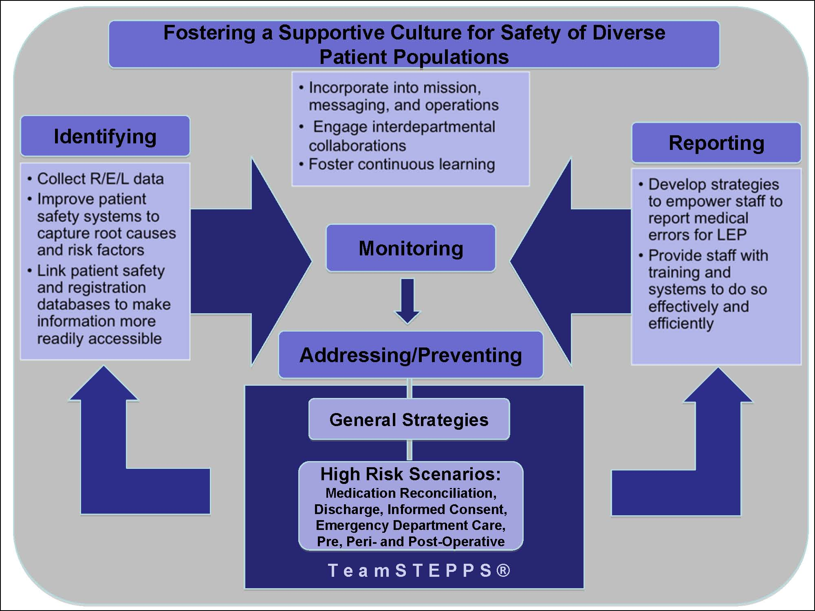

Slide 19
Systems and Strategies to Improve Safety for LEP Patients: Culture
Foster a Supportive Culture for Safety of Diverse Patient Populations
  Link the goal of overcoming language and cultural barriers to the overall message and mission of the culture of quality and safety
  Frame this goal within existing operational policies and standards related to quality and safety for all patients
  Share lessons learned from patient safety events with all staff to help build an institutional culture sensitive to issues that affect LEP patients and ensure ongoing learning and training in this area
  Involve patients in Family Advisory Councils or Cultural Advisory Groups to incorporate patient perspectives

Slide 20
Systems and Strategies to Improve Safety for LEP Patients: Identification
Adapt Current Systems to Better Identify Medical Errors Among LEP Patients
  Document data on race, ethnicity, patient language and interpreter needs in the electronic medical record
  Include these data fields in patient safety systems to track the role of language and culture in patient safety events that staff report

Slide 21
Systems and Strategies to Improve Safety for LEP Patients: Reporting
Improve Reporting of Medical Errors for LEP Patients
  Empower frontline staff and interpreters to report any patient safety events
  Train all staff on what constitutes a patient safety event (including near misses) and how to report them
  Consider other methods of identifying errors outside of standard reporting

Slide 22
Systems and Strategies to Improve Safety for LEP Patients: Monitor
Routinely Monitor Patient Safety for LEP Patients
  Develop routine (quarterly, yearly) hospital-wide safety reports or dashboards that focus on patient safety among LEP patients
  Create routine forums for analyzing cases of medical errors and near misses
  Develop strategies for improvement and error prevention

Slide 23
Systems and Strategies to Improve Safety for LEP Patients: Address
Address Root Causes to Prevent Medical Errors Among LEP Patients
  Develop dedicated services for medical interpretation
  Provide patients with written materials in their preferred written language

Slide 24
Systems and Strategies to Improve Safety for LEP Patients: Address
Address Root Causes to Prevent Medical Errors Among LEP Patients
  Automatically schedule an interpreter at clinical points of service for patients identified as LEP
  Train staff on team communication, use of interpreter services, cultural competency, and advocacy by using the TeamSTEPPS® LEP training module
  Use fluent bilingual staff as a form of language assistance, but ensure that they receive training in basic medical interpretation

Slide 25
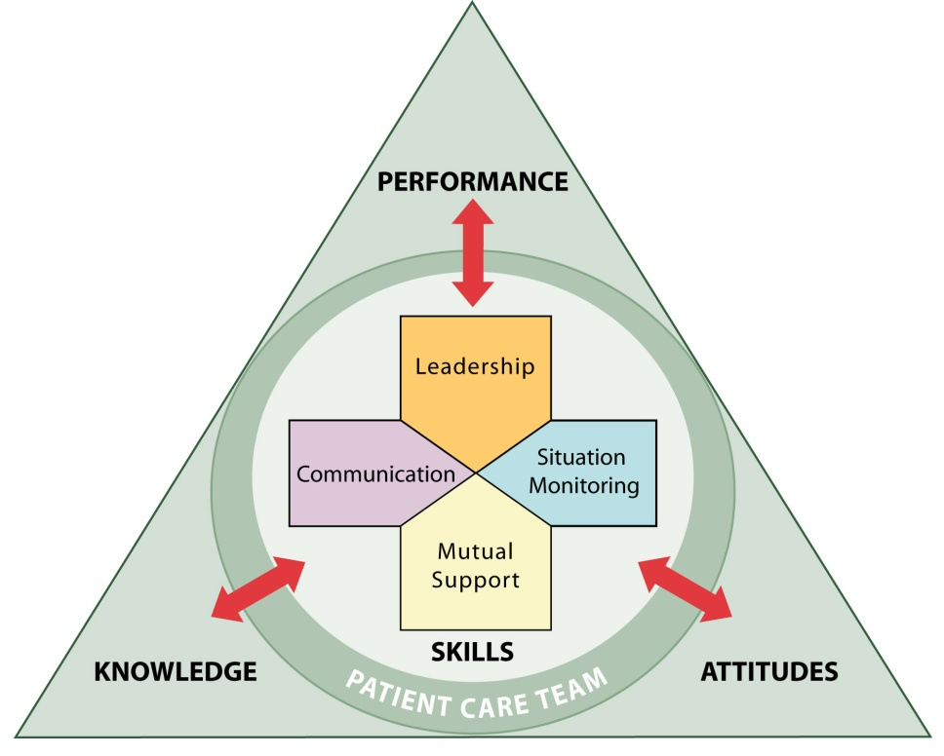
Improving Team Communication to Foster Safety for LEP Patients: TeamSTEPPS®
Team Strategies and Tools to Enhance Performance and Patient Safety

Slide 26
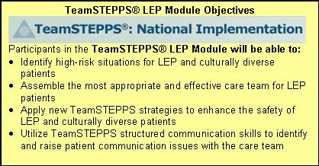
Improving Team Communication to Foster Safety for LEP Patients: TeamSTEPPS®
http://teamstepps.ahrq.gov/

Slide 27
High-Risk Settings and Situations
Emergency Department (ED)
OB/GYN
Surgery
Transitions in care, including intake and discharge
Medication reconciliation

Slide 28
Added Risk for LEP Patients
Not using a professional interpreter
  Using family members or housekeeping staff as interpreters
  “Getting by” with provider’s or patient’s poor language skills
Interpreter only present for part of the encounter

Slide 29
Close Call: An Interpreter’s Story
Patient spoke some English…
  Interpreter not called
  Inaccurate medical history
  Latex allergy almost missed before surgery

Slide 30
Case Study Discussion

Slide 31
Benefits of Including
Interpreter on the Care Team
Receive more complete and accurate information
Facilitate better clinical decisions
Receive support from a cultural broker who is also an advocate for the patient

Slide 32
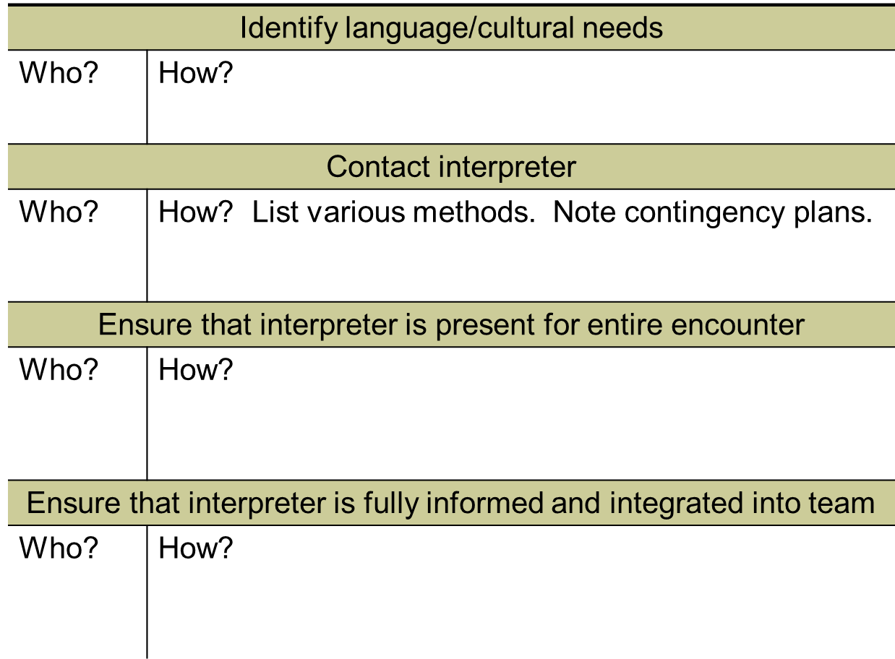
Implementation

Slide 33
Assertion, Advocacy, and
Conflict Resolution
Scenario:
Mrs. Gilbert, a Haitian immigrant, is in the ED in triage. The front desk staff called the Creole interpreter, Ms. Pierre-Louis. Dr. Malbec is interviewing Mrs. Gilbert in French, but she does not understand his French. Ms. Pierre-Louis knows that Mrs. Gilbert does not understand, but when she attempts to interpret, Dr. Malbec says, “You are not needed. I’ve got it.”

Slide 34
Advocacy and Assertion
Advocate for the patient
  Stop all activity if needed
  Speak up on behalf of the patient
Assert a corrective action in a firm and respectful manner
  Assertion is not aggression

Slide 35
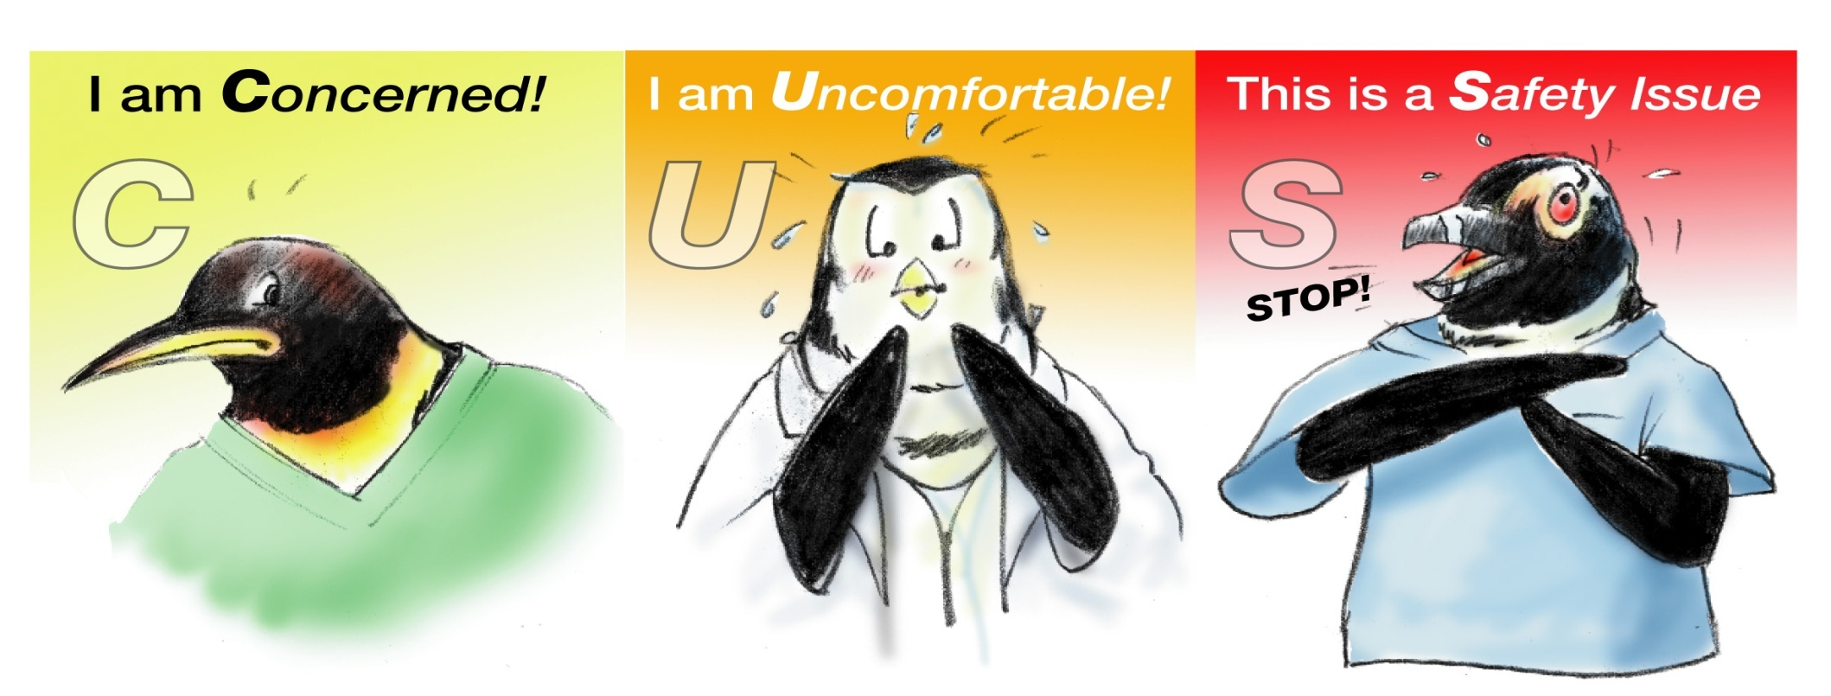
Stop the Line: CUS

Slide 36
When Initial Assertion Is Ignored…
Voice your concern at least two times…it’s your responsibility
If you are being challenged, acknowledge the concern
  Correct the problem
  Teach
If the outcome is still not acceptable
  Take a stronger course of action
  Use supervisor or chain of command

Slide 37
Briefs
Planning
  Form the team
  Designate team roles and responsibilities
  Establish climate (psychological safety) and goals
  Engage team in short- and long-term planning

Slide 38
Psychological Safety
Proactively invite input
Be accessible
Ask for mutual support
Remember: Team leader sets the tone for the team, while interpreter creates safety for the patient
  Leader: “Feel free to stop us at any time if anything is not clear, or if there is anything I should know about the patient's culture, beliefs, or concerns”
  Interpreter: “If anything we say is not clear, please let me know ”

Slide 39
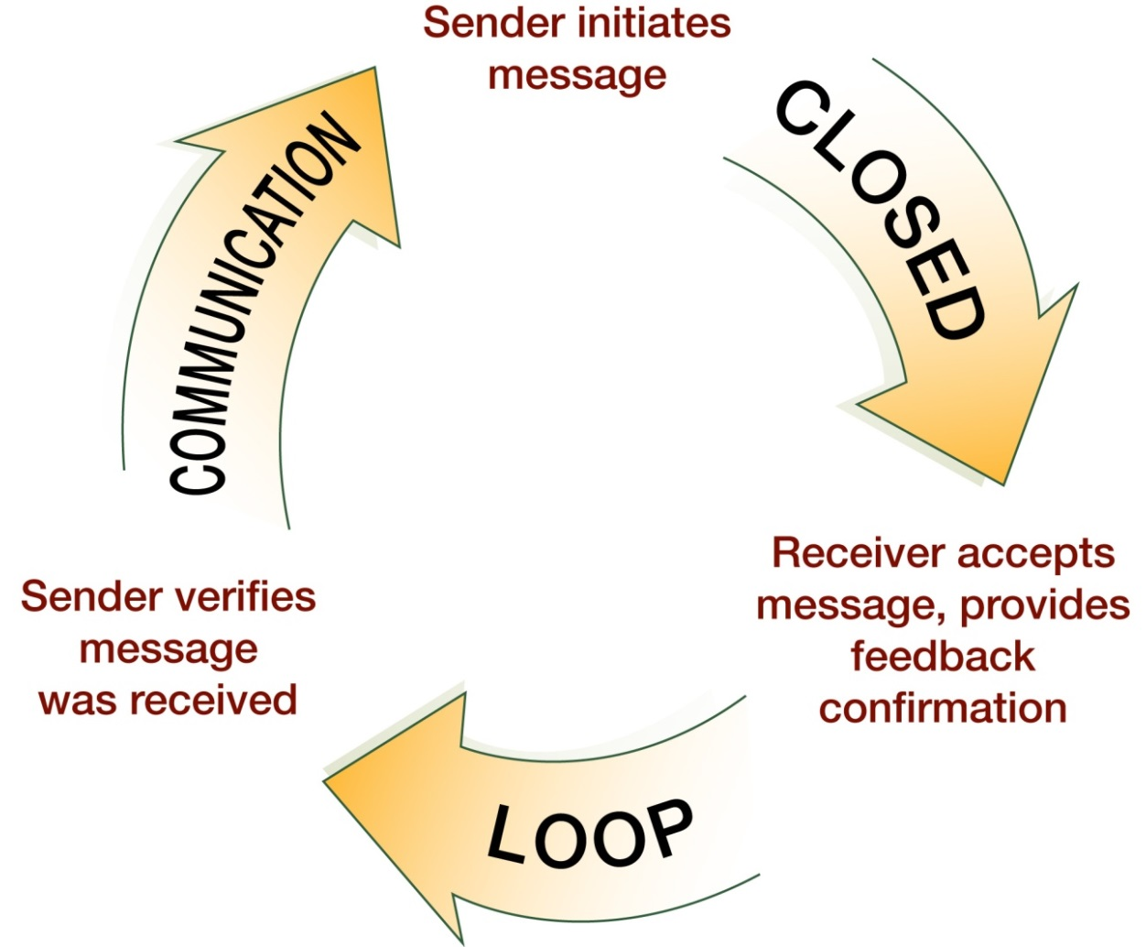
Check-Back Is…

Slide 40
Teach-Back Is…
Confirmation of understanding
Opportunity to correct miscommunication
Comprehensive
  “Tell me in your own words how you will take this medicine when you get home…”
  http://www.nchealthliteracy.org/toolkit/tool5.pdf
  http://www.ihconline.org/aspx/general/page.aspx?pid=107

Slide 41
Summary
TOOLS and STRATEGIES to Enhance the Safety of Patients With Limited English Proficiency:
  Process for including in-person and phone interpreters
  Brief/psychological safety
  Advocacy and assertion
  CUS
  Check-back
  Teach-back

Slide 42
References
Institute of Medicine, Committee on Quality of Health Care in America. To err is human: building safer health system. Washington: National Academies Press; 2000.
Institute of Medicine, Committee on Quality of Health Care in America. Crossing the quality chasm: a new health system for the 21st century. Washington: National Academies Press; 2001.
Divi C, Koss RG, Schmaltz SP, et al. Language proficiency and adverse events in U.S. hospitals: a pilot study. Int J Qual Health Care 2007;19(2):60-67. Epub 2007 Feb 2.
Cohen AL, Rivara F, Marcuse EK, et al. Are language barriers associated with serious medical events in hospitalized pediatric patients? Pediatrics 2005;116(3):575-9.
Flores G, Laws MB, Mayo SJ, et al. Errors in medical interpretation and their potential clinical consequences in pediatric encounters. Pediatrics 2003;111(1):6-14.
Root Causes for Sentinel Events. Oakbrook Terrace, IL: The Joint Commission. Available at: http://www.jointcommission.org/assets/1/18/Root_Causes_Event_Type_2004-3Q2011.pdf.
American Community Survey data accessed through American Factfinder. Suitland, MD: U.S. Census Bureau; 2009. Available at: http://factfinder.census.gov/home/saff/main.html?_lang=en.
John-Baptiste A, Naglie G, Tomlinson G, et al. The effect of English language proficiency on length of stay and in-hospital mortality. J Gen Intern Med 2004;19(3):221-8.
Graham CL, Ivey SL, Neuhauser L. From hospital to home: assessing the transitional care needs of vulnerable seniors. The Gerontologist 2009;49(1):23-33.
Jiang HJ, Andrews R, Stryer D, et al. Racial/ethnic disparities in potentially preventable readmissions: the case of diabetes. Am J Public Health 2005;95(9):1561-7.
Price-Wise G. Language, culture, and medical tragedy: the case of Willie Ramirez. Health Affairs Blog 2008 Nov 19. Available at: http://healthaffairs.org/blog/2008/11/19/language-culture-and-medical-tragedy-the-case-of-willie-ramirez/.
Quan K. The high costs of language barriers in medical malpractice. Berkeley: University of California School of Public Health; 2010. Available at: http://www.healthlaw.org/images/stories/High_Costs_of_Language_Barriers_in_Malpractice.pdf.
Carbone E, Gorrie J, Oliver R. Without proper language interpretation, sight is lost in Oregon and a $350,000 verdict is reached. Legal Rev Commentary Suppl Healthcare Risk Manage 2003(May 1–3).
2011 Comprehensive Accreditation Manual for Hospitals: The Official Handbook. Oakbrook Terrace, IL: Joint Commission on Accreditation of Healthcare Organizations; 2010.

Slide 43
Questions and Answers

Slide 44
Upcoming TeamSTEPPS Events
Monthly Webinars
  Scheduled through September 2014
  Topics, speakers, and registration information will be posted on the portal
Annual Conference
  Summer 2014
  More details to be provided in the coming months

Slide 45
Thank You!
For more information, please contact our team at:
AHRQTeamSTEPPS@aha.org

